Slide 1
What Do We Believe? The Mark of the Beast 13
ROMANS 3:23
For all have sinned, and come short of the glory of God;

Slide 2
Birthdays, Anniversaries & Events

Slide 3
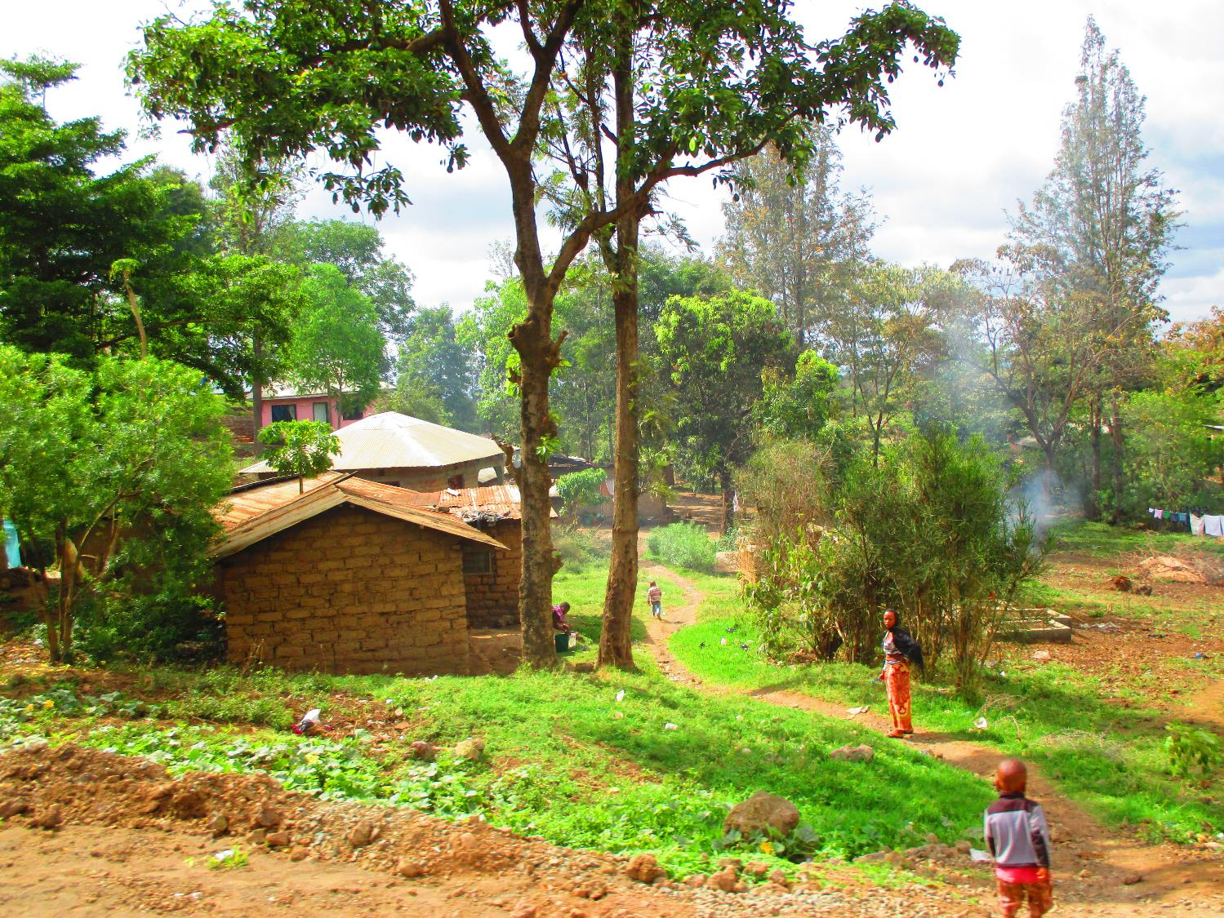
Tanzania 2018

Slide 4
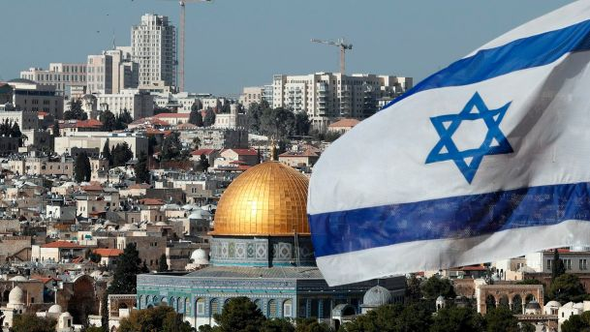
Israel 2019

Slide 5
What Do We Believe? The Mark of the Beast 13
ROMANS 3:23
For all have sinned, and come short of the glory of God;

Slide 6
I JOHN 1:7-9
But if we walk in the light, as he is in the light, we have fellowship one with another, and the blood of Jesus Christ his Son cleanseth us from all sin. 8 If we say that we have no sin, we deceive ourselves, and the truth is not in us. 9 If we confess our sins, he is faithful and just to forgive us our sins, and to cleanse us from all unrighteousness.

Slide 7
MODERN.EVENTS
60 Come back into the Word of God and get lined up... We must be Christian soldiers, and get orders from the Bible for this hour now; not the charge yesterday, but the charge today (which way we go).
61 And these modern events is slipping by us too swiftly, and one day we're going to find out we'll be left behind without nothing, and be caught, sealed into the mark of the beast before we know it.
65-1206

Slide 8
CONDEMNATION.BY.REPRESENTATION
184 Jesus died that He might breed back. Oh, hallelujah. Only the Blood can do that. Only through the chemistry of the Blood of Jesus Christ can breed back again a person that won't vary one word from what God said.
60-1113

Slide 10
REVELATION 13:15-18
And he had power to give life unto the image of the beast, that the image of the beast should both speak, and cause that as many as would not worship the image of the beast should be killed. 16 And he causeth all, both small and great, rich and poor, free and bond, to receive a mark in their right hand, or in their foreheads: 17 And that no man might buy or sell, save he that had the mark, or the name of the beast, or the number of his name. 18 Here is wisdom. Let him that hath understanding count the number of the beast: for it is the number of a man; and his number is Six hundred threescore and six.

Slide 11
REVELATION 14:9-10
And the third angel followed them, saying with a loud voice, If any man worship the beast and his image, and receive his mark in his forehead, or in his hand,
10 The same shall drink of the wine of the wrath of God, which is poured out without mixture into the cup of his indigna-tion; and he shall be tormented with fire and brimstone in the presence of the holy angels, and in the presence of the Lamb:

Slide 12
THE.RAPTURE
205 People, no one wants to die. No one wants to be lost. I don't care how loyal you are to church, nothing against that. You should go to church. Keep on going to church.
But, whatever, just throw away your traditions, and move right on up into Christ. Cause, it's going to sound one of these days, and you're going to be caught with the mark of the beast on you, and not know what it is until it's too late.
65-1204

Slide 13
REVELATION 20:4
And I saw thrones, and they sat upon them, and judgment was given unto them: and I saw the souls of them that were beheaded for the witness of Jesus, and for the word of God, and which had not worshipped the beast, neither his image, neither had received his mark upon their foreheads, or in their hands; and they lived and reigned with Christ a thousand years. 5 But the rest of the dead lived not again until the thousand years were finished. This is the first resurrection.

Slide 14
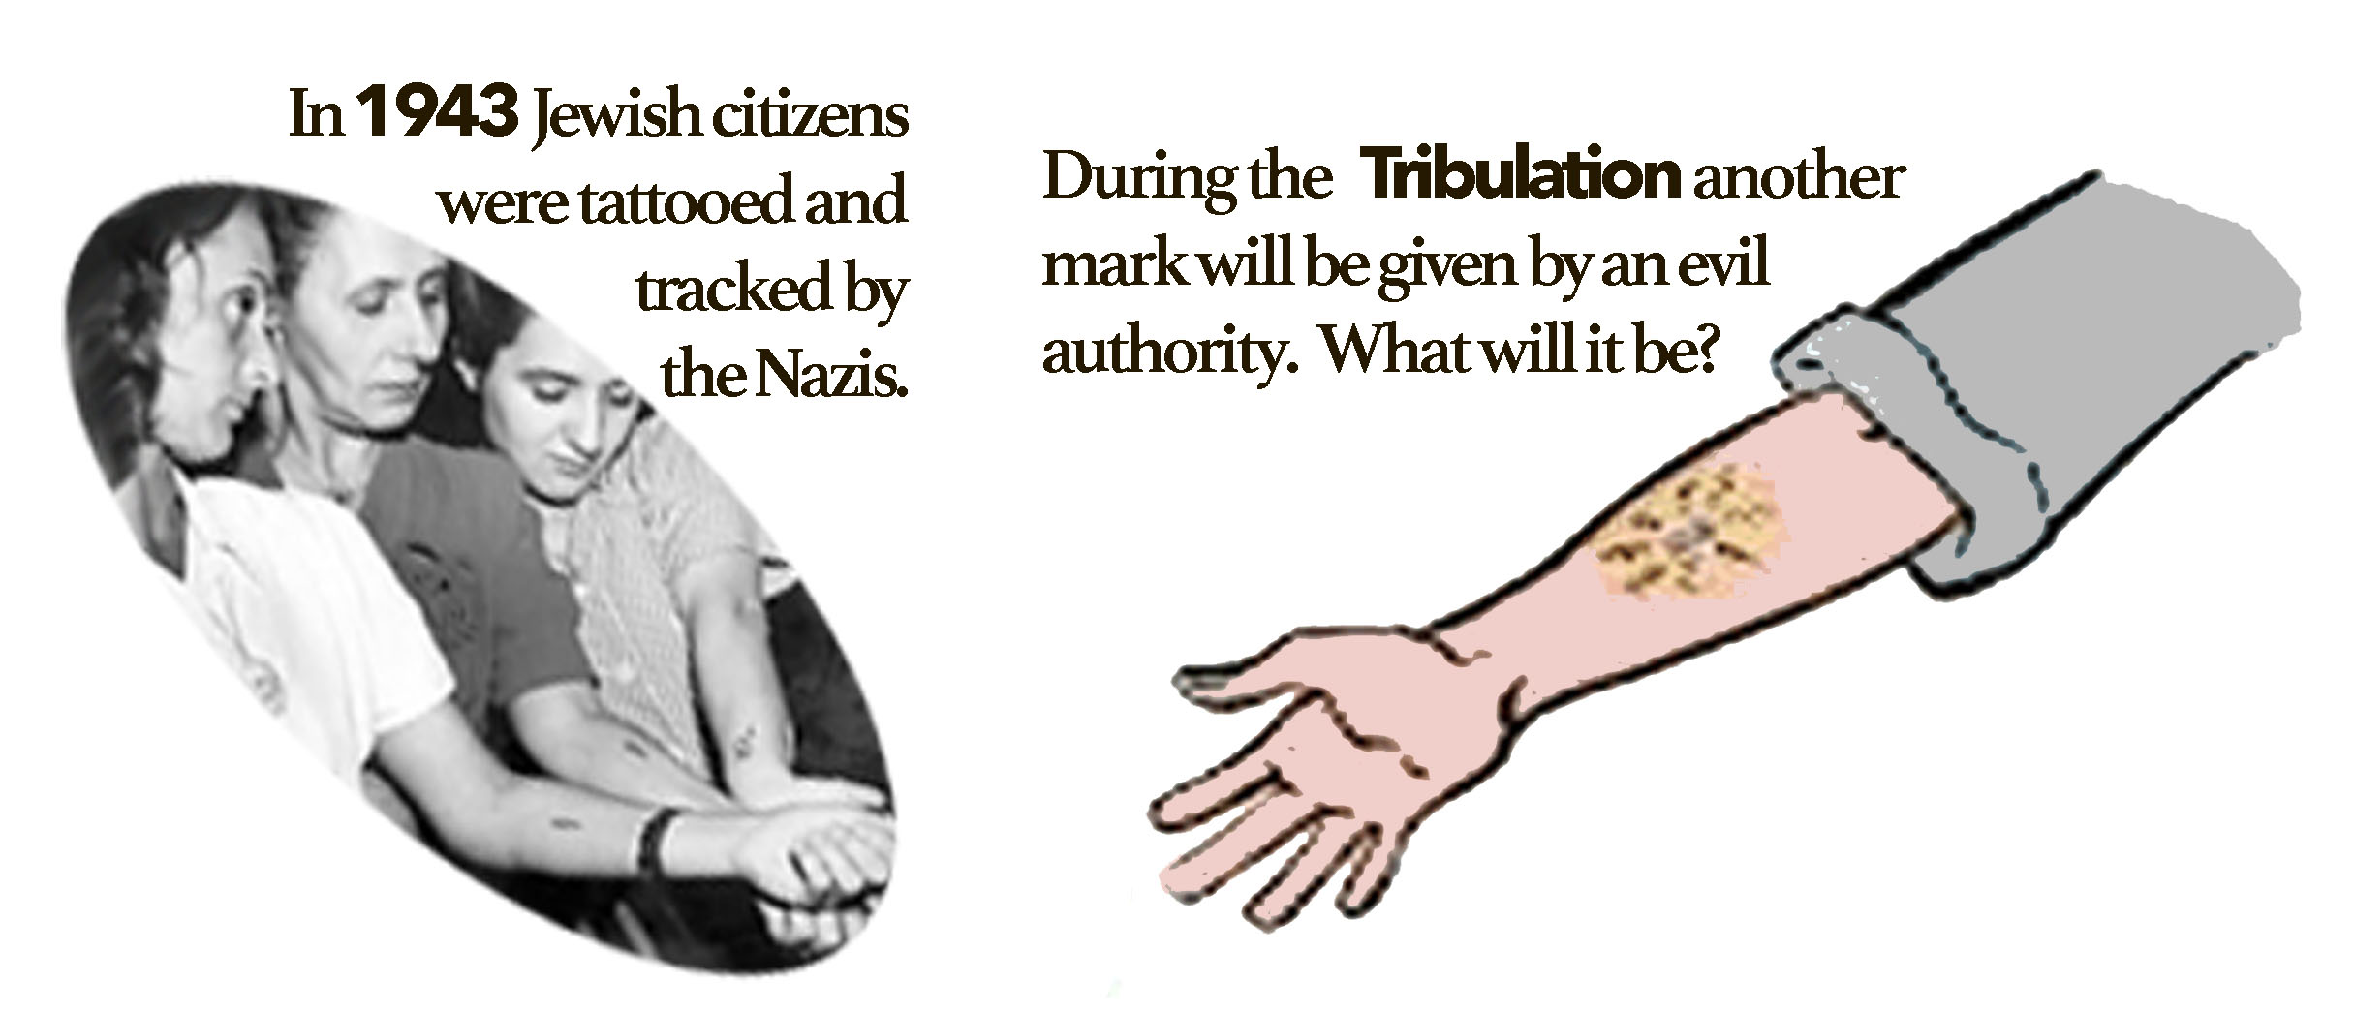

Slide 15
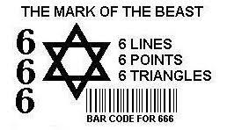

Slide 17
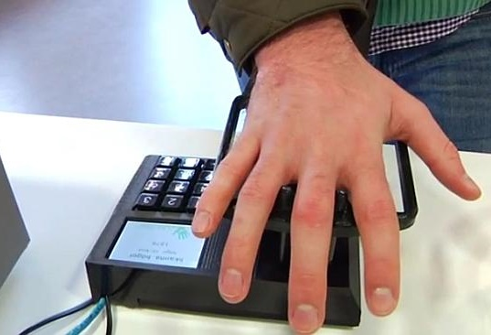

Slide 19
What is the Mark of the Beast?
The mark of the beast is a combination of letters and symbols that will be physically and permanently placed on your forehead or right hand. Most people will consider it an honor to receive the mark. It will be like a key for them that will open doors of acceptance, prosperity and peace. There will be 666 different ways to get the mark.
The mark of the beast will be placed on people who worship the beast and choose to receive his mark. There will be severe penalties for refusing the mark and great rewards for getting it.
http://www.markbeast.com/mark/what-is-mark-beast.htm

Slide 20
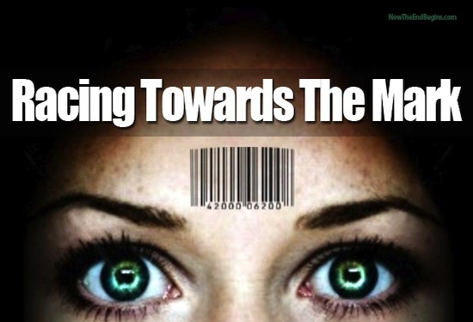

Slide 21
The ‘Left Behind’ Series Was Just The Latest Way America Prepared For The Rapture
By Alissa Wilkinson July 13, 2016
This belief about the timeline of events at the end of the world has deep roots in American religion. In the 18th century, American Puritan minister and Harvard President Increase Mather and his son Cotton spoke of a Rapture of the faithful before a period of tribulation. Their views and similar ones were crystallized and popularized in 1827 by John N. Darby, one of the original members of the Plymouth Brethren denomination (Dispensationalism), holds the view that the modern state of Israel as Biblical Israel, awaiting the fulfillment of all of the Old Testament’s promises before the end of days.

Slide 22
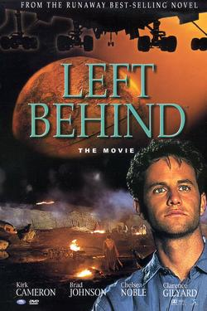
Some Christians — fundamentalists, evangel-icals — believe that the Bible foretells -a “premillennialist” Rapture: After peace is achieved between the state of Israel and the rest of the world, and following the rise of a one-world government, there will come a moment in which Christians will disappear from the earth en masse, signaling the rise of the Antichrist and the beginning of a seven-year tribulation period before Jesus’s eventual return to earth and, after a thousand-year period of peace, Satan’s final defeat.
www.washingtonpost.com/news/act-four/wp/2016/07/13/the-left-behind-series-was-just-the-latest-way-america-prepared-for-the-rapture/?utm_term=.28f8f33152d3

Slide 24
THE.MARK.OF.THE.BEAST
8 This great subject that we are approach-ing has certainly caused some great contro-versy... And I believe that it's such a great, vital part of the Scripture, that all the Scripture should be taught: We should not leave any of it out.
God spoke through the Scriptures about the mark of the beast and how it was to appear in the last days… There has been many thoughts projected to the peoples concerning this vital, God sent message, warning to the church…

Slide 25
Many things has been thought and given to the people what this mark of the beast was. And of course, like all other Scripture, it causes cults to rise... But surely, if there is such a thing fixing to befall the people of the earth, there should be some Gospel sensible answer to the question.
56-0715

Slide 26
THE.REVELATION.OF.JESUS.CHRIST
And if Satan hates any Book in the Bible, it's the Revelation… he despises mostly, Revelation and Genesis. And the Book of Revelation has more symbols in it than all the rest of the Books in the Bible, because it is a Book of prophecy. Therefore it has to be understood by a prophetic class. This Book is not meant for everybody. There's nobody can understand it, hardly. Deuteronomy says, "The hidden things belong to the Lord…” And He reveals to us, His children, the hidden things.
60-1204

Slide 27
POWER.OF.TRANSFORMATION
The church in the last days is going to be twins, "so close that it'll deceive the Elected..." Matt. 24:24. See, just two fathers; same mother, same church, same movement... The bedding ground is the same, where the Word falls; but one of them, like here, is perverted, because it's the wrong father. Which, I will prove someday, if God will let me, that denomination is the mark of the beast. See, it's the wrong father, he is stirring people to an organization instead of to the Word. See, it's the wrong father. It's a Cain move.
65-1031

Slide 28
THE.MARK.OF.THE.BEAST
17 I've heard it predicted by many different ways, that the tattoo a sign in your hand, a sign on your head. I do not believe that that's correct with Scripture. And there's going to be a group of people that's going to be marked for destiny in hell. And there's going to be people marked for their eternal destiny in heaven. These two marks run side by side.
And it's going to get so great, so pinching, just before the coming of the Lord, you'll have to have one mark or the other, or there'll be a boycott: you can't buy nor sell. 56-0715

Slide 29
LEVITICUS 25:10-13
And ye shall hallow the fiftieth year, and pro-claim liberty throughout all the land unto all the inhabitants thereof: it shall be a jubile unto you; and ye shall return every man unto his possession, and ye shall return every man unto his family. 11 A jubile shall that fiftieth year be unto you: ye shall not sow, neither reap that which groweth of itself in it, nor gather the grapes in it of thy vine undressed. 12 For it is the jubile; it shall be holy unto you: ye shall eat the increase thereof out of the field. 13 In the year of this jubile ye shall return every man unto his possession.

Slide 30
THE.MARK.OF.THE.BEAST
23 Every slave, when he heard that trumpet sound, he could throw down his hoe, say, "I am a free man. I couldn't redeem myself. But God, through His grace has declared a year of jubilee. Therefore, I believe God. And I don't have to work any more." And the laws of the land claimed him free. What a beautiful type of today.
We, poor, aliens, nothing we could do, if we kept every Sabbath, quit eating meat, done all kinds of religious sacrifice, we are under a load. We are sold in sin.

Slide 31
Our parents sold us out to sin in the garden of Eden. And we are laden under the bonds of sin as a slave to the devil. We were born in sin, shaped in iniquity... But when the jubilee time comes, we are free... And the trumpet is the Gospel, the good news. The trumpet was the Gospel then: good news. You're no longer bound. You no longer have to live in sin. You can go home and be free. You don't owe any debts at all.
24 And today, when a man hears the good news, Christ died in your stead, nothing that you can do about it, Christ paid the price, the Gospel sound,

Slide 32
you can drop every cigarette, every chew tobacco, every whiskey bottle, every thing that's binding you and say, "I am free. This is the good news. Christ has made me free." You're a free people. You don't have to serve the devil any longer. You can be free if you desire to be free.
Now, you don't have to drink; run around; don't have to mistreat your wife; curse; lie; steal; don't have to be weary. Why, you've got the resources up yonder that's never been tapped of the bountiful blessings of God that the world knows nothing about.
56-0715

Slide 33
If that isn't a perfect type of the marking of the beast... The good news is the Gospel. To reject to hear the Gospel, your ears are sealed up that you'll always call it fanaticism, and there's nothing to it. And you'll be serving sin in forms of godliness as long as you live. No matter how religious you are, you're sealed off from the Presence of God.

Slide 34
THE.TEN.VIRGINS
250 Now, the seal of God is the "Holy Spirit." (Rev.9:1-4) Ephesians 4:30, "Grieve not the Holy Spirit…" that's that Angel that come forth sealing upon their forehead. Now, that doesn't mean He takes and puts a spot up there; your forehead is your revelation, see, and your hand is the thing you do about it. See, it's a spiritual mark. He don't take a big stamp and stamp you like that.

Slide 35
251 A few years ago they said, the N.R.A. come out, it was this, Don't look for that, it's already. The Bible said it begin plumb back there, it's about run out now. But He marked the Sealed. Now, how was the first seal, what did it look like? They were filled with the Holy Ghost, and their works was the works of Christ. They laid hands on the sick and they recovered, they done all kinds of signs, miracles and wonder. And in their forehead, was sealed by the revelation that He was the Son of God, and they were working with Him (the Deity of Christ), there's the mark.
60-1211

Slide 36
CHURCH.AGE.BOOK
175-2 I believe according to Rev. 13:16 that the bride will have to stop preaching for the beast is demanding the mark in the hand or forehead if permission to preach be granted. Denominations will take the mark, or be forced to quit preaching. Then the Lamb will come for His bride and judge the great harlot.

Slide 37
IS.YOUR.LIFE.WORTHY.OF.THE.GOSPEL
62 Now, somebody said, "Now, there's going to be a mark of the beast, it's going to come someday." Let me tell you. It's already come. As soon as the Holy Ghost begin to fall, the mark of the beast begin to take place.
63 You only have two things. One of them, is, accept It, takes the Seal of God. To reject It, takes the mark of the beast. Everybody understand? When the trumpet sounded, and all wanted to go free could go. Them that didn't, was marked.

Slide 38
Now, you see, the mark of the beast, if we talk about it in the future, is when it's going to be made manifest, when you realize it's what you've already done. And so is the Holy Spirit, It's to be manifested.
When we see the Lord Jesus coming in glory, and feel that transforming power, see the dead rising out of the grave, and know, in a second longer, we'll be changed and have a body like His. It'll be made manifest. Then, to see those who rejected It, will be left down, out.
63-0630

Slide 39
ISAIAH 61:1-2
The Spirit of the Lord GOD is upon me; because the LORD hath anointed me to preach good tidings unto the meek; he hath sent me to bind up the brokenhearted, to proclaim liberty to the captives, and the opening of the prison to them that are bound; 2 To proclaim the accept-able year of the LORD, and the day of vengeance of our God; to comfort all that mourn;

Slide 40
LUKE 4:17-21
And there was delivered unto him the book of the prophet Esaias. And when he had opened the book, he found the place where it was written, 18 The Spirit of the Lord is upon me, because he hath anointed me to preach the gospel to the poor; he hath sent me to heal the broken-hearted, to preach deliverance to the captives, and recovering of sight to the blind, to set at liberty them that are bruised, 19 To preach the acceptable year of the Lord. 20 And he closed the book, and he gave it again to the minister, and sat down. And the eyes of all them that were in the synagogue were fastened on him. 21 And he began to say unto them, This day is this scripture fulfilled in your ears.

Slide 41
THIS.DAY.THIS.SCRIPTURE.
45 The Messiah standing in the platform, to identify Himself with the Word of promise for that age: "To preach the acceptable year."
46 "The acceptable year," as we all know, was "the year of jubilee..." No matter how long they had been in bondage, when the year come, of the jubilee every man could go free if he wanted to go free. But if you desired to remain a slave, then you had to be taken down to the temple… a hole in your ear, and then you had to serve that slave master the rest of your days.

Slide 42
48 What a perfect example it is of the Gospel of Jesus Christ! When It's preached, the acceptable time, the time of Jubilee; anybody, no matter who you are, what color you are, what denomination you belong to, how it's far you've stooped in sin, or what's wrong with you; you can go free when you hear the Gospel trumpet sound out. You are free!

Slide 43
49 But if you turn your back upon the Message and refuse to hear It, you were bored in the ear with an awl. That means, that you have crossed the line between grace and judgment, you will never hear the Gospel again. You'll never get any further. You must be a slave to the system you're in, the rest of your days, if you refuse to hear the acceptable year.
65-0219

