Slide 1
What is
Worship?
Part 4
PS. 47:6-7
Sing praises to God, sing praises: sing praises unto our King, sing praises. 7 For God is the King of all the earth: sing ye praises with understanding.

Slide 2
Birthdays & Anniversaries & Events
Jan. 29th Keith Buchanan
Jan. 30th Sabrina Stephens
Jan. 31st Brian McCall, Katherine May Pritchard,
Wayne Coffey
Feb. 2nd Shirley Lingle, Troy Hughes
Feb. 4th Tom & Kim Ward
Feb. 5th Jennifer Cockman
Feb. 7th Anwar & Sheba Javed
Feb. 8th Katelyn Sylvester

Slide 3
Events
Feb. 10th Marriage Banquet
April 19-21 Father & Son Campout
April 28th Mother & Daughter Tea

Slide 4
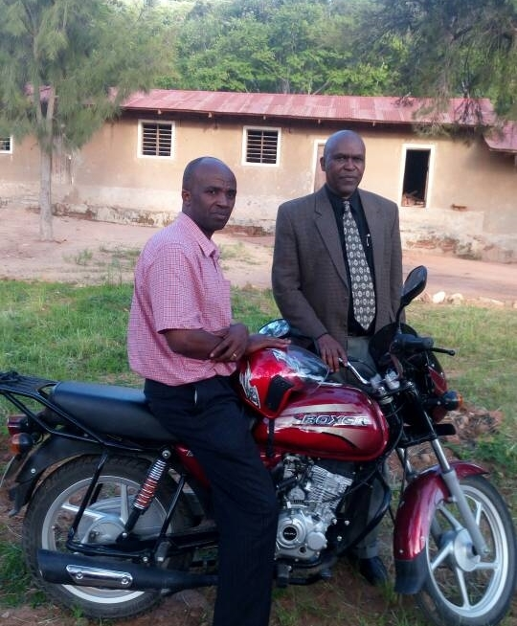
Motorcyle #2
Tanzania

Slide 5
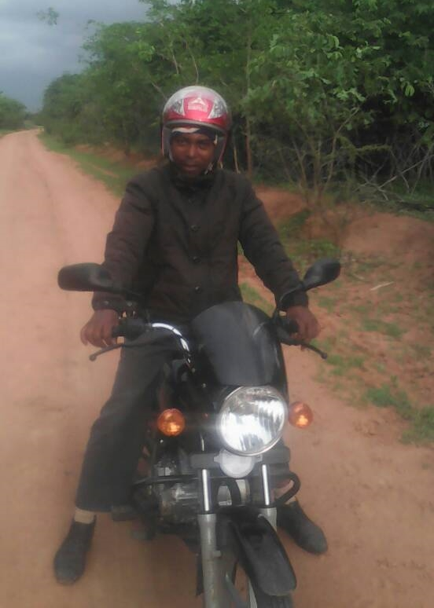
Motorcyle
No. 3
Tanzania

Slide 6
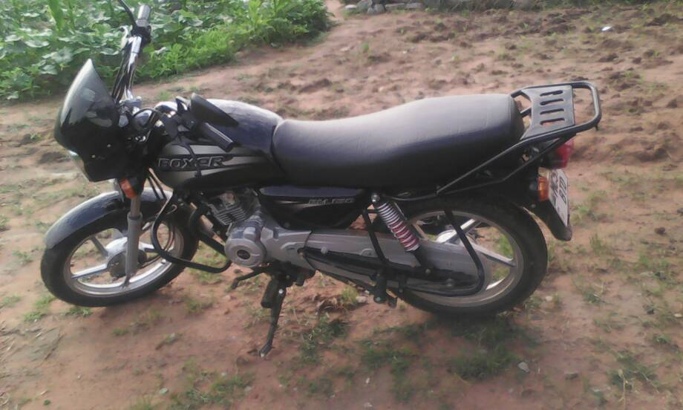

Slide 7
What is
Worship?
Part 4
PS. 47:6-7
Sing praises to God, sing praises: sing praises unto our King, sing praises. 7 For God is the King of all the earth: sing ye praises with understanding.

Slide 8
JOHN 4:23-24
But the hour cometh, and now is, when the true worshippers shall worship the Father in spirit and in truth: for the Father seeketh such to worship him. 24 God is a Spirit: and they that worship him must worship him in spirit and in truth.

Slide 9
CHURCH.AGE.BOOK
47-3 …When one turns to the Lord and is filled with the Holy Ghost he ceases from all such things. He has a rest in his soul. He really begins to live, and love God and worship Him.

Slide 10
Worship:
“True worship is defined by the priority we place on who God is in our lives and where God is on our list of priorities. True worship is a matter of the heart expressed through a lifestyle of holiness. Thus, if your life does not express the beauty of holiness through an exaggerated love for God, and you do not live in extreme or excessive submission to God, then I invite you to make worship a non-negotiable priority in your life.”

Slide 11
MATTHEW 22:37
Jesus said unto him, Thou shalt love the Lord thy God with all thy heart, and with all thy soul, and with all thy mind. 38 This is the first and great commandment. 39 And the second is like unto it, Thou shalt love thy neighbour as thyself. 40 On these two commandments hang all the law and the prophets.

Slide 12
SIRS.WE.WOULD.SEE.JESUS
7 And I deem this a great privilege. Trust that God will bless this trustee board who let us have this beautiful building for the worship of God. Bless the pastor. May it grow to be a mighty, mighty, church, more so than it is now, if that would be possible.
We only represent one thing, that's Christ. I think He's the main object of our worship and our dedication.
61-0519

Slide 13
Worship
(Gr. Proskuneo) Worthiness
To kiss the hand; in token of reverence; hence among the Orientals, esp. the Persians, to fall upon the knees and touch the ground with the forehead as an expression of profound reverence; in the NT by kneeling or prostration to do homage or make obeisance, whether in order to express respect or to make supplication; Homage rendered to God and the ascended Christ, to heavenly beings, and to demons.

Slide 14
LOOKING.FOR.JESUS
8 Well now, we want to speak, as every meeting, about Jesus Christ. And He's the Center of our worship, the Center of our attraction, the Center of our life, all that we have and are and will be is based upon Him. He was the One Who came and gave His life for us, come down from God, out of glory, and was made flesh, dwelled among us.
54-0228

Slide 15
GOD.HIDING.HIMSELF.IN.SIMPLICITY
14 I think it's our duty to make the inside right by the grace of God to be so grateful to God that... This will just not only be a beautiful building… but may everyone who comes in see the beautiful characteristic of Jesus Christ in every person that comes in.
May it be a consecrated place to our Lord, a consecrated people, for no matter how beautiful the structure is, the beauty of the church is the character of the people. I trust it'll always be a house of God of beauty. 63-0317

Slide 16
Worship & Music
PSALMS 22:3-5
But thou art holy, O thou that inhabitest the praises of Israel. 4 Our fathers trusted in thee: they trusted, and thou didst deliver them. 5 They cried unto thee, and were delivered: they trusted in thee, and were not confounded.

Slide 17
Principle 1
True Christian Music should bring praise and glory to God and not the singer.
Principle 2
True Christian Music expresses a new song (new life), not the old life with Bible lyrics.
Principle 3
True Christian Music lyrics and music should be clear, not vague, deceptive, or mixed up.

Slide 18
BY.FAITH.MOSES
The other day, coming down the road, I turned on my radio… I kept listening. I had to take nearly the song through, before I could tell whether it was, absolutely, a religious song, or the devil is trying to bring down the things of God to the level of the world. You can't do that…
I don't care how many albums Elvis writes, of all the good religious songs, he's still possessed of the devil. He's sent more children to hell... Pat Boone and the rest of them, even belong to the Church of Christ, Elvis Presley: Pentecostals are Judas Iscariot in the form of those men.
1958

Slide 19
Principle 4
True Christian Music should emphasize the message of the song, not the music, beat, or the singer’s talent.
Principle 5
True Christian Music should feed your soul and refresh your spirit, not feed the flesh and excite lust.

Slide 20
Principle 6
True Christian Music drives away evil spirits, never invites them.
I SAMUEL 16:23
And it came to pass, when the evil spirit from God was upon Saul, that David took an harp, and played with his hand: so Saul was refreshed, and was well, and the evil spirit departed from him.

Slide 21
Principle 7
True Christian Music leads you into worship and godliness, never more worldliness.
I CHRONICLES 16:29
Give unto the LORD the glory due unto his name: bring an offering, and come before him: worship the LORD in the beauty of holiness.

Slide 22
DO.YOU.NOW.BELIEVE?
All of our songs out here, is all some kind of this old jazz music and everything, screaming out. You can't even go in a restaurant and eat without that stuff going on. It's a shame. I go in one, I see it, I turn around and go out, if I can, get away from there. No, sir.
That kind of stuff leads right down to destructions. The devil is in that thing, and it'll finally pull you into it. Shun the appearance of evil. Now, you're going to think I'm a holy-roller, sure enough.

Slide 23
I CHRONICLES 15:1-3
And David made him houses in the city of David, and prepared a place for the ark of God, and pitched for it a tent. 2 Then David said, None ought to carry the ark of God but the Levites: for them hath the LORD chosen to carry the ark of God, and to minister unto him for ever. 3 And David gathered all Israel together to Jerusalem, to bring up the ark of the LORD unto his place, which he had prepared for it.

Slide 24
I CHRONICLES 15:15-16
And the children of the Levites bare the ark of God upon their shoulders with the staves thereon, as Moses commanded according to the word of the LORD. 16 And David spake to the chief of the Levites to appoint their brethren to be the singers with instruments of musick, psalteries and harps and cymbals, sounding, by lifting up the voice with joy.

Slide 25
Satmar Rebbe Rabbi Zalman Leib Teitelbaum
(Williamsburg, NY)
Dancing Mitzvah Tanz At The Wedding Of His Grand-daughter In Bet Shemesh, Israel Wednesday January 23 2013 Jerusalem.
The children of two prominent Hassidic rabbis -- the daughter of Rabbi Chaim Tzvi Teitelbaum, head of the Jerusalem branch of Satmar, and the son of Rabbi Shaya Labin Ziditshov of Williamsburg, Brooklyn, were wed on January 23, 2013.
This visit is the first time in thirty years that a Satmar Grand Rabbi has traveled to Israel and marks the first time that Rabbi Teitelbaum will go to Israel as Grand Rabbi of the Satmar chasidim.

Slide 26
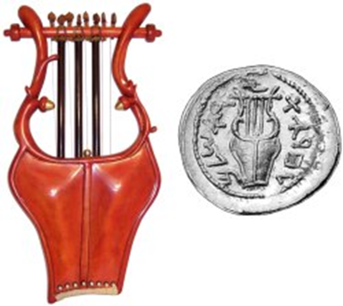
LYRE (ke-nor', khe-nor’)

Slide 27



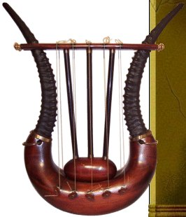
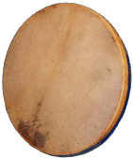







12 Instruments of the Bible

Slide 28
LYRE (ke-nor', khe-nor’)
1. an ancient type of stringed instrument used to accompany the voice or as a solo melodic instrument. With at least seven or possibly eight strings, it was primarily considered a chording instrument in relation to the musical performances of the Levites providing the harmonic support for the singers and the harps.
Genesis 4:21, 31:27; 1 Samuel 10:5, 16:16, 16:23; 2 Samuel 6:5; 1 Kings 10:12; Isaiah 5:12, 16:11, 23:16, 24:8, 30:32; Ezekiel 26:13; Psalm 33:2, 43:4, 49:4 (49:5 JPS), 57:8 (57:9 JPS), 71:22, 81:2 (81:3 JPS), 92:3 (92:4 JPS), 98:5 (2x), 108:2 (108:3 JPS), 137:2, 147:7, 149:3, 150:3; Job 21:12, 30:31; Nehemiah 12:27; 1 Chronicles 13:8, 15:16, 15:28, 15:21, 16:5, 25:1, 25:3, 25:6; 2 Chronicles 5:12, 9:11, 20:28, 29:25 (total 42 occurrences)

Slide 29
Psalm 96
Sing to YAHVEH a new song. Sing to YAHVEH all the earth.
Sing to YAHVEH, bless His Name. Proclaim His help from day-to-day.
Recount among the nations His splendor, His wonders among all the people.
For great is YAHVEH and much to be praised. He is to be feared above all gods.
For all the gods of the people are worthless. It is YAHVEH who made the heavens.
Honor and majesty are before Him. Strength and beauty are in His Sanctuary.

Slide 30
Give to YAHVEH you races of people. Give to YAHVEH respect and power.
Give to YAHVEH the respect due His Name. Bring an offering and enter into His courts.
Bow down to YAHVEH in the beauty of His sacredness.
Tremble before Him from the surface of all the earth.
Say among the nations, 'YAHVEH is King!'
The world is also established, not to be moved. He will judge the people with uprightness.
Let the heavens rejoice and the earth be glad. Let the sea roar and all that it holds.

Slide 31
PSALM 66:1-2
To the chief Musician: Make a joyful noise unto God, all ye lands: 2 Sing forth the honour of his name: make his praise glorious.

Slide 32
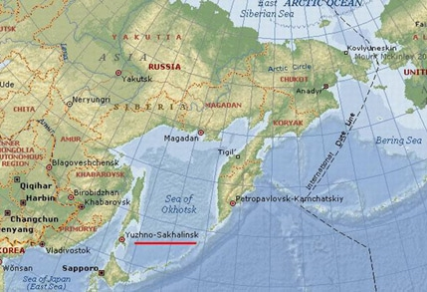

Slide 33
I CHRONICLES 16:41-42
And with them Heman and Jeduthun, and the rest that were chosen, who were expressed by name, to give thanks to the LORD, because his mercy endureth for ever; 42 And with them Heman and Jeduthun with trumpets and cymbals for those that should make a sound, and with musical instruments of God. And the sons of Jeduthun were porters.

Slide 34
LIFE
There's nothing any prettier than old fashion pentecostal singing, with the glory of God in the meeting. That's real joy to my heart, and I was so glad to refresh myself in the presence of that good singing tonight.
1958

