Slide 1
What is Worship? Part 5
PSALM 66:1-2
To the chief Musician:
Make a joyful noise unto God, all ye lands: 2 Sing forth the honour of his name: make his praise glorious.

Slide 2
Worship:
“True worship is defined by the priority we place on who God is in our lives and where God is on our list of priorities. True worship is a matter of the heart expressed through a lifestyle of holiness. Thus, if your life does not express the beauty of holiness through an exaggerated love for God, and you do not live in extreme or excessive submission to God, then I invite you to make worship a non-negotiable priority in your life.”

Slide 3
GOD.HIDING.HIMSELF.IN.SIMPLICITY
14 I think it's our duty to make the inside right by the grace of God to be so grateful to God that... This will just not only be a beautiful building… but may everyone who comes in see the beautiful characteristic of Jesus Christ in every person that comes in.
May it be a consecrated place to our Lord, a consecrated people, for no matter how beautiful the structure is, the beauty of the church is the character of the people. I trust it'll always be a house of God of beauty. 63-0317

Slide 5
Andrew Fletcher
Born: 1655, East Saltoun
Died: September 1716, London, UK
Battles & Wars:
Monmouth Rebellion,
Great Turkish War, Glorious Revolution

Slide 6
Worship & Music
PSALMS 22:3-5
But thou art holy, O thou that inhabitest the praises of Israel. 4 Our fathers trusted in thee: they trusted, and thou didst deliver them. 5 They cried unto thee, and were delivered: they trusted in thee, and were not confounded.

Slide 7
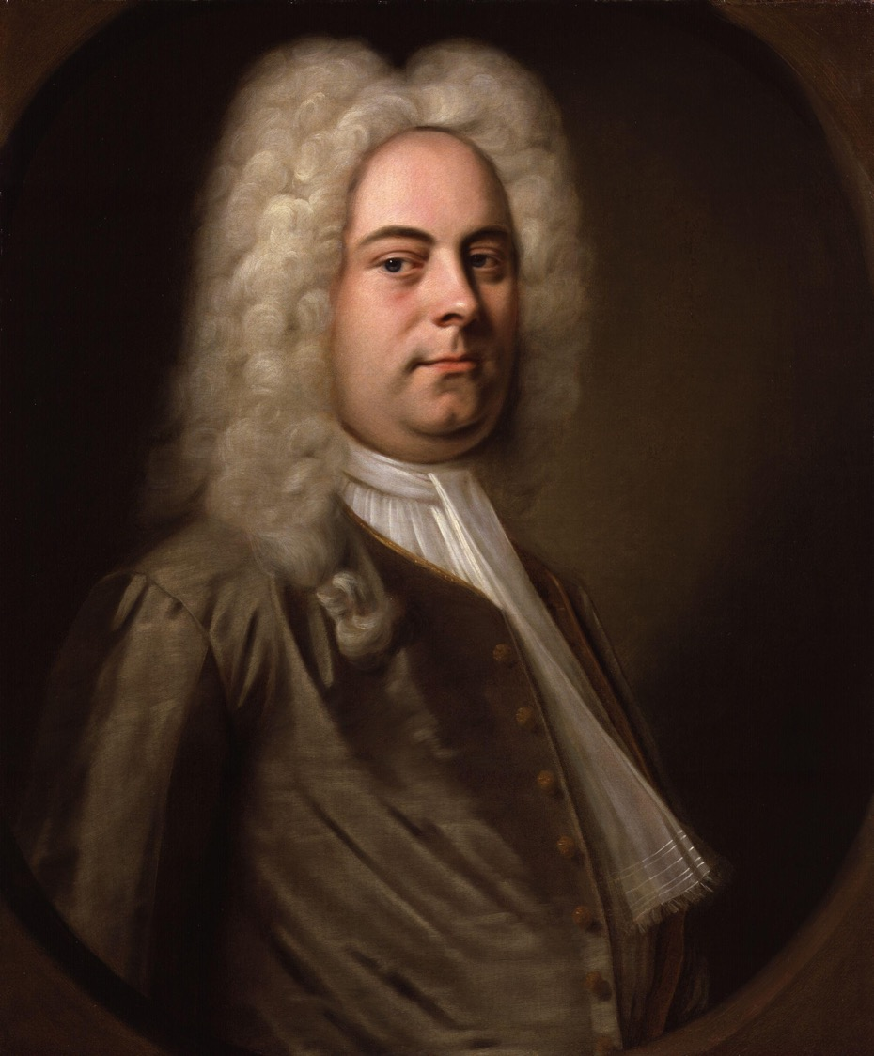
George Frideric Handel
The Messiah
From the King James Bible
& Book of Common Prayer
1741

Slide 8
John Newton, the author of "Amazing Grace," refused to let Handel's Messiah be performed in his church. He thought the musical style was too worldly.
In 1784–85 he gave a series of 50 sermons at his own church in response to the oratorio being played at Westminster Abbey as part of a commemoration festival of Handel's 100th birthday. His stated goal was to preach on the Scriptural passages found in the lyrics of the Messiah, though he also found ample oppor-tunity to further his critique of the oratorio and its performance.

Slide 9
The music of Messiah, though majestic and greatly admired, deflects attention from the scriptural text upon which it is based;
The audience that gathered to hear Messiah came for the wrong reasons;
The place of its performance was inappropriate.

Slide 10
“If the far greater part of the people who frequent the Oratorio, are evidently unaffected by the Redeemer's love, and uninfluenced by his commands, I am afriad, it is no better, than a profanation of the name and truths of God, a crucifying the Son of God afresh.
John Newton
(Sermon 50)

Slide 11
Controversies for Handel’s Messiah
Before he wrote Messiah, Handel was an enormously successful opera composer. He was born in Germany in 1685 (the same year as J. S. Bach) just 50 miles from Bach’s home town (but they never met!) He studied opera in Italy and then moved to London in 1712, where he worked the rest of his life. He wrote some 29 operas that were enormously popular.
But, then politics changed and opera went out of fashion. Most of this change was driven by religious concerns.

Slide 12
For example, Jonathan Swift (Gulliver’s Travels) tried to stop the Dublin premiere of Messiah. Many Church leaders considered Handel’s music profane and subversive, because of his association with opera and the theater. They objected to their Cathedral Choirs participating. This controversy almost prevented Messiah from the very start. Handel put the premiere in Dublin, in part because of his fears over the controversy a London performance would create.

Slide 13
What do the other great composers think of Handel? This is certainly not a controversy! Johann Sebastian Bach said, “[Handel] is the only person I would wish to see before I die, and the only person I would wish to be, were I not Bach.”
After hearing this statement, Mozart is said to have exclaimed. “Truly, I would say the same myself if I were permitted to put in a word.” Haydn said Handel was “master of us all” and Beethoven, when asked who was the greatest composer said, “Handel, to him I bow the knee.”

Slide 14
LOOKING.FOR.JESUS
8 Well now, we want to speak, as every meeting, about Jesus Christ. And He's the Center of our worship, the Center of our attraction, the Center of our life, all that we have and are and will be is based upon Him. He was the One Who came and gave His life for us, come down from God, out of glory, and was made flesh, dwelled among us.
54-0228

Slide 15
Thirst
146 “My soul thirsts for the living God, like the hart panting for the water brook. Unless I can find It, I’ll perish.” When you get to hungering for God like that, something is going to take place. The Holy Spirit is to lead you to those great fountains of God.
Now, there is a good thing, to worship in the Spirit. But sometimes you have Spirit without Truth. John 4, “We worship God, Spirit and Truth.” And Jesus is the Truth.

Slide 16
And He is the Word. The streams God sent to satisfy you, in the natural, Satan has polluted every one of them. He has put the poisoned dope in every one that he could get into. He took that great stream, of the church. 65-0919

Slide 18
QUESTIONS.AND.ANSWERS.2
5 Youthful members swing out to jazz. Passion play tells of the crucifixion in modern i-d-i-o-m, rock-and-roll. The pastor here leading all the teen-agers up there and going through the passions of Christ, the crucifixion played out in rock-and-roll and jazz. It's in Maryland.
I was telling you this morning of those Beatles, "Return of Beatles," and there's the articles; you just should read it out of the magazine: "...as it were, had founded a new religion." 64-0823

Slide 19
THE.THIRD.SEAL
306 Now, oil typifies Spirit, and wine symbolizes stimulation of revelation. Boy, I like to run all over the place. It's a wonder I didn't wake up the neighborhood when the Lord showed me that. Stimulation of revelation...
Oil and wine in the Bible is associated together always.
63-0320

Slide 20
THE.THIRD.SEAL
308 When the truth of a promised Word of God has been truly revealed to His saints that's filled with oil, they all get stimulated. Wine is a stimulation. Glory, I feel it right now, stimulated with joy, shouts. And when it does, it has the same effect upon them that wine does upon a natural man; because when the revelation has been given of a truth of God, and the true believer filled with oil, and the revelation is revealed, the stimulation becomes so great that it makes him behave hisself unnormally.
63-0320

Slide 21
THE.FOURTH.SEAL
64 Now, the power of revelation brings stimulation to the believer, for the power of wine, natural wine is to stimulate. It's to bring a person that's all slumped down to a stimulation. Well there's a power of the revelation of the Word gives stimulation of joy to the believer, stimulation of satisfaction, the stimulation that it's vindicated, it's proved. It's called in the Scripture, as we want to refer to it, as new wine. We always refer to it like that as "These are drunk on new wine,” or spiritual wine. As the natural wine reveals itself in stimulated power, so does the new wine as it reveals the Word of God which is Spirit. 63-0321

Slide 22
DO.YOU.NOW.BELIEVE?
All of our songs out here, is all some kind of this old jazz music and everything, screaming out. You can't even go in a restaurant and eat without that stuff going on. It's a shame. I go in one, I see it, I turn around and go out, if I can, get away from there. No, sir.
That kind of stuff leads right down to destructions. The devil is in that thing, and it'll finally pull you into it. Shun the appearance of evil. Now, you're going to think I'm a holy-roller, sure enough.

Slide 23
I CHRONICLES 15:1-3
And David made him houses in the city of David, and prepared a place for the ark of God, and pitched for it a tent. 2 Then David said, None ought to carry the ark of God but the Levites: for them hath the LORD chosen to carry the ark of God, and to minister unto him for ever. 3 And David gathered all Israel together to Jerusalem, to bring up the ark of the LORD unto his place, which he had prepared for it.

Slide 24
I CHRONICLES 15:15-16
And the children of the Levites bare the ark of God upon their shoulders with the staves thereon, as Moses commanded according to the word of the LORD. 16 And David spake to the chief of the Levites to appoint their brethren to be the singers with instruments of musick, psalteries and harps and cymbals, sounding, by lifting up the voice with joy.

Slide 25
MATTHEW 22:37
Jesus said unto him, Thou shalt love the Lord thy God with all thy heart, and with all thy soul, and with all thy mind. 38 This is the first and great commandment. 39 And the second is like unto it, Thou shalt love thy neighbour as thyself. 40 On these two commandments hang all the law and the prophets.

Slide 26
LIFE
There's nothing any prettier than old fashion pentecostal singing, with the glory of God in the meeting. That's real joy to my heart, and I was so glad to refresh myself in the presence of that good singing tonight.
1958

