Slide 1
What is Worship? Part 6
II Thes. 3:1
Finally, brethren, pray for us, that the word of the Lord may have free course, and be glorified, even as it is with you:

Slide 2
Birthdays, Anniversaries & Exciting Events
Feb. 17th Jaron Brown
Feb. 19th Johannah Irish
Feb. 22nd Luther Roy
Jeremy & Julia Clayville
Feb. 24th Judy Arnold
Feb. 25th Communion
March 31 & April 1st Easter Meetings

Slide 3
Worship & Music
PSALMS 149:1-5
Praise ye the LORD. Sing unto the LORD a new song, and his praise in the congregation of saints. 2 Let Israel rejoice in him that made him: let the children of Zion be joyful in their King. 3 Let them praise his name in the dance: let them sing praises unto him with the timbrel and harp. 4 For the LORD taketh pleasure in his people: he will beautify the meek with salvation. 5 Let the saints be joyful in glory: let them sing aloud upon their beds.

Slide 5
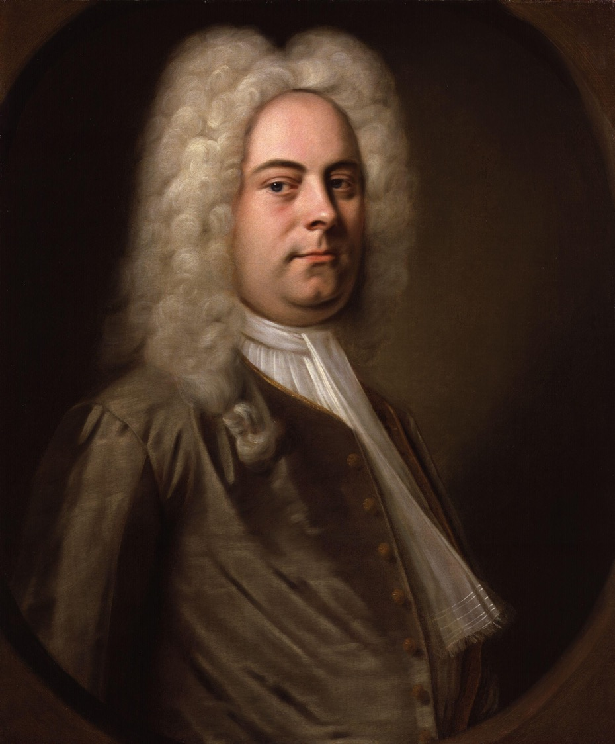
George Frideric Handel
The Messiah
From the King James Bible
& Book of Common Prayer
1741

Slide 6
“If the far greater part of the people who frequent the Oratorio, are evidently unaffected by the Redeemer's love, and uninfluenced by his commands, I am afriad, it is no better, than a profanation of the name and truths of God, a crucifying the Son of God afresh.
John Newton
(Sermon 50)

Slide 7
LOOKING.FOR.JESUS
8 Well now, we want to speak, as every meeting, about Jesus Christ. And He's the Center of our worship, the Center of our attraction, the Center of our life, all that we have and are and will be is based upon Him. He was the One Who came and gave His life for us, come down from God, out of glory, and was made flesh, dwelled among us.
54-0228

Slide 8
PHILIPPIANS 3:3
For we are the circumcision, which worship God in the spirit, and rejoice in Christ Jesus, and have no confidence in the flesh.
EPHESIANS 5:18-19
And be not drunk with wine, wherein is excess; but be filled with the Spirit; 19 Speaking to yourselves in psalms and hymns and spiritual songs, singing and making melody in your heart to the Lord;

Slide 9
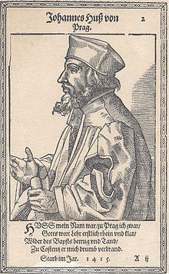
Jan Hus
1369 – 6 July, 1415
Czech theologian, Roman Catholic priest, philosopher
Church reformer,
Founder of Hussitism, a key predecessor to Protestantism and a seminal figure in the Bohemian Reformation

Slide 10
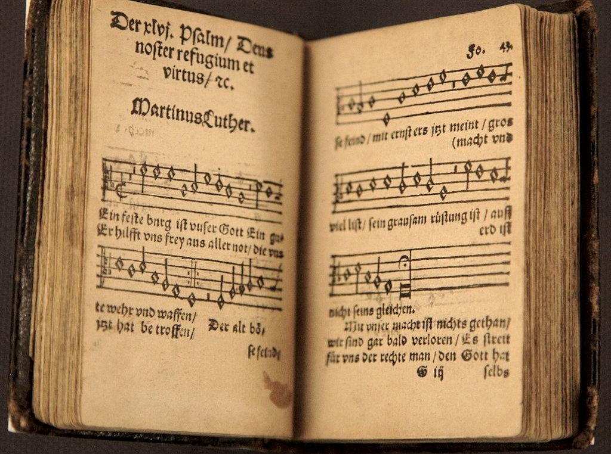
A Mighty Fortress is our God
By Martin Luther
(Ps. 46)

Slide 11
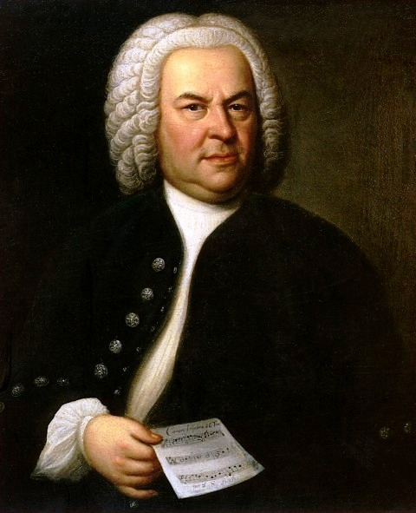
Johann Sebastian
Bach
Born: March 31, 1685
Eisenach, Germany
Died: July 28, 1750
Leipzig, Germany
(Baroque Period)
Soli Deo Gloria
Glory to God Alone

Slide 12
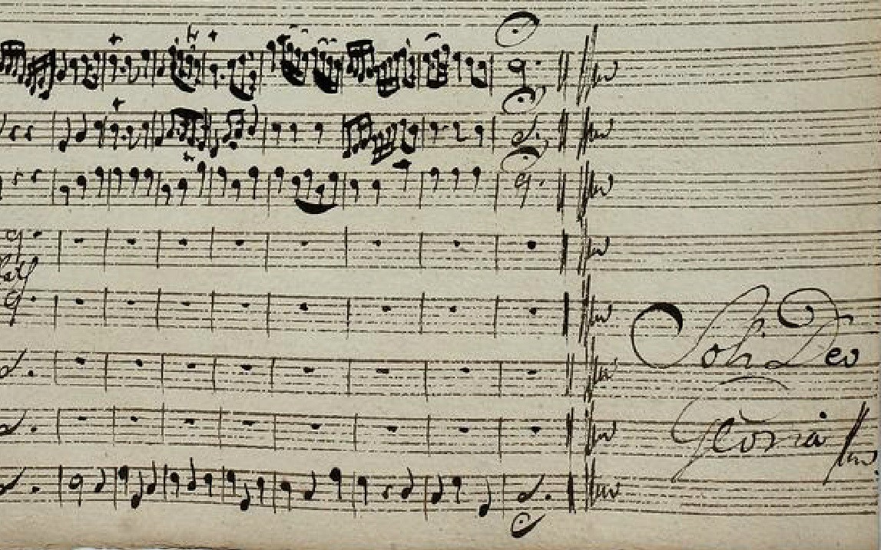

Slide 14
Thirst
146 The Holy Spirit is to lead you to those great fountains of God. Now, there is a good thing, to worship in the Spirit. But sometimes you have Spirit without Truth. And He is the Word. The streams God sent to satisfy you, in the natural, Satan has polluted every one of them. He has put the poisoned dope in every one that he could get into. He took that great stream, of the church. 65-0919

Slide 15
AMOS 5:4, 21-23
For thus saith the LORD unto the house of Israel, Seek ye me, and ye shall live…
I hate, I despise your feast days, and I will not smell in your solemn assemblies. 22 Though ye offer me burnt offerings and your meat offerings, I will not accept them: neither will I regard the peace offerings of your fat beasts. 23 Take thou away from me the noise of thy songs; for I will not hear the melody of thy viols.

Slide 17
THE.THIRD.SEAL
306 Now, oil typifies Spirit, and wine symbolizes stimulation of revelation. Boy, I like to run all over the place. It's a wonder I didn't wake up the neighborhood when the Lord showed me that. Stimulation of revelation...
63-0320

Slide 18
THE.FOURTH.SEAL
64 Now, the power of revelation brings stimulation to the believer, for the power of wine, natural wine is to stimulate. It's to bring a person that's all slumped down to a stimulation. Well there's a power of the revelation of the Word gives stimulation of joy to the believer, stimula-tion of satisfaction, the stimulation that it's vindicated, proved… As the natural wine reveals itself in stimulated power, so does the new wine as it reveals the Word of God which is Spirit. 63-0321

Slide 19
THE.SMYRNAEAN.CHURCH.AGE
54 Somebody called me, said, "Bro. Branham, if you don't stop that, every organization will be against you."
"Why, there's One that won't be, that's the One that's in Heaven. That's the One I'm looking for." Now, I love people in every organization. Sure. But have I ever told you anything in the Name of the Lord, didn't come to pass? Have I ever begged you for money? Then stay out of the organizations! You stay free in Christ, let the Holy Spirit always move in and out the church.
60-1206

Slide 20
Thousands of Caribou Die in Quebec Rivers
By Doug Martin NYT October 4, 1984
The animals were trying to cross the Caniapiscau and Koksoak Rivers about 60 miles upriver from Kuujjiaq, a town on Ungava Bay.
The caribous, which were making an annual migration, were swept over waterfalls or carried away in the rapids of the two swollen rivers.

Slide 25
THE.SMYRNAEAN.CHURCH.AGE
54 Somebody called me, said, "Bro. Branham, if you don't stop that, every organization will be against you."
"Why, there's One that won't be, that's the One that's in Heaven. That's the One I'm looking for." Now, I love people in every organization. Sure. But have I ever told you anything in the Name of the Lord, didn't come to pass? Have I ever begged you for money? Then stay out of the organizations! You stay free in Christ, let the Holy Spirit always move in and out the church.
60-1206

Slide 26
JESUS.CHRIST.THE.SAME
6 You know I think some of the best meetings we ever have is in churches. Crowds are great; we can't get into the little churches, or the big churches. But there's something about a church house... I hope you won't think that I've went off on some tantrum. But, I believe that a church, is where God stays.
Angels dwell among the churches. It's a place that's dedicated to service of God. Out in these auditoriums and things we find they have parties, dances, drinking, and everything.

Slide 27
And you feel the spirit that don't seem right. The Holy Spirit always seems to work so much different when you're in a church, especially in a good Spirit-filled church, where the people are filled with the Holy Spirit and great signs and wonders take place... And people who believe these things to be true...
61-0118

Slide 28
DEMONOLOGY
16 Now, I'm speaking directly to Christians so that you could see the pro and con.. Now, everything that God has, the devil has a counterfeit. Like these old dances; that's of the devil; but God has a holy dance for the people.
I was one of the greatest critics on that you ever seen, till God told me just what to do. I find out that Miriam danced in the Spirit. David danced when he had victory. All of it was victory. It was dancing, holy dancing.
53-1112

Slide 29
EXODUS 15:20
And Miriam the prophetess, the sister of Aaron, took a timbrel in her hand; and all the women went out after her with timbrels and with dances. 21 And Miriam answered them, Sing ye to the LORD, for he hath tri-umphed gloriously; the horse and his rider hath he thrown into the sea.
POSSESSING.ALL.THINGS
81 Miriam grabbed the tambourine went down the bank, dancing on the other side. After she had come through the Red Sea, seen her enemies drowned, then she could dance in the Spirit. When she seen the enemies that had tormented her, dead, then she danced in the Spirit. After the battle's won, then the glory of God comes down.
62-0506

Slide 30
CHRIST
7 God is in music, and He's in art; God is in the universe. He's in His creatures, and He's in the church, and He's in His creation; God's all around, everywhere. He's here in the Shriner auditorium right now at this night, right present. God's everywhere. I just wonder sometime if He'd just take the shades off of our eyes, till our sight would be fast enough to catch His Presence in the building.
55-0221

Slide 31
Daniel 6:18
¹⁸ Then the king (Darius) went to his palace, and passed the night fasting: neither were instruments of musick brought before him: and his sleep went from him.

Slide 32
WHO.DO.YOU.SAY.THIS.IS
23 Now, years ago, it was very easy when I first started out; and the signs, and message, and preaching. Everywhere was a arm open, "Come! Come!" But then every genuine sign from God has a Message, a Voice. It follows it. God don't give anything like that just for the fun of giving it.
He sends something forth to attract atten-tion to what He's fixing to say. Like we have this wonderful singing this choir done; what was it to do? To quieten the people for an oncoming message. 64-1227

Slide 33
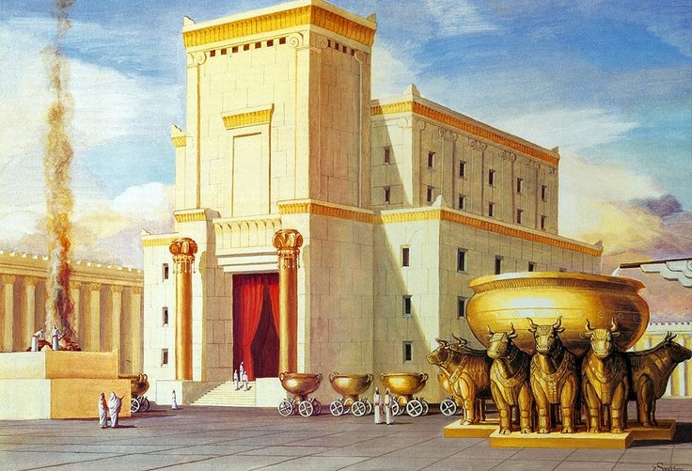
Temple Worship

Slide 34
Temple Worship:
II CHRONICLES 29:25
And he set the Levites in the house of the LORD with cymbals, with psalteries, and with harps, according to the commandment of David, and of Gad the king's seer, and Nathan the prophet: for so was the commandment of the LORD by his prophets. 26 And the Levites stood with the instruments of David, and the priests with the trumpets.

Slide 35
I CHRONICLES 23:1-5
So when David was old and full of days, he made Solomon his son king over Israel… 3 Now the Levites were numbered from the age of thirty years and upward: and their number by their polls, man by man, was thirty and eight thousand. 4 Of which, twenty and four thousand were to set forward the work of the house of the LORD; and six thousand were officers and judges: 5 Moreover four thousand were porters; and four thousand praised the LORD with the instruments which I made, said David, to praise therewith.

Slide 36
What Songs Do Miserable People Sing?
PSALM 62:8
Trust in him at all times; ye people, pour out your heart before him: God is a refuge for us. Selah.
JEREMIAH 23:9
Mine heart within me is broken because of the prophets; all my bones shake; I am like a drunken man, and like a man whom wine hath overcome, because of the LORD, and because of the words of his holiness. 10 For the land is full of adulterers; for because of swearing the land mourneth; the pleasant places of the wilderness are dried up, and their course is evil, and their force is not right. 11 For both prophet and priest are profane; yea, in my house have I found their wickedness, saith the LORD.

Slide 38
I CHRONICLES 15:15-16
And the children of the Levites bare the ark of God upon their shoulders with the staves thereon, as Moses commanded according to the word of the LORD. 16 And David spake to the chief of the Levites to appoint their brethren to be the singers with instruments of musick, psalteries and harps and cymbals, sounding, by lifting up the voice with joy.

Slide 39
I CHRONICLES 15:1-3
And David made him houses in the city of David, and prepared a place for the ark of God, and pitched for it a tent. 2 Then David said, None ought to carry the ark of God but the Levites: for them hath the LORD chosen to carry the ark of God, and to minister unto him for ever. 3 And David gathered all Israel together to Jerusalem, to bring up the ark of the LORD unto his place, which he had prepared for it.

Slide 40
A.GUIDE
35 And the Holy Spirit always speaks of the Word. "I've got many things to tell you, you cannot understand It now, but when He comes, He'll guide you to It."
62-1014

Slide 41
MATTHEW 22:37
Jesus said unto him, Thou shalt love the Lord thy God with all thy heart, and with all thy soul, and with all thy mind. 38 This is the first and great commandment. 39 And the second is like unto it, Thou shalt love thy neighbour as thyself. 40 On these two commandments hang all the law and the prophets.

Slide 42
LIFE
There's nothing any prettier than old fashion pentecostal singing, with the glory of God in the meeting. That's real joy to my heart, and I was so glad to refresh myself in the presence of that good singing tonight.
1958

