Slide 1
A Masters In The Thought of Human Ability
Ephesians 2:8-9, “For by grace are ye saved through faith; and that not of yourselves: it is the gift of God: Not of works, lest any man should boast. For we are his workmanship, created in Christ Jesus unto good works, which God hath before ordained that we should walk in them.”

Slide 2
61-1119 - Perfect Strength By Perfect Weakness
The important thing, one of the important things that we must master…Now remember this, and especially you young preachers, and lay members alike. There’s one thing that we’ve got to master if we expect to fulfill God’s desire in our life, that is, we have to master the thought of human ability.

Slide 3
The continuation of this quote:
If we ever get to a spot where we think that we can do it with our own intelligence and our own abilities, we’ve got to master that in such a way that we can get rid of the thing and lay it aside so that God can use us. That’s right.
61-1119 - Perfect Strength By Perfect Weakness

Slide 4
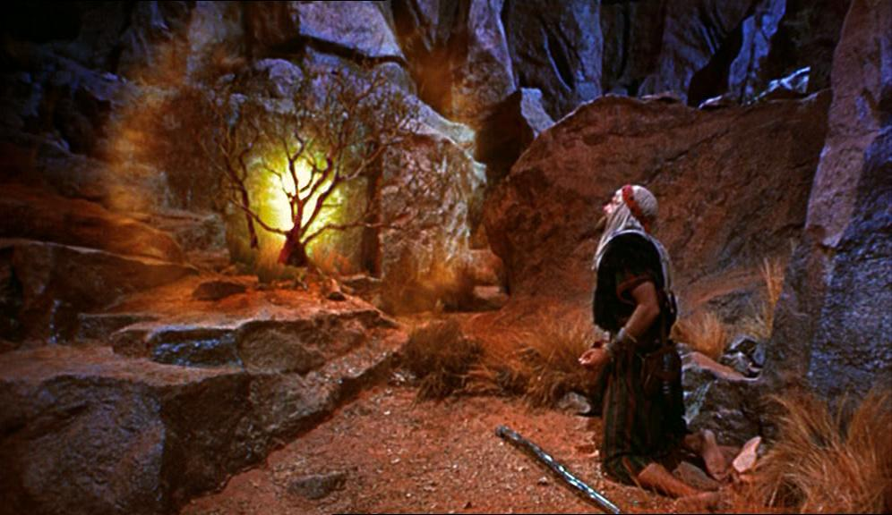

Slide 5
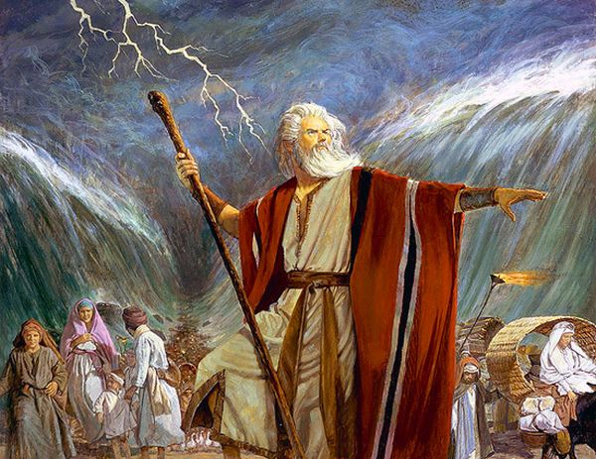

Slide 6
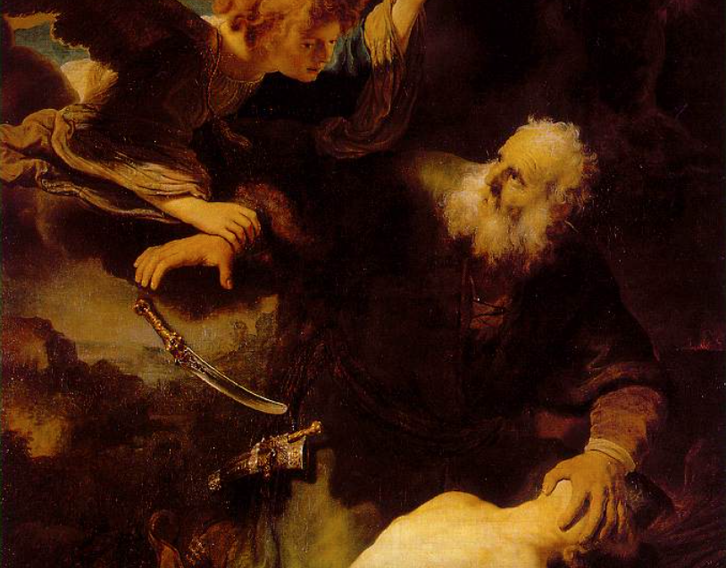

Slide 7
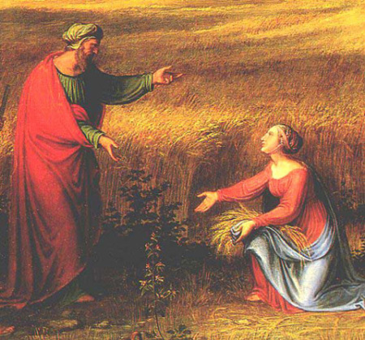

Slide 8
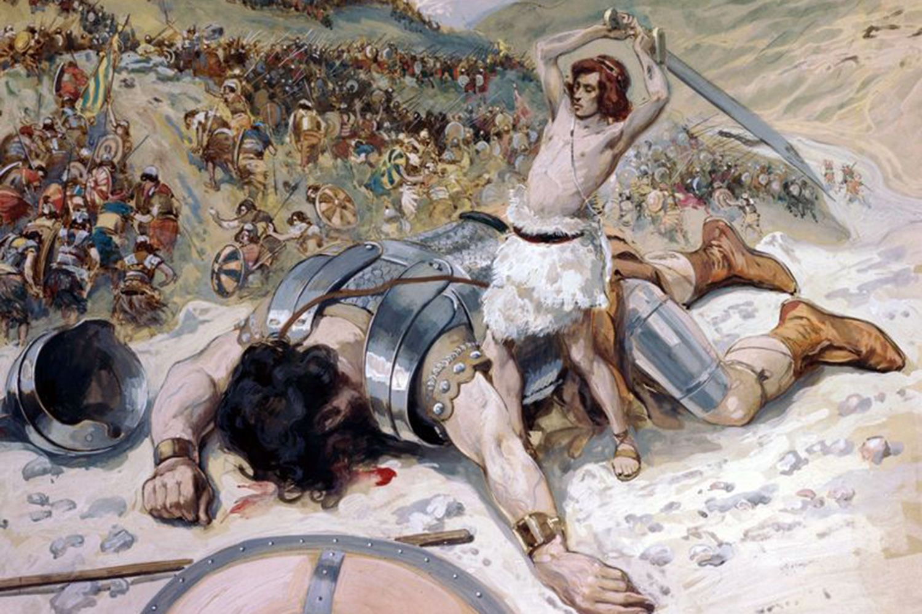

Slide 10
58-1221E - The Unity Of One God In The One Church
You know, God has made man to—to achieve. That’s what man was made for. And all down through life, he has tried to achieve something. And his achievements, the reason he tries that, is because he was so designed to do so. God made him that way. But the trouble of it is, in his achievement, he tries to do something within himself. There’s where he makes his mistake and he gets in trouble.

Slide 11
57-0120M - The Impersonation Of Christianity
73 Now, I—I want you to get this, and never let it slip. If we only need the intellectual conception of man, we don’t need the Holy Spirit. If the church is to be run and governed upon the intellect, the educational program, and upon the intellects of mankind, we do not need the Holy Spirit. And if it’s to be run by the Holy Spirit, we do not need the intellectual. It’s either one or the other.

Slide 12
Matthew Henry, "By His grace and Holy Spirit He directs the thoughts, affections, and designs of good men. He has all hearts in His hand, but theirs by their own consent.”

Slide 13
65-0801M - The God Of This Evil Age
But the inside of that spirit is a soul, and it’s controlled by one thing, your free will. You can accept what the devil says or accept what God says. And that’ll determine what spirit is in there.

Slide 14
65-0801M - The God Of This Evil Age
But the inside of that spirit is a soul, and it’s controlled by one thing, your free will. You can accept what the devil says or accept what God says. And that’ll determine what spirit is in there.

Slide 15
64-0726M - Recognizing Your Day And Its Message
Notice, man has the same six senses he had six thousand years ago. Six thousand years ago, with the senses he had, he contacted his earthly home and served God. And now, in the past seventy-five years, that man has come from a horse and buggy, to an astronaut. Why? He turned away from his faith in God, and turned it over to his senses and his ability as a human being. Did you notice it? He quit trusting God. He trusts himself.

Slide 16
53-0325 - Israel And The Church #1
That love of God’s a-ringing in your heart, and you know that you’ve passed from death unto Life, you love everybody, and the—the whole world has become different to you, and she’s anchored right there and nothing moves you, just be happy and move on. Glory to God! Let nothing turn you around. Oh, you might get out and get cold and get shook up a little bit, but that Seed of God will remain true.

Slide 17
So what is the desire of God in our life?
61-1231E - If God Be With Us, Then Where Is All The Miracles?
Faith is not that loose. It’s got to be based upon some noted fact. You’ve got to know something about what you are having faith in, before you can have faith in it. So we first must know how and what, what God’s desire is, what God’s plan is, and how to approach God by that plan. And then we can walk up boldly to the Throne of Grace, and plead what the plan is promised us.

Slide 18
55-0118 - This Great Warrior, David
You’re not a Christian by your desire; you’re a Christian by God’s desire.
58-0609 - The Message To The Laodicean Church
That’s God’s desire tonight above everything, is to have His church one.
55-0220E - Contend For The Faith
(Jesus) And I’ve just said that He was God’s example for all Christians. And He was God’s desire.
58-0512 - Life
Oh, the depths of the love of Eternal Life that God desires to give to His people.

Slide 19
Ephesians 1:5-6
“Having predestinated us unto the adoption of children by Jesus Christ to himself, according to the good pleasure of his will, To the praise of the glory of his grace, wherein he hath made us accepted in the beloved.”

Slide 20
53-1212 - The Inside Man
Now, we are His hands on earth. We are His eyes on earth. We are His Gospel on earth. And the Gospel is not altogether by the Word. The Word made manifest is the Gospel. The Gospel come not in Word only, but through power and demonstration of the Holy Spirit. “Go ye into all the world and demonstrate the power of the Holy Spirit to all the nations.”

Slide 21
57-0113 - What Does It Take To Make A Christian Life?
The Holy Spirit will make every movement like Christ. It’ll make you Christ-like. The fruits of the Spirit is love, joy, peace, longsuffering, goodness, meekness, gentleness, patience, faith. Those things are what the Holy Spirit controls, our emotions. Our emotions is not so much as jumping up and down. You could do that. A shindig will bring that to you. But the Holy Spirit brings you into operation, or in control of God, that you walk in peace and in love and in joy with longsuffering, goodness, meekness, gentleness, patience. You see? It isn’t something that you do. It’s something the Holy Spirit does in you. You see, it’s no longer an intellectual thought of your own; it’s a subconscious moving of the Holy Spirit. Oh, I wish I could shout the praises of God around the world to that.

Slide 22
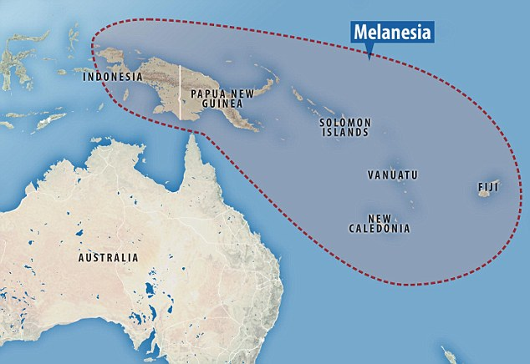

Slide 23
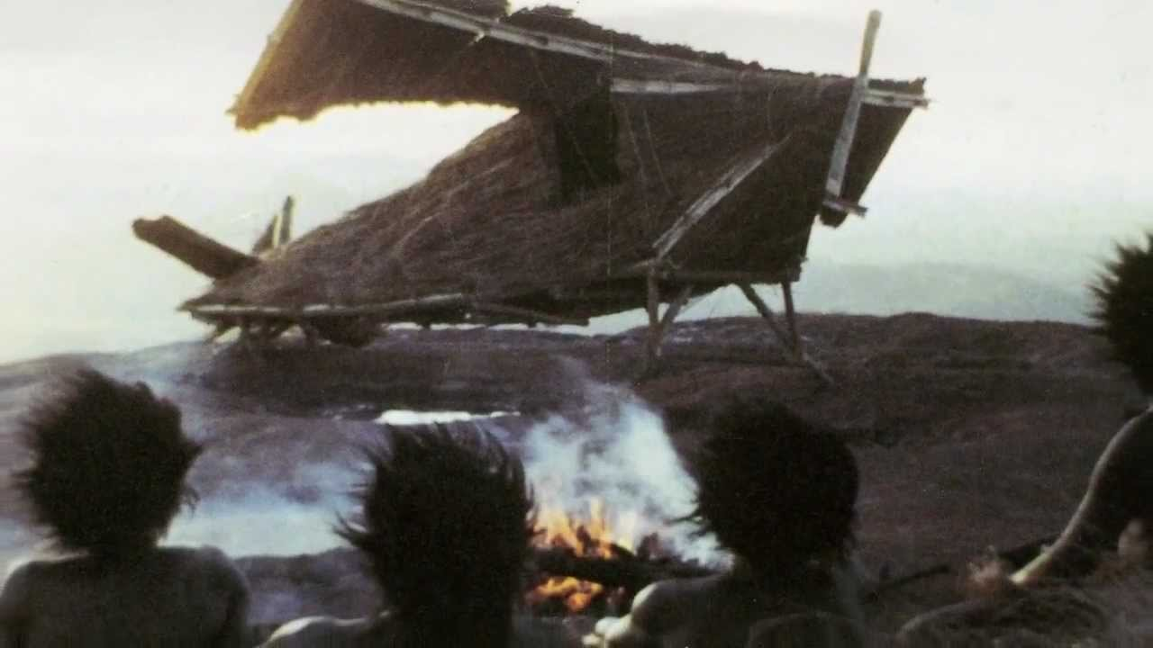

Slide 24
LEGALISM:
dependence on the moral law, rather than by faith.

Slide 25
62-0527 - Questions And Answers
Oh, there’s so much of this legalism today, the “touch not, taste not.” You don’t do things legally. 108 I didn’t come to this church tonight legally. I feel tired, I—I—I’ve been nervous, I’m upset, I’m wondering about something that’s out before me, my heart’s burning, even as such as much till my heart’s fluttering. I got a cramp, pain, right at this minute, just shooting back and forth, up and down through here. Weak, nervous, trembly; catch a hold here and squeeze; got my toes squeezed up in my shoes. I felt anything but come down here. Why did I come, then? Because I love God.

Slide 26
65-0221M - Marriage And Divorce
Whether…I say, as long as it’s in my heart to do it, I go do it. Legalism won’t let me do it, is because that I knowed I’d get punished for doing it. But the real Truth of it is, is when the love of God comes into your heart till you want to do It. That’s the Truth of it. There is the two schools. Not legalism or other, or the Calvinism, it’s both.

Slide 27
61-1119 - Perfect Strength By Perfect Weakness
No ability, I don’t care whose it is, will never be usable in the sight of God. God has to get all of our abilities out of us before He can achieve His purpose. If He’s got something for us to do, and as long as we feel that we’re doing a pretty good job out of it, then we’ll never be able to be used of God.

Slide 28
FAITH
65-1126 - Works Is Faith Expressed
Now, faith is “a revelation from God.” Now, faith is a revelation. There’s where I want to stay, there, just a moment. It’s a revelation. He has revealed it to you by His grace. It’s nothing you did. You didn’t work yourself up into faith. You ever have faith, it’s give to you by the grace of God. And God reveals it to you, therefore faith is a revelation. And the whole Church of God is built upon the revelation.

Slide 29
Romans 4:1-8

Slide 30
WORKS
56-0726 - Love
“Amen, Lord, that means me.” That settles it all. Anything God says, you love Him so much you believe it. Oh, I feel real religious right now. To think, that perfect love casts out all fear. You’re not scared about nothing; you’re just resting. You’re not, “Oh, I may backslide tomorrow. I may backslide next week.” I won’t worry about that. I’m not trying to hold on. I—I… He held on for me. And He put a love in my heart that holds there. It’s Him holding me, not me holding Him. If it was me holding Him, I’d probably turn loose. But as long as He’s holding me, He will never turn loose. He promised He wouldn’t.

Slide 31
James 2:14-26

Slide 32
65-1126 - Works Is Faith Expressed
Now the two men that were talking on faith: Paul justified Abraham by what God saw in Abraham; but James justified Abraham by what man saw in—in Abraham. 87 See, now, James said, “He’s justified by his works.” 88 Paul said, “He’s justified by faith.” 89 But see, Abraham believed God, that’s what God saw in him; he believed It. But then when he went to acting as though it was already done, that’s what man saw in him. 90 And that’s the same as it is to us, because our works express what faith we have. But if we’re afraid to act on what we believe, then we do not believe It. See, you’ve got to believe It.

Slide 33
65-0217 - "A Man Running From The Presence Of The Lord"
101 Then faith without works is dead; if you say, “I believe it,” and don’t make no act. Just like the Message, if you say, “I believe it,” don’t make an act, what good does it do? See? Noah went to work with his hammer and built an ark, to confirm what he was talking about. That’s what we have to do, too. We have to go to work, to prove our faith, by our works. Our works proves our faith. 102 Moses had to do it, and Elijah had to do it. Every prophet in his age had to stand up and face these responsibilities. But many of them didn’t do like Jonah. He run; they didn’t.

Slide 34
50-0110 - Moses
23 And they had the Holy Ghost, friends. The Angel… We’re… it’s not a worship of Angels. It’s God sending His ministering Spirit in the Church to minister to the people. There’s no flesh can glory before God. If anybody could’ve gloried, it would’ve been Jesus. But He said, “It’s not Me that doeth the works; it’s My Father that dwelleth in Me; He doeth the works.” Is that right?

Slide 35
61-1119 - Perfect Strength By Perfect Weakness
So we—we got to get away from that, that human ability. We got to get to a place where we can surrender our souls and lives, even to the housewife, to the farmer, to the mechanic, or whoever we are, we got to surrender completely to God and know that “we are nothing.” Then let God start from there. Then He starts moving, working. And that includes all of us, everyone. That’s the—the thing that we got to do.

