Slide 1
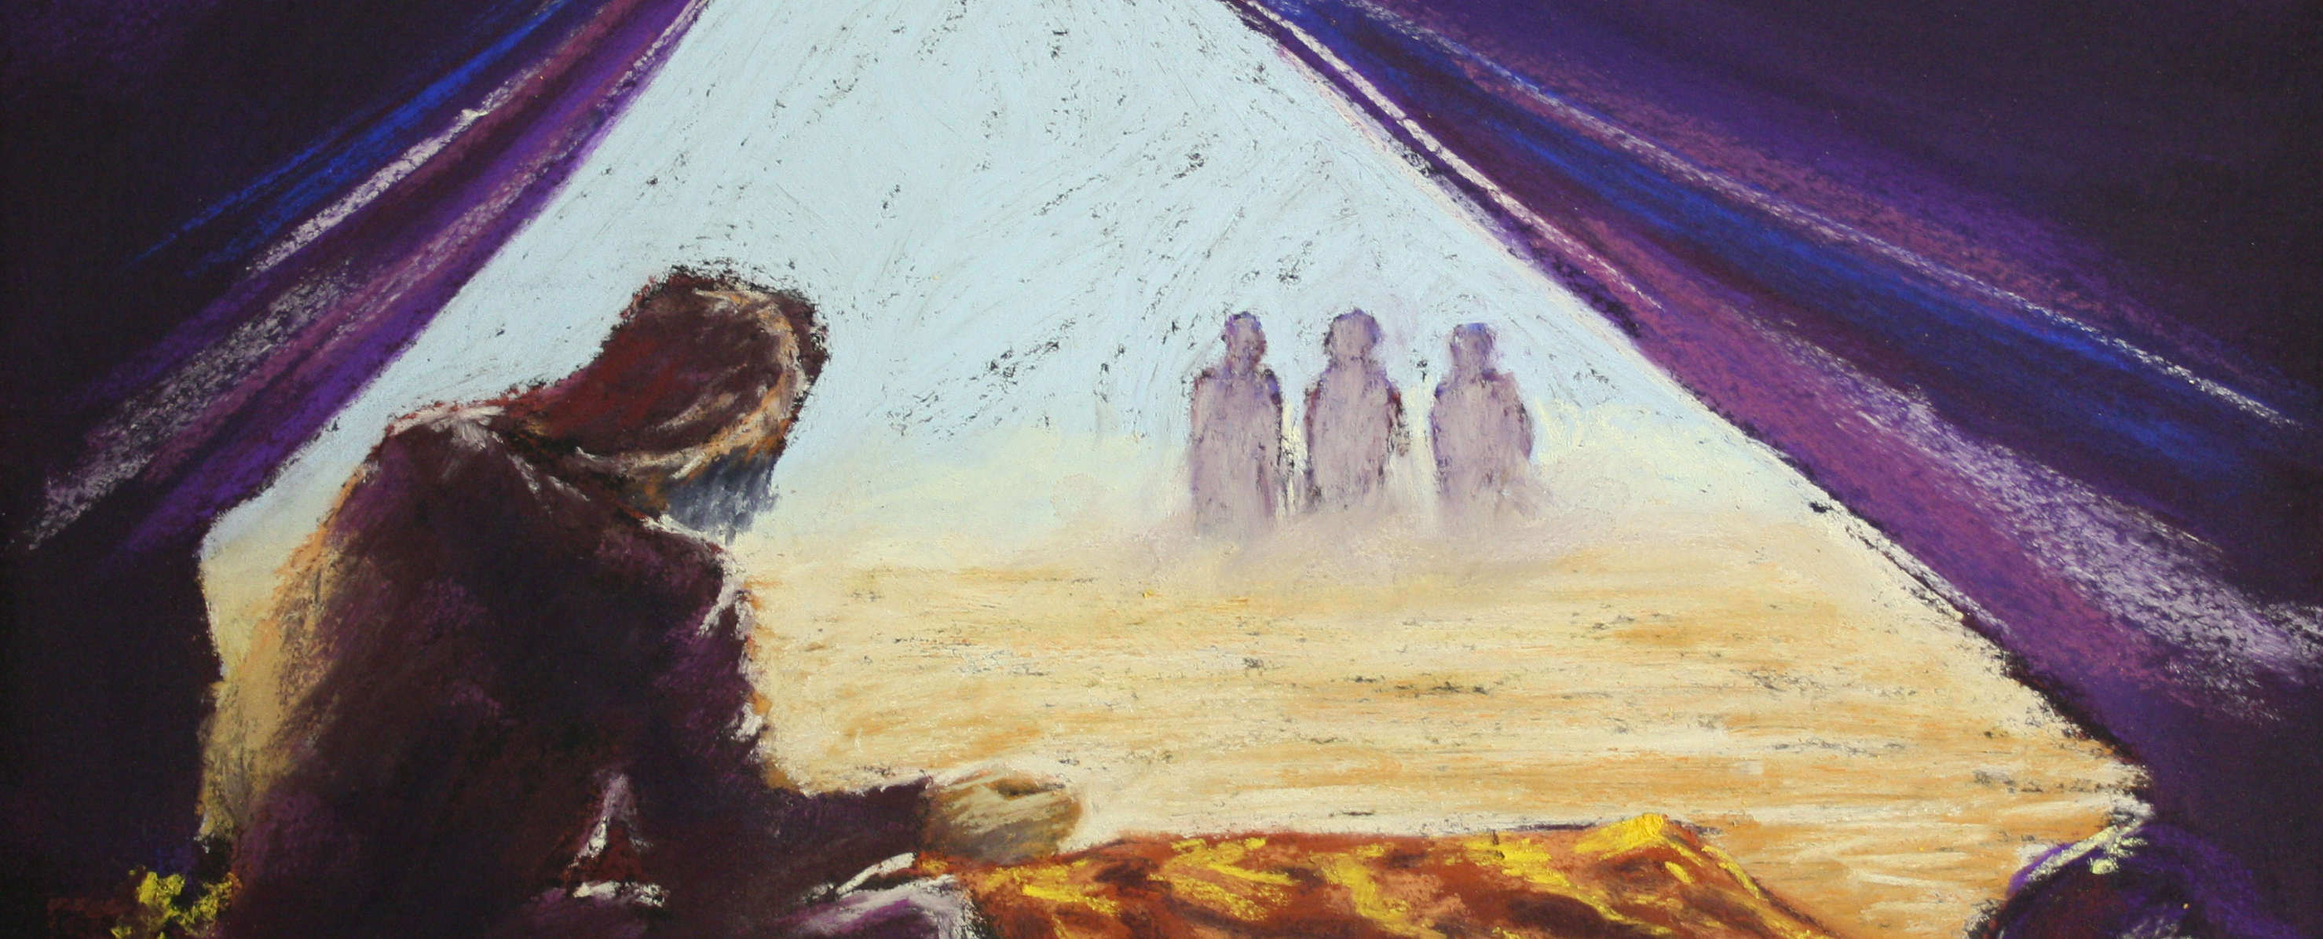
Prophets, Messengers, Angels & Sodom
GENESIS 18:1-2

Slide 2
Birthdays, Anniversaries & Really Cool Events at HBT
Feb. 26th Rachel Coffey
Feb. 28th Bill & Cindy Walters
Joel Johnson, Cohen Pritchard
March 3rd Peter & Rachel Coffey
Macy Stevens
Easter Mar. 31st & April 1st

Slide 3
Bro. Branham Comments On Oral Roberts’ & Billy Graham’s Ministry?
Abraham And His Seed After Him
Then you see why we got our name on a missile hanging out yonder somewhere. You see where judgment stands. Sure we're doomed. There's the Billy Graham group down there, preaching to that "Lot come out of Sodom. Get out of Sodom."
Maybe the boy don't know it for all I know, or the man… don't realize what it is. He's the messenger of the day to that church, not realizing he had to be called like that. 61-0423

Slide 4
THY SEED SHALL
POSSESS THE GATE OF
HIS ENEMY
59-1121
14 Just before that took place there was three Messengers came from heaven. And They came first to Abraham, the church elect, and set down, and talked with him. And two of them got up and started on down to Sodom to bring the church formal out, the church denominational, a form, ritualistic church. But One stayed behind to talk to the church elect, the seed of Abraham.

Slide 6
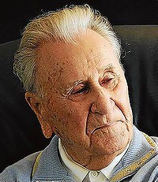
Oral Roberts
January 24, 1918 – December 15, 2009
Likewise also as it was in the days of Lot; they did eat, they drank, they bought, they sold, they planted, they builded; But the same day that Lot went out of Sodom it rained fire and brimstone from heaven, and destroyed them all.
LUKE 17:28-29

Slide 7
ISRAEL.AND.THE.CHURCH.5 53-0329
Everybody always told me Oral Roberts would pray for 500 while I prayed for two. But I'm not Oral Roberts. God gave me a ministry; He give Oral one.
PAINTED.FACE.JEZEBEL 56-1005
I can't take Oral Roberts' ministry. And neither can Oral Roberts take mine. The Lord has given us both something to do.
WHAT.IS.A.VISION 56-0408
5-2 Now, what the Americans responds best to the healing services of my opinion is of Bro. Oral Roberts. Now, Bro. Oral Roberts is a forceful speaker, a real preacher, and a good God-fearing brother: Brother Oral Roberts, and a bosom friend of mine, a lovely brother. And I have a great deep respect for Brother Roberts. And the Lord is with him and blessing him tremendously.

Slide 8
COD 54-0103
86-171 Now, "Well, Brother Branham, what do you mean?“ I believe that day is about finished; them that's in is in. The doors are closing together; you don't have that burden no more. Billy Graham's had meetings all across the country, and Oral Roberts, and all the rest of us. We've cried, and prayed, and prayed, and everything else. But you see, the doors are closing. "Let him that's filthy be filthy still… " And I believe the doors of the Gentiles is closing together.

Slide 9
GOD.HATH.A.PROVIDED.WAY 56-0108
51 I knew that I was brought into the world to pray for sick. I couldn't pray for all God's sick children when I started out back there… But God raised from the ministry, Oral Roberts, and the hundreds of others, all around; went into Africa… the other countries, there they're having a big revival. God's men, everywhere, working together, not against one another, all together for one big unit, for the glory of God, trying to make His children well, and to show them the glory of the Lord Jesus Christ, according to His Word. He's promised It.

Slide 10
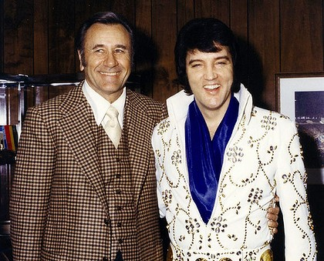
HAVE.FAITH.IN.GOD 58-0510
7 Though our nation
continually wades in sin, Billy
Grahams, Oral Roberts, others
who go through the nation with
great striking revivals, they
continually... Sin’s on the march.
You can't tell them, because the
devil has taken the nation over.
It come to us a few years ago;
he lived in Paris, the devil and his angels… Many of you people wouldn't let your children go to picture shows and see such stuff. The devil's a smart man; he brings it right in on television, so you'd be sure to get it. And today, people stay home from prayer meetings, and great religious gatherings, because they want to see, "We love Susie," or something like that, or Elvis Presley in a rock-and-roll.

Slide 11
Convinced And Then Concerned
And a modern Billy Graham, like, come into this city here, and God's blessed him, and sent him out as a messenger to the denominational world. And he doesn't pull punches.
He places it right in there. He’s got a grip on that Word of repentance like no man I know of, hardly, to hear him preach. Why? That's his ministry. That's what he's supposed to do. But that certainly represented what those Men had down in there in confirmation of their ministry.
62-0521

Slide 12
The Supernatural
A few weeks ago I was in Karlsruhe, Germany. I went in. Billy Graham was there one night in Zurich, and I went in the next day.
And my advertisement and Billy Graham's was setting together. Billy Graham has a place in my heart as a true servant of God. He preaches repentance, and he's doing a very fine job at it. God is using him; we know that.
56-0129

Slide 13
EXPECTATION
11 Bless this great city; send them a revival, Lord. Send Thy servants in here from different parts of the nations where they're ministering now and give this great city a shaking for God. When Thy servants come in, Billy Graham and them, Lord, pour out Your Spirit upon them. Literally thousands will be saved and turned to Christ.
51-0930

Slide 14
NAHUM 1:7
The LORD is good, a strong hold in the day of trouble; and he knoweth them that trust in him.
II TIMOTHY 2:19
Nevertheless the foundation of God standeth sure, having this seal, The Lord knoweth them that are his. And, Let every one that nameth the name of Christ depart from iniquity.

Slide 15
JOHN 10:28-29
And I give unto them eternal life; and they shall never perish, neither shall any man pluck them out of my hand. 29 My Father, which gave them me, is greater than all; and no man is able to pluck them out of my Father's hand.

Slide 16
TRYING.TO.DO.GOD.A.SERVICE
341 Dear God, the Word has gone forth. It cannot return void, It'll find Its place somewhere. If the seed has already been planted, It'll water it till it grows. And none can pluck it from Your hand, "All the Father has given Me will come to Me, no man can pluck them out of My hand. My Father has given them to Me before the foundation of the world"; when the plans were all drawed up, as so, Jesus was given His Church, His Bride.
65-1127

Slide 17
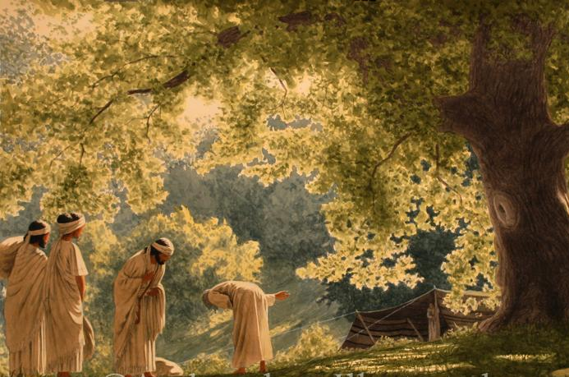
GENESIS 18:1
And the LORD appeared unto him in the plains of Mamre: and he sat in the tent door in the heat of the day; 2 And he lift up his eyes and looked, and, lo, three men stood by him: and when he saw them, he ran to meet them from the tent door, and bowed himself toward the ground,

Slide 18
What Did Billy Graham Teach?
ISRAEL.AND.THE.CHURCH.1
141 You said awhile ago you were a Christian. What made you a Christian? Because God called you before the foundation of the world to be a Christian... Now, if you say, "Well, you said awhile ago about Billy Graham and them hollering, 'Well, how many wants to accept Christ as personal Saviour, raise up their hand?' Is that all right?" Certainly that's all right. That's good, but that's just beginning. Then if you really believe it, and really have accepted it in your heart, and are taught right, then the Holy Spirit will come as a circumcision, that He give Abraham after his faith, a confirmation.
53-0325

Slide 19
MODERN.EVENTS
249 Now I want to ask you theologians, my brethren: we’ve never had a messenger in Sodom before that his name ended with a h-a-m till now. We've had a Spurgeon, a Wesley, a Luther, but never a international messenger that his name end with h-a-m before. G-r-a-h-a-m, six letters, G-r-a-h-a-m, Billy Graham; that noted evangelist, great work of God, the man is sent from God. He's got that justification down so pat, shakes the nation with it. Look at Oral Roberts to the Pentecostal denomination. When was there ever one like that?

Slide 20
252 Six letters, not seven. Abraham is A-b-r-a-h-a-m. Billy Graham is G-r-a-h-a-m, six. Now look at the messengers. Look at the time we're setting, never was a time in history. Look at the same signs that He promised would be give to each group. Look where they're at. Nature, the world, everything, setting right exactly to the time.
255 Look at the age now we're living. Aren't we living right in that Sodom time? Watch the messen-ger to Abraham's group. Watch the numbers, letters, numerology of his name. You say, "There's nothing in a name." Don't never let anybody tell you that. Why did He change Abram to Abraham, Sarai to Sarah? Simon to Peter, and all those other? Sure there is.
65-1206

Slide 22
GENESIS 13:10-13
And Lot lifted up his eyes, and beheld all the plain of Jordan, that it was well watered every where, before the LORD destroyed Sodom and Gomorrah, even as the garden of the LORD, like the land of Egypt, as thou comest unto Zoar. 11 Then Lot chose him all the plain of Jordan; and Lot journeyed east: and they separated themselves the one from the other. 12 Abram dwelled in the land of Canaan, and Lot dwelled in the cities of the plain, and pitched his tent toward Sodom. 13 But the men of Sodom were wicked and sinners before the LORD exceedingly.

Slide 23
GENESIS 18:20-22
And the LORD said, Because the cry of Sodom and Gomorrah is great, and because their sin is very grievous; 21 I will go down now, and see whether they have done altogether according to the cry of it, which is come unto me; and if not, I will know. 22 And the men turned their faces from thence, and went toward Sodom: but Abraham stood yet before the LORD.

Slide 24
Warning Before Judgment Requires 3 Stages of Grace

Slide 25
THE.TOKEN
82 We find that death was ready to strike Egypt at any time now. God had showed them His grace, power, and signs. I want you to know that that's followed every revival; grace, power, and signs. Grace, to come to the people; power, to make Himself known; and the sign of the time. Just exactly what He's done today. He has done it in many ways.
84 How it would symbolize the three stages that we've come through! It would symbolize the three mercies of God, through Luther Martin, and also through Wesley, and Pentecost, the three

Slide 26
stages of the journey. The three stages of Israel's journey, the three messengers to Sodom, all these different things it would symbolize.
85 It would symbolize the ministry of today. It would symbolize the message of Billy Graham, of grace to the world; of Oral Roberts, as power to the world; and of the Presence of Jesus Christ, as the last sign to the world. For Sodom got their last sign, the Church spiritual, the one that was called out, got their last sign before the Gentile world was burned. Jesus said, "So shall it be in the coming of the Son of man, the same thing.“ 63-1128E

Slide 27
THE.ANGEL.OF.THE.LORD
11 Remember this and watch it close. Watch geographically where your war is coming out. Watch the Gog up there coming down, down in Turkey... The battles will not be settled in Korea but over there in Palestine. We're near. And yesterday, or this morning...?... joy when I heard that Brother Graham, Billy Graham, is going to have a meeting there in Washington. I was so happy for that, but I'm just a little afraid that is, that we've sinned away our day of grace. I believe we're in for it.
51-0502

Slide 28
RECOGNIZING.YOUR.DAY
185 …The Bride has recognized the evening Light... The hungry Pentecostals have begin to recognize that organizations hasn't got any things they was looking for, they're so twisted and tore up. The world has recognized. The nations... Science... The devil has recognized it's the time that he can wreck women, wreck the church, wreck the people. And God has recognized that there is a people on earth that He predestinated to Life. He recognized this is the time to send His Message. He's did it. The people has recognized It, the Bride time has realized the evening Light.

Slide 29
186 If Sodom had recognized her days, when she seen those messengers come down there, like Billy Graham and Oral Roberts! The same time, the Bride has realized the evening Light. If Sodom would have recognized their hour! Now, (this same person put on tape,) said, "Look here, you Pentecostal people, and you Baptists. This false prophet, Wm. Branham, said that Oral Roberts and Billy Graham was in Sodom."
See, then cut the tape off. Wouldn't go ahead to say, that, "They were messengers to Sodom." Not in Sodom, "They were there as a messenger to Sodom." Anybody knows I said that. "If Sodom had recognized her messenger, she would have been standing today," Jesus said, if she'd have recognized the same as Abraham recognized.

Slide 30
Abraham knowed there was a promised son coming. But he knowed there had to be a change some way, because he was too old, so was Sarah. But when he saw that One Who could discern the thoughts of Sarah, behind Him, he recognized the hour he was living. Said, "My Lord, let me fetch a little water here and wash Your feet." They ate a morsel of bread. "Let me pray Thee, hold on just a little bit longer, my L-o-r-d, Elohim."
He recognized that God was speaking to him out of human flesh. He recognized his sign, and was blessed of the Lord. Sodom didn't recognize their day, and was burned up. Jesus said, "As it was in that day, so shall it be…."

Slide 31
191 Now, the church has not recognized her day. Like Israel, forced back to Palestine, she is going to be forced into the World Council of Churches. Why? She didn't recognize her hour. "People, come out of her, be not partakers of her sin!" Flee, your life, or you'll be caught with the mark of the beast and can't do nothing else about it… "But let him that's holy be holy still. Let him that's righteous be righteous still…" The church has not recognized her day.
64-0726

Slide 32
THE.ANGEL.OF.THE.LORD
15 …what we need is an old fashion, breaking up, rooting out revival that starts in every home, sweeps through the city, close all the bootleg joints... That's a revival. Not just walking up and making a confession, going back, it's no revival. That's just a form. It's a lukewarm condition. We need a real revival. And God help us to have it.
16 And when you see these crowds gathering, that doesn't mean revival; that's just a gather-ing. But a revival is when people get really right with God, and pray through, and starts a revival throughout the city, and everything. They put away sin, put away their iniquity, and turn to God, turn around and start back again...

Slide 33
DOOR.TO.THE.HEART
If God lets America get by with this sinful, unbelieving, church-going bunch of hypocrites, He will have to raise up Sodom and Gomorrah and apologize to them for sinking them to be just. Even though Angels smote them blind, they were in the darkness feeling around, a perverted spirit. And tonight America stands in the same shape, nothing left but fire.
58-0316

Slide 34
I want you to notice what was that Angel's message that come tried to get them out of there. I want to give you just a little on the side now, just a minute. When the Angel come to Abraham, Sarah was back in the tent. And the Angel had His back turned to the tent. And the Angel, which was Christ... We know that was Christ.
He was called Elohim, the Almighty God in a form of a man, He stood there. And when He was, He was looking at Abraham. He said, "According to the time of life, I'm going to visit you." And Sarah, back in the tent went laughed, back behind His back. He said, "Why did Sarah laugh?"

Slide 35
What was it? It was the Angel's message to Sodom before it burnt up. And we're going to get the fire. And before the fire falls, that same Angel with the same signs and wonders, touch His garment and find out. Can you see it's a Angel, the last warning to the Church. The same Angel has to do the same thing. There He is, the same Christ. He was the One that was with Abraham. Here He is tonight doing the same thing, and America just sets still. Sure, it can't be nothing else, has to be that way. But there's some eagles.
Open your eyes now. God anoint your eyes.

Slide 36
29 Now, watch the last message to Sodom and Gomorrah. There's always three classes of people: the true, the elected, the virgin; and the sinner, the unbeliever. That's a believer, a unbeliever, and a make believer. Every city has them, and every church has them: real believers, and unbelievers, and then make believers. Before Sodom was burned, the Angels of the Lord, three of them, came down to Abraham, which was the believer, the elected, and which was the real bride, the real virgin that had Oil in the lamp. And Lot was that lukewarm. And two of the Angels went down to try to get Lot out of there, out of the sinners and the unbelievers.
30 And notice what taken place, watch the nature of this Angel. When they had left, He done a sign to Abraham, which is a very type sign of today… and the Angel said, "Will I keep from Abraham the things that's going to happen, seeing that he's the heir unto the world? I'm going to visit you about according to the time of life and you're going to get this baby that you've waited on."

Slide 37
