Slide 1
The Walk
Eph. 4:17-20

Slide 2
Marriage Banquet

Slide 3
EPHESIANS 4:17-20
This I say therefore, and testify in the Lord, that ye henceforth walk not as other Gentiles walk, in the vanity of their mind, 18 Having the understanding darkened, being alienated from the life of God through the ignorance that is in them, because of the blindness of their heart: 19 Who being past feeling have given themselves over unto lasciviousness, to work all uncleanness with greediness. 20 But ye have not so learned Christ;

Slide 4
A.TESTIMONY.ON.THE.SEA
14 (“Shake the country“) that don't mean shake the cannon fodder out here. There's millions up and down this coast here that profess Christianity, will never see nothing. "All the Father has given Me will come.... So it's just for that elected group that's been called… "Some fell by the wayside..." And a lot of it's just filler, to fill in the time. Millions of people that's professing Christianity will miss it a million miles. It's all in the making of God. It's here in the Bible. So the thing for you to do, and I have to do, is seek out our own salvation, not just haphazardly. It means more than everything there is on the earth, and anything to you. This is your chance, and don't you take any chance of missing it. Heaven is great.
62-0720

Slide 5
THE.DOOR.INSIDE.THE.DOOR
5 So I took him out on the walk. I said, "Son, you're coming away from there right now. I'm going to send you to Bible school, no matter how lonesome you get. I want you to stretch out your arms like this.
This is left, this is right. Now, you cannot be going both ways the same time. You're in the shape of a cross. As long as you're going right, you may think you're going wrong; but you've got to come out right.

Slide 6
You can't go east and west at the same time. You can't be doing right and wrong at the same time."
Sometimes people are going wrong, thinking they're doing right; but it'll wind up wrong. So always think right, do right, and you'll come out right; you just got to. That's exactly. Do right; that's your duty to God. Think right; know that you've got to come out right; and you will come out right.
60-0711

Slide 7
WHY.CRY.SPEAK
300 It was He that foretold where these things to be. It was He that said this, He that done these things. He's done everything just exactly like He said He would do it. Why should I wait? God has a vindicated the Word. It's the Truth. Let's journey. Let's walk. Let's go on the walk of the Lord, laying aside all doubts, all sins. Clean up the house, scrub it up.
304 Lay aside everything else contrary to It. Remember, this is Truth, regardless of how fana-tically It seems, sometimes. Move right on with It.

Slide 8
It's the Holy Spirit. The same God that raised up Jesus Christ from the dead, that can speak things into existence, same One that lived in the days of Moses, is the same today.
305 His call in this last day, He's a vindi-cated. "As it was in the days of Sodom..." There is Sodom down there: a Billy Graham, Oral Roberts out there. And the Church is moving on, by the same signs that He promised, both places, and there they are. It's He that said it, O Lord, give me courage, is my prayer.
63-0714

Slide 9
DEMONOLOGY.PHYSICAL.REALM
96 Not by feelings, not by sight. You don't walk by feelings or sight. It's by faith.
53-0608
II COR. 5:7
(For we walk by faith, not by sight:)

Slide 11
QUESTIONS.AND.ANSWERS.ON.HEBREWS.3_
791 It's a shame for a man to have long hair... That's a woman's place. God made a man different from a woman: sex and in looks, and in everything else. The Bible said that if a woman will put on a pair of slacks or any garment that pertains to a man, it's an abominable and dirty and filthy sight in the front of God. And God will make her pay for it. Who you going to listen to? But this is the Bible. And you run around and say, "Why, I think it's nice to see women wearing slacks."

Slide 12
But God made them different; He wants them dressed different. And the Bible said, "If a woman will even put on a garment that pertains to a man, it's an abomina-tion." You know what abomination is? It's "something that's filthy in the sight of God." And the great Jehovah Who looks down upon you as being a filthy thing...
57-1006

Slide 17
im·ag·i·na·tion (noun)
The faculty or action of forming new ideas, or images or concepts of external objects not present to the senses.
ROMANS 1:21
Because that, when they knew God, they glorified him not as God, neither were thankful; but became vain in their imaginations, and their foolish heart was darkened.

Slide 18
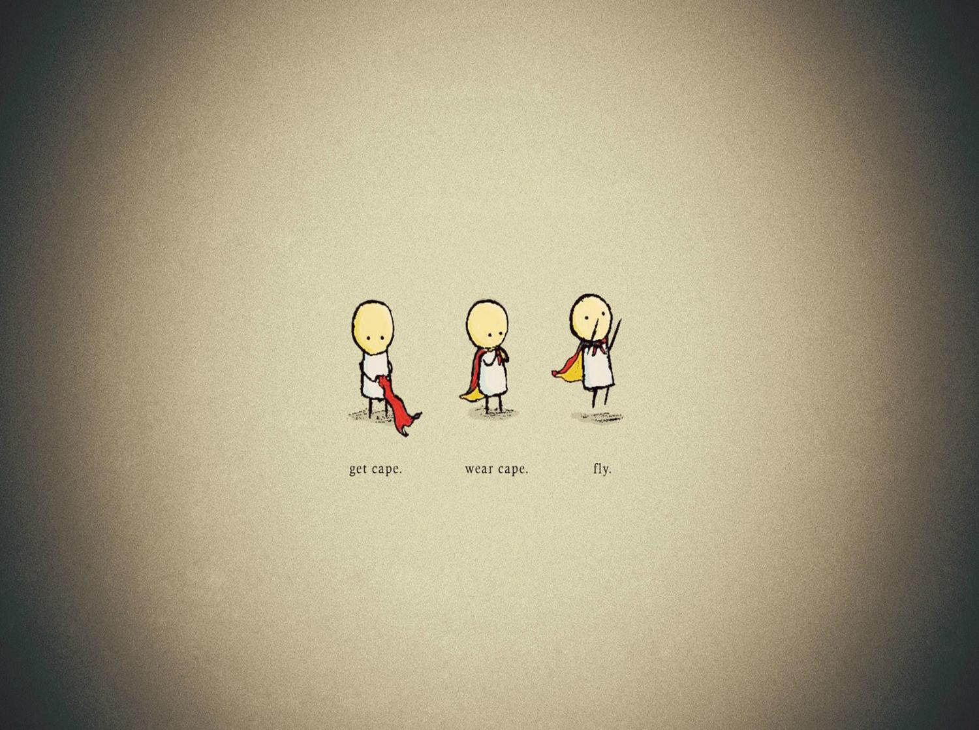

Slide 19
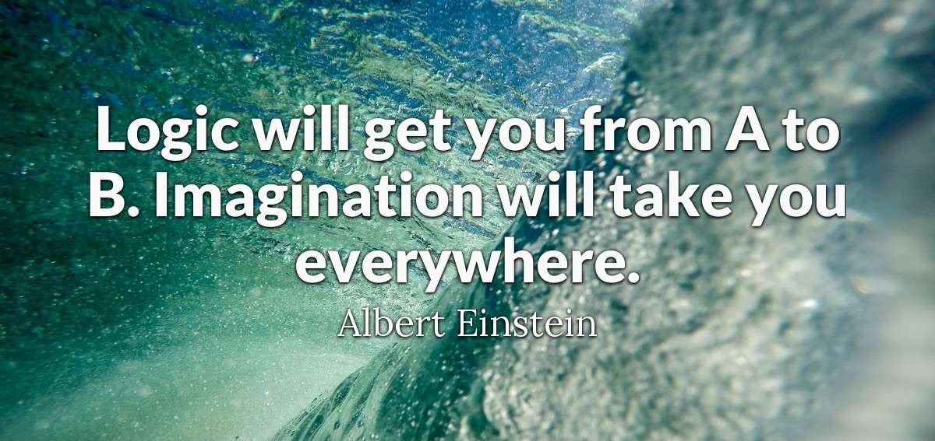

Slide 22
II COR. 5:7
For we walk by faith,
not by sight:

Slide 23
I CHRONICLES 29:17
I know also (David), my God, that thou triest the heart, and hast pleasure in uprightness. As for me, in the uprightness of mine heart I have willingly offered all these things: and now have I seen with joy thy people, which are present here, to offer willingly unto thee.
18 O LORD God of Abraham, Isaac, and of Israel, our fathers, keep this for ever in the imagination of the thoughts of the heart of thy people, and prepare their heart unto thee: 19 And give unto Solomon my son a perfect heart, to keep thy commandments, thy testimonies, and thy statutes, and to do all these things, and to build the palace, for the which I have made provision.

Slide 25
PROVERBS 6:16-19
These six things doth the LORD hate: yea, seven are an abomination unto him: 17 A proud look, a lying tongue, and hands that shed innocent blood, 18 An heart that deviseth wicked imaginations, feet that be swift in running to mischief, 19 A false witness that speaketh lies, and he that soweth discord among brethren.

Slide 26
JEREMIAH 23:16
Thus saith the LORD of hosts, Hearken not unto the words of the prophets that prophesy unto you: they make you vain: they speak a vision of their own heart, and not out of the mouth of the LORD. 17 They say still unto them that despise me, The LORD hath said, Ye shall have peace; and they say unto every one that walketh after the imagination of his own heart, No evil shall come upon you. 18 For who hath stood in the counsel of the LORD, and hath perceived and heard his word? who hath marked his word, and heard it?

Slide 27
MELCHISEDEC.THE.GREAT.PRINCE&KING
46 In order to obtain this same promise that Abraham has, you have to separate yourself from all worldly contacts, all the things of the world. Your sinful desires, lust, passions of the world... Come apart into a strange land, a land that you've never been in before, to walk, not by sight, but by faith. For Abraham had nothing; no one had crossed this river Euphrates and sojourned into this land. But Abraham, by faith, forsook his own and went forward, separating himself, as the Blood of Jesus Christ today by the Holy Spirit separates us from the things of the world to walk in a new life. Criticized, made fun of, called holy-rollers, misunder-stood, but our anchor holds. 55-0109

Slide 28
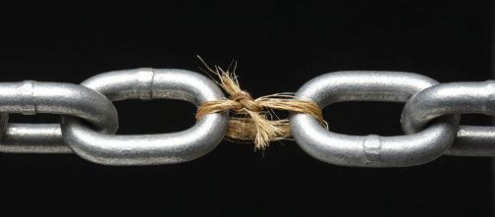
II TIMOTHY 2:22
Flee also youthful lusts: but follow righteousness, faith, charity, peace, with them that call on the Lord out of a pure heart.

Slide 29
HEAR.YE.HIM
5 And every time you read [the Scripture] it, you learn something new, because it's the Word of the Eternal God... and It does something to you. It brings you in closer fellowship with God... The soul of a man lives on God's Word.
It strengthens him, the inner man. And it makes us feel good, to know that our souls can feed upon the good things that God has written to us. It's His letter... to His church. And It's so inspiring as we read; does something to us that nothing else does.
58-0301

Slide 30
II CORINTHIANS 10:5
Casting down imaginations, and every high thing that exalteth itself against the knowledge of God, and bringing into captivity every thought to the obedience of Christ;
PROVERBS 4:23
Keep thy heart with all diligence; for out of it are the issues of life

Slide 31
FAITH.AFRICA.TRIP.REPORT
35 Now, He may never deal with you like that in that manner. I was born to this end, as a different person. I guess I've been odd, misunder-stood. Your life might not be like that, but this one thing I do know. You do what God tells you to do. Don't make any difference what anybody else says; you do what God says. And be sure that you know it's God, not some imagination or some feeling. You be sure it's God, then follow God's route. He'll take you where He wants you to go. 52-0725

Slide 32
BELIEVE.FROM.THE.HEART
44 …Notice, I have begin to think this, that it is possible, that when a man, like the apostles, and when you can live close to God, and God through His grace operates through you, that the more God you get, the more godly you become. The more Eternal Life comes in, the more of the intellectual it pushes out.
57-0623

Slide 33
EPHESIANS 3:17
That Christ may dwell in your hearts by faith; that ye, being rooted and grounded in love,
COLOSSIANS 3:15
And let the peace of God rule in your hearts, to the which also ye are called in one body; and be ye thankful.

Slide 34
GREATEST.BATTLE.EVER.FOUGHT
159 God will heal you in this atmosphere of the Holy Ghost... Just believe it. Open up them flues of the soul and body, senses, and conscience, and just let God's Words penetrate... There is the battle ground.
160 Not say, "Well, if I could feel it, if I'd feel the glory of God falling!" That has nothing to do with it... Open up that mind. That's the battle ground. There is where the battle sets in array, right here in the front line, your mind. Say, ”Every doubt, I doubt my doubts. I'm believing God's Word. Here I come, Satan." Something is going to take place. Sure, it will.
62-0311

Slide 35
THE.GOD.OF.THIS.EVIL.AGE
69 Just as your natural life and traits is handed down from the natural breeding of your father, so the Spirit of God, that was predestin-ated before the foundation of the world.
And when the entire Word of God, complete, was headed up in a human body called Jesus Christ, in there God made me pay for my sins, in Him there. Then He raised me up with Him, in the resurrection. And now we are seated with Him, with power and authority over every devil. Oh, if you could only believe what God has given...!
65-0801

Slide 36
EPHESIANS 3:16-17
That he would grant you, according to the riches of his glory, to be strengthened with might by his Spirit in the inner man; 17 That Christ may dwell in your hearts by faith; that ye, being rooted and grounded in love...

Slide 37
ASHAMED
220 Then, if I'm a Christian and been filled with the Spirit, wearing the testimony of Jesus Christ's resurrection… don't let any devil try to push you around, say, "You don't do this and you don't do that." You do do It.
221 See, we don't have power. [A] police man don't have power to stop one car... But he's got authority. And that's the Church. We have authority, by the resurrection of Jesus Christ and His promised Word, hallelujah, "The things that I do shall you do also; more than this will you do, for I go unto the Father.” 65-0711

Slide 38
BELIEVEST.THOU.THIS
51 Oh, how wonderful, how mighty is He. How many'd like to consecrate your lives to God right now, afresh? This is the Holy Spirit that comes. This is that unseen force that drives us into the Kingdom of God, the blessings of Pentecost. Come back home…
You're precious people. God wants you to consecrate yourself. Women, clean up yourselves. Men, clean up yourselves. Let's get started back to God and serve God with a real clean heart.
60-0402

Slide 39
THAT.DAY.ON.CALVARY
11-6 He broke the powers of Satan. He opened the prison doors of hell… You don't have to no longer be torn down by sin. You don't have to no longer yield your members to sin: drinking, smoking, gambling, telling lies. You can be honest, just, and upright; and Satan can do nothing about it; because you got ahold of a line, a lifeline. It's anchored in the Rock of Ages. Nothing can shake you from it.
60-0925

