Slide 1
What is Worship? Part 7
HOSEA 9:4-5
What will ye do in the solemn day, and in the day of the feast of the LORD?

Slide 2
Birthdays, Anniversaries & Exciting Events
March 4th Luther & Mary Ann Roy
March 8th Sharon McCafferty
March 9th Matt Cross
March 10th Joel & Ruth Franklin
March 31 & April 1st Easter Meetings

Slide 3
Father
Son
Campout
April 19-22
Morrow
Mountain
State Park

Slide 4
LOOKING.FOR.JESUS
8 Well now, we want to speak, as every meeting, about Jesus Christ. And He's the Center of our worship, the Center of our attraction, the Center of our life, all that we have and are and will be is based upon Him. He was the One Who came and gave His life for us, come down from God, out of glory, and was made flesh, dwelled among us.
54-0228

Slide 6
strange fire
Lev. 10:1-2

Slide 7
Thirst
146 The Holy Spirit is to lead you to those great fountains of God. Now, there is a good thing, to worship in the Spirit. But sometimes you have Spirit without Truth. And He is the Word. The streams God sent to satisfy you, in the natural, Satan has polluted every one of them. He has put the poisoned dope in every one that he could get into. He took that great stream, of the church. 65-0919

Slide 8
CHURCH.AGE.BOOK
309-3 The preaching of the Word was never greater. As Satan raised up his hordes of free thinkers, the originators of communism rose up, as liberal theologians spread their filthy wares, God raised up mighty warriors of faith, the greatest works of Christian literature, teaching and preaching came from this era. Never has its preachers and teachers been matched and never will they be. The Spurgeons, Parkers, McClarens, the Edwards, Bunyans, Meullers, Brainards, Barnes, Bishops, all came from this era. They preached, taught and wrote the Word. They glorified His Name.

Slide 9
REVELATION 14:1-3
And I looked, and, lo, a Lamb stood on the mount Sion, and with him an hundred forty and four thousand, having his Father's name written in their foreheads. 2 And I heard a voice from heaven, as the voice of many waters, and as the voice of a great thunder: and I heard the voice of harpers harping with their harps: 3 And they sung as it were a new song before the throne, and before the four beasts, and the elders: and no man could learn that song but the hundred and forty and four thousand, which were redeemed from the earth.

Slide 10
REVELATION 18:21-23
And a mighty angel took up a stone like a great millstone, and cast it into the sea, saying, Thus with violence shall that great city Babylon be thrown down, and shall be found no more at all. 22 And the voice of harpers, and musicians, and of pipers, and trumpeters, shall be heard no more at all in thee; and no craftsman, of whatsoever craft he be, shall be found any more in thee; and the sound of a millstone shall be heard no more at all in thee; 23 And the light of a candle shall shine no more at all in thee; and the voice of the bridegroom and of the bride shall be heard no more at all in thee: for thy merchants were the great men of the earth; for by thy sorceries were all nations deceived.

Slide 11
CHRIST
7 God is in music, and He's in art; God is in the universe. He's in His creatures, and He's in the church, and He's in His creation; God's all around, everywhere. He's here in the Shriner auditorium right now at this night, right present. God's everywhere. I just wonder sometime if He'd just take the shades off of our eyes, till our sight would be fast enough to catch His Presence in the building.
55-0221

Slide 12
JESUS.CHRIST.THE.SAME
38 (John the Baptist) His ministry was short, six months, no doctrine, just speaking of the coming of the Lord Jesus, "Prepare to meet Him."
But when Jesus came, He was the beginning of the Christian church. And He introduced to the world the Christian faith, the Christ faith. His apostles that succeeded Him, carried out the same faith that He introduced. And if we can find out what that was, then we ought to earnestly contend for that. Isn't that liberal to every one of us? I don't mean now, leave your church. I mean stay in your church and just keep this faith that was once delivered to the saints.
55-1113

Slide 13
WHO.DO.YOU.SAY.THIS.IS
23 Now, years ago, it was very easy when I first started out; and the signs, and message, and preaching. Everywhere was a arm open, "Come! Come!" But then every genuine sign from God has a Message, a Voice. It follows it. God don't give anything like that just for the fun of giving it.
He sends something forth to attract atten-tion to what He's fixing to say. Like we have this wonderful singing this choir done; what was it to do? To quieten the people for an oncoming message. 64-1227

Slide 14
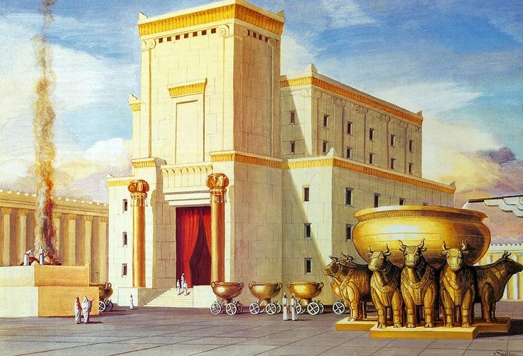
Temple Worship

Slide 15
Temple Worship:
II CHRONICLES 29:25
And he set the Levites in the house of the LORD with cymbals, with psalteries, and with harps, according to the commandment of David, and of Gad the king's seer, and Nathan the prophet: for so was the commandment of the LORD by his prophets. 26 And the Levites stood with the instruments of David, and the priests with the trumpets.

Slide 16
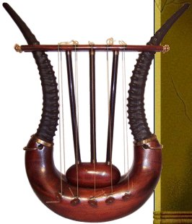
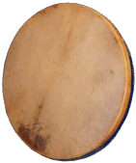
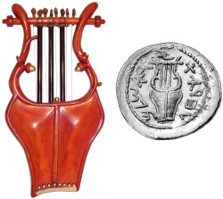
12 Instruments of the Bible

Slide 17
LYRE (ke-nor', khe-nor’)

Slide 18
I CHRONICLES 23:1-5
So when David was old and full of days, he made Solomon his son king over Israel… 3 Now the Levites were numbered from the age of thirty years and upward: and their number by their polls, man by man, was thirty and eight thousand. 4 Of which, twenty and four thousand were to set forward the work of the house of the LORD; and six thousand were officers and judges: 5 Moreover four thousand were porters; and four thousand praised the LORD with the instruments which I made, said David, to praise therewith.

Slide 19
PSALM 66:1-2
To the chief Musician: Make a joyful noise unto God, all ye lands: 2 Sing forth the honour of his name: make his praise glorious.

Slide 20
A.HIDDEN.LIFE
42 Now, when that old dead rod was brought in there and laid in the Presence of God Himself, what happened? It budded; blossomed, and yielded fruit... That rod was off of an almond tree, and when it was cut off it died. And when man was cut off from God, he died spiritually.
But once brought into the place of God, before the Presence of God, he comes to life and he yields life. He yield blossoms. He yields fruit.
55-1006

Slide 21
THE.POWER.OF.DECISION
28 Put Aaron's rod in there, an old dead almond tree. But as it went under the Shekinah Glory, everything it was, was restored again. That's the way a sinner is when he goes under the Shekinah Glory of the Holy Spirit, the veils drop behind him, everything that he ought to have been, a son of God blooms out in him again. Amen.
55-1007

Slide 22
HIDDEN.LIFE.WITH.CHRIST
53 Aaron's rod, they laid it in there one night. And what did it do? It budded; blossomed and yielded almonds the same night. What was it? It must have been an almond tree, staff then or rod, must have come off of an almond tree.
And there's a many almond tree, staff, right here in Minneapolis tonight. But as long as you're outside of this hidden life, you'll never be able to be refreshed and bring forth the fruits that God intended you to do, until you come into the Presence of God.
56-0213

Slide 23
It is a dangerous thing, in the service of God, to decline from his institutions; we have to do with a God, who is wise to prescribe his own worship--just to require what he has prescribed--and powerful to avenge what he has not prescribed.
B.P. Hall

Slide 24
EXODUS 40:30-37
And he set the laver between the tent of the congregation and the altar, and put water there, to wash withal. 31 And Moses and Aaron and his sons washed their hands and their feet thereat:
LEVITICUS 1:1
And the LORD called unto Moses, and spake unto him out of the tabernacle of the congregation, saying, 2 Speak unto the children of Israel, and say unto them, If any man of you bring an offering unto the LORD, ye shall bring your offering of the cattle, even of the herd, and of the flock…

Slide 25
LEVITICUS 9:23-24
And Moses and Aaron went into the tabernacle of the congregation, and came out, and blessed the people: and the glory of the LORD appeared unto all the people. 24 And there came a fire out from before the LORD, and consumed upon the altar the burnt offering and the fat: which when all the people saw, they shouted, and fell on their faces.

Slide 26
LEVITICUS 6:8-13
And the LORD spake unto Moses, saying, Command Aaron and his sons, saying, This is the law of the burnt offering: It is the burnt offering, because of the burning upon the altar all night unto the morning, and the fire of the altar shall be burning in it. 10 And the priest shall put on his linen garment, and his linen breeches shall he put upon his flesh, and take up the ashes which the fire hath consumed with the burnt offering on the altar, and he shall put them beside the altar. 11 And he shall put off his garments, and put on other garments, and carry forth the ashes without the camp unto a clean place. 12 And the fire upon the altar shall be burning in it; it shall not be put out: and the priest shall burn wood on it every morning, and lay the burnt offering in order upon it; and he shall burn thereon the fat of the peace offerings. 13 The fire shall ever be burning upon the altar; it shall never go out.

Slide 27
LEVITICUS 10:1-3
And Nadab and Abihu, the sons of Aaron, took either of them his censer, and put fire therein, and put incense thereon, and offered strange fire before the LORD, which he commanded them not. 2 And there went out fire from the LORD, and devoured them, and they died before the LORD.
3 Then Moses said unto Aaron, This is it that the LORD spake, saying, I will be sanctified in them that come nigh me, and before all the people I will be glorified. And Aaron held his peace.

Slide 28
Example: ACTS 5:13
But a certain man named Ananias, with Sapphira his wife, sold a possession, 2 And kept back part of the price, his wife also being privy to it, and brought a certain part, and laid it at the apostles' feet. 3 But Peter said, Ananias, why hath Satan filled thine heart to lie to the Holy Ghost, and to keep back part of the price of the land?

Slide 29
Example: TO.WHOM.IS.THE.ARM.OF.THE.LORD.REVEALED
34 So the same Spirit that was in that day, is here today. When they seen the apostle Peter, and recognized him to have the gift of God... And told Ananias and Sapphira their sins. The prayer lines got so great, till Peter couldn't pray for them, they laid the people in the streets… an old fisherman, his shadow would pass over them. There's no Scripture for that. But God healed them because they respected the Gospel of Jesus Christ. And He will do the same thing today. It wasn't Peter. They respected God Who he represented. 50-0824

Slide 30
Example: I SAMUEL 2:34
And this shall be a sign unto thee, that shall come upon thy two sons, on Hophni and Phinehas; in one day they shall die both of them. 35 And I will raise me up a faithful priest, (Samuel) (that shall do according to that which is in mine heart and in my mind: and I will build him a sure house; and he shall walk before mine anointed for ever.

Slide 31
NUMBERS 3:4
And Nadab and Abihu died before the LORD, when they offered strange fire before the LORD, in the wilderness of Sinai, and they had no children: and Eleazar and Ithamar ministered in the priest's office in the sight of Aaron their father.
I CHRONICLES 24:2
But Nadab and Abihu died before their father, and had no children: therefore Eleazar and Ithamar executed the priest's office.

Slide 32
REVELATION.CHAPTER 4
223 Oh, if somebody started into this Holiest of holies without coming through here, he died.
Aaron's son took strange fire one day, some denominational fire (when It wasn't denominational fire), and they died at the door.
61-0108

Slide 33
MATTHEW 22:37
Jesus said unto him, Thou shalt love the Lord thy God with all thy heart, and with all thy soul, and with all thy mind. 38 This is the first and great commandment. 39 And the second is like unto it, Thou shalt love thy neighbour as thyself. 40 On these two commandments hang all the law and the prophets.

Slide 34
LIFE
There's nothing any prettier than old fashion pentecostal singing, with the glory of God in the meeting. That's real joy to my heart, and I was so glad to refresh myself in the presence of that good singing tonight.
1958

