Slide 1
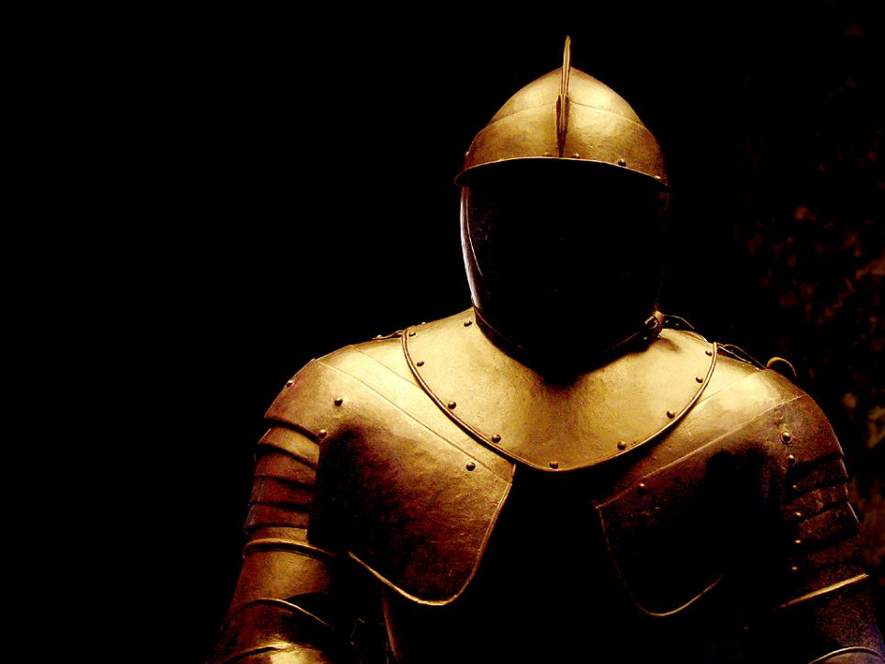
What Do We Believe?
We Are in A Battle 14
I CORINTHIANS 6:12
All things are lawful unto me, but all things are not expedient: all things are lawful for me, but I will not be brought under the power of any.

Slide 2
Birthdays,
Anniversaries
& Exciting Events
March 10th Joel & Ruth Franklin (17th)
Mar. 14th Connie Hughes
Mar. 15th David Mourghlea
March 17th Samuel Brown
Mar. 19th Hailey Johnson
March 31 & April 1st Easter Meetings

Slide 3
The
Men’s
Campout
April 19-22
Morrow
Mountain
State Park

Slide 4
SOULS.IN.PRISON.NOW
3 …That's why we're gathered here today, Lord: To confess our wrongs and ask for mercy. That's why we face this altar this morning, because that we know we're mortal, and there's many mistakes in us, and we're full of fault. But we come to confess our wrongs and look to our heavenly Father with open hearts, for the blessings and renewal of strength and faith… May He teach us the things that He'd have us to know.
63-1110

Slide 5
The Battle
PROVERBS 2:6-7
For the LORD giveth wisdom: out of his mouth cometh knowledge and under-standing. 7 He layeth up sound wisdom for the righteous: he is a buckler to them that walk uprightly. 8 He keepeth the paths of judgment, and preserveth the way of his saints.

Slide 6
Life is a hard fight, a struggle,
a wrestling with the principles of evil, hand to hand, foot to foot. Every inch of the way is disputed.
Florence Nightingale

Slide 7
GOD.OF.THIS.EVIL.AGE
29 …Now, this message points out the evils of this evil age, and it is fitting to prophecy for this evil age. And it's my belief that the Bible has every answer for every age already written in the Bible for the believer of that age. I believe that every-thing that we have need of is written right here, just needs to be interpreted by the Holy Spirit.
65-0801

Slide 8
GREATEST.BATTLE.EVER.FOUGHT
30-4 These are ministering Spirits sent from the Presence of God to be ministers… And remember if it ministers something besides the Word, it didn't come from God... Always in heaven, the Word, God watches over It, He will never send a Spirit to minister something besides the Word.
“…Well, the days of miracles is passed." No, no. That didn't come from God; it's contrary to the Word. He sends the ones that ministers the Spirit of the Word.
62-0311

Slide 9
PSALM 104:1-2, 4
1 Bless the LORD, O my soul. O LORD my God, thou art very great; thou art clothed with honour and majesty. 2 Who coverest thyself with light as with a garment: who stretchest out the heavens like a curtain: 4 Who maketh his angels spirits; his ministers a flaming fire:
II CORINTHIANS 11:13-15
13 For such are false apostles, deceitful workers, transforming themselves into the apostles of Christ. 14 And no marvel; for Satan himself is transformed into an angel of light. 15 Therefore it is no great thing if his ministers also be transformed as the ministers of righteousness; whose end shall be according to their works.

Slide 10
HIS.UNFAILING.WORDS.OF.PROMISE
82 And now, so when we come out here, I constantly in meetings, doing everything I can for the Lord. But I don't do all that I should; I know that. I make so many mistakes.
And my wife has had to be both mother and daddy both for those children, 'cause I'm away. A father and mother should agree upon their decisions for their children. But I'm not there; I'm in the service of the Lord.
64-0120

Slide 11
INTERVIEW.OF.SISTER.BRUCE
I'm fixing to pray for you. I'm not worthy of that… But I come to represent Him. Must, remember, me being a sinner and before God, I'm not a sinner, neither are you; we got a Blood Sacrifice laying there. God don't even see us. He hears our voice, but He sees the Blood of Christ… We are Christians. I believe you to be a genuine Christian woman.
Sister Bruce says, "I make so many mistakes, and I fail so many times."
That's why Christ had to die, so that you with your mistakes wouldn't be 'lotted to you. He took your mistakes. Your desire in your heart is to serve Him.

Slide 12
[Sis. Bruce says, "Yes.“] All right. That's what He died for, so that you could serve Him. He is your Sin-offering. Your sins are not known. You're not a sinner before God.
[Sis. Bruce: "But I've never had an exper-ience that I have been filled with the Holy Ghost, that I could put my foot on."]
All right. Ordinarily, a human being is born in sin… That's the nature of a human being. ["Yes.“] That was your nature. It change once. But what changed it? ["Christ."] There you are. "He that heareth My Words and believeth on Him that sent Me, hath Eternal Life… Jn 5:24. 64-0705

Slide 13
The Battle
AS.THE.EAGLE.STIRRETH.HER.NEST
90 What a joy it is, and a privilege to serve God. Give it to these young people, Lord. They've got an awful battle… Look at their television: rotten and polluted. Look at the nation they're coming up in: politics rotten to the core, the antichrist arising in seat and power.
60-0804

Slide 14
JAMES 1:2-3
My brethren, count it all joy when ye fall into divers temptations; 3 Knowing this, that the trying of your faith worketh patience.
hupomone
Steadfastness, constancy, endurance: in the NT The characteristic of a man who is not swerved from his deliberate purpose and his loyalty to faith and piety by even the greatest trials and sufferings:
Heroic Endurance.

Slide 15
LUKE 8:15
But that on the good ground are they, which in an honest and good heart, having heard the word, keep it, and bring forth fruit with patience.
LUKE 21:19
In your patience possess ye your souls.
ROMANS 5:3
And not only so, but we glory in tribulations also: knowing that tribulation worketh patience;

Slide 16
GOD.HATH.A.PROVIDED.WAY
80 Is that little baby to be prayed for, sister? From Indiana? You believe the little baby's going to get well? Get into the attitude of this, "Jesus, You're here. I'm now accepting the healing. I believe it with all my heart. And now it's finished.“
82 How long has your baby been sick, brother? Since it was born. What's its trouble? Retarded? You know the Devil done that. God can make that little baby well again. Both of you Christians? Neither one of you Christians? Will you give your life to Jesus this morning?

Slide 17
83 Now, heavenly Father, by laying hands upon this blessed little child, that's two newborn children that has just come, father and mother. And had to partake this baby to bring them to Eternal Life.
Maybe, if it hadn't have been for the baby being this way, they'd have been lost forever. But the baby has become a temporary, or a minor saviour to them, to bring them to the Lord Jesus for their salvation. We thank Thee, Father. And now bless them. They are Your children…

Slide 18
84 We bless their baby in Jesus Christ's Name… I rebuke the works of the Devil. Now, Satan, you have no more right; it's all over.
So we beseech you through the Blood of Jesus Christ Who bid us to do so, and we cast you away from this child. And now, may it start growing, and developing, and getting normal and well, and make a fine young child…
Watch the difference of your baby. Write me or call me in the next four or five days, and see what a difference you see in your baby.
56-0108

Slide 19
THE.ENTOMBMENT
77 He went and preached to the souls that were in prison. Let's see where He went.
Just below the regions of mortal beings lays the realm of demon power; below that lays the souls of the unjust; below it lays the very domain of Satan: hell. Then just above us lays the Holy Spirit; then under the Altar lays the souls of the just men; the next is God Himself. One going downward, one upward; two spirits are here on earth, influencing the people of this earth. 57-0420

Slide 20
Heaven
Souls of Just Men
Angels
Stream of Humanity
Evil Spirts
Souls of Unjust Men
Hell

Slide 21
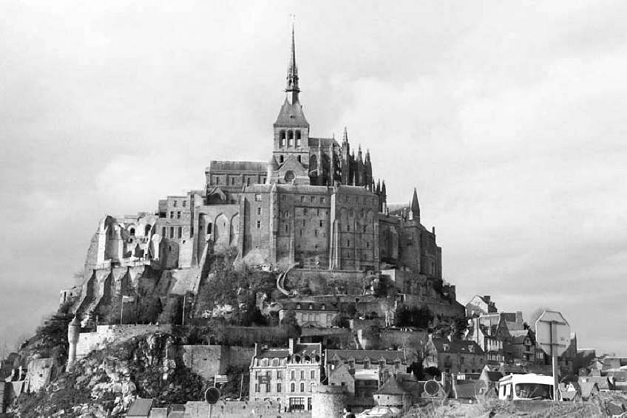
THE.EXPECTATIONS
2 And we realize that we are fighting a strong enemy. And our warfares are not carnal, but is strong, bringing down the strongholds of the enemy. 58-0508

Slide 22
ZECHARIAH 10:5-6
5 And they shall be as mighty men, which tread down their enemies in the mire of the streets in the battle: and they shall fight, because the LORD is with them, and the riders on horses shall be confounded. 6 And I will strengthen the house of Judah, and I will save the house of Joseph, and I will bring them again to place them; for I have mercy upon them: and they shall be as though I had not cast them off: for I am the LORD their God, and will hear them.

Slide 23
II CHRONICLES 29:1
Hezekiah began to reign when he was five and twenty years old, and he reigned nine and twenty years in Jerusalem… 2 And he did that which was right in the sight of the LORD, according to all that David his father had done. 3 He in the first year of his reign, in the first month, opened the doors of the house of the LORD, and repaired them. 4 And he brought in the priests and the Levites, and gathered them together into the east street, 5 And said unto them, Hear me, ye Levites, sanctify now yourselves, and sanctify the house of the LORD God of your fathers, and carry forth the filthiness out of the holy place.

Slide 24
II CHRONICLES 29:15-16
And they gathered their brethren, and sanctified themselves, and came, according to the commandment of the king, by the words of the LORD, to cleanse the house of the LORD. 16 And the priests went into the inner part of the house of the LORD, to cleanse it, and brought out all the uncleanness that they found in the temple of the LORD into the court of the house of the LORD. And the Levites took it, to carry it out abroad into the brook Kidron.

Slide 25
II CHRONICLES 30:25
And all the congregation of Judah, with the priests and the Levites, and all the congregation that came out of Israel, and the strangers that came out of the land of Israel, and that dwelt in Judah, rejoiced. 26 So there was great joy in Jerusalem: for since the time of Solomon the son of David king of Israel there was not the like in Jerusalem. 27 Then the priests the Levites arose and blessed the people: and their voice was heard, and their prayer came up to his holy dwelling place, even unto heaven.

Slide 26
II CHRONICLES 31:20-21
And thus did Hezekiah throughout all Judah, and wrought that which was good and right and truth before the LORD his God. 21 And in every work that he began in the service of the house of God, and in the law, and in the commandments, to seek his God, he did it with all his heart, and prospered.

Slide 27
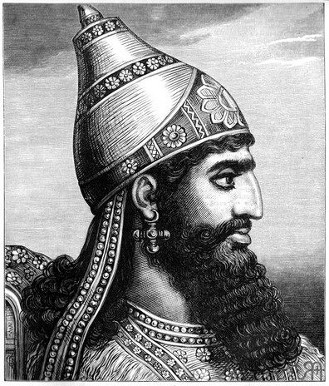
II Chron. 32:1
After these things, and the establishment thereof, Sennacherib king of Assyria came, and entered into Judah, and encamped against the fenced cities, and thought to win them for himself.

Slide 28
II CHRONICLES 32:7-8
Be strong and courageous, be not afraid nor dismayed for the king of Assyria, nor for all the multitude that is with him: for there be more with us than with him: 8 With him is an arm of flesh; but with us is the LORD our God to help us, and to fight our battles. And the people rested themselves upon the words of Hezekiah king of Judah.

Slide 29
II CHRONICLES 32:18-19
Then they cried with a loud voice in the Jews' speech unto the people of Jerusalem that were on the wall, to affright them, and to trouble them; that they might take the city. 19 And they spake against the God of Jerusalem, as against the gods of the people of the earth, which were the work of the hands of man.

Slide 30
II CHRONICLES 32:21-22
And the LORD sent an angel, which cut off all the mighty men of valour, and the leaders and captains in the camp of the king of Assyria. So he returned with shame of face to his own land. And when he was come into the house of his god, they that came forth of his own bowels slew him there with the sword. 22 Thus the LORD saved Hezekiah and the inhabitants of Jerusalem from the hand of Sennacherib the king of Assyria, and from the hand of all other, and guided them on every side.

Slide 31
PROVERBS 2:6-7
For the LORD giveth wisdom: out of his mouth cometh knowledge and under-standing. 7 He layeth up sound wisdom for the righteous: he is a buckler to them that walk uprightly. 8 He keepeth the paths of judgment, and preserveth the way of his saints.

Slide 32
GOD.OF.THIS.EVIL.AGE
69 He raised me up with Him, in the resurrection. And now we are seated with Him, with power and authority over every devil. Oh, if you could only believe what God has given!
But if you're not seated there, you don't have it. And if you're seated there, and don't believe it, and afraid to move, you'll never use it. But if you are seated there, you will use it, for you're ordained to do what you do.
65-0801

Slide 33
ASHAMED
220 Then, if I'm a Christian, been filled with the Spirit, wearing the testimony of Jesus Christ's resurrection… don't let any devil try to push you around, "You don't do this and that." You do do It.
221 See, we don't have power. That policeman don't have power to stop one car… But he's got authority. And that's the Church. We have authority, by the resurrection of Jesus Christ and His promised Word, hallelujah, "The things that I do shall you do also; more than this will you do, for I go unto the Father.“
65-0711

Slide 34
FAITH.IS.THE.SUBSTANCE
55 That's a hard word, isn't it? But it's the truth. He gave all the power and authority that He had to His Church, and you're just afraid to act upon it. Now, you believe that?
51-0508

Slide 35
SPIRITUAL.FOOD.IN.DUE.SEASON
70 Don't you see the authority of the living God in the living Church, the Bride? The sick are healed, the dead are raised up, the cripples walk, the blind see, the Gospel goes forth in Its power, for the Message and the messenger are the same. The Word is in the Church, in the person.
71 The Word of God was in Elijah when he walked up there with THUS SAITH THE LORD, and said, "It isn't going to rain." That wasn't Elijah; that was God in Elijah.
65-0718

Slide 36
(Couple from Indiana)
84 We bless their baby in Jesus Christ's Name… I rebuke the works of the Devil. Now, Satan, you have no more right; it's all over.
So we beseech you through the Blood of Jesus Christ Who bid us to do so, and we cast you away from this child. And now, may it start growing, and developing, and getting normal and well, and make a fine young child…

Slide 37
MATTHEW 28:17
And when they saw him, they worshipped him: but some doubted. 18 And Jesus came and spake unto them, saying, All power is given unto me in heaven and in earth.

Slide 38
SPOKEN.WORD.IS.THE.ORIGINAL.SEED.2
388 Now, the power of the believing Church. "Christ has all power in heavens and earth." Believe that? Now, what if He's in you?
Has Christ got all power? Matt. 28:18. He is the Seed-Word in His Body. And He, in us, becomes the Seed-Word in us. All that God was, He poured into Christ; and all Christ was, was poured into the Church.
62-0318

Slide 39
CHURCH.AGE.BOOK
79-2 There He is with the seven stars in His right hand. The right hand or arm signifies the power and authority of God. Psalms 44:3, In that right hand of power are seven stars, who, according to Revelation 1:20, are the seven church messengers.
This signifies that the very power and authority of God are behind His messengers to every age. They go forth in the fire and power of the Holy Ghost with the Word.

