Slide 1
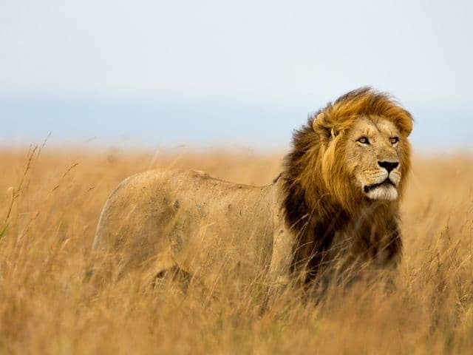
“All the World…” And this gospel of the kingdom shall be preached in all the world for a witness unto all nations; and then shall the end come. Matthew 24:14

Slide 2
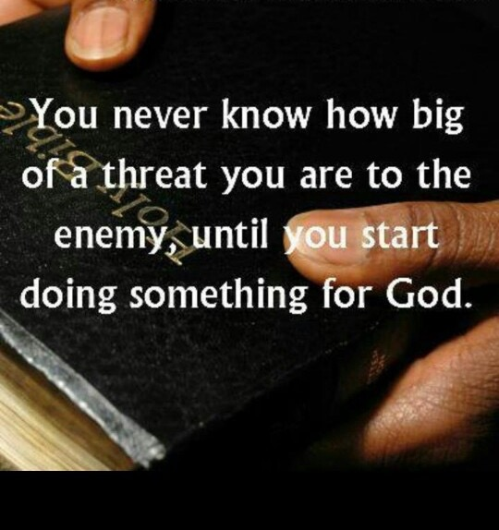
END.TIME.
EVANGELISM
When we are doing mission work or foreign mission, with the Word of God, we know we're always in the will of God, because Jesus' first commission to His church was "Go out and preach the Gospel." This last commission was to preach the Gospel.
62-0603

Slide 3
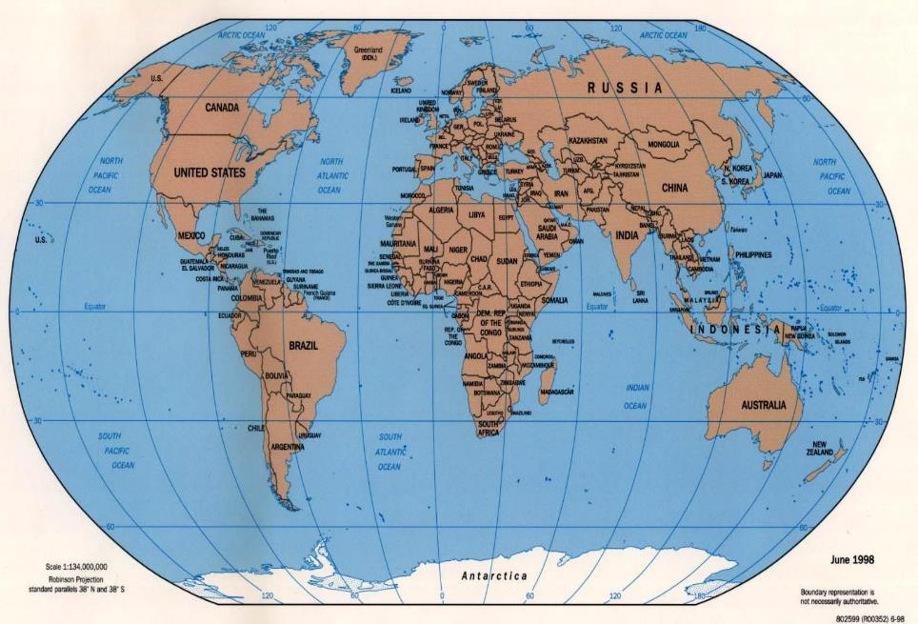
Witness/
Communication

Slide 4
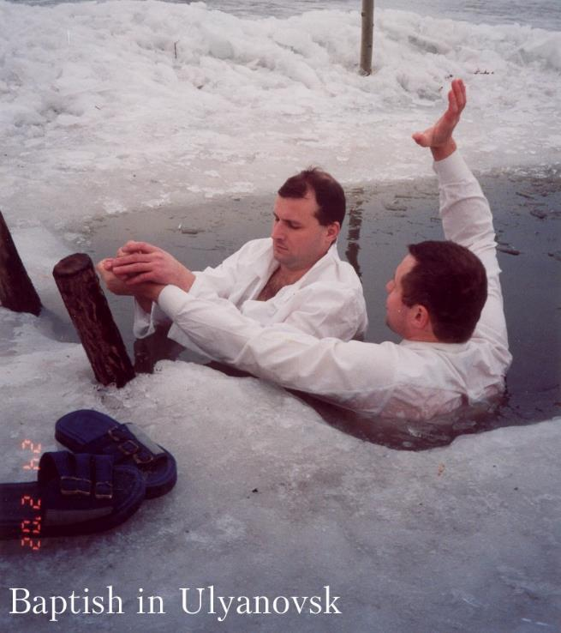
Baptizing in
Ulyanovsk,
Russia
2002

Slide 5
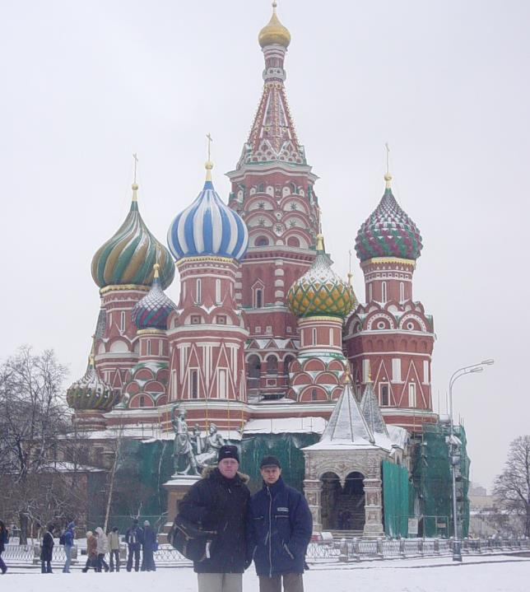
St. Bazil’s Church
Red Square, Moscow
December, 2003

Slide 6
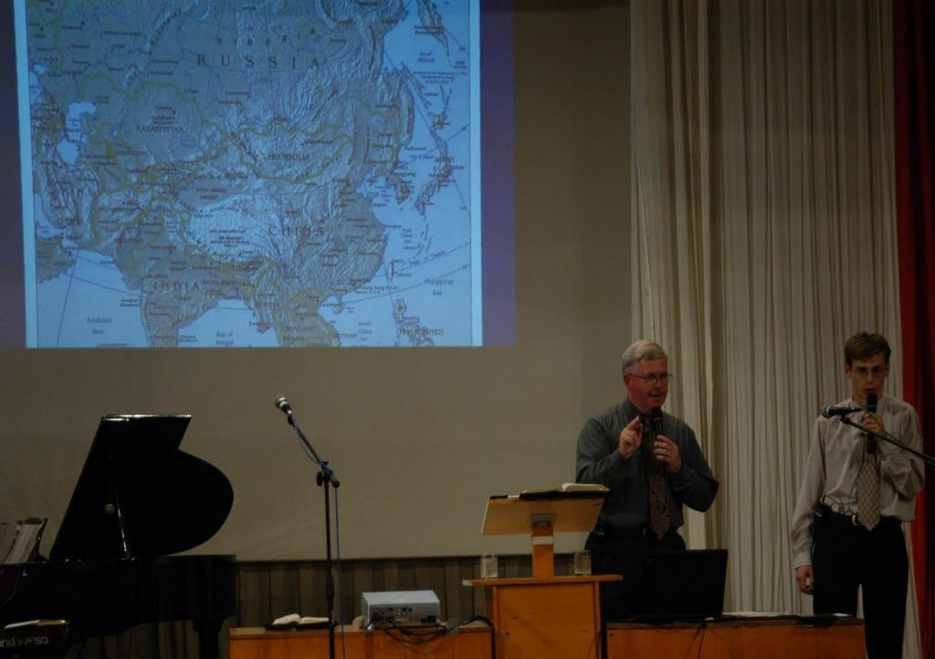
Alushta, Ukraine
May, 2004

Slide 7
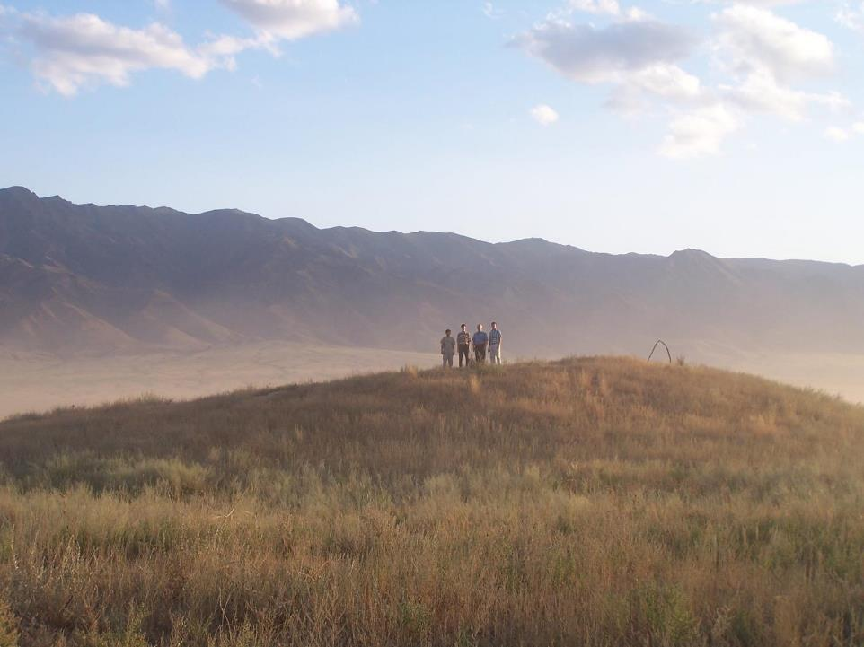
Kazakhstan
July 2005

Slide 8
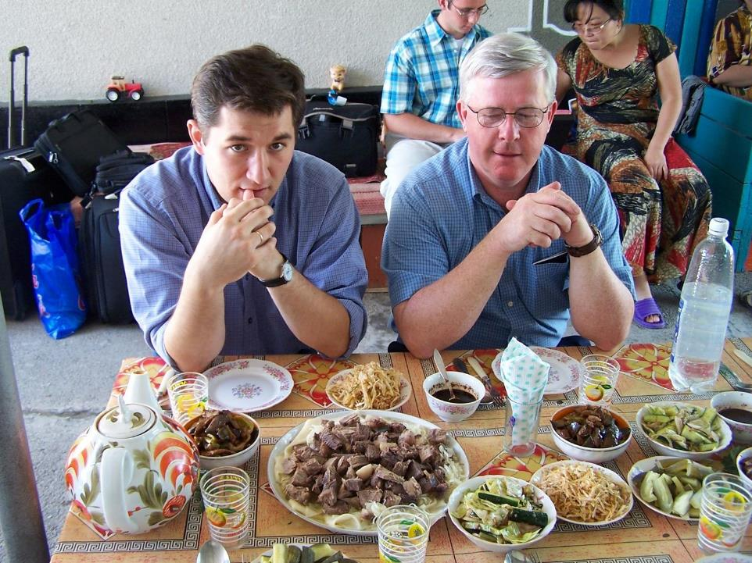

Slide 9
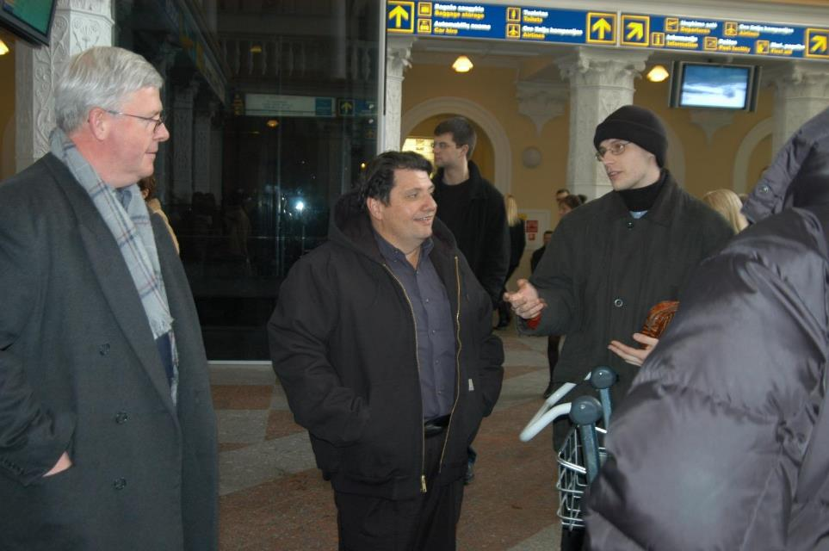
Arriving in Vilnius, Lithuania
March, 2006

Slide 10
Vilnius, Lithuania
March, 2006

Slide 11
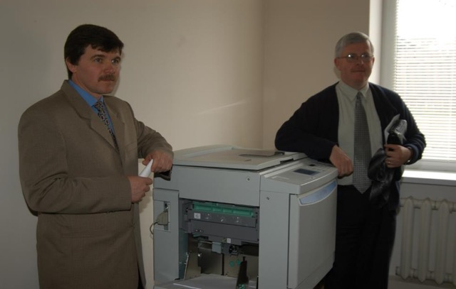
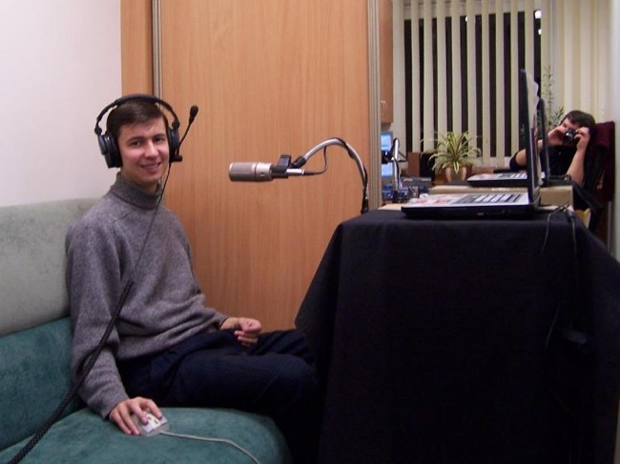
Bro. Vitaly in recording studio
Vilnius, Lithuania
Bro. Vladimir and
His new printing
Press in Donetsk, Ukraine

Slide 12
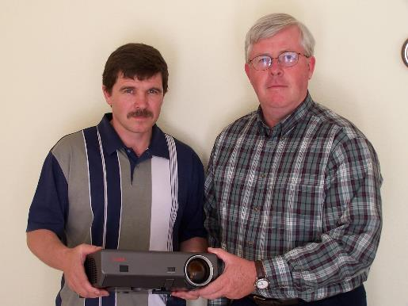
Presenting a new video projector to
Bro. Ryabov from Donetsk, Ukraine

Slide 13
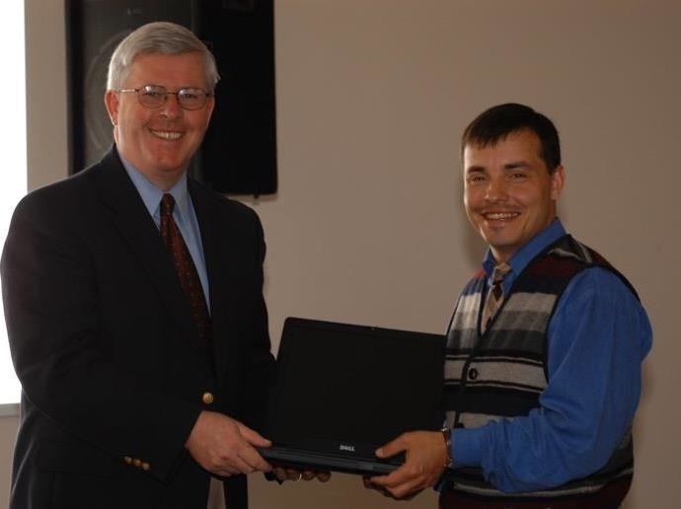
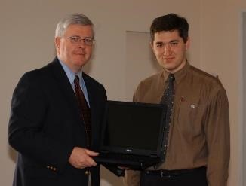
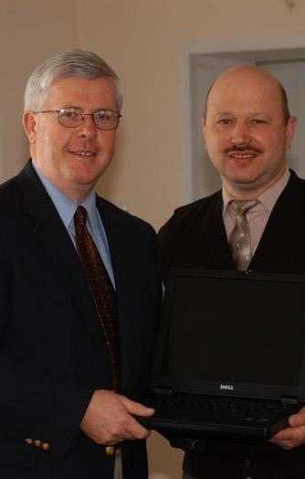
Donated Laptops
For Ministers

Slide 14
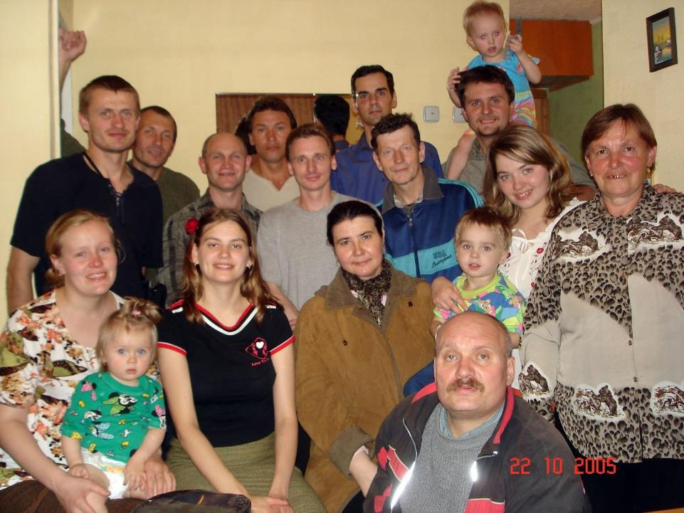
Sakhalinsk, Russia
(Sakhalin Islands)

Slide 15
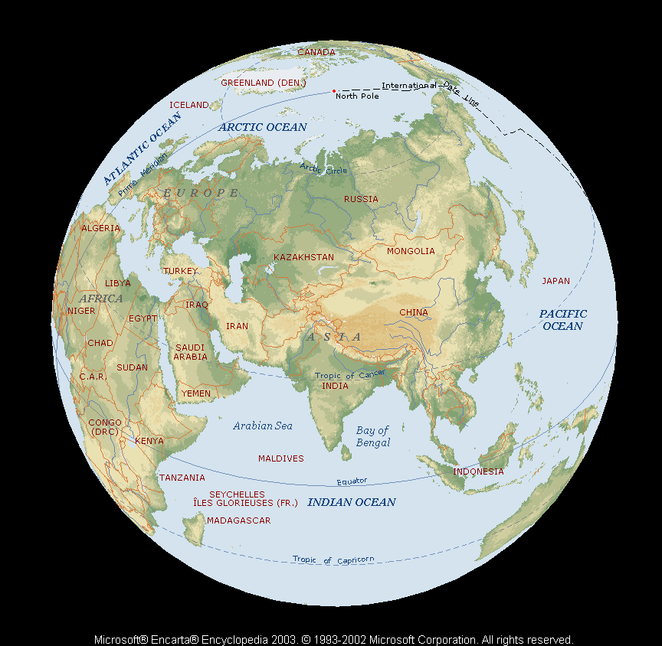
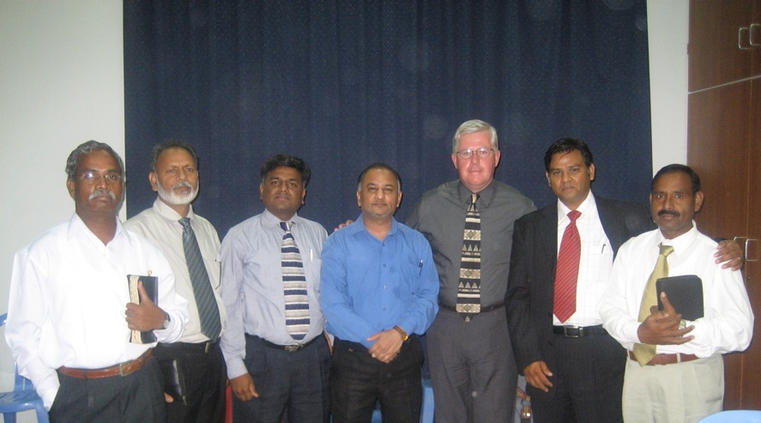
Dubai &
Philippines

Slide 16
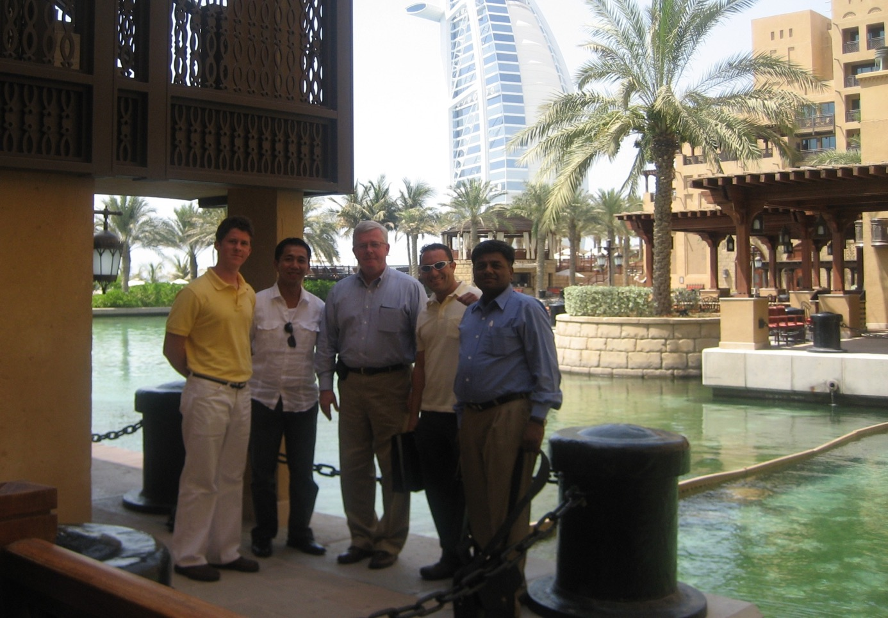
Dubai
United Arab Emirates

Slide 17
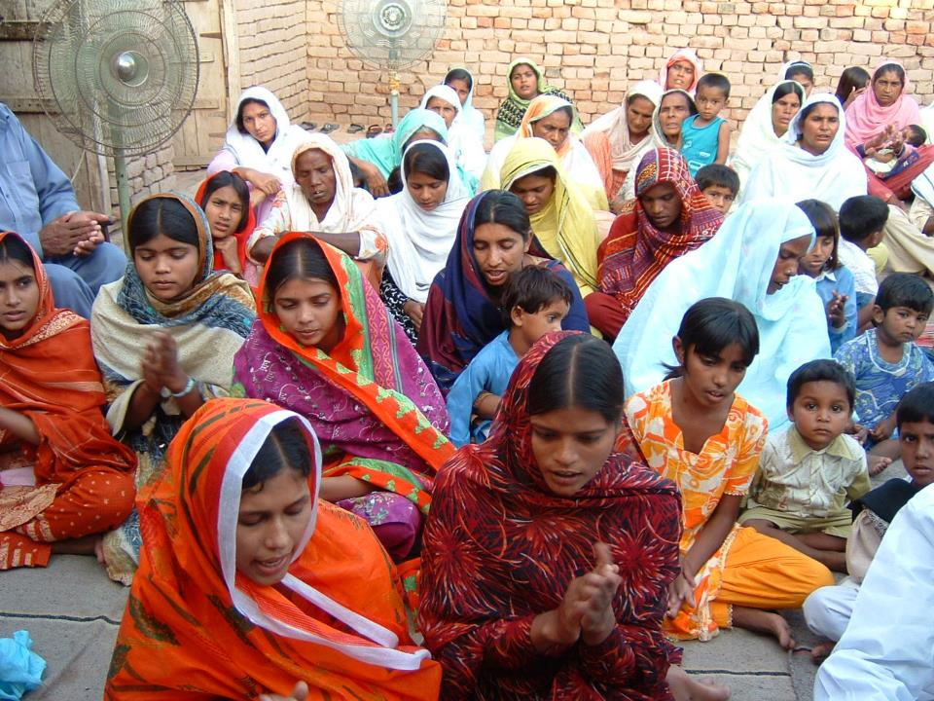
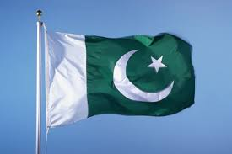
Lahore
Pakistan

Slide 18
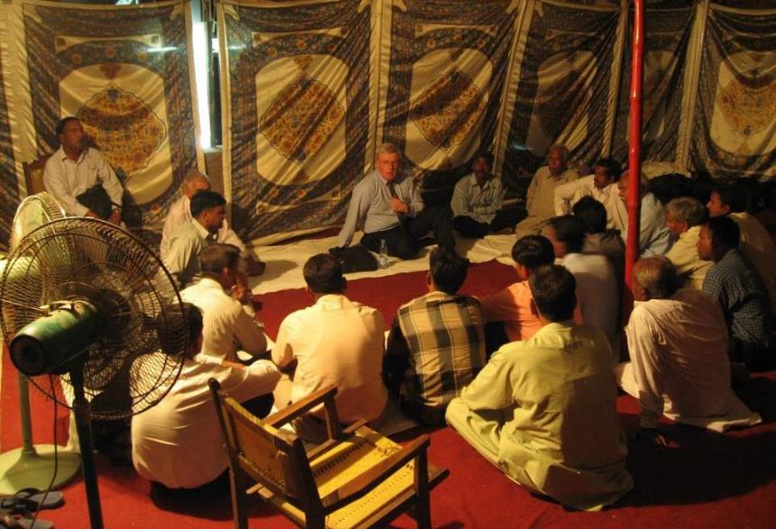

Slide 19
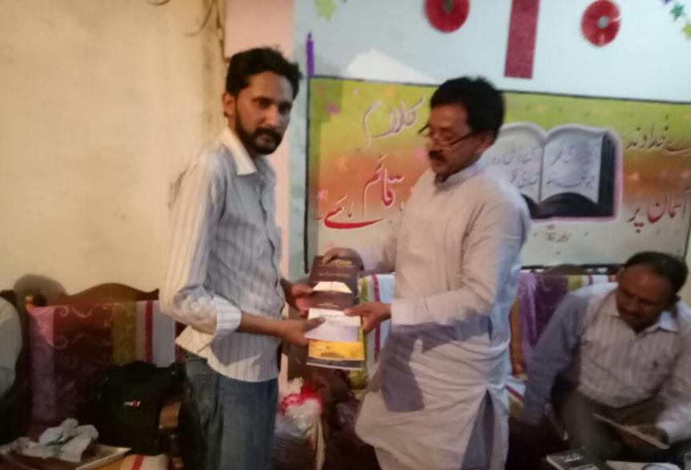

Slide 20
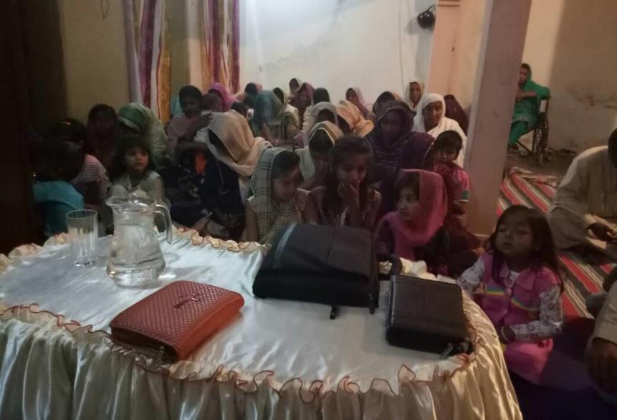

Slide 21
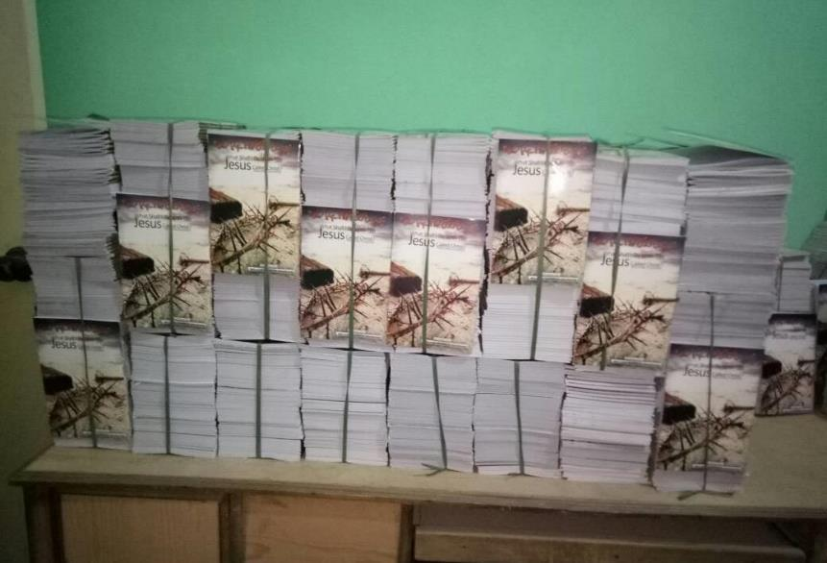

Slide 22
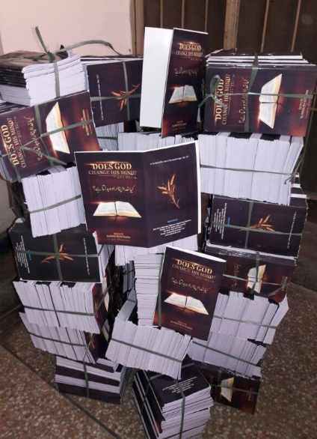

Slide 23
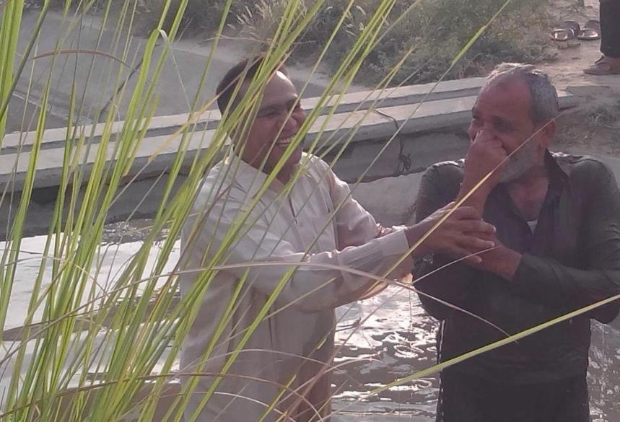

Slide 24
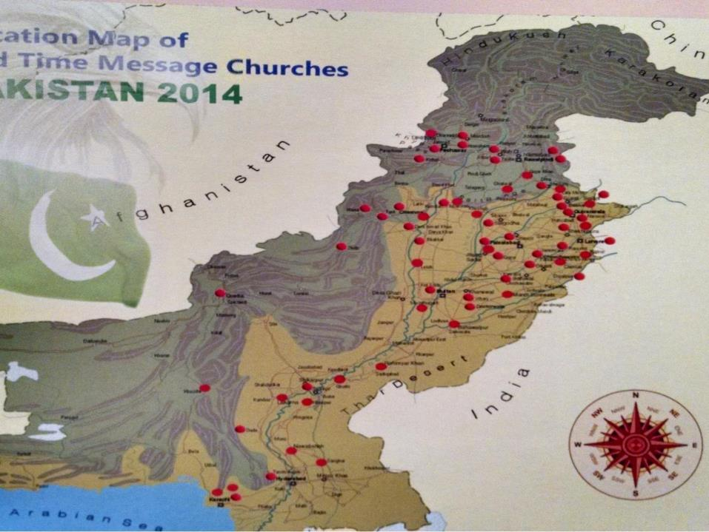

Slide 25
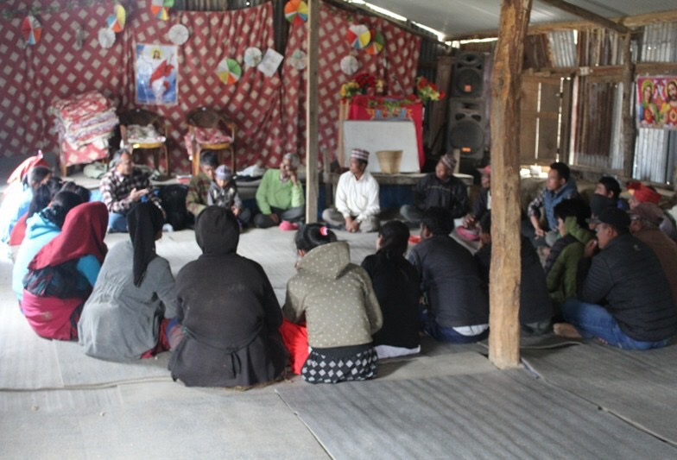
Bro. Bishnu
Naurange, Nepal

Slide 26
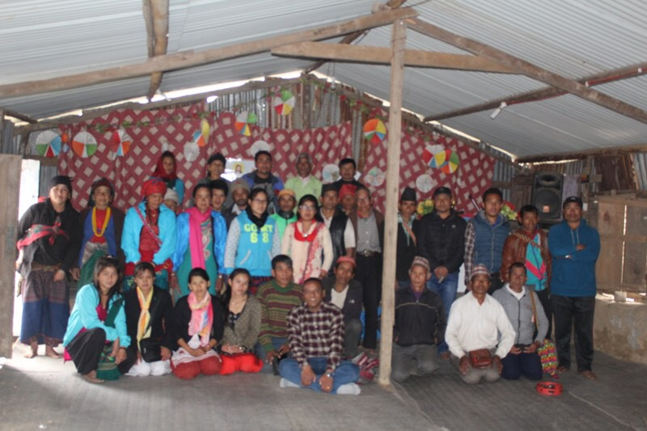

Slide 27
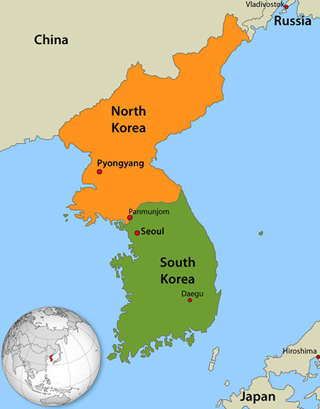
North &
South Korea
& Japan

Slide 28
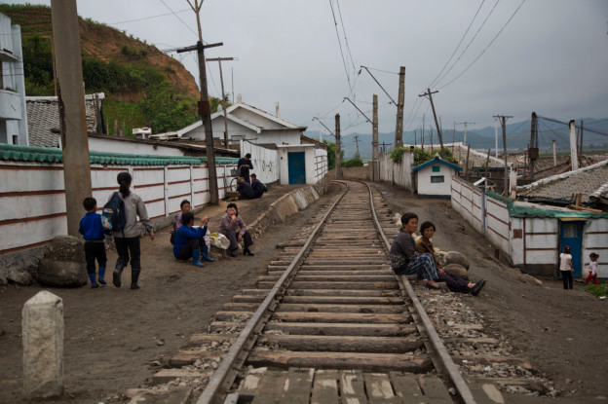
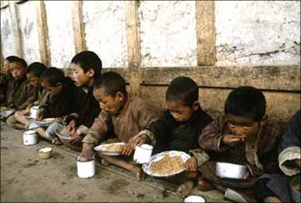

Slide 29
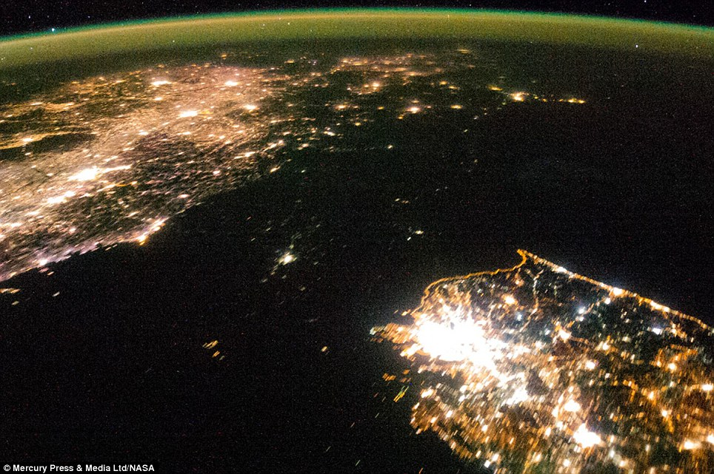

Slide 30
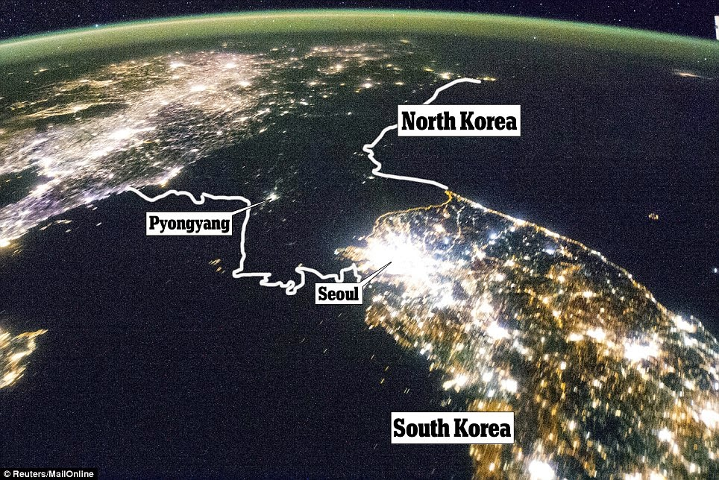

Slide 31
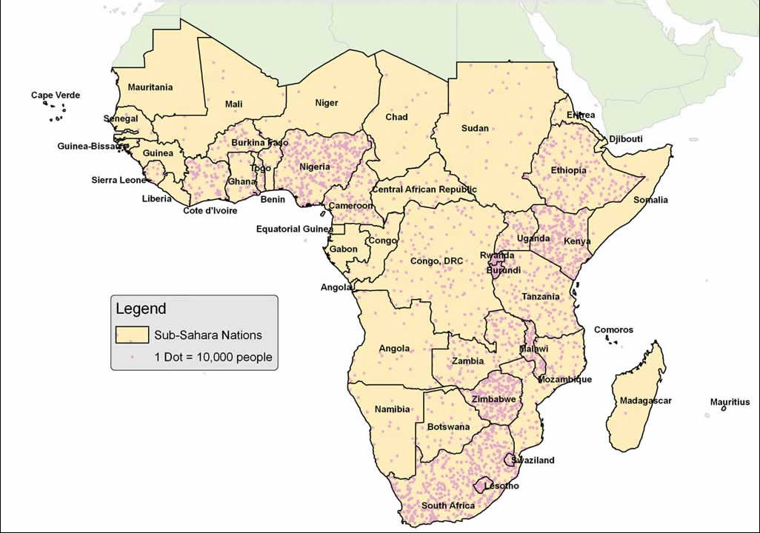
Sub-Saharan Africa

Slide 32
Mozambique River Crossing

Slide 33
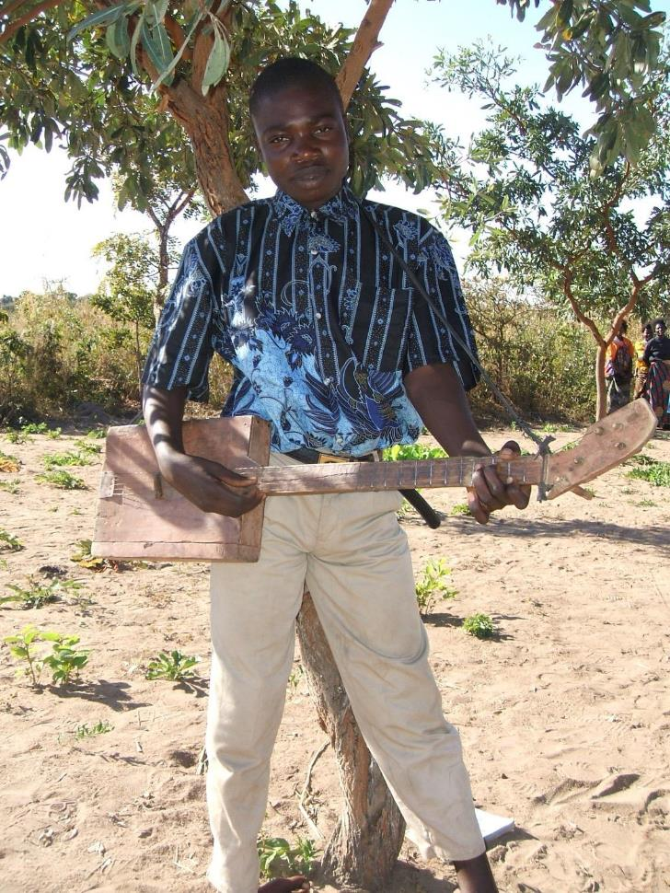
Lame boy
with his
guitar in
June 2006

Slide 34
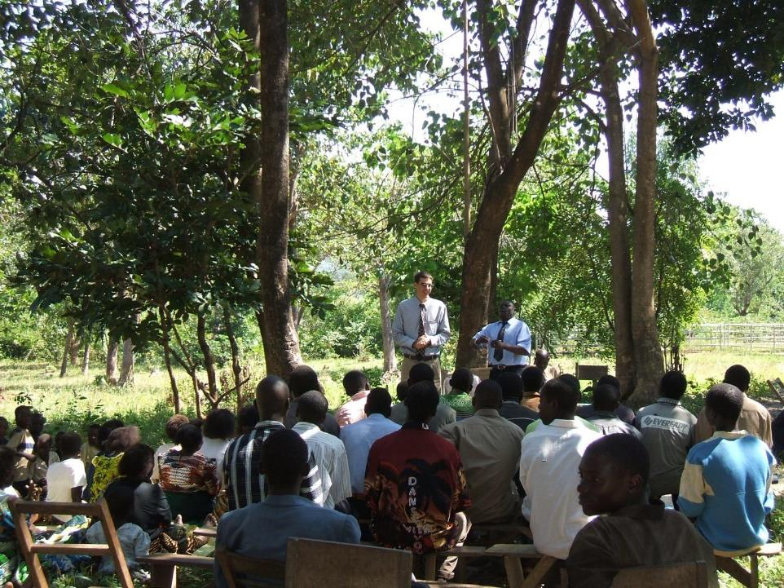
Bro. Rapp Crook
Malawi

Slide 35
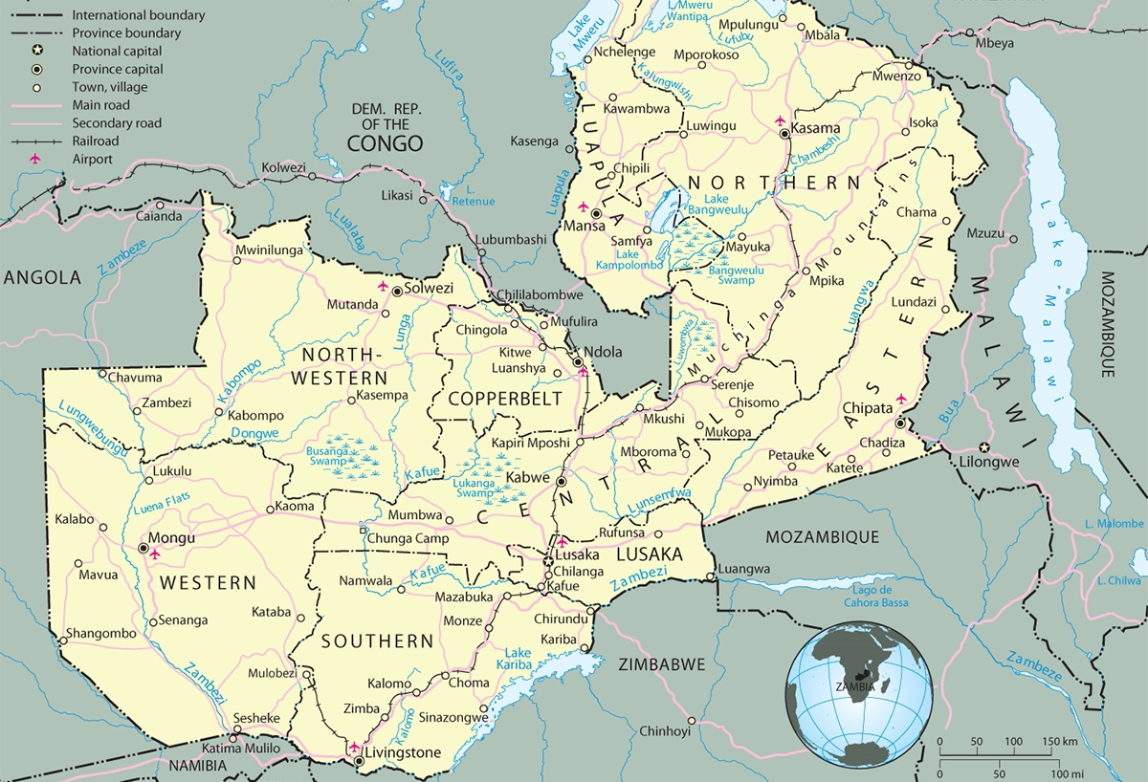
Zambia

Slide 36
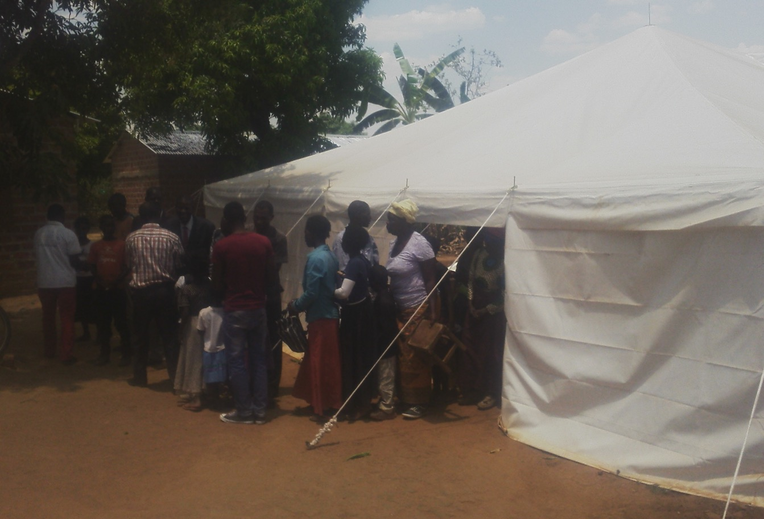
Mumbwa, Zambia

Slide 37
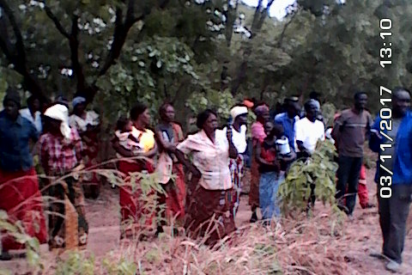
Village of Mumbwa, Zambia

Slide 38
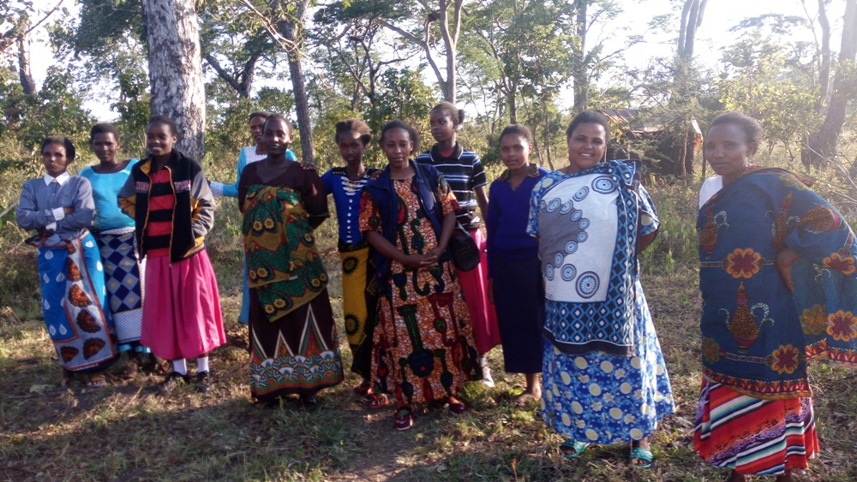
Tanzania

Slide 39
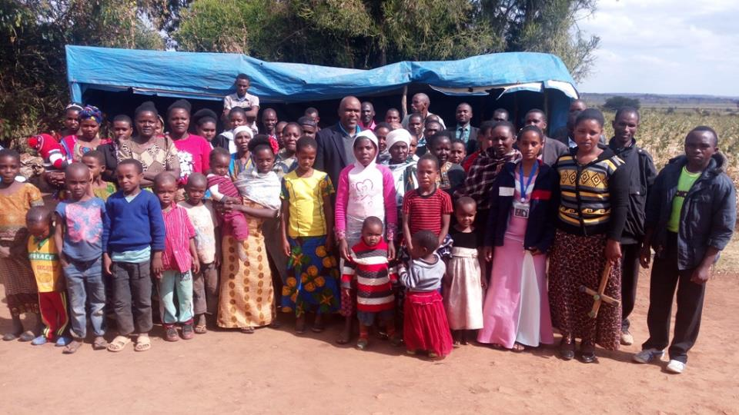
Duru Church (Mang’atti)

Slide 40
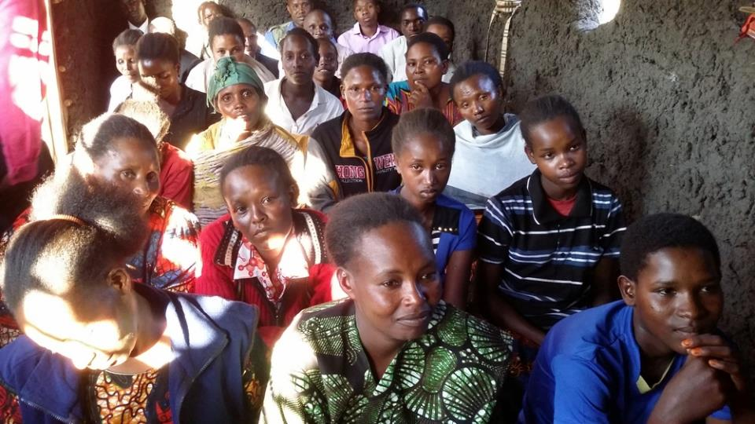
Turiani Church – in Morogoro

Slide 41
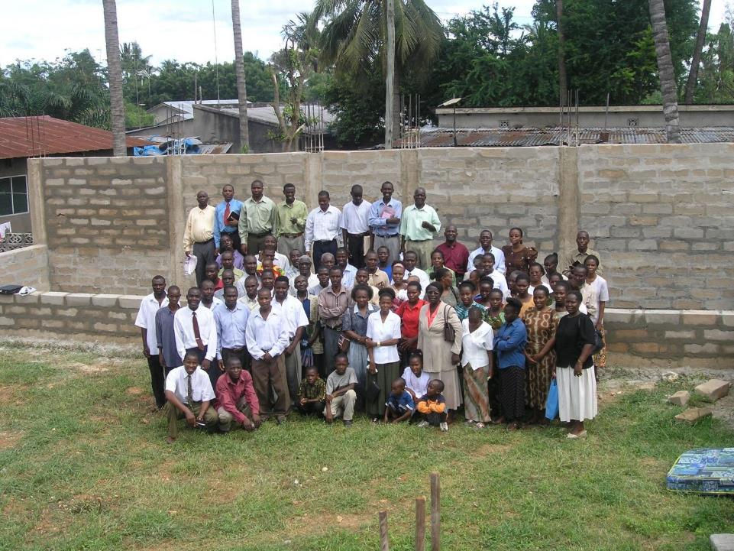
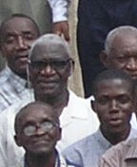
New Church
Dar Es Salaam, Tanzania

Slide 42
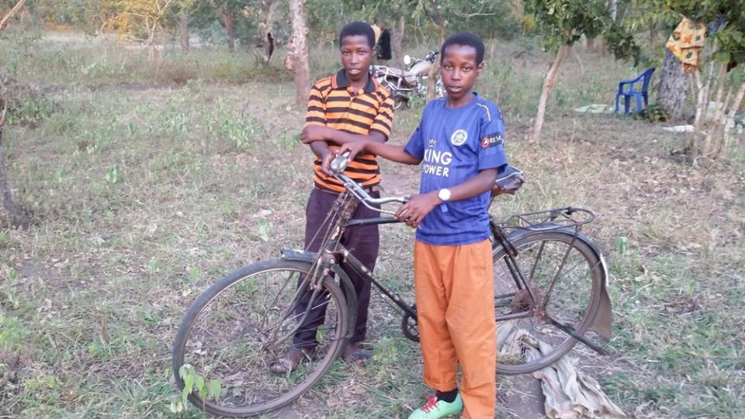
6.5 hours to Church

Slide 43
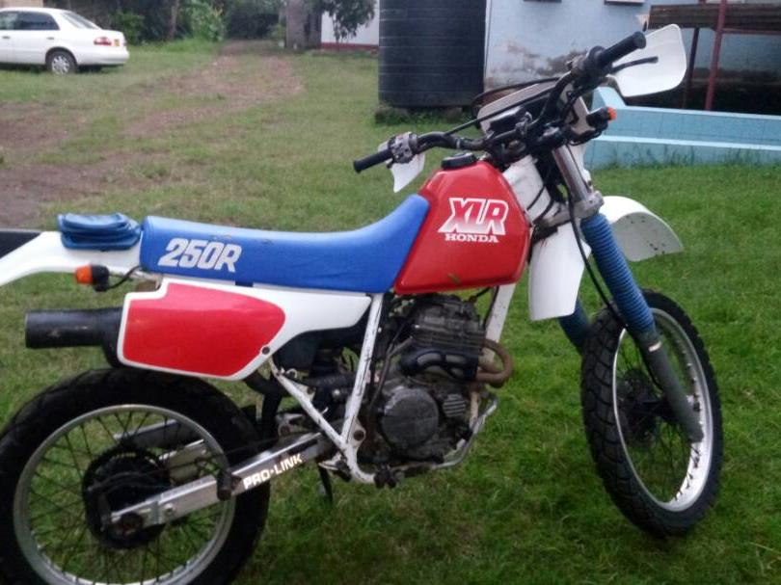

Slide 44
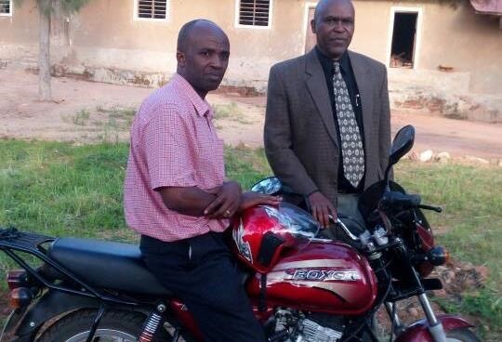

Slide 45
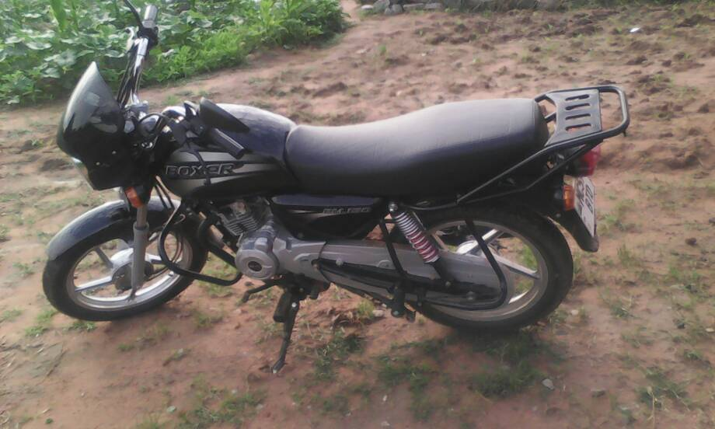

Slide 46
Bro. Barry,
We have been trying to start planning and do preliminary preparations for the coming convention. Even though we are not decided yet, It seems the venue will be at the church due to financial situation in our country.
Currently, we have very tough life (not believers only), due to economy environment. Money circulation is minimal – people are closing down their businesses. Every level of business is in jeopardy now.

Slide 47
So, we thought we can only try to raise some funds that can only be enough by using our church building as a convention hall. For that matter, we will be forced to reduce the number of invitees. We need your prayers so that God can make a way and we only trust in Him – otherwise this is the first convention with such difficult economic situation.
I just decided to inform you of this situation because you are familiar with our meetings and you are also an important stake holder.
God bless, Bro. Elias

Slide 49
Bro. Anjelus
Haule

Slide 50
Bible and Books waiting to be
shipped from Arusha

Slide 51
Total Cards Sent: 3,976
Total MP# Messages: 5,083,035
Total PDF Messages: 5,497,228
Bibles: 3,976

Slide 52
Vietnam

Slide 54
Chevak, Alaska

Slide 55
Arriving
At Church

