Slide 1
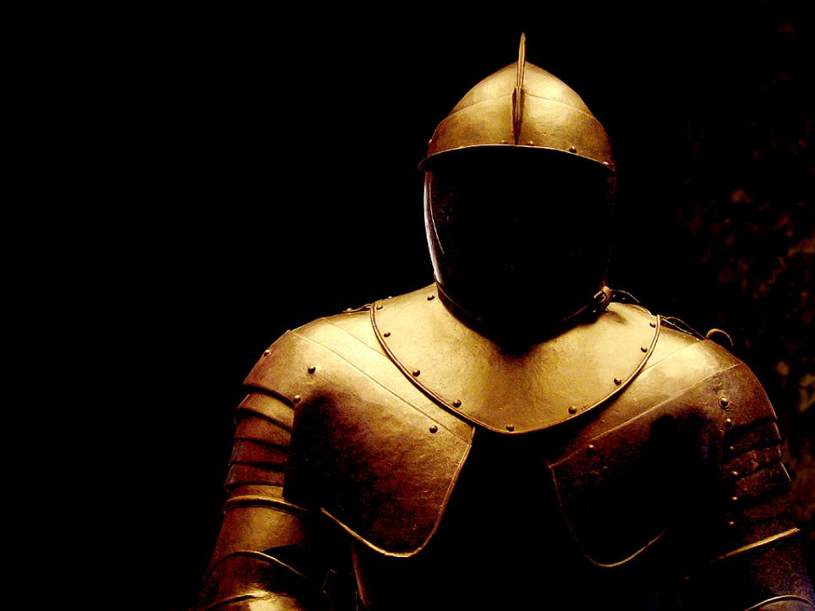
What Do We Believe?
We Are in A Battle 15
GALATIANS 5:1
Stand fast therefore in the liberty wherewith Christ hath made us free, and be not entangled again with the yoke of bondage.

Slide 2
Birthdays,
Anniversaries
& Exciting Events
March 26th
Ben & Rachel Pritchard
Troy & Connie Hughes
Mar. 29th Mike & Angela Pritchard
Immanuel Irish
Mar. 31st Noah Cockman
March 31 at 7:00 pm
& April 1st Easter Meetings

Slide 3
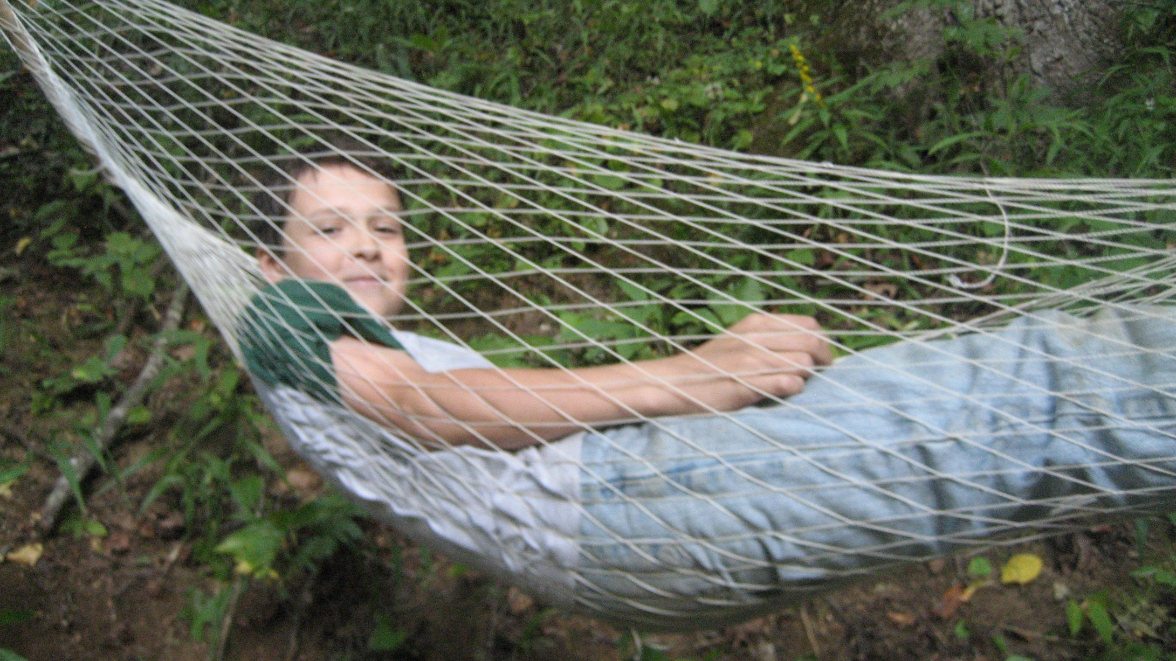
The Men’s Campout
April 19-22
Morrow
Mountain
State Park

Slide 4
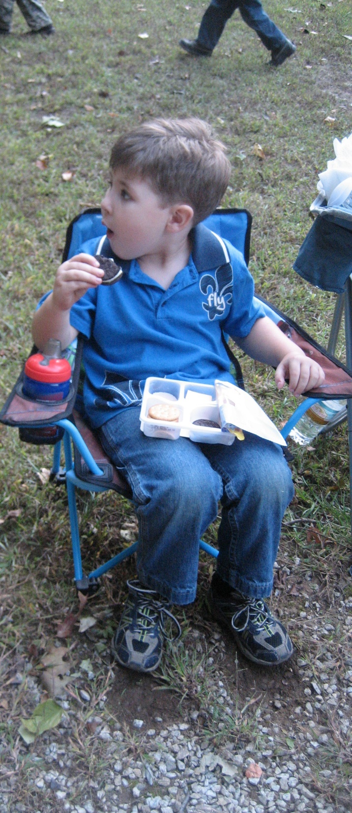
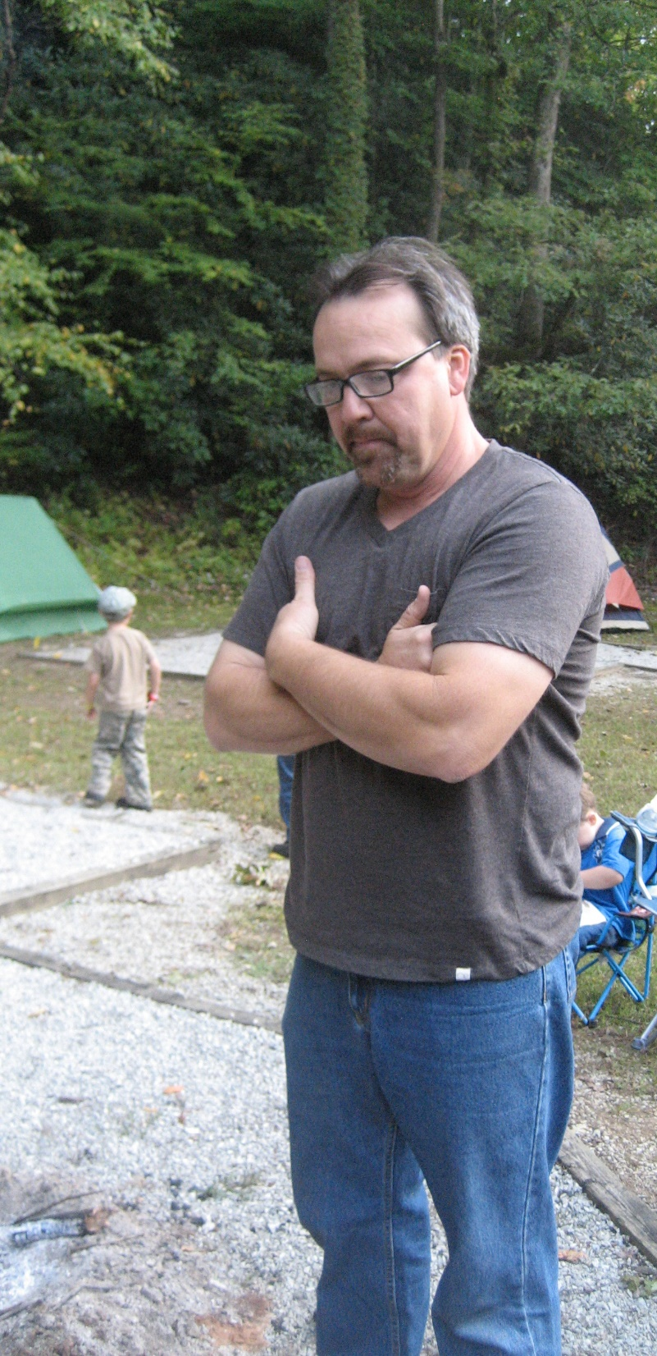
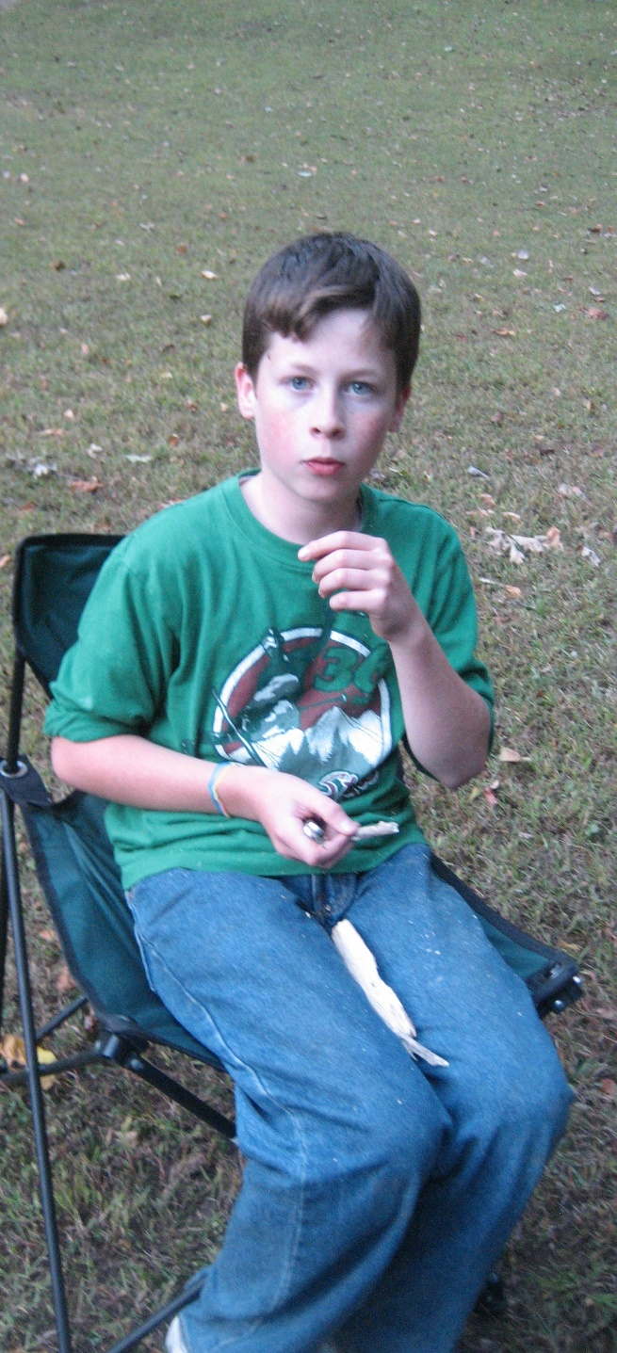

Slide 5
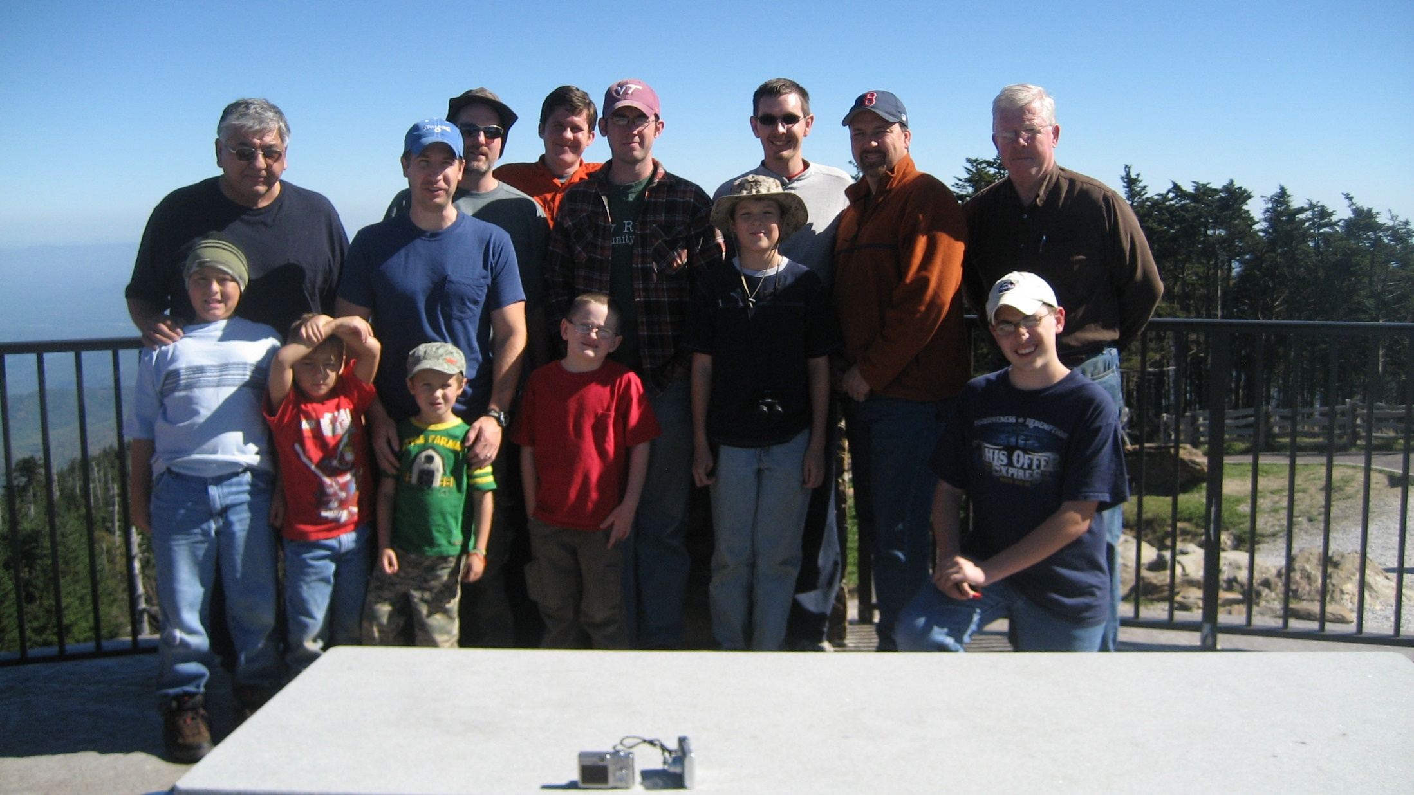

Slide 6
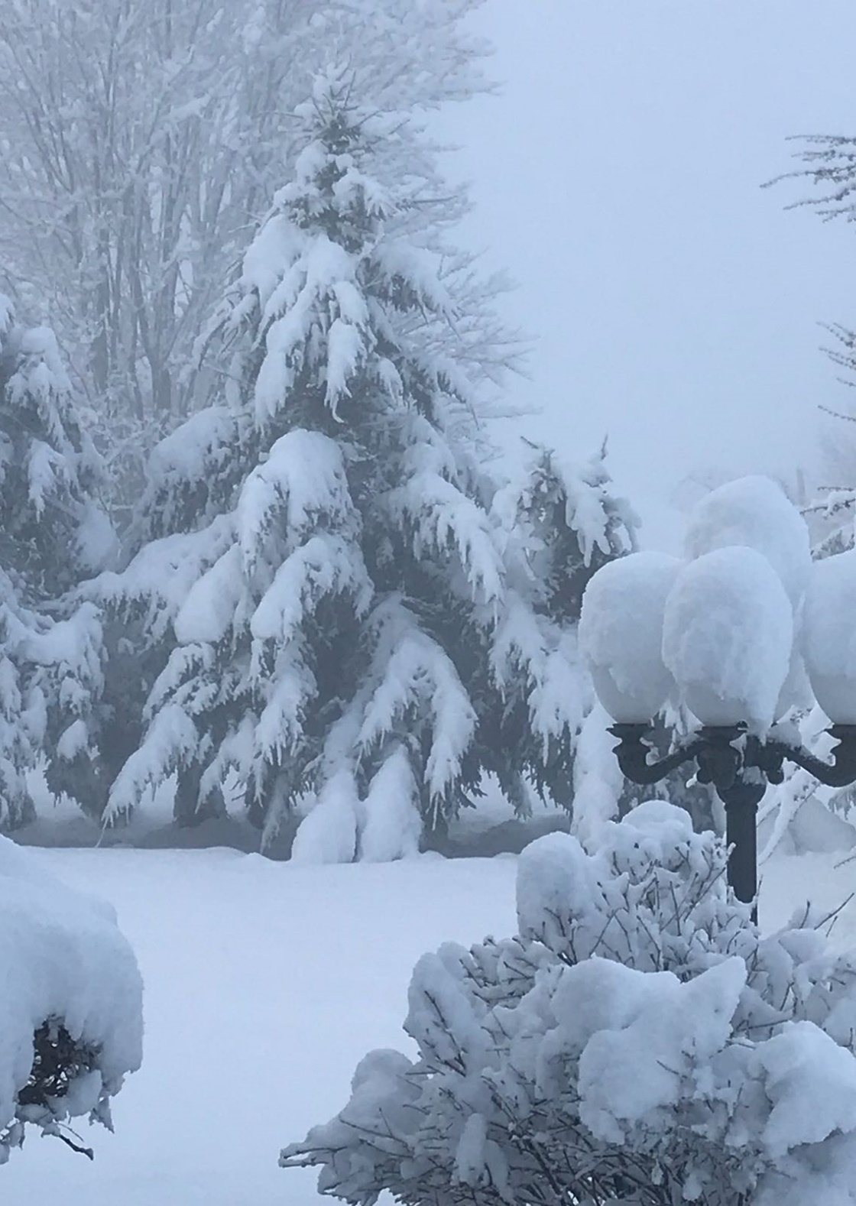
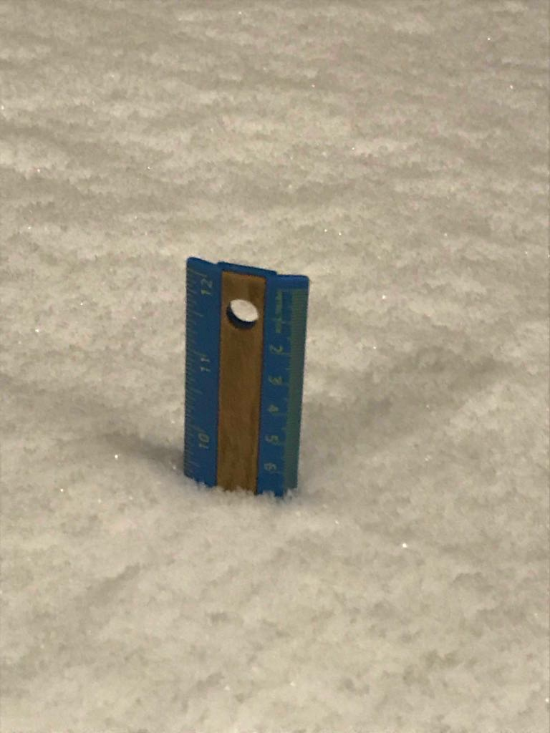
The Ruler at 11:00 pm

Slide 7
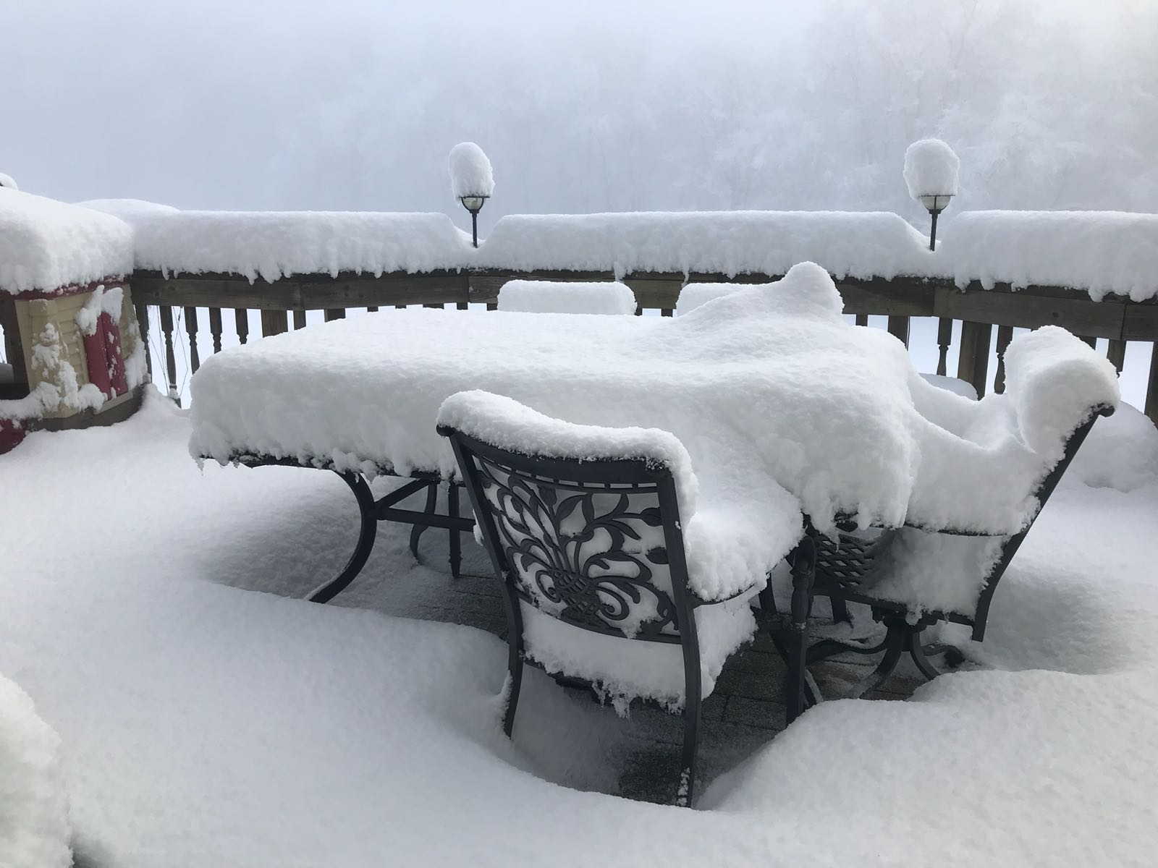

Slide 8
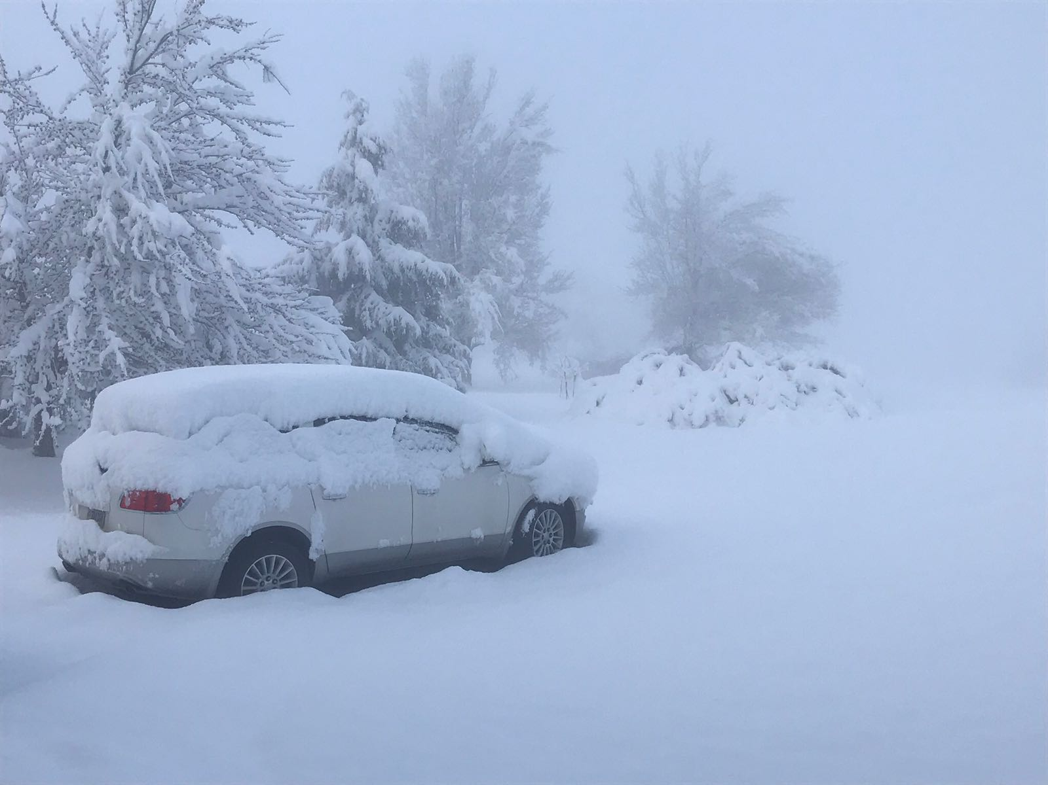
Riner, Virginia
3-25-2018 8:00 am

Slide 9
What Do We Believe?
We Are in A Battle 15
GALATIANS 5:1
Stand fast therefore in the liberty wherewith Christ hath made us free, and be not entangled again with the yoke of bondage.

Slide 10
GOD.OF.THIS.EVIL.AGE
29 …And it's my belief that the Bible has every answer for every age already written in the Bible for the believer of that age. I believe that every-thing that we have need of is written right here, just needs to be interpreted by the Holy Spirit.
65-0801

Slide 11
The enemy is not after your money,
Or your stuff.
He wants your Mind. Your Attitude. Your Heart. Your Faith. Your Peace.
Understand that you’re not being
attacked over the tangible things in your life, the enemy is fighting
over things you cannot see.

Slide 12
GREATEST.BATTLE.EVER.FOUGHT
30-4 These are ministering Spirits sent from the Presence of God to be ministers… And remember if it ministers something besides the Word, it didn't come from God... Always in heaven, the Word, God watches over It, He will never send a Spirit to minister something besides the Word.
“…Well, the days of miracles is passed." No, no. That didn't come from God; it's contrary to the Word. He sends the ones that ministers the Spirit of the Word.
62-0311

Slide 13
EXODUS 2:23-25
And it came to pass in process of time, that the king of Egypt died: and the children of Israel sighed by reason of the bondage, and they cried, and their cry came up unto God by reason of the bondage. 24 And God heard their groaning, and God remembered his covenant with Abraham, with Isaac, and with Jacob. 25 And God looked upon the children of Israel, and God had respect unto them.

Slide 14
JAMES 1:2-3
My brethren, count it all joy when ye fall into divers temptations; 3 Knowing this, that the trying of your faith worketh patience.
hupomone
Steadfastness, constancy, endurance: in the NT the characteristic of a man who is not swerved from his deliberate purpose and his loyalty to faith and piety by even the greatest trials and sufferings: Heroic Endurance.

Slide 15
Response to Warfare
I SAMUEL 28:1
And it came to pass in those days, that the Philistines gathered their armies together for warfare, to fight with Israel. And Achish said unto David, Know thou assuredly, that thou shalt go out with me to battle, thou and thy men.
II CORINTHIANS 10:4
(For the weapons of our warfare are not carnal, but mighty through God to the pulling down of strong holds;) 5 Casting down imaginations, and every high thing that exalteth itself against the knowledge of God, and bringing into captivity every thought to the obedience of Christ; 6 And having in a readiness to revenge all disobedience, when your obedience is fulfilled.

Slide 16
II CHRONICLES 29:1
Hezekiah began to reign when he was five and twenty years old, and he reigned nine and twenty years in Jerusalem… 2 And he did that which was right in the sight of the LORD, according to all that David his father had done. 3 He in the first year of his reign, in the first month, opened the doors of the house of the LORD, and repaired them. 4 And he brought in the priests and the Levites, and gathered them together into the east street, 5 And said unto them, Hear me, ye Levites, sanctify now yourselves, and sanctify the house of the LORD God of your fathers, and carry forth the filthiness out of the holy place.

Slide 17
II CHRONICLES 29:15-16
And they gathered their brethren, and sanctified themselves, and came, according to the commandment of the king, by the words of the LORD, to cleanse the house of the LORD. 16 And the priests went into the inner part of the house of the LORD, to cleanse it, and brought out all the uncleanness that they found in the temple of the LORD into the court of the house of the LORD. And the Levites took it, to carry it out abroad into the brook Kidron.

Slide 18
II CHRONICLES 30:25-27
And all the congregation of Judah, with the priests and the Levites, and all the congregation that came out of Israel, and the strangers that came out of the land of Israel, and that dwelt in Judah, rejoiced. 26 So there was great joy in Jerusalem: for since the time of Solomon the son of David king of Israel there was not the like in Jerusalem. 27 Then the priests the Levites arose and blessed the people: and their voice was heard, and their prayer came up to his holy dwelling place, even unto heaven.

Slide 19
II CHRONICLES 31:20-21
And thus did Hezekiah throughout all Judah, and wrought that which was good and right and truth before the LORD his God. 21 And in every work that he began in the service of the house of God, and in the law, and in the commandments, to seek his God, he did it with all his heart, and prospered.

Slide 20
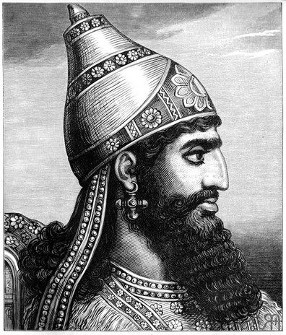
II Chron. 32:1
After these things, and the establishment thereof, Sennacherib king of Assyria came, and entered into Judah, and encamped against the fenced cities, and thought to win them for himself.

Slide 21
Sennacherib
King of Assyria from 705-681 BCE. He is principally remembered for his military campaigns against Babylon and Judah, and for his building programs – most notably at Nineveh. Born in 740 BC, Nimrud, Iraq; Died January 681 BC, Nineveh.
In approximately 701 BCE, Sennacherib attacked the fortified cities of Judah, laying siege on Jerusalem, but failed to capture it.

Slide 22
II CHRONICLES 32:7-8
Be strong and courageous, be not afraid nor dismayed for the king of Assyria, nor for all the multitude that is with him: for there be more with us than with him: 8 With him is an arm of flesh; but with us is the LORD our God to help us, and to fight our battles. And the people rested themselves upon the words of Hezekiah king of Judah.

Slide 23
II CHRONICLES 32:18-19
Then they cried with a loud voice in the Jews' speech unto the people of Jerusalem that were on the wall, to affright them, and to trouble them; that they might take the city. 19 And they spake against the God of Jerusalem, as against the gods of the people of the earth, which were the work of the hands of man.

Slide 24
II CHRONICLES 32:21-22
And the LORD sent an angel, which cut off all the mighty men of valour, and the leaders and captains in the camp of the king of Assyria. So he returned with shame of face to his own land. And when he was come into the house of his god, they that came forth of his own bowels slew him there with the sword. 22 Thus the LORD saved Hezekiah and the inhabitants of Jerusalem from the hand of Sennacherib the king of Assyria, and from the hand of all other, and guided them on every side.

Slide 25
BELIEVING.GOD
182 Not circumstances, not what some-body else said, "What if somebody else died when you got the same thing?" Don't consider it.
... when [Abraham] was about an hundred years old, neither... the deadness of Sarah's womb: She was included in it. God never give Sarah the promise; He give Abraham the promise, but Sarah was included.
He made the promise in Christ Jesus, and I was included in Him; you were too.
52-0224

Slide 26
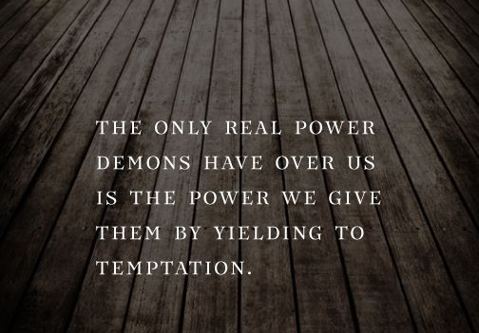

Slide 27
NUMBERS 13:30-33
And Caleb stilled the people before Moses, and said, Let us go up at once, and possess it; for we are well able to overcome it. 31 But the men that went up with him said, We be not able to go up against the people; for they are stronger than we. 32 And they brought up an evil report of the land which they had searched unto the children of Israel, saying, The land, through which we have gone to search it, is a land that eateth up the inhabitants thereof; and all the people that we saw in it are men of a great stature. 33 And there we saw the giants, the sons of Anak, which come of the giants: and we were in our own sight as grasshoppers, and so we were in their sight.

Slide 28
PROVING.HIS.WORD
101 Only two of them believed it, that was Joshua and Caleb. But, the circumstances that's what was what hindered them. Because, they said, "We're not able to take that land, because their cities are walled, their people are a great giants. Why, we look like grasshoppers, up aside of them."
103 God had give it to them, no matter how big the giants was. The obstacle meant nothing to [Joshua and Caleb], God had said so!
65-0426

Slide 29
MATTHEW 28:17
And when they saw him, they worshipped him: but some doubted. 18 And Jesus came and spake unto them, saying, All power is given unto me in heaven and in earth.
FAITH.IS.THE.SUBSTANCE
55 That's a hard word, isn't it? But it's the truth. He gave all the power and authority that He had to His Church, and you're just afraid to act upon it.
51-0508

Slide 30
THIRST
29 Now we find, God gives the control tower to you, to give to you the things that you need. Now, the control tower in you is what directs you… There is a control tower in the body, that tells you the need that's needed in your body, and it's brought to you by thirst.
Also, there is a control tower in your soul, that tells you the spiritual things that you have need of, something in your spirit, and, by this you can tell what kind of a life is controlling you.

Slide 31
30 When you can see what your desires are, then you can tell, by that, what kind of something that's in you, that's creating this desire that you have. See, there is a certain thing that you thirst for, and it can tell you in your soul what this desire is, by the nature of the thirst that you have.… We find there, what's a great trouble today, that too many people try to live between those two desires. For one of them desires the things of the earth, the other desires the things of Heaven.

Slide 32
33 Like Rom. 7:21, "When I would do good, then evil is nigh." Did you ever have that experience, Christians? That when you're trying to do something that's worth-while, go to make an effort to do something that's good, then you find out that there is the Devil, on every hand, just to upset you… And that's one good thing I'd like to say this, that Christians might know.
That when you are starting to do some-thing, and there is something always trying to upset you in doing it, do it anyhow. That's the Devil there, trying to keep you from doing what's right.
65-0919

Slide 33
SPOKEN.WORD.IS.THE.ORIGINAL.SEED.2
388 Now, the power of the believing Church. "Christ has all power in heavens and earth." Believe that? Now, what if He's in you?
Has Christ got all power? Matt. 28:18. He is the Seed-Word in His Body. And He, in us, becomes the Seed-Word in us. All that God was, He poured into Christ; and all Christ was, was poured into the Church.
62-0318

Slide 34
GOD.OF.THIS.EVIL.AGE
69 He raised me up with Him, in the resurrection. And now we are seated with Him, with power and authority over every devil. Oh, if you could only believe what God has given!
65-0801

Slide 35
ASHAMED
220 Then, if I'm a Christian, been filled with the Spirit, wearing the testimony of Jesus Christ's resurrection… don't let any devil try to push you around, "You don't do this and that." You do do It.
221 See, we don't have power. That policeman don't have power to stop one car… But he's got authority. And that's the Church. We have authority, by the resurrection of Jesus Christ and His promised Word, hallelujah, "The things that I do shall you do also; more than this will you do, for I go unto the Father.“
65-0711

Slide 36
CHURCH.AGE.BOOK
79-2 There He is with the seven stars in His right hand. The right hand or arm signifies the power and authority of God. Psalms 44:3, In that right hand of power are seven stars, who, according to Revelation 1:20, are the seven church messengers.
This signifies that the very power and authority of God are behind His messengers to every age. They go forth in the fire and power of the Holy Ghost with the Word.

