Slide 1
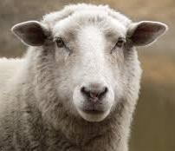
Sheep:
I COR. 12:13
For by one Spirit are we all baptized into one body, whether we be Jews or Gentiles, whether we be bond or free; and have been all made to drink into one Spirit.

Slide 2
THE.FAITH.THAT.WAS.ONCE.
DELIVERED.TO THE.SAINTS
25 And when you're borned of the Spirit of God, you become a son of God and a daughter of God. And without that you just belong to the church then. But when you're born again you belong to Christ, and we must be born again.
There's one fundamental doctrine that I believe. That's John 3.
53-1129

Slide 3
TO.WHOM.WOULD.WE.GO
78 Now, you're in the stage of glorification the moment you accept Jesus Christ as your Saviour… And then you'll be filled with the Spirit.
That'll give you power to live, live as Christians until the time of the restoration of all things when Jesus comes.
60-0606

Slide 4
EPHESIANS 4:8-11
Wherefore he saith, When he ascended up on high, he led captivity captive, and gave gifts unto men. (Now that he ascended, what is it but that he also descended first into the lower parts of the earth? 10 He that descended is the same also that ascended up far above all heavens, that he might fill all things.) 11 And he gave some, apostles; and some, prophets; and some, evangelists; and some, pastors and teachers;

Slide 5
BLIND.BARTIMAEUS
30 My ministry's not to minister to individuals. The thing of it is is to come together, set in heavenly places.
Then when you see God's Spirit moving, and you're sure that it's God's Spirit moving, then you just accept God where you are. Accept Jesus and healing will take care for its own then.
54-0402

Slide 6
Personal & Ministry Practices
MINISTRY.EXPLAINED
5 So I thought tonight I'd take it just a little easy, and preach twice tomorrow, and have one of those lines for Tuesday night…
I hope that pleases the Holy Spirit, and pleases the people. It's my desire always is to please God first, and then try to make burdens just as light for my fellow men as I possibly can.
56-1001

Slide 7
WARNING.THEN.JUDGMENT
104 But, you see, in the church there is the pastor, and that pastor is a special person. He's built to where he can put up with the fusses of the people. He's a burden-bearer; he's the ox of the team. He's a man that can set down when somebody's got something against somebody else, and set down with them two families, and take neither side, and reason it out, and bring it right back into sweetness. He's a pastor; he knows how to take care of things.
63-0724

Slide 8
I TIMOTHY 3:1-7
This is a true saying, If a man desire the office of a bishop, he desireth a good work. 2 A bishop then must be blameless, the husband of one wife, vigilant, sober, of good behaviour, given to hospitality, apt to teach; 3 Not given to wine, no striker, not greedy of filthy lucre; but patient, not a brawler, not covetous; 4 One that ruleth well his own house, having his children in subjection with all gravity; 5 (For if a man know not how to rule his own house, how shall he take care of the church of God?) 6 Not a novice, lest being lifted up with pride he fall into the condem-nation of the devil. 7 Moreover he must have a good report of them which are without; lest he fall into reproach and the snare of the devil.

Slide 9
THE.VOICE.OF.THE.SIGN
12 We believe that every Christian ought to have a home church they go to. Every Christian ought to meet somewhere with believers. And wherever you meet, that's the church…
Now that's a real pastor, that's looking out for all the spiritual benefits that he can, of everything God is a doing, that he is trying his best to help his church to move on for God. I certainly take off my hat in admiration for a pastor like that.
64-0321

Slide 10
CHRIST.IS.THE.MYSTERY
81 And stay with your pastor. See, he's the shepherd, and you give him respects. He'll lead you through, and, 'cause he's ordained of God to do so.
63-0728

Slide 11
I.HAVE.HEARD.BUT.NOW.I.SEE
80 (Job) He had only to be inspired, because he knowed his position that he was God's prophet. Now, the only thing that had to happen, was for the inspiration to strike him. And then he knowed what he said would happen, because it was by inspiration.
82 He had a channel of communication to God, that he'd got by inspiration.
He had a way of moving himself out, and letting God move in.

Slide 12
It was a gift, it was a gift for the people; not for Job, but for the people. That's what all Divine gifts are, to serve God's people with.
Everybody's not ordered to be a prophet. All of you is not ordered to be praying for the sick. All of them's not ordered to be pastors, so forth.
But it's a channel that God has opened to them... One man has no business deviating in the next man's channel, no matter how inspired...
65-1127

Slide 13
I CORINTHIANS 4:1-4
Let a man so account of us, as of the ministers of Christ, and stewards of the mysteries of God. 2 Moreover it is required in stewards, that a man be found faithful. 3 But with me it is a very small thing that I should be judged of you, or of man's judgment: yea, I judge not mine own self. 4 For I know nothing by myself; yet am I not hereby justified: but he that judgeth me is the Lord.

Slide 14
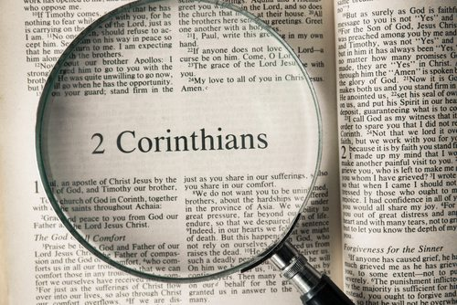
I CORINTHIANS 12:12
For as the body is one, and hath many members, and all the members of that one body, being many, are one body: so also is Christ. 13 For by one Spirit are we all baptized into one body, whether we be Jews or Gentiles, whether we be bond or free; and have been all made to drink into one Spirit. 14 For the body is not one member, but many.

Slide 15
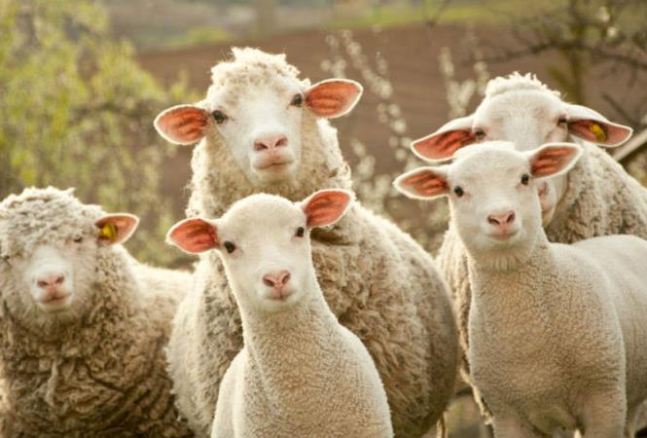
The Sheep

Slide 16
QUESTIONS.AND.ANSWERS
41 So I do not believe that I would be affiliated with a congregation who did not believe in the full Gospel of the Lord Jesus Christ, to believe that He was the same yesterday, today, and ever.
59-0628

Slide 17
HEBREWS.CHAPTER.THREE
28 There is something about where you go, what church you go to, and what teacher teaches you. Did you know that? It, it's got something to it.
Therefore we ought to seek out the very best that we can find, so we're getting the best; not because it's sociable and so forth, but the real Bible teaching.
57-0901

Slide 18
THE.GREAT.COMMISSION
33 Brother Vayle's my associate; he's my brother. He just happens to be making the arrangements for the meetings and helping me along…
We're just all one great big family and one big Body. We're not one above the other one; we're all just the same; we're a unit of God working together.
58-0301

Slide 19
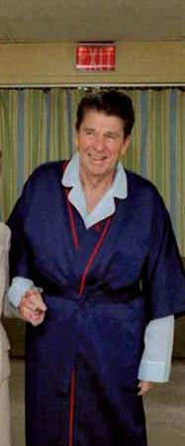
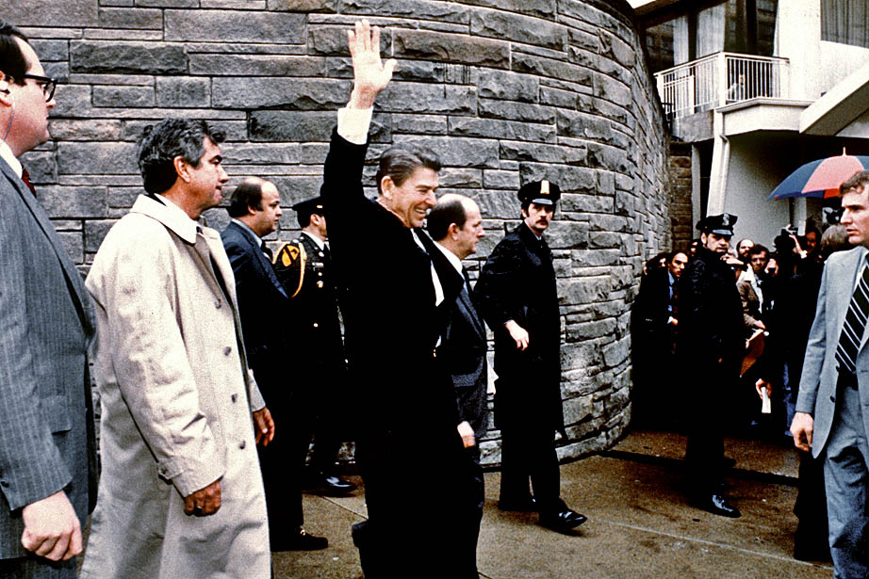

Slide 20
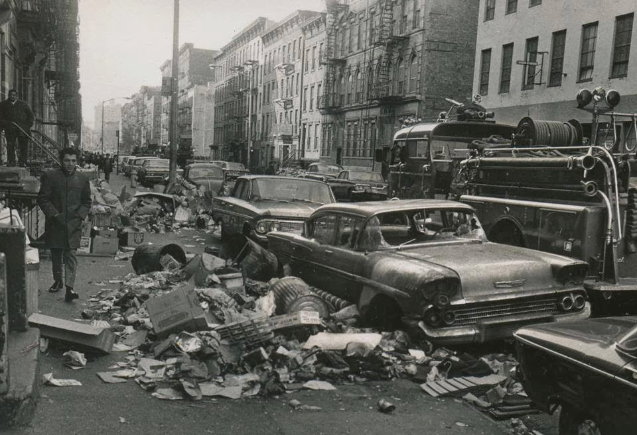
New York City
1968

Slide 21
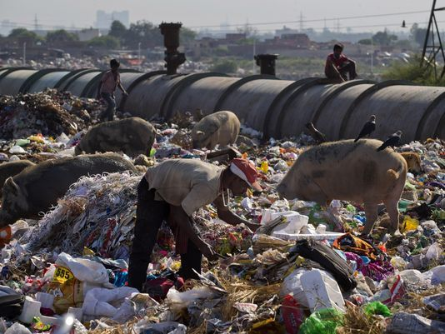

Slide 22
GOD'S.ONLY.PROVIDED.PLACE
237 Now, the family of God obeys the order of the Father of the family... And Him being Governor, King, Emmanuel, First, Last, Prince of Peace, the Mighty God, everlasting Father, every one of His children obey every Word to the order because they're a part of Him.
238 We live in our home like Branhams live. You live in your home like the Joneses live. And in the House of God we live by the Word of God and every One that proceedeth out of the mouth of God…
65-1128

Slide 23
GOD.USING.HIS.GIFT
18 ...Any Christian will think of others before himself. Every Christian tries to put God first, his family second; he's number three. I've tried to make that a practice in my own life.
56-0311

Slide 24
CHRIST
MAN
But I would have you know, that the head of every man is Christ; and the head of the woman is the man; and the head of Christ is God.
I Cor. 11:3
WIFE

Slide 25
COLOSSIANS 3:19-20
19 Husbands, love your wives, and be not bitter against them. 20 Children, obey your parents in all things: for this is well pleasing unto the Lord.

Slide 26
TRUE.SIGN.THAT'S.OVERLOOKED
…Elijah was positive. "THUS SAITH THE LORD, that barrel will not fail, neither will that cruse run dry until the day that God sends rain upon the earth." That ought to have been enough sign for her. She represents the church today… She had a little boy. He got sick. His sickness was so bad till there's no breath left in him; he died.

Slide 27
Then what did she do? The church had already seen those signs. As soon as a little disaster comes, quickly she wants to blame the church for it, blame Elijah.
Elijah took the son, went up into the loft where he was sleeping up there, laid him upon his own bed, stretched hisself over, and said, "Lord God (Hallelujah.), send back the soul of this boy." And the baby woke up.

Slide 28
He took it back down, that woman looked at the baby, looked at him; then she knowed something was there; said, "By this I know that the Word of God's in your mouth." He was a sign to that widow. When she seen the power of God, Who makes alive or can kill, raise her dead baby to life, she said, "By this, I know that you're a man of God." She knew it… Them prophets are always signs of God.

Slide 29
I Cor. 12:5
And there are differences of administrations, but the same Lord…
Administration: (Gr.) diakonia
The ministration of those who render to others the offices of Christian affection, especially those who help meet needs;
The office of the deacon in the church;
The service of those who prepare and present food.

Slide 30
Pulpit
Congregation

Slide 31
Example: THINKING.ON.OUR.WAY
9 (Bob Ingersol) dying in his hospital room, he screamed, "Oh God, if there be a God, have mercy on me." You might say some great things while you're feeling good, but when death comes knocking, you're going to change your opinion.
I've seen many men who didn't care for church, for God, and nothing that was right. But just let them get in trouble, the doctor says there's a cancer eating you to pieces. They'll hunt for somebody to pray for them right quick. God has a way of making you recognize Him.
59-0706

Slide 32
AT.THY.WORD
3 A person who lives their life for theirself, lives a selfish life. We must live for others: "Bear ye one another's burdens and so fill full the law of Christ." And we got to have a feeling for one another… I can't make everyone believe.
That's impossible. Jesus couldn't do that when He was on earth. And I know there'll just be a few that believes. But if anything I can add to help the Gospel, that's my duty of being here, is to try to help somebody along the way.
50-0714

Slide 33
I CORINTHIANS 12:25-26
25 That there should be no schism in the body; but that the members should have the same care one for another. 26 And whether one member suffer, all the members suffer with it; or one member be honoured, all the members rejoice with it.

Slide 34
BELIEVEST.THOU.THIS
44 (Mary & Elizabeth) I like that. I hate that old, cold, formal way we got. People today, so far away from one another, don't care for one another. Even church members get the same way. They don't care for one another. Why, if anybody does anything wrong, trying to shove him down. Don't shove him down; pick him up; help him. Don't try to criticize him and tell somebody else; go to him with your arms around him.
50-0716

Slide 35
GALATIANS 6:1-3
1 Brethren, if a man be overtaken in a fault, ye which are spiritual, restore such an one in the spirit of meekness; considering thyself, lest thou also be tempted. 2 Bear ye one another's burdens, and so fulfil the law of Christ. 3 For if a man think himself to be something, when he is nothing, he deceiveth himself.

Slide 36
DIVINE.HEALING
72 Now, there's no need of fighting. God takes care of all things. Return good for evil, all the time. When anybody speaks good about you, be thankful. If anybody speaks bad about you, bless them anyhow…. Now, you can see a brother doing wrong, and try to guide him, but if he won't listen, then the only thing to do is love him, anyhow, and pray for him.
54-1219

Slide 37
HE.CARETH.FOR.YOU
48 The Lord's Body is the Church. And we do not have spiritual discernment enough to care for one another. How can we care [of the lost and dying] if we can't care for each other? "Cast our cares upon Him, for He careth for you…” God made man to be happy, to have satisfaction, to be comforted. God doesn't want His children to be uncomfortable. Why, you mothers would get up in the middle of the night… because your children mean something to you. They're a part of you; they're your life.
52 And the Church is the Life of God on earth, and He wants to comfort His Church… There's many remedies, but one Cure… He cares for us.

Slide 38
He loves us, He wants us to come to Him. God made us that way, that holy thing in us that wants to be comforted.
55 God gave man a wife to comfort him, to touch him. And any man knows, that's got a good wife, there's something about a good wife that can... A man be upset in his business or walk of life, and come home; no matter, there's no one, no doctor… It is that way with me… And just a few little pats from the wife mean so much: same thing, a husband to a wife. That's the way God wants it to be.

Slide 39
58 And when we substitute something for that, and you'll get some other woman to try to take that place, or some other man, you see what you do. Now, He give us friends. We should be friends. We should be brothers. And how that it's good to go to a good friend in time of trouble and say, "Oh, friend of mine, certain-certain thing has happened."
And a good, trusted friend to set down and talk with you, that's wonderful. That's of God. Just like your wife is of God, your husband, when you're true. 60-0301

Slide 40
THIRSTING.FOR.LIFE
65 Now, we're in a unity; an agreement. We're Christians; the Holy Spirit's here, that great Angel of God… That same Angel of God is right here now in this building… Now, don't pray for yourself; pray for the person you got your hands on. You pray for the next man; he's praying for you. And you be praying for one another, and while I pray for you, that'll make the chain here, and God will heal every person here. There will not be one sick person left in our midst, if you'll just believe. 60-0304

Slide 41
BLIND.BARTIMAEUS
46 And I would that you'd just lay your hands on someone near you. The Scripture said, "These signs shall follow 'them' that believe. They shall lay 'their' hands on the sick; they shall recover." And you all are believers. And each one of you start praying right out, as you would in church, asking God to heal the person next to you. And while you're asking healing for them, healing shall come to you. Now, start praying for one another, that God will heal one another.
54-0402

