Slide 1
Love’s Enduring Foundation 4
PSALM 16:11
Thou wilt shew me the path of life: in thy presence is fulness of joy; at thy right hand there are pleasures for evermore.

Slide 2
Birthdays & Anniversaries & Exciting Events
June 23rd HBT Family Day
Stephen & Sarah Coffey and Billy Ivy
May 10th Angela Pritchard, Jen Irish
May 8th Jackie Sylvester, Carrie Whitlock
May 9th Mitchel Buchanan
May 13th Gabe Gunter
May 14th Nathan Brown
May 18th Mary Ann Roy
May 19th Danny & Kaitlyn Florian

Slide 3
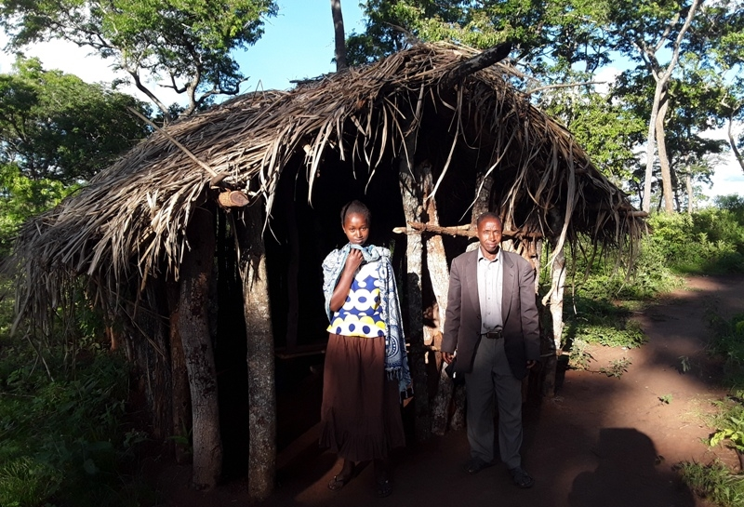
Msunga Church
Tanga, TZ

Slide 4
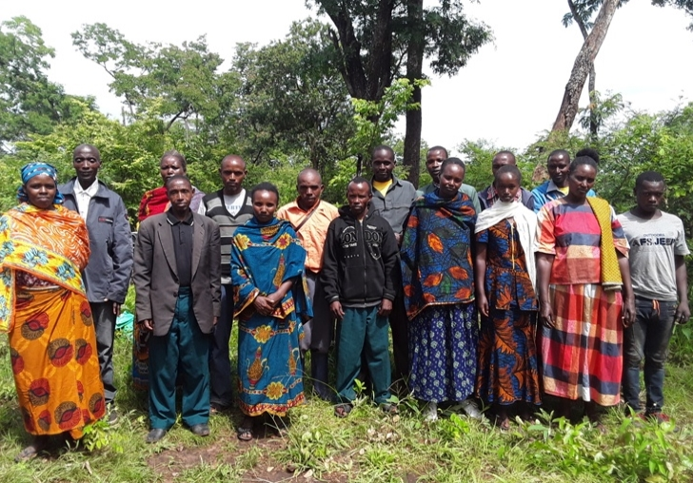

Slide 5
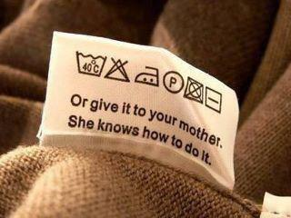
EXODUS 2:10
And the child grew, and she brought him unto Pharaoh's daughter, and he became her son. And she called his name Moses: and she said, Because I drew him out of the water.
Mother’s Day

Slide 6
Love’s Enduring Foundation 4
John 14:15
If ye love me, keep my commandments.

Slide 7
Can Love last a lifetime?
KINSMAN.REDEEMER
45 And when a man loves a woman and marries her because she's just pretty, there'll be an end to that. But when a man finds a woman that he loves, he don't know why, but he loves her... And she finds the man that she loves, no matter what he looks like... He loves her. She loves him. That's an eternal mate in glory… Because they are from eternity, and they stepped out into space of time, and will return back to eternity.

Slide 8
THE.GREAT.COMMISSION
7 I believe if we'll all get together, pray together, stand together, that God will bless us together. Don't you think so? I believe He will, if we'll put forth an effort now…
It takes all of us together. I need you, and we all need God. So we need each other and we need God.
57-0804

Slide 9
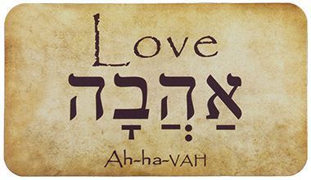
aHaVaH= To Give
CHiBa = Love & Affection
CHoVa = Obligation, to Give.

Slide 10
DEUTERONOMY 6:5
And thou shalt love the LORD thy God with all thine heart, and with all thy soul, and with all thy might.
אתה תאהב את אלוהים בכל הלב שלך
את= AZ
Intense, eternal, all-encompassing

Slide 11
LEVITICUS 19:18
Thou shalt not avenge, nor bear any grudge against the children of thy people, but thou shalt love thy neighbour (friend) as thyself: I am the LORD.
לויציקוס 19:18
אבל אתה אוהב ל לאהוב השכן כמוך: אני יהוה.
ל=loving action, finite; the things you would expect if the roles were reversed.

Slide 12
Example:
EPHESIANS 5:25
Husbands, love your wives, even as Christ also loved the church, and gave himself for it;

Slide 13
FAITH.IN.THE.SON.OF.GOD
4 There might've been one more girl in the world that I could've married. But you know, I found the one lady that I really love. And I asked her if she thought that much of me. She said "Yes." So we got married.
I told her, "Now, look, all my love I give to you." No matter what other women are, that woman has my love. Perhaps, I go down the street, and here comes a more attractive girl than my wife. And she says, "Oh, Billy, I really love you with all my heart."

Slide 14
Now, the first place, if she has a love for me, it's bound to be false, 'cause my first duty is to what I pledged to my wife, that's her first. I've got to think of her first. She's my first. I told her I'd give her all my love.
And then my first duty is to my wife. I'd say, "Now, look, sister. See, you're just infatuated, or something, because you're not in love. And I'm not in love with you. Because I love one woman; that's the mother of my children." That's my first duty.
52-0715

Slide 15
HEBREWS 13:4-5
Marriage is honourable in all, and the bed undefiled: but whoremongers and adulterers God will judge. Let your conversation be without covetousness; and be content with such things as ye have: for he hath said, I will never leave thee, nor forsake thee.

Slide 16
Hebrews 13:4-5
J.B. Phillips New Testament
⁴⁻⁵ Both honourable marriage and chastity should be respected by all of you. God himself will judge those who traffic in the bodies of others or defile the relationship of marriage. Keep your lives free from the lust for money: be content with what you have. God has said: ‘I will never leave you nor forsake you’.

Slide 17
Hebrews 13:4-5
Complete Jewish Bible
⁴ Marriage is honorable in every respect; and, in particular, sex within marriage is pure. But God will indeed punish fornicators and adulterers.
⁵ Keep your lives free from the love of money; and be satisfied with what you have; for God himself has said, “I will never fail you or abandon you.”

Slide 18
Pillars of Marriage relationships

Slide 19
1. respect each other, even when you disagree.
Name calling and contempt aren’t how you should operate. Instead, you maintain a respectful tone even during your most difficult conversations.
If you can respect your partner no matter what, this shows that your relationship can withstand many things.

Slide 20
IT.IS.I
19 Love... You let your wife know that you love her; she loves you. When you're young and you find favor with one another, it makes you join yourselves together for a lifetime journey: Love, and that's phileo love; human love.
What will Agapao love do, when you can really get into a place that you can show God that you love Him and you got confidence in Him? How you'll join yourself to Him, not only for a life's journey, but for eternity.
60-0720

Slide 21
2. Talk Straight & Fight Fair.
At the early stages, you may resist getting differences out in the open, looking them straight in the eye, and having a dissagreement when necessary. Instead, you may ride the relationship like a two-person bicycle that will topple over if there’s not perfect agreement and togetherness.
The more of your authentic self you bring into the relationship, and the less you silence your authentic voice to avoid the possibility of conflict or disapproval, the more solid the foundation of your relationship.

Slide 22
QUESTIONS.AND.ANSWERS.3
326. Brother Branham, I love the Lord, but for the past year I have been faced with a problem. Seems sometimes I've almost been out of my mind. What is it? Please pray for me and my husband.
If this person was on private interview, it would pull that out what it is, whatever it is. The Lord would reveal what it is. Now, if there's something that you have done that's wrong, that's bothered you, then check it with the Bible and see what you must do.

Slide 23
But if you haven't done anything and you're not condemned of anything, it's perhaps your nerves. It could be many things that happened: maybe some trouble back in your life.
Maybe it's a woman here might be in the menopause time. That's when everything is wrong with her, and there's nothing wrong with her, yet everything's wrong with her. And she's not just putting on; she really feels that; it's just as real. Any person that's nervous is that way. And don't never disagree.
64-0830

Slide 24
3. You’re Not Looking to Your Spouse To Make You Happy.
In general, marriage doesn’t make anyone happier. We enter marriage with a sort of baseline happiness, and marriage doesn’t fundamentally alter that.
PSALM 16:11
Thou wilt shew me the path of life: in thy presence is fulness of joy; at thy right hand there are pleasures for evermore.

Slide 25
NEHEMIAH 8:10
Then he said unto them, Go your way, eat the fat, and drink the sweet, and send portions unto them for whom nothing is prepared: for this day is holy unto our Lord: neither be ye sorry; for the joy of the LORD is your strength.

Slide 26
BELIEVEST.THOU.THIS
9 There's a land somewhere that... one out of every ten thousand Christians knows no more about but just by faith to believe about it. But there's a place that a human being, while yet in here, can be lifted up into that spot.
Now, it is not a rejoicing time like you just lifted up in joy. I seen much joy, not enough real solid faith to cure a toothache. That's the joy of the Lord, not the power of the Lord. I want more joy of the Lord. That's what I desire. And that's what you have need of.
51-0506

Slide 27
SIRS.WE.WOULD.SEE.JESUS
16 There's a little place in a man's heart or a woman's heart, and God made that place for Himself. How dare you to try to take the things of the world and put it in there where God made for Himself to set there.
God is our joy. God is our pleasure. God is our satisfaction. That's where it belongs, in here; let God in, and then the other things are so dead, you don't even care nothing about them no more.

Slide 28
DOOR.TO.THE.HEART
60 We're strangers? If the Lord God will reveal to me what you're here for... I don't know; I never seen her. But if Jesus Christ is the same yesterday, today, and forever, if she needs healing, God's already done it. If she needs salvation, Christ already prepared it.
Anything she has need of, Christ is our Portion. But now, for me to give it to her, I can't. I couldn't do it, but Christ can, on one basis: if her faith will believe it.
58-0302

Slide 29
BROKEN.CISTERNS
117 And when the people want joy today, what do they do? Instead of accepting the joy of the Lord, they turn to sin, for joy. People who go to church and claim to be servants of Christ, when they get real nervous they'll light up a cigarette. (Immoral cloths) They do everything to be popular. They want to look like the movie stars. That's their joy.
Jesus said, "I am their sufficiency… they don't want to drink from that Fountain. They have turned It down.
64-0726

Slide 30
WATCHMAN.WHAT.OF.THE.NIGHT
57 Oh, isn't He wonderful? I remember one time when I had a date with a minister's sister. She said, "Where will we go tonight, Billy?“
I said, "Well, let's just go out and ride around somewhere."
She said, "Let's go to a movie.“ I said, "I don't go to movies."
She said, "Well, there's a dance down at the Odd Fellows Hall.“ I said, "I don't go to dances.“

Slide 31
She said, "Now, you said you didn't smoke; you didn't drink; you didn't dance; you don't go to movies. What do you like to do for a pastime?"
"I like to fish, and hunt, and things like that." But that didn't interest her. And she said, "Where do you get any joy?“ I said, "the joy of the Lord is my joy.“
And a few nights after that, I was in the tent meeting. Started... And the girl was there. And I made an altar call, and souls swarmed up around that altar. I seen her setting back there crying.

Slide 32
I said, "Come here, Helen." And she came up to where I was.
I said, "You want to know what joy I have? This is worth more to me than all the movies and all the dances. It's the joy of the Lord; it's a peace that passes understanding. I know that someday I'll meet these people in glory. They'll all be saved and be over there; and that's the joy I have.“
60-0722

Slide 33
4. You Accept That The Person You Chose Is Not Perfect.
You’re not perfect and neither is your partner. If there a red flags at the outset — say, a partner who lies or treats you with disrespect — you’re wise to think twice.
But the ordinary challenging stuff — his car is like a dump, or she loves shopping too much — isn’t going to disappear once you say ‘I do.’ The key is to appreciate the person and find peace with what’s less than ideal.

Slide 34
Communication is the number-one problem for couples. None of us are perfect at it, but when we can talk about difficult topics like money, kids, religion or politics, and do so respectfully, we’ve got a good foundation for a happy future together.

Slide 35
יָדִיד (yud, dalet, yud, dalet)
Friend, fellow, pal, beloved.
יד = Hand
1. Friends will move toward each other the things that are required for health, prosperity, and the others’ welfare.
2. One must graciously learn to accept an extended hand.

Slide 36
ShuLChaN = Table
SHul = “The Place of”
CHaN = Grace
1) To Rest in One Place;
2) Economic Activity.

Slide 37
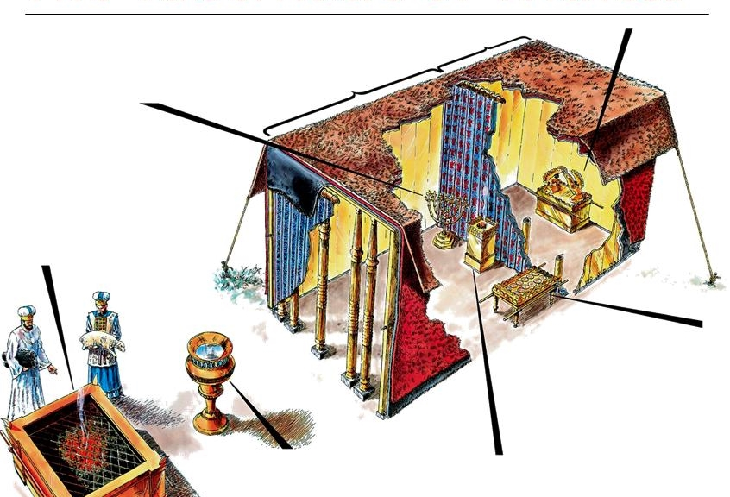

Slide 38
EXODUS 29:41-43
And the other lamb thou shalt offer at even, and shalt do thereto according to the meat offering of the morning, and according to the drink offering thereof, for a sweet savour, an offering made by fire unto the LORD. 42 This shall be a continual burnt offering throughout your generations at the door of the tabernacle of the congregation before the LORD: where I will meet you, to speak there unto thee. 43 And there I will meet with the children of Israel, and the tabernacle shall be sanctified by my glory.

Slide 39
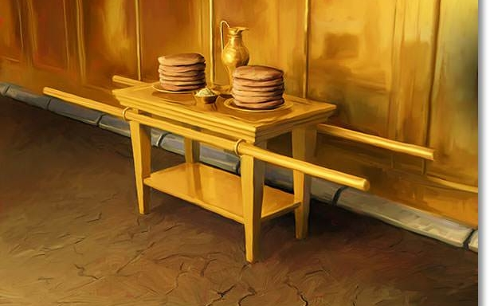
Table of Shewbread

Slide 40
EXODUS 33:2
And I will send an angel before thee; and I will drive out the Canaanite, the Amorite, and the Hittite, and the Perizzite, the Hivite, and the Jebusite:

Slide 41
II SAMUEL 9:11, 13
Then said Ziba unto the king, According to all that my lord the king hath commanded his servant, so shall thy servant do. As for Mephibosheth, said the king, he shall eat at my table, as one of the king's sons.
13 So Mephibosheth dwelt in Jerusalem: for he did eat continually at the king's table; and was lame on both his feet.

Slide 42
PSALM 23:5-7
Thou preparest a table before me in the presence of mine enemies: thou anointest my head with oil; my cup runneth over.
REVELATION 19:9
And he saith unto me, Write, Blessed are they which are called unto the marriage supper of the Lamb. And he saith unto me, These are the true sayings of God.

Slide 43
LIFE
56 We're going to meet at a supper someday. That's a wedding supper, when that great table is stretched across the skies, reaching from sky to sky. We look across the table one to another, there's bound to be a little tear drop from our cheeks, as we think, as we shake each other's hand, say, "I remember the Salem meeting. Here's Bro. So-and-so, was the one that come in at that time, one down here.” Then the King in His beauty will walk out in His white robes
62-0719

Slide 44
5. You Have A Good Relationship With Your In-laws.
All marriages are indirectly a marriage between two families. We bring our families with us, physically or symbolically, whether we want to or not. When the in-law connection works well, it can help protect the couple during stressful times.
Conversely, fractured in-law relationships, especially if they become chronic, usually stress the couple — sometimes beyond their endurance.

Slide 45
6. You Share How Much You
Love Each Other.
Partners who are in the habit of telling one another what they appreciate about each other have a solid foundation. If they see something positive, they point it out.
When we appreciate the positives we avoid the very negative habit of scanning for the negatives, which results in contempt — one of the strongest predictors of divorce.

Slide 46
CHURCH.AND.ITS.CONDITION
35 God, wanting to make love, had to make something lovable, gentle like Himself. He had to make something that could be loved, something of His Own nature.
37 You couldn't love nothing that wasn't of your own nature. Loving has to unite with love. A husband and wife has to love one another, family has to love one another. You search everywhere, find a girl to be your wife that you love. She searches, finding a husband that she could love. And God searches, trying to find a soul that He can love. 56-0805

Slide 47
MATTHEW 6:33-34
But seek ye first the kingdom of God, and his righteousness; except when you’re choosing someone to marry. In that case, you should follow your emotions, insist on a thrilling romantic attraction and overall compatibility that makes the relationship fun, and all these things shall be added unto you.
34 Take therefore no thought for the morrow: for the morrow shall take thought for the things of itself. Sufficient unto the day is the evil thereof.

