Slide 1
The Open Book 2
REVELATION 10:1-2
Blessed is he that readeth, and they that hear the words of this prophecy, and keep those things which are written therein: for the time is at hand. REVELATION 1:3

Slide 2
Uniting.Time.And.Sign
Never before, since the early church age, was the pillar of fire ever among the people. Never before, since the early church age, did they ever see the things that we are seeing today. And this was only made possible when God sent the Seven Seals…
63-0818

Slide 3
JUDGES 10:13-14
Yet ye have forsaken me, and served other gods: wherefore I will deliver you no more. 14 Go and cry unto the gods which ye have chosen; let them deliver you in the time of your tribulation.
MODERN.EVENTS
Father, as we open this Word, speak to us directly out of this Word, that we might know the hour that we're living. If we know the hour we're living, then we can prepare for that hour; but if we go in blindly not knowing what or where, then we don't know how to prepare.
65-1206

Slide 4
“You are entitled to your own opinion, But you are not entitled to your own facts.”
Sen. Daniel P. Moynihan
John 8:30-31
Then said Jesus to those Jews which believed on him, If ye continue in my word, then are ye my disciples indeed; 32 And ye shall know the truth, and the truth shall make you free.

Slide 5
Absolute
227 The red light settles the case, tells you who goes. No matter what anybody else says, it’s what the red light says. You can really have a traffic jam if you don’t mind the red light. There must be an absolute. Just like to the Church, there has got to be an absolute. To the people in the Church, you’ve got to have your absolute. But, today, each church has its own absolute. And don’t try to take, “We Baptist believe this. We Methodists believe this.” That’s all right, but why don’t you take the rest of It? 62-1230

Slide 6
Absolute
62 But the word absolute is “an ultimate.” And, therefore, I think that everybody should have an ultimate. And every great achievement that’s ever been achieved, there has been an absolute behind it.
And every person, in order to achieve something, has to first have the absolute. And that’s the final wind back, through this, that, the other, till you come to that absolute, or the amen, or the ultimate. 62-1230

Slide 7
II KINGS 22:1
Josiah (whom Jehovah heals) was eight years old when he began to reign, and he reigned thirty and one years in Jerusalem. And his mother's name was Jedidah, the daughter of Adaiah of Boscath.
II KINGS 22:11
And it came to pass, when the king had heard the words of the book of the law, that he rent his clothes.

Slide 9
II KINGS 22:18
But to the king of Judah which sent you to enquire of the LORD, thus shall ye say to him, Thus saith the LORD God of Israel, As touching the words which thou hast heard; 19 Because thine heart was tender, and thou hast humbled thyself before the LORD, when thou heardest what I spake against this place, and against the inhabitants thereof, that they should become a desolation and a curse, and hast rent thy clothes, and wept before me; I also have heard thee, saith the LORD. 20 Behold therefore, I will gather thee unto thy fathers, and thou shalt be gathered into thy grave in peace; and thine eyes shall not see all the evil which I will bring upon this place. And they brought the king word again.

Slide 10
The.Unveiling.Of.God
184 It's been veiled through these ages, according to what God said, and it will be opened in the last days, those Seven Seals would be broke, and the full thing would come into view of the people, what's took place all along. The hour of the seventh angel's message, all the mysteries of God should be made known in that Elijah, this last hour.
64-0614

Slide 11
THE.FIRST.SEAL 63-0318
119-2 And now as we study this… The first three books of Revelations is the Seven Church Ages. Now, there's seven church ages, seven seals, seven trumpets, and vials, and unclean spirits like frogs, and all this goes together. My, how I'd like to have a great big map and draw it all across the way I see it, you know; just how that each one takes its place. I drawed it out on a little sheet of paper …And everything so far hit just exactly right. And with the time and the ages as they have come and gone and everything has blended in just perfectly right.

Slide 12
COLOSSIANS 1:16-18
16 For by him were all things created, that are in heaven, and that are in earth, visible and invisible, whether they be thrones, or dominions, or principalities, or powers: all things were created by him, and for him: 17 And he is before all things, and by him all things consist.
18 And he is the head of the body, the church: who is the beginning, the firstborn from the dead; that in all things he might have the preeminence.

Slide 13
DANIEL 12:4, 8 – 9
But thou, O Daniel, shut up the words, and seal the book, even to the time of the end: many shall run to and fro, and knowledge shall be increased.
And I heard, but I understood not: then said I, O my Lord, what shall be the end of these things? 9 And he said, Go thy way, Daniel: for the words are closed up and sealed till the time of the end..

Slide 14
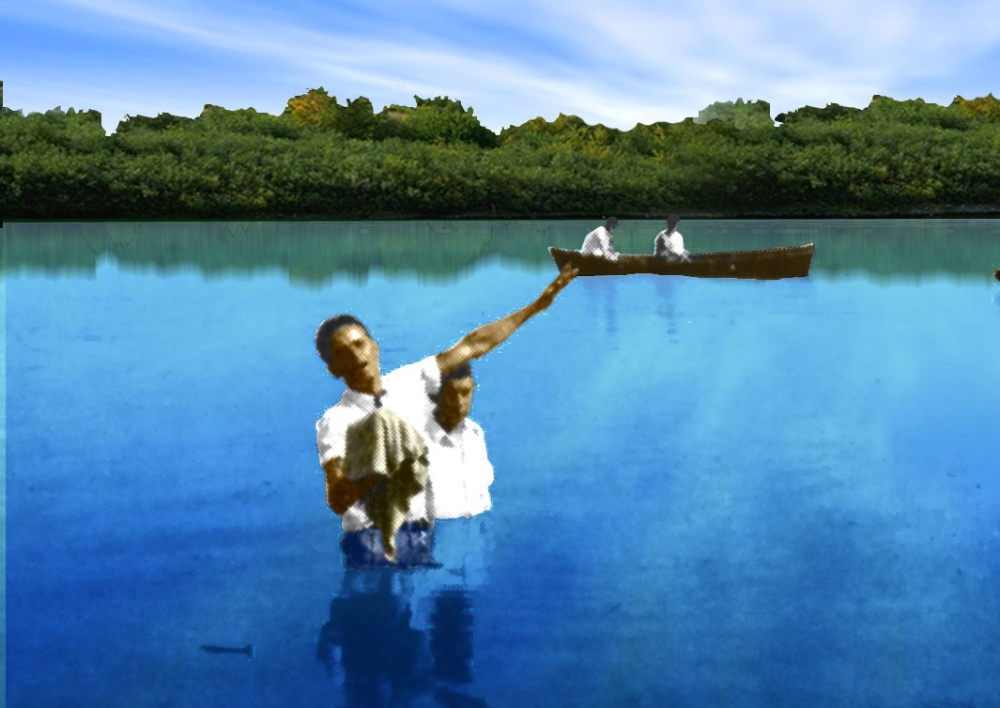
DO.YOU.NOW.BELIEVE
Recently when I was baptizing on the river at Jeffersonville… here It come right down out of the heavens, right at two o'clock in the afternoon, hung right over where I was, and a Voice from It, saying, "As John the Baptist was sent to warn the people of the first coming of Christ, so is this Message to warn the people of the second coming.” 52-0817

Slide 15
EPHESIAN.CHURCH.AGE
79-2 In that right hand of power are seven stars, who, according to Rev. 1:20, are the seven church messengers. This signifies that the very power and authority of God are behind His messengers to every age. They go forth in the fire and power of the Holy Ghost with the Word. They are stars because they reflect light. The light they reflect is His light. They have no light of their own.

Slide 16
ROMANS 11:25
For I would not, brethren, that ye should be ignorant of this mystery, lest ye should be wise in your own conceits; that blindness in part is happened to Israel, until the fulness of the Gentiles be come in.
LUKE 21:29-31

Slide 17
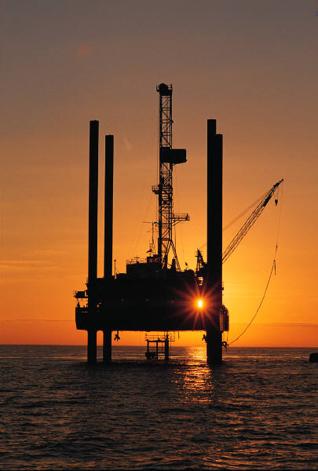
We see the Jews now..... The prophet spoke, "That day water will come from the north." There was no water there then, no springs, but in the last few years there's a gusher come up watering the valleys, irri-gating one of the greatest agrcultural spots for its size in the world. And all these great chemicals right in the Dead Sea, there's enough chemicals found in the bottom of it that all the wealth of the world couldn't buy: uranium and everything, right in the bottom of the Dead Sea, which now belongs to Israel.
BEGINNING.ENDING.GEN-TILE.DISPENSATION
55-0109

Slide 19
REVELATION 5:1-4
1 And I saw in the right hand of him that sat on the throne a book written within and on the backside, sealed with seven seals. 2 And I saw a strong angel proclaiming with a loud voice, Who is worthy to open the book, and to loose the seals thereof? 3 And no man in heaven, nor in earth, neither under the earth, was able to open the book, neither to look thereon. 4 And I wept much, because no man was found worthy to open and to read the book, neither to look thereon.

Slide 21
TRYING.TO.DO.GOD.A.SERVICE
As Abraham of old looked for the promised son, seeing those last signs of God come down on the earth, then he knew that it wouldn't be long until the son would arrive. And now we see it repeat again. Jesus told us , "When these things begin to come to pass, to lift up our heads, our redemption was drawing nigh,” perplexity of the time, distress between nations, earthquakes in divers places, the sea roaring, man's heart failing for fear.“ We realize that we're in that hour, when the nations don't know what to do.
65-0718M

Slide 22
Current View of the Temple Mount

Slide 23
Proposed
3rd Temple
Design

Slide 25
SEED.IS.NOT.HEIR.WITH.THE.SHUCK 101 But at the opening of the Seven Seals, Rev. 10, the full Word is to be born into manifestation again, and vindicated by the Spirit of God, in the full strength as It was when He was here on earth; manifested in the same way, doing the same things that It did when It was here on earth. Hebrews 13:8.
65-0218

Slide 26
THE.FEAST.OF.THE.TRUMPETS
113 He shall appear in the last days, is to bring the people back to the Word, so that the Bride will know Her Husband, know Her Mate, the revealed Word.
114 It wasn't in the reformers; wasn't in Luther, Wesley, Pentecostals, Scripture says it wasn't. But it will come. That is His promise for this age. We're living in the age that His Coming will be in. 64-0719

Slide 27
WHO.DO.YOU.SAY.THIS.IS ?
64-1227
155 Look what the Lord God has done. Started off in great signs, and wonders, and miracles, which we all enjoyed. Then watch... Then come the Message behind it.
156 Watch what's taken place. Walking along, not just by yourself, man along with you. See a cluster of Angels come from the Heavens, shake the whole earth, just stand there.

Slide 28
I THESSALONIANS 5:1-3
1 But of the times and the seasons, brethren, ye have no need that I write unto you. 2 For yourselves know perfectly that the day of the Lord so cometh as a thief in the night. 3 For when they shall say, Peace and safety; then sudden destruction cometh upon them, as travail upon a woman with child; and they shall not escape.

Slide 29
Seasons: (Gr.) kairos
A fixed and definite time, when things are brought to a crisis, the decisive epoch waited for, opportune or seasonable time; the right time;
Example: Matt. 13:30 Let both grow together until the harvest: and in the time of harvest I will say to the reapers, Gather ye together first the tares, and bind them in bundles to burn them: but gather the wheat into my barn.
EPHESIANS 1:10 That in the dispensation of the fulness of times he might gather together in one all things in Christ, both which are in heaven, and which are on earth; even in him:

Slide 30
Satan’s Eden
The Kingdom of God

Slide 31
SEED.IS.NOT.HEIR.WITH.THE.SHUCK
149 Then what is it now? "We must be about the Father's business," the Wheat would cry back, the Grain. What must it do? Vindicate Mal. 4, vindicate Luke 17:30, Heb. 13:8, Jn. 14:12, vindicate all of His Word. Vindicate Rev. 10, the opening of the Seven Seals, and the mysteries of God; even to serpent's seed, and would be manifested; marriage and divorce and all these other mysteries that's been hid under the pillars for all these years, from the theologians and so forth, but it's now the hour. That's the Father's business.
65-0218

Slide 32
Time Line
“So likewise ye, when ye see these things come to pass, know ye that the kingdom of God is at hand.”
Luke 21:31
Israel at the United Nations
WCC- Amsterdam
NATO Formed
1930
1950
1960
1940
7 Seals
Pillar of Fire Appears
Angel in Cave
America Spurns Mercy
Millennium

Slide 33
SEED.IS.NOT.HEIR.WITH.THE.SHUCK 128 They (Christians) want the Word of God, fresh, the promise of the hour. God promised rabbits in the days of Luther. He promised other things in the days of others. But now He promised us a full square Meal, the full seven course Menu, for all the Seven Seals are opened, and everything is ready for the Word of God, to those who can receive...
65-0218

Slide 34
TALK.ON.THE.WORD
24 ...And I believe that the age has come now, the miraculous, the phenomenal, the baptism of the Spirit, and power, and signs, and wonders, this great pouring out of God's Spirit in the last days, and that's the thing that'll bring faith into the people that'll take a rapturing faith that'll take the Church into glory.
53-0831

Slide 35
QA.ON.THE.SEALS 63-0324
34. After the rapture has been taken place, will any of the church be saved in the end who was not taken in the rapture?
No. Huh-uh, 'cause the Blood's done left. You see, there'll be no intercessions; the Gentile age is finished. There'll be no one saved after the rapture, none of the church. The church... "Let him that's filthy be filthy still, him that's holy be holy still.“ That won't take place, not after the Church is gone.

Slide 36
We see the Jews now..... The prophet spoke and said, "That day that water will come from the north." There was no water there then, no springs there then, but in the last few years there's a gusher come up and is watering the valleys. And they're irrigating is one of the greatest agricultural spots for its size in the world. And all these great chemicals right in the Dead Sea, there's enough chemicals found in the bottom of it that all the wealth of the world couldn't buy, of chemicals, uranium and everything else, right in the bottom of the Dead Sea, which now belongs to Israel.
BEGINNING.ENDING.GENTILE.DISPENSATION
55-0109

Slide 37
THIS.DAY.THIS.SCRIPTURE.IS.FULFILLED
44 How accurate is the Scripture! Notice Is. 61:1-2, where our Lord was reading from... But in the middle of the 2nd verse He stopped, "The Spirit of the Lord is upon Me…" then He stopped. Why? The other part, to bring judgment, didn't apply to His first coming, but His second Coming.
How the Scriptures never make a mistake! They are always perfect. Jesus stopped just where the Scripture stopped, 'cause that was exactly what was to be vindicated in His day, now, in that first coming. The second Coming He will bring judgment upon the earth; but not then.

Slide 38
ISAIAH 61:1-3
The Spirit of the Lord GOD is upon me; because the LORD hath anointed me to preach good tidings unto the meek; he hath sent me to bind up the broken-hearted, to proclaim liberty to the captives, and the opening of the prison to them that are bound; 2 To proclaim the acceptable year of the LORD, and the day of vengeance of our God; to comfort all that mourn; 3 To appoint unto them that mourn in Zion, to give unto them beauty for ashes, the oil of joy for mourning, the garment of praise for the spirit of heaviness; that they might be called trees of righteousness, the planting of the LORD, that he might be glorified.

Slide 39
45 Notice the Messiah standing in the platform, to identify Himself with the Word of promise for that age… "The acceptable year," as we all know, as Bible readers, was "the year of jubilee." That, when all slaves and prisoners, as they were, been taken, prison; and had to give a son, to pay a debt; or a daughter, to pay a debt, and they were in bondage.

Slide 40
LEVITICUS 25:8-13
8 And thou shalt number seven sabbaths of years unto thee, seven times seven years; and the space of the seven sabbaths of years shall be unto thee forty and nine years. 9 Then shalt thou cause the trumpet of the jubile to sound on the tenth day of the seventh month, in the day of atonement shall ye make the trumpet sound throughout all your land. 10 And ye shall hallow the fiftieth year, and proclaim liberty throughout all the land unto all the inhabitants thereof:

Slide 41
it shall be a jubile unto you; and ye shall return every man unto his possession, and ye shall return every man unto his family.
11 A jubile shall that fiftieth year be unto you: ye shall not sow, neither reap that which groweth of itself in it, nor gather the grapes in it of thy vine undressed. 12 For it is the jubile; it shall be holy unto you: ye shall eat the increase thereof out of the field. 13 In the year of this jubile ye shall return every man unto his possession.

Slide 42
48 What a perfect example it is of the Gospel of Jesus Christ! When It's preached, the acceptable time, and the time of Jubilee; anybody, no matter who you are, what color you are, what denomination you belong to, how it's far you've stooped in sin, or what's wrong with you; you can go free when you hear the Gospel trumpet sound out. You are free!
49 But if you turn your back upon the Message and refuse to hear It, you were bored in the ear, with an awl. That means that you have crossed the line between grace and judgment, and you will never hear the Gospel again. You'll never get any further. You must be a slave to the system you're in, the rest of your days, if you refuse to hear the acceptable year. 65-0219

Slide 43
SHOUT, VOICE, TRUMPET:
“For the Lord himself shall descend from heaven with a shout, with the voice of the archangel, and with the trump of God: and the dead in Christ shall rise first: Then we which are alive and remain shall be caught up together with them in the clouds, to meet the Lord in the air: and so shall we ever be with the Lord.” I Thes. 4:16-17

Slide 44
...The Pentecostals, so forth, can almost impersonate anything can be done. But when that time comes, when the squeeze comes down, then you'll see, what you've seen temporarily, be manifested in the fullness of its power.
LOOK.AWAY.TO.JESUS
63-1229

Slide 45
THE BREACH
Now, this seven-sealed Book is the mystery of redemption… all the mysteries at this time should be finished at the sounding of this messenger. Now, here's the angel on earth, and another Angel, mighty Messenger come down. This angel was a earthly angel, messenger. But here comes One down from heaven: a rainbow, covenant. Only Christ, it could be; just exactly like it was in Rev. 1, standing in the midst of the seven golden candlesticks with a rainbow...

Slide 46
QUESTIONS & ANSWERS.3 1092-142 And now, the opening of the Seven Seals that was given by the Holy Spirit, the Seven Seals only was to make known what had been left off in the dispensations behind us.
64-0830

Slide 47
“So likewise ye, when ye see these things come to pass, know ye that the kingdom of God is at hand.”
Luke 21:31
3/63
“Seals Revealed”
7 Thunders Sound
2nd Pull Ends
3rd Pull Begins
Rapture Cycle Begins
7th Trumpet to Israel
3.5 Years End
Millennium
Gog & Magog
White Throne
New Heaven and Earth
12/62
“Sirs?”
01/63
“Sword”
2/63
“Angels & Cloud”
Church age Ceases
Laodicea into Chaos
Translation for the Bride
Tribulation Begins
144,000 Sealed
Armageddon
1963
7th Trumpet to Israel

Slide 48
REVELATION 10:1-2
1 And I saw another mighty angel come down from heaven, clothed with a cloud: and a rainbow was upon his head, and his face was as it were the sun, and his feet as pillars of fire: 2 And he had in his hand a little book open: and he set his right foot upon the sea, and his left foot on the earth…
REVELATION 10:7
But in the days of the voice of the seventh angel, when he shall begin to sound, the mystery of God should be finished, as he hath declared to his servants the prophets.

Slide 49
THE.FIRST.SEAL
122-2 And now, the Lamb is standing now tonight as we enter into this 6th chapter; He's got the Book in His hand and starting to reveal it.... And I hope that people are spiritual. I would've had a horrible mistake on that if it hadn't been about twelve o'clock today when the Holy Spirit came in the room and corrected me on something that I was writing down to say.
I was taking it from an old context. I had nothing on it. I don't know what the Second Seal is no more than nothing...

Slide 50
And Dr. Smith, many great outstanding teachers and all of them believed that, so I'd wrote it down. And I was fixing to say, "Well, now I'll study it from that standpoint." And there about twelve o'clock in the day the Holy Spirit just swept right down into the room, and the whole thing just opened up to me, and there it was, this First Seal being opened.
63-0318

Slide 51
FIRST.SEAL.THE
128-2 And then there's coming forth seven mysterious thunders that's not even written at all. That's right. And I believe that through those seven thunders will be revealed in the last days in order to get the Bride together for rapturing faith; because what we got right now, we wouldn't be able to do it.
63-0318

Slide 52
LEADERSHIP
144 We've turned a corner. We're looking towards heaven, watching for the coming of the cap on the pyramid, as we would say, His coming back… And the only way you can, is not say, "Why, I belong to the Assemblies, Oneness…” that don't mean a thing. "Our fathers shouted and danced." That's just perfectly all right; that was their day.
But today you're confronted, not with the organization that they made, but with the Life that's going on, which is Jesus Christ.
65-1207

Slide 53
ANOINTED.ONES.AT.THE.END.TIME
261 Revelations 10 “…The sounding of that angel," when that church age is done denominated and become a church age, when it's done in its Pentecostal organization... Where has the Life gone now? Away from an organization. No more shuck; it's the Grain. A rebuke to the Pentecost, see, to fulfill the Scripture of this hour.

Slide 54
262 Notice, the very day when this messenger... Not when he starts on, but when he begins to declare his Message. The First Pull, healing; Second Pull, prophesying; Third Pull, the opening of the Word, the mysteries revealed… there is no more higher order to reveal the Word, than prophets. But the only way the prophet can be vindicated is by the Word. And, remember, the Third Pull was the opening of them Seven Seals, to reveal the hidden Truth that's been sealed in the Word.
65-0725

Slide 55
ISRAEL.AND.THE.CHURCH
53 …Now, we got to come to full Doctrine. I like good old shouting meetings, where we just clap our hands, or shout and have a good time, have great powerful services… But, when the showdown time come, you don't know where you're standing.… there's a great journey and a great battle ahead for the Church... God's going to turn His Church into manhood now… now we're going to have to put away childish things and take on manhood: maturity.
53-0325

Slide 56
THE.FIRST.SEAL
145-4 This last message of the last church age is not a reformer; he is a prophet, not a reformer… Others was reformers but not prophets. If they would've been, the Word of the Lord comes to the prophet; that's the reason they continued on in the baptism in Father, Son, Holy Ghost, and all these other things, because they were reformers and not prophets. But yet they were great men of God and saw the need of the day that they lived in, and God anointed them, and they sent out there and tore those things to pieces. But the full Word of God never come to them, because they was not prophets. They were reformers.
63-0318

Slide 57
THE.FIRST.SEAL
145-5 But in the last days it'll have to be a prophet to take up the mysteries of God, bring it back, because the mysteries was only known by prophets. He can't be a reformer; it's got to be a prophet, because it's got to be somebody that's gifted and set there that catches the Word. Now, them reformers knowed there was something wrong. Luther knowed that the bread wasn't the body of Christ, and so he preached, "The just shall live by faith," and that was his message.

Slide 58
And when John Wesley come along, he saw that there was sanctification, so he preached sanctification. That was his message. The Pentecostals brought in the message of the Holy Ghost and so forth. But in the last days in this last age the messenger is not to start any reformation, but is to take all the mysteries that those reformers left off, and gather them together, and solve them to the people.

Slide 59
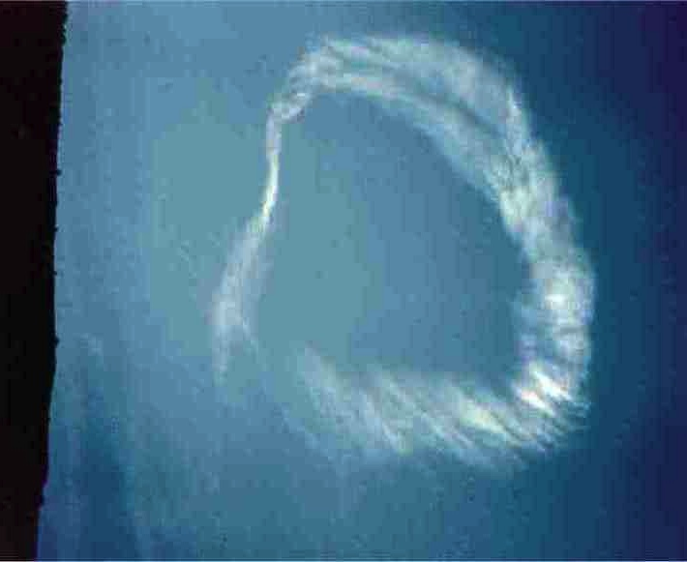
The.Feast.Of.The.Trumpets 64-0719
…Now, the hidden mysteries of Christ was fully revealed in the Seven Seals.

Slide 60
Blindlness:
ROMANS 11:25 For I would not, brethren, that ye should be ignorant of this mystery, lest ye should be wise in your own conceits; that blindness in part is happened to Israel, until the fulness of the Gentiles be come in.
A Change in Administration:
COLOSSIANS 1:25 Whereof I am made a minister, according to the dispensation of God which is given to me for you, to fulfil the word of God;

Slide 61
BREACH.THE
96-7 John hadn't noticed this Lamb before... Where did It come from? It come from the Father's throne where He had been seated since He had been slain and raised again. He raised up and set on the right hand of God, ever living to make intercessions. Raised there today as an Intercessor with His own Blood to make intercession upon the ignorance of the people. Now, that's the One I'm depending on. He still was covered with the bleach of the forgiveness of sin.
Remember, He'd been on His mediatorial work back here. But remember, these Seals are ready to be opened… there's no more intercession; the Sacrifice has left; it's a judgment seat.
63-0317

Slide 62
First Seal:
But, see, the kingdom still belongs to Satan. He's still got this part in his hand because why? It is redeemed by Christ, but He's doing the part of the Kinsman Redeemer taking His subjects, until the last one name is put on that Book, has already received it and been sealed away. Then He comes from His Father's throne, walks forward, takes the Book out of God's hand from the throne and claims His rights. The first thing He does is call for His Bride.

Slide 63
WHEN.DIVINE.LOVE.IS.PROJECTED
SOVEREIGN GRACE.TAKES.ITS.PLACE
7 Be merciful and heal the sick and afflicted. For in this Thou has atoned for at Calvary, and we feel that it is our personal property...
And now, Father, may the Holy Spirit take the Word, open the Book, and loose the power of the Spirit in the Word, and may it find Its resting place in each heart. For we ask it in the Name of Thy beloved Child, the Lord Jesus. Amen.
57-0126

Slide 64
FROM.THE.BEGINNING.IT.WASN'T.SO
25 And if the Word makes a promise, God keeps that promise… Enoch just got tired walking around; he'd had walked with Him five hundred years and pleased Him all the time, said, "I'm just not adjusted to the earth so I'll think I'll go home with Him this afternoon," and just walked right on up through the sky. It's going to take that kind of faith at the coming of the Lord, to take a little stroll some afternoon out here and walk right on out home with Him… Yes, sir, because we'll have to be that way before we are raptured with Him in the last days.
59-1125

Slide 65
PERSEVERANCE
And now we see nature, the very sign like the star that led the wise men to Bethlehem, on the move again. Jesus said there'd be perplexity of time, distress between the nations, signs in the heaven and earth, great storms and tidal waves and earthquakes in divers places. These things are buzzers that sets our hearts alarm, Lord, that we know to be ready.
62-0218

Slide 66
THIRST
We realize that judgment is striking. Great faults are falling in, nation is shaking, earthquakes in divers places. Great historical things that we've heard of in the days past, of judgment, through the Bible, and we see it repeating again today. The prophecy saying, "As it was in the days of Noah… As it was in the days of Lot…" and we see it happening now. "Man's hearts failing; perplexity of time; distress between nations."
God, we know we're at the end time. Help us, Lord, to take the Message to every crack and corner, to every child that You've ordained to Life.
65-0919

Slide 67
10 I was in the Spirit on the Lord's day, and heard behind me a great voice, as of a trumpet,
16 And he had in his right hand seven stars:
20 The mystery of the seven stars which thou sawest in my right hand, and the seven golden candlesticks. The seven stars are the angels of the seven churches: and the seven candlesticks which thou sawest are the seven churches.
Revelation 1: 10-20

Slide 68
The Seventh Star In The Right Hand Of Jesus – Rev. 1:20b
Last, or seventh church age:
Rev. 3:14 “Unto the angel of the church of the Laodiceans, write …”
Rev. 10:7 “But in the days of the voice of the seventh angel … the mystery of God should be finished …

Slide 69
10 I was in the Spirit on the Lord's day, and heard behind me a great voice, as of a trumpet,
16 And he had in his right hand seven stars:
20 The mystery of the seven stars which thou sawest in my right hand, and the seven golden candlesticks. The seven stars are the angels of the seven churches: and the seven candlesticks which thou sawest are the seven churches.
Revelation 1: 10-20

Slide 70
The Seventh Star In The Right Hand Of Jesus – Rev. 1:20b
Last, or seventh church age:
Rev. 3:14 “Unto the angel of the church of the Laodiceans, write …”
Rev. 10:7 “But in the days of the voice of the seventh angel … the mystery of God should be finished …

Slide 71
10 I was in the Spirit on the Lord's day, and heard behind me a great voice, as of a trumpet,
16 And he had in his right hand seven stars:
20 The mystery of the seven stars which thou sawest in my right hand, and the seven golden candlesticks. The seven stars are the angels of the seven churches: and the seven candlesticks which thou sawest are the seven churches.
Revelation 1: 10-20

Slide 72
The Seventh Star In The Right Hand Of Jesus – Rev. 1:20b
Last, or seventh church age:
Rev. 3:14 “Unto the angel of the church of the Laodiceans, write …”
Rev. 10:7 “But in the days of the voice of the seventh angel … the mystery of God should be finished …

