Slide 1
Love’s Enduring Foundation 5
GENESIS 10:32
These are the families of the sons of Noah, after their generations, in their nations: and by these were the nations divided in the earth after the flood.

Slide 2
Birthdays & Anniversaries
May 13th Gabriel Gunter
May 14th Nathan Brown
May 18th Mary Ann Roy
May 19th Danny & Kaitlyn Florian
May 26th Tina Knoblaugh
May 28th The Pastor
May 30th Taylor Coffey
May 31st David & Sabrina Stevens
June 1st Ben & Sharon McCafferty
June 2nd Clarence & Peggy Haney

Slide 4
THE.GREAT.COMMISSION
7 I believe if we'll all get together, pray together, stand together, that God will bless us together. Don't you think so? I believe He will, if we'll put forth an effort now…
It takes all of us together. I need you, and we all need God. So we need each other and we need God.
57-0804

Slide 5
Can Love last a lifetime?
IT.IS.I
19 You let your wife know that you love her; she loves you. When you're young couple and you find favor with one another, it makes you join yourselves together for a lifetime journey: that's phileo love; that's human love. What will Agapao love do, when you can really get into a place that you can show God that you love Him and you got confidence in Him? How you'll join yourself to Him, not only for a life's journey, but for eternity. That's what takes real love. 60-0720

Slide 6
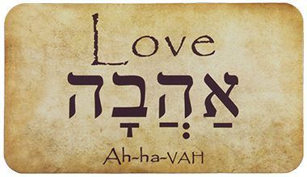
aHaVaH= To Give
CHiBa = Love & Affection
CHoVa = Obligation, to Give.

Slide 7
EXODUS 19:5
Now therefore, if ye will obey my voice indeed, and keep my covenant, then ye shall be a peculiar treasure unto me above all people: for all the earth is mine:
DEUTERONOMY 7:6
For thou art an holy people unto the LORD thy God: the LORD thy God hath chosen thee to be a special people unto himself, above all people that are upon the face of the earth.

Slide 8
MODERN.EVENTS
113 This is a hard mark to make… the churches are being bewitched by this Ecumenical Council, he's taking you right into it, to say "You're the same group." You're not the same group! Come out from among that stuff and be separated! Certainly is, It's true. We're to keep away from that stuff, as far as you can from it.
114 Balaam said, ”Let's let our children marry together because, after all, we believe the same God.” How can two walk together 'less they be agreed? How can you walk with God 'less you're agreed with His Word? 65-1206

Slide 9
SONG OF SOLOMON 8:6
Set me as a seal upon thine heart, as a seal upon thine arm: for love is strong as death; jealousy is cruel as the grave: the coals thereof are coals of fire, which hath a most vehement flame. 7 Many waters cannot quench love, neither can the floods drown it: if a man would give all the substance of his house for love, it would utterly be contemned.
(If a man tried to buy love with all his wealth,
his offer would be utterly scorned.)

Slide 10
Pillars of Marriage relationships

Slide 11
You Accept That The Person You Chose Is Not Perfect.
You’re not perfect and neither is your partner. If there a red flags at the outset — say, a partner who lies or treats you with disrespect — you’re wise to think twice.
But the ordinary challenging stuff isn’t going to disappear once you say ‘I do.’ The key is to appreciate the person and find peace with what’s less than ideal.

Slide 12
Communication is the number-one problem for couples. None of us are perfect at it, but when we can talk about difficult topics like money, kids, religion or politics, and do so respectfully, we’ve got a good foundation for a better future together.

Slide 13
יָדִיד (yud, dalet, yud, dalet)
Friend, fellow, pal, beloved.
יד = Hand
1. Friends will move toward each other the things that are required for health, prosperity, and the others’ welfare.
2. One must graciously learn to accept an extended hand.

Slide 14
SHuLChaN = Table
SHul = “The Place of”
CHaN = Grace
1) To Rest in One Place;
2) Economic Activity.

Slide 15
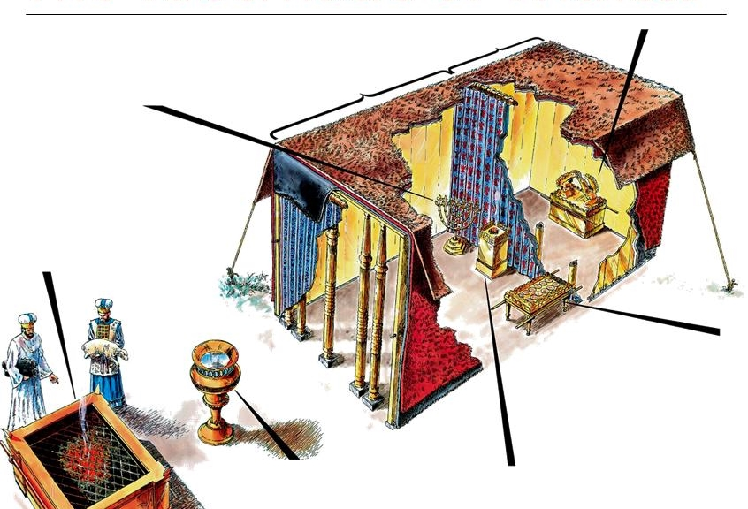

Slide 16
EXODUS 29:41-43
And the other lamb thou shalt offer at even, and shalt do thereto according to the meat offering of the morning, and according to the drink offering thereof, for a sweet savour, an offering made by fire unto the LORD. 42 This shall be a continual burnt offering throughout your generations at the door of the tabernacle of the congregation before the LORD: where I will meet you, to speak there unto thee. 43 And there I will meet with the children of Israel, and the tabernacle shall be sanctified by my glory.

Slide 17
II SAMUEL 9:11, 13
Then said Ziba unto the king, According to all that my lord the king hath commanded his servant, so shall thy servant do. As for Mephibosheth, said the king, he shall eat at my table, as one of the king's sons.
13 So Mephibosheth dwelt in Jerusalem: for he did eat continually at the king's table; and was lame on both his feet.

Slide 18
PSALM 23:5-7
Thou preparest a table before me in the presence of mine enemies: thou anointest my head with oil; my cup runneth over.
REVELATION 19:9
And he saith unto me, Write, Blessed are they which are called unto the marriage supper of the Lamb. And he saith unto me, These are the true sayings of God.

Slide 19
LIFE
56 We're going to meet at a supper someday. That's a wedding supper, when that great table is stretched across the skies, reaching from sky to sky. We look across the table one to another, there's bound to be a little tear drop from our cheeks, as we think, as we shake each other's hand, say, "I remember the Salem meeting. Here's Bro. So-and-so, was the one that come in at that time, one down here.” Then the King in His beauty will walk out in His white robes
62-0719

Slide 20
5. You Share How Much You
Love Each Other.
Partners, and families, who are in the habit of telling one another what they appreciate about each other build on a solid foundation. If they see something positive, they point it out.
When we appreciate the positives we avoid the very spirit of contempt — one of the strongest predictors of divorce.

Slide 21
CHURCH.AND.ITS.CONDITION
35 God, wanting to make love, had to make something lovable, gentle like Himself. He had to make something that could be loved, something of His Own nature.
37 You couldn't love nothing that wasn't of your own nature. Loving has to unite with love. A husband and wife has to love one another, family has to love one another. You search everywhere, find a girl to be your wife that you love. She searches, finding a husband that she could love. And God searches, trying to find a soul that He can love. 56-0805

Slide 22
GENESIS 2:22
And the rib, which the LORD God had taken from man, made he a woman, and brought her unto the man. 23 And Adam said, This is now bone of my bones, and flesh of my flesh: she shall be called Woman, because she was taken out of Man. 24 Therefore shall a man leave his father and his mother, and shall cleave unto his wife: and they shall be one flesh.

Slide 23
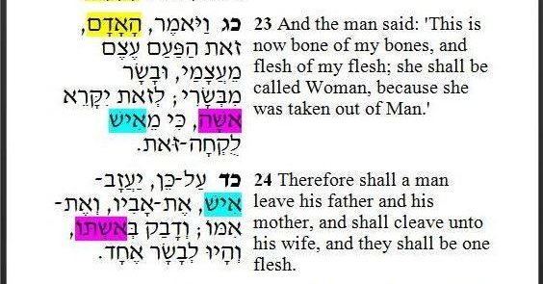

Slide 24
Male Gender Nouns:
Bull: (PaR) Cow: PaRaH
Prophet: NaVi Prophetess: NaViaH
Male: iSH Female: iSHaH
Family:
Brother: aCH Sister: aCHoT
Son: BeN Daughter: BaT

Slide 25
THINGS.THAT.ARE.TO.BE
33 Now, if we are those attributes of God, we cannot live by creeds… by denominationalism. We must live by the Word, because the Bride is a part of the Bridegroom, like any wife is a part of her husband. Therefore, we must be that Word Bride. And what is that Word Bride? The manifestation of this hour, not a creed, denom-ination; but a living oracle of God, a living attribute of God, displaying to the world the attributes of God, in the formation of the Bride that's to be expressed in this hour that we're now living. Luther could not express the attributes that we express, because that that was in the beginning, the resurrection, like the corn of wheat... 65-1205

Slide 26
FUTURE.HOME
263 There is no such a thing as spiritual death now, to a baptized saint of God. "Though he were dead, yet shall he live…." All Scripture, It must be fulfilled. You can't die. You got Eternal Life. Only thing, the Redeemer has made you recognize it. And you were always That, and that's the reason you see the day you're living in.
264 Methodist said, "When you shout, you got It." A lot of them shouted and didn't have It. Pentecost said, "When you speak in tongues, you got It." Many speak with tongues, and didn't have It.

Slide 27
Look how, all kind of forms those Pharisees had, but when the Word was made manifest, they didn't recognize It.
267 And if you are the Bride, the Bride is a part of the Husband. The only place that you'll ever recognize It, is recognize what part of that Husband (that Word) you are, or you can't recognize being the Bride… You have to recognize your position. You can't recognize somebody else's. What if Moses would have come with Noah's message? If Jesus would have come with Moses' Message? It wouldn't have worked. It was a different age, different prophecy, different part of the Word had to be fulfilled there. 64-0802

Slide 28
Male Gender Nouns:
Bull: (PaR) Cow: PaRaH
Prophet: NaVi Prophetess: NaViaH
Male: iSH Female: iSHaH
Family:
Brother: aCH Sister: aCHoT
Son: BeN Daughter: BaT

Slide 29
GALATIANS 3:26
For ye are all the children of God by faith in Christ Jesus. 27 For as many of you as have been baptized into Christ have put on Christ. 28 There is neither Jew nor Greek, there is neither bond nor free, there is neither male nor female: for ye are all one in Christ Jesus. 29 And if ye be Christ's, then are ye Abraham's seed, and heirs according to the promise.

Slide 30
FELLOWSHIP
14 Now, fellowship in love affairs, like a young man and a young woman, that's fellowship and what we would call "phileo" that's just a earthly love. But fellowship in the Gospel like this is "Agapao" the high, Divine love,' as I spoke the other night of my vision. When you're in there, it's neither male nor female. We're just all one in Christ. And should get acquainted with that kind of a fellowship here on earth, while we must have respects for each other, and love for one another, and highest of thoughts for our sisters and our brothers, and never any foul thing…

Slide 31
Because we are citizens of the Kingdom of God; we are a called out and separated people.
15 Now, God wanted fellowship. And if men today is a fallen son of God, there's some parts of God still with that man in his fallen state. Man today can split an atom, drive a jet plane around the world in a few hours... Something in him is a fallen creation... And that shows that man never come from animal life, 'cause animal continually builds the same habitations to live in. But man makes him a better house, a better way of living, better clothes, better transportation. And then when he wants fellowship, and when we want courtship and things like that, it has to come upon a basis of an agreement.
60-0611

Slide 32
Shema: (to hear) DEUT. 6:4
Hear, O Israel: The LORD our God is one LORD: 5 And thou shalt love the LORD thy God with all thine heart, and with all thy soul, and with all thy might. 6 And these words, which I command thee this day, shall be in thine heart: 7 And thou shalt teach them diligently unto thy children, and shalt talk of them when thou sittest in thine house, and when thou walkest by the way, and when thou liest down, and when thou risest up. 8 And thou shalt bind them for a sign upon thine hand, and they shall be as frontlets between thine eyes. 9 And thou shalt write them upon the posts of thy house, and on thy gates.

Slide 33
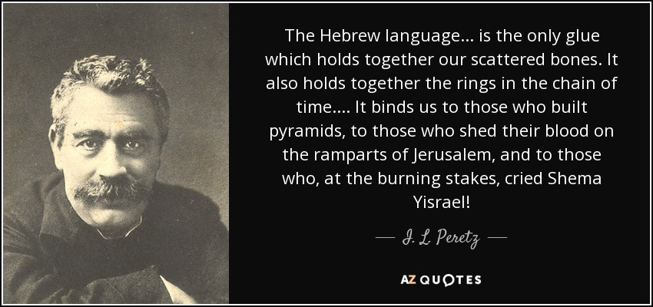
(May 18, 1852 – 3 April 1915)

Slide 34
CHURCH.AGE.BOOK
320-1 The name, Laodicea, 'the people's rights', or 'justice of the peoples.' Was there ever an age like the twentieth century church age that has seen ALL nations rising up and demanding equality, socially and financially? This is the age of the communists where all men are supposedly equal, though it is only so in theory. This is the age of political parties who call themselves Christian Democrats, and Christian Socialists, Christian Commonwealth Federation, etc.

Slide 35
320-2 When the ancients called Laodicea the metropolis it was looking forward to the one-world government that we are now setting up. As we think of that city being the location of a great church council we see foreshadowed the ecumenical move taking place today, wherein very soon we will see all the 'so-called' Christians come together.
Indeed, the church and state, religion and politics are coming together. The tares are being bound. The wheat will soon be ready for the garner.

Slide 36
THE.UNCERTAIN.SOUND
32 This nation has been a great deal like Israel. Israel was a people that was in bondage. And that little group of Israelites, that were in bondage, and loved freedom, and want to worship the true and living God, God delivered them from their slave pits and took them to a land promised to them, and drove back the occupants of that land. And they took over the land and become a mighty nation. They had mighty men.

Slide 37
And this nation did the same thing. We were a people tied down, no freedom of religion. And God sent our forefathers to this nation. And we drove back the occupants and took over. And it's become the leading nation of the world.
This nation was known all over the world as the leading nation, 'cause we'd had godly men behind it: Abraham Lincoln, George Washington, men like that who trusted God and feared God. But just as Israel made its mistake and put Ahab in, we did the same thing not long ago.
61-0429

Slide 38
CHURCH.AGE.BOOK
322-1 The 5th vision had to do with the moral problem of our age, centering mostly around women. God showed me that women began to be out of their place with the granting of the vote. Then they cut off their hair, which signified that they were no longer under the authority of a man but insisted on either equal rights, or in most cases, more than equal rights.

Slide 39
THE.LAODICEAN.CHURCH.AGE
49 But there'll be a powerful woman… great woman, she'll either be President, or it'll be a woman representing the Catholic church (which I think it is) will take over here someday and she'll rule this country. This nation is a woman's nation. Flag was made by a woman, it's number thirteen. She started out, thirteen stars, thirteen stripes, thirteen colonies. Everything's thirteen... and appears in the Rev. 13! Everything is "woman, woman…” She's took over Hollywood, the nations, the offices. She's took over everything there is; equal rights with the man, votes with the man, cusses like a man, drinks like a man, anything else.
60-1211

Slide 40
GENESIS 14:17-18
And the king of Sodom went out to meet him after his return from the slaughter of Chedorlaomer, and of the kings that were with him, at the valley of Shaveh, which is the king's dale. 18 And Melchizedek king of Salem brought forth bread and wine: and he was the priest of the most high God.
Shaveh: (Heb.) Level plain, equality.

Slide 41
GENESIS 14:1
And it came to pass in the days of Amraphel king of Shinar, Arioch king of Ellasar, Chedorlaomer king of Elam, and Tidal king of nations; 2 That these made war with Bera king of Sodom, and with Birsha king of Gomorrah, Shinab king of Admah, and Shemeber king of Zeboiim, and the king of Bela, which is Zoar. 3 All these were joined together in the vale of Siddim, which is the salt sea.

Slide 42
ISRAEL.AND.THE.CHURCH.1
42 Abraham, coming from Babylon, with his father, down into the valley of Shinar, where the souls of many journeyed after the destroying of Babylon, confusion taken place... Abraham's father, brought Abraham and his loved ones down into Shinar. And all that land, among all those people, God found favor with one man found favor with God, rather.
43 I want you to notice, that is the beginning of Christianity, of the church. And it wasn't because Abraham was a good man; it was because God elected and chose Abraham. It wasn't Abraham choosing God; it was God choosing Abraham. Now, as it was then, so is it today. It isn't you choosing God; it's God choosing you.
53-0325

Slide 43
GENESIS 11:1-4
And the whole earth was of one language, and of one speech. 2 And it came to pass, as they journeyed from the east, that they found a plain in the land of Shinar; and they dwelt there. 3 And they said one to another, Go to, let us make brick, and burn them throughly. And they had brick for stone, and slime had they for morter. 4 And they said, Go to, let us build us a city and a tower, whose top may reach unto heaven; and let us make us a name, lest we be scattered abroad upon the face of the whole earth.

Slide 44
And Nimrod dwelt in Babel, and he there renewed his reign over the rest of his subjects, and he reigned securely, and the subjects and princes of Nimrod called his name Amraphel, saying that at the tower his princes and men fell through his means.
— Sefer haYashar 11
https://en.wikipedia.org/wiki/Amraphel

Slide 45
MATTHEW 6:33-34
But seek ye first the kingdom of God, and his righteousness; except when you’re choosing someone to marry. In that case, you should follow your emotions, insist on a thrilling romantic attraction and overall compatibility that makes the relationship fun, and all these things shall be added unto you.
34 Take therefore no thought for the morrow: for the morrow shall take thought for the things of itself. Sufficient unto the day is the evil thereof.

