Slide 1
A Proud Look
PROV. 6:16
These six things doth the LORD hate: yea, seven are an abomination unto him: 17 A proud look…

Slide 2
God: New Birth
Our Witness
Outsiders
The Church
Local Body
Me
Walk in wisdom toward them that are without, redeeming the time.
(Col. 4:5)
So we, being many, are one body in Christ, and every one members one of another. (Rom. 12:5)

Slide 3
THE.GREAT.COMMISSION
33 Brother Vayle's my associate; he's my brother. He just happens to be making the arrangements for the meetings and helping me along… We're just all one great big family and one big Body. We're not one above the other one; we're all just the same; we're a unit of God working together.
58-0301

Slide 4
Pulpit
Congregation

Slide 5
BLIND.BARTIMAEUS
The world's a dying, not for better economics… not for better buildings, a bigger denomination. But it's dying for somebody to reach out a hand of love, to show that we care one for the other.
And Jesus told us that, "By this all men would know that you were My disciples," when we got love one for the other.
61-0124

Slide 6
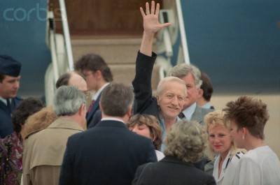
Frank Reed Released from Captivity
in Lebanon
DURING THE 44 MONTHS that Frank Reed was held hostage in Lebanon, (1986-1990) he tried several times to escape. Each time, he was caught, and each time punished mercilessly…
May 4, 1990: Freed American hostage Frank Reed waves on arriving at Andrews Air Force Base

Slide 7
“Nothing I did mattered to anyone. I began to realize how withering it is to exist with not a single expression of caring around me.
I learned one overriding fact: Caring is a powerful force. If no one cares, you
are truly alone.”
Frank Reed
Time Magazine 1991

Slide 8
GALATIANS 6:1-3
1 Brethren, if a man be overtaken in a fault, ye which are spiritual, restore such an one in the spirit of meekness; considering thyself, lest thou also be tempted. 2 Bear ye one another's burdens, and so fulfil the law of Christ. 3 For if a man think himself to be something, when he is nothing, he deceiveth himself.

Slide 9
I CORINTHIANS 12:25-26
25 That there should be no schism in the body; but that the members should have the same care one for another. 26 And whether one member suffer, all the members suffer with it; or one member be honoured, all the members rejoice with it.
PHILIPPIANS 4:6
Be careful for nothing; but in every thing by prayer and supplication with thanksgiving let your requests be made known unto God.

Slide 10
MATTHEW 6:34
Take therefore no thought for the morrow: for the morrow shall take thought for the things of itself. Sufficient unto the day is the evil thereof.
MATTHEW 10:19
But when they deliver you up, take no thought how or what ye shall speak: for it shall be given you in that same hour what ye shall speak.
LUKE 10:41
And Jesus answered and said unto her, Martha, Martha, thou art careful and troubled about many things:

Slide 11
TO.WHOM.WOULD.WE.GO
…See, in here it's unsettled peace. You don't have no peace. It wasn't meant for you to have peace here. If you did, you'd get customized to the world. God don't want you customized to this world. He wants you to rest in Him. Come to Him, then you have peace. 60-0606
Nahum 1:7
The LORD is good, a strong hold in the day of trouble; and he knoweth them that trust in him.

Slide 12
Wherefore is there a price in the hand of a fool to get wisdom,
seeing he hath no heart to it?
PROVERBS 17:16

Slide 13
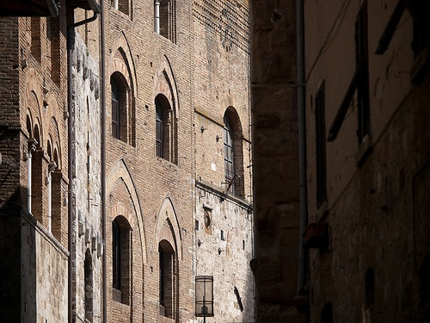
Pride
A Proud
Look
Proverbs 16:18
Pride goeth before destruction, and an haughty spirit before a fall. 19 better it is to be of an humble spirit with the lowly, than to divide the spoil with the proud.

Slide 14
The Ten Commandments
EXODUS 20:2-17 And God spake all these words, saying, 2 I am the LORD thy God, which have brought thee out of the land of Egypt, out of the house of bondage. 3 Thou shalt have no other gods before me…
12 Honour thy father and thy mother: that thy days may be long upon the land which the LORD thy God giveth thee.
13 Thou shalt not kill. (Heb. Ratsach)
14 Thou shalt not commit adultery.
15 Thou shalt not steal.

Slide 15
PROVERBS 6:16-19
These six things doth the LORD hate: yea, seven are an abomination unto him: 17 A proud look, a lying tongue, and hands that shed innocent blood, 18 An heart that deviseth wicked imaginations, feet that be swift in running to mischief, 19 A false witness that speaketh lies, and he that soweth discord among brethren.

Slide 16
II TIMOTHY 3:1-5
This know also, that in the last days perilous times shall come. 2 For men shall be lovers of their own selves, covetous, boasters, proud, blasphemers, disobedient to parents, unthankful, unholy, 3 Without natural affection, trucebreakers, false accusers, incontinent, fierce, despisers of those that are good, 4 Traitors, heady, highminded, lovers of pleasures more than lovers of God; 5 Having a form of godliness…
Highminded: (Gr.) Tuphoo
Puffed up with haughtiness or pride; to blind with pride or conceit, to render foolish or stupid.

Slide 17
Pride (w)
Implies an unduly favorable idea of one's own appearance, advantages, achievements, etc. Pride is a lofty and often arrogant assumption of superiority in some respect.
The proud person has difficulty with others since he or she does not react well to feedback.
Irrationally believes that one is better, superior and more important than others, failing to acknowledge the accomplishments of others. Refusing to acknowledge one’s own limits, faults or frailities as a human being.

Slide 18
GO.TELL.MY.DISCIPLES
93 Mary Magdalene, she'd knew His power. She knew there was something about Him was different from anyone else… She had seven devils cast out of her: pride and envy, and she thought she was so pretty and there was no one like her.
But when Jesus spoke and said, "Be thou clean," all that left her. She become a new person. She wasn't so pretty any more in her own sight. But she wrapped herself in the robe of meekness and gentleness, and followed the Master. She loved Him.
53-0405

Slide 19
Psalm 101:4-6
4 A froward heart shall depart from me: I will not know a wicked person. 5 Whoso privily slandereth his neighbour, him will I cut off: him that hath an high look and a proud heart will not I suffer.
6 Mine eyes shall be upon the faithful of the land, that they may dwell with me: he that walketh in a perfect way, he shall serve me.

Slide 20
DOOR.TO.THE.HEART
17 Oh, we Christians, though alienated from the world, and we are heaven-bound subjects of the Lord Jesus, we should conduct ourselves as sons and daughters of God. Pride keeps us from doing it. We're afraid somebody will say something against us. When the spirit blesses, many are ashamed to say "Amen."
There is many who in their office work, the Lord Jesus could have healed them of diseases, and they're afraid to testify to the glory of God because of pride. Many are afraid to stand and say, "I have received Christ as my personal Saviour and been filled with the Holy Spirit.": ashamed. Pride, oh, what a great thing that is.
58-0112

Slide 21
JAMES 4:6-7
But he giveth more grace. Wherefore he saith, God resisteth the proud, but giveth grace unto the humble. 7 Submit yourselves therefore to God. Resist the devil, and he will flee from you.
I PETER 5:5-6
Likewise, ye younger, submit yourselves unto the elder. Yea, all of you be subject one to another, and be clothed with humility: for God resisteth the proud, and giveth grace to the humble. 6 Humble yourselves therefore under the mighty hand of God, that he may exalt you in due time:

Slide 22
TRYING.TO.DO.GOD.A.SERVICE
234 (David) He was king, anointed king. You say, "I'm a minister, anointed." Then stay a minister, don't try to be a prophet. If you're evangelist, stay evangelist.
235 Remember Uzziah, in the days of Isaiah, the young prophet. Uzziah was a great man, anointed man, God blessed him… And one day he got so highly up till he thought he could just take the office of a priest, and took the fire and went in before the Lord, and the priests told him, "Don't do that, Uzziah!" But he got exalted. The prophet couldn't tell him nothing.
65-1127

Slide 23
DANIEL 4:30-33
The king spake, and said, Is not this great Babylon, that I have built for the house of the kingdom by the might of my power, and for the honour of my majesty? 31 While the word was in the king's mouth, there fell a voice from heaven, saying, O king Nebuchadnezzar, to thee it is spoken; The kingdom is departed from thee. 32 And they shall drive thee from men, and thy dwelling shall be with the beasts of the field: they shall make thee to eat grass as oxen, and seven times shall pass over thee, until thou know that the most High ruleth in the kingdom of men, and giveth it to whomsoever he will.

Slide 24
INFLUENCES
45 Now many man today makes that sad mistake like this fellow did, when he got exalted, got big, got so he had everything in his own hands, he felt secure, "God loves me so much, till there is nothing can bother me now."
When he did that, he throwed hisself in the same shape that Nebuchadnezzar did one time, as you Bible readers know. Then we find out that he was smitten with leprosy because he tried to take a minister's place.
64-0215

Slide 25
DANIEL 4:34-37
And at the end of the days I Nebuchadnezzar lifted up mine eyes unto heaven, and mine understanding returned unto me, and I blessed the most High, and I praised and honoured him that liveth for ever, whose dominion is an everlasting dominion, and his kingdom is from generation to generation: 35 And all the inhabitants of the earth are reputed as nothing: and he doeth according to his will in the army of heaven, and among the inhabitants of the earth: and none can stay his hand, or say unto him, What doest thou…? 37 Now I Nebuchad-nezzar praise and extol and honour the King of heaven, all whose works are truth, and his ways judgment: and those that walk in pride he is able to abase.

Slide 26
GENESIS 3:5-7
For God doth know that in the day ye eat thereof, then your eyes shall be opened, and ye shall be as gods, knowing good and evil. 6 And when the woman saw that the tree was good for food, and that it was pleasant to the eyes, and a tree to be desired to make one wise, she took of the fruit thereof, and did eat, and gave also unto her husband with her; and he did eat. 7 And the eyes of them both were opened, and they knew that they were naked; and they sewed fig leaves together, and made themselves aprons.

Slide 27
GENESIS 13:10
And Lot lifted up his eyes, and beheld all the plain of Jordan, that it was well watered every where, before the LORD destroyed Sodom and Gomorrah, even as the garden of the LORD, like the land of Egypt, as thou comest unto Zoar.
GENESIS 13:14
And the LORD said unto Abram, after that Lot was separated from him, Lift up now thine eyes, and look from the place where thou art northward, and southward, and eastward, and westward:

Slide 28
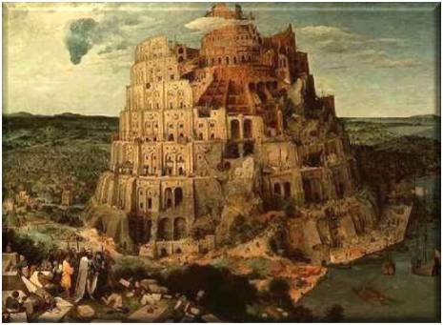

Slide 29
ESTHER 5:9-13
Then went Haman forth that day joyful and with a glad heart: but when Haman saw Mordecai in the king's gate, that he stood not up, nor moved for him, he was full of indignation against Mordecai. 10 Nevertheless Haman refrained himself: and when he came home, he sent and called for his friends, and Zeresh his wife. 11 And Haman told them of the glory of his riches, and the multitude of his children, and all the things wherein the king had promoted him, and how he had advanced him above the princes and servants of the king. 12 Haman said moreover, Yea, Esther the queen did let no man come in with the king unto the banquet that she had prepared but myself; and to morrow am I invited unto her also with the king. 13 Yet all this availeth me nothing, so long as I see Mordecai the Jew sitting at the king's gate.

Slide 30
ESTHER 6:4-6
And the king said, Who is in the court? Now Haman was come into the outward court of the king's house, to speak unto the king to hang Mordecai on the gallows that he had prepared for him. 5 And the king's servants said unto him, Behold, Haman standeth in the court. And the king said, Let him come in. 6 So Haman came in. And the king said unto him, What shall be done unto the man whom the king delighteth to honour? Now Haman thought in his heart, To whom would the king delight to do honour more than to myself?

Slide 31
DEUTERONOMY 12:8-12
Ye shall not do after all the things that we do here this day, every man whatsoever is right in his own eyes. 9 For ye are not as yet come to the rest and to the inheritance, which the LORD your God giveth you. 10 But when ye go over Jordan, and dwell in the land which the LORD your God giveth you to inherit, and when he giveth you rest from all your enemies round about, so that ye dwell in safety;

Slide 32
11 Then there shall be a place which the LORD your God shall choose to cause his name to dwell there; thither shall ye bring all that I command you; your burnt offerings, and your sacrifices, your tithes, and the heave offering of your hand, and all your choice vows which ye vow unto the LORD: 12 And ye shall rejoice before the LORD your God, ye, and your sons, and your daughters, and your menservants, and your maidservants, and the Levite that is within your gates; forasmuch as he hath no part nor inheritance with you.

Slide 33
Shema: (to hear) DEUT. 6:4
Hear, O Israel: The LORD our God is one LORD: 5 And thou shalt love the LORD thy God with all thine heart, and with all thy soul, and with all thy might. 6 And these words, which I command thee this day, shall be in thine heart: 7 And thou shalt teach them diligently unto thy children, and shalt talk of them when thou sittest in thine house, and when thou walkest by the way, and when thou liest down, and when thou risest up. 8 And thou shalt bind them for a sign upon thine hand, and they shall be as frontlets between thine eyes. 9 And thou shalt write them upon the posts of thy house, and on thy gates.

Slide 34
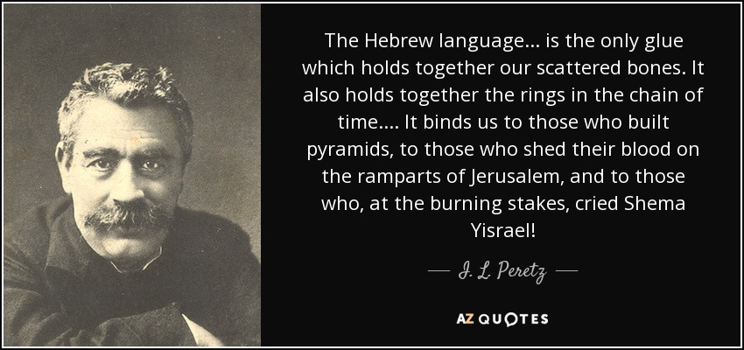
(May 18, 1852 – 3 April 1915)

Slide 35
CHURCH.AGE.BOOK
320-1 The name, Laodicea, 'the people's rights', or 'justice of the peoples.' Was there ever an age like the twentieth century church age that has seen ALL nations rising up and demanding equality, socially and financially? This is the age of the communists where all men are supposedly equal, though it is only so in theory. This is the age of political parties who call themselves Christian Democrats, and Christian Socialists, Christian Commonwealth Federation, etc.

Slide 36
320-2 When the ancients called Laodicea the metropolis it was looking forward to the one-world government that we are now setting up. As we think of that city being the location of a great church council we see foreshadowed the ecumenical move taking place today, wherein very soon we will see all the 'so-called' Christians come together.
Indeed, the church and state, religion and politics are coming together. The tares are being bound. The wheat will soon be ready for the garner.

Slide 37
THE.UNCERTAIN.SOUND
32 This nation has been a great deal like Israel. Israel was a people that was in bondage. And that little group of Israelites, that were in bondage, and loved freedom, and want to worship the true and living God, God delivered them from their slave pits and took them to a land promised to them, and drove back the occupants of that land. And they took over the land and become a mighty nation. They had mighty men.

Slide 38
And this nation did the same thing. We were a people tied down, no freedom of religion. And God sent our forefathers to this nation. And we drove back the occupants and took over. And it's become the leading nation of the world.
This nation was known all over the world as the leading nation, 'cause we'd had godly men behind it: Abraham Lincoln, George Washington, men like that who trusted God and feared God. But just as Israel made its mistake and put Ahab in, we did the same thing not long ago.
61-0429

Slide 39
CHURCH.AGE.BOOK
322-1 The 5th vision had to do with the moral problem of our age, centering mostly around women. God showed me that women began to be out of their place with the granting of the vote. Then they cut off their hair, which signified that they were no longer under the authority of a man but insisted on either equal rights, or in most cases, more than equal rights.

Slide 40
THE.LAODICEAN.CHURCH.AGE
49 But there'll be a powerful woman… great woman, she'll either be President, or it'll be a woman representing the Catholic church (which I think it is) will take over here someday and she'll rule this country. This nation is a woman's nation. Flag was made by a woman, it's number thirteen. She started out, thirteen stars, thirteen stripes, thirteen colonies. Everything's thirteen... and appears in the Rev. 13! Everything is "woman, woman…” She's took over Hollywood, the nations, the offices. She's took over everything there is; equal rights with the man, votes with the man, cusses like a man, drinks like a man, anything else.
60-1211

Slide 41
GENESIS 14:17-18
And the king of Sodom went out to meet him after his return from the slaughter of Chedorlaomer, and of the kings that were with him, at the valley of Shaveh, which is the king's dale. 18 And Melchizedek king of Salem brought forth bread and wine: and he was the priest of the most high God.
Shaveh: (Heb.) Level plain, equality.

Slide 42
GENESIS 14:1
And it came to pass in the days of Amraphel king of Shinar, Arioch king of Ellasar, Chedorlaomer king of Elam, and Tidal king of nations; 2 That these made war with Bera king of Sodom, and with Birsha king of Gomorrah, Shinab king of Admah, and Shemeber king of Zeboiim, and the king of Bela, which is Zoar. 3 All these were joined together in the vale of Siddim, which is the salt sea.

Slide 43
ISRAEL.AND.THE.CHURCH.1
42 Abraham, coming from Babylon, with his father, down into the valley of Shinar, where the souls of many journeyed after the destroying of Babylon, confusion taken place... Abraham's father, brought Abraham and his loved ones down into Shinar. And all that land, among all those people, God found favor with one man found favor with God, rather.
43 I want you to notice, that is the beginning of Christianity, of the church. And it wasn't because Abraham was a good man; it was because God elected and chose Abraham. It wasn't Abraham choosing God; it was God choosing Abraham. Now, as it was then, so is it today. It isn't you choosing God; it's God choosing you.
53-0325

Slide 44
GENESIS 11:1-4
And the whole earth was of one language, and of one speech. 2 And it came to pass, as they journeyed from the east, that they found a plain in the land of Shinar; and they dwelt there. 3 And they said one to another, Go to, let us make brick, and burn them throughly. And they had brick for stone, and slime had they for morter. 4 And they said, Go to, let us build us a city and a tower, whose top may reach unto heaven; and let us make us a name, lest we be scattered abroad upon the face of the whole earth.

Slide 45
And Nimrod dwelt in Babel, and he there renewed his reign over the rest of his subjects, and he reigned securely, and the subjects and princes of Nimrod called his name Amraphel, saying that at the tower his princes and men fell through his means.
— Sefer haYashar 11
https://en.wikipedia.org/wiki/Amraphel

