Slide 1
Feeling All Alone Overcoming Depression & Fear Part 3
JEREMIAH 17:14
Heal me, O LORD, and I shall be healed; save me, and I shall be saved: for thou art my praise.

Slide 2
Birthdays & Anniversaries
June 9th Pruette 50th Anniversary
June 13th Larry Pruette
June 1st Richard Smith & Nayab Javed
June 16th Kristie Williams
James & Patricia O’Berry
June 23rd HBT Family Day 10:00 am-8:00 pm

Slide 3
TO.WHOM.WOULD.WE.GO
41 ...It wasn't meant for you to have peace here. If you did, you'd get customized to the world. God don't want you customized to this world.
He wants you to rest in Him. Come to Him, then you have peace.
60-0606

Slide 4
I.WAS.NOT.DISOBEDIENT…
10 Christians, sinner friends, lawyers, doctors, whoever you are, there has been much mockery in the name of Divine healing… in every phase of religion, but there is a real power of the Holy Spirit that delivers the human being from the bondage of sin… that delivers the sufferer from his suffering.
And I do not see how that clergy could preach the Gospel without including Divine healing in the atonement, because "He was wounded for our transgressions; and with His stripes we are healed.” It's an act of faith heals you. 49-0718

Slide 5
Sickness & the Need for Healing
Physical Diseases
Mental Disease
Spiritual Warfare

Slide 6
WATCHMAN.WHAT.OF.THE.NIGHT
6 There is none of us that is immune from troubles. God has not promised to excuse us from all sickness, but it is written that His strength is sufficient. And He will never put so much upon us, but what He will give us grace to bear. So we have that consolation of knowing.
58-1130

Slide 7
THE.SECOND.MIRACLE
32 (Black diphtheria) Well, they took me in and robed me all up with a whole lot of stuff over me, washed my hands... Walked into where the boy was. I said to the [parents] standing there, "Do you believe?“ He said, "Ask God, Brother Branham."
And I knelt down and started to pray. And while I was praying, the Angel of the Lord come down and said, "You shall live." I got back up; I said, "Did you hear that, brother?“ He said, "Yes sir, Praise the Good Lord."
The nurse come back; she said, "I'm sorry, but you all will have to go right away, especially Rev. Branham.“ I said, "Thank you, ma'am."

Slide 8
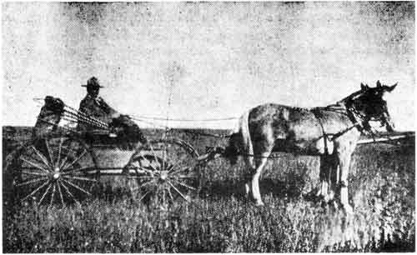
The “Black Killer” Manitoba, Canada 1898
Taken from: “Saddlebag Surgeon” by Robert Tyre

Slide 9
Started walking out. This man started walking along saying, "Thank You, Lord, Thank You." And the mother just as happy and a shouting. The nurse said to her, said, “Did you realize that your boy's dying?“ Said, "Sure, I know what you said.”
They was happy and shaking hands, hugging one another, thanking God for his healing. The boy just dying right out.
So he said, "Well, what are you so happy about? Did you understand the doctor said, your boy will be dead in two hours?"

Slide 10
Said, "I understood what you said, and I understood what God said.“ He said, "Well look, it's all right to have faith, but I can't see how that you can just ignore such things as that, when that boy laying there dying?"
And the man turned around, which was a minister, and said, "Sir, looky here. That cardiogram shows that heart, when that drops down, all the world's history, there's never been a time that that's ever come up. Death's on the boy now. Look, sir, you're looking at that chart, and I'm looking to a Divine promise, what God said.”
51-0729

Slide 11
GOD.WHO.IS.RICH.IN.MERCY
104 He sent forth Jesus to be both Saviour and healer, "As Moses lifted up the brass serpent in the wilderness, so must the Son of man be lifted up," for the same purpose. He, the atonement, that's what we have claim upon, nothing but the atonement. What Jesus purchased by His Blood, that's what we have claims upon. "He was wounded for our transgressions…" That's what we can claim, because that's the atonement, that we stand for, ordered for us. God, rich in mercy!

Slide 12
Atonement: EXODUS 30:10
And Aaron shall make an atonement upon the horns of it once in a year with the blood of the sin offering of atonements: once in the year shall he make atonement upon it throughout your generations: it is most holy unto the LORD.
NUMBERS 21:8
And the LORD said unto Moses, Make thee a fiery serpent, and set it upon a pole: and it shall come to pass, that every one that is bitten, when he looketh upon it, shall live.

Slide 13
Atonement: JOHN 5:2-4
Now there is at Jerusalem by the sheep market a pool, which is called in the Hebrew tongue Bethesda, having five porches. 3 In these lay a great multitude of impotent folk, of blind, halt, withered, waiting for the moving of the water. 4 For an angel went down at a certain season into the pool, and troubled the water: whosoever then first after the troubling of the water stepped in was made whole of whatsoever disease he had.

Slide 14
ROMANS 5:8-12
But God commendeth his love toward us, in that, while we were yet sinners, Christ died for us. 9 Much more then, being now justified by his blood, we shall be saved from wrath through him. 10 For if, when we were enemies, we were reconciled to God by the death of his Son, much more, being reconciled, we shall be saved by his life. 11 And not only so, but we also joy in God through our Lord Jesus Christ, by whom we have now received the atonement. 12 Wherefore, as by one man sin entered into the world, and death by sin; and so death passed upon all men, for that all have sinned:

Slide 15
105 This was to be an Eternal atonement, because He came Himself, in the form of sinful flesh, to make an Eternal atonement; and suffered in the flesh, and made the atonement; and returned back in the form of the Holy Ghost, to confirm that atonement.
Where no brass serpent or no trouble's water could do it, it all pointed to that perfect Atonement. God, rich in His mercy, has did this.
65-0119

Slide 16
THE.POWER.OF.THE.DEVIL
18 When Jesus come dealing with sin at Cal-vary, He killed sin, and every attribute that goes with it (Amen.) and completely redeemed us back to God. And today, we are sons and daugh-ters of God, perfectly redeemed by a perfect Redeemer, the Lord Jesus Christ.
Now, we have not got it in full. But we have the earnest of our salvation. Now, we are not a past temptation. Neither are we above sin. But Jesus will help us in every temptation. And now, when I do wrong, I'm ready to repent. Anyone else is that wants to live right with God.

Slide 17
You don't desire to do wrong, but when Satan upsets you somewhere, because there is an atonement… If I confess my wrong, God's just to forgive it. And the same thing, when you got sick. It no sign your immune from sickness, but every time God is willing to deliver you from that sickness. Every time, you go to God, ask Him, then He's willing to deliver you, because there is an atonement. It's based upon your faith in that atonement, which is your redemption. And if we know this joy that we have, just being the earnest money, what will it be when we draw the full benefit of the policy? 55-1005

Slide 18
MY.ANGEL.SHALL.GO.BEFORE.THEE
…You listened to the afternoon services and so forth. That is a demon. All sickness is of the devil. You can't pin that on God. It's of the devil. 53-0216
AN.ENSIGN
And all sickness is caused by sin. Before we had sin, we had no sickness. But sickness, is an attribute of sin. Sickness came because of sin: maybe not what you done; inherited it. Three or four generations it'll follow. 53-0606

Slide 19
A.SECONDHANDED.ROBE
18 Elijah told Elisha, "You better turn back, because the way may be a little hard…" I heard the pastor say this morning... Many are becoming discouraged. What we need brother is take courage… to be encouraged. Trials may come; we never was promised to be immune from them; but He will give grace to go through them. If the mountain's too high to go over, too deep to go under it, too wide to go around it, He will give grace to go through it. Just don't worry, but keep your eyes on Christ, for He's the only one that can take us through.
56-1125

Slide 20
I.KNOW
27 And sometimes we have more troubles when we become a Christian than we did when we were sinners. "Many is the afflictions of the righteous, but God delivereth him from them all." God promised many afflictions, strange feelings, strange things that would be beyond our understanding, but it's always done for our good. Just can't understand it, because if we did, then it would not be of faith to us; we would go with an understanding. But we do it, we have it, and we believe by faith His Word, that it's going to work some good thing for us.... And there's none of us immune from them. 60-0417

Slide 21
FROM.THAT.TIME
29 …Now, there is times, and things that happen that changes the whole course of our life. We know that. We're all aware. Certain things take place along life's journey that changes the whole course of life for us.
62-0713

Slide 22
1. Take on tasks, responsibilities in bite size chunks, (everything seems to pile up).
2. Take advantage of the alone time, read, edify, pray, counsel.
3. Change the atmosphere around you.

Slide 23
HANDWRITING.ON.THE.WALL
21 …The devil likes to work on you and oppress you. You know, that's a trick of the devil to oppress. But when the Christian knows his legal rights, when you can quote God's Word, "I'll never leave thee nor forsake thee," that takes all the oppression away.
And the clouds begin to clear back. But if you just know that God has promised and God's faithful, He can keep His promise or He'd never promised it.
56-0902

Slide 24
HEBREWS 2:16-18
For verily he took not on him the nature of] angels; but he took on him the seed of Abraham. 17 Wherefore in all things it behoved him to be made like unto his brethren, that he might be a merciful and faithful high priest in things pertaining to God, to make reconciliation for the sins of the people. 18 For in that he himself hath suffered being tempted, he is able to succour them that are tempted.

Slide 25
HEBREWS.Chap.2. Pt.2
For in that he himself hath suffered being subject,... and able to succour them that are tempted. ("Succour" means "to sympathize.“) The reason He become this, He might be sympathetic with you who have your ups-and-downs and your little ins-and-outs, and your temptations get so great you can't hardly stand it.
He knows how to sympathize with you, sets there to make intercessions, to love you. And though you go astray, He won't forsake you. He'll still come after you and knock at your heart.

Slide 26
There's not a backslider in the building but what know that God knocks at his heart daily. And He will do it as long as you're a mortal on this earth, for He's loved you. He redeemed you. Men has tried to express that theme of love, and it cannot be found in human expressions, One said: Oh, love of God, how rich and pure!
...he is able to succour those that are tempted. Or in other words, He is able to help those, to sympathize with them, because God Himself became man in order to feel it.
57-0825

Slide 27
INFALLIBILITY.OF.GOD'S.SPOKEN.WORD
I was telling the boys coming over, we must be happy all the time. God don't want you to be sad. You know what ill temper does? That old temper, that's one of the awfullest old things. And it's about 60% of the cause of all sickness is temper.
Yes, them tantrums you fly loose, remember, you just developing a cancer, ulcer, or something like, when you do it. When you get all stewed up about somebody, "I won't go back there any more. Wait till I give them a piece of my mind." Remember, you're the one's going to pay for it. Just keep happy.
56-0404

Slide 28
DEMONOLOGY
He's making every enemy His footstool. All devils is under His feet. All sickness is under His feet. All sin is under His feet.
And we're in Him, more than conquerors through Him that loved us. 53-1112

Slide 29
LUKE 18:1-8
And he spake a parable unto them to this end, that men ought always to pray, and not to faint; 2 Saying, There was in a city a judge, which feared not God, neither regarded man: 3 And there was a widow in that city; and she came unto him, saying, Avenge me of mine adversary. 4 And he would not for a while: but afterward he said within himself, Though I fear not God, nor regard man; 5 Yet because this widow troubleth me, I will avenge her, lest by her continual coming she weary me. 6 And the Lord said, Hear what the unjust judge saith. 7 And shall not God avenge his own elect, which cry day and night unto him, though he bear long with them? 8 I tell you that he will avenge them speedily. Nevertheless when the Son of man cometh, shall he find faith on the earth?

Slide 30
PERSEVERANCE
48 Knock... just not say, "Lord...“ walk away. No, you just keep standing there knocking: "Lord, I'm wanting in. Open up to me." That's it; that's it. Like the widow and the unjust judge. Just keep knocking constantly. She was determined. Faith caught something, and she was persistent with it… She had to get there; that's all there was to it. She must get there, and she was persistent. No matter if He turned her down... 62-0520

Slide 31
MATTHEW 7:7-11
Ask, and it shall be given you; seek, and ye shall find; knock, and it shall be opened unto you: 8 For every one that asketh receiveth; and he that seeketh findeth; and to him that knocketh it shall be opened. 9 Or what man is there of you, whom if his son ask bread, will he give him a stone? 10 Or if he ask a fish, will he give him a serpent? 11 If ye then, being evil, know how to give good gifts unto your children, how much more shall your Father which is in heaven give good things to them that ask him?

Slide 32
ACCEPTING.GOD'S.PROVIDED.WAY.
AT.THE.END.TIME 63-0115
189 Cry for your needs. That's God's provided way. Didn't Jesus explain it when He said the unjust judge, to the woman that cried day and night? How much more will the Heavenly Father give them the Spirit who cry out for It, day and night? Seek, keep seeking. Knock, keep knocking. Just keep on till He opens. Stay out with it. Cry until the promised Word is vindicated, then you got it. You don't have to worry no more.

Slide 33
Fatalism: (w)
A submissive mental attitude resulting from acceptance of the doctrine that everything that happens is predetermined and inevitable;
A philosophical doctrine holding that all events are predetermined in advance for all time and human beings are powerless to change them.

Slide 34
GOD'S.PROVIDED.WAY
54 …He told Joshua, "Every place the sole of your foot treads, that I have given you." They had to fight for every inch of it. So do we fight for every inch of it. …Come with a deter-mination. Come, that you're going to stay there, till it's over… until God answers and vindicates... He's here to answer everything that He made promise for in this day. Then cry till you get it. Hold on to Him. Don't leave, if you have to stay day and night. God don't want His children listening to intellectual speeches…
64-0206

Slide 35
MARK 9:28-29
28 And when he was come into the house, his disciples asked him privately, Why could not we cast him out? 29 And he said unto them, This kind can come forth by nothing, but by prayer and fasting.

Slide 36
HE.WAS.TO.PASS.THIS.WAY
16 Rebekah had found this Jesus. He was to her exactly the fulfilling of the promise the Jews had been looking for, for their day… She had got busy to praying about her businessman husband. We need more Rebekahs. See, prayer changes things. If you lay your husband, your unsaved one, before God then pray, God will make a way somewhere 'cause He promised to… if a person ever meets Jesus and finds Him really in your heart, you're interested not only in your own household but the household of God every-where.... So she had prayed hard. 64-0321

Slide 37
MATTHEW 12:22-29
Then was brought unto him one possessed with a devil, blind, and dumb: and he healed him, insomuch that the blind and dumb both spake and saw. 23 And all the people were amazed, and said, Is not this the son of David? 24 But when the Pharisees heard it, they said, This fellow doth not cast out devils, but by Beelzebub the prince of the devils. 25 And Jesus knew their thoughts, and said unto them, Every kingdom divided against itself is brought to desolation; and every city or house divided against itself shall not stand:

Slide 38
26 And if Satan cast out Satan, he is divided against himself; how shall then his kingdom stand? 27 And if I by Beelzebub cast out devils, by whom do your children cast them out? therefore they shall be your judges. 28 But if I cast out devils by the Spirit of God, then the kingdom of God is come unto you. 29 Or else how can one enter into a strong man's house, and spoil his goods, except he first bind the strong man? and then he will spoil his house.

Slide 39
WHEN.THEIR.EYES.WERE.OPENED
13 Now we have chiropractic. The medical doctor condemns the chiropractor; the chiropractor condemns the medical doctor. Osteopath, they condemn both. And all of them together condemn Divine healing. You know, the osteopath does a lot of good things; the chiropractor does too. The medicine does also. Surgery does also. Even a medical doctor sometime condemn a surgeon. The surgeon condemn a medicine doctor. What's the matter? Forgive me, doctor, whoever you are. We need you, and we need one another.

Slide 40
It looks to me like that anyone that would condemn anything that would help anyone, it's a selfish motive. There's something wrong with the person. If we just all forget that, osteopath, chiropractic, medical doctor, surgeons, ministers, and all work together to try to help our fellow man, to make life a little better for them, to make their journey a little more pleasant, I think God would be more pleased with all of us.
56-0420

Slide 41
WHY36 Some woman said to me, "What're you going to say about penicillin for the flu?“ "Well, penicillin is just like you had your house full of rats. They was eating holes everywhere, and you put out some rat poison, and poison the rats. That don't patch the holes. Penicillin only kills the germ. It doesn't patch the holes, or build up the tissue that it tore down. It takes God, the Healer, to do that. He's the Lord who heals all of our diseases. Certainly, I believe that, and I'm thankful to God for these toxins, and the Salk vaccine. And it's a dangerous thing to not take it. The little children, and things, to get inoculation, what would we do without such?

Slide 42
Now, everybody can't have faith for healing. They should, but they don't. So what would you do? You'd just have sickness, and, it would be a terrible place if we had no hospitals, or things. It'd be an awful place if you didn't have hygiene, so forth, health clinics, and what we have. We thank God for everything that we've got. Every good thing cometh from God. Certainly.
61-0128

Slide 43
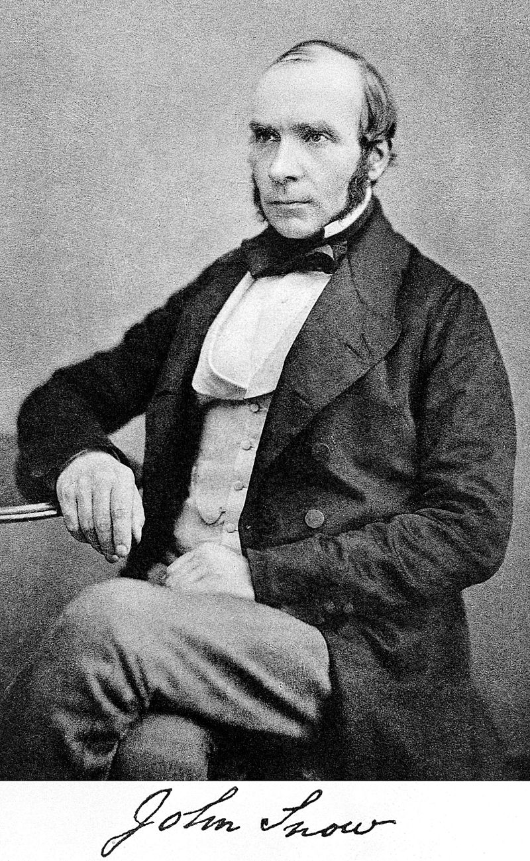
John Snow (1813 – 1858)
English physician, a leader in the adoption of anaesthesia and medical hygiene. He is considered one of the fathers of modern epidemiology, in part because of his work in tracing the source of a cholera outbreak in Soho, London, in 1854. His findings inspired fundamental changes in the water and waste systems of London, which led to similar changes in other cities, and a significant improvement in general public health around the world.

Slide 44
JESUS.CHRIST.THE.SAME
8 ...I think this, that each of us, and all know that operations does good, medicine does good. Bible said so. And you know a chiropractic and osteopathic, many times helps people... That's a good aid, a help. So what we should do, would each one of us join hands and hearts together and march forward to do everything we can for our people... to help one another, do all that we can to benefit and to make life more pleasant for each person that's traveling this journey. It's to this end that I'm here, to try to do that, to join hands with your doctor, your chiropractor, surgeon, pastor, neighbor, and all to try to make life just a little better.
58-0207

Slide 45
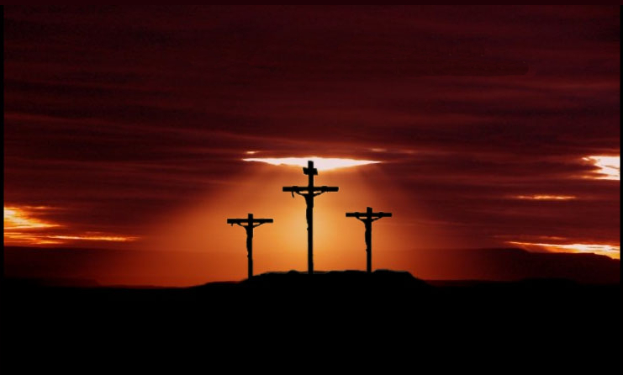
ISAIAH 53:5
But he was wounded for our transgressions, he was bruised for our iniquities: the chastisement of our peace was upon him; and with his stripes we are healed.

Slide 46
TEACHING.ON.MOSES
31 I find more doctors believing in Divine healing than I do preachers... "Bro. Branham, you do more for humanity than I ever could do. You can help people that I couldn't even touch.” I said, "Well, 'course, you can sew them up, or set a bone, or something like that. But God does the healing."
He said, "That's correct." Amen. I like to see wide-minded, sensible thinking people. I think a surgery, medical doctor, a chiropractic, osteopathic, Divine healing, and all together, if any of that can help anybody, I'm for it. And when you take a doctor condemn a preacher, and the preacher condemn a doctor, and an osteopath condemn a surgeon, the surgeon condemn a medical doctor, there's some selfish motive somewhere 'cause each one of them has proved that they help somebody.
56-0513

Slide 47
I CORINTHIANS 12:9
To another faith by the same Spirit; to another the gifts of healing (a means of healing, remedy, medicine) by the same Spirit;
28 And God hath set some in the church, first apostles, secondarily prophets, thirdly teachers, after that miracles, then gifts of healings, helps, governments, diversities of tongues.
30 Have all the gifts of healing? do all speak with tongues? do all interpret?

Slide 48
A.GREATER.THAN.SOLOMON.IS.HERE
8 Now, not in every case... But many times the medical doctors will say, "The surgeon's wrong. They don't need an operation.” The surgeon say, "He don't need them sugar pills. You need an operation…” But I have come to this conclusion, that when you see attitudes like that, the motive behind it is wrong. We have to admit that there's been many lives saved and helped by operations, by medicine, by chiropractic, osteopathic, and many healed by prayer. So if the right kind of a motive was behind it, we'd put our arms together and march forward to try to help our suffering friends, humanity, the minister, the doctor, the chiropractor, the osteopathic, all together.
57-0228

Slide 49
JESUS.CHRIST.THE.SAME
84 Now God heals in many ways. A doctor asked me, said, "What's your opinion of medicine, Bro. Branham?“ I said, "Well, God is the only One that can heal, sir. The Bible don't lie, said, 'I am the Lord, heals all your diseases.‘ God heals by medicine. God heals by love. God heals by understanding. God heals by care. God heals by prayer. God heals by miracles. The whole thing, God heals. He is the healer."
86 We haven't got a medicine that can create a cell in your hand, to heal… We can move a tooth, we can cut out appendix, or take out a gallbladder, but who healed? God. No medicine will build tissue, only God. Life builds tissue. God is the only healer… 63-0627

Slide 50
FROM.THAT.TIME
49 (Moses) …But he tried to deliver the children in his own way. You can't do that. You've got to forget your way and take God's way. That's what I'm trying to say tonight. Divine healing isn't based upon some mental tantrum. Neither is it based upon some oil out of somebody's hands; Divine healing is based upon the shed Blood of Jesus Christ, the Atonement. "He was wounded for our transgressions..." So it's upon the Atonement. And as long as we try to achieve a church for God, we're going contrary, against His will. We must let the Spirit come into our lives, take over our lives. Let Him have His way in our heart.
61-0520

Slide 51
PSALMS 37:5
Commit thy way unto the LORD; trust also in him; and he shall bring it to pass. 6 And he shall bring forth thy righteousness as the light, and thy judgment as the noonday. 7 Rest in the LORD, and wait patiently for him: fret not thyself because of him who prospereth in his way, because of the man who bringeth wicked devices to pass. 8 Cease from anger, and forsake wrath: fret not thyself in any wise to do evil.

Slide 52
LOOK
6 There's nothing like music. You know, God heals by music… God heals by love. God heals by medicine. God heals by prayer. God has many ways of healing. Depends on what type that you need.
Sometimes a little love, stretched out, will just cure an old sore, an old place that's been a grudge or something. It'll heal it right over, just a little love, a little care. Sometime when you feel all down, and, as we call it, a street expression, down in the dumps, just put on one of those tapes, that music or a record, and go to playing it. The first thing you know, you're patting your foot, or your hand, and it's all over then.
63-0428

Slide 53
RESURRECTION.OF.JAIRUS.DAUGHTER
24 I can hear some of his (Jairus) members say, "Where are you going?“ "I'm going to find Jesus.“ "Well, looky here. Don't you disgrace our church, to fool with such a fanatic as that…
But Jairus had a need. His baby was laying dying. The doctor had done all he could do. He must contact God. When a man gets desperate like that, he's going to find something. That's where I had to get one time. A desperate moment, when Mayo's looked me in the face and said, "He's just got a few minutes to live." I got desperate. And I found Him. I'm not condemning Jairus; I'm one with him. I'm just glad I found Him.
54-0302

Slide 54
FELLOWSHIP
5 The Word is a Seed, but the Seed won't grow unless it's placed in the right kind of ground... And every promise of God will come to pass if you will receive it and don't doubt it, can place it in your heart, and believe it come from God, and water it with faith, it'll spring forth of its kind. Don't never forget this statement. The right mental attitude towards any promise of God will bring it to pass. If you'll take the right attitude, that it's God's Word, and God is behind His Word, and the Word is God, it'll bring to pass what it says.

Slide 55
If you plant wheat, you get wheat. If you plant corn, you get corn. If you want to be saved, accept His plan of salvation. If you want to be healed, accept His plan of healing. Here they are. He, Christ, was wounded for our transgressions; with His stripes we were healed. That's all you have to know. The next thing you have to do, is to believe it, and it'll take care of itself.
55-0813

Slide 56
EXPECTATIONS
23 If they'd only realize who you are. You're sons and daughters of God, heirs of the Kingdom. Right now we are kings. Claim your legal rights. Don't let Satan press anything on you. You're of God. And he's has got no rights to hold it.
53-0507

