Slide 1
Seismology and Prophecy

Slide 2
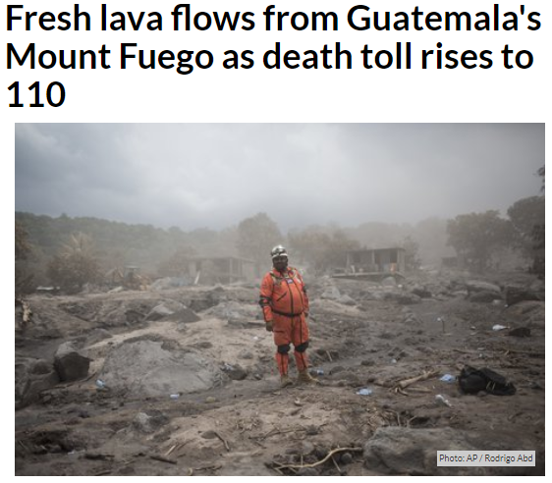

Slide 3
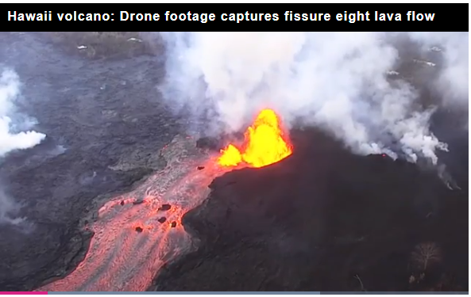

Slide 4
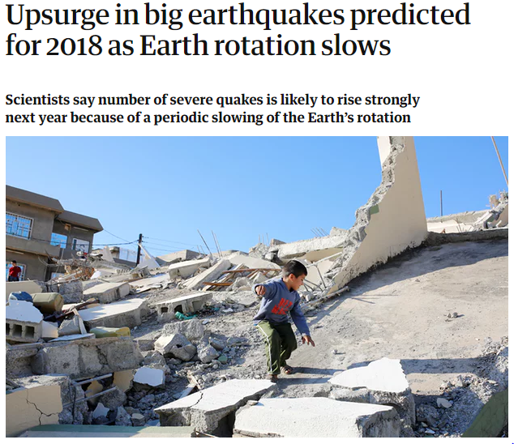

Slide 5
Role of earthquakes in prophetic events
Creation
Flood
Crucifixion
Los Angeles sinking
Sixth seal

Slide 6
58-0927 - Why Are We Not A Denomination?
When He got it all made, it was just a great big volcanic eruption. He let them old volcanics brood up there for a hundred million years, to make some calcium. What is it? It’s part of you. And then, before there was one speck of life on this earth, our bodies were laying here. Hallelujah! Before one drop of moisture ever come on the earth, we were laying here.

Slide 7
Ezekiel 28
14 Thou art the anointed cherub that covereth; and I have set thee so: thou wast upon the holy mountain of God; thou hast walked up and down in the midst of the stones of fire…
16 By the multitude of thy merchandise they have filled the midst of thee with violence, and thou hast sinned: therefore I will cast thee as profane out of the mountain of God: and I will destroy thee, O covering cherub, from the midst of the stones of fire.
17… I will cast thee to the ground, I will lay thee before kings, that they may behold thee.
18 …therefore will I bring forth a fire from the midst of thee, it shall devour thee, and I will bring thee to ashes upon the earth in the sight of all them that behold thee.

Slide 8
Gen 2:5-6
the LORD God had not caused it to rain upon the earth, and there was not a man to till the ground. But there went up a mist from the earth, and watered the whole face of the ground.

Slide 9
Water comes from Volcanos
When the mantle rocks melt, the water dissolves into the magma. As the magma rises towards the surface and cools, pressure is reduced, crystals form and the water is released and emitted as vapour through volcanoes. With this mechanism, water from great depth can be degassed to the surface.
We know that the oceans could not have condensed out of the early atmosphere, because even a 100% water vapour atmosphere would only contain 10 metres of liquid water.
New evidence from actual deep mantle minerals certainly indicates that Earth’s water comes from a depth.

Slide 10
Psalm 78:15
He clave the rocks in the wilderness, and gave them drink as out of the great depths.

Slide 11
Gen 7:11
In the six hundredth year of Noah's life, in the second month, the seventeenth day of the month, the same day were all the fountains of the great deep broken up, and the windows of heaven were opened.

Slide 12
Earthquake and Volcanic activity during the Flood
258 Now, how could science say, “Rain come from there?” But, you see, God knowed how to bring rain from there. He either caused an earthquake, or somebody had atomic power, that they throwed it and bursted some part of the earth. And it swung the earth backward, throwed it out of its orbit, and now it leans back. 60-1218 - The Uncertain Sound

Slide 13
Polar jerk and jounce
two time-derivative aspects of polar drift, jerk and jounce, appear to affect the timing of large quakes, and presumably the triggering.
in 1960, speed was relatively fast at 24.5 cm/yr and the speed trace took a turn (large jerk) and the greatest earthquake ever instrumentally recorded, the 1960 M9.5 Chilean megaquake occurred.
in 1964, the acceleration trace of polar drift (upper, black trace) took a turn (accompanied with large jounce—the second time-derivative of acceleration) and the 1964 M9.2 Alaskan megaquake occurred.

Slide 14
Slowed rotation precedes eruptions
In October 2017, University of Colorado Boulder professor Roger Bilham presented the findings of a study, conducted alongside his University of Montana colleague Rebecca Bendick, that suggested that we could potentially see the amount of earthquakes magnitude 7.0 or above double between 2017 and 2018.
variations in the speed of Earth’s rotation could trigger intense seismic activity, particularly in heavily populated tropical regions.
Although such fluctuations in rotation are small – changing the length of the day by a millisecond – they could still be implicated in the release of vast amounts of underground energy, it is argued.

Slide 15
Toba supervolcano
800 cubic miles of volcanic ash released into the atmosphere
The bright ash reflected sunlight off the landscape, and volcanic sulfur aerosols impeded solar radiation for six years, initiating an "Instant Ice Age" that -- according to evidence in ice cores taken in Greenland -- lasted about 1,800 years.
(BBC) Indonesia, Malaysia and India are thought to have been blanketed in at least 5cm of ash from Toba, which undoubtedly affected vegetation and caused mass floods. Yet archaeological studies of ash deposits appear to show that humans were remarkably resilient to the environmental changes.

Slide 16
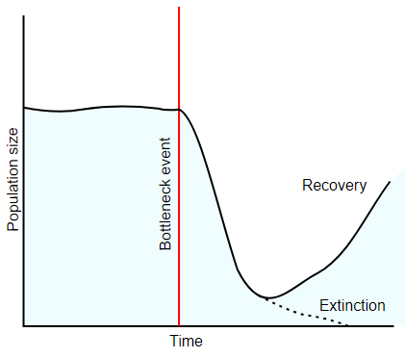
Genetic Bottleneck
Humans deeply effected
Humanoids wiped out
Other bottlenecks:
Chimpanzees
Gorillas
rhesus macaques
orangutans
tigers.

Slide 17
Migration out of Africa

Slide 18
Matthew 24:6-8
You will hear of wars and rumors of wars, but see to it that you are not alarmed. Such things must happen, but the end is still to come. Nation will rise against nation, and kingdom against kingdom. There will be famines and earthquakes in various places. All these are the beginning of birth pains.

Slide 19
Romans 8:22
We know that the whole creation has been groaning as in the pains of childbirth right up to the present time.

Slide 20
Revival corresponded to activity?
And now we’ve enjoyed about a fifteen-year revival, which according to history is longer than any revival has ever lasted, to my knowing. Usually, a revival lasts about three years, then it gets scattered. But believing that this is one of the last great revivals that the world will receive, and it’s come in the last age, the Laodicean age, at the end of the Pentecostal dispensation. And I believe the church now is going out into its lukewarmness, as the Bible predicted. And we’re seeing just the catching of the last part, when we see things happening like has been happening in the world, in the last few days.

Slide 21
For instance, the great earthquake in Alaska. Never has been an earthquake like that, in all the world. Did you notice? It come on Good Friday. You know, the last time the world was shaken was on Good Friday, too, when our Master died, and it shook the whole world. And remember, it might be the sign of Him returning. He said, that, “There’d be earthquakes in diverse places.” Today we got another one in California, and they’re just appearing everywhere, light earthquakes. We notice, even the Capital building has moved out of its place, and moved back. And—and down here in Baton Rouge, Louisiana, there’s a swimming pool there, dashed the waters out, from plumb from Alaska. Over in Switzerland, Sweden, and through there, shook buildings and things, around the world. 64-0401 - The Identified Christ Of All Ages

Slide 22
Earthquakes caused by the rejection of the Messiah
193 The earth shaking all over, with earthquakes. Why? The first time the earthquake ever shook the whole earth, was on Good Friday. The last time it shook it, was another Good Friday. What did it shake for? Because they had rejected their Messiah. Why did it shake again? They’ve done the same thing. See? 64-0409 - The Identification Of Christ In All Ages

Slide 23
1950 – 1965 revival
Richard Aster of the New Mexico Institute of Mining and Technology: “The rate of large earthquakes increased substantially from 1950-1967 and appears to be increasing again since the 2004 Sumatra-Andaman earthquake.”
Charles Bufe and David Perkins, both of the U.S. Geological Survey: “found significant clustering of magnitude-8.6 and larger earthquakes during 1950-1965 and documented a long period (beginning during 1965 and continuing to 2001) of significant global quiescence with no events of magnitude-8.4 or larger. The 8.4 in 2001 could mark the beginning of a new global sequence of larger earthquakes.

Slide 24
LAY, Thorne, Earth and Planetary Sciences, University of California Santa Cruz, 1156 High Street, Santa Cruz, CA 95064, tlay@ucsc.edu
During the past decade from December 2004 to present 18 great (M_{w} ≥ 8.0) earthquakes occurred globally (~1.8 per year), compared to 71 from 1900 to mid-2004 (~0.68 per year), yielding an effective rate increase of 265%. Six events had M_{w} ≥ 8.5, larger than any prior event since the 1965 Rat Islands earthquake.

Slide 25
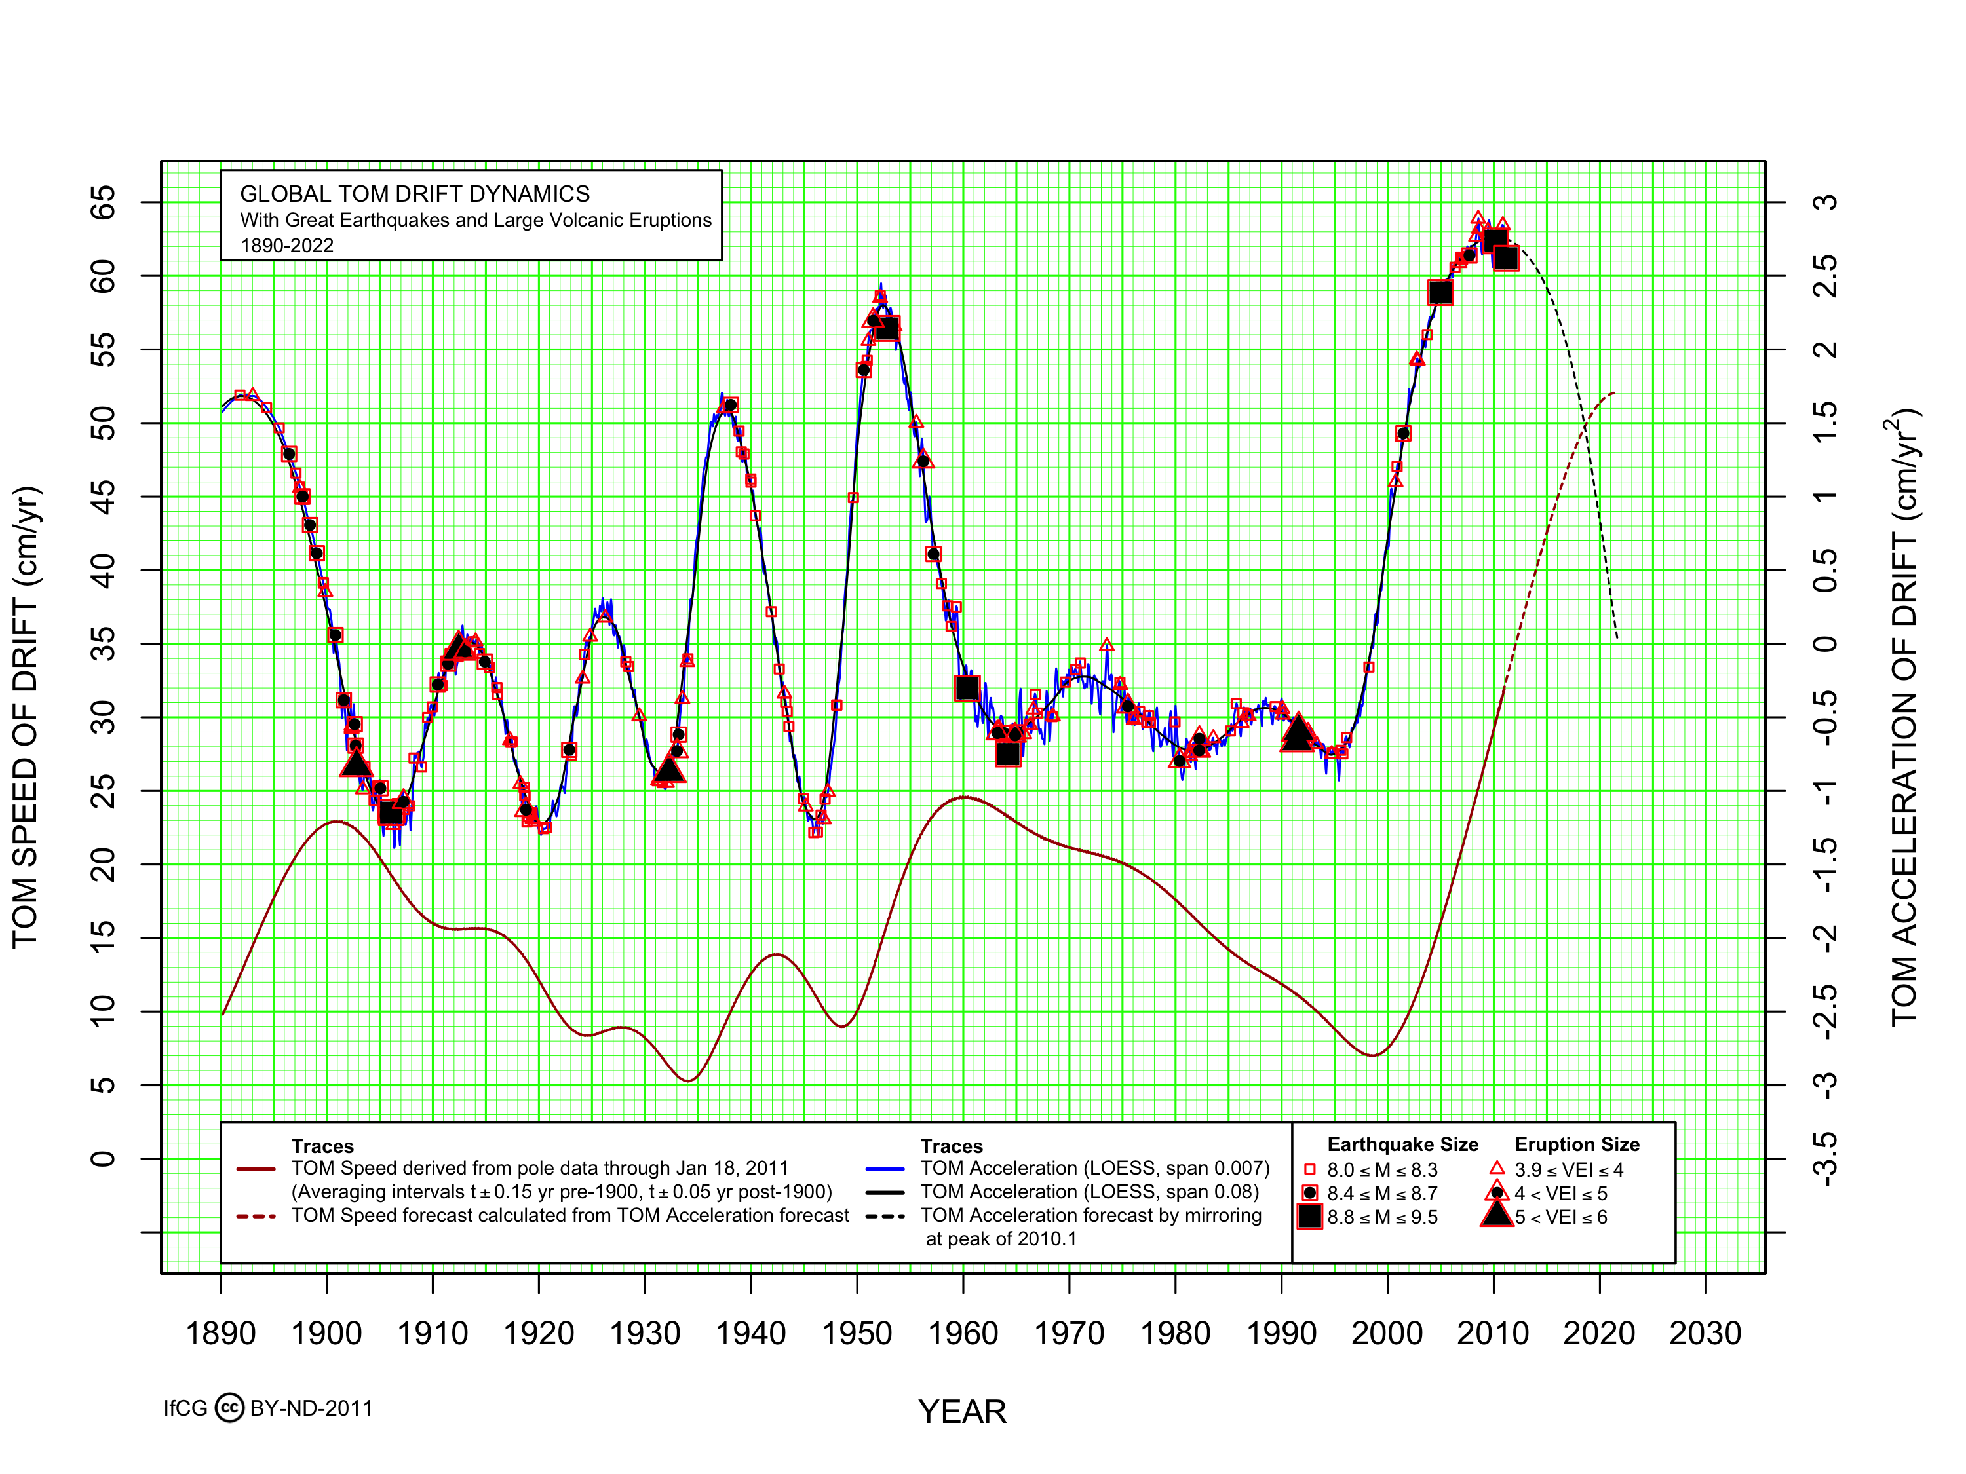

Slide 26
Like Capernaum
51 And Jesus stood, and said, “Capernaum, if Sodom would have had the works done in it that you’ve had done in you, it would have been standing today. But now you must be brought down to hell!” And about two hundred or three hundred years after His prophecy, with all them coastal towns, every one of them still standing but Capernaum, and it lays in the bottom of the sea. An earthquake sunk it into the sea. 65-0711 - Ashamed

Slide 27
Capernaum
Hometown of Peter, Andrew, James, John, Matthew
Healing of Peter’s mother-in-law
Healing of the Centurion’s servant
Healing of a man possessed of an unclean spirit
Healing of the paralytic lowered through the ceiling

Slide 28
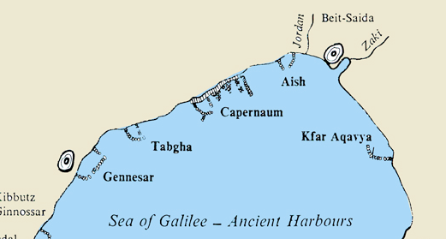
Capernaum

Slide 29
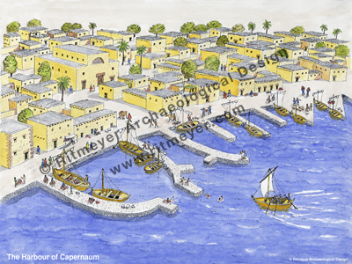
Capernaum harbor underwater
Reconstruction of the harbour of Capernaum on the Sea of Galilee at the time of Christ, based on archaeological remains discovered by the archaeologist Mendel Nun.
Several piers, which can still be seen when the water level is low, jutted out into the sea to provide a quiet and safe harbor for fishing boats.

Slide 30
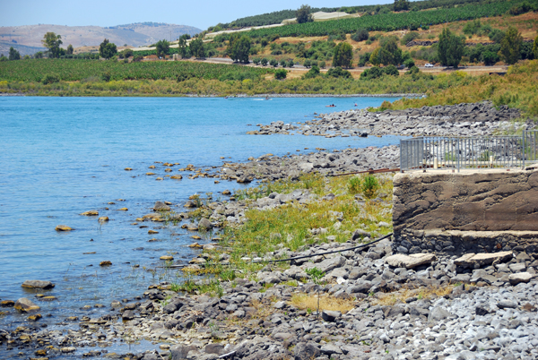
Ruins of Capernaum harbor in low water

Slide 31
Activity can be triggered by man
And when man left the Tree of Life and took the first bite off the tree of knowledge, he separated himself from God. And now he bit off gunpowder, destroys himself. He bit off an electricity, pulling the coal from the earth, where un—beneath it, is eight thousand miles of burning volcano, and these…
Now, he’s bit hisself off automobile, kills more people than all the wars. He’s got hisself a hydrogen bomb now; I wonder what he’s going to do with that. He’s still biting from that tree of knowledge. And every time he bites, he just separates himself away, destroys himself.
51-0728 - Three Witnesses

Slide 32
Seismological Society of America
Several damaging Los Angeles-area earthquakes of the 1920s and 1930s, including the deadliest ever in southern California, may have been brought on by oil production during the region’s drilling boom of that era, US government scientists have reported.
a growing frequency of quakes in Oklahoma and elsewhere to underground wastewater injection associated with fossil fuel production.
Four years of drought and heavy reliance on pumping of groundwater have made the land sink faster than ever up and down the Central Valley.
Warming climate causing ocean levels to rise

Slide 33
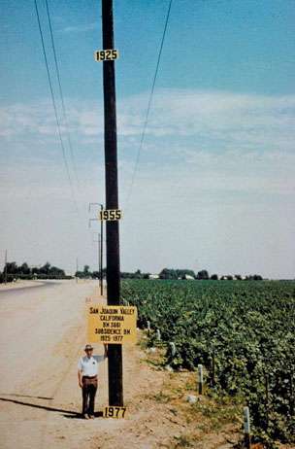

Slide 34
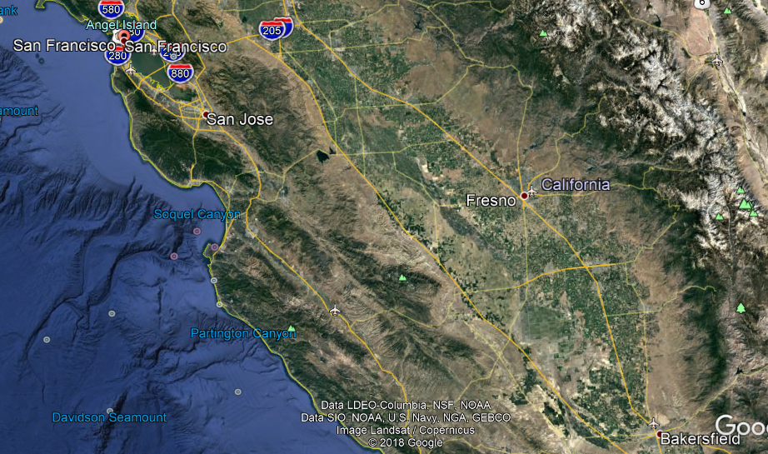

Slide 35
65-1126 - Works Is Faith Expressed
60 I said, “I don’t want to tell you; it was a judgment sign. In a few days, a great earthquake’s going to strike on the West. And it won’t stop. California, Los Angeles will sink. It’s going down. She’ll slide right into the ocean.” And two days after that, the Alaskan earthquake shook Alaska. 61 And then, the last meeting I had in California, while speaking, and didn’t know nothing happened till I got on the street, It told California, said—

Slide 36
“Capernaum, Capernaum, the city that’s called by the name of the angels,” (that’s Los Angeles) “you’ve exalted yourself into heaven, but you’ll be brought down into hell. For if the mighty works had been done in Sodom that’s been done in you, it would have been standing till this day.” 62 Now, the last few days, the great roaring and popping. Then, here come out a paper of science, said, “It’s all honeycombed, it’s got to go under.” They just know it. 63 And you watch, the water will come plumb back into the Salton Sea. Los Angeles is doomed for judgment. I tell you before it happens, that you might know when it does happen. I never spoke that by myself. And I’ve never had Him to tell me one thing but what happened. And you can bear record of that. That’s right. When? I don’t know.

Slide 37
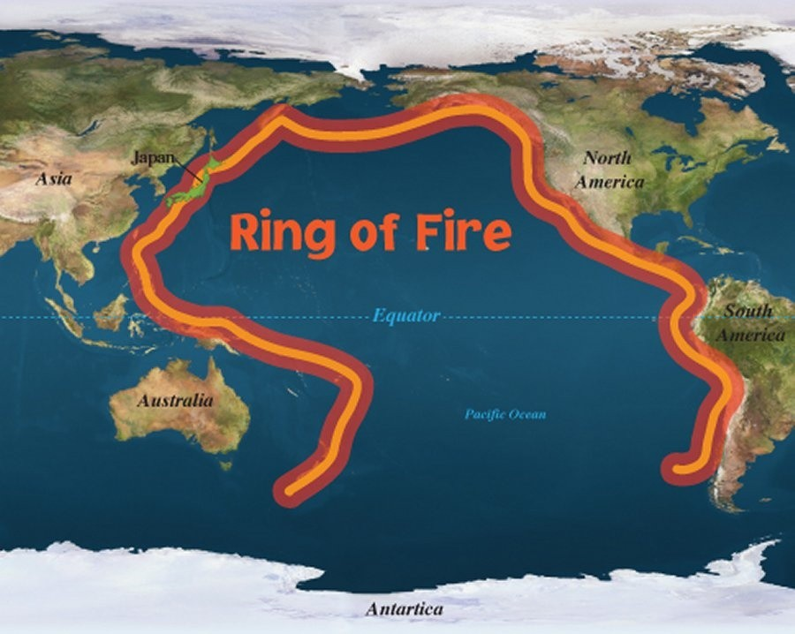

Slide 38
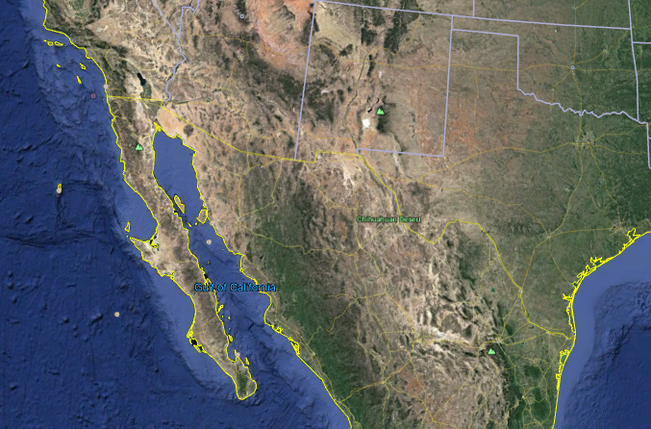

Slide 39
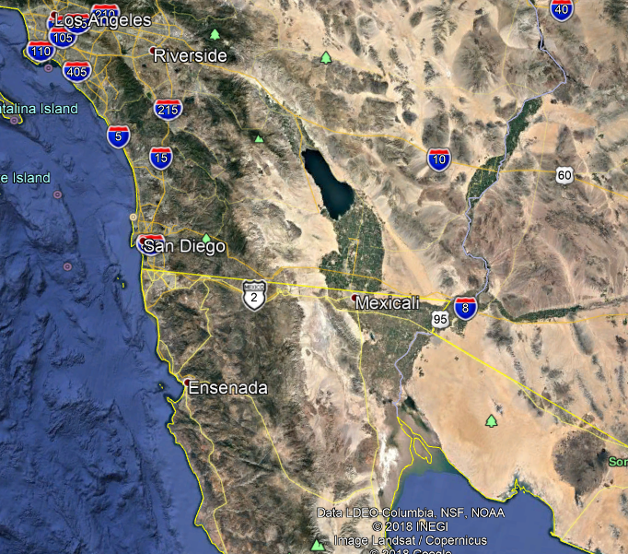

Slide 40
Los Angeles
Until recently it was thought that Los Angeles could not sink because of the lateral nature of the San Andreas Fault.
Major earthquakes on the fault centuries ago caused a parts of Seal Beach near the Orange County coast to sink 3ft in just seconds.
“It’s not just a gradual sinking. This is boom — it would drop. It’s very rapid sinking,” Robert Leeper, lead author of a new study published in Nature, carried out with the help of the US Geological Survey, told the LA Times.

Slide 41
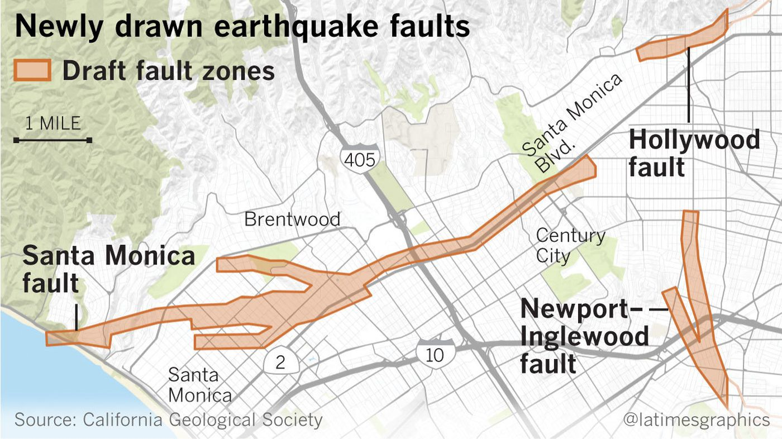

Slide 42
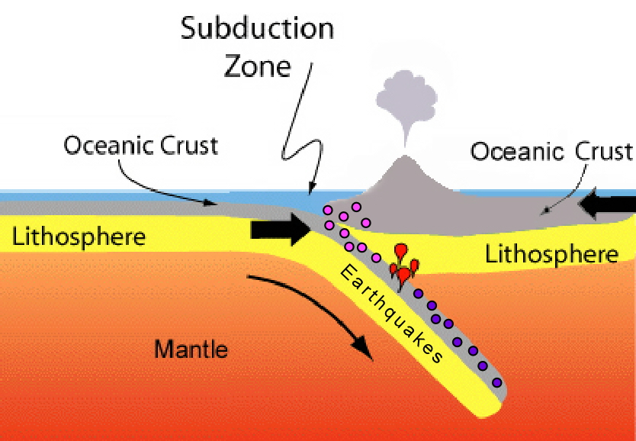

Slide 43
Micah 1:3-4 (6th Seal)
For, behold, the LORD cometh forth out of his place, and will come down, and tread upon the high places of the earth.
And the mountains shall be molten under him, and the valleys shall be cleft, as wax before the fire, and as the waters that are poured down a steep place.

Slide 44
Sirs We Would See Jesus Dawson Creek BC 05-19-61
And that's exactly what God prophesied would take place. "The heavens and earth would be on fire and burn with fervent heat." Said, "Before that great and terrible day of the Lord shall come, the world will be burnt up with a fire," Malachi 4, and said, "The righteous shall walk out upon the ashes (the volcanic ashes) of the wicked," in the millennium. That's right.

Slide 45
Yellowstone Supervolcano
A super-eruption would equal the force of 1,000 Hiroshima atomic bombs exploding every second.
You could fit Tokyo, the world's biggest city, in Yellowstone's super-volcanic crater.
Three super-eruptions at Yellowstone appear to have occurred on a 600,000-700,000 year cycle starting 2.1 million years ago. The most recent took place 640,000 years ago – suggesting Yellowstone is overdue for an eruption.
Earthquake swarms increasing to record levels

Slide 46
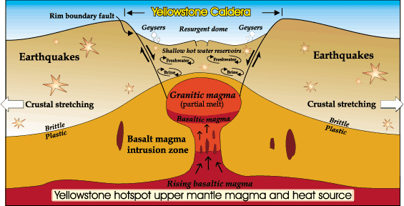

Slide 47
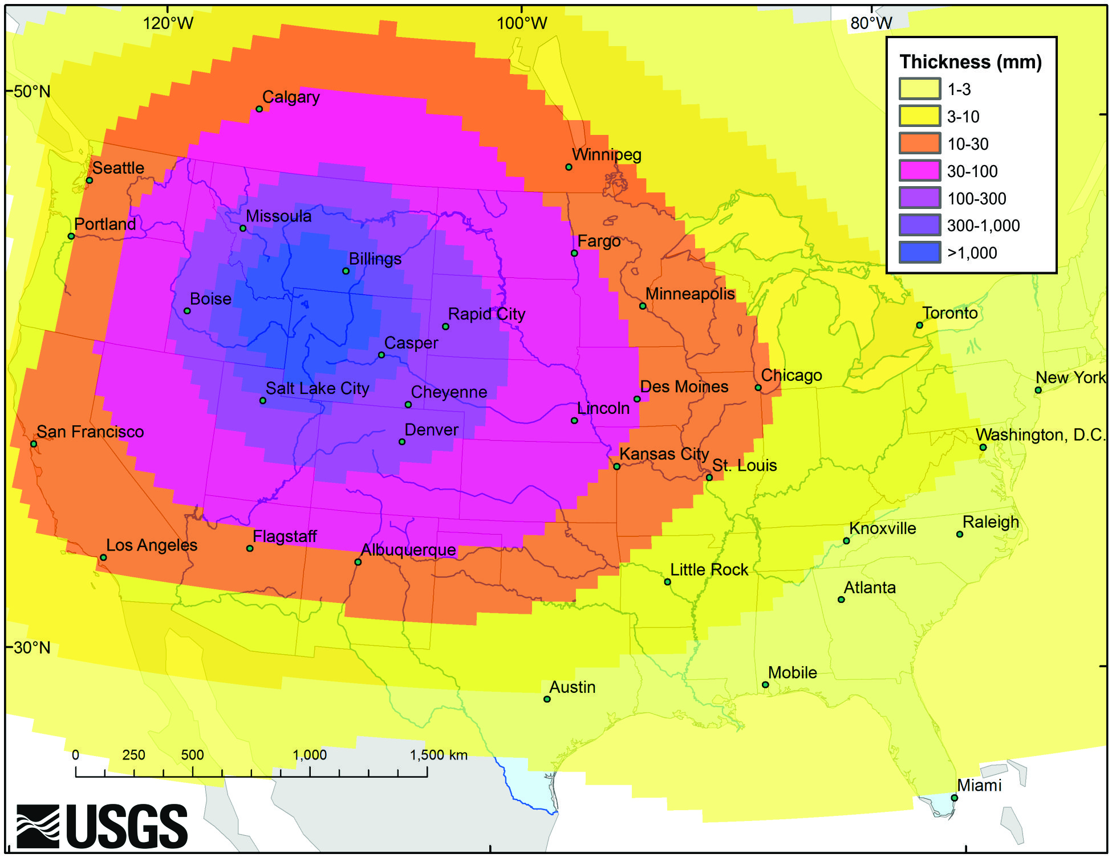

Slide 48
64-0823E - Questions And Answers #2
Now then, there will be a camp meeting of the saints upon the breadth of the earth. And Satan is loosed out of his prison and goes to make war again with the saints, just exactly what he done in Glory to begin with. And then God rains fire and brimstone out of the heavens, and the whole earth is removed like…It just burn up and destroyed. And there’s no more sea, no more water, no more nothing left on the earth. Volcanic will spray and burst and blow, and the whole thing…

Slide 49
Zach 14:3-12
Then shall the LORD go forth, and fight against those nations, as when he fought in the day of battle. And his feet shall stand in that day upon the mount of Olives, which is before Jerusalem on the east, and the mount of Olives shall cleave in the midst thereof toward the east and toward the west, and there shall be a very great valley; and half of the mountain shall remove toward the north, and half of it toward the south. And ye shall flee to the valley of the mountains; for the valley of the mountains shall reach unto Azal: yea, ye shall flee, like as ye fled from before the earthquake in the days of Uzziah king of Judah: and the LORD my God shall come, and all the saints with thee.

Slide 50
6th seal event
353 And this Sixth Plague lets her go. Brother, the earthquake bursts open, and the stars shake, volcanics will come forth, and the earth will renew itself. New lava will break forth from the center of the earth. And she’ll crumble, all around and around and around, when she spins out in yonder... Sixth Seal is going to do something. Yes, sir. Truly the whole world is groaning and paining, for the Millennium age!
63-0323 - The Sixth Seal
Rev. William Marrion Branham
http://table.branham.org

Slide 51
6th Seal Event
Nations are breaking. The world is falling apart. Fifteen-hundred-mile chunk of it, three- or four-hundred-miles wide, will sink, hundred…or maybe forty miles down into that great fault out yonder, one of these days, and waves will shoot plumb out to the state of Kentucky. And when it does, it’ll shake the world so hard that everything on top of it will shake down. 65-0822E - A Thinking Man's Filter

Slide 52
Rev 16:16-20 The seventh vial
16 And he gathered them together into a place called in the Hebrew tongue Armageddon.
17 And the seventh angel poured out his vial into the air; and there came a great voice out of the temple of heaven, from the throne, saying, It is done.
18 And there were voices, and thunders, and lightnings; and there was a great earthquake, such as was not since men were upon the earth, so mighty an earthquake, and so great.
19 And the great city was divided into three parts, and the cities of the nations fell: and great Babylon came in remembrance before God, to give unto her the cup of the wine of the fierceness of his wrath.
20 And every island fled away, and the mountains were not found.

Slide 53
And the land shall be turned as a plain from Geba to Rimmon south of Jerusalem: and it shall be lifted up, and inhabited in her place, from Benjamin's gate unto the place of the first gate, unto the corner gate, and from the tower of Hananeel unto the king's winepresses. And men shall dwell in it, and there shall be no more utter destruction; but Jerusalem shall be safely inhabited.

