Slide 1
5 Feeling All Alone… The God of Peace ISAIAH 9:6 For unto us a child is born, unto us a son is given: and the government shall be upon his shoulder: and his name shall be called Wonderful, Counsellor, The mighty God, The everlasting Father, The Prince of Peace.

Slide 2
SHALOM
38 We're facing two Scriptures, a contrast one to the other. In Isaiah "Arise, and shine, for the glory of God has come upon you. The Light is here." And then the very next verse he says, "Gross darkness is upon this people." And then when we are in a mixtury of Light and darkness...
The world is in one of the most chaotic times of darkness that it's ever stood in, and yet it's standing in, again, the most blessed Light that it ever shined in.
64-0112

Slide 3
THE.INTER.VEIL
20 The most people that can profess Christianity, they seem to have such a hard struggling time to hold on. I believe it's because of a lack of correct teaching of the Bible.
There's no such a thing as holding on. He done the holding on. The whole Christian principle is based upon rest.
56-0121

Slide 4
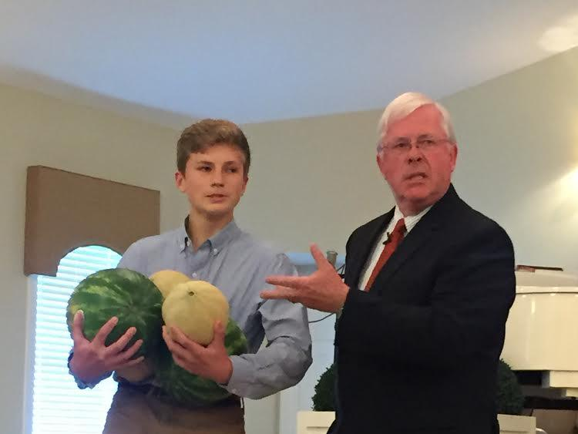

Slide 5
Sickness & the Need for Healing
Physical Diseases
Mental Disease
Spiritual Warfare

Slide 6
TO.WHOM.WOULD.WE.GO
41 ...It wasn't meant for you to have peace here. If you did, you'd get customized to the world. God don't want you custom-ized to this world.
He wants you to rest in Him. Come to Him, then you have peace.
60-0606

Slide 7
Dear Bro. Barry
You said we weren't meant to have peace in this life. What about inward peace? I've always wanted true peace....like they said "peace like a river", and to be happy and confident like most Christians are--or look to be. Because I haven't been able to overcome the shrinking feeling I have, or the great lack of confidence, I feel like God either has rejected me, or else I just don't know how to pray right.
…The message has brought so much more knowledge, it has brought so much more fear. Before, you become a Christian, live godly, and you felt happy. Now, you have to worry about predestination, foolish virgin, vessels of dishonor, deception, etc... Is it possible to feel peaceful?

Slide 8
WATCHMAN.WHAT.OF.THE.NIGHT
6 There is none of us that is immune from troubles. God has not promised to excuse us from all sickness, but it is written that His strength is sufficient.
And He will never put so much upon us, but what He will give us grace to bear. So we have that consolation of knowing.
58-1130

Slide 9
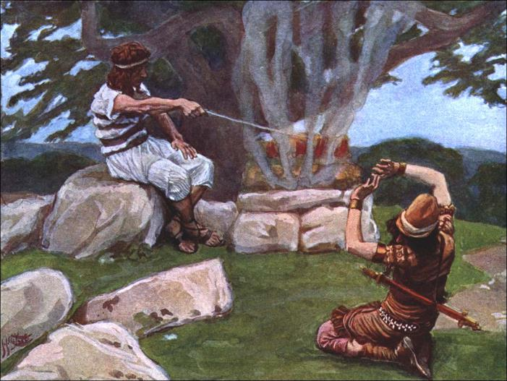
JUDGES 6:23
And the LORD said unto him, Peace be unto thee; fear not: thou shalt not die. 24 Then Gideon built an altar there unto the LORD, and called it Jehovah-shalom…

Slide 10
Peace/Shalom:
Completeness, contentment, safety, soundness; peace from war;
Of human relationships and with God, especially in covenant relationship.

Slide 11
II SAMUEL 12:24-25
24 And David comforted Bathsheba his wife, and went in unto her, and lay with her: and she bare a son, and he called his name Solomon: and the LORD loved him. 25 And he sent by the hand of Nathan the prophet; and he called his name Jedidiah, because of the LORD.
Solomon: (Heb.) Shlomoh "peace“
Jedidiah: (Heb.) "beloved of Jehovah"

Slide 12
ROJC
37 Satan will constantly punch at you until you're finished here on earth. Remember that. You'll never have a time but what there's a punching going on all the time, 'cause you're in a battle. Did you ask to come to [come] to a picnic? Well, you're sure going to be surprised, because it's a constant battle. I've been on the field for 31 yrs. and I've fought every inch of the way. Israel had to fight every inch of the way. Palestine was given to them, but they had to fight every inch of the way to get it.
61-0618

Slide 13
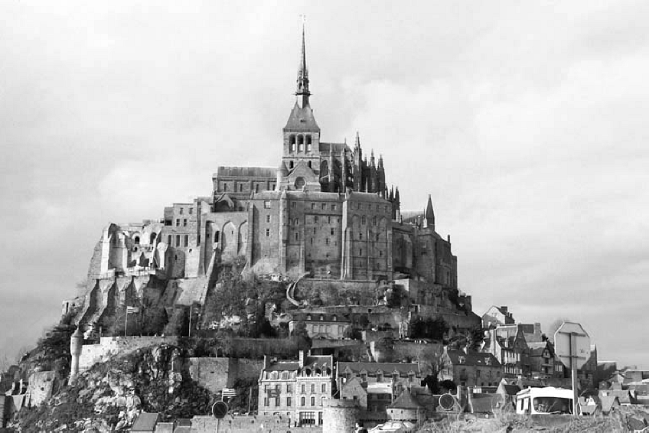
THE.EXPECTATIONS 58-0508
2 And we realize that we are fighting a strong enemy. And our warfares are not carnal, but is strong, bringing down the strong-holds of the enemy.

Slide 14
GREATEST.BATTLE.EVER.FOUGHT
30-4 And remember if it ministers something besides the Word, it didn't come from God... Always in heaven, the Word, God watches over It, and He will never send a Spirit to minister something besides the Word.
He will never send a Spirit… that, say, "Well, of course, the days of miracles is passed." No, no. That didn't come from God; it's contrary to the Word. He sends the ones that ministers the Spirit of the Word. Satan and his demons are anointed.
62-0311

Slide 15
Heaven
Souls of Just Men
Angels
Stream of Humanity
Evil Spirts
Souls of Unjust Men
Hell

Slide 16
DEMONOLOGY.RELIGIOUS.REALM 53-0609
212 And today, my dear Christian friend, demons are working on every hand. And God's Spirit's moving right out on the other hand, to counteract it every time.
It's the foreshadow of the great showdown that's coming pretty soon between God and devil. Get on God's side and be right in your heart.

Slide 17
TESTIMONY 51-0509
57 And one time, Jesus cast out some demons out of a man from Gadara, and they went into a herd of swine. Demons are powerless unless they're embodied. So they begged for mercy, even to go into swine. 'Cause Jesus wouldn't permit them in a human body.
So now, if you're irreverent, keep your head up...

Slide 18
I THESSALONIANS 5:8-9
But let us, who are of the day, be sober, putting on the breastplate of faith and love; and for an helmet, the hope of salvation. 9 For God hath not appointed us to wrath, but to obtain salvation by our Lord Jesus Christ, 10 Who died for us, that, whether we wake or sleep, we should live together with him.

Slide 19
BROKEN.CISTERNS
142 Now, speaking of grace just for a moment... We got laws and by-laws, "And if you don't measure up to this standard... I got a religious measuring stick; if you don't measure just up to that, you've got to, well, you can't come in," and so forth. But God saves us by grace, not by a measuring stick.
65-0123

Slide 20
TESTIMONY.RAISING.DEAD.BOY
23 Could you imagine somebody buying a house… Look into the kitchen, say, "Well, I'll buy it.“ No, sir. If somebody gives me a house, I'm going to go into the garage, the attic, basement. I'm going to look every bit of it over and see what I own.
Well, that's the way God wants us to do. When you're baptized by the Holy Ghost, that's a good thing. When you become a Christian, good thing, but the thing of it is, you haven't looked around to see yet to see all the blessings you got in there. There's Divine healing in there. There's joy in there. There's peace in there. There's everything in there. There's power.
53-1203

Slide 21
The LORD is nigh unto them that are of a broken heart; and saveth such as be of a contrite spirit. Many are the afflictions of the righteous: but the LORD delivereth him out of them all.
PSALM 34:18

Slide 22
HEBREWS
562 How the Christian should be established in the Faith… But first put the first thing, which is that Birth that makes you kinfolks to God… What is the fruit of the Spirit? Love, joy, faith, peace, long-suffering.
That's a part of God that's in you. And forbear-ing one another's burdens. Forgiving one another, as God for Christ's sake forgive you. The Spirit of God makes you that way...

Slide 23
566 And He's a good God. If you want to, certain things your way, you know, God is good enough to do that.
He loves to make you happy. He wants to. He is love, and His great love constrains Him to even step down sometime, to let you have the things that you want.
57-0915

Slide 24
1. Talk to God
HEAR.YE.HIM
21 You have to talk to God. When Moses took off his shoes and walked up to the burning bush, he set down and talked to it.
Just talk to God like that one time. Lay your problem out before Him in the face of His Word.
56-1215

Slide 25
Prayer: (Heb)
To judge and reconcile.
תְפִלָה PaLiel
My view of myself and His view.

Slide 26
GOD'S.PROVIDED.WAY
54 …He told Joshua, "Every place the sole of your foot treads, that I have given you." They had to fight for every inch of it. So do we fight for every inch of it. …Come with a deter-mination. Come, that you're going to stay there, till it's over… until God answers and vindicates... He's here to answer everything that He made promise for in this day. Then cry till you get it. Hold on to Him. Don't leave, if you have to stay day and night. God don't want His children listening to intellectual speeches…
64-0206

Slide 27
Fatalism: (w)
A philosophical doctrine holding that all events are predetermined in advance for all time and human beings are powerless to change them.

Slide 28
ACCEPTING.GOD'S.PROVIDED.WAY.
AT.THE.END.TIME 63-0115
189 Cry for your needs. That's God's provided way. Didn't Jesus explain the woman that cried [to the unjust judge] day and night? How much more will the Heavenly Father give them the Spirit who cry out for It, day and night? Seek, keep seeking. Knock, keep knocking. Just keep on till He opens. Stay out with it. Cry until the promised Word is vindicated, then you got it. You don't have to worry no more.

Slide 29
JOB 23:14-16
For he performeth the thing that is appointed for me: and many such things are with him. 15 Therefore am I troubled at his presence: when I consider, I am afraid of him. 16 For God maketh my heart soft, and the Almighty troubleth me: (shock)

Slide 30
TIME.TESTED.MEMORIALS.OF.GOD
6 We believe, God, that You intend for Your children to be happy. It is not meant for us to be frowning, sorrowful, it is written, "A merry heart doeth good like medicine." And we love to enjoy Your blessings and have this great fellowship together. As believers in Your Word, we fellowship around the Word. That's what we come here for, is not just to hear a message, but to worship and fellowship with Thee through the reading and preaching of the Word. 57-0818
A merry heart doeth good like a medicine: but a broken spirit drieth the bones. (Prov. 17:22)

Slide 31
MARK 9:28-29
And when he was come into the house, his disciples asked him privately, Why could not we cast him out? 29 And he said unto them, This kind can come forth by nothing, but by prayer and fasting.

Slide 32
2. Change Your Way
GOD.HAS.A.PROVIDED.WAY 62-0728
39 God always makes a provided way; we must follow it. God's made a provided way for the human race to escape the oncoming judgments… But when God makes a way and man refuses to walk in it, then if they miss it, it's not God's fault…
God, before He was going to destroy the world, He... had a ark built… God's got a Messenger tonight called the Holy Spirit. He is the Word. He's the one that manifests the Word. But you must walk in that way.

Slide 33
FROM.THAT.TIME
49 (Moses) …tried to deliver the children in his own way. You can't do that. That's what I'm trying to say tonight. Divine healing isn't based upon some mental tantrum. Neither oil out of somebody's hands; Divine healing is based upon the shed Blood of Jesus Christ, the Atonement. "He was wounded for our transgressions..." So it's upon the Atonement. And as long as we try to achieve a church for God, we're going contrary, against His will. We must let the Spirit come into our lives, take over our lives. Let Him have His way in our heart. 61-0520

Slide 34
JESUS.CHRIST.THE.SAME
84 Now God heals in many ways. A doctor asked me, "What's your opinion of medicine, Bro. Branham?“ I said, "Well, God is the only One that can heal, sir. The Bible don't lie, said, 'I am the Lord, heals all your diseases.‘ God heals by medicine. God heals by love. God heals by understanding. God heals by care. God heals by prayer. God heals by miracles. The whole thing, God heals. He is the healer.”
63-0627

Slide 35
1. Take on tasks, responsibilities in bite size chunks, (everything seems to pile up).
2. Take advantage of the alone time, read, edify, pray, counsel.
3. Change the atmosphere around you.

Slide 36
GOD.REVEALING.HIMSELF.TO.HIS.PEOPLE
36 Sister. You have troubles, inward troubles… Yes, it's a nervous condition, mental nervousness. You feel like you're going lose your mind. You're upset, aren't you? It works on you; the worst time is in the evening. I see sometimes you go set in a chair. You are doing something when you were praying too. I believe you were washing the dishes when you were praying. When you heard about the meeting, you prayed then that you'd get a card and your card would be a new number. You come tonight and your card was called…

Slide 37
37 Now, do you believe that God will hear my prayer? Ask God… Now, do you believe if I would tell you then, that it left you, you would know that I told you the truth, because I told you the truth on this side, and it's bothering you. Weary, and the sun looks gloomy...
And everything seems like a phobia; you get scared at things. And it isn't normal… You're wanting to get well. And I'm going to ask Jesus now to heal you. I believe He will do it. You've had quite a struggle in life anyhow… I don't have to say it, 'cause this is alive here. But you know what I'm speaking of.

Slide 38
38 “Our heavenly Father, by Your Spirit, look down through the stream of time. You're so lovely and kind… And our sister standing here, bound by an oppression of Satan. Foul spirits have tried to put pride upon her. But Thou art here to remove this curse of the enemy.” Help me, dear God, this duel of faith against the enemy…”
... I was trying to get her in the right mental attitude; she wouldn't have to be prayed for. The right mental attitude towards any promise of God will bring it to pass.

Slide 39
And every Seed will bring forth of its kind. If you need salvation, the Seed's here. If you need healing, here's the Seed in the Word.
The Word of God is a Seed. Put it in your heart. Don't dig it up every morning to see if it's sprouted, put it in there and leave it there.
It's God's business to bring forth the harvest. You just leave it there; water it by faith and praise every day thanking God for it.

Slide 40
RESURRECTION.OF.JAIRUS.DAUGHTER
24 I can hear some of (Jairus) members say, "Where are you going?“ "I'm going to find Jesus.“ "Well, looky here. Don't you disgrace our church, to fool with such a fanatic as that…
But Jairus had a need. His baby was dying. The doctor had done all he could do. He must contact God. When a man gets desperate like that, he's going to find something. That's where I had to get one time. (Mayo Clinic) I got desperate. And I found Him. I'm not condemning Jairus; I'm one with him.
54-0302

Slide 41
GOD.HAS.A.PROVIDED.WAY
49 Through the wilderness they come, the journey, heartaches and sorrows as they passed through. Moses got old, 120 yrs. old, one day he needed a place that he could die. God provided a rock, that same rock that had followed him through the wilderness.
He climbed up on the rock and died. Then he needed pallbearers to bury him, and God provided Angels… If we'll walk in God's provided way, God will provide everything we have need of. God provides. No matter what the circumstances is, He provides. 62-0728

Slide 42
PSALM 142:1
1 A Prayer when he was in the cave. I cried unto the LORD with my voice; with my voice unto the LORD did I make my supplication.
2 I poured out my complaint before him; I shewed before him my trouble.
3 When my spirit was overwhelmed within me, then thou knewest my path. In the way wherein I walked have they privily laid a snare for me.

Slide 43
TESTIMONY.RAISING.DEAD.BOY
21 God said, "I'm not going to give it to you all at one time. If I give it to you [all at once] then the wild beasts will multiply against you, and overcome you. I'm just going to give it to you little by little, as you're able to possess the land.“ That's the way God does tonight. Maybe you say, “I do feel a little bit better. Well, praise God. We got Canaanites today. We'll take Amorites tomorrow." And just as you're able to take it, God just gives it to you just as you're able to fight it out.
"Well," you say, "I couldn't move my hand only that much yesterday, but I can move it this much today. Praise the Lord. Tomorrow I'll move it that much." Just little by little you shall have it. 53-1203

Slide 44
TURNING.NORTHWARD
36 You've been on this mountain of organization forty years. Let's move upward, out of here. Ministers, don't you think we've been on this mountain long enough? Let's get off of this mountain and move up to the promised land. Let's start going up, and possess the land. God told them, "Go up and possess the land. All the old fighters is gone now. Put your sword back in its sheath. Don't fight."
37 Listen, men, don't you make the same mistake your fathers did, or you'll be here forty years, too. If you ever organize it, you'll stick right here another forty years. But it's time that God is calling His church to move up. He said, "Now, as you go by Mount Seir... "Now, there's your denominational brother Esau's setting up there (a good Presbyterian, Methodist or Baptist). Now, don't bother him. Don't fuss, just pass by, say, 'How do you do, brother?'" Walk right on. But you been wanting to get him and shake him and tell him he hasn't got nothing. That's right! Remember, he's got just what God give him. He come out of the same revival you did. 61-0129

Slide 45
EZEKIEL 35:2-8
Son of man, set thy face against mount Seir, and prophesy against it, 3 And say unto it, Thus saith the Lord GOD; Behold, O mount Seir, I am against thee, and I will stretch out mine hand against thee, and I will make thee most desolate. 4 I will lay thy cities waste, and thou shalt be desolate, and thou shalt know that I am the LORD. 5 Because thou hast had a perpetual hatred, and hast shed the blood of the children of Israel by the force of the sword in the time of their calamity, in the time that their iniquity had an end:

Slide 46
7 Thus will I make mount Seir most desolate, and cut off from it him that passeth out and him that returneth. 8 And I will fill his mountains with his slain men: in thy hills, and in thy valleys, and in all thy rivers, shall they fall that are slain with the sword.
14 Thus saith the Lord GOD; When the whole earth rejoiceth, I will make thee desolate. 15 As thou didst rejoice at the inheritance of the house of Israel, because it was desolate, so will I do unto thee: thou shalt be desolate, O mount Seir, and all Idumea, even all of it: and they shall know that I am the LORD.

Slide 47
GREATEST.BATTLE.EVER.FOUGHT 55-1 See his attack? Disbelieve God's Word; that's his attack. There, can you see the greatest battle that's ever fought? There's only two forces: Satan and God. And what's Satan's weapon against you? Is to try to get you to disbelieve your Weapon. If he can get you to disbelieve, your Weapon is equivalent; if he gets you to believe that your Weapon is not strong enough, he's disarmed you.
62-0311

Slide 49
SPIRITUAL.AMNESIA 64-0411
29 You must be identified. Somewhere you must show, your life… where you are identified. You are identified either in Christ or out of Christ. You are not halfway… There's no black white bird. You're either a saved, or you're not saved. You're a saint or a sinner, one or the other. And your spiritual attitude towards God's Word identifies you, exactly where you're standing.

Slide 50
CHRIST.IS.THE.MYSTERY 63-0728
36-4 You say, "Well, Brother Branham, what is the new birth?" It is the revelation of Jesus Christ personally to you. Amen. Not you joined a church, you shook a hand… you promised to live by a code of rules; but Christ…
II CORINTHIANS 5:17
Therefore if any man be in Christ, he is a new creature: old things are passed away; behold, all things are become new.

Slide 51
HEBREWS 13:5-6
5 Let your conversation be without covetousness; and be content with such things as ye have: for he hath said, I will never leave thee, nor forsake thee. 6 So that we may boldly say, The Lord is my helper, and I will not fear what man shall do unto me.
II CHRONICLES 15:3-4
3 Now for a long season Israel hath been without the true God, and without a teaching priest, and without law. 4 But when they in their trouble did turn unto the LORD God of Israel, and sought him, he was found of them.

Slide 52
Committal
LETTING.OFF.THE.PRESSURE 62-0513E
Commit your case to God, and go on as if it was all over. Don't build up pressure; it lets off pressure. "Well," you say, "I am so worried, Brother Branham, I just don't know." Let off the pressure…
Cast your cares on Him, for He careth for you. Don't you worry about your cares; that's His business.

Slide 53
EPHESIANS 6:12-13
For we wrestle not against flesh and blood, but against principalities, against powers, against the rulers of the darkness of this world, against spiritual wickedness in high places. 13 Wherefore take unto you the whole armour of God, that ye may be able to withstand in the evil day, and having done all, to stand.
Stand: (Gr.) histemi to stand immovable, firm, the foundation of a building; continue safe and sound, stand unharmed, to stand ready or prepared; to be of a steadfast mind; the quality of one who does not hesitate, does not waiver.

Slide 54
ENTICING.SPIRITS
Lay aside every weight. If you got a temper, some-thing about you that you talk when you ought not to, lay it there now. Watch the fire come down and take it away, the love of God lick it up. Watch all that old selfishness, the way you've been talking to your wife, the way you been talking to your husband, to your neighbor, way you've talked about the people in the church; lay it on the altar this morning and the fire of God will come down and take it right away and Divine love will burn in its place. If you got sickness, lay it on the altar. Say, "Lord, here it is. Create in me a clean spirit. Create in me a healing power." See what God will do. 55-0724

