Slide 1
6 Feeling All Alone
PSALM 142:1-3
A Prayer when he was in the cave. I cried unto the LORD with my voice; with my voice unto the LORD did I make my supplication. 2 I poured out my complaint before him; I shewed before him my trouble. 3 When my spirit was overwhelmed within me, then thou knewest my path. In the way wherein I walked have they privily laid a snare for me.

Slide 2
THE.INTER.VEIL
20 The most people that can profess Christianity, they seem to have such a hard struggling time to hold on. I believe it's because of a lack of correct teaching of the Bible.
There's no such a thing as holding on. He done the holding on. The whole Christian principle is based upon rest.
56-0121

Slide 3
Dear Bro. Barry
You said we weren't meant to have peace in this life. What about inward peace? I've always wanted true peace....like they said "peace like a river", and to be happy and confident like most Christians are--or look to be. Because I haven't been able to overcome the shrinking feeling I have, or the great lack of confidence, I feel like God either has rejected me, or else I just don't know how to pray right.
…The message has brought so much more knowledge, it has brought so much more fear. Before, you become a Christian, live godly, and you felt happy. Now, you have to worry about predestination, foolish virgin, vessels of dishonor, deception, etc... Is it possible to feel peaceful?

Slide 4
ROJC
37 Satan will constantly punch at you until you're finished here on earth. Remember that. You'll never have a time but what there's a punching going on all the time, 'cause you're in a battle. Did you ask to come to [come] to a picnic? Well, you're sure going to be surprised, because it's a constant battle. I've been on the field for 31 yrs. and I've fought every inch of the way. Israel had to fight every inch of the way. Palestine was given to them, but they had to fight every inch of the way to get it.
61-0618

Slide 5
TESTIMONY.RAISING.DEAD.BOY
23 Could you imagine somebody buying a house… Look into the kitchen, say, "Well, I'll buy it.“ No, sir. If somebody gives me a house, I'm going to go into the garage, the attic, basement. I'm going to look every bit of it over and see what I own.
Well, that's the way God wants us to do. When you're baptized by the Holy Ghost, that's a good thing. When you become a Christian, good thing, but the thing of it is, you haven't looked around to see yet to see all the blessings you got in there. There's Divine healing in there. There's joy in there. There's peace in there. There's everything in there. There's power.
53-1203

Slide 6
The LORD is nigh unto them that are of a broken heart; and saveth such as be of a contrite spirit. Many are the afflictions of the righteous: but the LORD delivereth him out of them all.
PSALM 34:18

Slide 7
1. Talk to God
HEAR.YE.HIM
21 You have to talk to God. When Moses took off his shoes and walked up to the burning bush, he set down and talked to it.
Just talk to God like that one time. Lay your problem out before Him in the face of His Word.
56-1215

Slide 8
Prayer: (Heb)
To judge and reconcile.
תְפִלָה PaLiel
My view of myself and His view.

Slide 9
Fatalism: (w)
A philosophical doctrine holding that all events are predetermined in advance for all time and human beings are powerless to change them.

Slide 10
MARK 9:28-29
And when he was come into the house, his disciples asked him privately, Why could not we cast him out? 29 And he said unto them, This kind can come forth by nothing, but by prayer and fasting.

Slide 11
2. Change Your Way
GOD.HAS.A.PROVIDED.WAY 62-0728
39 God always makes a provided way; we must follow it. God's made a provided way for the human race to escape the oncoming judgments… But when God makes a way and man refuses to walk in it, then if they miss it, it's not God's fault…
God, before He was going to destroy the world, He... had a ark built… God's got a Messenger tonight called the Holy Spirit. He is the Word. He's the one that manifests the Word. But you must walk in that way.

Slide 12
FROM.THAT.TIME
49 (Moses) …tried to deliver the children in his own way. You can't do that. That's what I'm trying to say tonight. Divine healing isn't based upon some mental tantrum. Neither oil out of somebody's hands; Divine healing is based upon the shed Blood of Jesus Christ, the Atonement. "He was wounded for our transgressions..." So it's upon the Atonement. And as long as we try to achieve a church for God, we're going contrary, against His will. We must let the Spirit come into our lives, take over our lives. Let Him have His way in our heart. 61-0520

Slide 13
JESUS.CHRIST.THE.SAME
84 Now God heals in many ways. A doctor asked me, "What's your opinion of medicine, Bro. Branham?“ I said, "Well, God is the only One that can heal, sir. The Bible don't lie, said, 'I am the Lord, heals all your diseases.‘ God heals by medicine. God heals by love. God heals by understanding. God heals by care. God heals by prayer. God heals by miracles. The whole thing, God heals. He is the healer.”
63-0627

Slide 14
1. Take on tasks, responsibilities in bite size chunks, (everything seems to pile up).
2. Take advantage of the alone time, read, edify, pray, counsel.
3. Change the atmosphere around you.

Slide 15
GOD.REVEALING.HIMSELF.TO.HIS.PEOPLE
36 Sister. You have troubles, inward troubles… Yes, it's a nervous condition, mental nervousness. You feel like you're going lose your mind. You're upset, aren't you? It works on you; the worst time is in the evening. I see sometimes you go set in a chair. You are doing something when you were praying too. I believe you were washing the dishes when you were praying. When you heard about the meeting, you prayed then that you'd get a card and your card would be a new number. You come tonight and your card was called…

Slide 16
37 Now, do you believe that God will hear my prayer? Ask God… Now, do you believe if I would tell you then, that it left you, you would know that I told you the truth, because I told you the truth on this side, and it's bothering you. Weary, and the sun looks gloomy...
And everything seems like a phobia; you get scared at things. And it isn't normal… You're wanting to get well. And I'm going to ask Jesus now to heal you. I believe He will do it. You've had quite a struggle in life anyhow… I don't have to say it, 'cause this is alive here. But you know what I'm speaking of.

Slide 17
38 “Our heavenly Father, by Your Spirit, look down through the stream of time. You're so lovely and kind… And our sister standing here, bound by an oppression of Satan. Foul spirits have tried to put pride upon her. But Thou art here to remove this curse of the enemy.” Help me, dear God, this duel of faith against the enemy…”
... I was trying to get her in the right mental attitude; she wouldn't have to be prayed for. The right mental attitude towards any promise of God will bring it to pass.

Slide 18
And every Seed will bring forth of its kind. If you need salvation, the Seed's here. If you need healing, here's the Seed in the Word.
The Word of God is a Seed. Put it in your heart. Don't dig it up every morning to see if it's sprouted, put it in there and leave it there.
It's God's business to bring forth the harvest. You just leave it there; water it by faith and praise every day thanking God for it.

Slide 19
RESURRECTION.OF.JAIRUS.DAUGHTER
24 I can hear some of (Jairus) members say, "Where are you going?“ "I'm going to find Jesus.“ "Well, looky here. Don't you disgrace our church, to fool with such a fanatic as that…
But Jairus had a need. His baby was dying. The doctor had done all he could do. He must contact God. When a man gets desperate like that, he's going to find something. That's where I had to get one time. (Mayo Clinic) I got desperate. And I found Him. I'm not condemning Jairus; I'm one with him.
54-0302

Slide 20
GOD.HAS.A.PROVIDED.WAY
49 Moses got old, 120 yrs. old, one day he needed a place that he could die. God provided a rock, that same rock that had followed him through the wilderness.
He climbed up on the rock and died. Then he needed pallbearers to bury him, and God provided Angels… If we'll walk in God's provided way, God will provide everything we have need of. God provides. No matter what the circumstances is, He provides. 62-0728

Slide 21
PSALM 142:1
A Prayer when he was in the cave. I cried unto the LORD with my voice; with my voice unto the LORD did I make my supplication.
2 I poured out my complaint before him; I shewed before him my trouble.
3 When my spirit was overwhelmed within me, then thou knewest my path. In the way wherein I walked have they privily laid a snare for me.

Slide 22
TESTIMONY.RAISING.DEAD.BOY
21 God said, "I'm not going to give it to you all at one time. If I give it to you [all at once] then the wild beasts will multiply against you, and overcome you. I'm just going to give it to you little by little, as you're able to possess the land.“ That's the way God does tonight. Maybe you say, “I do feel a little bit better. Well, praise God. We got Canaanites today. We'll take Amorites tomorrow." And just as you're able to take it, God just gives it to you just as you're able to fight it out.
"Well," you say, "I couldn't move my hand only that much yesterday, but I can move it this much today. Praise the Lord. Tomorrow I'll move it that much." Just little by little you shall have it. 53-1203

Slide 23
TURNING.NORTHWARD
36 Let's get off of this mountain and move up to the promised land. Let's start going up, and possess the land. God told them, "All the old fighters is gone now. Put your sword back in its sheath. Don't fight."
37 Listen, don't you make the same mistake your fathers did, or you'll be here forty years, too. But it's time that God is calling His church to move up. He said, "Now, as you go by Mount Seir...

Slide 25
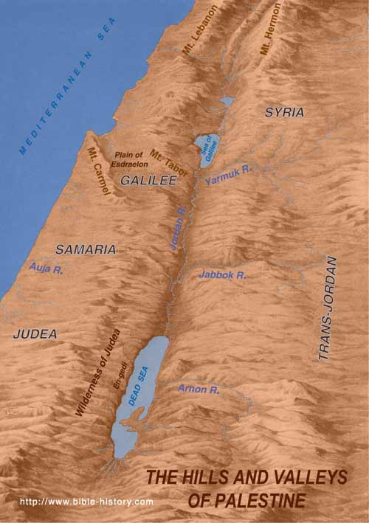
Moabites –
E & SE of the Dead Sea
Edomites -
Between Red Sea and Dead Sea, East
Jordan
A
r
a
b
i
a
Midianites -
East of the Red Sea

Slide 26
"Now, there's your denominational brother Esau's setting up there (a good Presbyterian, Methodist or Baptist). Now, don't bother him. Don't fuss, just pass by, say, 'How do you do, brother?’”
Walk right on. But you been wanting to get him and shake him and tell him he hasn't got nothing. Remember, he's got just what God give him. He come out of the same revival you did.
61-0129

Slide 27
GENESIS 36:6-8
Now these are the generations of Esau, who is Edom.
6 And Esau took his wives, and his sons, and his daughters, and all the persons of his house, and his cattle, and all his beasts, and all his substance, which he had got in the land of Canaan; and went into the country from the face of his brother Jacob.
7 For their riches were more than that they might dwell together; and the land wherein they were strangers could not bear them because of their cattle. 8 Thus dwelt Esau in mount Seir: Esau is Edom.

Slide 28
EZEKIEL 35:2-8
Son of man, set thy face against mount Seir, and prophesy against it, 3 And say unto it, Thus saith the Lord GOD; Behold, O mount Seir, I am against thee, and I will stretch out mine hand against thee, and I will make thee most desolate. 4 I will lay thy cities waste, and thou shalt be desolate, and thou shalt know that I am the LORD. 5 Because thou hast had a perpetual hatred, and hast shed the blood of the children of Israel by the force of the sword in the time of their calamity, in the time that their iniquity had an end:

Slide 29
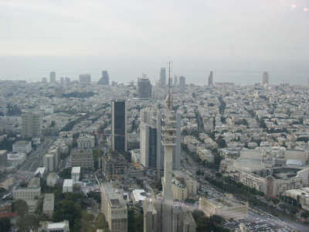
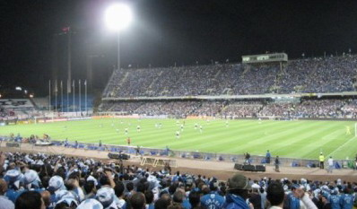
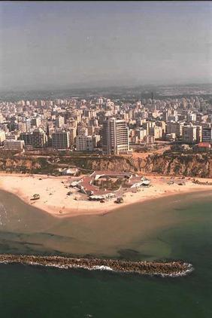
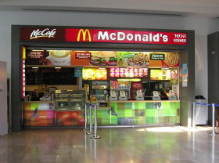
29

Slide 30
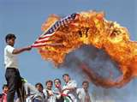
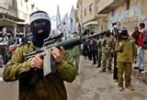
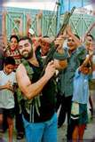
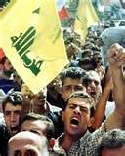
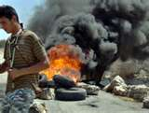
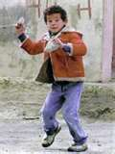
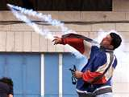

Slide 31
7 Thus will I make mount Seir most desolate, and cut off from it him that passeth out and him that returneth. 8 And I will fill his mountains with his slain men: in thy hills, and in thy valleys, and in all thy rivers, shall they fall that are slain with the sword.
14 Thus saith the Lord GOD; When the whole earth rejoiceth, I will make thee desolate. 15 As thou didst rejoice at the inheritance of the house of Israel, because it was desolate, so will I do unto thee: thou shalt be desolate, O mount Seir, and all Idumea, even all of it: and they shall know that I am the LORD.

Slide 33

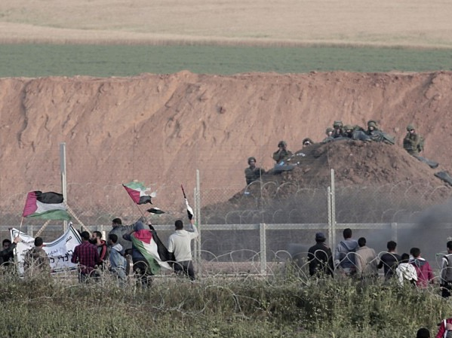

Slide 35
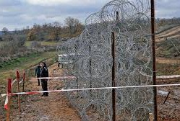


Slide 36
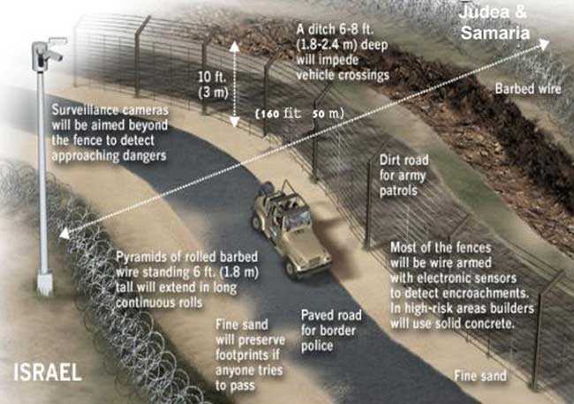

Slide 37
EZEKIEL 36:36-38
And they shall say, This land that was desolate is become like the garden of Eden; and the waste and desolate and ruined cities are become fenced, and are inhabited. Then the heathen that are left round about you shall know that I the LORD build the ruined places, and plant that that was desolate: I the LORD have spoken it, and I will do it. 37 Thus saith the Lord GOD; I will yet for this be enquired of by the house of Israel, to do it for them; I will increase them with men like a flock. 38 As the holy flock, as the flock of Jerusalem in her solemn feasts; so shall the waste cities be filled with flocks of men: and they shall know that I am the LORD.

Slide 38
GREATEST.BATTLE.EVER.FOUGHT 55-1 See his attack? Disbelieve God's Word; that's his attack. There, can you see the greatest battle that's ever fought? There's only two forces: Satan and God. And what's Satan's weapon against you? Is to try to get you to disbelieve your Weapon. If he can get you to disbelieve, your Weapon is equivalent; if he gets you to believe that your Weapon is not strong enough, he's disarmed you.
62-0311

Slide 39
LETTING.OFF.THE.PRESSURE
Commit your case to God, and go on as if it was all over. Don't build up pressure; it lets off pressure. "Well," you say, "I am so worried, Brother Branham, I just don't know." Let off the pressure…
Cast your cares on Him, for He careth for you. Don't you worry about your cares; that's His business.
62-0513

Slide 40
EPHESIANS 6:12-13
For we wrestle not against flesh and blood, but against principalities, against powers, against the rulers of the darkness of this world, against spiritual wickedness in high places. 13 Wherefore take unto you the whole armour of God, that ye may be able to withstand in the evil day, and having done all, to stand.
Stand: (Gr.) histemi to stand immovable, firm, the foundation of a building; continue safe and sound, stand unharmed, to stand ready or prepared; to be of a steadfast mind; the quality of one who does not hesitate, does not waiver.

Slide 41
ENTICING.SPIRITS
Lay aside every weight. If you got a temper, some-thing about you that you talk when you ought not to, lay it there now. Watch the fire come down and take it away, the love of God lick it up. Watch all that old selfishness, the way you've been talking to your wife, the way you been talking to your husband, to your neighbor, way you've talked about the people in the church; lay it on the altar this morning and the fire of God will come down and take it right away and Divine love will burn in its place. If you got sickness, lay it on the altar. Say, "Lord, here it is. Create in me a clean spirit. Create in me a healing power." See what God will do. 55-0724

