Slide 1

A Very Good World
GENESIS 1:31
And God saw every thing that he had made, and, behold, it was very good. And the evening and the morning were the sixth day.

Slide 2
THE.ONENESS.OF.UNITY
2-5 The devil has messengers; God has messengers. And we are at liberty to make our choice to whom we will yield ourself to, that's whose servants we are. God made man to thirst, but to thirst after Him. That's why thirst was placed in a man. But the devil comes along, and perverts that, and causes the people to thirst after him with the things of the world.
The Bible said, "If ye love the world or the things of the world, the love of the Father is not in you." Then you see, the devil perverts. He can't create anything, but he can pervert what God has already created. The devil is not a creator; he's just a perverter of the original creation. 58-0128

Slide 3
UNITED.UNDER.ONE.HEAD
12 …Nimrod had built them a tower. And it's very strange to think that all the things that the devil has, he stole the copyright from God to make it. Satan cannot create. Satan is no creator; he's a perverter of something God created.
13 …No one that knows his Bible or knows God would say that the devil can heal. Healing is creation. And if the devil can create, he could create himself a world and some people. But he cannot create; he perverts what God has created. What is unrighteousness? It's righteousness perverted. Everything that you see that's wrong, just do opposite and you'll be right, for unrighteousness is righteousness perverted. And remember, that anything that man does that's outside the plan of God, it's perverted. No matter how good it looks, it's still perverted, because God's got His original idea, and He gave it to man, and man wants to make something of his own self. He wants to have something to do into it.
58-0326

Slide 4
DANIEL 12:4
But thou, O Daniel, shut up the words, and seal the book, even to the time of the end: many shall run to and fro, and knowledge shall be increased.
II PETER 3:18
But grow in grace, and in the knowledge of our Lord and Saviour Jesus Christ. To him be glory both now and for ever. Amen.

Slide 5
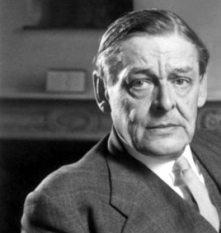
The endless cycle of idea and action,
Endless invention, endless experiment,
Brings knowledge of motion, but not of stillness;
Knowledge of speech, but not of silence;
Knowledge of words, and ignorance of the Word.
All our knowledge brings us nearer to our ignorance,
All our ignorance brings us nearer to death,
But nearness to death no nearer to GOD.
Where is the Life we have lost in living?
Where is the wisdom we have lost in knowledge?
Where is the knowledge we have lost in information?
T. S. Elliott

Slide 6
PHILIPPIANS 1:9
And this I pray, that your love may abound yet more and more in knowledge and in all judgment; 10 That ye may approve things that are excellent; that ye may be sincere and without offence till the day of Christ; 11 Being filled with the fruits of righteousness, which are by Jesus Christ, unto the glory and praise of God.

Slide 7
COLOSSIANS 2:6-8
As ye have therefore received Christ Jesus the Lord, so walk ye in him: 7 Rooted and built up in him, and stablished in the faith, as ye have been taught, abounding therein with thanksgiving. 8 Beware lest any man spoil you through philosophy and vain deceit, after the tradition of men, after the rudiments of the world, and not after Christ.

Slide 8
SATAN'S.EDEN
142 Now, he now wears her bangs, also. He combs them down, puts a curler in them. Some of the most sickly sights I've ever seen in my life, is some of those kids out here today with their bangs combed down like this, and colored, bleached hair, with some kind of a peroxide something, and bleach their hair, and rolling it in curlers, making bangs. You big sissy! You don't even know whether you're a man or woman. And I understand that our United States Army is coming out next in shorts.
143 The other day I was over, Howard Johnson's. And I just sat back in amazement. Here come a little boy along, his mouth open. And he had dark hair here, combed it over this a way; and put a

Slide 9
roller in it, and curled it up around, top of his eyes... If I ever seen a perversion! See, he wouldn't believe it. He could prove maybe he was male, but in his spirit he is female. He don't know what side of the house he belongs on. How perverted!
144 That's what Satan does. He perverts the nations. He perverts the church. He perverts the people. He is a deceiver, a perverter of the original Truth.
145 God made a man a man. He made a woman a woman. And He dressed them different, and He meant for them to stay that way and to act that way; one is feminish, and the other is masculine. He separated Adam in the garden of Eden, and did this, separated Eve from him.
65-0829

Slide 10
COLOSSIANS 2:6-8
As ye have therefore received Christ Jesus the Lord, so walk ye in him: 7 Rooted and built up in him, and stablished in the faith, as ye have been taught, abounding therein with thanksgiving. 8 Beware lest any man spoil you through philosophy and vain deceit, after the tradition of men, after the rudiments of the world, and not after Christ.

Slide 11
THE COCAINE INDUSTRY IN BOLIVIA - ITS IMPACT ON THE PEASANTRY
By Healy Kevin
For the indigenous people of Andean Bolivia who have been growing and consuming the coca leaf for several thousand years, the rising demand for cocaine in the United States is rapidly restructuring their economic and social relations. In recent years, underground, illegal economic activities have emerged on a grand scale. Surpassing most other legal economic endeavors, these underground activities are distorting patterns of economic development and the social well-being of the Andean peasant majority.

Slide 12
COLOSSIANS 2:6-8
As ye have therefore received Christ Jesus the Lord, so walk ye in him: 7 Rooted and built up in him, and stablished in the faith, as ye have been taught, abounding therein with thanksgiving. 8 Beware lest any man spoil you through philosophy and vain deceit, after the tradition of men, after the rudiments of the world, and not after Christ.

Slide 13
CONFIRMATION.OF.THE.COMMISSION
116 If he denies, this man that's going around, saying, "Now, don't you listen to them people. You were down to a tabernacle the other night? Well, we belong to So-and-so. That's nothing but just a bunch of riffraff."
118 Did you know that Paul said to Agrippa, "In the way that's called 'heresy,' that's the way that I worship the God of our fathers"? You know what heresy is? "A way that seems crazy." Because you have passed from death unto Life. You're no more of the world, but you been set aside from the world. And therefore your mind is spiritual, and you think on things Above and not the things on that goes on here on earth. Your affections are on things Above. 62-0122

Slide 14
kosmos
The arrangement or constitution, order, government; ornament, decoration, adornment, i.e. the arrangement of the stars, as the ornament of the heavens. 1 Pet. 3:3;
The inhabitants of the earth, men, the human race; the ungodly multitude; the whole mass of men alienated from God, and therefore hostile to the cause of Christ.
World affairs, the aggregate of things earthly; the whole circle of earthly goods, endowments riches, advantages, pleasures, etc, which although hollow and frail, stir desire, seduce from God and are obstacles to the cause of Christ;
The Gentiles as contrasted to the Jews (Rom. 11:12 etc)

Slide 15
“Computers will be where we go live our lives and live alternate lives and lifestyles.” (1980)
Sherry Turkle:
is Abby Rockefeller Mauzé Professor of the Social Studies of Science and Technology at MIT. She's the founder and director of the MIT Initiative on Technology and Self. Her books include Alone Together: Why We Expect More from Technology and Less from Each Other.

Slide 16
DEUTERONOMY 2:3
Ye have compassed this mountain long enough: turn you northward…

Slide 17
TURNING.NORTHWARD
36 Let's get off of this mountain and move up to the promised land. Let's start going up, and possess the land. God told them, "All the old fighters is gone now. Put your sword back in its sheath. Don't fight."
37 Listen, don't you make the same mistake your fathers did, or you'll be here forty years, too. But it's time that God is calling His church to move up. He said, "Now, as you go by Mount Seir...

Slide 19
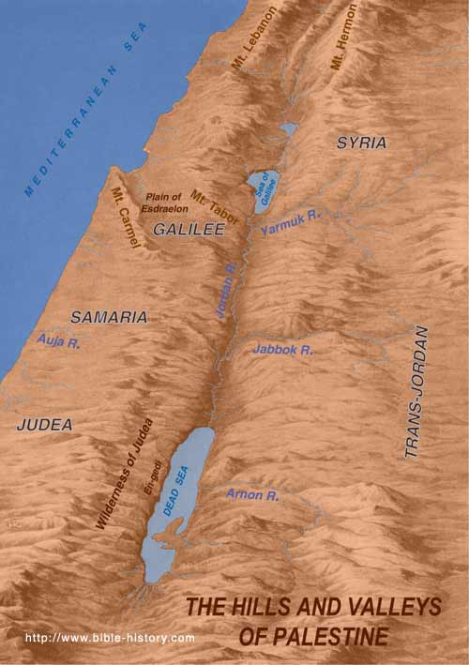
Moabites –
E & SE of the Dead Sea
Edomites -
Between Red Sea and Dead Sea, East
Jordan
A
r
a
b
i
a
Midianites -
East of the Red Sea

Slide 20
TURNING.NORTHWARD
36 Let's get off of this mountain and move up to the promised land. Let's start going up, and possess the land. God told them, "All the old fighters is gone now. Put your sword back in its sheath. Don't fight."
37 Listen, don't you make the same mistake your fathers did, or you'll be here forty years, too. But it's time that God is calling His church to move up. He said, "Now, as you go by Mount Seir...

Slide 21
"Now, there's your denominational brother Esau's setting up there (a good Presbyterian, Methodist or Baptist). Now, don't bother him. Don't fuss, just pass by, say, 'How do you do, brother?’”
Walk right on. But you been wanting to get him and shake him and tell him he hasn't got nothing. Remember, he's got just what God give him. He come out of the same revival you did.
61-0129

Slide 22
NUMBERS 20:17-21
Let us pass, I pray thee, through thy country: we will not pass through the fields, or through the vineyards, neither will we drink of the water of the wells: we will go by the king's high way, we will not turn to the right hand nor to the left, until we have passed thy borders. 18 And Edom said unto him, Thou shalt not pass by me, lest I come out against thee with the sword. 19 And the children of Israel said unto him, We will go by the high way: and if I and my cattle drink of thy water, then I will pay for it: I will only, without doing any thing else, go through on my feet. 20 And he said, Thou shalt not go through. And Edom came out against him with much people, and with a strong hand. 21 Thus Edom refused to give Israel passage through his border: wherefore Israel turned away from him.

Slide 23
GENESIS 36:6-8
1. Now these are the generations of Esau, who is Edom…
6 And Esau took his wives, and his sons, and his daughters, and all the persons of his house, and his cattle, and all his beasts, and all his substance, which he had got in the land of Canaan; and went into the country from the face of his brother Jacob. 7 For their riches were more than that they might dwell together; and the land wherein they were strangers could not bear them because of their cattle. 8 Thus dwelt Esau in mount Seir: Esau is Edom.

Slide 24
Moabites –
E & SE of the Dead Sea
Edomites -
Between Red Sea and Dead Sea, East
Jordan
A
r
a
b
i
a
Midianites -
East of the Red Sea

Slide 25
EZEKIEL 35:2-8
Son of man, set thy face against mount Seir, and prophesy against it, 3 And say unto it, Thus saith the Lord GOD; Behold, O mount Seir, I am against thee, and I will stretch out mine hand against thee, and I will make thee most desolate. 4 I will lay thy cities waste, and thou shalt be desolate, and thou shalt know that I am the LORD.
5 Because thou hast had a perpetual hatred, and hast shed the blood of the children of Israel by the force of the sword in the time of their calamity, in the time that their iniquity had an end:

Slide 26
7 Thus will I make mount Seir most desolate, and cut off from it him that passeth out and him that returneth. 8 And I will fill his mountains with his slain men: in thy hills, and in thy valleys, and in all thy rivers, shall they fall that are slain with the sword.
14 Thus saith the Lord GOD; When the whole earth rejoiceth, I will make thee desolate. 15 As thou didst rejoice at the inheritance of the house of Israel, because it was desolate, so will I do unto thee: thou shalt be desolate, O mount Seir, and all Idumea, even all of it: and they shall know that I am the LORD.

Slide 27
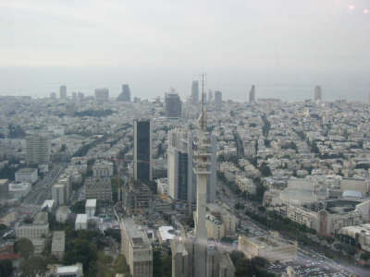
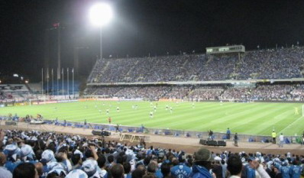
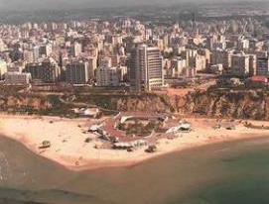
27

Slide 28
EZEKIEL 36:36-38
And they shall say, This land that was desolate is become like the garden of Eden; and the waste and desolate and ruined cities are become fenced, and are inhabited. Then the heathen that are left round about you shall know that I the LORD build the ruined places, and plant that that was desolate: I the LORD have spoken it, and I will do it. 37 Thus saith the Lord GOD; I will yet for this be enquired of by the house of Israel, to do it for them; I will increase them with men like a flock. 38 As the holy flock, as the flock of Jerusalem in her solemn feasts; so shall the waste cities be filled with flocks of men: and they shall know that I am the LORD.

Slide 29
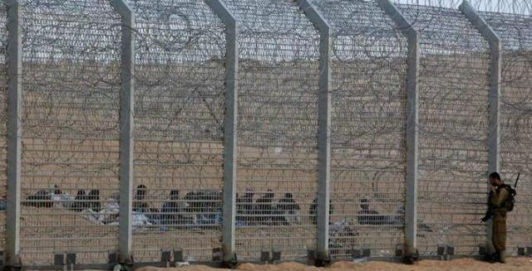

Slide 30
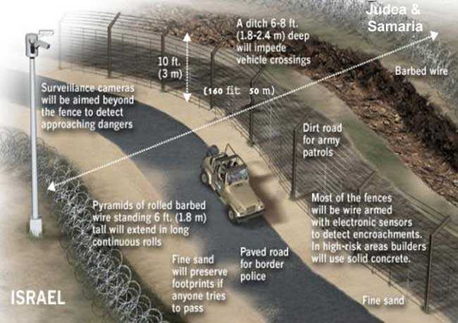

Slide 33
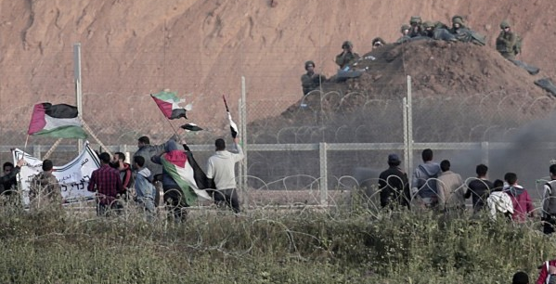

Slide 34
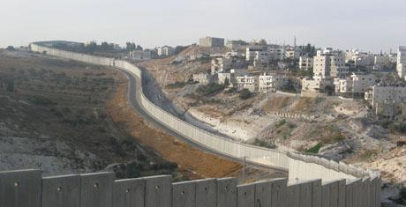

Slide 35
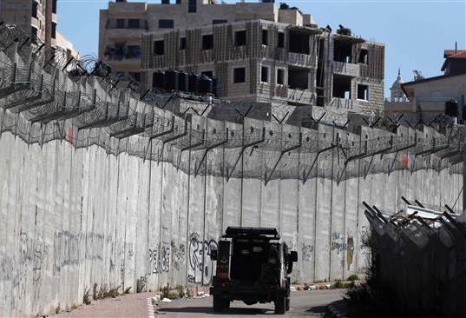

Slide 36
GOD'S.POWER.TO.TRANSFORM
134 I wanted to give you my analysis of what Satan done in Eden: sprayed horrible poison spray. Would you like to know what that spray was? I can tell you. I got the formula of it, two words: unbelief, which is contrary to faith, sprayed unbelief, doubt. And science filled its place. Where the cavity is, that went into the Seed, Satan filled that cavity with knowledge and science and civilization, and it's deformed the whole, entire creation of God.
65-0911

Slide 37
God Has His Own Repellent!
GOD'S.POWER.TO.TRANSFORM
220 Oh, Satan tried and tried again, do everything. One night, laying on the back of a ship, he seen Him asleep. And said, "I'll destroy Him right now." But he couldn’t.
221 He tried to tempt Him into doing the wrong thing, but he couldn't do it. Why? He had been sprayed with the repellent of predestination. It can't be deceived. No, no. The Word said He would be here. Amen. There ain't no devil going to bother Him, and no other son of God, that's predestinated to take his place. He is sprayed with a repellent.
65-0911

