Slide 1
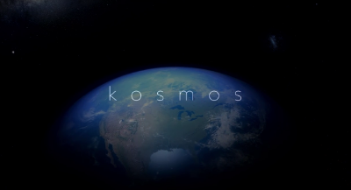
A Very Good World 2 Growing Up in the Message
GENESIS 1:31
And God saw every thing that he had made, and, behold, it was very good. And the evening and the morning were the sixth day.

Slide 2
Birthdays & Anniversaries & Really Great Events Happening at HBT
October 12-147th Dedication Meetings

Slide 3
THE.TESTIMONY.OF.A.TRUE.WITNESS
71 Now, the one reason that I am a Calvinistic thinker, security of the believer, is because when a man or a woman is in their right mind, that is the time to accept the Lord Jesus and get it all settled then, once for ever. Because when we come to the end of the road, we don't know just where and how we're going to be sick.
We may be sick in our mind; there might be a fever that would really cook our very brain; and we might say anything or do anything at the end of the road. We don't know. But, you see, if we have already anchored in Christ, no matter what sickness takes us, or what condition we are when we go, it's already settled. We are sealed until the day of our redemption. Ephesians 4:30.
61-1105

Slide 4
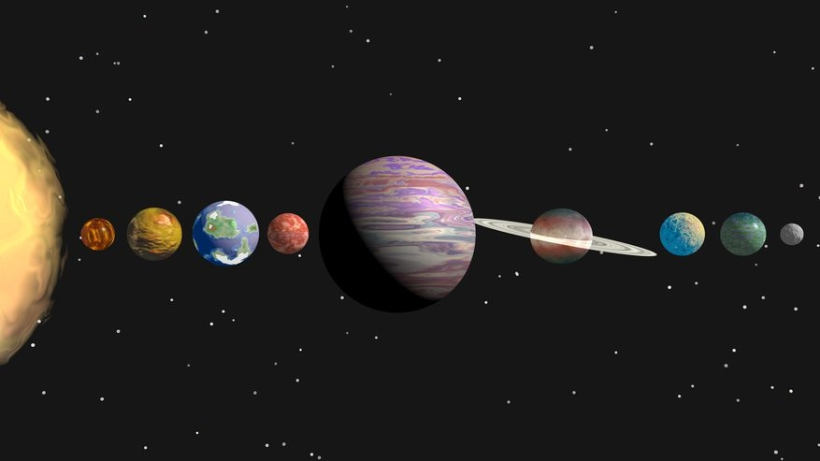
PLANETARY ALIGNMENT 2018
JULY 19TH TO SEPTEMBER 1ST
https://spotthestation.nasa.gov/sightings/view.cfm?country=United_States&region=Virginia&city=Roanoke#.W0DgKadKg2w

Slide 5
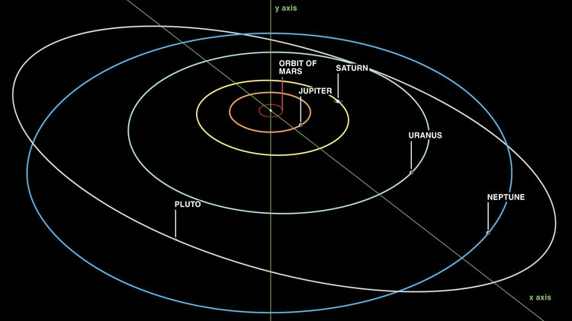

Slide 6
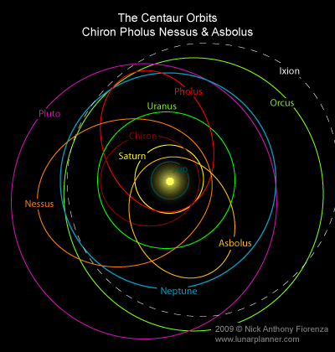

Slide 7
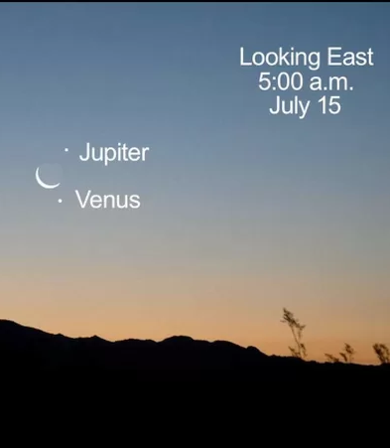
INFLUENCE
139 The wise men that come from up in Babylon, and studying the stars. They were astronomers. As they studied the stars, they seen these three stars line up. Ham, Shem, and Japheth's star, that they were borned under, lined up, and they knew. Those scientific believers watched the heavenly beings, how they moved, and when they seen those stars come into line over Jerusalem… 63-0803E

Slide 8
SHALOM
64 But did you notice before the Seven Seals was revealed, before the great mysterious Light showed forth in the heavens up here at above Tucson, Flagstaff, where we were? …But He showed it first in the heavens.
65 …He declares it in the heavens before He does it on earth. He always does that.
64-0112

Slide 9
A Very Good World 2 Growing Up in the Message
GENESIS 1:31
And God saw every thing that he had made, and, behold, it was very good. And the evening and the morning were the sixth day.

Slide 10
THE.SEAL.OF.THE.CHRIST 55-0312
8 ... If any thing is contrary to this Word, it's not the truth… (Urim & Thummim) If any preacher preaches, or any prophet prophesies, or any dreamer dreams a dream that's contrary to This, then it's wrong. It must come from the Word.
I'm a great believer in the Word. That's what keeps us straightened out. Come back to the Word of God.

Slide 11
THE.ONENESS.OF.UNITY
2-5 The devil has messengers; God has messengers. And we are at liberty to make our choice to whom we will yield ourself to, that's whose servants we are. God made man to thirst, but to thirst after Him. That's why thirst was placed in a man. But the devil comes along, and perverts that, and causes the people to thirst after him with the things of the world.
The Bible said, "If ye love the world or the things of the world, the love of the Father is not in you." Then you see, the devil perverts. He can't create anything, but he can pervert what God has already created. The devil is not a creator; he's just a perverter of the original creation. 58-0128

Slide 12
COLOSSIANS 2:6-8
As ye have therefore received Christ Jesus the Lord, so walk ye in him: 7 Rooted and built up in him, and stablished in the faith, as ye have been taught, abounding therein with thanksgiving. 8 Beware lest any man spoil you through philosophy and vain deceit, after the tradition of men, after the rudiments of the world, and not after Christ.

Slide 13
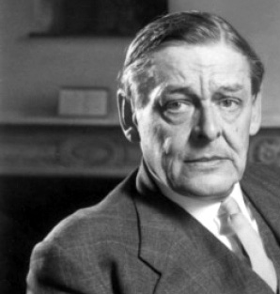
The endless cycle of idea and action, Endless invention, endless experiment, Brings knowledge of motion, but not of stillness; Knowledge of speech, but not of silence; Knowledge of words, and ignorance of the Word. All our knowledge brings us nearer to our ignorance, All our ignorance brings us nearer to death, But nearness to death no nearer to GOD. Where is the Life we have lost in living? Where is the wisdom we have lost in knowledge? Where is the knowledge we have lost in information?
T. S. Eliott
T. S. Elliott

Slide 14
SATAN'S.EDEN
142 Now, he now wears her bangs, also. He combs them down, puts a curler in them. Some of the most sickly sights I've ever seen in my life, is some of those kids out here today with their bangs combed down like this, and colored, bleached hair, with some kind of a peroxide something, and bleach their hair, and rolling it in curlers, making bangs. You big sissy! You don't even know whether you're a man or woman. And I understand that our United States Army is coming out next in shorts.
143 The other day I was over, Howard Johnson's. And I just sat back in amazement. Here come a little boy along, his mouth open. And he had dark hair here, combed it over this a way; and put a

Slide 15
roller in it, and curled it up around, top of his eyes... If I ever seen a perversion! See, he wouldn't believe it. He could prove maybe he was male, but in his spirit he is female. He don't know what side of the house he belongs on. How perverted!
144 That's what Satan does. He perverts the nations. He perverts the church. He perverts the people. He is a deceiver, a perverter of the original Truth.
145 God made a man a man. He made a woman a woman. And He dressed them different, and He meant for them to stay that way and to act that way; one is feminish, and the other is masculine. He separated Adam in the garden of Eden, and did this, separated Eve from him.
65-0829

Slide 16
kosmos
The arrangement or constitution, order, government; ornament, decoration, adornment;
The inhabitants of the earth; the ungodly multitude; the whole mass of men alienated from God, and therefore hostile to the cause of Christ.
World affairs, the aggregate of things earthly; the whole circle of earthly goods, endowments riches, advantages, pleasures, etc, which although hollow and frail, stir desire, seduce from God and are obstacles to the cause of Christ;
The Gentiles as contrasted to the Jews (Rom. 11:12 etc)

Slide 17
“Computers will be where we go live our lives and live alternate lives and lifestyles.” (1980)
Sherry Turkle:
is Abby Rockefeller Mauzé Professor of the Social Studies of Science and Technology at MIT. She's the founder and director of the MIT Initiative on Technology and Self. Her books include Alone Together: Why We Expect More from Technology and Less from Each Other.

Slide 18
GOD'S.POWER.TO.TRANSFORM
134 I wanted to give you my analysis of what Satan done in Eden: sprayed horrible poison spray. Would you like to know what that spray was? I can tell you.
I got the formula of it, two words: unbelief, which is contrary to faith, sprayed unbelief, doubt. And science filled its place. Where the cavity is, that went into the Seed, Satan filled that cavity with knowledge and science and civilization, and it's deformed the whole, entire creation of God.
65-0911

Slide 19
God Has His Own Repellent!
GOD'S.POWER.TO.TRANSFORM
220 Oh, Satan tried and tried again, do everything. One night, laying on the back of a ship, he seen Him asleep. And said, "I'll destroy Him right now." But he couldn’t.
221 He tried to tempt Him into doing the wrong thing, but he couldn't do it. Why? He had been sprayed with the repellent of predestination. It can't be deceived. No, no. There ain't no devil going to bother Him, and no other son of God, that's predestinated to take his place. He is sprayed with a repellent.
65-0911

Slide 20
Growing Up in the message
PHILIPPIANS 1:9
And this I pray, that your love may abound yet more and more in knowledge and in all judgment; 10 That ye may approve things that are excellent; that ye may be sincere and without offence till the day of Christ; 11 Being filled with the fruits of righteousness, which are by Jesus Christ, unto the glory and praise of God.

Slide 21
Coincidence
(w) accident, luck or fate. “What a coincidence.”
Adolescence
(w) Someone desiring the privileges of adulthood along with the irresponsibility of childhood.

Slide 22
TO.SEE.JESUS
50 Now, to Him that's able to keep us, and steady us, keep out nerves quiet, during the time of this service, may He tonight, spread forth His great wings of protection over you all.
Sometimes spirits get away. Sometimes they act up on the platform when they come present. Watch the expression on the people's face as they walk forward coming here, after the Holy Spirit has taken a hold. Watch how they act.
54-0718

Slide 23
TRUE.VINE.AND.A.FALSE.VINE
9 And may the glory of God come down upon us and bless us, like it was on the day of Pentecost. God repeat it again tonight here. Give us and outpouring of Thy blessings; may we set not with an umbrella over us, but with a cup straight up, ready for the blessings of God to fall.
55-0607

Slide 24
BALM.IN.GILEAD
13 It's just like this: a man dying on the doorsteps of a doctor's office, when the doctor in the building has the cure for his disease, but he refuses to take it. If the man has a disease, and the doctor has the cure for it, and the man may lay on the doctor's doorsteps. But if he refuses to take his medicine, he will die on the doorstep. You can't blame the doctor.
So is it today, that many people die in front of the church, on the steps, in the pews, die in their sins because they refuse to accept God's Balm that's in Gilead.

Slide 25
They die in their sins because they refuse it, not because there isn't any there; but they just refuse to take it. Then what will they take? They have to take something false instead. It's not because there's none there, because there is.
But men and women just refuse to take it, and they die, die in the church, set in the meetings and listen night after night to inspired prophets of God, who's takes the Word fearlessly and lays it out, "Ye must be borned again." Men and women set in the pews and die, and sink into utter despair, and annihilated from God. Not because there's not grace and salvation, but because they refuse to receive it.
59-0614

Slide 26
DOOR.TO.THE.HEART
50 (One time there was a man going down to the seashore…) The old sailor said, "I was borned on the sea. I've been there for forty years. There isn't nothing thrilling about it that I can see." He'd seen it so much, till it become common to him.
That's what's the matter with the church tonight. You've seen God's blessings, the baptism of the Holy Spirit, and those things, which has been going for years in the church, till it's become a common thing to you. Your fathers and mothers rejoiced when God begin to pour out His Spirit upon the church.
51 You did run well, what hindered you? It's become so common to you. You believe it all, sure, but it doesn't thrill you any more. It's so common. God's so good to you, and you don't realize it.
58-0302

Slide 27
I CORINTHIANS 9:27
But I keep under my body, and bring it into subjection: lest that by any means, when I have preached to others, I myself should be a castaway.
Subjection: (Gr.) doulagogeo
To lead away into slavery, claim as one's slave, to make a slave and to treat as a slave i.e. with severity, subject to stern and rigid discipline.

Slide 28
The New Birth
THE.HANDWRITING.ON.THE.WALL
95 You can be Methodist, Baptist, Pentecostal, Catholic, you're lost until you become of Christ's. And Christ comes into you, it's the new birth by the Holy Spirit. 58-0108
For as the father raiseth up the dead, and quickeneth them; even so the son quickeneth whom he will.
John 5:21

Slide 29
EZEKIEL 36:24-27
For I will take you from among the heathen, and gather you out of all countries, and will bring you into your own land. 25 Then will I sprinkle clean water upon you, and ye shall be clean: from all your filthiness, and from all your idols, will I cleanse you. 26 A new heart also will I give you, and a new spirit will I put within you: and I will take away the stony heart out of your flesh, and I will give you an heart of flesh. 27 And I will put my spirit within you, and cause you to walk in my statutes, and ye shall keep my judgments, and do them.

Slide 30
THE.SEAL.OF.THE.CHRIST
48 They (Paul & Barnabas) were preaching the Gospel to those Jews, and they rejected it. God preached the Gospel down through the age for about, from A.D. thirty-three to ninety-six; still the Jews rejecting it.
God turned to the Gentile, and then the Angel of mercy left all those Jews, and one of them went to the Gentile church; Paul said, "Lo, we turn to the Gentiles, they will hear it," and went to preaching to the Gentiles.
55-0312

Slide 31
ACTS 13:46-48
Then Paul and Barnabas waxed bold, and said, It was necessary that the word of God should first have been spoken to you: but seeing ye put it from you, and judge yourselves unworthy of everlasting life, lo, we turn to the Gentiles. 47 For so hath the Lord commanded us, saying, I have set thee to be a light of the Gentiles, that thou shouldest be for salvation unto the ends of the earth. 48 And when the Gentiles heard this, they were glad, and glorified the word of the Lord: and as many as were ordained to eternal life believed.

Slide 32
ROMANS 8:11-14
But if the Spirit of him that raised up Jesus from the dead dwell in you, he that raised up Christ from the dead shall also quicken your mortal bodies by his Spirit that dwelleth in you. 12 Therefore, brethren, we are debtors, not to the flesh, to live after the flesh. 13 For if ye live after the flesh, ye shall die: but if ye through the Spirit do mortify the deeds of the body, ye shall live. 14 For as many as are led by the Spirit of God, they are the sons of God.
Quicken: (Gr.) zoopoieo
To make alive, give life; by spiritual power to arouse; restore to life; to give increase of life: physical life; of the spirit, endued with new and greater powers of life; metaphorically, of seeds quickened into life, i.e. germinating, springing up, growing.

Slide 33
II KINGS 13:20-21
And Elisha died, and they buried him. And the bands of the Moabites invaded the land at the coming in of the year. 21 And it came to pass, as they were burying a man, that, behold, they spied a band of men; and they cast the man into the sepulchre of Elisha: and when the man was let down, and touched the bones of Elisha, he revived, and stood up on his feet.

Slide 34
GOD'S.PROVIDED.PLACE.OF.WORSHIP
(Elisha) …That quickening power was in the grave with him. It's always there, when you get quickening power of God…
Now remember, in Christ, we are flesh of His flesh, bone of His bones… body of His body, Name of His Name, Bride of Him. See, we are in Him, we are His flesh and His bones.
And God has already raised us up, potentially. The quickening power that raised us from a life of sin, and changed our being, it has potentially raised us up in Christ Jesus, which, the resurrection will bring us forth in the fully maturity.
65-0425

Slide 35
EPHESIANS 2:1-6
And you hath he quickened, who were dead in trespasses and sins; 2 Wherein in time past ye walked according to the course of this world, according to the prince of the power of the air, the spirit that now worketh in the children of disobedience: 3 Among whom also we all had our conversation in times past in the lusts of our flesh, fulfilling the desires of the flesh and of the mind; and were by nature the children of wrath, even as others. 4 But God, who is rich in mercy, for his great love wherewith he loved us 5 Even when we were dead in sins, hath quickened us together with Christ, (by grace ye are saved;) 6 And hath raised us up together, and made us sit together in heavenly places in Christ Jesus:

Slide 36
(1) And you hath he quickened, who were dead in trespasses and sins;
Dead: (Gr.) nekros
One that has breathed his last, lifeless, deceased, departed, spiritually dead.
i.e. destitute of a life that recognizes and is devoted to God, because it’s given up to trespasses and sins; inactive as respects doing right; destitute of force or power.

Slide 37
GOD'S.PROVIDED.PLACE.OF.WORSHIP
(Romans 8:11) What does the word quicken mean? The Greek word means, "to be brought to life after death.“
…Worshiping in the Spirit and Truth, mechanics and dynamics, together. "If the Spirit that raised up Jesus from the dead dwells in you, It will quicken, make alive, your mortal bodies, because It's already Life." And when It comes into your body, It brings your whole body subject to the Word of God.

Slide 38
Now if it's something in you, telling you, "Well, that was the days past. Mark 16 is not true, and that Pentecostal idea of the baptism of the Holy Ghost..." That ain't the Spirit of God in you…
"Well, my mother belonged to this, my father..." Whatever you want to say about your relatives, that might have been all right with them; but it ain't for you, you've got to this day come into Christ Jesus, for this age and the promise that's meant for this age.
65-0425

Slide 39
IT.IS.THE.RISING.OF.THE.SUN
“…Because I live, ye live also." What a resurrect-tion that that was! And what a resurrection this is, to be quickened from the dead, "to be made alive in Christ Jesus," by God's quickening Power.
The Word, which He was, was waved on the Day of Pentecost, the Word made manifest. It's to be waved again in the last day...
65-0418

Slide 40
IT.IS.THE.RISING.OF.THE.SUN
Notice, it's just like a little seed laying in the ground. Now, potentially, you are resurrected. You're resurrected when you receive the Holy Spirit in you. You're resurrected right then. Your body is potentially resurrected.
Look at a little seed. Plant it in the ground… And as it drinks, it pushes up towards Him, coming more like the likeness of the seed that went into the ground. The Church come that way, through justification, sanctification, baptism of the Holy Ghost, now in the blossom. The Spirit of God come through that… on your way, growing to the fullness of the resurrection, led by the Spirit!
65-0418M

Slide 41
IT.IS.THE.RISING.OF.THE.SUN
The darkened world of unbelief, where churches and denominations had drawed us out, something in us calling, "Oh, we want God! We're hungering and thirsting for God.“ Joined the Methodist, Baptist, Pentecostal, still there was something wrong, we just couldn't find It yet. And all of a sudden, while we was groping in darkness, the great resurrection came to us in the manifestation of the promised Word of God.
Like, He was the manifestation of the promised Word of God… He manifested It, every Word of God that was promised to Him. He proved it when He raised on the Easter morning.
65-0418M

Slide 42
The Easter Seal
If God said, "In this day," back in the beginning, "John Doe will be My servant.” Now, John Doe is born in sin, shaped in iniquity, come to the world speaking lies, because he's a mortal. But, maybe, he gets a little religious feeling. He'll go join a church. Maybe he'll join Pentecostal church. He might join anything. But let him get under the atmosphere of God, once. John Doe is bound to recognize Who his Father is, just as that eagle recognized who the mother was. It's got to realize it. Only, that John Doe is God's attribute that's

Slide 43
become a word, spoken, and then the Holy Spirit seeks that word out.
…Now, if you're not, you'll wonder and flusterate, and run here and there, and everything else, and never come to the knowledge of the Truth. If you are one of those, the old things pass away right quick, see, and you become new, and the plan of salvation is finished. You're ready to obey every Word that God ever spoke of you, for you to do. You're submissive to His Word… The debts are all paid. It's all struck off, and as it was at the Day of Pentecost.
1965

Slide 44
What is the “Dynamics” or “Quickening Power”?
I believe that the Bride of Christ is called. I believe She is sealed in the Kingdom of God. I believe the mechanics is there. They're waiting for the Dynamics that'll take Her off the earth, into Glory, in the Rapture… We don't know how He's going to do it, but He shall do it. He is the Dynamics. We just become members of the machine, of His Body, forming ourself into His image, and see Him uniting Himself with us, in His works, with His love gifts, as He hands them to us just before the Wedding Supper. And we're waiting, watching for that.
The Dynamics of this Church will be a refilling of the Holy Spirit that we have worked in a small measure while the Headstone is coming down to unite with the Body. But when that Head and Body unites together, the full power of the Holy Ghost would raise Her up just exactly like that; even the dead, that's dead in Christ, for hundreds of years ago, will rise in the beauty of His holiness, and take a flight to the skies. The Dynamics is the Holy Spirit.
WHAT.SHALL.I.DO.WITH.JESUS.CALLED.CHRIST 63-1124M

Slide 45
IT.IS.THE.RISING.OF.THE.SUN
Not all man will receive Christ. Oh, no. But those which God foreordained Life, is housed around some of the dirt of the earth, that's the One He comes to quicken.
That dirt would lay there in the sun, say, "Oh, this old sun is so hot! This old sun is so hot!" But that little seed, said, "That's what I'm looking for," and it begin to spring forth to life. It quickened that part of the dirt. Because, the sun was sent not to quicken the rock, not to quicken the dirt, but to quicken the life of the seed. Why won't all the people receive It? It wasn't sent to them. 65-0418

Slide 46
IT.IS.THE.RISING.OF.THE.SUN
Now, that it is the greatest week in history, the greatest celebration of all times, Easter is where He proved what He said… Not only is it a memorial day, of flowers, bonnets, pink rabbits, that we've got into… which is all right, but this is not the real thing… As people today are trying to say, "We should wash feet once a year, on Friday we should take the communion,” …All these things are just merely tradition. What good would any of it do you, whether you had Lent or not Lent, if there is no Life in you? It's only a memorial. Which, there's nothing against it, but they have certainly carried out their traditions, but left off the main thing.

Slide 47
Satan doesn't care how religious you are, or how right you are in your Doctrine. If you miss that Life, you won't come up, anyhow. No matter how religious, how good, how many churches you've belonged to or will belong to, it doesn't matter one thing unless you have been born again.
Therefore… is this resurrection morning one day in the year, or a certain day that we celebrate this? Or, are we benefactors of His resurrection? What does it mean to me? What does it mean to you? Now we believe, by faith, that He raised from the dead, but what has that got to do with me? That was two thousand years ago.
65-0418M

