Slide 1
The Value of Respect Education & Training of Children & Families
Psalm 34:1
Come, ye children, hearken unto me:
I will teach you the fear of the Lord.

Slide 2
WHY
12 Paul told Timothy to stir up the gift that was in him, that come from his grandmother, Lois. We find out that in Heb. 7, that Paul speaking on tithe paying, that Levi, who had an order from God to receive tithing of his brother, paid tithes, for he was yet in the loins of Abraham when he met Melchisedec, which was his great, great-grandfather. And it was accounted to him for paying tithing.
Your life will impress your children, and influence your children by the example you set before them. And I think it's a good thing that we put every effort we can before our children as godly parents. Make an example, be an example.
60-0309

Slide 3
DEUTERONOMY 4:8-10
8 And what nation is there so great, that hath statutes and judgments so righteous as all this law, which I set before you this day? 9 Only take heed to thyself, and keep thy soul diligently, lest thou forget the things which thine eyes have seen, and lest they depart from thy heart all the days of thy life: but teach them thy sons, and thy sons' sons; 10 Specially the day that thou stoodest before the LORD thy God in Horeb, when the LORD said unto me, Gather me the people together, and I will make them hear my words, that they may learn to fear me all the days that they shall live upon the earth, and that they may teach their children.

Slide 4
MOSES
16 And listen, friends; more simpler you can be, more God can deal with you. I'm not against education. Education’s are all right. But people get so highly educated, till they think they know more about it than God does. And then they miss the goal.
You've got to forget all you ever knowed in your own knowledge to know Christ. Well, you just come child-like and accept Him. That's all. That's the way you accept God.

Slide 5
I was borned of a very humble parent, a very humble home. I have no education at all, and I'm not... When I made that remark a while ago about education, I wasn't trying to take crutches for my ignorance.
But what I'm trying to say, that it doesn't take education to know God; it takes a submissive heart to know God.
50-0110

Slide 6
Psalms 78:2-7
2 I will open my mouth in a parable: I will utter dark sayings of old: 3 Which we have heard and known, and our fathers have told us. 4 We will not hide them from their children, shewing to the generation to come the praises of the Lord, and his strength, and his wonderful works that he hath done. 5 For he established a testimony in Jacob, and appointed a law in Israel, which he commanded our fathers, that they should make them known to their children: 6 That the generation to come might know them, even the children which should be born; who should arise and declare them to their children: 7 That they might set their hope in God, and not forget the works of God, but keep his commandments:

Slide 7
EPHESIANS 6:4
And, ye fathers, provoke not your children to wrath: but bring them up in the nurture and admonition of the Lord.
Nurture: (Gr.) paideia
The whole training and education of children relating to the cultivation of mind and morals, and employs for this purpose commands and admonitions, reproof and punishment. It also includes the training and care of the body.
Whatever in adults also cultivates the soul, esp. by correcting mistakes and curbing passions.
Instruction which aims at increasing virtue.

Slide 8
II TIMOTHY 3:16
All scripture is given by inspiration of God, and is profitable for doctrine, for reproof, for correction, for instruction in righteousness:
HEBREWS 12:5
And ye have forgotten the exhortation which speaketh unto you as unto children, My son, despise not thou the chastening of the Lord, nor faint when thou art rebuked of him:

Slide 9
Admonition: (Gr.) nouthesia
Exhortation
I Corinthians 10:11-12
Now all these things happened unto them for ensamples: and they are written for our admonition, upon whom the ends of the world are come. 12 Wherefore let him that thinketh he standeth take heed lest he fall.

Slide 10
MAN.RUNNING.FROM.THE.PRESENCE.OF.THE.LORD
53 [Facing Responsibilities] As a father, to face up the responsibility, to give your child a whipping. Them little fellows, you don't want to do that. But as a father or a mother, you've got to face the responsibility of raising that child, because "Spare the rod and you'll spoil your son." And that still stands good in the sight of every psychologist in the world, still remains God's Truth. If there had been more of that practiced, we wouldn't have had so much juvenile delinquency, and the rot we got in the world today. But the old golden rule of the home has been broken, long time ago, and they let the kids do whatever they want to. 65-0217

Slide 11
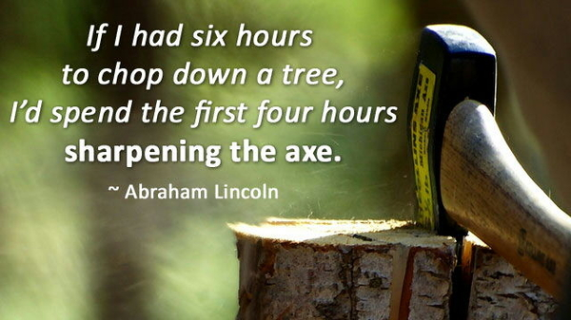
Abraham Lincoln, who attended school for less than a year, became a lawyer under an Illinois law (1833.) To be a lawyer someone had to "obtain a certificate procured from the court of an Illinois county certifying to the applicant's good moral character." Lincoln actually went to the Illinois Supreme Court to get his certificate. On September 9, 1836, a license to practice law was issued to Abraham Lincoln by two justices of the Illinois Supreme Court.

Slide 12
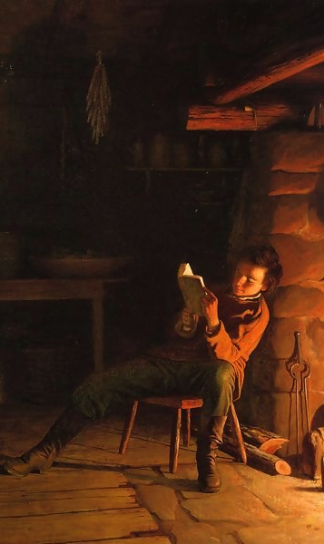
“Upon the subject of education, not presuming to dictate any plan or system respecting it, I can only say that I view it as the most important subject which we as a people can be engaged in. That every man may receive at least, a moderate education, thereby be enabled to read the histories of his own and other countries, by which he may duly appreciate the value of our free institutions, appears to be an object of vital importance, even on this
Abraham Lincoln

Slide 13
account alone, to say nothing of the advantages and satisfaction to be derived from all being able to read the Scriptures and other works, both of a religious and moral nature, for themselves.
For my part, I desire to see the time when education, and by its means, morality, sobriety, enterprise and industry, shall become much more general than at present, and should be gratified to have it in my power to contribute something to the advancement of any measure which might have a tendency to accelerate the happy period. March 9, 1832
First Political Announcement

Slide 14
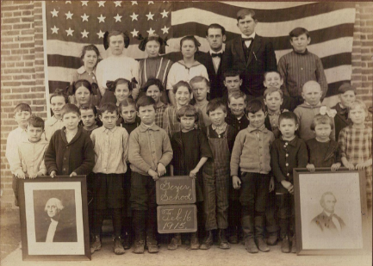
Religion & Schools
As the majority of the nation
was Protestant in the 19th cent.
most States passed a Consti-
tutional amendment, called the
Blaine Amendment, forbid-
ding tax money be used to fund parochial
schools. There was anti-Catholic sentiment related to heavy immigration from Catholic Ireland (1845-1852), and a feeling that Catholic children should be educated in public schools to become American.
The Irish and other Catholic ethnic groups looked to parochial schools not only to protect their religion, but to enhance their culture and language.

Slide 15
THE.ODDBALL (1964)
43 Do you know the politicians can't judge right and wrong? You see them keeping quiet on this voting the Bible back in the church or into the... Bible back into the school? They don't know which way the politics are going to blow.
Think of it! I don't know how it is in Indiana now, but in Arizona it's against the law to read the Bible in school. I think it's the same thing in Indiana, nearly the whole United States, because some infidel woman changed the whole program.

Slide 16
And, remember, it's against the law to read the Bible in our public schools, but believers' taxes supports infidelity to be taught in the school.
44 Politics. We need another Abraham Lincoln. We need another Patrick Henry. We need an American who can stand out regardless of where the politics are, and call right, "right," and wrong, "wrong.”
64-0614

Slide 17
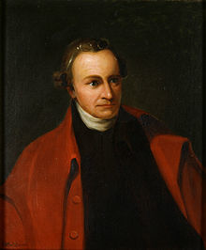
“The Constitution is not an instrument for the government to restrain the people, it is an instrument for the people to restrain the government - lest it come to dominate our lives and interests. Fear is the passion of slaves.
“It is the business of a virtuous clergy to censure vice in every appearance of it.
“I have now disposed of all my property to my family. There is one thing more I wish I could give them, and that is the Christian religion. This is all the inheritance I give them... The religion of Christ will give them One which will make them rich indeed.
Patrick Henry

Slide 18
Textbooks
In the 17th century, schoolbooks were brought over from England. By 1690, Boston publishers were reprinting the English Protestant Tutor under the title of The New England Primer, built on rote memorization. By simplifying Calvinist teaching, the Primer enabled the Puritan child to define the limits of the self by relating his life to authority of God and parents.
The Primer included material that made it widely popular in colonial schools until supplanted by Webster's work. The “Blue Backed Speller" of Noah Webster was by far the most common textbook from the 1790-1836, when the McGuffey Readers appeared. Both series emphasized civic duty and morality, and sold tens of millions of copies nationwide.

Slide 19
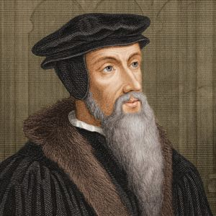
John Calvin
John Calvin was an influential French theologian and pastor during the Protestant Reformation. He was a principal figure in the development of the system of Christian writings later called “Calvinism.”
Born: July 10, 1509, Noyon, France
Died: May 27, 1564, Geneva, Switzerland

Slide 20
Textbooks
In the 17th century, schoolbooks were brought over from England. By 1690, Boston publishers were reprinting the English Protestant Tutor under the title of The New England Primer, built on rote memorization. By simplifying Calvinist teaching, the Primer enabled the Puritan child to define the limits of the self by relating his life to authority of God and parents.
The Primer included material that made it widely popular in colonial schools until supplanted by Webster's work. The “Blue Backed Speller" of Noah Webster was by far the most common textbook from the 1790-1836, when the McGuffey Readers appeared. Both series emphasized civic duty and morality, and sold tens of millions of copies nationwide.

Slide 21
FELLOWSHIP
27 We have fellowship one with another then when the Blood cleanses us from all unrighteousness… I have nothing against denominations. Those are all right. Nothing against education, that's all right. Nothing against great song festivals, that's all right.
Nothing against joining church, or whatever you may be, it's all right, but it'll never, never produce until the Blood's been applied. The Blood applied to the human heart will always bring a result.
56-0212

Slide 22
THE.INFLUENCE.OF.ANOTHER
83 About 5 yrs. ago, I was in Ohio having a meeting at Chautauqua. I was listening to a newscast in the hotel. And said, "The flower of freedom died this afternoon, in a court here in Ohio." The Amish people don't believe in sending their children to these public schools. They have their own schools. And in this certain neighborhood where these were at, they didn't have any high school. It's the law of Ohio and Indiana, I think, a national law, that all children much go to school till they're 16. And this man had a couple of children, boy and girl, that wasn't 16. And they refused to send them to the public schools where they teach the ethics of Darwin, that, "Man descended from a single cell, be a

Slide 23
monkey. All he is, just a glorified monkey." And so they didn't agree with that, and they won't let their children hear it. And so the courts pulled them in. And this little smart aleck judge said to the old aged father and mother, with his crock haircut, his overalls on. He said, "Sir, this state of Ohio has a law that says that the child must attend school till it's sixteen. You refused to send your children. What do you answer?"
84 He said, "Honorable sir, I respect the laws of this lovely state in which I am a native. But we come here, years ago, our forefathers, for freedom of religion. Our religion teaches us that we don't believe that we come from animals, to be man. We believe that we were created in the image of God.

Slide 24
Therefore, it's against our religious beliefs to send our children to a school that teaches such. We don't have any high school here for our children to go. And it's not because we don't respect you. We respect what you believe. But, for us, we don't believe that, and we don't want it taught to our children.” He said, "You'll either send your children to school or you and your wife will spend two years in the state penitentiary. What's your decision?" He said, "Mother and I will spend the two years." And they turned and started to walk out. The old judge must have felt a little bit condemned, so he said, "Remember, don't your Bible say, 'Give Caesar what's Caesar's'?” And the father turned around, and he said, "'And to God... '?"

Slide 25
The man on the news said, "Well, then the flower of freedom, died in that court room, this afternoon.”
85 After all, the Amish, no matter how peculiar they are, they believe in holy living. And there is not one record, in the United States, to where they ever had any juvenile delinquency… I don't blame them.
86 But, listen. The flower died there, right then. But, about 10 mins. it revived again. The prosecuting attorney, all off of them, pushed back their books, and said, "Then we resign from our job, for, if you break that constitutional right, they'll break the rest of them."
62-1013

Slide 26
“The Huguenins are free to think, to say, to believe as they wish; they may pray to the God of their choice and follow those commandments in their personal lives wherever they lead. The Constitution protects the Huguenins in that respect and much more. But there is a price to pay somewhere in our civic life.

Slide 27
In the smaller, more focused world of the marketplace, of commerce of public accommod-ation, the Huguenins have to channel their conduct, not their beliefs, so as to leave space for other Americans who believe something different.”
Justice Bosson,
New Mexico Supreme Court

Slide 28
COME.FOLLOW.ME 41 And the father and mother praying constantly that their son would not turn out just an ordinary man, that he would be an extraordinary man. All parents want that… And that's the ambition of any parent, to do the best for their children, that they can, educate them, give them things maybe that they wasn't able to get. That's the way I feel about my children. 42 I think, sometime, in going to school, now; I think, send Becky and Sarah and Joseph into these high schools and things, where all this going-on is at? I think I'll take them and get back into the mountain, and raise them up there like the Indians live.
COME.FOLLOW.ME
41 And the father and mother praying constantly that their son would not turn out just an ordinary man, that he would be an extraordinary man. All parents want that… And that's the ambition of any parent, to do the best for their children, that they can, educate them, give them things maybe that they wasn't able to get. That's the way I feel about my children.
42 I think, sometime, in going to school, now; I think, send Becky and Sarah and Joseph into these high schools and things, where all this going-on is at? I think I'll take them and get back into the mountain, and raise them up there with the... like the Indians live.

Slide 29
43 But here is what it is. What's in the kid is going to come out. No matter where it is, it's going to come out. If it's evil in there, it'll come out in the Indian camp. If it's good in there, it'll come out in any camp. It's what's in the kid, the make-up of the kid, what's on the inside of you. And what you are now is what you're probably be the rest of your life. You're on a changing spot. 44 Do you know what? 86% of the conversions to Jesus Christ is done before 21 yrs. Old. Statistics shows it... You, after you pass that age, you become more molded or set in your ways. Oh, it's possible, sure. They come, seventy and eighty, years old, but it's very rare.

Slide 30
45 You make yourself when you're young. You set your ambitions to what you want to do, and what you're trying to achieve in life. You think of it. And as you think, of course, your mind, it's presented into your mind by an unknown something that dominates your mind. And then when it becomes in your mind, then you speak it, that you're going to do it. And then your ambitions drive you to it.
63-0601

Slide 31
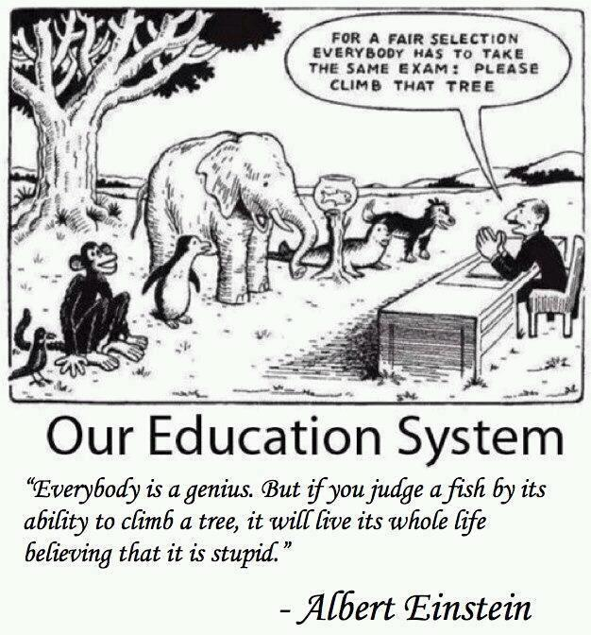

Slide 33
Family Economics & Mentoring Conference
Vision for the Family Economy
Practical Wisdom for Family Business
Business in a Box
Promote Your Family Business

Slide 34
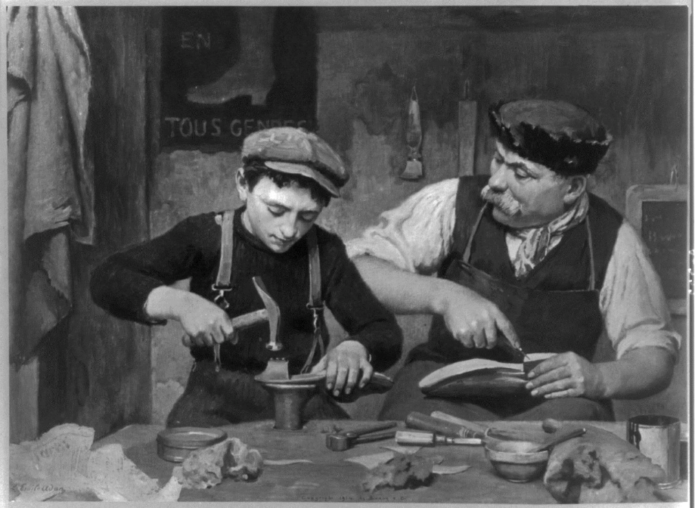
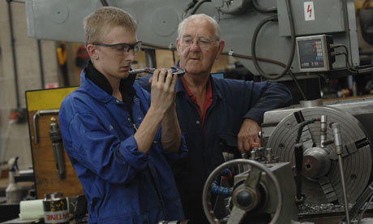

Slide 35
BE.NOT.AFRAID.IT.IS.I
32 (Let's just dramatize him for a moment.) "One day when dad come in, and set me upon the bow of the boat, said, 'Simon, my little boy, daddy has always believed that someday the Messiah would come. All of us Jewish people has looked for that. But perhaps I won't see Him… But, Simon, when He comes, there'll be a lot of stuff go out before He comes that'll cause the whole country to be confused… But, Simon, I want you to be taught.'”
33 Oh, how it would do good if we American people would teach our children such things, instead of tap dancing, rock-and-roll, and stuff that we do today, and just let them join the church, but tell them what to look for. 61-0414

Slide 36
INFLUENCE
15 Now, Uzziah the king was a shepherd boy. He was a young fellow, that, a king's son, and that loved outdoors. He liked the woods, was a herdsman, he liked to see things grow.
And this young fellow was brought up under real good influence. Amaziah, his father, had been a great man, in his last days he let down a little, and picked up some gods from another country, and the Lord then taken him out of the earth.

Slide 37
But this young fellow had had good influence, because his mother was a daughter of Jerusalem, his father a believer, and therefore the boy had been raised up with good influence.
16 And that's a good way to bring up a child, in the way it should go. And you know what? Your children is one of the main eyes that's watching you. They watch what you do. And whatever you do, they copy after you, because you're setting the example before them, to what you do.
63-0803

Slide 38
HEAR.YE.HIM
And then our character is watched by the Holy Spirit. If we're Methodist today, and they make us a little mad, and we go over to the Baptists the next day, and they fuss at us a little bit, preacher steps on your toe, then away you go down to Pilgrim Holiness, or Nazarene. No wonder. You pack your paper from place to place till it's about tore up… Let God take care of it and fellowship with all the brethren of like precious faith. Whether you see eye to eye alike that doesn't matter. We're at least Christians, brethren, borned in the same family. God received us in our peculiarities; we should receive each other.

Slide 39
FAITH.WITHOUT.WORKS.IS.DEAD
41 I have nothing against education. But the world they got a educational program. And they got it down into the church. A minister has to be a certain degree or he has to have so many degrees or he ain't welcome in the platform…
Well look, brother, the Kingdom of God don't come by education, it comes by a surrendered heart to God. And I'm not trying to support my ignorance. But I'm saying this, my dear friends, that a simple child faith... Don't seek for knowledge.

Slide 40
Now, you're think that I'm throwing it at the doctors. I believe in doctors. I believe in hospitals, institutions. Whatever can help anybody, God, send more.
But there's not a one of them that ever did heal anybody. And they don't profess to heal somebody. They claim to assist nature. God is the Healer. 50-0822

Slide 41
FELLOWSHIP.WITH.GOD.THRU.RECONCILIATION 16 But this great strain of man longing for fellowship, we've tried to bring people together through the ages. Many times educational programs has tried to unite people together by education. Standing in this auditorium tonight, of this lovely school, I certainly wouldn't speak against education, but education is not the appropriated way for fellowship.
You can't educate people to love one another. You think you can, but it takes a Divine order to do that. There's no way to do it through education. 56-0120

Slide 42
CONFERENCES
147 I don't know how many times that they've tried to educate the man. They have tried to tell him that an educational program will do it. It's failed every time, and it will. We try to organize... Now, I'm not against education, neither am I against organization. But the organization and educational programs, and all the other that we've man-made, is fig leaves. It's, back to God's original decision at that first conference, Eden, back to the blood!
63-0608

Slide 48
Not every Truth is Obvious
MATTHEW 11:25-26
25 At that time Jesus answered and said, I thank thee, O Father, Lord of heaven and earth, because thou hast hid these things from the wise and prudent, and hast revealed them unto babes. 26 Even so, Father: for so it seemed good in thy sight.

Slide 49
WHO.IS.THIS.MELCHISEDEC
It makes our heart most happy and joyful, to know that we have come in contact with the living God; Who vindicates it right back in physical, material evidences, as He did in the days gone by, and as He has promised for this day... This dark day where no one seems to know which way to go, we're so glad that we found the safety zone, the retreat. Now bless us tonight, as we speak of Thy Word. And the promises that's given to us, may we nurture them in our hearts, cherish them with reverence, and obey them with real godly discipline. For we ask it in Jesus' Name. Amen.
65-0221

Slide 50
Church Order
Reverence the sanctuary:
Attire – Attitude – Quietness
Conduct ourselves as if Jesus was on His throne right here on the platform.
Expectation

Slide 51
“Thus Saith the Lord”
Bring ye all the tithes into the storehouse, that there may be meat in mine house, and prove me now herewith, saith the LORD of hosts, if I will not open you the windows of heaven, and pour you out a blessing, that there shall not be room enough to receive it. 11 And I will rebuke the devourer for your sakes, and he shall not destroy the fruits of your ground; neither shall your vine cast her fruit before the time in the field, saith the LORD of hosts. MALACHI 3:10, 11
Notes:
MALACHI. 3:7
Even from the days of your fathers ye are gone away from mine ordinances, and have not kept [them]. Return unto me, and I will return unto you, saith the LORD of hosts. But ye said, Wherein shall we return?
3:8 Will a man rob God? Yet ye have robbed me. But ye say, Wherein have we robbed thee? In tithes and offerings.
3:9 Ye [are] cursed with a curse: for ye have robbed me, [even] this whole nation.
3:10 Bring ye all the tithes into the storehouse, that there may be meat in mine house, and prove me now herewith, saith the LORD of hosts, if I will not open you the windows of heaven, and pour you out a blessing, that [there shall] not [be room] enough [to receive it].
3:11 And I will rebuke the devourer for your sakes, and he shall not destroy the fruits of your ground; neither shall your vine cast her fruit before the time in the field, saith the LORD of hosts.

Slide 52
LET US SEE GOD
But, you know, I feel like this, that a member of a church, their first obligation is, with their tithe and offerings, is to support their church… and your obligation is to your church and not to an evangelist like me.
November 29,1959
Notes:
MALACHI. 3:7
Even from the days of your fathers ye are gone away from mine ordinances, and have not kept [them]. Return unto me, and I will return unto you, saith the LORD of hosts. But ye said, Wherein shall we return?
3:8 Will a man rob God? Yet ye have robbed me. But ye say, Wherein have we robbed thee? In tithes and offerings.
3:9 Ye [are] cursed with a curse: for ye have robbed me, [even] this whole nation.
3:10 Bring ye all the tithes into the storehouse, that there may be meat in mine house, and prove me now herewith, saith the LORD of hosts, if I will not open you the windows of heaven, and pour you out a blessing, that [there shall] not [be room] enough [to receive it].
3:11 And I will rebuke the devourer for your sakes, and he shall not destroy the fruits of your ground; neither shall your vine cast her fruit before the time in the field, saith the LORD of hosts.

Slide 53
Quotes on Tithes and Offerings
HEBREWS, Chapter Seven, Part I,
September 15,1957
123 ....Why would he ask Abraham to pay tithes? You see what a strict thing it is to pay tithes? Tithing's right. Every Christian is duty bound to pay tithe. That's right. Never has been changed!
Notes:
MALACHI. 3:7
Even from the days of your fathers ye are gone away from mine ordinances, and have not kept [them]. Return unto me, and I will return unto you, saith the LORD of hosts. But ye said, Wherein shall we return?
3:8 Will a man rob God? Yet ye have robbed me. But ye say, Wherein have we robbed thee? In tithes and offerings.
3:9 Ye [are] cursed with a curse: for ye have robbed me, [even] this whole nation.
3:10 Bring ye all the tithes into the storehouse, that there may be meat in mine house, and prove me now herewith, saith the LORD of hosts, if I will not open you the windows of heaven, and pour you out a blessing, that [there shall] not [be room] enough [to receive it].
3:11 And I will rebuke the devourer for your sakes, and he shall not destroy the fruits of your ground; neither shall your vine cast her fruit before the time in the field, saith the LORD of hosts.

Slide 54
God’s view: Malachi 3:7 to 11
In paying your tithes and offerings, you:
1.) Will be bringing your tithes into the storehouse
2.) Are returning to God what is His;
3.) No longer robbing God - free from God’s curse
4.) Can put God to the test – He said, “Prove me.”
5.) Have Gods’ promise, I will open you the windows of heaven, and pour you out a blessing, that there shall not be room enough to receive it.
Notes:
MALACHI. 3:7
Even from the days of your fathers ye are gone away from mine ordinances, and have not kept [them]. Return unto me, and I will return unto you, saith the LORD of hosts. But ye said, Wherein shall we return?
3:8 Will a man rob God? Yet ye have robbed me. But ye say, Wherein have we robbed thee? In tithes and offerings.
3:9 Ye [are] cursed with a curse: for ye have robbed me, [even] this whole nation.
3:10 Bring ye all the tithes into the storehouse, that there may be meat in mine house, and prove me now herewith, saith the LORD of hosts, if I will not open you the windows of heaven, and pour you out a blessing, that [there shall] not [be room] enough [to receive it].
3:11 And I will rebuke the devourer for your sakes, and he shall not destroy the fruits of your ground; neither shall your vine cast her fruit before the time in the field, saith the LORD of hosts.

Slide 55
QA.GOD.BEING.MISUNDERSTOODTithes and Offerings, unpaid
136. Can a Christian go to heaven if he or she does not pay tithe?
Now, that's one that I could not answer Scripturally… But I do believe every Christian is obligated to pay tithings because it is a com-mandment of the Lord. "And blessed are they that do all His commandments, that they might have a right to enter into the Life, the Tree of Life." Now, I do believe that tithe-paying is essential to a Christian experience.
COD 61-0723
Notes:
MALACHI. 3:7
Even from the days of your fathers ye are gone away from mine ordinances, and have not kept [them]. Return unto me, and I will return unto you, saith the LORD of hosts. But ye said, Wherein shall we return?
3:8 Will a man rob God? Yet ye have robbed me. But ye say, Wherein have we robbed thee? In tithes and offerings.
3:9 Ye [are] cursed with a curse: for ye have robbed me, [even] this whole nation.
3:10 Bring ye all the tithes into the storehouse, that there may be meat in mine house, and prove me now herewith, saith the LORD of hosts, if I will not open you the windows of heaven, and pour you out a blessing, that [there shall] not [be room] enough [to receive it].
3:11 And I will rebuke the devourer for your sakes, and he shall not destroy the fruits of your ground; neither shall your vine cast her fruit before the time in the field, saith the LORD of hosts.

Slide 56
Tithes & Offerings Unpaid
God’s view: Mal. 3:7 to 11
1.) “Gone away from mine ordinances”
2.) A thief: Nor thieves… nor revilers, nor extortioners, shall inherit the kingdom of God. (I Cor. 6:10)
3.) You are cursed with a curse;
4.) The devourer has been loosed upon you to destroy your crops;
5.) That which you have worked so hard to raise, will spoil (self destruct) before reaching harvest.
Notes:
MALACHI. 3:7
Even from the days of your fathers ye are gone away from mine ordinances, and have not kept [them]. Return unto me, and I will return unto you, saith the LORD of hosts. But ye said, Wherein shall we return?
3:8 Will a man rob God? Yet ye have robbed me. But ye say, Wherein have we robbed thee? In tithes and offerings.
3:9 Ye [are] cursed with a curse: for ye have robbed me, [even] this whole nation.
3:10 Bring ye all the tithes into the storehouse, that there may be meat in mine house, and prove me now herewith, saith the LORD of hosts, if I will not open you the windows of heaven, and pour you out a blessing, that [there shall] not [be room] enough [to receive it].
3:11 And I will rebuke the devourer for your sakes, and he shall not destroy the fruits of your ground; neither shall your vine cast her fruit before the time in the field, saith the LORD of hosts.

Slide 57
Scriptures: Tithes & Offerings
Genesis 14:18-20*
Genesis 28:22 **
Hebrews 7:1-10
Genesis 28:20-22
Leviticus 27:30-33
Numbers 18:24 & 26
* 422 years before the law
** 270 years before the law
Deuteronomy 12:5, 11, 17 14:22-23, 28 26:12
II Chron. 31:4-6,12
Nehemiah 10:37-39
12:44, 13:5,11
New Testament
Matthew 23:23
Luke 11:42
Notes:
MALACHI. 3:7
Even from the days of your fathers ye are gone away from mine ordinances, and have not kept [them]. Return unto me, and I will return unto you, saith the LORD of hosts. But ye said, Wherein shall we return?
3:8 Will a man rob God? Yet ye have robbed me. But ye say, Wherein have we robbed thee? In tithes and offerings.
3:9 Ye [are] cursed with a curse: for ye have robbed me, [even] this whole nation.
3:10 Bring ye all the tithes into the storehouse, that there may be meat in mine house, and prove me now herewith, saith the LORD of hosts, if I will not open you the windows of heaven, and pour you out a blessing, that [there shall] not [be room] enough [to receive it].
3:11 And I will rebuke the devourer for your sakes, and he shall not destroy the fruits of your ground; neither shall your vine cast her fruit before the time in the field, saith the LORD of hosts.

Slide 58
Quotes: Tithes and Offerings
SPIRIT SPEAKS THROUGH THE PROPHET
....Every man ought to have a church home. You ought to have a place, not just to float about from pillar to post, but have somewhere that you go to church and you call it your church, somewhere you pay your tithe, and somewhere that you help support the cause.....
March 8,1960
Notes:
MALACHI. 3:7
Even from the days of your fathers ye are gone away from mine ordinances, and have not kept [them]. Return unto me, and I will return unto you, saith the LORD of hosts. But ye said, Wherein shall we return?
3:8 Will a man rob God? Yet ye have robbed me. But ye say, Wherein have we robbed thee? In tithes and offerings.
3:9 Ye [are] cursed with a curse: for ye have robbed me, [even] this whole nation.
3:10 Bring ye all the tithes into the storehouse, that there may be meat in mine house, and prove me now herewith, saith the LORD of hosts, if I will not open you the windows of heaven, and pour you out a blessing, that [there shall] not [be room] enough [to receive it].
3:11 And I will rebuke the devourer for your sakes, and he shall not destroy the fruits of your ground; neither shall your vine cast her fruit before the time in the field, saith the LORD of hosts.

Slide 59
Quotes on Tithes and Offerings
THE.UNPARDONABLE.SIN. 54‑1024
104 …And I went down there and worked during the depression and they brought their tithes in, instead of me keeping it and not working, I put my own tithes in, and my offerings in, and the money in and we built the tabernacle here. And it's built on the alms of the people that they give to me to make a living with. I worked and put it back in the tabernacle. And that's the reason we call it the Branham Tabernacle.
Notes:
MALACHI. 3:7
Even from the days of your fathers ye are gone away from mine ordinances, and have not kept [them]. Return unto me, and I will return unto you, saith the LORD of hosts. But ye said, Wherein shall we return?
3:8 Will a man rob God? Yet ye have robbed me. But ye say, Wherein have we robbed thee? In tithes and offerings.
3:9 Ye [are] cursed with a curse: for ye have robbed me, [even] this whole nation.
3:10 Bring ye all the tithes into the storehouse, that there may be meat in mine house, and prove me now herewith, saith the LORD of hosts, if I will not open you the windows of heaven, and pour you out a blessing, that [there shall] not [be room] enough [to receive it].
3:11 And I will rebuke the devourer for your sakes, and he shall not destroy the fruits of your ground; neither shall your vine cast her fruit before the time in the field, saith the LORD of hosts.

Slide 60
Offerings - Giving
God’s view, according to Old & New Testaments
Give, and it shall be given unto you; good measure, pressed down, and shaken together, and running over, shall men give into your bosom. For with the same measure that ye mete withal it shall be measured to you again. LUKE 6:38
He that giveth unto the poor shall not lack: but he that hideth his eyes shall have many a curse. PROV. 28:27
He that hath pity upon the poor lendeth unto the LORD; and that which he hath given will he pay him again. PROV. 19:17
Notes:
MALACHI. 3:7
Even from the days of your fathers ye are gone away from mine ordinances, and have not kept [them]. Return unto me, and I will return unto you, saith the LORD of hosts. But ye said, Wherein shall we return?
3:8 Will a man rob God? Yet ye have robbed me. But ye say, Wherein have we robbed thee? In tithes and offerings.
3:9 Ye [are] cursed with a curse: for ye have robbed me, [even] this whole nation.
3:10 Bring ye all the tithes into the storehouse, that there may be meat in mine house, and prove me now herewith, saith the LORD of hosts, if I will not open you the windows of heaven, and pour you out a blessing, that [there shall] not [be room] enough [to receive it].
3:11 And I will rebuke the devourer for your sakes, and he shall not destroy the fruits of your ground; neither shall your vine cast her fruit before the time in the field, saith the LORD of hosts.

Slide 61
Quotes: Tithes and Offerings
FORSAKING.ALL
14 … And now, today, to see great fine structures going up, clean, where people can come in and worship God, we're so thankful for this; and for the sacrifice that people, with their tithings and offerings and contribution, has built this house for the Lord.
62-0123
Notes:
MALACHI. 3:7
Even from the days of your fathers ye are gone away from mine ordinances, and have not kept [them]. Return unto me, and I will return unto you, saith the LORD of hosts. But ye said, Wherein shall we return?
3:8 Will a man rob God? Yet ye have robbed me. But ye say, Wherein have we robbed thee? In tithes and offerings.
3:9 Ye [are] cursed with a curse: for ye have robbed me, [even] this whole nation.
3:10 Bring ye all the tithes into the storehouse, that there may be meat in mine house, and prove me now herewith, saith the LORD of hosts, if I will not open you the windows of heaven, and pour you out a blessing, that [there shall] not [be room] enough [to receive it].
3:11 And I will rebuke the devourer for your sakes, and he shall not destroy the fruits of your ground; neither shall your vine cast her fruit before the time in the field, saith the LORD of hosts.

