Slide 1
The Value of Respect 2 Education & Training of Children & Families
Psalm 34:1
Come, ye children, hearken unto me:
I will teach you the fear of the Lord.

Slide 2
Psalms 78:2-7
2 I will open my mouth in a parable: I will utter dark sayings of old: 3 Which we have heard and known, and our fathers have told us. 4 We will not hide them from their children, shewing to the generation to come the praises of the Lord, and his strength, and his wonderful works that he hath done. 5 For he established a testimony in Jacob, and appointed a law in Israel, which he commanded our fathers, that they should make them known to their children: 6 That the generation to come might know them, even the children which should be born; who should arise and declare them to their children: 7 That they might set their hope in God, and not forget the works of God, but keep his commandments:

Slide 3
TAKING.SIDES.WITH.JESUS
Now, we got to think of young people. We got children… So we've got to think of the others that's coming on behind us, these young people and so forth, and a place for our children. Our daughters, we don't want them out in the world in these things like that, we want them girls raised like their mothers. And we've got to make arrange-ments for that. And if there is no tomorrow, we don't know that. If there is no tomorrow, we haven't done nothing but been at the Master's business and been found at our post of duty when He does come.
62-0601

Slide 4
II TIMOTHY 2:1-2
Thou therefore, my son, be strong in the grace that is in Christ Jesus. And the things that thou hast heard of me among many witnesses, the same commit thou to faithful men, who shall be able to teach others also.
Titus 2:3-5
The aged women like-wise, that they be in behaviour as becometh holiness, not false accusers, not given to much wine, teachers of good things; That they may teach the young women to be sober, to love their husbands, to love their children, To be discreet, chaste, keepers at home, good, obedient to their own husbands, that the word of God be not blasphemed.

Slide 5
Encourage them to resist wrong ideas and people.
“To raise only a child by intellect without morality
is to raise a menace.”
T. Roosevelt

Slide 6
WHO.IS.THIS.MELCHISEDEC
It makes our heart most happy, joyful, to know that we’ve come in contact with the living God; Who vindicates it back in physical, material evidences, as He did in the days gone by, and as He has promised for this day...
This dark day where no one seems to know which way to go, we're so glad that we found the safety zone, the retreat. Now bless us tonight, as we speak of Thy Word. And the promises that's given to us, may we nurture them in our hearts, cherish them with reverence, and obey them with real godly discipline. For we ask it in Jesus' Name. Amen.
65-0221

Slide 7
Not every Truth is Obvious
MATTHEW 11:25-26
25 At that time Jesus answered and said, I thank thee, O Father, Lord of heaven and earth, because thou hast hid these things from the wise and prudent, and hast revealed them unto babes. 26 Even so, Father: for so it seemed good in thy sight.

Slide 8
AND.KNOWETH.IT.NOT 65-0815
Help us this morning to take corrections from the Spirit and the Word, that we might prepare ourselves as we move away from the doors this morning, determined in our heart to live a better life than we have in the past. We ask it in Jesus' Name. Amen.

Slide 9
WHY
12 Paul told Timothy to stir up the gift that was in him, that come from his grandmother, Lois. We find out in Heb. 7, Paul speaking on tithe paying, that Levi, who had an order from God to receive tithing of his brother, paid tithes, for he was yet in the loins of Abraham when he met Melchisedec, which was his great, great-grandfather. And it was accounted to him for paying tithing.
Your life will impress your children, and influence your children by the example you set before them. And I think it's a good thing that we put every effort we can before our children as godly parents. Make an example, be an example.
60-0309

Slide 10
MOSES
16 And listen, friends; more simpler you can be, more God can deal with you. I'm not against education. Education’s are all right. But people get so highly educated, till they think they know more about it than God does. And then they miss the goal.
You've got to forget all you ever knowed in your own knowledge to know Christ. Well, you just come child-like and accept Him. That's all. That's the way you accept God.

Slide 11
45 You make yourself when you're young. You set your ambitions to what you want to do, and what you're trying to achieve in life. You think of it. And as you think, of course, your mind, it's presented into your mind by an unknown something that dominates your mind. And then when it becomes in your mind, then you speak it, that you're going to do it. And then your ambitions drive you to it.
63-0601

Slide 12
EPHESIANS 6:4
And, ye fathers, provoke not your children to wrath: but bring them up in the nurture and admonition of the Lord.
Nurture: (Gr.) paideia
The whole training and education of children relating to the cultivation of mind and morals, and employs for this purpose commands and admonitions, reproof and punishment. It also includes the training and care of the body.
Whatever in adults also cultivates the soul, esp. by correcting mistakes and curbing passions.
Instruction which aims at increasing virtue.

Slide 13
Admonition: (Gr.) nouthesia
Exhortation
I Corinthians 10:11-12
Now all these things happened unto them for ensamples: and they are written for our admonition, upon whom the ends of the world are come. 12 Wherefore let him that thinketh he standeth take heed lest he fall.

Slide 14
FELLOWSHIP
27 We have fellowship one with another then when the Blood cleanses us from all unrighteousness… I have nothing against denominations. Those are all right. Nothing against education, that's all right. Nothing against great song festivals, that's all right.
Nothing against joining church, or whatever you may be, it's all right, but it'll never, never produce until the Blood's been applied. The Blood applied to the human heart will always bring a result.
56-0212

Slide 15
DEUTERONOMY 4:8-10
8 And what nation is there so great, that hath statutes and judgments so righteous as all this law, which I set before you this day? 9 Only take heed to thyself, and keep thy soul diligently, lest thou forget the things which thine eyes have seen, and lest they depart from thy heart all the days of thy life: but teach them thy sons, and thy sons' sons; 10 Specially the day that thou stoodest before the LORD thy God in Horeb, when the LORD said unto me, Gather me the people together, and I will make them hear my words, that they may learn to fear me all the days that they shall live upon the earth, and that they may teach their children.

Slide 16
WISDOM.VERSUS.FAITH
477 Hide It down in your heart. David said, "Thy law have I hid in my heart," so no denomination can take It out, the birds can't pick It up. "I got It hid here. I meditate in It, day and night. They're written upon my bedposts and everywhere.
62-0401

Slide 18
CHRIST.IS.THE.MYSTERY
93 Keep us together, Father. Let the Holy Spirit guide us and direct us. Give us long life of service for You. Give us this great Message…that we're expecting out of Thy Word, that It might go to each heart. Make the lips that speak, Lord, speak Truth. Make the heart that hears be fertile to receive Truth, and may It grow into great trees of Eternal Life, to be shining lights, read epistles of all men; they might know that Jesus Christ has raised from the dead and lives among us. Make us so full of love and the fruit of the Spirit until other men, women, boys and girls can see the results of the Life of Christ still living in us, after 2000 yrs...
63-0728

Slide 19
BALM.IN.GILEAD
9 Now, mother, I want to ask you something, or daughter that's not mother yet. If your child, was out here in the street, and you know them little renegades running through that street, and them half drunk and everything, that kid is going to get killed, and it wouldn't stay out of the street, would you say, "Well, darling, just go ahead and set out in the street; I guess that'll be all right.“ You wouldn't love that baby if you acted like that.
61-0218

Slide 20
Real love would get out there, and you'd put it on such discipline and spank it until it did stay out of that street. Then don't get angry with me. Just want you to stay away from the things of the world; that's it, just stay away from it.

Slide 21
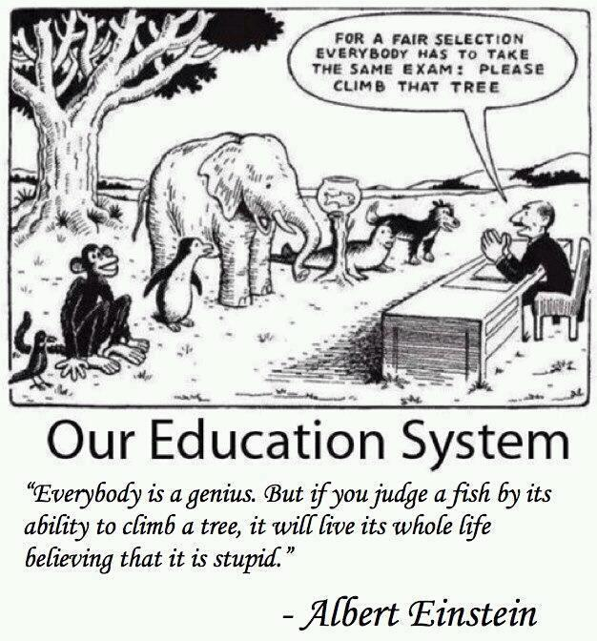

Slide 23
BE.NOT.AFRAID.IT.IS.I
32 (Let's just dramatize...) "One day when dad come in, set me upon the bow of the boat, said, 'Simon, my little boy, daddy has always believed that someday the Messiah would come. All of us Jewish people has looked for that. But perhaps I won't see Him… But, Simon, when He comes, there'll be a lot of stuff go out before He comes that'll cause the whole country to be confused… But, Simon, I want you to be taught.'”
33 Oh, how it would do good if we American people would teach our children such things, instead of tap dancing, rock-and-roll, and stuff that we do today, and just let them join the church, but tell them what to look for. 61-0414

Slide 24
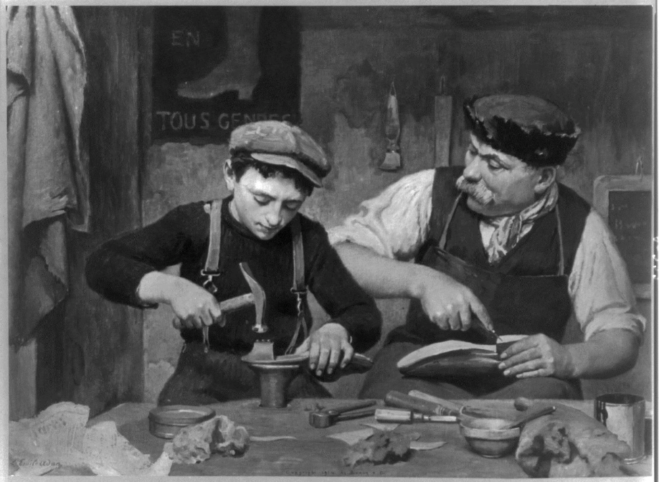
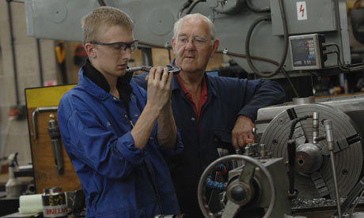

Slide 25
INFLUENCE
15 Now, Uzziah the king was a shepherd boy. He was a young fellow, a king's son, and loved outdoors. He liked the woods, was a herdsman, he liked to see things grow.
And this young fellow was brought up under real good influence. Amaziah, his father, had been a great man, in his last days he let down a little, and picked up some gods from another country, and the Lord then taken him out of the earth.

Slide 26
But this young fellow had had good influence, because his mother was a daughter of Jerusalem, his father a believer, and therefore the boy had been raised up with good influence.
16 And that's a good way to bring up a child, in the way it should go. And you know what? Your children is one of the main eyes that's watching you. They watch what you do. And whatever you do, they copy after you, because you're setting the example before them, to what you do.
63-0803

Slide 29
FAITH.WITHOUT.WORKS.IS.DEAD
41 I have nothing against education. But the world they got a educational program. And they got it down into the church. A minister has to be a certain degree or he has to have so many degrees or he ain't welcome in the platform…
Well look, brother, the Kingdom of God don't come by education, it comes by a surrendered heart to God. And I'm not trying to support my ignorance. But I'm saying this, my dear friends, that a simple child faith... Don't seek for knowledge. 50-0822

Slide 30
COME.FOLLOW.ME 41 And the father and mother praying constantly that their son would not turn out just an ordinary man, that he would be an extraordinary man. All parents want that… And that's the ambition of any parent, to do the best for their children, that they can, educate them, give them things maybe that they wasn't able to get. That's the way I feel about my children. 42 I think, sometime, in going to school, now; I think, send Becky and Sarah and Joseph into these high schools and things, where all this going-on is at? I think I'll take them and get back into the mountain, and raise them up there like the Indians live.
COME.FOLLOW.ME
41 And the father and mother praying constantly that their son would not turn out just an ordinary man, that he would be an extraordinary man. All parents want that… And that's the ambition of any parent, to do the best for their children, that they can, educate them, give them things maybe that they wasn't able to get. That's the way I feel about my children.
42 I think, sometime, in going to school, now; I think, send Becky and Sarah and Joseph into these high schools and things, where all this going-on is at? I think I'll take them and get back into the mountain, and raise them up there with the... like the Indians live.

Slide 31
43 But here is what it is. What's in the kid is going to come out. No matter where it is, it's going to come out. If it's evil in there, it'll come out in the Indian camp. If it's good in there, it'll come out in any camp. It's what's in the kid, the make-up of the kid, what's on the inside of you. And what you are now is what you're probably be the rest of your life. You're on a changing spot. 44 Do you know what? 86% of the conversions to Jesus Christ is done before 21 yrs. Old. Statistics shows it... You, after you pass that age, you become more molded or set in your ways. Oh, it's possible, sure. They come, seventy and eighty, years old, but it's very rare.

Slide 32
I was borned of a very humble parent, a very humble home. I have no education at all, and I'm not... When I made that remark a while ago about education, I wasn't trying to take crutches for my ignorance.
But what I'm trying to say, that it doesn't take education to know God; it takes a submissive heart to know God.
50-0110

Slide 33
Financial Stewardship
The direction in our lives should not be determined by our finances. Rather we should use our assets to create a plan that supports the direction we feel led to take in the will of God.
I CHRONICLES 29:11
Thine, O LORD, is the greatness, and the power, and the glory, and the victory, and the majesty: for all that is in the heaven and in the earth is thine; thine is the kingdom, O LORD, and thou art exalted as head above all.

Slide 34
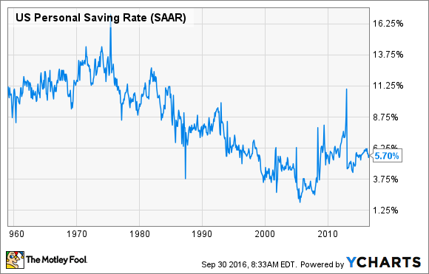

Slide 35
Saving
The point of an emergency fund is for your money to be readily accessible when you need it for an emergency. Experts generally suggest setting aside six months' worth of expenses, but any increase in your emergency savings is helpful. After all, an emergency stash of just $400 puts you in better shape than about half of all Americans.
The bottom line on savings: Americans are getting better about saving, but we still have a long way to go. The three keys to long-term financial success are simple – save more money, put it in the right places, and allocate it wisely.

Slide 36
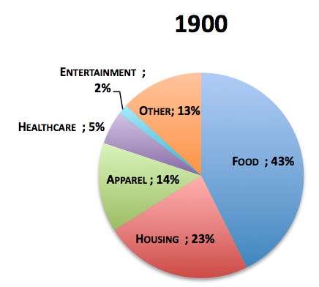
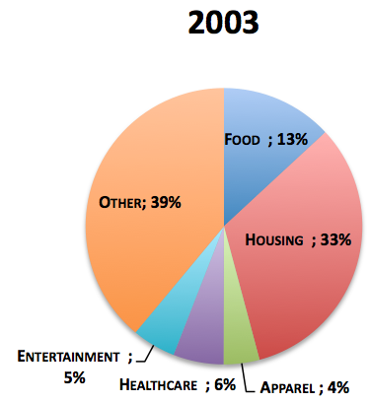
How We Spend Our Money
Food, Housing,
Apparel = 80%
Food, Housing,
Apparel = 50%

Slide 37
LET US SEE GOD
But, you know, I feel like this, that a member of a church, their first obligation is, with their tithe and offerings, is to support their church… and your obligation is to your church and not to an evangelist like me.
November 29,1959
Notes:
MALACHI. 3:7
Even from the days of your fathers ye are gone away from mine ordinances, and have not kept [them]. Return unto me, and I will return unto you, saith the LORD of hosts. But ye said, Wherein shall we return?
3:8 Will a man rob God? Yet ye have robbed me. But ye say, Wherein have we robbed thee? In tithes and offerings.
3:9 Ye [are] cursed with a curse: for ye have robbed me, [even] this whole nation.
3:10 Bring ye all the tithes into the storehouse, that there may be meat in mine house, and prove me now herewith, saith the LORD of hosts, if I will not open you the windows of heaven, and pour you out a blessing, that [there shall] not [be room] enough [to receive it].
3:11 And I will rebuke the devourer for your sakes, and he shall not destroy the fruits of your ground; neither shall your vine cast her fruit before the time in the field, saith the LORD of hosts.

Slide 38
“When you run in debt, you give another power over your liberty.”
Benjamin Franklin
“No one who is financially bound, can be spiritually free.” Larry Burkett
Over 50% of marriages fail in America.
Financial pressure is cited as the number one reason. 4:1 over any other reason, including infidelity!
Notes:
Job 24:9 The fatherless child is snatched from the breast; the infant of the poor is seized for a debt.
Psalm 109:11 May a creditor seize all he has; may strangers plunder the fruits of his labor.
Luke 12: 57 “Why don’t you judge for yourselves what is right? 58As you are going with your adversary to the magistrate, try hard to be reconciled to him on the way, or he may drag you off to the judge, and the judge turn you over to the officer, and the officer throw you into prison. 59I tell you, you will not get out until you have paid the last penny.£”

Slide 39
“Thus Saith the Lord”
Bring ye all the tithes into the storehouse, that there may be meat in mine house, and prove me now herewith, saith the LORD of hosts, if I will not open you the windows of heaven, and pour you out a blessing, that there shall not be room enough to receive it. 11 And I will rebuke the devourer for your sakes, and he shall not destroy the fruits of your ground; neither shall your vine cast her fruit before the time in the field, saith the LORD of hosts. MALACHI 3:10, 11
Notes:
MALACHI. 3:7
Even from the days of your fathers ye are gone away from mine ordinances, and have not kept [them]. Return unto me, and I will return unto you, saith the LORD of hosts. But ye said, Wherein shall we return?
3:8 Will a man rob God? Yet ye have robbed me. But ye say, Wherein have we robbed thee? In tithes and offerings.
3:9 Ye [are] cursed with a curse: for ye have robbed me, [even] this whole nation.
3:10 Bring ye all the tithes into the storehouse, that there may be meat in mine house, and prove me now herewith, saith the LORD of hosts, if I will not open you the windows of heaven, and pour you out a blessing, that [there shall] not [be room] enough [to receive it].
3:11 And I will rebuke the devourer for your sakes, and he shall not destroy the fruits of your ground; neither shall your vine cast her fruit before the time in the field, saith the LORD of hosts.

Slide 40
Proverbs 3:9-14
Honour the LORD with thy substance, and with the firstfruits of all thine increase: So shall thy barns be filled with plenty, and thy presses shall burst out with new wine. My son, despise not the chastening of the LORD; neither be weary of his correction: For whom the LORD loveth he correcteth; even as a father the son in whom he delighteth. Happy is the man that findeth wisdom, and the man that getteth understanding. For the merchandise of it is better than the merchandise of silver, and the gain thereof than fine gold.

Slide 41
God’s view: Malachi 3:7 to 11
In paying your tithes and offerings, you:
1.) Will be bringing your tithes into the storehouse
2.) Are returning to God what is His;
3.) No longer robbing God - free from God’s curse
4.) Can put God to the test – He said, “Prove me.”
5.) Have Gods’ promise, I will open you the windows of heaven, and pour you out a blessing, that there shall not be room enough to receive it.
Notes:
MALACHI. 3:7
Even from the days of your fathers ye are gone away from mine ordinances, and have not kept [them]. Return unto me, and I will return unto you, saith the LORD of hosts. But ye said, Wherein shall we return?
3:8 Will a man rob God? Yet ye have robbed me. But ye say, Wherein have we robbed thee? In tithes and offerings.
3:9 Ye [are] cursed with a curse: for ye have robbed me, [even] this whole nation.
3:10 Bring ye all the tithes into the storehouse, that there may be meat in mine house, and prove me now herewith, saith the LORD of hosts, if I will not open you the windows of heaven, and pour you out a blessing, that [there shall] not [be room] enough [to receive it].
3:11 And I will rebuke the devourer for your sakes, and he shall not destroy the fruits of your ground; neither shall your vine cast her fruit before the time in the field, saith the LORD of hosts.

Slide 42
Tithes & Offerings Unpaid
God’s view: Mal. 3:7 to 11
1.) “Gone away from mine ordinances”
2.) A thief: Nor thieves… nor revilers, nor extortioners, shall inherit the kingdom of God. (I Cor. 6:10)
3.) You are cursed with a curse;
4.) The devourer has been loosed upon you to destroy your crops;
5.) That which you have worked so hard to raise, will spoil (self destruct) before reaching harvest.
Notes:
MALACHI. 3:7
Even from the days of your fathers ye are gone away from mine ordinances, and have not kept [them]. Return unto me, and I will return unto you, saith the LORD of hosts. But ye said, Wherein shall we return?
3:8 Will a man rob God? Yet ye have robbed me. But ye say, Wherein have we robbed thee? In tithes and offerings.
3:9 Ye [are] cursed with a curse: for ye have robbed me, [even] this whole nation.
3:10 Bring ye all the tithes into the storehouse, that there may be meat in mine house, and prove me now herewith, saith the LORD of hosts, if I will not open you the windows of heaven, and pour you out a blessing, that [there shall] not [be room] enough [to receive it].
3:11 And I will rebuke the devourer for your sakes, and he shall not destroy the fruits of your ground; neither shall your vine cast her fruit before the time in the field, saith the LORD of hosts.

Slide 43
Quotes on Tithes & Offerings
HEBREWS, Chapter 7, Part I,
123 ....Why would he ask Abraham to pay tithes? You see what a strict thing it is to pay tithes? Tithing's right. Every Christian is duty bound to pay tithe. That's right. Never has been changed!
September 15,1957
Notes:
MALACHI. 3:7
Even from the days of your fathers ye are gone away from mine ordinances, and have not kept [them]. Return unto me, and I will return unto you, saith the LORD of hosts. But ye said, Wherein shall we return?
3:8 Will a man rob God? Yet ye have robbed me. But ye say, Wherein have we robbed thee? In tithes and offerings.
3:9 Ye [are] cursed with a curse: for ye have robbed me, [even] this whole nation.
3:10 Bring ye all the tithes into the storehouse, that there may be meat in mine house, and prove me now herewith, saith the LORD of hosts, if I will not open you the windows of heaven, and pour you out a blessing, that [there shall] not [be room] enough [to receive it].
3:11 And I will rebuke the devourer for your sakes, and he shall not destroy the fruits of your ground; neither shall your vine cast her fruit before the time in the field, saith the LORD of hosts.

Slide 44
Scriptures: Tithes & Offerings
Genesis 14:18-20*
Genesis 28:22 **
Hebrews 7:1-10
Genesis 28:20-22
Leviticus 27:30-33
Numbers 18:24 & 26
* 422 years before the law
** 270 years before the law
Deuteronomy 12:5, 11, 17 14:22-23, 28 26:12
II Chron. 31:4-6,12
Nehemiah 10:37-39
12:44, 13:5,11
New Testament
Matthew 23:23
Luke 11:42
Notes:
MALACHI. 3:7
Even from the days of your fathers ye are gone away from mine ordinances, and have not kept [them]. Return unto me, and I will return unto you, saith the LORD of hosts. But ye said, Wherein shall we return?
3:8 Will a man rob God? Yet ye have robbed me. But ye say, Wherein have we robbed thee? In tithes and offerings.
3:9 Ye [are] cursed with a curse: for ye have robbed me, [even] this whole nation.
3:10 Bring ye all the tithes into the storehouse, that there may be meat in mine house, and prove me now herewith, saith the LORD of hosts, if I will not open you the windows of heaven, and pour you out a blessing, that [there shall] not [be room] enough [to receive it].
3:11 And I will rebuke the devourer for your sakes, and he shall not destroy the fruits of your ground; neither shall your vine cast her fruit before the time in the field, saith the LORD of hosts.

Slide 45
Quotes: Tithes and Offerings
SPIRIT SPEAKS THROUGH THE PROPHET
....Every man ought to have a church home. You ought to have a place, not just to float about from pillar to post, but have somewhere that you go to church and you call it your church, somewhere you pay your tithe, and somewhere that you help support the cause.....
March 8,1960
Notes:
MALACHI. 3:7
Even from the days of your fathers ye are gone away from mine ordinances, and have not kept [them]. Return unto me, and I will return unto you, saith the LORD of hosts. But ye said, Wherein shall we return?
3:8 Will a man rob God? Yet ye have robbed me. But ye say, Wherein have we robbed thee? In tithes and offerings.
3:9 Ye [are] cursed with a curse: for ye have robbed me, [even] this whole nation.
3:10 Bring ye all the tithes into the storehouse, that there may be meat in mine house, and prove me now herewith, saith the LORD of hosts, if I will not open you the windows of heaven, and pour you out a blessing, that [there shall] not [be room] enough [to receive it].
3:11 And I will rebuke the devourer for your sakes, and he shall not destroy the fruits of your ground; neither shall your vine cast her fruit before the time in the field, saith the LORD of hosts.

Slide 46
QA.GOD.BEING.MISUNDERSTOOD
136. Can a Christian go to heaven if he or she does not pay tithe?
Now, that's one that I could not answer Scripturally… But I do believe every Christian is obligated to pay tithings because it is a com-mandment of the Lord. "And blessed are they that do all His commandments, that they might have a right to enter into the Life, the Tree of Life." Now, I do believe that tithe-paying is essential to a Christian experience.
COD 61-0723
Notes:
MALACHI. 3:7
Even from the days of your fathers ye are gone away from mine ordinances, and have not kept [them]. Return unto me, and I will return unto you, saith the LORD of hosts. But ye said, Wherein shall we return?
3:8 Will a man rob God? Yet ye have robbed me. But ye say, Wherein have we robbed thee? In tithes and offerings.
3:9 Ye [are] cursed with a curse: for ye have robbed me, [even] this whole nation.
3:10 Bring ye all the tithes into the storehouse, that there may be meat in mine house, and prove me now herewith, saith the LORD of hosts, if I will not open you the windows of heaven, and pour you out a blessing, that [there shall] not [be room] enough [to receive it].
3:11 And I will rebuke the devourer for your sakes, and he shall not destroy the fruits of your ground; neither shall your vine cast her fruit before the time in the field, saith the LORD of hosts.

Slide 47
Offerings - Giving
God’s view, according to Old & New Testaments
Give, and it shall be given unto you; good measure, pressed down, and shaken together, and running over, shall men give into your bosom. For with the same measure that ye mete withal it shall be measured to you again. LUKE 6:38
He that giveth unto the poor shall not lack: but he that hideth his eyes shall have many a curse. PROV. 28:27 He that hath pity upon the poor lendeth unto the LORD; and that which he hath given will he pay him again. PROV. 19:17
Notes:
MALACHI. 3:7
Even from the days of your fathers ye are gone away from mine ordinances, and have not kept [them]. Return unto me, and I will return unto you, saith the LORD of hosts. But ye said, Wherein shall we return?
3:8 Will a man rob God? Yet ye have robbed me. But ye say, Wherein have we robbed thee? In tithes and offerings.
3:9 Ye [are] cursed with a curse: for ye have robbed me, [even] this whole nation.
3:10 Bring ye all the tithes into the storehouse, that there may be meat in mine house, and prove me now herewith, saith the LORD of hosts, if I will not open you the windows of heaven, and pour you out a blessing, that [there shall] not [be room] enough [to receive it].
3:11 And I will rebuke the devourer for your sakes, and he shall not destroy the fruits of your ground; neither shall your vine cast her fruit before the time in the field, saith the LORD of hosts.

Slide 48
Quotes: Tithes and Offerings
FORSAKING.ALL
14 … And now, today, to see great fine structures going up, clean, where people can come in and worship God, we're so thankful for this; and for the sacrifice that people, with their tithings and offerings and contribution, has built this house for the Lord.
62-0123
Notes:
MALACHI. 3:7
Even from the days of your fathers ye are gone away from mine ordinances, and have not kept [them]. Return unto me, and I will return unto you, saith the LORD of hosts. But ye said, Wherein shall we return?
3:8 Will a man rob God? Yet ye have robbed me. But ye say, Wherein have we robbed thee? In tithes and offerings.
3:9 Ye [are] cursed with a curse: for ye have robbed me, [even] this whole nation.
3:10 Bring ye all the tithes into the storehouse, that there may be meat in mine house, and prove me now herewith, saith the LORD of hosts, if I will not open you the windows of heaven, and pour you out a blessing, that [there shall] not [be room] enough [to receive it].
3:11 And I will rebuke the devourer for your sakes, and he shall not destroy the fruits of your ground; neither shall your vine cast her fruit before the time in the field, saith the LORD of hosts.

Slide 49
Psalms 144:11-15
Rid me, and deliver me from the hand of strange children, whose mouth speaketh vanity, and their right hand is a right hand of falsehood:12 That our sons may be as plants grown up in their youth; that our daughters may be as corner stones, polished after the similitude of a palace 13 That our garners may be full, affording all manner of store: that our sheep may bring forth thousands and ten thousands in our streets: 14 That our oxen may be strong to labour; that there be no breaking in, nor going out; that there be no complaining in our streets. 15 Happy is that people, that is in such a case: yea, happy is that people, whose God is the LORD…

