Slide 1
Touch Not!
II CORINTHIANS 6:16-17
And what agreement hath the temple of God with idols? for ye are the temple of the living God; as God hath said, I will dwell in them, and walk in them; and I will be their God, and they shall be my people. 17 Wherefore come out from among them, and be ye separate, saith the Lord, and touch not the unclean thing; and I will receive yo18 And will be a Father unto you, and ye shall be my sons and daughters, saith the Lord Almighty.

Slide 2
Objective:
HEBREWS 12:13-15
13 And make straight paths for your feet, lest that which is lame be turned out of the way; but let it rather be healed. 14 Follow peace with all men, and holiness, without which no man shall see the Lord: 15 Looking diligently lest any man fail of the grace of God; lest any root of bitterness springing up trouble you, and thereby many be defiled;

Slide 3
WHY
5 Brother Williams, God ever be with you and your son in this great work, the missionaries and so forth... How I appreciate this. Never, never get away from it, friends. Don't never let that spirit of worship and that clean holiness ever die among you. Keep that light burning, for it's the lifeline of the church. It's Christ in His Church.
60-0401

Slide 4
MATTHEW 5:18-20
For verily I say unto you, Till heaven and earth pass, one jot or one tittle shall in no wise pass from the law, till all be fulfilled. 19 Whosoever therefore shall break one of these least commandments, and shall teach men so, he shall be called the least in the kingdom of heaven: but whosoever shall do and teach them, the same shall be called great in the kingdom of heaven. 20 For I say unto you, That except your righteousness shall exceed the righteousness of the scribes and Pharisees, ye shall in no case enter into the kingdom of heaven.

Slide 5
Lev. 13:45-46
And the leper in whom the plague is, his clothes shall be rent, and his head bare, and he shall put a covering upon his upper lip, and shall cry, Unclean, unclean. 46 All the days wherein the plague shall be in him he shall be defiled; he is unclean: he shall dwell alone; without the camp shall his habitation be.

Slide 6
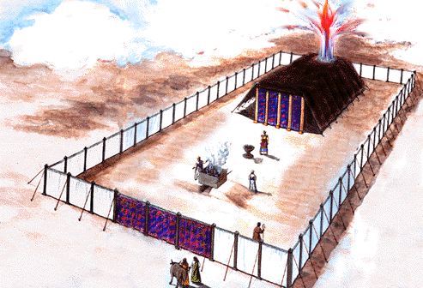

Slide 7
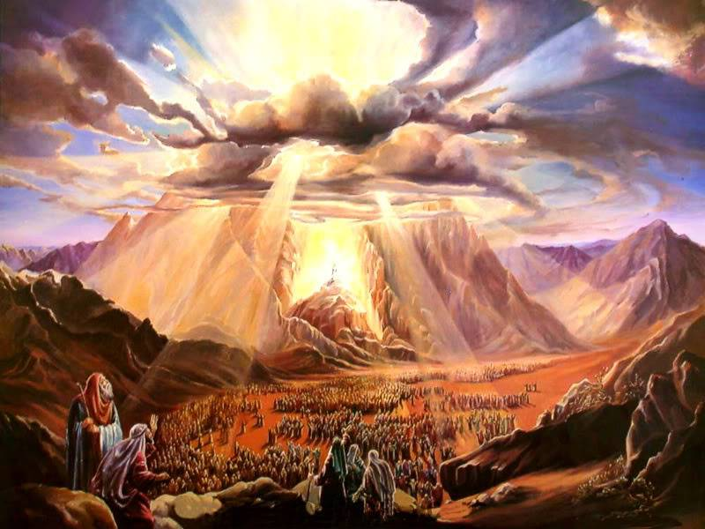
Mt. Sinai

Slide 8
EXODUS 19:23-24
And Moses said unto the LORD, The people cannot come up to mount Sinai: for thou chargedst us, saying, Set bounds about the mount, and sanctify it. 24 And the LORD said unto him, Away, get thee down, and thou shalt come up, thou, and Aaron with thee: but let not the priests and the people break through to come up unto the LORD, lest he break forth upon them.

Slide 9
LEVITICUS 20:25
Ye shall therefore put difference between clean beasts and unclean, and between unclean fowls and clean: and ye shall not make your souls abominable by beast, or by fowl, or by any manner of living thing that creepeth on the ground, which I have separated from you as unclean. 26 And ye shall be holy unto me: for I the LORD am holy, and have severed you from other people, that ye should be mine. 27 A man also or woman that hath a familiar spirit, or that is a wizard, shall surely be put to death: they shall stone them with stones: their blood shall be upon them.

Slide 10
NUMBERS 5:1-3
And the LORD spake unto Moses, saying, 2 Command the children of Israel, that they put out of the camp every leper, and every one that hath an issue, and whosoever is defiled by the dead: 3 Both male and female shall ye put out, without the camp shall ye put them; that they defile not their camps, in the midst whereof I dwell.

Slide 11
NUMBERS 19:11-13
He that toucheth the dead body of any man shall be unclean seven days. 12 He shall purify himself with it on the third day, and on the seventh day he shall be clean: but if he purify not himself the third day, then the seventh day he shall not be clean. 13 Whosoever toucheth the dead body of any man that is dead, and purifieth not himself, defileth the tabernacle of the LORD; and that soul shall be cut off from Israel: because the water of separation was not sprinkled upon him, he shall be unclean; his uncleanness is yet upon him.

Slide 12
QUESTIONS.AND.ANSWERS.1
78 [Peter] fell asleep, went beyond a sleep into a trance; seen a sheet coming down with all unclean and things in it, and he heard a Voice saying, "Rise, slay and eat.” He said, "Not so, Lord, nothing's ever come into my mouth unclean."
Now, that look like Peter's going to take a hunting trip and was going to find some kind of a animal he'd never eat before and try to eat it. "Not so, Lord, I never had anything unclean come into my lips.“ He said, "Don't call unclean what I make clean. Rise, there's men waiting at the gate for you. Go, don't doubt nothing." 64-0823

Slide 13
ISAIAH 6:1-7
Then said I, Woe is me! for I am undone; because I am a man of unclean lips, and I dwell in the midst of a people of unclean lips: for mine eyes have seen the King, the LORD of hosts. 6 Then flew one of the seraphims unto me, having a live coal in his hand, which he had taken with the tongs from off the altar: 7 And he laid it upon my mouth, and said, Lo, this hath touched thy lips; and thine iniquity is taken away, and thy sin purged.

Slide 14
THIRST
136 And then it was that the Cherubim took the tongs, and a coal of Fire from the altar, and touched them unclean lips. And turned him from a coward, or from an educated man, a teacher, to a prophet that the Word of God could speak through. Sure, while he was in the Presence of God, It was something different.
That thirst that he had reached that place then, till he was filled with It.
65-0919

Slide 15
EZEKIEL 47:1-12
Afterward he brought me again unto the door of the house; and, behold, waters issued out from under the threshold of the house eastward: for the forefront of the house stood toward the east, and the waters came down from under from the right side of the house, at the south side of the altar… 12 And by the river upon the bank thereof, on this side and on that side, shall grow all trees for meat, whose leaf shall not fade, neither shall the fruit thereof be consumed: it shall bring forth new fruit according to his months, because their waters they issued out of the sanctuary: and the fruit thereof shall be for meat, and the leaf thereof for medicine.

Slide 16
JOHN 2:19-21
Jesus answered and said unto them, Destroy this temple, and in three days I will raise it up.20 Then said the Jews, Forty and six years was this temple in building, and wilt thou rear it up in three days? 21 But he spake of the temple of his body.
I CORINTHIANS 3:16-17
Know ye not that ye are the temple of God, and that the Spirit of God dwelleth in you? 17 If any man defile the temple of God, him shall God destroy; for the temple of God is holy, which temple ye are.

Slide 17
JOHN 7:37-39
In the last day, that great day of the feast, Jesus stood and cried, saying, If any man thirst, let him come unto me, and drink. 38 He that believeth on me, as the scripture hath said, out of his belly shall flow rivers of living water. 39 (But this spake he of the Spirit, which they that believe on him should receive: for the Holy Ghost was not yet given; because that Jesus was not yet glorified.)

Slide 18
ZECHARIAH 14:8-9
And it shall be in that day, that living waters shall go out from Jerusalem; half of them toward the former sea, and half of them toward the hinder sea: in summer and in winter shall it be. 9 And the LORD shall be king over all the earth: in that day shall there be one LORD, and his name one.

Slide 19
REVELATION 22:1-3
And he shewed me a pure river of water of life, clear as crystal, proceeding out of the throne of God and of the Lamb. 2 In the midst of the street of it, and on either side of the river, was there the tree of life, which bare twelve manner of fruits, and yielded her fruit every month: and the leaves of the tree were for the healing of the nations. 3 And there shall be no more curse: but the throne of God and of the Lamb shall be in it; and his servants shall serve him:

Slide 20
CHURCH.AGE.BOOK
292-1 …As the Jews took refuge in the syna-gogue form of worship, so in the Philadelphian Age they were taking refuge in the church. It is not joining a church that counts. The life is not in the church. The life is in Christ.
…Man is made holy by the Spirit. It is the Spirit of Holiness that raised Jesus from the dead that in-dwells us and makes us holy with His holiness.

Slide 21
UNITED.UNDER.ONE.HEAD
26 Now, when sin came in and upset your heart and the devil come in and blocked it all off, but then God sent His own Son made in the likeness of sinful flesh to cleanse that heart, so that He could come in.
He made a way, appropriated a way that He could cleanse your heart so that He could come in. He can't come into your heart with all that sin and unbelief there…
58-0326

Slide 22
A.TESTIMONY.ON.THE.SEA
76 Our enthusiasm to make our denominations grow, we've built bigger schools to educate ministers, and send them farther from God than they was at the beginning. God is not known by education, by theology. God is knowed by faith.
77 Look what it's done, Pentecostal people that used to be pentecost. Our women has bobbed off their hair; wearing makeup. Our men is permit-ting it. Our ministers are permitting it. They're afraid to say something about it. It's a disgrace. 64-0307

Slide 23
WORLD.IS.FALLING.APART
175 Well, you say, "They're just having a little clean fun." A little clean fun? Nothing! I don't care how much Sunday school teacher you are. If that thing is in your heart, God can't dwell in that unclean place. What we need is an old-fashion holiness revival to sweep the church, from one end to the other.
63-1115

Slide 24
Matthew 8:1-4

Slide 25
MATTHEW 8:1
When he was come down from the mountain, great multitudes followed him. 2 And, behold, there came a leper and worshipped him, saying, Lord, if thou wilt, thou canst make me clean. 3 And Jesus put forth his hand, and touched him, saying, I will; be thou clean. And immediately his leprosy was cleansed. 4 And Jesus saith unto him, See thou tell no man; but go thy way, shew thyself to the priest, and offer the gift that Moses commanded, for a testimony unto them.

Slide 26
MATTHEW 23:25-27
Woe unto you, scribes and Pharisees, hypocrites! for ye make clean the outside of the cup and of the platter, but within they are full of extortion and excess. 26 Thou blind Pharisee, cleanse first that which is within the cup and platter, that the outside of them may be clean also. 27 Woe unto you, scribes and Pharisees, hypocrites! for ye are like unto whited sepulchres, which indeed appear beautiful outward, but are within full of dead men's bones, and of all uncleanness.

Slide 27
THE.SEAL.OF.THE.ANTICHRIST
69 You go into a home, you find the spirit of the home. And where you let yourself be, you take a real good woman, and put her out with some scalawags, them scalawags will be good or she'll be like them. That's exactly the truth. I've seen it in thousands of cases.
Same thing with men. Show me your company; I'll tell you what you are. What we need, to not associate ourselves with the world.
55-0311

Slide 28
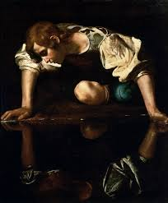
PROVERBS 27:19
As in water face answereth to face, so the heart of man to man.

Slide 29
GOD.KEEPS.HIS.WORD
35 Listen. Oil and water don't mix. And many time, a many a good life has been completely wrecked by your associates. Show me your company, I'll tell you who you are. Associate with people who believe God.
36 Don't let your children... If he runs across the street to little Oswald over here, he's a nice little boy; but be careful who little Oswald is.

Slide 30
Find out what his daddy is, what his mama is. They may be a hater of the Gospel. They may have everything projected into little Oswald. And you let your little boy or girl associate like that, and the first thing you know, he will come up and be like little Oswald.
57-0115

Slide 31
WHERE.HAS.THY.STRENGTH.GONE.SAMSON
6 Samson got into bad company. And you always can remember that when you are in bad company, you are out of the will of the Lord. My own southern mammy used to tell me, "If you lay down with a dog that's got fleas, you'll get up with the fleas." You just can't associate yourself with the things of the world and expect to stay spiritual and humble before the Lord. You're known by your company. There's an old saying, "Show me your company, I'll tell you who you are.“ And when the church begins to keep company with the world, then it's no more than the world. It gets out of the fellowship of the Holy Spirit, gets out of the company of God, and of angels, and of God's heritage, when it begins to flirt as Samson did. 59-0702

Slide 32
LED.BY.THE.SPIRIT.OF.GOD
42 Usually if a man's going to be a believer, he's got to separate himself from his worldly friends, all the people. Yoke yourself out up from amongst unbelievers. They'll only call you back into the world again. Environment has a lot to do with it.
56-0723

Slide 33
ROMANS 8:12
Therefore, brethren, we are debtors, not to the flesh, to live after the flesh. 13 For if ye live after the flesh, ye shall die: but if ye through the Spirit do mortify the deeds of the body, ye shall live.
Mortify:
The active work of weakening the roots of something, devoting all power and energy to constant warfare, uncompromisingly with an attitude of destroying the enemy.

Slide 34
JUST.ONE.MORE.TIME.LORD 63-0120
59 ... It wasn't God's fault he {Samson} was defeated; it was his own fault. And God's people, {who} he was raised up to preach the Gospel to in his strength, and by flirting with this immoral woman, he lost all the strength God had give him. So has it been with the church. God raised the church up to be a lighthouse to let out His powers… but we begin to creep in and let down the bars.

Slide 35
61 We took the wrong example. The women acted like the pastor's wife. He let her go haywire, cut off her hair, wear any kind of sexy clothes, never rebuked. And the other women say, "If Sister So-and-so can do it, I could too." Don't make that your example. God told you what to do; stay with that. Now, then when you do that, you fail God and you also fail His people... God set you there to be a watchman, and when you see sin creeping in, instead of cutting the thing off, they entice it.

Slide 36
A.MISSIONARY.TALK
1 Now, in the Bible, we always try at our church to follow the rules and regulations of the Scripture, just as close as we can. Some people sprinkle the little children, infant baptism. I never did find that in the Scripture.
58-0330

Slide 37
64-0823 COD
244. Bro. Branham, what do you think about our sisters in the church wearing such short dresses? Doesn't it mar our testimony and set the wrong example for our young people in this our church? It seems so... to see a grown woman wearing a dress so short that it shows her knees when she walks.

Slide 38
Ever who you are, I agree with you 100%. It's a disgrace, but tell me what to do about it. I preach it just as hard as I know how to preach it; they do it the same. So it's their judgment, 'cause the Word's went forth. Yes, I'm certainly against them little old skin-tight dresses...
I constantly fuss at my kids, Becky and Sarah. I don't care how little they are... Meda takes Becky apart every day about it. 'Cause kids, you can expect that in kids, and you have to correct them; but when it comes to a woman, there's something wrong there.

Slide 39
ACTS 15:7
And when there had been much disputing, Peter rose up, and said unto them, Men and brethren, ye know how that a good while ago God made choice among us, that the Gentiles by my mouth should hear the word of the gospel, and believe. 8 And God, which knoweth the hearts, bare them witness, giving them the Holy Ghost, even as he did unto us; 9 And put no difference between us and them, purifying their hearts by faith.

Slide 40
II CORINTHIANS 7:1
1 Having therefore these promises, dearly beloved, let us cleanse ourselves from all filthiness of the flesh and spirit, perfecting holiness in the fear of God.

Slide 41
QUEEN.OF.SHEBA
9 And then if you say that you're saved and still live for the things of the world, your fruits prove that you're not saved. I believe holiness... But if you just make yourself dress like a holy person or act like a holy person, that doesn't make you a holy person. You'd just be making out that. But if the Spirit within you makes you live that way, then you know you're all right. That's how you judge yourself…
60-0710

Slide 42
ROJC
216 And if our lives come from up there, then we act like that... Our Life is from a holy place; looks different; dresses different. The women up there has long hair, don't wear manicure on their face, don't wear shorts. They wear skirts and long robes and dresses, and they have long hair... So the nature of it from up there reflects back on us. The men don't smoke, chew, lie, steal… We're of a Kingdom, and we have a King. Then when a person is sanctified, Christ, the Holy Spirit, moves into the heart and becomes King over that... A king has his domain. 60-1204

Slide 43
PSALMS 141:4
Incline not my heart to any evil thing, to practise wicked works with men that work iniquity…

Slide 44
INFLUENCE
211 There's no holiness with us. We can't be holy; holiness is of God. It ain't a holy church, it's a holy God. Not holy people; a holy God. It's God in the people… it was a holy God there, the Presence of God, what made it holy.
It's the Presence of God in our midst now that brings holiness, not my holiness, not yours, but His holiness… We ought to humble ourselves, cover ourselves in reverence, humility, and say, "Lord Jesus, receive me into Your Kingdom." His holiness, not ours.
63-1114

Slide 45
MARRIAGE.OF.THE.LAMB
28 If you notice, it said, "She has made herself ready." So many says, "If the Lord will take this evil spirit from me, drinking, gambling, lying, or stealing, I'll serve Him." But that's up to you. You got to do something too. "They that overcome shall inherit all things," they that overcome. You have power to do it, but you must be willing to lay it down. She has made herself ready.
God could not push us through a little pipe, pull us out on the other end, and then say, "Blessed is he that overcometh." He just pushed you through. But you've got to make decisions for yourself… 62-0121

Slide 46
II CORINTHIANS 7:1
Having therefore these promises, dearly beloved, let us cleanse ourselves from all filthiness of the flesh and spirit, perfecting holiness in the fear of God.
ROMANS 13:12-14
12 The night is far spent, the day is at hand: let us therefore cast off the works of darkness, and let us put on the armour of light. 13 Let us walk honestly, as in the day; not in rioting and drunkenness, not in chambering and wantonness, not in strife and envying. 14 But put ye on the Lord Jesus Christ, and make not provision for the flesh, to fulfil the lusts thereof.

Slide 47
WHY?
126 The same God, lived one time, still lives today. His same, His same doctrine of holiness just lives tonight the same as it ever lived, just the same thing. Notice, the people has got away from the doctrine of it, that's all.
63-0626

Slide 48
TOTAL.SEPARATION 64-0121
27 I believe, tonight, that every man and woman, every boy and girl, that's born of the Spirit of God, is a Nazarite unto the Lord; because they have separated them things, themselves, from the cares of the world and whatever the world has got to say.
29 God has one way of bringing Light to you: that's when you're ready to separate yourself from all the things of the world, and all the cares of the world, and cling only to God's promised Word.

Slide 49
THE.VOICE.OF.THE.SIGN
180 He made women different from man, and man different from women. He dressed them different, and wants them to stay that way. Women wants to look like man, and man wants to look like women. And the whole thing, look like it's got a grip on the people, and you can't change it. Looks like a great monster, a great blackness; if you understand what I'm speaking of, in the spirit. A monster has got them grabbed, and they just can't get away from it; too much Hollywood, too much television, too much other nonsense. Everything we got is polluted. No wonder, "If the work isn't cut short, for the Elected sake, there will be no flesh saved.“64-0321

Slide 50
CHURCH.AGE.BOOK
292-1 It is not joining a church that counts. The life is not in the church. The life is in Christ.
"This is the record that God hath given us eternal life and this life is in His Son. He that hath the Son hath life, and he that hath not the Son hath not life."
Man is made holy by the Spirit. It is the Spirit of Holiness that raised Jesus from the dead that in-dwells us and makes us holy with His holiness.

Slide 51
