Slide 1
Jealousy & Envy
ACTS 7:9
And the patriarchs, moved with envy, sold Joseph into Egypt: but God was with him…

Slide 2
God: New Birth
Our Witness
Outsiders
The Church
Local Body
Me
Walk in wisdom toward them that are without, redeeming the time.
(Col. 4:5)
So we, being many, are one body in Christ, and every one members one of another. (Rom. 12:5)

Slide 3
BLIND.BARTIMAEUS
The world's a dying, not for a better economics… not for better buildings, a bigger denomination. But it's dying for somebody to reach out a hand of love, to show that we care one for the other.
And that's the very sign that Jesus told us that, "By this all men would know that you were My disciples," when we got love one for the other.
61-0124

Slide 4
GALATIANS 6:1-3
1 Brethren, if a man be overtaken in a fault, ye which are spiritual, restore such an one in the spirit of meekness; considering thyself, lest thou also be tempted. 2 Bear ye one another's burdens, and so fulfil the law of Christ. 3 For if a man think himself to be something, when he is nothing, he deceiveth himself.

Slide 5
I CORINTHIANS 12:25-26
25 That there should be no schism in the body; but that the members should have the same care one for another. 26 And whether one member suffer, all the members suffer with it; or one member be honoured, all the members rejoice with it.

Slide 6
Wherefore is there a price in the hand of a fool to get wisdom, seeing he hath no heart to it?
PROVERBS 17:16

Slide 8
NAHUM 1:2
God is jealous, and the LORD revengeth; the LORD revengeth, and is furious; the LORD will take vengeance on his adversaries, and he reserveth wrath for his enemies. 3 The LORD is slow to anger, and great in power, and will not at all acquit the wicked: the LORD hath his way in the whirlwind and in the storm, and the clouds are the dust of his feet.

Slide 9
DEUTERONOMY 5:8
Thou shalt not make thee any graven image, or any likeness of any thing that is in heaven above, or that is in the earth beneath, or that is in the waters beneath the earth: 9 Thou shalt not bow down thyself unto them, nor serve them: for I the LORD thy God am a jealous God, visiting the iniquity of the fathers upon the children unto the third and fourth generation of them that hate me, 10 And shewing mercy unto thousands of them that love me and keep my commandments.

Slide 10
JOSHUA 24:19
And Joshua said unto the people, Ye cannot serve the LORD: for he is an holy God; he is a jealous God; he will not forgive your transgressions nor your sins. 20 If ye forsake the LORD, and serve strange gods, then he will turn and do you hurt, and consume you, after that he hath done you good. 21 And the people said unto Joshua, Nay; but we will serve the LORD.

Slide 11
II CORINTHIANS 11:2
For I am jealous over you with godly jealousy: for I have espoused you to one husband, that I may present you as a chaste virgin to Christ.

Slide 12
FAITH.THAT.WAS.ONCE.DELIVERED
65 Here comes Cain. Then he looked around and he seen Abel's sacrifice was accepted, he become jealous. Then we find a whole lot of that today. Don't tell nobody, but it is.
Jealousy, "Oh, they're a bunch of nitwits. They haven't even got education… We got our degrees. We know what we're doing." Go ahead. Let the blind lead the blind; they'll all fall in the ditch. And he becomes jealous. He becomes angry. Where did that come from? That never come from God.
53-1129

Slide 13
SPEAK.TO.THE.ROCK
18 Now, a lot of people apply Canaan, to being over in the promise land, to being the type of heaven. No, it couldn't type heaven. It's the stages of the journey of the Church.
If you notice how that Israel got down there, how that Joseph, a dreamer, a seer... Now, he couldn't help cause he was a seer. God just made him a seer. They dreamed dreams and he'd interpret it, and God told him what was going to happen. And all of his brothers was jealous of him.
53-1115

Slide 14
I SAMUEL 18:6-9
And it came to pass as they came, when David was returned from the slaughter of the Philistine, that the women came out of all cities of Israel, singing and dancing, to meet king Saul, with tabrets, with joy, and with instruments of musick. 7 And the women answered one another as they played, and said, Saul hath slain his thousands, and David his ten thousands. 8 And Saul was very wroth, and the saying displeased him; and he said, They have ascribed unto David ten thousands, and to me they have ascribed but thous-ands: and what can he have more but the kingdom? 9 And Saul eyed David from that day and forward.

Slide 15
THE.SEED.SHALL.NOT.BE.HEIR
141 I'm slipping into a nation right now, because of organization, they won't let the ministry that God... One of them believes, "You got to be baptized three times; once for the Father, and once for the Son, and Holy Ghost; face forward." The other said, "No, you got to be baptized three times backwards; once for the Son, the Father, and Holy Ghost." And they're both wrong. Such nonsense, separating people, shows it's jealousy. It's from Satan. It isn't of God.
144 In the midst of both sides, God is neither on either side, but He is calling from both sides, "Come out from among them,..” 65-0429

Slide 16
DOES.GOD.CHANGE.HIS.MIND
36 I think Abel had at the beginning, a spiritual revelation that it wasn't fruit or works of our hands, so forth. It was blood. And he offered to God a more excellent sacrifice than Cain did.
37 We find in Abraham and Lot, the same thing, in a choice, because Lot went down, when the time come, when the spiritual the natural church come in a clash, because of the herdsmen. They had to separate one for another. And when-ever this does, it sets up a jealousy…

Slide 17
So we find out, that when God accepted Abel's revelation and his offering, it made Cain get jealous of Abel. And there was the first murder.
39 We find out that jealousy become between the herdsmen of Abraham and Lot, and they had to separate. We find out that Moses and Korah had a clash, also.
65-0427

Slide 18
MARK 15:9-10
But Pilate answered them, saying, Will ye that I release unto you the King of the Jews? 10 For he knew that the chief priests had delivered him for envy.

Slide 19
Envy: (zelos)
Ardour, fervour of spirit in embracing, pursuing, defending anything; zeal in behalf of, or for a person or thing;
An envious and contentious rivalry, jealousy.
A sound heart is the life of the flesh: but envy the rottenness of the bones.
PROVERBS 14:30

Slide 20
Solutions?
Wrath is cruel, and anger is outrageous; but who is able to stand before envy?
PROVERBS 27:4

Slide 21
“Jealousy is nothing more than self-fury. It is a personal attack on yourself for not doing what you knew had to be done, which is then vented outward to those who are doing what there is to be done.”
S. Benhayon

Slide 22
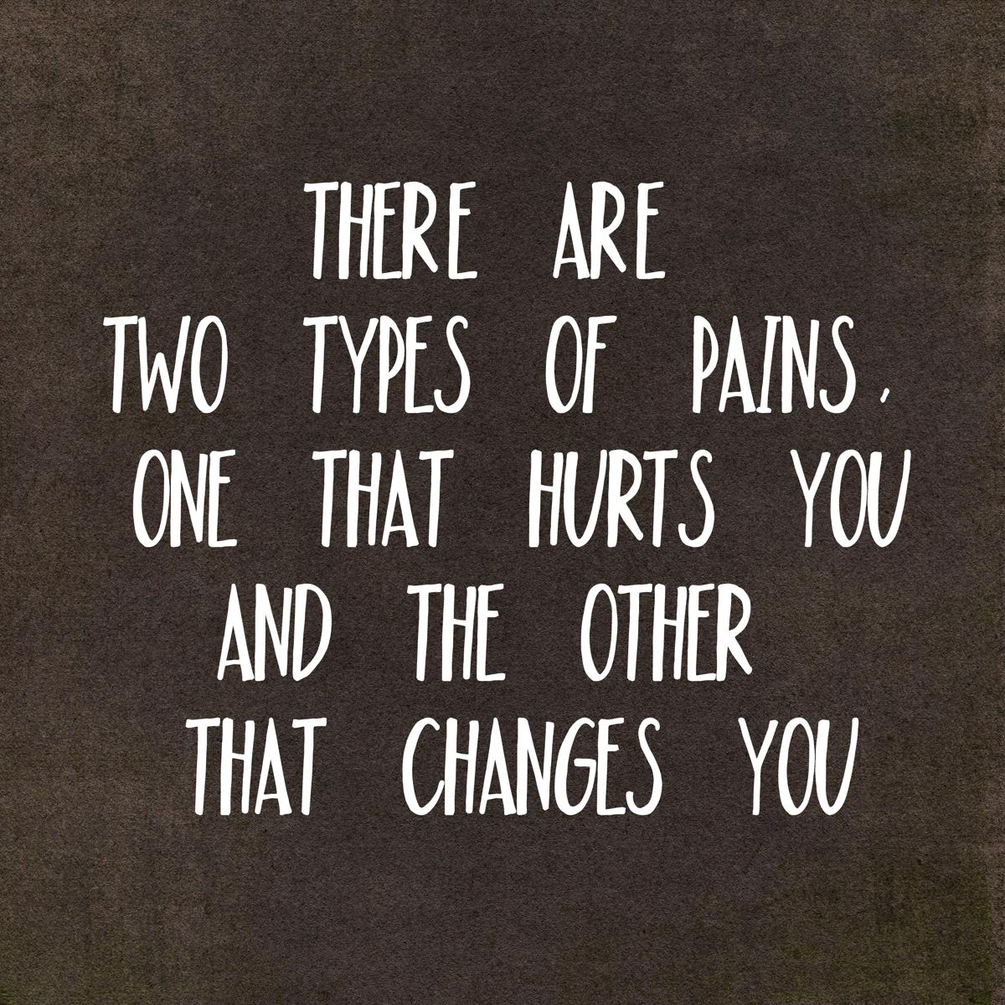

Slide 23
ACTS 13:45-46
But when the Jews saw the multitudes, they were filled with envy, and spake against those things which were spoken by Paul, contradicting and blaspheming. 46 Then Paul and Barnabas waxed bold, and said, It was necessary that the word of God should first have been spoken to you: but seeing ye put it from you, and judge yourselves unworthy of everlasting life, lo, we turn to the Gentiles.

Slide 24
ACTS 13:42-44
And when the Jews were gone out of the synagogue, the Gentiles besought that these words might be preached to them the next sabbath. 43 Now when the congregation was broken up, many of the Jews and religious proselytes followed Paul and Barnabas: who, speaking to them, persuaded them to continue in the grace of God. 44 And the next sabbath day came almost the whole city together to hear the word of God.

Slide 25
PROVERBS 14:30
A sound heart is the life of the flesh: but envy the rottenness of the bones.

Slide 26
THE.FUTURE.HOME
89 Here is a human heart; and here is a human heart. Now, this one over here has a snake in it, that's sin, here he has his life. This one over here has a dove in it, which is the Holy Spirit, here he has a Life. Well, this one here, he has malice, hatred, envy; that's what's causing it, is this fellow here. Well, this one over here has love, and joy, and long-suffering; and That's what does it, down here.
90 Now, when you are asked, or you are forgiven of your sins, you've only done this, taken that away. But the thing that made you do it is still there. That's the old root of evil; it's still there.

Slide 27
Notice, then you repent and are baptized in the Name of Jesus Christ, that He forgave you of your sins. Then, secondly, comes sanctification, which sets our mind in order for holiness, to think right.
92 Then, the next, comes the baptism of the Fire and Holy Ghost, that God might dwell in us. And the Fire of God cleanses our hearts from sin, and puts the Holy Ghost inside. Then we bring forth the same Life that This did, because That's in us.
64-0802

Slide 28
THE.DEITY.OF.JESUS.CHRIST
98 But that is the God, the Creator, living in you, and giving you all the power. And you're in possession of anything that He had.
So is It in you to abstain from evil, to do good, shun evil, flee to righteousness, turn away from temptation. All malice, hatred, strife, envy, come away from it, for that'll take Him from your heart…
Receive Him, embrace Him and love Him, and hold Him in your heart and love Him.
49-1225

Slide 29
Search Me, O God…
Search me, O god, and know my heart: try me, and know my thoughts: 24 and see if there be any wicked way in me, and lead me in the way everlasting.
Psalm 139:23-24

