Slide 1
While We Wait… The Third Part
JOHN 6:64-71
Then said Jesus unto the twelve, Will ye also go away? 68 Then Simon Peter answered him, Lord, to whom shall we go? thou hast the words of eternal life.

Slide 2
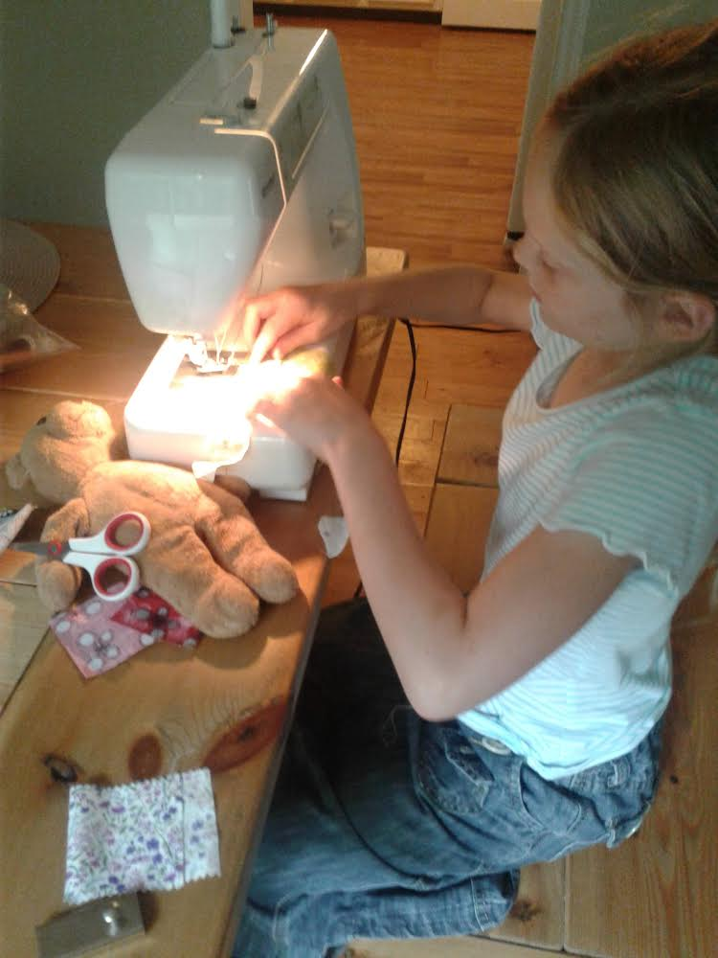

Slide 3
Birthdays & anniversaries & events
3rd Aug.
Josh Godwin
6 Aug.
Lydie Ivy
7 Aug.
Tracy Rabon
8 Aug.
Ethan & Anna Pritchard
9 Aug.
Andy Irish
10 Aug.
John & Jennifer Cockman
5 Aug.
Amanda Bilton
October 12-14th Dedication Meetings

Slide 4
“We have certain basic things: water baptism, repentance, communion, paying tithes, giving offerings, praying and all these basic things that’s part of the commandments of God that a Christian lives. So it isn’t like someone ought to be saying, “Thank you for doing what a servant is supposed to do.” Therefore, we might be looking for praise for many of the things we do but no, that is part of our job/calling. Sure, it’s nice to have a pat on the back, but still remember that we are servants to the King. We have certain responsibilities that automatically go with who we are and what we are.”
(Lk. 17:7-10) Lonnie Jenkins

Slide 5
While We Wait… The Third Part
JOHN 6:64-71
Then said Jesus unto the twelve, Will ye also go away? 68 Then Simon Peter answered him, Lord, to whom shall we go? thou hast the words of eternal life.

Slide 6
JESUS.CHRIST.THE.SAME
33 Thinking in the days, an atomic bomb hanging in the hangar yonder that could destroy the nations, what's left for the human race?
But there's a Lord Jesus, and a heaven, and an eternity. And the blessings of God waits for those who wait for Him and believe in Him. How marvelous. No wonder it's emotional. No wonder it causes us to feel the way we do. He's glorious.
55-0806

Slide 7
CHURCH.ORDER
31 Now I suggest this for the Branham Tabernacle... And we have some very fine gifted people here, each one of those gifts are a ministry of their own. They are gifts, just like preaching is a gift, like healing, they are ministries of their own. And each man is commanded to wait on his own ministry.
32 Therefore let Branham Tabernacle be operated like this, and in the day [of] so much make-belief. We don't want make-belief. If we can't have the real, let's not have any at all, let's wait till we do get the real.… We got to have what's real, what's genuine. If we haven't got it, let's wait till we do get it…
63-1226

Slide 8
LAMENTATIONS 3:25
The LORD is good unto them that wait for him, to the soul that seeketh him. 26 It is good that a man should both hope and quietly wait for the salvation of the LORD. 27 It is good for a man that he bear the yoke in his youth.

Slide 9
FAITH
30 Then if we are God's children… heirs of the kingdom, heirs of Abraham, we should walk as our father Abraham walked… If God said they are then we don't know how it's going to be; but God said so, so we just believe it and move forward, walking by faith. What a beautiful life.
Just think, Abraham at a hundred years old, yet many disappointments, many upsets like all Christians do, waiting on the promise... The Bible said that he staggered not at the promise of God through unbelief. There's many things taken place: famine, distress, but Abraham didn't stagger. He still believed that God was going to give him the baby. 53-1213

Slide 10
I SAMUEL 13:8-14
And he tarried seven days, according to the set time that Samuel had appointed: but Samuel came not to Gilgal; and the people were scattered from him. 9 And Saul said, Bring hither a burnt offering to me, and peace offerings. And he offered the burnt offering.

Slide 11
THE.CHURCH.OF.THE.LIVING.GOD
30 Where the Lord leads me, I try to go. And it's hard, in one way, but it's so sweet… All this isn't a flowery bed of ease, friend.
At nighttime, the struggles. And sometimes when demons has been ordered from people, and them fighting, and that person believing, then they'll haunt right back at you at night like that. Better know what you're doing.
51-0727

Slide 12
SEVENTIETH.WEEK.OF.DANIEL
105 Down through these ages, we had the Holy Spirit come in, and God, back in the beginning, begin to tell then at the rejection of Christ... God showed John exactly what would take place during the Gentile reign. Now, you haven't got any limited time like the Jews, but we got a sign.
We got a signpost. Well, God did with the Jews just exactly what He said He would do in them 483 years, but sixty-nine weeks. And one week left, one week's yet determined. Now, we cannot apply it in here, 'cause this is Gentile, the church. 61-0806

Slide 13
DANIEL 9:24-25
Seventy weeks are determined upon thy people and upon thy holy city, to finish the transgression, and to make an end of sins, and to make reconciliation for iniquity, and to bring in everlasting righteousness, and to seal up the vision and prophecy, and to anoint the most Holy. 25 Know therefore and understand, that from the going forth of the commandment to restore and to build Jerusalem unto the Messiah the Prince shall be seven weeks, and threescore and two weeks: the street shall be built again, and the wall, even in troublous times.

Slide 14
NEHEMIAH 2:17-18
Then said I unto them, Ye see the distress that we are in, how Jerusalem lieth waste, and the gates thereof are burned with fire: come, and let us build up the wall of Jerusalem, that we be no more a reproach. 18 Then I told them of the hand of my God which was good upon me; as also the king's words that he had spoken unto me. And they said, Let us rise up and build. So they strengthened their hands for this good work.

Slide 15
70 Weeks
DANIEL 9:24 Seventy weeks are determined upon thy people and upon thy holy city
70 Weeks
69 Weeks
3.5
Yrs.
Gentiles
3.5
Yrs.

Slide 16
REVELATION 11:1
And there was given me a reed like unto a rod: and the angel stood, saying, Rise, and measure the temple of God, and the altar, and them that worship therein. 2 But the court which is without the temple leave out, and measure it not; for it is given unto the Gentiles: and the holy city shall they tread under foot forty and two months.

Slide 18
GOD'S.ONLY.PROVIDED.PLACE
40 I believe the church is beginning to hear the Message, and beginning to understand It. But we've got to lay in the Presence of the Son, we've got to be ripened. Our faith isn't ripe. Intellectually we're hearing the Message that God has give us, and seeing the signs that He showed us, and proving it by the Bible, but, how the church needs to lay in His Presence till it tenders up, gets sweet in the Spirit...
But when the Church once gets It, the Elected is called out and separated, then in the Presence of God, I know it'll be something like the people was there when it takes its Rapture. 65-1128

Slide 19
LEADERSHIP
138 Now look, every three years after a message has went forth sent from God, they organize. This has been twenty years, and there's no organization. It won’t.
Now the shuck has to pull away, give the Wheat a chance to lay before the Son, to ripen; the Message coming right back into the Church again, forming the Body of Jesus Christ just like the first original One that went into the ground.
65-1207

Slide 20
To Whom Else Shall We Go?
JOHN 6:64-71
Then said Jesus unto the twelve, Will ye also go away? 68 Then Simon Peter answered him, Lord, to whom shall we go? thou hast the words of eternal life.

Slide 21
DEUTERONOMY 14:1-2
1 Ye are the children of the LORD your God: ye shall not cut yourselves, nor make any baldness between your eyes for the dead. 2 For thou art an holy people unto the LORD thy God, and the LORD hath chosen thee to be a peculiar people unto himself, above all the nations that are upon the earth.

Slide 22
EXODUS 19:1-6
5 Now therefore, if ye will obey my voice indeed, and keep my covenant, then ye shall be a peculiar treasure unto me above all people: for all the earth is mine: 6 And ye shall be unto me a kingdom of priests, and an holy nation…

Slide 23
JEHOVAH.JIREH.1
58 Now, the covenant was give uncondition-ally! Israel, the seed natural exchanged that, and lost it in Exodus 19, when they made that rashel thing to take away the grace, and accepted law in its place. What a rashel mistake that Israel made there!
62-0705

Slide 24
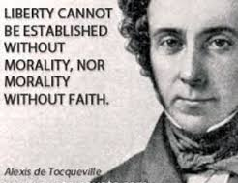

Slide 25
HE.SWORE.BY.HIMSELF
200 … (Moses) God's obligated to His Word. God, went down there and sent a saviour... Here come Moses, leading the children of Israel out.
When they come out with him, got out in the wilderness, said, "Oh, give us something to do. We want to form us an organization, and we want you to give us something to do. Let us make us something like this. Give us a law to keep." Exodus 19 was the greatest mistake that Israel ever made. When grace had already provided their salvation, then they wanted something to do to merit it. God already swore to Abraham, what He was going to go. They said, "Let us have the law." No one never kept it. They never did.
54-1212

Slide 26
CHURCH.CHOOSING.LAW.FOR.GRACE
14 The greatest mistake that Israel ever made was when it renounced grace and accepted law. It made its greatest mistake in Exodus 19, was one of the fatal mistakes that Israel made.
The covenant that God made with Abraham was completely grace. But grace had provided for them a deliverer, a prophet, a sacrificial lamb. It had provided the greatest revival they'd ever had. And yet, they wasn't satisfied with it. They wanted something that they could argue about.
61-0316

Slide 27
NUMBERS 16:25-28
And Moses rose up and went unto Dathan and Abiram; and the elders of Israel followed him. 26 And he spake unto the congregation, saying, Depart, I pray you, from the tents of these wicked men, and touch nothing of theirs, lest ye be consumed in all their sins. 27 So they gat up from the tabernacle of Korah, Dathan, and Abiram, on every side: and Dathan and Abiram came out, and stood in the door of their tents, and their wives, and their sons, and their little children. 28 And Moses said, Hereby ye shall know that the LORD hath sent me to do all these works; for I have not done them of mine own mind.

Slide 28
THE.GOD.OF.THIS.EVIL.AGE
120 Just the same as Balaam's teaching, that he caused the pretty, intellectual, scientific women of Moab with their flirty eyes, paints and powders, fine perfumes, to entice the sons of God; against their own women that worked and had callouses in their hands, with no makeup on. Enticed them over, "Let us marry one another, because we're all the same people.” It was a lie, and an achievement of the devil, to get the sons of God to marry the daughters of men.

Slide 29
It was the lie of the devil, for Balaam, that false prophet, to try to prophesy against Moses that tried to hold the race together; to say, "Well, we believe the same God. We offer the same offerings. We have the same sacrifices. We do everything just alike."
"So close that it would deceive the Elected if possible.” Come away from her, people! You have nothing to do with her!
121 Notice, it was not likely that God would interpret His Word to Cain's evil generation. No. God would not interpret His Word to them.
65-0801

Slide 30
ANOINTED.ONES.AT.THE.END.TIME
68 Balaam, anointed with the same Spirit that was upon Moses. What was the difference? The teaching of Moses was perfect… And, because, another prophet come in with a teaching, contrary, disputed with Moses, and tried to prove to the people that Moses was wrong. And Korah, and many of them, agreed with him and taught the children of Israel to commit fornications, to go after his organization, "We're all the same."

Slide 31
"Whether we're Methodist, Baptist, or Pentecostals, we're all the same.“ We are not the same! Ye are a separated people, holy unto the Lord, dedicated to the Word and the Spirit of God, to bear fruit of His promise of this day.
And you're not of them! I know that's awful strong, but that's the Truth just the same. Dedicated to a service in this last days! "Come out from amongst it.“
65-0725

Slide 32
JOHN 11:21-27
Then said Martha unto Jesus, Lord, if thou hadst been here, my brother had not died. 22 But I know, that even now, whatsoever thou wilt ask of God, God will give it thee. 23 Jesus saith unto her, Thy brother shall rise again. 24 Martha saith unto him, I know that he shall rise again in the resurrection at the last day.
25 Jesus said unto her, I am the resurrection, and the life: he that believeth in me, though he were dead, yet shall he live: 26 And whosoever liveth and believeth in me shall never die. Believest thou this? 27 She saith unto him, Yea, Lord: I believe that thou art the Christ, the Son of God, which should come into the world.

Slide 33
I.AM.THE.RESURRECTION & THE.LIFE
68 …[If] the Shunammite woman got what she asked for, so could Mary. She come [and] called Him "Lord." She knew who He was. She said, "I believe that Thou art the Son of God that should come into the world."
There's a confessor; there's a believer with a impossibility in her heart for Him to do, but she's recognizing God's gift. She's recognizing God's Man, His Son; she's right at the spot. Every one of them cogs are moving right in, like that, to exact place. Something has to take place.
52-0810

Slide 34
JOHN 10:25-30
Jesus answered them, I told you, and ye believed not: the works that I do in my Father's name, they bear witness of me. 26 But ye believe not, because ye are not of my sheep, as I said unto you. 27 My sheep hear my voice, and I know them, and they follow me: 28 And I give unto them eternal life; and they shall never perish, neither shall any man pluck them out of my hand. 29 My Father, which gave them me, is greater than all; and no man is able to pluck them out of my Father's hand.

Slide 35
John 10:30
I and my Father are one.
1) Jesus claimed to be one with God in the sense of being equal with Him. Jesus did not claim to be merely a messenger or prophet of God, but equal with God.

Slide 36
JOHN 10:31
Then the Jews took up stones again to stone him.
2) His audience understood he was claiming equality with God the Father. Why? Blasphemy was a crime punishable by death. Jesus asked why they were planning to kill Him, “For blasphemy, because you, being a man, make yourself God” (Jn. 10:33).

Slide 37
JOHN 10:36
Say ye of him, whom the Father hath sanctified, and sent into the world, Thou blasphemest; because I said, I am the Son of God?
3. In this statement, Jesus claimed preexistence. No biblical prophet had ever made such a claim before; yet Jesus claimed to exist before Abraham
(John 8:58).

Slide 38
John 10:38
“But if I do, though ye believe not me, believe the works: that ye may know, and believe, that the Father is in me, and I in him.”
4. Jesus only stated that the Jews did not believe Him; He never said they misunderstood His claim to be God. Jesus was not correcting a misunderstanding. They understood what He said perfectly. He was correcting their willful rejection of Him.

Slide 39
HEBREWS 11:6
But without faith it is impossible to please him: for he that cometh to God must believe that he is, and that he is a rewarder of them that diligently seek him.
WHO.DO.YOU.SAY.THIS.IS
66 Notice, how few recognized Him to be the Anointed Word, of that day. God in the beginning, being infinite, and knowed all things from the beginning... 64-1227

Slide 40
AND.WHEN.THEIR.EYES.WERE.OPENED
84 He revealed to them the Scripture promises concerning Hisself for that age. He begin with the beginning, "O fools and slow of heart."
He explained to them the Scriptures. And after the Scriptures had been preached to them, yet they didn't recognize Him. If that isn't a modern congregation, I don't know. The Scriptures, explained to them, and still they didn't get it, never recognized Him, after He had done told them the Scripture for that age.
64-0416

Slide 41
REVELATION 10:1-2,7,8-11
And I saw another mighty angel come down from heaven, clothed with a cloud: and a rainbow was upon his head, and his face was as it were the sun, and his feet as pillars of fire:
7 But in the days of the voice of the seventh angel, when he shall begin to sound, the mystery of God should be finished, as he hath declared to his servants the prophets.
8 And the voice which I heard from heaven spake unto me again, and said, Go and take the little book which is open in the hand of the angel which standeth upon the sea and upon the earth.

Slide 42
THE.SEVENTH.SEAL
88 Now, could you imagine when this person comes on the scene it'll be so humble and things till the churches will miss it a long ways. And could you imagine the churches, still under the tradition of the reformers, would ever receive a prophet from God who would be firmly against their teachings and organizations?
Now, there's only one person could fulfill that, only one spirit's ever been on earth that I know; It would have to be Elijah in his time. 63-0324

Slide 43
A.GREATER.THAN.SOLOMON.IS.HERE.NOW
30 "Where did this Man come from?" And they didn't realize the very sign, that He was the Messiah, was there. Now, like that woman at the well. She recognized it, and it did something for her. And those who recog-nized it, they were the seed of God that was to be called in that day.
33 God, and always in all times, has always give spiritual gifts to His people. That's how He is identified and known, by spiritual gifts. And when God sends a spiritual gift to His people, and that spiritual gift is rejected, that people goes into the darkness of a chaos. Every time…
64-0306

Slide 44
GOD.PERFECTING.HIS.CHURCH
16 …God Himself came down into a blood cell and wrapped the Blood around Him. The germ of Life of God Himself, wrapped in this Blood cell that brought forth the Son, Christ Jesus.
Now, by that, bring you back into fellowship, He brings you through that Blood cell into Himself. Through the Blood cell of the Lord Jesus that veiled the Life of Jehovah, we, coming through the Blood cell, becomes a part of that Life.

Slide 45
So, Deity itself lays in the man that's received the Holy Spirit. You are a son. I'm a Branham by birth. And a part of Mr. and Mrs. Branham is in me. And if you become a son or a daughter of God, part of Deity lays in you.
17 See how the devil robs you. Say, "Oh, you can't do this." All things are possible to them that believe. No matter what it is. You are a part of Deity, not a servant, a son and a daughter.
54-1204

Slide 46
THE.RAPTURE
147 Don't the Bible say, "In the last days, there shall come false Christs"? Not "false Jesus," "False Christs," anointed ones, falsely anointed to the Word; denominational anointed, but not to the Word. But when it comes to an "Oh, glory! I got the anointing!" And it's the genuine anointing. But that don't have nothing to do with this, inside. Unless that was God's seed, His gene from the beginning, predestinated, you're finished. I don't care how much you shout, speak with tongues, that has nothing to do with it.
65-1204

Slide 48
God’s Family Is Unique
No Grandchildren
All Births in this Family are Supernatural
All Sons and Daughters still need to be “Adopted”
The Children are as Eternal as the Father
Sons and Daughters can also be identified as members of the “Bride”

Slide 49
THE.SUPER.SIGN
21 All these signs are the marking of a spiritual darkness. All these things that we see happening in these super, super, super, if we only know…! Super age!
Even the churches, they ain't got enough activity among them, they have to have them a room where they can all play and jump up-and-down. Used to be the Spirit made them do that, but now they have to get out there, sort of a super time. See, all leading to a spiritual darkness, a great day that we're living in.
63-1129

Slide 50
DOES.GOD.CHANGE.HIS.MIND
179 Watch when Jesus come, what He did to prove Himself to be that Messiah… The Father had came down and dwelt in Him, in the form of a dove coming down from Heaven, saying, "This is My beloved Son, in Whom I am pleased to dwell in."
180 That's the reason He said, "I and My Father are One… John bear record, seeing that Spirit of God, like a dove, descending. A Voice coming from It, saying, "This is My beloved Son in Whom I'm pleased to dwell."
65-0427

Slide 51
THE.LAW.HAVING.A.SHADOW
40 Now, in the Blood cell that God the Father when He brought forth Christ Jesus from the womb of Mary... Look.
He created a Blood cell. And now, that Blood cell in that was the Life, God, Himself.
54-1203

Slide 52
LAW.HAVING.A.SHADOW
84 Now, and that same Life that was in that Blood cell returns back into your blood cell and gives you the same Life. Jesus said, "I'll give to them Eternal Life."
It come from the word Zoe. Look what Zoe is: Zoe is "the Life of God Himself." And if Jesus, through His death, gave up His Own Life, which was Zoe, we have Eternal Life and can't perish. Hallelujah.
54-0516

