Slide 1
The King’s high way Touch Not 4
ISAIAH 35:8
And an highway shall be there, and a way, and it shall be called The way of holiness; the unclean shall not pass over it; but it shall be for those: the wayfaring men, though fools, shall not err therein.

Slide 2
Birthdays & Anniversaries
Sept. 2nd Abigail McCafferty
Sept 5th Karen Mourglea
Sept. 7th Mary Smith
Sept 15th Work Day
Oct. 12-14th Meetings

Slide 3
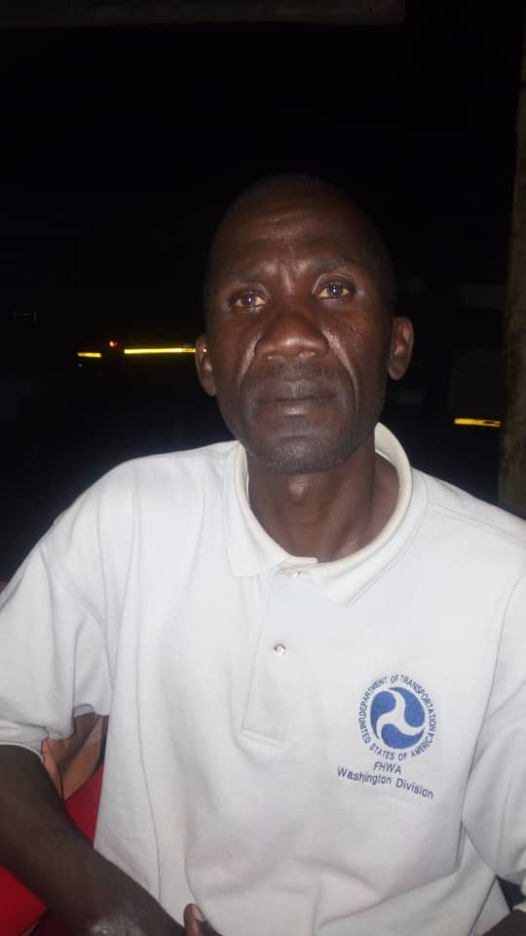
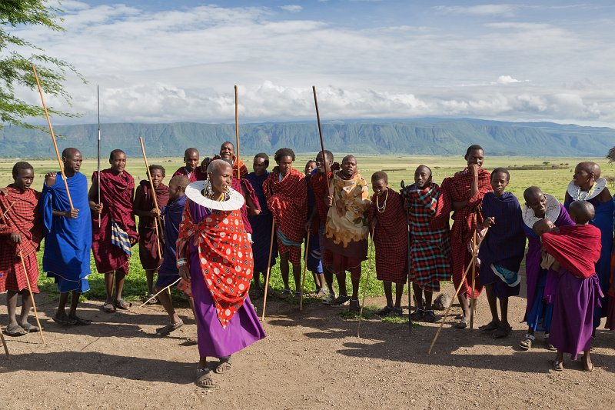
Bro. Elibariki Mollel
Manyara Region

Slide 4
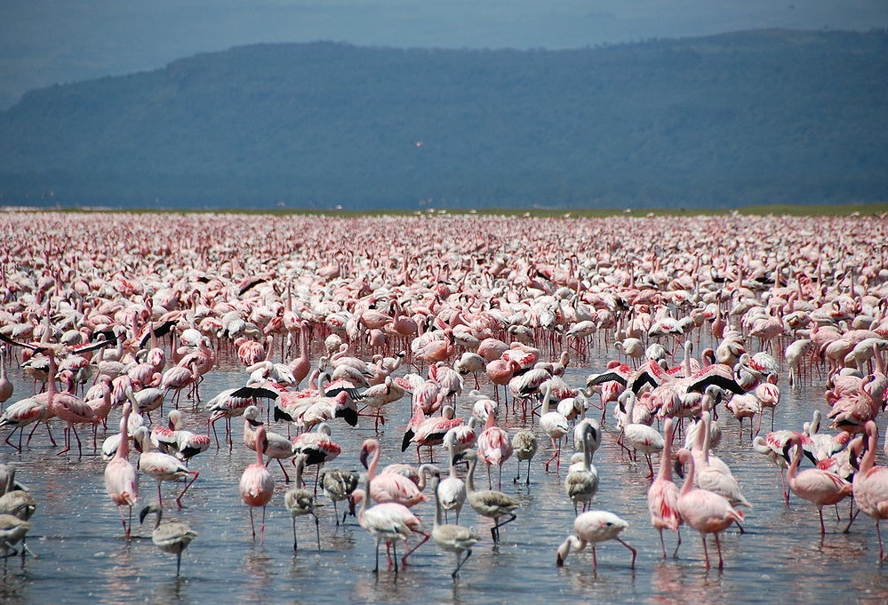

Slide 5
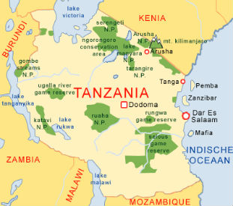

Slide 6
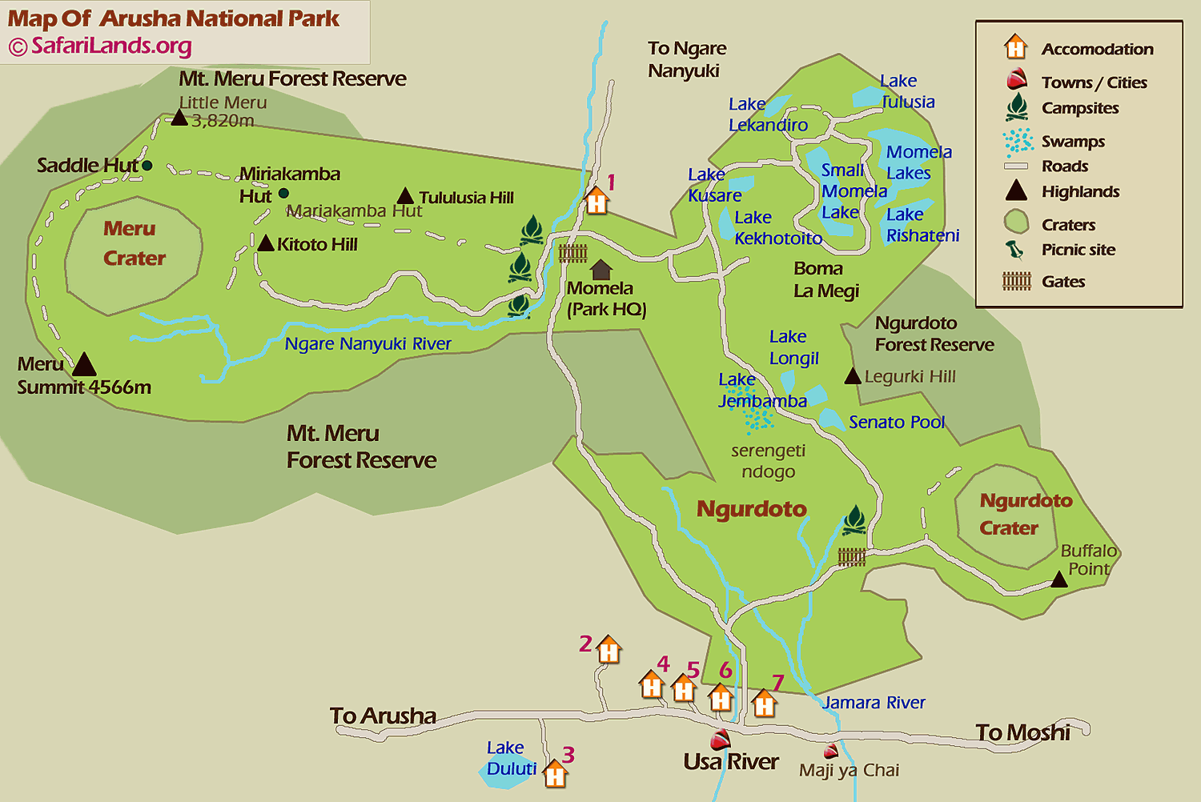

Slide 7
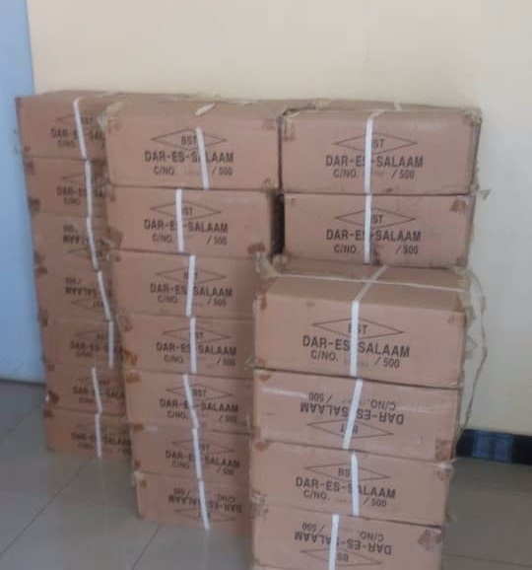
Bibles Swahili Language

Slide 8
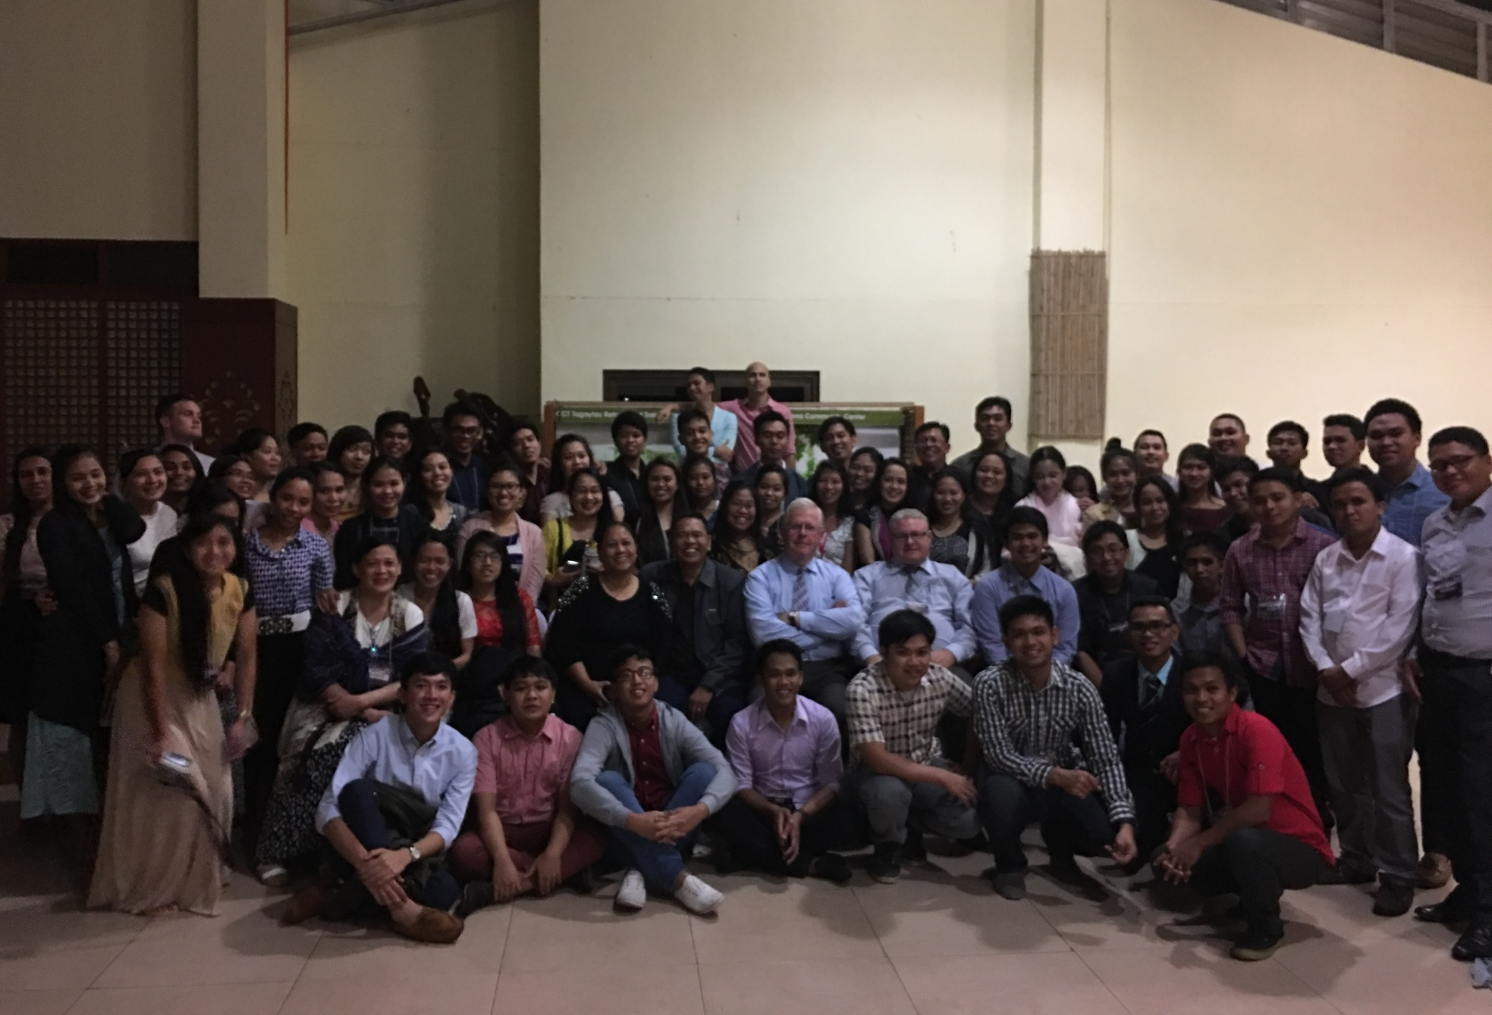
Manila Youth Retreat 2016

Slide 9
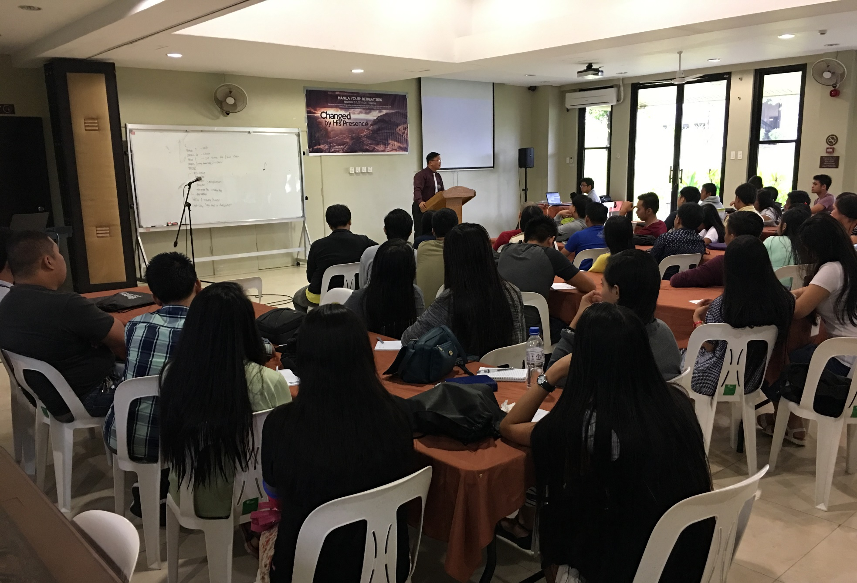

Slide 10
HEAR.YE.HIM
11 And we should not be just gadding about from place to place. We should always go and consider the Lord before we go. Do you do that when you leave home? Pray, "Lord, help me to have a safe journey over where I am going and back, ordering my steps today, that I'll not step out of Your blessed path. But if I should make the wrong move, You'll warn me and bring me back into the right way again. If my tongue should start to speak things that was not right, will You just stop my tongue from speaking? Bring me back into the right place again.

Slide 11
And if I should start to thinking wrong thoughts, will You just change my way of thinking, let me think the right things."
What you think is usually what you do. You know, if you'll do right, that's your duty to God. If you'll think right, that's your duty to yourself. And you've got to come out right. You can't be going east when you're going west. You can't be going wrong when you're going right, or vice versa. Think right; do right; and you'll be right.
57-0322

Slide 12
Holiness (or, Purity):
Internal and External Quality Co-existant.

Slide 13
ISAIAH 59:13-15
13 In transgressing and lying against the LORD, and departing away from our God, speaking oppression and revolt, conceiving and uttering from the heart words of falsehood. 14 And judgment is turned away backward, and justice standeth afar off: for truth is fallen in the street, and equity cannot enter. 15 Yea, truth faileth; and he that departeth from evil maketh himself a prey: and the LORD saw it, and it displeased him that there was no judgment.

Slide 14
Example No. 1
II CORINTHIANS 7:1
Having therefore these promises, dearly beloved, let us cleanse ourselves from all filthiness of the flesh and spirit, perfecting holiness in the fear of God.

Slide 15
JUST.ONE.MORE.TIME.LORD
59 ... It wasn't God's fault he {Samson} was defeated; it was his own fault. And God's people, {who} he was raised up to preach the Gospel to in his, he lostrength, and by flirting with this immoral woman all the strength God had give him. So has it been with the church. God raised the church up to be a lighthouse to let out His powers… but we begin to creep in and let down the bars.

Slide 16
61 We took the wrong example. The women acted like the pastor's wife. He let her go haywire, cut off her hair, wear any kind of sexy clothes, never rebuked. And the other women say, "If Sister So-and-so can do it, I could too." Don't make that your example. God told you what to do; stay with that. Now, when you do that, you fail God and you also fail His people... God set you there to be a watchman, and when you see sin creeping in, instead of cutting the thing off, they entice it.
63-0120

Slide 17
ROMANS 8:12
Therefore, brethren, we are debtors, not to the flesh, to live after the flesh. 13 For if ye live after the flesh, ye shall die: but if ye through the Spirit do mortify the deeds of the body, ye shall live.
Mortify:
The active work of weakening the roots of something, devoting all power and energy to constant warfare, uncompromisingly with an attitude of destroying the enemy.

Slide 18
EXODUS 23:20-31
Behold, I send an Angel before thee, to keep thee in the way, and to bring thee into the place which I have prepared. 21 Beware of him, and obey his voice, provoke him not; for he will not pardon your transgressions: for my name is in him. 22 But if thou shalt indeed obey his voice, and do all that I speak; then I will be an enemy unto thine enemies, and an adversary unto thine adversaries.

Slide 19
EXODUS 23:30-31
By little and little I will drive them out from before thee, until thou be increased, and inherit the land. 31 And I will set thy bounds from the Red sea even unto the sea of the Philistines, and from the desert unto the river: for I will deliver the inhabitants of the land into your hand; and thou shalt drive them out before thee.

Slide 20
THE.SECOND.COMING
3 That's our purpose of being here, is to try to do what little that we have a knowledge to do with, to try to help along this pilgrimage just that we're here in the earth, to make life a little easier to live right and a little harder to do wrong. That's what our purpose is: to see Jesus Christ receive the glory that's due Him among His people.
55-0220

Slide 21
GOD.HIDING.HIMSELF.IN.SIMPLICITY
234 Now, an highway of holiness... People try to make themselves holy. And when you do, it would be like a buzzard trying to put dove feathers in himself to make a dove out of it, when his nature's still a buzzard… and saying, "You see, I'm a beautiful bird." See, it's something manufactured.
But a peacock don't have to worry whether he's going to have peacock feathers or not.

Slide 22
The dove don't have to worry whether he's going to have dove feathers or not. As long as his nature is a dove, he will have dove feathers.
And see, the holiness people begin to say, "The women must wear long hair and long sleeves," and all these things, "and long skirts, and not wear any wedding rings, or jewelry of any type." See, it become a self-righteous holiness.
63-0317

Slide 23
QUEEN.OF.SHEBA
9 And then if you say that you're saved and still live for the things of the world, your fruits prove that you're not saved. I believe in holiness... But if you just make yourself dress like a holy person or act like a holy person, that doesn't make you a holy person. You'd just be making out that. But if the Spirit within you makes you live that way, then you know you're all right. That's how you judge yourself…
60-0710

Slide 24
PSALMS 141:4
Incline not my heart to any evil thing, to practise wicked works with men that work iniquity…

Slide 25
THE.DEITY.OF.JESUS.CHRIST
98 But that is the God, the Creator, living in you, and giving you all the power. And you're in possession of anything that He had. So is It in you to abstain from evil, to do good, to shun evil and flee to righteousness, to turn away from temptation. All malice, hatred, strife, envy, and so forth, come away from it, for that'll take Him from your heart, if you will receive Him, embrace Him and love Him, and hold Him in your heart and love Him.
49-1225

Slide 26
MARRIAGE.OF.THE.LAMB
28 If you notice, it said, "She has made herself ready." So many says, "If the Lord will take this evil spirit from me, drinking, gambling, lying, or stealing, I'll serve Him." But that's up to you. You got to do something too. "They that overcome shall inherit all things," they that overcome. You have power to do it, but you must be willing to lay it down. She has made herself ready.
God could not push us through a little pipe, pull us out on the other end, and then say, "Blessed is he that overcometh." He just pushed you through. But you've got to make decisions for yourself… 62-0121

Slide 27
II CORINTHIANS 7:1
Having therefore these promises, dearly beloved, let us cleanse ourselves from all filthiness of the flesh and spirit, perfecting holiness in the fear of God.
ROMANS 13:12-14
12 The night is far spent, the day is at hand: let us therefore cast off the works of darkness, and let us put on the armour of light. 13 Let us walk honestly, as in the day; not in rioting and drunkenness, not in chambering and wantonness, not in strife and envying. 14 But put ye on the Lord Jesus Christ, and make not provision for the flesh, to fulfil the lusts thereof.

Slide 28
Example No. 2
“peer pressure” (n)
Social pressure by members of one's peer group to take a certain action, adopt certain values, or otherwise conform in order to be accepted.

Slide 29
WHERE.HAS.THY.STRENGTH.GONE.SAMSON
6 Samson got into bad company. And you always can remember that when you are in bad company, you are out of the will of the Lord.
My own southern mammy used to tell me, "If you lay down with a dog that's got fleas, you'll get up with the fleas." You just can't associate yourself with the things of the world and expect to stay spiritual and humble before the Lord. You're known by your company. There's an old saying, "Show me your company, I'll tell you who you are.“ 59-0702

Slide 30
I PETER 4:1-4
Forasmuch then as Christ hath suffered for us in the flesh, arm yourselves likewise with the same mind: for he that hath suffered in the flesh hath ceased from sin; 2 That he no longer should live the rest of his time in the flesh to the lusts of men, but to the will of God. 3 For the time past of our life may suffice us to have wrought the will of the Gentiles, when we walked in lasciviousness, lusts, excess of wine, revellings, banquetings, and abominable idolatries: 4 Wherein they think it strange that ye run not with them to the same excess of riot, speaking evil of you:

Slide 31
LED.BY.THE.SPIRIT.OF.GOD
42 Usually if a man's going to be a believer, he's got to separate himself from his worldly friends, all the people. Yoke yourself out up from amongst unbelievers. They'll only call you back into the world again. Environment has a lot to do with it.
56-0723

Slide 32
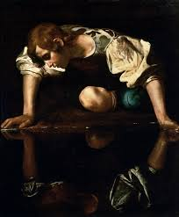
PROVERBS 27:19
As in water face answereth to face, so the heart of man to man.
Narcissus:

Slide 33
TOTAL.SEPARATION 64-0121
27 I believe, tonight, that every man and woman, every boy and girl, that's born of the Spirit of God, is a Nazarite unto the Lord; because they have separated them things, themselves, from the cares of the world and whatever the world has got to say.
29 God has one way of bringing Light to you: that's when you're ready to separate yourself from all the things of the world, and all the cares of the world, and cling only to God's promised Word.

Slide 34
GOD.KEEPS.HIS.WORD
35 Listen. Oil and water don't mix. And many time, a many a good life has been completely wrecked by your associates. Show me your company, I'll tell you who you are. Associate with people who believe God.
36 Don't let your children... If he runs across the street to little Oswald over here, he's a nice little boy; but be careful who little Oswald is.

Slide 35
Characteristics of Narcissism
Inability to view the world from the perspective of other people;
Difficulty with empathy;
Hypersensitivity to insults or imagined insult
Flattery towards people who admire and affirm them, Detesting those who don’t;
Using other people without considering the cost of doing so;
Pretending to be more important than they actually are;
Bragging persistently and exaggerating their achievements;
Claiming to be an "expert" at many things.

Slide 36
INFLUENCE
211 There's no holiness with us. We can't be holy; holiness is of God. It ain't a holy church, it's a holy God. Not holy people; a holy God. It's God in the people… it was a holy God there, the Presence of God, what made it holy.
It's the Presence of God in our midst now that brings holiness, not my holiness, not yours, but His holiness… We ought to humble ourselves, cover ourselves in reverence, humility, and say, "Lord Jesus, receive me into Your Kingdom." His holiness, not ours.
63-1114

Slide 37
CHURCH.AGE.BOOK
292-1 It is not joining a church that counts. The life is not in the church. The life is in Christ.
"This is the record that God hath given us eternal life and this life is in His Son. He that hath the Son hath life, and he that hath not the Son hath not life."
Man is made holy by the Spirit. It is the Spirit of Holiness that raised Jesus from the dead that in-dwells us and makes us holy with His holiness.

Slide 38
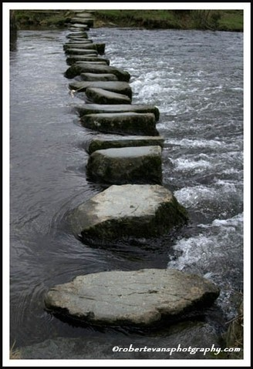
The Journey

Slide 39
HEAR.YE.HIM
20 (Mt. Transfiguration) Peter said, "When we were in the holy mount..." Not that the mount was holy, it was the holy God that met them on the mount: not the holy mountain, but the holy God.
People today sometimes call the church, "Well, they believe in holiness." It isn't the holiness people. It's the holy God that dwells among the holy people. It isn't holy people; it's a holy God that they are representing on the earth.
57-0322

Slide 40
PSALM 37:23-25
23 The steps of a good man are ordered by the LORD: and he delighteth in his way. 24 Though he fall, he shall not be utterly cast down: for the LORD upholdeth him with his hand. 25 I have been young, and now am old; yet have I not seen the righteous forsaken, nor his seed begging bread.

Slide 41
(Example) GENESIS 41:30
30 And there shall arise after them seven years of famine; and all the plenty shall be forgotten in the land of Egypt; and the famine shall consume the land; 31 And the plenty shall not be known in the land by reason of that famine following; for it shall be very grievous. 32 And for that the dream was doubled unto Pharaoh twice; it is because the thing is established by God, and God will shortly bring it to pass.

Slide 42
LOOK.AWAY.TO.JESUS
250 If you're looking for the fulfillment of the promise of today, you'll see it. But, if you're looking for some intellectual, something that they've always looked for, some great founder, historian, you'll fail to see It. But when you look at Him through the Word, the Word declares Who He is.
251 He challenged the people of His day to do the same. They couldn't see Him. He said, "You blind leaders of the blind. You claim Moses to be your prophet. If you would a-knowed Moses, you would know Me. Moses wrote about Me." And they were too blind to see It.
63-1229

Slide 43
PARADOX
41 Paul turned to the Gentiles, away from the Jews, God's heritage. A time come where he had to do it. They talked against him; but he made that famous word, "I was not disobedient to the Heavenly vision."
42 And may I say that same thing, brother, the vision of today, the vision of the promise of today, the Holy Spirit in the land today.
64-0206

Slide 44
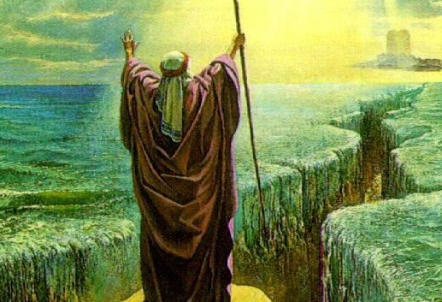

Slide 45
THE.VOICE.OF.THE.SIGN
50 Notice, He is going to speak by His promised Word, something that He said He is going to do. Notice, "I have heard, and I remember My promise. I heard their cries in Egypt; I remember what I promised Abraham."
51 See what He is going to do? He attracted his attention, now he has got His Word, He is going to give It to the prophet, Moses. Because, that was, is, and ever is, His way of speaking. "The Word comes to the prophet.“
64-0214

Slide 46
TRYING.TO.DO.GOD.A.SERVICE
155 Notice what David was trying to do, too. He was trying to bring the ark to the city of David, his own denomination. Look when the Lord first spoke down here on the river, "As John the Baptist was sent to forerun the first coming...“ Brother, the Assemblies couldn't stand for that, neither could all of them. They had to have one somewhere. Ah, they all had to do it, see, just exactly. All of them had to bring it to their own house.
157 Wanted to bring it to the city of David. Why? There was no place ready for it.

Slide 47
And that's the reason you can't bring the Message to a denomination. The Word, the Ark, Christ… you can't bring It to your organization.
They'll never believe It, because there is no room for It. Don't the Bible say He was outside the church of the Laodicean Age, trying to get in?
There was no place in the city of David, no matter how loyal, and how great it was. It was going to be at Jerusalem. That's where it went later, when the prophet told them what to do with it. So David had to bring it to his own city. No place ready for it.
65-0718

