Slide 1
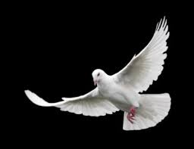
Sealed… with the Holy Spirit
II CORINTHIANS 5:17
Therefore if any man be in Christ, he is a new creature: old things are passed away; behold, all things are become new.

Slide 2
QUESTIONS & ANSWERS.ON.HEB.1
You can't go through a teaching without arousing the suspicions and the thoughts of many of the people. You've got to. Now, I'm far from being a teacher, not a Bible expositor at all. But I never try to say anything, or to even do anything, but first asking or finding out my best thing for it.
57-0925

Slide 3
Bro. Barry
I have a question that I’ve been really pondering over and have been confused on. Do you have to have the Seal of God, or the Holy Ghost to make it into heaven? And where do Jews, children, and those outside the city in heaven come into all of this? Because if everyone either has the mark of the beast or the seal of God then does everyone who’s not predestinated bride have the mark of the beast and don’t make it in?

Slide 4
MATTHEW 25:31-46
When the Son of man shall come in his glory, and all the holy angels with him, then shall he sit upon the throne of his glory: 32 And before him shall be gathered all nations: and he shall separate them one from another, as a shepherd divideth his sheep from the goats: 33 And he shall set the sheep on his right hand, but the goats on the left.

Slide 5
THE.TRUE.EASTER.SEAL
198 And Satan's sons will be sealed in this last days. There's a time now, that the Bible spoke of, that all that did not have the Seal of God took the mark of the beast. And we know that the mark of the beast is disbelief. "Where'd you say the mark of the beast begin?" In the garden of Eden. Mark of the beast and the Seal of God was performed in the garden of Eden.
61-0402

Slide 6
1. Those Outside the City
REVELATION 21:1-26
And I saw a new heaven and a new earth: for the first heaven and the first earth were passed away; and there was no more sea.
24 And the nations of them which are saved shall walk in the light of it: and the kings of the earth do bring their glory and honour into it. 25 And the gates of it shall not be shut at all by day: for there shall be no night there. 26 And they shall bring the glory and honour of the nations into it.

Slide 7
QUESTIONS.AND.ANSWERS.4
380. Brother Branham, who will populate the earth outside the heavenly city?
I want my children to know these things. Now, “who will populate the earth outside of the city?" It will be the redeemed that will populate the earth outside the city, but they will not be the elected and called Bride. The Bride will live inside the Kingdom with the King. On the outside will be the kings of the earth that labor and bring their fruits into the city. And the doors will not be closed by night. 64-0830

Slide 8
49 …in the new world, that from one new moon to the other will the people come up before the Lord unto Zion--up to the city to worship.
And now, they will be outside the city, not the Bride, but the people that come up in the second resurrection that will be tillers of the soil, just like Adam was, and so forth, and carers of the garden.
But the King and Queen will remain in the city.

Slide 9
Those Outside the City
Babies

Slide 10
QUESTIONS.AND.ANSWERS.2
308. Dear Brother Branham, if a baby is born out of wedlock, can this child ever be saved or go in the rapture?
Saved? Why sure, I believe the child could be... The child can't help what's been done.... About going in the rapture... Saved, I'd say, "Yes." But in the rapture it's a predestinated seed that goes in the rapture. And I can't believe that adultery was a predestinated seed. I believe the baby can be saved…

Slide 11
But now, in the Old Testament when a baby was born…
But you see, there was nothing there strong enough to forgive that sin. The blood of the Old Testament did not forgive sins; it covered sins. But the Blood of Jesus Christ divorces it. That's different now. When the Blood of Jesus Christ comes in, it's the different.
64-0823

Slide 12
Q&A ON.THE.HOLY.GHOST
95. If a person must have the Holy Ghost to be converted and to go in the rapture, what will be the state of children that have died before the years of accountability? And when will they rise?
Now, my brother, sister, I cannot tell you that. There's no Scripture on it in the Bible... But I can express my thoughts… Because the Holy Ghost filled people is the first resurrection, the Elect. The rest of the dead live not for a thousand years… After the Millennium, then the second resurrection, the great white throne judgment. That's exactly Bible order. But this person wants to know what about these babies. In other words, did they have the Holy Ghost before they were born? Now, that I cannot tell you.

Slide 13
106 We know that babies that die, regard-less of their parent, they are saved. Now, I disagree with the school of prophets on that. They said if it died with a parent that was sinful, that that baby would go to hell, rot away; there'd be no more to it. Well, John said when Jesus come, "Behold the Lamb of God that take away the sin of the world."
And if that baby was a human being, which would have to come under the judgments of God, and Jesus died to take away the sin, all sin was expelled before God when Jesus died for that purpose. Your sins were forgiven.

Slide 14
My sins were forgiven. And the only way that you can ever be forgiven is to accept His pardon. Now, the baby cannot accept its pardon, so it hasn't done nothing at all. So it is absolutely freely to go to heaven.
But you will say, "Will they go in the rapture?" I can't prove this by the Bible. But look. If God before the foundation of the world knew every human being would ever be on earth... Do you believe that? He knowed every gnat, every flea, every fly; He knowed everything that would ever be on the earth.

Slide 15
108 Let's take for instance, God told Jeremiah, "Before you was even formed in your mother's womb, before you was ever formed in her womb, I knew you, and sanctified you, and ordained you a prophet to the nations”; John the Baptist. The predestination or the foreknowledge of God knows all about the little babies, what they were to do.
And He knowed they would die. He knowed. Nothing can happen without God knowing about it
59-1219

Slide 16
MARRIAGE.AND.DIVORCE
59 Your question now, "Eve said, 'I have gotten a man from the Lord…'" And nothing can grow life but God, because it operates under His laws. Therefore when the evil seed was planted in the womb of Eve, it had to bring forth, because it's God's law of production.
61 That's the reason that people say, "Little babies that's not born with Christian parents, are lost."

Slide 17
62 Jesus Christ's Blood atones for the child, I don't care how much it was born and how evil it was born. He is the Lamb of God that takes away the sin of the world. The little child cannot repent, because it has nothing to repent for, and that was the sin of the world which was taken away by the Blood of Christ. Babies go to Heaven.
65-0221

Slide 18
THE.INVISIBLE.UNION
223 Now, your old book is gone, with your old union. Now, your name has been transferred. Now, you say, "Do you mean to tell me that my old book..." God put it in the Sea of His Forgetfulness. You stand perfectly before God.
224 Now, your name is now in the new Book; not the book of life, but the Lamb's Book of Life, what the Lamb redeemed. Not the old book of your natural union, but your new, Bride. Hallelujah! Your new life is in the Lamb's Book of Life, your marriage certificate, where your true Eternal germ, from the beginning, takes hold. Now you're not only forgiven, but you're justified. Glory! Romans 5:1
65-1125

Slide 19
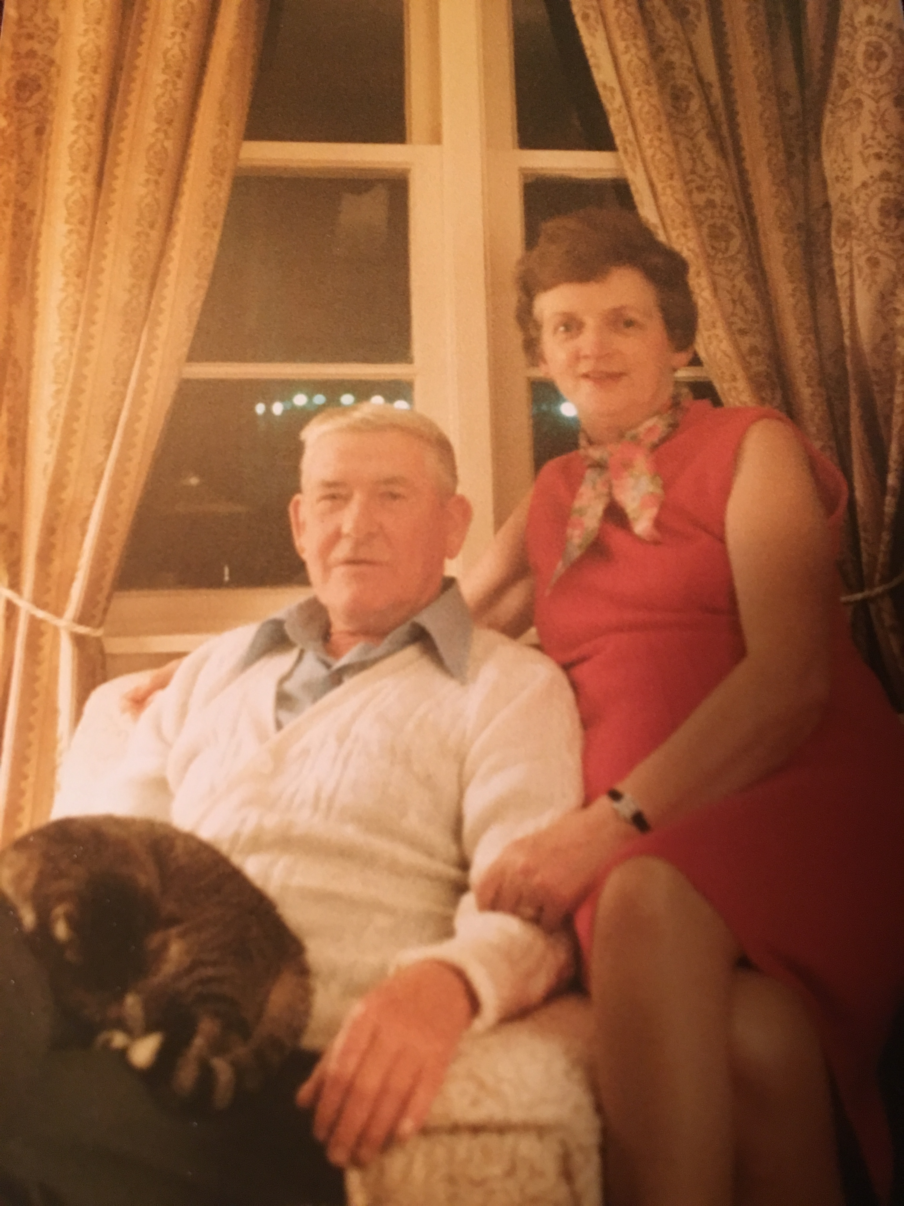

Slide 20
THE.INVISIBLE.UNION
223 Now, your old book is gone, with your old union. Now, your name has been transferred. Now, you say, "Do you mean to tell me that my old book..." God put it in the Sea of His Forgetfulness. You stand perfectly before God.
224 Now, your name is now in the new Book; not the book of life, but the Lamb's Book of Life, what the Lamb redeemed. Not the old book of your natural union, but your new, Bride. Hallelujah! Your new life is in the Lamb's Book of Life, your marriage certificate, where your true Eternal germ, from the beginning, takes hold. Now you're not only forgiven, but you're justified. Glory! Romans 5:1
65-1125

Slide 21
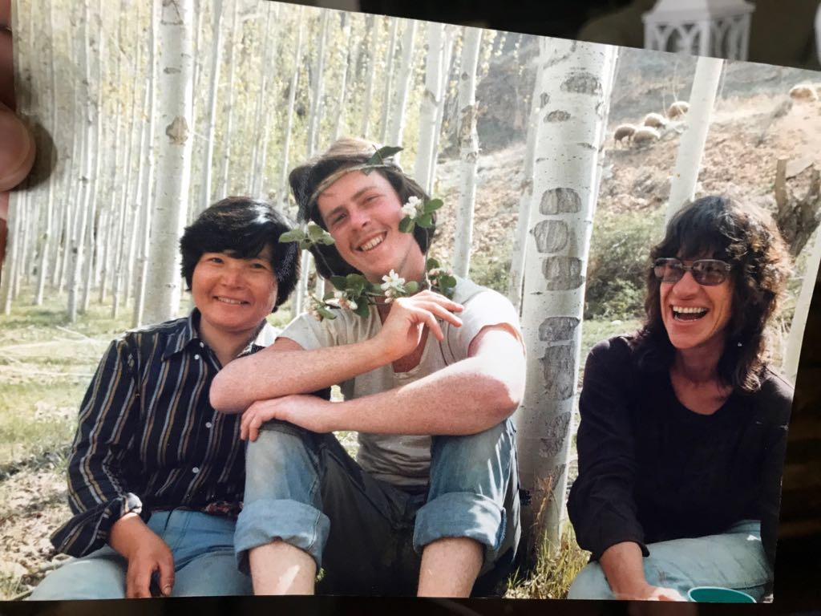

Slide 22
THE.SEED.SHALL.NOT.BE.HEIR
47 …God knew, before the foundation of the world, who would be saved and who would not be saved. By predestination, by foreknowledge, He saw every member, put every name on the Lamb's Book of Life, before the Church ever began. Jesus come to seek and save that which was on that Book.
He bought the Book of Redemption. It was lost, and He redeemed us, and all names was on that Book was redeemed when He redeemed us.
65-0429B

Slide 24
Those Outside the City
Babies
The Jews

Slide 25
ROMANS 1:16-18
For I am not ashamed of the gospel of Christ: for it is the power of God unto salvation to every one that believeth; to the Jew first, and also to the Greek. 17 For therein is the righteousness of God revealed from faith to faith: as it is written, The just shall live by faith. 18 For the wrath of God is revealed from heaven against all ungodliness and unrighteousness of men, who hold the truth in unrighteousness;

Slide 26
JOHN 4:21-24
Jesus saith unto her, Woman, believe me, the hour cometh, when ye shall neither in this mountain, nor yet at Jerusalem, worship the Father. 22 Ye worship ye know not what: we know what we worship: for salvation is of the Jews. 23 But the hour cometh, and now is, when the true worshippers shall worship the Father in spirit and in truth: for the Father seeketh such to worship him. 24 God is a Spirit: and they that worship him must worship him in spirit and in truth.

Slide 27
JOHN 12:44-46
Jesus cried and said, He that believeth on me, believeth not on me, but on him that sent me. 45 And he that seeth me seeth him that sent me. 46 I am come a light into the world, that whosoever believeth on me should not abide in darkness.
GALATIANS 3:28
There is neither Jew nor Greek, there is neither bond nor free, there is neither male nor female: for ye are all one in Christ Jesus. 29 And if ye be Christ's, then are ye Abraham's seed, and heirs according to the promise.

Slide 28
JOHN 11:25-26
Jesus said unto her, I am the resurrection, and the life: he that believeth in me, though he were dead, yet shall he live: 26 And whosoever liveth and believeth in me shall never die. Believest thou this?
GALATIANS 3:6
Even as Abraham believed God, and it was accounted to him for righteousness. 7 Know ye therefore that they which are of faith, the same are the children of Abraham.

Slide 29
ISAIAH 61:10
I will greatly rejoice in the LORD, my soul shall be joyful in my God; for he hath clothed me with the garments of salvation, he hath covered me with the robe of righteousness, as a bridegroom decketh himself with ornaments, and as a bride adorneth herself with her jewels.11 For as the earth bringeth forth her bud, and as the garden causeth the things that are sown in it to spring forth; so the Lord GOD will cause righteousness and praise to spring forth before all the nations.

Slide 30
CHURCH.AGE
293-3 The Jews back there in the time of Jesus did not want to accept that sacrifice. The blood of bulls and goats made nothing perfect. It was once God's ordained method. But now Christ having appeared in the flesh, and by the shedding of His own blood has put away sin and by that offering of Himself has made us perfect. The Jews would not take that.
Now works are fine, but they don't save you. They don't make you perfect. It is Christ or perish.

Slide 31
And it is not even Christ AND works. It is Christ alone. (Arminianism) It does not sing of "Nothing but the Blood," for it sings of "Nothing but the blood AND my own conduct". Now I believe in good conduct… But salvation is NOT Jesus PLUS. It is Jesus ALONE. SALVATION IS OF THE LORD. From start to finish it is all GOD. Let His life be in me. Let it be His blood that cleanses me. Let it be His Spirit that fills me. Let it be His Word in my heart and mouth. Let it be His stripes that heal me. Let it be Jesus, and Jesus Alone.

Slide 32
Those Outside the City
Babies
The Jews
True Salvation & the Promise of the Spirit

Slide 33
As it is written,
There is none righteous, no, not one:
Romans 3:10
God’s Righteous Requirement
For all have sinned, and come short of the glory of God;
ROMANS 3:23
Sinner

Slide 34
THE.LAW.HAVING.A.SHADOW
30 Notice, in the Old Testament the believer, when he come and maybe committed adultery, told a lie or something. He came with a lamb… testified [of] the Lamb slain the foundation of the world. The first thing, the lamb must be perfect. The lamb must be without a blemish for the sin offering.
A lot of people think, "Well, I could be a Christian if I'd just could quit this. If I could just be a better man. If I could be a better woman." You'll never be better in that estate. You can never get better until something comes in you to make you better, and then you're borned again. You can't do it.
54-1203

Slide 35
For by grace are ye saved through faith; and that not of yourselves: it is the gift of God:
EPHESIANS 2:8
Saved
Blood of Christ
Sinner

Slide 36
CHRIST.IS.THE.MYSTERY (63-0728)
36-4 You say, "Well, Bro. Branham, what is the new birth?" It is the revelation of Jesus Christ personally to you. Amen. Not you joined a church, shook a hand… you promised to live by a code of rules; but Christ…
II CORINTHIANS 5:17
Therefore if any man be in Christ, he is a new creature: old things are passed away; behold, all things are become new.

Slide 37
ABRAHAM'S.SEED
20 We're imperfect, borned in sin, shaped in iniquity, come to the world speaking lies. We're no good to begin with. But God don't look at you; He looks at the sacrifice. He looks at the Lamb. He doesn't see you, because He sees Christ. Jesus died for you.
Now, if you can find some fault with Jesus, then your healing might not be right. But if you don't find no fault with Him, it's perfect.
59-0423

Slide 38
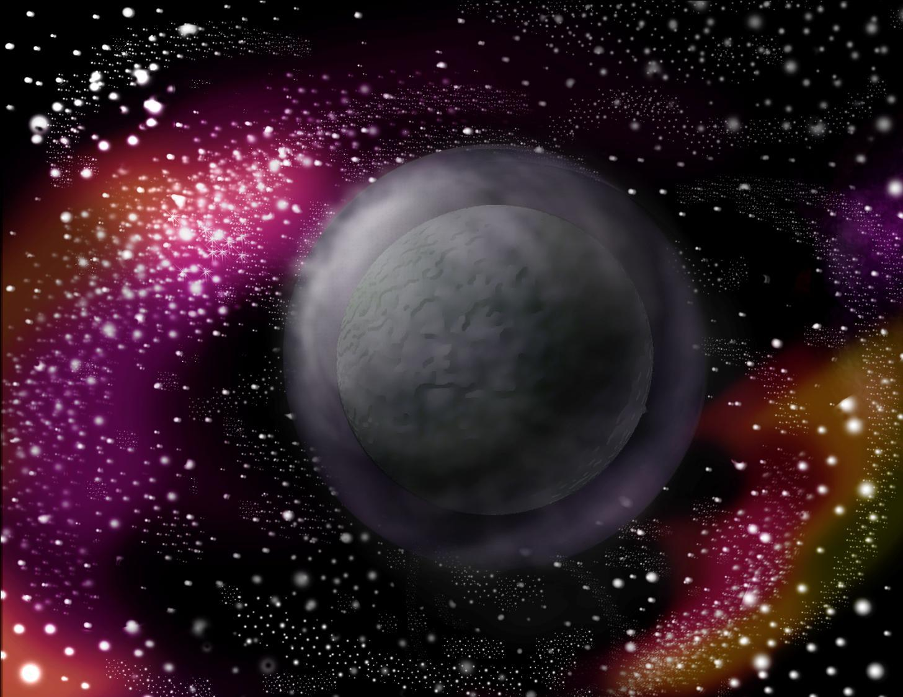
GENESIS 1:1
1 In the beginning God created the heaven and
the earth. 2 And the
earth was without
form, and void;
and darkness was
upon the face of the
deep. And the Spirit of
God moved upon the face of the waters.

Slide 39
FOURTH.SEAL
292-1 I said, "I believe every seed was laying there from some other civilization or something, and as soon as the water lifted off and the light struck it, up come the trees and everything."
The same thing with the human being; it's a type. When all the mist is moved away, and the revealed Truth to that real seed laying there still germitized, and the Light of the Gospel can strike it by true a-vindication of the Word, it'll live; it's got Life in it... Outside of that it can't live. It hasn't got no Life in it.
63-0321

Slide 40
And the earth was without form, and void; and darkness was upon the face of the deep. And the Spirit of God moved upon the face of the waters.
GENESIS 1:2

Slide 41
I JOHN 1:7
But if we walk in the light, as he is in the light, we have fellowship one with another, and the blood of Jesus Christ his Son cleanseth us from all sin.

Slide 42
IS.YOUR.LIFE.WORTHY
138 Christians, you must have a personal relationship to God... There's only thing that will produce that; that's the new birth.
63-0630
GOD'S.CHOSEN.PLACE.OF.WORSHIP
88 …when you are truly baptized into Him, the true evidence is that you believe Him, the Word. 65-0220

Slide 43
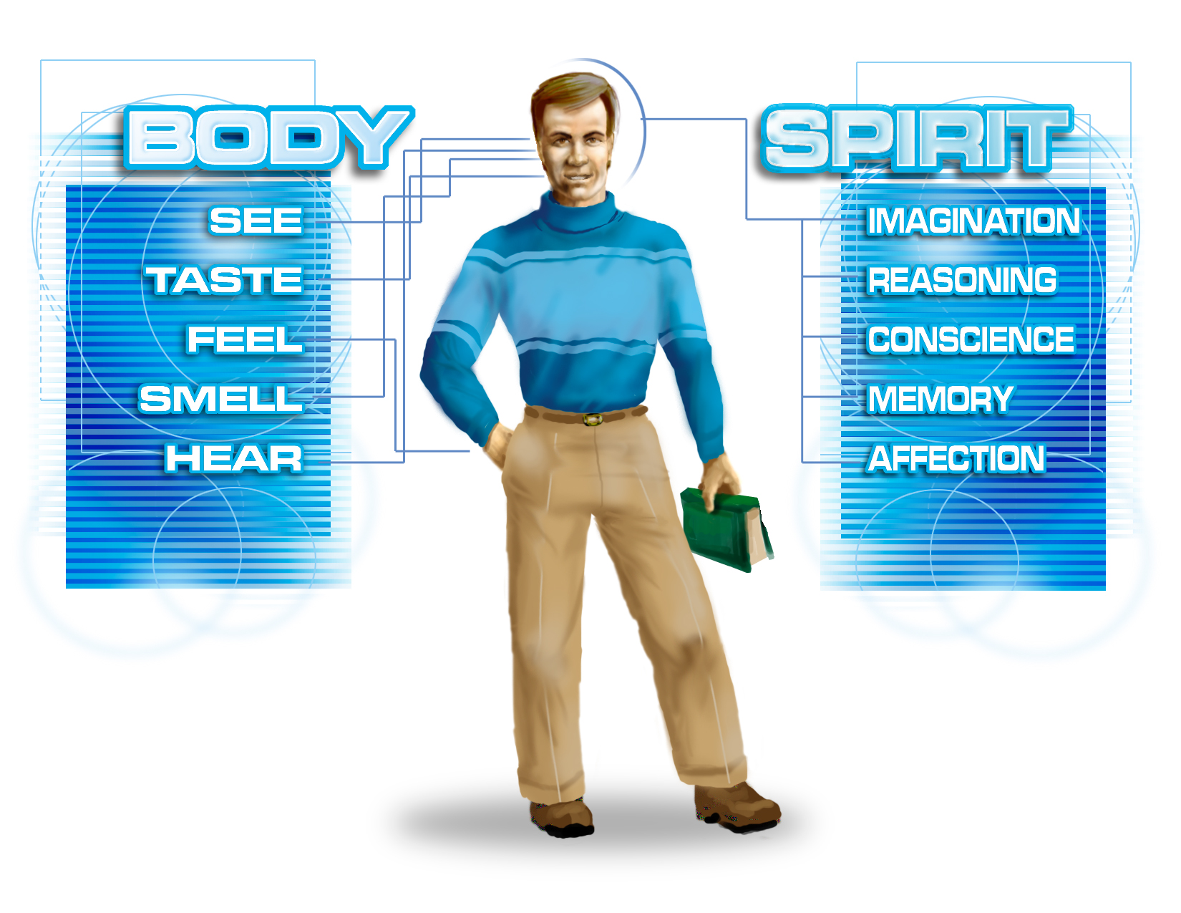

Slide 44
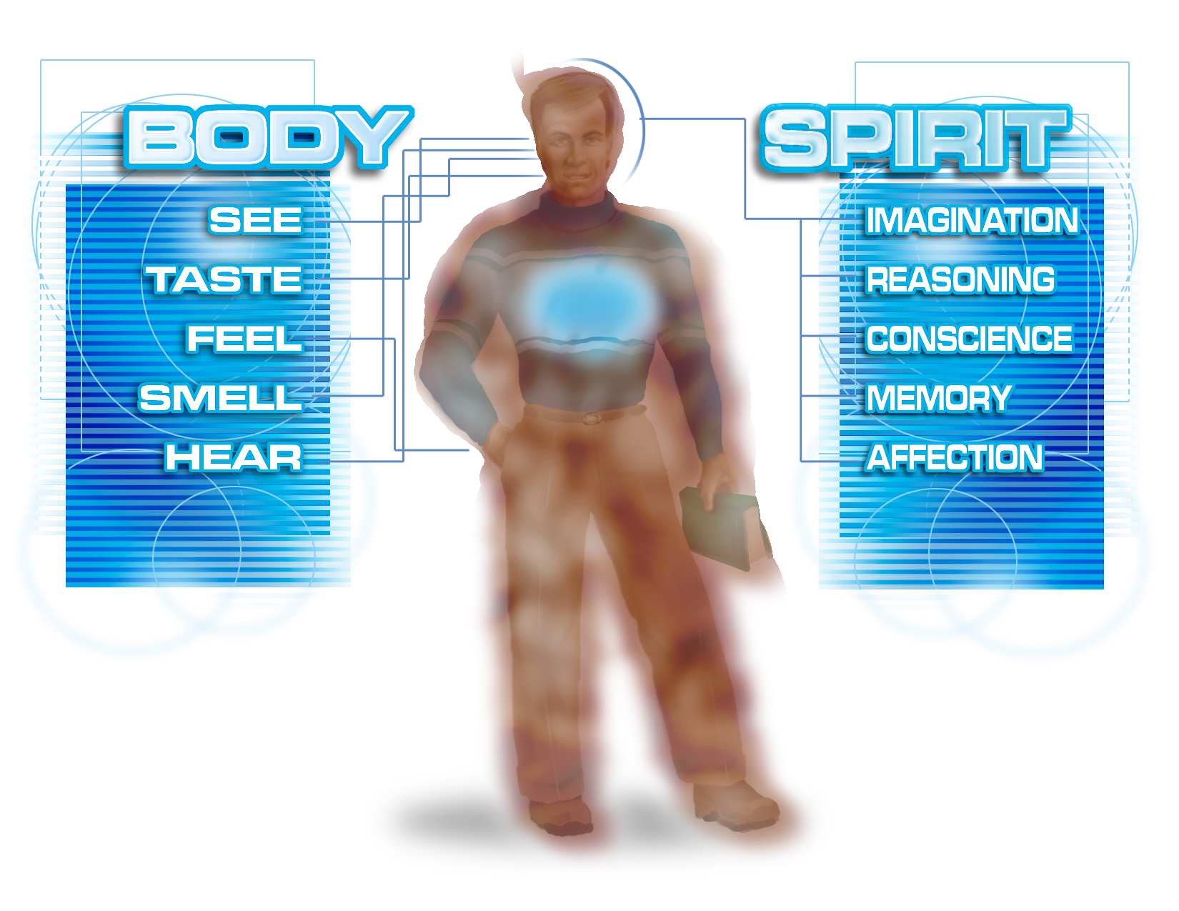

Slide 45
KNOWETH.IT.NOT
17-5 Now, inside of that is a spirit, which you become when you're borned in here and the breath of life is breathed into you, that spirit is of a worldly nature, because it was not given from God, but it was given, permitted by God.
65-0815

Slide 46
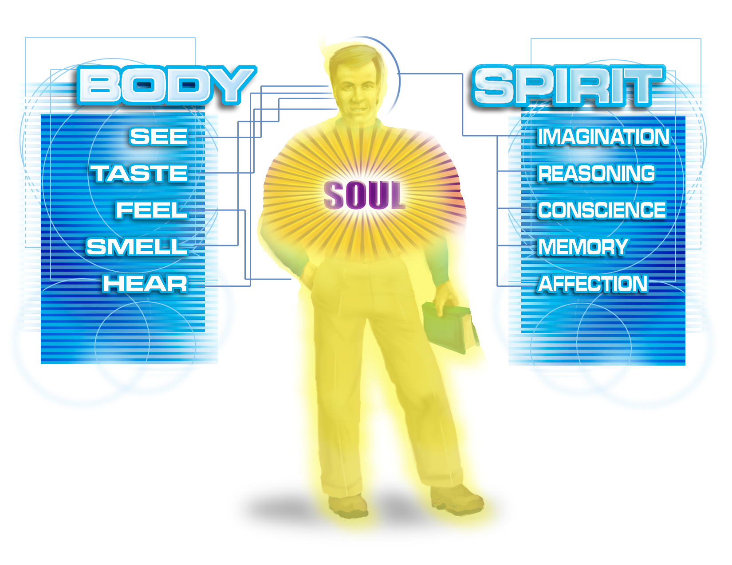
I PETER 1:22-23
22 Seeing ye have purified your souls in obeying the truth through the Spirit unto unfeigned love of the brethren, see that ye love one another with a pure heart fervently: Being born again, not of corruptible seed, but of incorruptible, by the word of God, which liveth and abideth for ever.

Slide 47
EXPECTATION
22 …See, your church doesn't save you. Jesus is your Saviour. You know, people say, "Do I have to quit this, Bro. Branham… Will I have to give up shows, dances, and so forth?" No. Don't have to give up anything. Not a thing.
We're nearly all northern people here. (Scrub oaks) When springtime comes, you all don't have to go out and take off the old leaves so the new ones can come on. Just let the new life come up, and the old leaves goes off anyhow. You don't have to have a measuring stick; just get new life in there; it'll take care of itself. The old things just fade away and the new life comes on.
54-0220

Slide 48
CHURCH.AGE.BOOK
144-1 When Scripture teaches us that the work of the Holy Spirit, and the manifestation of that Blessed Person is to bring the truth of each age to the true seed of that age, then we know that the Spirit has to be abiding in the person or he cannot receive the truth for that time.

Slide 49
CHURCH.AGE
154-3 If you are true seed, you will hear that Word; the Spirit will baptize you into the body of Christ, filling you and empowering you, and you will receive the Word for your day and age. See how clear the true evidence becomes when the Word is revealed to you?

Slide 50
TOKEN.THE
153 The Holy Spirit, the Word has been quickened to you by the Holy Spirit to vindicate this age, that you have passed from death unto Life, and now you are His. Oh, because He is, we have the right to all that He has purchased for us. Every promise in the Bible is yours.… When God has give you the true baptism of the Holy Spirit, then the Life of Jesus Christ is within you. Now, that's true; every theologian will have to admit that to be the truth; it's the new birth.
63-1128

Slide 51
CALLING.JESUS.ON.THE.SCENE
72 …Oh, if we tonight could only catch that vision: the very Jehovah that made the heavens and earth is right in this little vessel of ours, while we're sailing life's solemn main. For the Holy Ghost is Jehovah in Spirit form in you.
63-0804

Slide 53
CHURCH.AGE.BOOK
When Israel rejected the leadership of God in the pillar of fire, and turned to worship the golden calves their names were removed from the Book of Life. Exodus 32:33. (Whosoever has sinned against Me, him will I blot out of My book.) If such turning to idols demands the penalty of the removal of names from the Book of Life, then most assuredly Israel's rejection of Jesus Christ as Messiah would demand as severe a penalty.
In Psalms 69:21-28 Let them be blotted out of the Book of the Living, and not be written with the righteous.“ When the Jews rejected Jesus there was a literal turning away of God from them to the Gentiles.

Slide 54
Acts 13:46-48, “…lo, we turn to the Gentiles.” This is not to suggest that there will be no more names from the tribes of Israel remaining in the Book of Life, for many (but not multitudes) through the principle of election will be in the Gentile church age and come into the body of Jesus Christ, showing that their names did indeed remain in the Book of Life. Also, according to the fifth seal multitudes of martyred Jews will be given white robes and eternal life by the Lord. Also 144,000 will be sealed at His coming, proving that their names were not deleted either. But it is even as most accurately set forth in Psalms 69 that it is the wicked or unrighteous rejecters of Christ and the destroyers of His people whose names are removed.

Slide 55
TRYING.TO.DO.GOD.A.SERVICE
250 And you say, "Glory to God! The Holy Ghost fell on me, hallelujah, just like It did on the Day of Pentecost." But that might be different today. It fell on David, too, didn't it? Sure. Fell on Uzziah, but it was wrong! See, you got to go deeper than that now.
He don't need our wisdom, it's nonsense. 65-1127

Slide 56
BE.NOT.AFRAID
355 Now, while they're laying hands upon the sick, if there's a sinner, or a person that wants to be saved, that wants to come up around the altar now, next, rise right up and come forward now. We're here to minister. If the personal workers come with them, who rise up and come.
357 If there's any of you that's needy, needs the Holy Ghost, needs salvation, Divine healing, we are here, as ministers of Christ, to serve you in the capacity of laying on of hands, and seeing you filled with the Spirit.

Slide 57
358 Everybody would like to have this Jesus that knows the secret of your heart! You people who doesn't know Him, and feel that funny little feeling around your heart, Come up here now, say, "Lord Jesus, I come because I need You, and I'm coming to receive You," God will grant you your request if you won't doubt. And believe with all your heart that the things you see right now is the works of Jesus Christ! If you're Methodist, Baptist, Roman Catholic, orthodox Jew, a rank sinner, atheist; I don't care who you are. Walk up here, believing God, and see what happens right now.
63-0607

Slide 58
LUKE 11:9-13
9 And I say unto you, Ask, and it shall be given you; seek, and ye shall find; knock, and it shall be opened unto you. 10 For every one that asketh receiveth; and he that seeketh findeth; and to him that knocketh it shall be opened. 11 If a son shall ask bread of any of you that is a father, will he give him a stone? or if he ask a fish, will he for a fish give him a serpent? 12 Or if he shall ask an egg, will he offer him a scorpion?
13 If ye then, being evil, know how to give good gifts unto your children: how much more shall your heavenly Father give the Holy Spirit to them that ask him?

Slide 59
ONLY.ONE.WAY.PROVIDED.BY.GOD
140 The Hebrew children needed some water... But God provided them a fourth Man. That's all they needed …There wasn't even the smell of fire on them. They went God's provided way. The wise men needed a compass to guide them to the newborn Babe, but God provided a Star. The world needed a Saviour. God provided a Son.
144 The church needed power. God provided…?.....
63-0731

Slide 60
ONLY.ONE.WAY.PROVIDED.BY.GOD
140 The Hebrew children needed some water... But God provided them a fourth Man. That's all they needed …There wasn't even the smell of fire on them. They went God's provided way. The wise men needed a compass to guide them to the newborn Babe, but God provided a Star. The world needed a Saviour. God provided a Son.
144 The church needed power. God provided the Holy Ghost. He didn't provide a book of ethics. He didn't provide a Christian government. He provided the Holy Ghost.
63-0731

Slide 61
SPIRITUAL.AMNESIA
29 You must be identified… You are identified either in Christ or out of Christ. You are not halfway. There's no such a thing as a drunk sober man. There's no black white bird.
You're either a saved, or you're not saved. You're a saint or a sinner, one or the other. And your spiritual attitude towards God's Word identifies you, exactly where you're standing.
64-0411

Slide 62
64-0823E QUESTIONS.AND.ANSWERS.2_ JEFFERSONVILLE.IN COD SUNDAY_
« 212 † 318. What is the evidence that a person is really filled with the Holy Ghost?
John 14:26: He will... "When the Holy Ghost is come (See?), He will show you things to come." See? He'll be a... He'll perfect it; man-mades won't do it; and He is the Word. When He the Holy Ghost is come, He will identify Himself in you with the Scripture. And that is the true sign that the Holy Spirit is in you, because It is the Word.
Now, look. What if you spoke with tongues? I just want to ask you that. Jesus said when the Holy Ghost come what He would do. And what if you spoke with tongues, jumped up-and-down, shouted, and everything else, and then come to the Word; and I'd tell you the baptism of--prove to you by the Scripture as I have, that the baptism using the title of Father, Son, and Holy Ghost is absolutely a misunderstanding in the Scripture; nobody was ever baptized like that, and you go ahead and hang with it anyhow? Could you tell me the Holy Spirit in you would do a thing like that? How can It deny It's own Word?

Slide 63
How could this
be possible?
“For the Holy Ghost is Jehovah in Spirit form in you.”

Slide 64
CHRIST.IS.IDENTIFIED.THE.SAME
IN.ALL.GENERATIONS
71 He's Eternal, and He's the only source of Eternal Life… Now, therefore, if we have Eternal Life, we have part of God in us... Then, that's the only way you could have Eternal Life. It isn't something that was manufactured, then given to you by some creed, or you lived into it, you grew into a better man or a better woman. It's God Himself in you. Just like you're a part of your father here on earth; you're a part of your Heavenly Father.
64-0415

Slide 65
IT.WASN'T.SO.FROM.THE.BEGINNING
48 And hybriding was such a horrible thing in the Old Testament… Think. Ten generations, 400 years before a illegitimate child could ever come into the Kingdom of God… He had to just breed it out through the family.
But today, since the Blood of the Jesus Christ has been shed and you've been interbred by all different kinds of ideas, the Holy Spirit is here this morning to breed you back to the original, bring you back to Pentecost, breed you back.
60-1127

Slide 66
GOD.PERFECTING.HIS.CHURCH
16 Then the next time God was manifested, was in His Son, Christ Jesus… a virgin birth. Conceived by a virgin, overshadowed by the Holy Spirit. God Himself came down into a blood cell and wrapped the Blood around Him. The Blood cell, the germ of Life of God Himself, wrapped in this Blood cell that brought forth the Son, Christ Jesus.
Now, what He does by that, to make you perfect and to bring you back into fellowship, He brings you through that Blood cell into Himself. Through the Blood cell of the Lord Jesus that in-veiled the Life of Jehovah, and we, coming through the Blood cell, becomes a part of that Life.
54-1204

Slide 67
HEBREWS 9:11-14
11 But Christ being come an high priest of good things to come, by a greater and more perfect tabernacle, not made with hands, that is to say, not of this building; 12 Neither by the blood of goats and calves, but by his own blood he entered in once into the holy place, having obtained eternal redemption for us. 13 For if the blood of bulls and of goats, and the ashes of an heifer sprinkling the unclean, sanctifieth to the purifying of the flesh: 14 How much more shall the blood of Christ, who through the eternal Spirit offered himself without spot to God, purge your conscience from dead works to serve the living God?

Slide 68
THE.LAW.HAVING.A.SHADOW 54-1203
42 …And God being manifested in the flesh with Christ Jesus the anointed, wrapped Himself in a Blood cell in the womb of Mary, brought forth His Life. He lived a man; He died a man to give His Blood, that through His body, and the shedding of His Blood that every believer could be wrapped in that Blood cell with Him.... And the Church is wrapped into the Blood cell of the Life of Jesus Christ. Then we are sons of God, joint heirs with Jesus Christ in the Kingdom.

Slide 69
*•PIN • 1x *

Slide 70
2x

Slide 71
4x

Slide 72
6x

Slide 73
8x

Slide 74
*10x *

Slide 75
•HAIR • 20x

Slide 76
40x

Slide 77
•DUST MITE• 60x

Slide 78
80x

Slide 79
*100x *

Slide 80
200x

Slide 81
400x

Slide 82
600x

Slide 83
•RAGWEED POLLEN • 800x

Slide 84
* 1000x *

Slide 85
•LYMPHOCYTE • 2000x

Slide 86
•RED BLOOD CELL • 4000x

Slide 87
LAW.HAVING.A.SHADOW
43 …And the Life that was in the Blood Cell of Christ, none other than God Himself, the Holy Spirit, comes back into your life, and coincides with your body, and you act and walk as a Christian life till the day you leave the world. And the devil couldn't touch you if he had to. Every promise in the Book is yours then. He can't do it, why? The blood cell, where did it originate?
56-0621

Slide 88
THE.LAW.HAVING.A.SHADOW
42 And God being manifested in the flesh with Christ Jesus the anointed, wrapped Himself in a Blood cell in the womb of Mary, brought forth His Life…
54-1203

Slide 89
42 …Which if a borned again Spirit of a man is wrapped in the Blood cell of the Son of God, and God can no more deny you than He could deny Himself. For by one Spirit we're all baptized into one Body, and become partakers of the same Spirit that's in this Blood cell. And the Church is wrapped into the Blood cell of the Life of Jesus Christ. Then we are sons of God, joint heirs with Jesus Christ in the Kingdom.

Slide 90
MARK.OF.THE.BEAST
28 …We find Israel and compared it with Moab, how that Israel stayed true, the blood line. And we find out here that Moab, a illegitimate, all fundamental, just the same as Israel was. But Israel, who had the true bloodline, had signs and wonders following them. They had a brass serpent, Divine healing… They were having a glorious time, not yoked up with nothing, just a interdenominational floating around.
They were headed for their homeland, a perfect type of the true church today…
61-0217

Slide 91
THE.BELIEVER'S.POSITION.IN.CHRIST 27 …Outside of Christ, without God, without hope, in the world condemned to die, then, God by grace, elects us, calls us to Christ. We hear Him inside the Blood cell calling to us, Life. And we come then, confess our sins, and are baptized for the remission of our sins.
...We come through the spray of Blood, then by the Holy Spirit are baptized inside this Blood cell; and we have fellowship one with another, while the Blood of Jesus Christ the Son of God cleanses from all unrighteousness.
55-0116

Slide 92
FELLOWSHIP.BY.REDEMPTION
239 You may be ever so good. You may belong to a fine church… nothing against that. But have you ever come down to the fellowship yet with Him? And only way you'll do it, is through the Blood of His suffering. Then you come to the place and hear the Word, and say, "Yes, Jesus died in my stead. I believe that. Now, I've got to be cleansed from all this temper and all this stuff that I go on with. Now, Lord, take me through the Blood. Here I am."
And after while, the sweet peace that passes all understanding will come into the human heart. Then you'll look up there and you'll say, "Now, I'm living in the fellowship.

Slide 93
Wherever I go, whatever I do, I'm in this wonderful fellowship, peace that passes all understanding, the Holy Spirit's living in me....
If death comes, what can it do to me? Can't harm me." Your soul longs for something out there… Your old tabernacle, your aches and groans and squeaks, and, the old birth pains are coming upon it... What does it mean? This old lump of clay someday's going to fade away. But there's something inside of that little lump of clay there that's trying to get out, trying to liberate itself.
55-0403

Slide 94
CHURCH.AGE.BOOK
155-1 Now we have been constantly saying that the true evidence of being baptized with the Holy Ghost is for the believer to receive the Word for the age in which he lives. Let me show you most clearly.
In every single age, it says "... He that hath an ear, let him (singular) hear what the Spirit saith to the churches." Notice here that Jesus (by the Spirit) in EVERY age addresses Himself to ONLY ONE person relative to the Word for that age. Only ONE messenger for each age receives what the Spirit has to say to that age, and that ONE MESSENGER is the messenger to the true church. He speaks for God by revelation to the "churches", both true and false.

