Slide 1
Where Was God?
When Bad Things Happen & When Bad Things Happen to Good People
HEBREWS 3:7-10
Wherefore I was grieved with that generation, and said, They do alway err in their heart; and they have not known my ways.

Slide 2
Birthdays & Anniversaries
Sept. 19th Sarah Coffey
Sept. 23rd Cindy Walters
Sept. 24th Gabrielle Walter
Sept 22nd Work Day
Oct. 12-14th Dedication Meetings

Slide 3
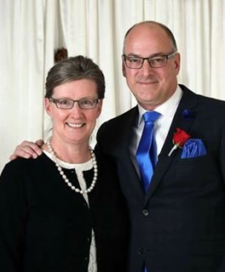
Bro. Ken & Sis. Shelly Boyer

Slide 4
THE.UNCERTAIN.SOUND
268 Moses, trained, polished... Oh, my, was he a scholar, and a military man. He thought, "With all of my scholarship. I've got a PH.D., and all the D.D.'s that can be thought of. But surely I'll know how to do this, because I'm the brains of Egypt."
I don't care what you're the brains of, it's no good. When it comes to God's, it's foolishness. Your brains is foolishness to God. "Because My ways are higher than your ways…" saith God. 60-1218

Slide 5
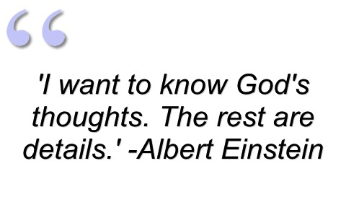

Slide 6
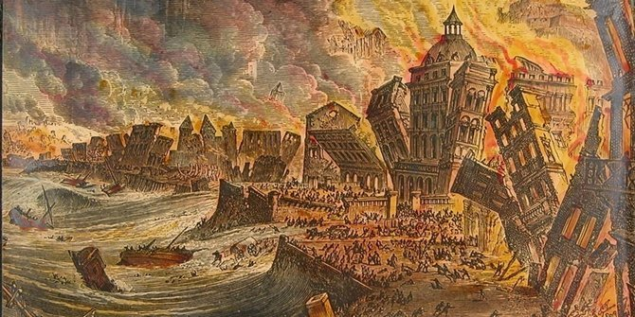
The Lisbon, Portugal Earthquake
The 1755 Great Lisbon earthquake, occurred in the Kingdom of Portugal on the morning of Saturday, 1 Nov., 1755 on the holy day of All Saints' Day, at 9:40 am.

Slide 7
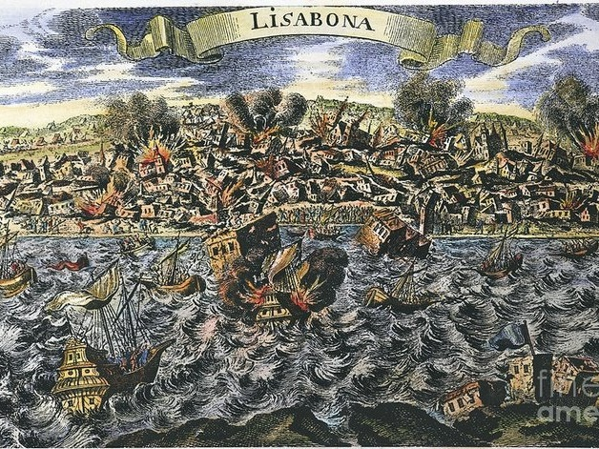

Slide 8
People fled in the direction of the seaport where the large royal palace promised shelter from the debris of the collapsing buildings. It was there that they witnessed a strange phenomenon: The sea had vanished and the riverbed of the Tejo was dry. At 10:10 a 12m high tsunami-wave reached the city and destroyed the entire harbour, thousands of people standing along the shores were swept away and killed.
After the earthquake and the tsunami a terrible fire broke out; raging for five days it destroyed what earth and water had left over.
https://blogs.scientificamerican.com/history-of-geology/november-1-1755-the-earthquake-of-lisbon-wraith-of-god-or-natural-disaster/

Slide 9
“The Inquisition has become too lax!”
Roman Catholics
“This is God’s judgement for the Inquisition in the first place.”
Protestant Church Leaders

Slide 10
The Enlightenment, sometimes called the 'Age of Enlightenment', was a late 17th-18th century intellectual movement emphasizing reason, individualism, and skepticism. The Enlightenment presented a challenge to traditional religious views. Enlightenment thinkers were the liberals of their day. The Age of Reason, spread rapidly across Europe and eventually to America.

Slide 11
The Impact of Enlightenment in Europe: In the late 17th century, scientists like Isaac Newton and writers like John Locke were challenging the old order.... Europe (and America) would be forever changed by these ideas.
Spawned “Deism,” the belief that God exists and made the Universe but that it operates under natural laws and forces.

Slide 13
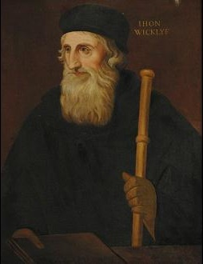
“Holy Scripture is the highest authority for every believer, the standard of faith and the foundation for reform...”
John Wycliffe
1320s – 31 December 1384
Regularly taught his followers how to die a Christian death

Slide 14
GOD.HIDING.HIMSELF.IN.SIMPLICITY
204 And those great early reformers and men back in those days, how they taught the baptism of the Holy Ghost! How Saint Martin, Irenaeus, those great men, taught the baptism of the Holy Ghost! They wouldn't let their people be comfortable, and set around in plush, and things like we do today.
63-0412

Slide 15
Wycliffe’s influence proved harder to destroy than his mortal remains.
Decades after his death, Wycliffe and his teachings were still perceived to be a threat by the church at Rome. Because he had escaped the prescribed punishment for heresy, he was tried a second time in 1415 and this time condemned. The Council of Constance ordered that his body be disinterred and burned.
The Word of God had been savored by many English people and, in spite of a grim century of suppression that was to follow, the stage had been set for the great work of translation from the original languages that would be undertaken by William Tyndale.

Slide 16
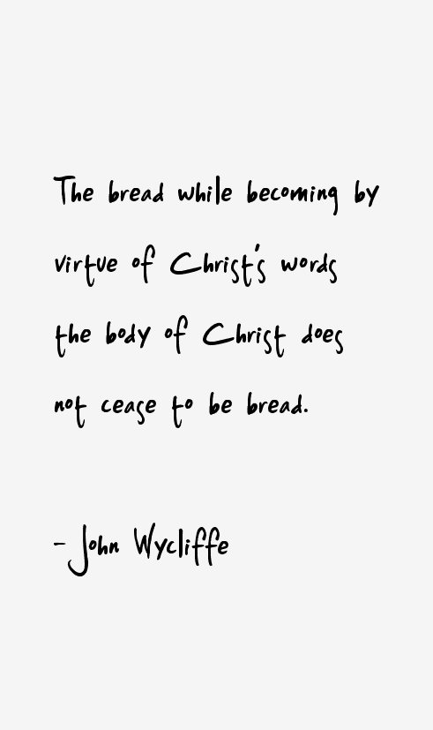

Slide 17
ROMANS 8:19-23
For the earnest expectation of the creature waiteth for the manifestation of the sons of God. 20 For the creature was made subject to vanity, not willingly, but by reason of him who hath subjected the same in hope, 21 Because the creature itself also shall be delivered from the bondage of corruption into the glorious liberty of the children of God. 22 For we know that the whole creation groaneth and travaileth in pain together until now. 23 And not only they, but ourselves also, which have the firstfruits of the Spirit, even we ourselves groan within ourselves, waiting for the adoption, to wit, the redemption of our body.

Slide 18
Natural Disasters reveal people’s values.
6,000 people die per hour on Earth.
“Even the Devil is God’s Devil.”
Martin Luther

Slide 19
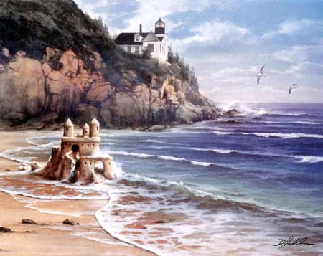
MATTHEW 7:24-27
Therefore whosoever heareth these sayings of mine, and doeth them, I will liken him unto a wise man, which built his house upon a rock: 25 And the rain descended, and the floods came, and the winds blew, and beat upon that house; and it fell not: for it was founded upon a rock. 26 And every one that heareth these sayings of mine, and doeth them not, shall be likened unto a foolish man, which built his house upon the sand: 27 And the rain descended, and the floods came, and the winds blew, and beat upon that house; and it fell: and great was the fall of it.

Slide 20
JOB 1:18-22
While he was yet speaking, there came also another, and said, Thy sons and thy daughters were eating and drinking wine in their eldest brother's house: 19 And, behold, there came a great wind from the wilderness, and smote the four corners of the house, and it fell upon the young men, and they are dead; and I only am escaped alone to tell thee. 20 Then Job arose, and rent his mantle, and shaved his head, and fell down upon the ground, and worshipped, 21 And said, Naked came I out of my mother's womb, and naked shall I return thither: the LORD gave, and the LORD hath taken away; blessed be the name of the LORD. 22 In all this Job sinned not, nor charged God foolishly.

Slide 21
PSALM 135:6-9
Whatsoever the LORD pleased, that did he in heaven, and in earth, in the seas, and all deep places. 7 He causeth the vapours to ascend from the ends of the earth; he maketh lightnings for the rain; he bringeth the wind out of his treasuries. 8 Who smote the first-born of Egypt, both of man and beast. 9 Who sent tokens and wonders into the midst of thee, O Egypt, upon Pharaoh, and upon all his servants.

Slide 22
JONAH 1:4-5
But the LORD sent out a great wind into the sea, and there was a mighty tempest in the sea, so that the ship was like to be broken.
5 Then the mariners were afraid, and cried every man unto his god, and cast forth the wares that were in the ship into the sea, to lighten it of them. But Jonah was gone down into the sides of the ship; and he lay, and was fast asleep.

Slide 23
GENESIS 7:11
In the six hundredth year of Noah's life, in the second month, the seventeenth day of the month, the same day were all the fountains of the great deep broken up, and the windows of heaven were opened.
GENESIS 8:1-2
And God remembered Noah, and every living thing, and all the cattle that was with him in the ark: and God made a wind to pass over the earth, and the waters asswaged; 2 The fountains also of the deep and the windows of heaven were stopped, and the rain from heaven was restrained;

Slide 24
RESPECTS
56 You can only do two things; either mercy or judgment. You have to accept one or the other. There's where we stand tonight. We either take God's mercy or we stand His judgment. God always makes a way of escape for those who desire to escape. What's left over has to stand the judgment, not because that God wants them to, but because they have chosen that way themselves… Because all that refuse the way of escape will have to come under judgment.
61-1015

Slide 25
JOB 37:6-13
For he saith to the snow, Be thou on the earth; likewise to the small rain, and to the great rain of his strength. 7 He sealeth up the hand of every man; that all men may know his work. 8 Then the beasts go into dens, and remain in their places. 9 Out of the south cometh the whirlwind: and cold out of the north. 10 By the breath of God frost is given: and the breadth of the waters is straitened. 11 Also by watering he wearieth the thick cloud: he scattereth his bright cloud: 12 And it is turned round about by his counsels: that they may do whatsoever he commandeth them upon the face of the world in the earth. 13 He causeth it to come, whether for correction, or for his land, or for mercy.

Slide 26
“It’s just Nature!”
THE.FEAST.OF.THE.TRUMPETS
49 And, being uneducated, myself, not knowing the words and how to speak them, I've always taught in types, in patterns of nature. Nature will follow nature. Nature is of God.
64-0719

Slide 27
TESTIMONY
152 I said, "They will never even find a trace of it. For, the Lord my God, Who is Creator, can stop winds and storms, rebuke the seas, He is the Creator of heavens and earth. And I love Him and believe Him… And You, Who could create a squirrel and put it into existence, could take an enemy out of existence. When the Devil wrapped hisself in the storm... The winds is God's creation. The water is God's creation. But the Devil got into it, that's what did it, and put a spasm in the sea, like that. 63-1128

Slide 28
THE.FUTURE.HOME
272 Then, in this New Earth, the skies will never be black again; no, that's from the curse, see. Never be black again with angry clouds. Winds will never blow across her again like that. No. She'll never tear up the trees, and tear up the houses, and turn over the things. Lightning and the wrath will never belch from Satan across there, and kill a man walking down the road, or burn up a building. No, no more. There'll be no more typhoons sweep down, or storms and tornadoes, and tear up houses, and kill little children, and things. Trying to destroy, it won't be there. Satan is cast out. 64-0802

Slide 29
LUKE 13:1-5
There were present at that season some that told him of the Galilaeans, whose blood Pilate had mingled with their sacrifices. 2 And Jesus answering said unto them, Suppose ye that these Galilaeans were sinners above all the Galilaeans, because they suffered such things? 3 I tell you, Nay: but, except ye repent, ye shall all likewise perish. 4 Or those eighteen, upon whom the tower in Siloam fell, and slew them, think ye that they were sinners above all men that dwelt in Jerusalem? 5 I tell you, Nay: but, except ye repent, ye shall all likewise perish.

Slide 30
JAMES 4:14-15
Whereas ye know not what shall be on the morrow. For what is your life? It is even a vapour, that appeareth for a little time, and then vanisheth away. 15 For that ye ought to say, If the Lord will, we shall live, and do this, or that.

Slide 31
His Ways vs. His Works
DEUT. 8:6
Therefore thou shalt keep the commandments of the LORD thy God, to walk in his ways, and to fear him.

Slide 32
ISAIAH 55:6-11
6 Seek ye the LORD while he may be found, call ye upon him while he is near: 7 Let the wicked forsake his way, and the unrighteous man his thoughts: and let him return unto the LORD, and he will have mercy upon him; and to our God, for he will abundantly pardon. 8 For my thoughts are not your thoughts, neither are your ways my ways, saith the LORD. 9 For as the heavens are higher than the earth, so are my ways higher than your ways, and my thoughts than your thoughts. 10 For as the rain cometh down, and the snow from heaven, and returneth not thither, but watereth the earth, and maketh it bring forth and bud, that it may give seed to the sower, and bread to the eater:

Slide 33
PSALM 2:11
Serve the LORD with fear, and rejoice with trembling.
When things go wrong, it usually stems from a violation of a principle much earlier, which sets things in motion.

Slide 34
II SAMUEL 6:6-9
And when they came to Nachon's threshing floor, Uzzah put forth his hand to the ark of God, and took hold of it; for the oxen shook it. 7 And the anger of the LORD was kindled against Uzzah; and God smote him there for his error; and there he died by the ark of God. 8 And David was dis-pleased, because the LORD had made a breach upon Uzzah: and he called the name of the place Perezuzzah to this day. 9 And David was afraid of the LORD that day, and said, How shall the ark of the LORD come to me?

Slide 35
II SAMUEL 6:3-5
And they set the ark of God upon a new cart, and brought it out of the house of Abinadab that was in Gibeah: and Uzzah and Ahio, the sons of Abinadab, drave the new cart. 4 And they brought it out of the house of Abinadab which was at Gibeah, accompanying the ark of God: and Ahio went before the ark. 5 And David and all the house of Israel played before the LORD on all manner of instruments made of fir wood, even on harps, and on psalteries, and on timbrels, and on cornets, and on cymbals.

Slide 36
NUMBERS 7:4-9
And the LORD spake unto Moses, saying, 5 Take it of them, (sons of Levi) that they may be to do the service of the tabernacle of the congregation; and thou shalt give them unto the Levites, to every man according to his service. 6 And Moses took the wagons and the oxen, and gave them unto the Levites. 7 Two wagons and four oxen he gave unto the sons of Gershon, according to their service: 8 And four wagons and eight oxen he gave unto the sons of Merari, according unto their service, under the hand of Ithamar the son of Aaron the priest. 9 But unto the sons of Kohath he gave none: because the service of the sanctuary belonging unto them was that they should bear upon their shoulders.

Slide 37
DEUTERONOMY 10:12-14
And now, Israel, what doth the LORD thy God require of thee, but to fear the LORD thy God, to walk in all his ways, and to love him, and to serve the LORD thy God with all thy heart and with all thy soul, 13 To keep the commandments of the LORD, and his statutes, which I command thee this day for thy good? 14 Behold, the heaven and the heaven of heavens is the LORD'S thy God, the earth also, with all that therein is.

Slide 38
My Ways
I KINGS 3:14 And if thou wilt walk in my ways, to keep my statutes and my commandments, as thy father David did walk, then I will lengthen thy days.
I KINGS 11:33 Because that they have forsaken me, and have worshipped Ashtoreth the goddess of the Zidonians, Chemosh the god of the Moabites, and Milcom the god of the children of Ammon, and have not walked in my ways, to do that which is right in mine eyes, and to keep my statutes and my judgments, as did David his father.

Slide 39
MATTHEW 5:16
Let your light so shine before men, that they may see your good works, and glorify your Father which is in heaven.
MATTHEW 23:3
All therefore whatsoever they bid you observe, that observe and do; but do not ye after their works: for they say, and do not. (5) But all their works they do for to be seen of men…

Slide 40
Works: (Gr.) ergon
Business, employment, that which any one is occupied, enterprise, undertaking; any thing accomplished by hand, art, industry, or mind;
An act, deed, thing done.
PSALM 145:17
The LORD is righteous in all his ways, and holy in all his works.

Slide 41
JOHN 6:28-29
Then said they unto him, What shall we do, that we might work the works of God? 29 Jesus answered and said unto them, This is the work of God, that ye believe on him whom he hath sent.
JOHN 8:39-41
They answered and said unto him, Abraham is our father. Jesus saith unto them, If ye were Abraham's children, ye would do the works of Abraham. 41Ye do the deeds of your father. Then said they to him, We be not born of fornication; we have one Father, even God.

Slide 42
PSALM 81:13-16
13 Oh that my people had hearkened unto me, and Israel had walked in my ways! 14 I should soon have subdued their enemies, and turned my hand against their adversaries. 15 The haters of the LORD should have submitted themselves to him: but their time should have endured for ever. 16 He should have fed them also with the finest of the wheat: and with honey out of the rock should I have satisfied thee.

Slide 43
THE.POWER.OF.DECISION
23 Look like God led them right into the trap. You know, we find out that God sometime leads us right into a great thing, and then to show His power and His glory to deliver us.
And when Moses called to God, God said, "Stand still, and see the salvation of God." My, isn't that a encouragement? "Stand still.“
55-1007

Slide 44
REDEMPTION.BY.POWER
137 Standing there, the Angel of God went before the camp of Israel, and removed, and went and stood between them and the enemy. And the Angel of God is standing tonight between every individual here and the enemy. I know what I'm speaking of… I know that God has condescended, coming down from glory, standing in this building now. If you'll only dare to move out on God's Word, see if He don't move before you now.

Slide 45
And It came between the camp and the Egyptians. He's coming between you and your sickness. He's standing between you and your sins right now. Why? We are in the exodus of the Church. Egypt was always called the world. And when Israel come out of...
Remember, they were church members down there. But after the blood and the atonement was made, they become the circumcised of God.
54-0329

Slide 46
HIDDEN.LIFE.WITH.CHRIST
60 And that's a man or woman who consecrates themself and forsakes the things of the world and gives their life entirely over to the Lord Jesus Christ, is eating off of the manna day and night. Whether the storms are flying outside or what was he's hid in Christ. Amen.
Make any difference whether there's sickness in the house, or trouble on the line, doesn't make a bit of difference, he's hid in Christ Jesus.
56-0213

