Slide 1
The Higher Way
When Bad Things Happen & When Bad Things Happen to Good People
HEBREWS 3:7-10
Wherefore I was grieved with that generation, and said, They do alway err in their heart; and they have not known my ways.

Slide 2
Birthdays & Anniversaries
Sept. 23rd Cindy Walters
Sept. 23rd Gabrielle Walters
Sept. 25th Ethan Pritchard, Rebekah Irish, Sherry Holly
Sept. 26th The Irish’s, Sis. Sue Sheppard
Sept. 29th Sis. Freida Drum
Oct. 1st Kaitlyn Florian
Oct. 2nd David Cockman
Oct. 3rd Katie Franklin, Sophie Cockman
Oct. 5th The Browns
Oct. 12-14th Dedication Meetings

Slide 3
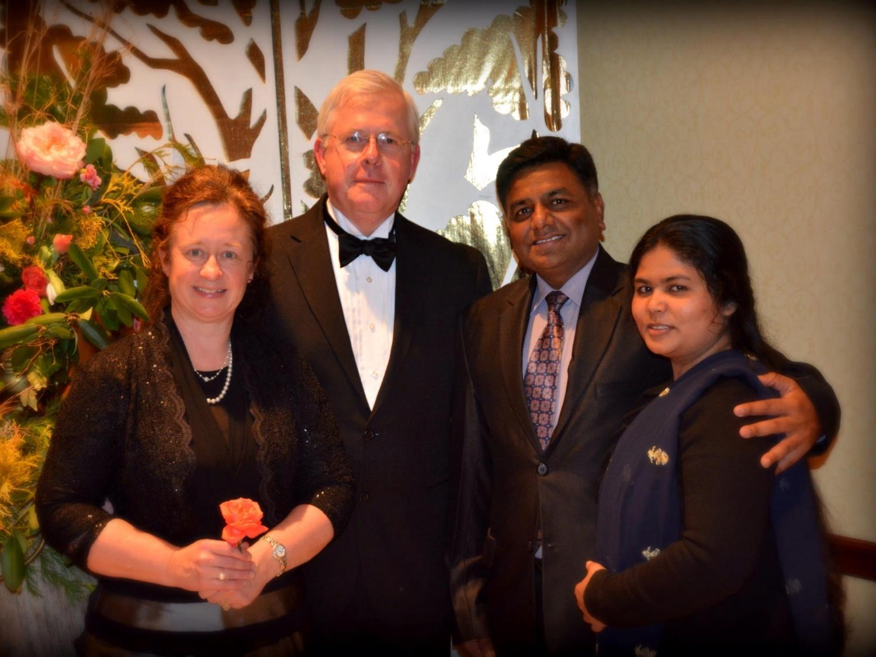
February 2014

Slide 4
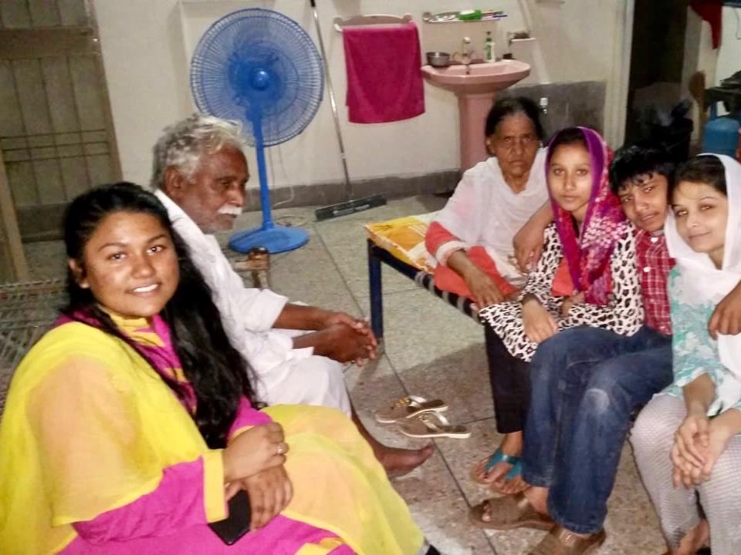
Nayab, Sheba’s Father, Anwar’s Mother, & Cousins

Slide 5
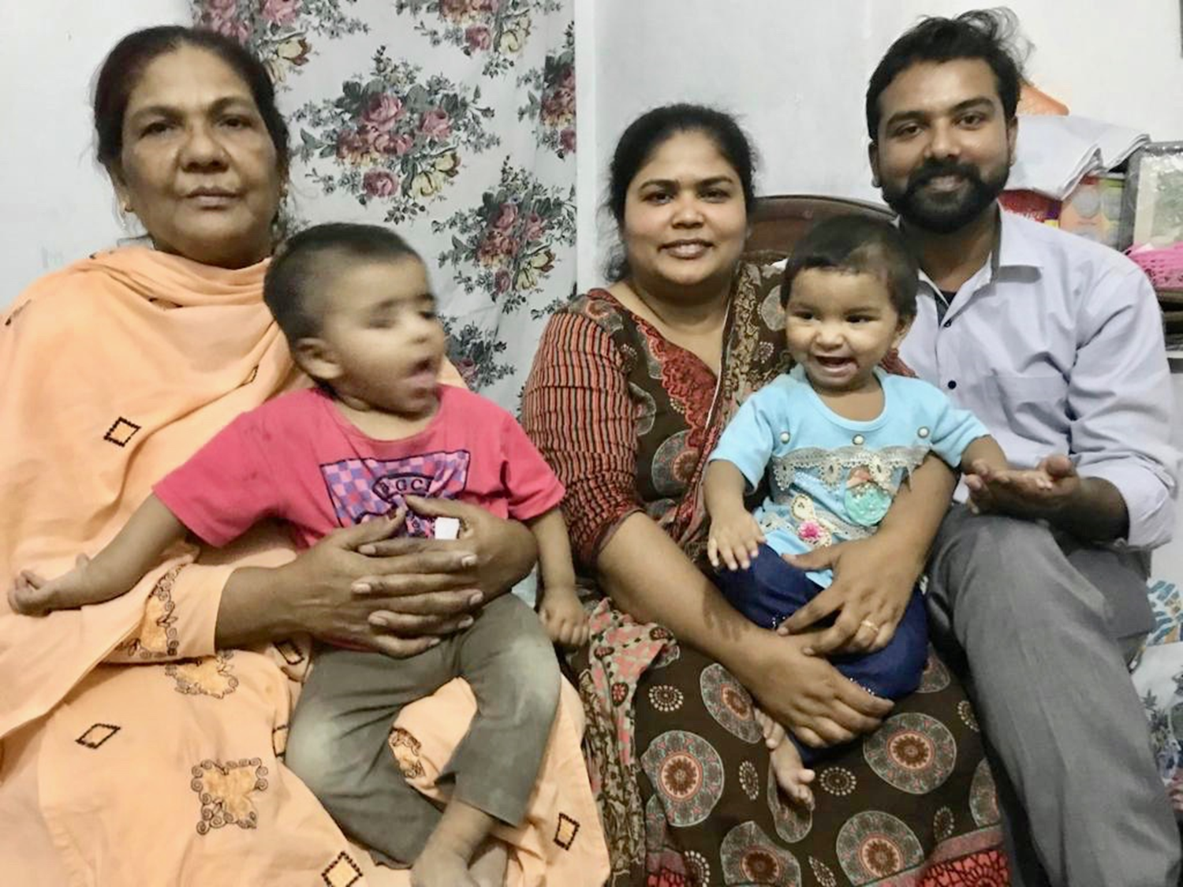
The Javeds with Sis. Sheba’s father and
Anwar’s mother and cousins.
Sis. Sheba and her mother and younger brother

Slide 6
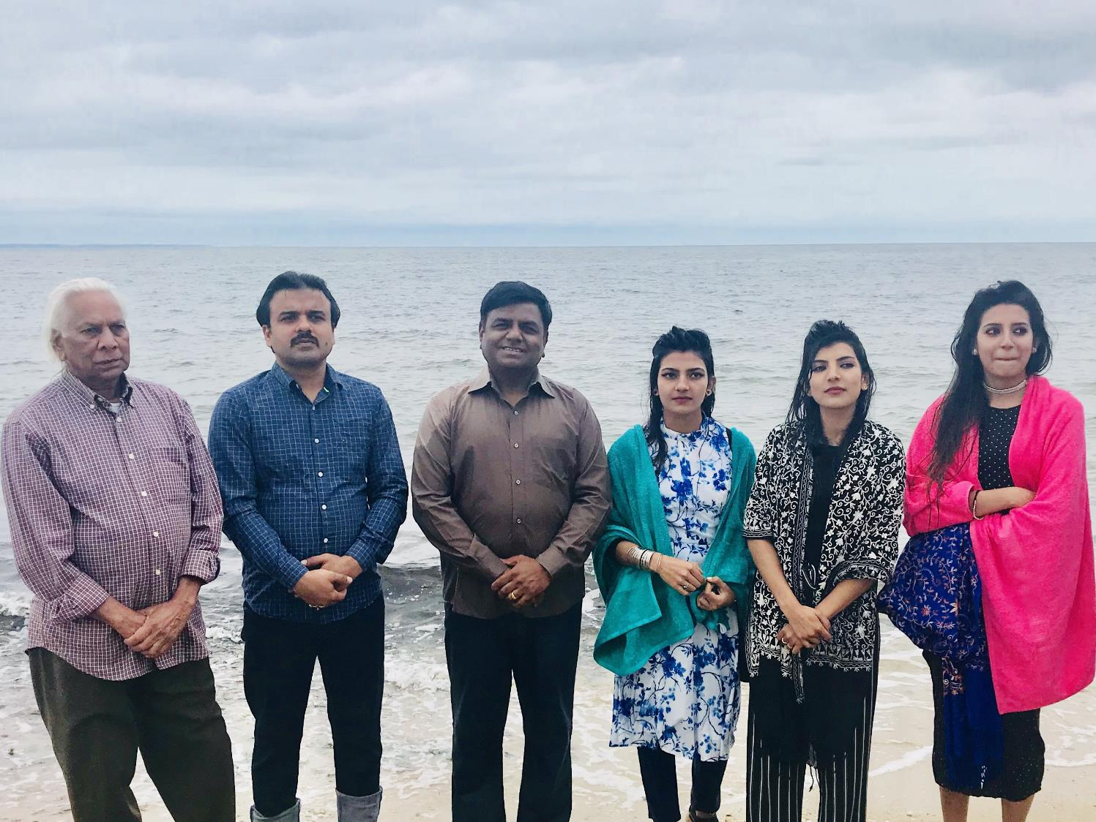

Slide 7
THE.UNCERTAIN.SOUND
268 Moses, trained, polished... Oh, my, was he a scholar, and a military man. He thought, "With all of my scholarship. I've got a PH.D., and all the D.D.'s that can be thought of. But surely I'll know how to do this, because I'm the brains of Egypt."
I don't care what you're the brains of, it's no good. When it comes to God's, it's foolishness. Your brains is foolishness to God. "Because My ways are higher than your ways…" saith God. 60-1218

Slide 8
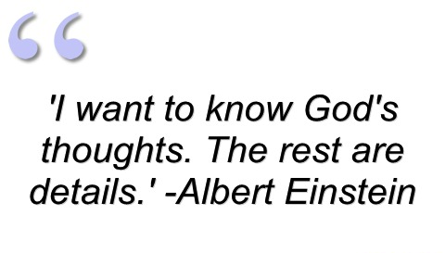

Slide 9
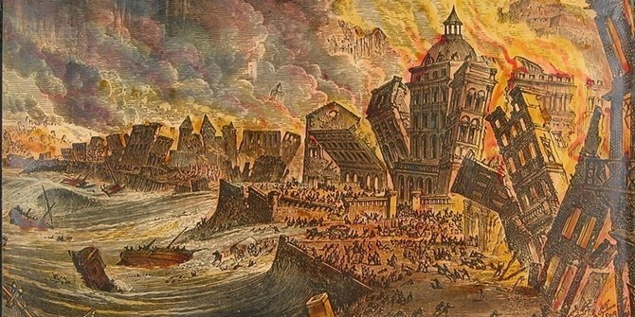
The Lisbon, Portugal Earthquake
The 1755 Great Lisbon earthquake, occurred in the Kingdom of Portugal on the morning of Saturday, 1 Nov., 1755 on the holy day of All Saints' Day, at 9:40 am.

Slide 10
JAMES 4:14-15
Whereas ye know not what shall be on the morrow. For what is your life? It is even a vapour, that appeareth for a little time, and then vanisheth away. 15 For that ye ought to say, If the Lord will, we shall live, and do this, or that.

Slide 11
His Ways vs. His Works
DEUT. 8:6
Therefore thou shalt keep the command-ments of the LORD thy God, to walk in his ways, and to fear him.

Slide 12
THE.QUEEN.OF.SHEBA
22 So if He's infinite, He knew the end from the beginning. And that's the reason He could predict the end from the beginning… But we know He is infinite and we are the finite. We get things so mixed up and so settled that we're right, then God with His infinite mind just rides so far over it. "My thoughts are higher than your thoughts," said God. His ways are higher than our ways. So we must summit ourselves to His way.
61-0219

Slide 13
ISAIAH 55:6-11
6 Seek ye the LORD while he may be found, call ye upon him while he is near: 7 Let the wicked forsake his way, and the unrighteous man his thoughts: and let him return unto the LORD, and he will have mercy upon him; and to our God, for he will abundantly pardon. 8 For my thoughts are not your thoughts, neither are your ways my ways, saith the LORD. 9 For as the heavens are higher than the earth, so are my ways higher than your ways, and my thoughts than your thoughts. 10 For as the rain cometh down, and the snow from heaven, and returneth not thither, but watereth the earth, and maketh it bring forth and bud, that it may give seed to the sower, and bread to the eater:

Slide 14
IT.IS.I.BE.NOT.AFRAID
6 And there's where I get the fall back: "You don't pray for enough." I do believe with all my heart that they're doing what God told them to do. That's their ministry.
Now, I believe there is a higher way to reach Christ than laying on hands, 'cause the patient can say this, "Brother So-and-so laid hands on me. I felt the power of God coming through his hands." See, that puts a man in it again.

Slide 15
MARK 5:22-23
And, behold, there cometh one of the rulers of the synagogue, Jairus by name; and when he saw him, he fell at his feet,
23 And besought him greatly, saying, My little daughter lieth at the point of death: I pray thee, come and lay thy hands on her, that she may be healed; and she shall live.

Slide 16
7 But that was a Jewish tradition. (Jairus) said, "Come lay your hands on my daughter and she will be well.“ But the Roman, the Gentile, said, "I'm not worthy that You'd come under my roof. Just speak the word and my servant will live…“ What did Jesus say about that? He certainly did honor that Roman. He said, "I have not seen faith like that in Israel." Now, that's where we're trying to get people, to believe that He... It's not some human being; it's your Lord, Jesus Christ. It's what He did for you.
61-0213

Slide 17
PSALM 2:11
Serve the LORD with fear, and rejoice with trembling.
When things go wrong, it usually stems from a violation of a principle much earlier, which sets things in motion.

Slide 18
II SAMUEL 6:6-9
And when they came to Nachon's threshing floor, Uzzah put forth his hand to the ark of God, and took hold of it; for the oxen shook it. 7 And the anger of the LORD was kindled against Uzzah; and God smote him there for his error; and there he died by the ark of God. 8 And David was dis-pleased, because the LORD had made a breach upon Uzzah: and he called the name of the place Perezuzzah to this day. 9 And David was afraid of the LORD that day, and said, How shall the ark of the LORD come to me?

Slide 19
II SAMUEL 6:3-5
And they set the ark of God upon a new cart, and brought it out of the house of Abinadab that was in Gibeah: and Uzzah and Ahio, the sons of Abinadab, drave the new cart. 4 And they brought it out of the house of Abinadab which was at Gibeah, accompanying the ark of God: and Ahio went before the ark. 5 And David and all the house of Israel played before the LORD on all manner of instruments made of fir wood, even on harps, and on psalteries, and on timbrels, and on cornets, and on cymbals.

Slide 20
NUMBERS 7:4-9
And the LORD spake unto Moses, saying, 5 Take it of them, (sons of Levi) that they may be to do the service of the tabernacle of the congregation; and thou shalt give them unto the Levites, to every man according to his service. 6 And Moses took the wagons and the oxen, and gave them unto the Levites. 7 Two wagons and four oxen he gave unto the sons of Gershon, according to their service: 8 And four wagons and eight oxen he gave unto the sons of Merari, according unto their service, under the hand of Ithamar the son of Aaron the priest. 9 But unto the sons of Kohath he gave none: because the service of the sanctuary belonging unto them was that they should bear upon their shoulders.

Slide 21
DEUTERONOMY 10:12-14
And now, Israel, what doth the LORD thy God require of thee, but to fear the LORD thy God, to walk in all his ways, and to love him, and to serve the LORD thy God with all thy heart and with all thy soul, 13 To keep the commandments of the LORD, and his statutes, which I command thee this day for thy good? 14 Behold, the heaven and the heaven of heavens is the LORD'S thy God, the earth also, with all that therein is.

Slide 22
II CHRONICLES 7:9
And in the eighth day they made a solemn assembly: for they kept the dedication of the altar seven days, and the feast seven days. 10 And on the three and twentieth day of the seventh month he sent the people away into their tents, glad and merry in heart for the goodness that the LORD had shewed unto David, and to Solomon, and to Israel his people.

Slide 23
PSALM 92:1-6
A Psalm or Song for the sabbath day. It is a good thing to give thanks unto the LORD, and to sing praises unto thy name, O most High: 2 To shew forth thy lovingkindness in the morning, and thy faithfulness every night, 3 Upon an instrument of ten strings, and upon the psaltery; upon the harp with a solemn sound. 4 For thou, LORD, hast made me glad through thy work: I will triumph in the works of thy hands. 5 O LORD, how great are thy works! and thy thoughts are very deep. 6 A brutish man knoweth not; neither doth a fool understand this.

Slide 24
PSALM 92:1-6
A Psalm or Song for the sabbath day. It is a good thing to give thanks unto the LORD, and to sing praises unto thy name, O most High… 6 A brutish man knoweth not; neither doth a fool understand this.
Brutish: (Heb.) ba’ar
To be stupid, dull-hearted, unreceptive.
Fool: (Heb.) kciyl
A stupid fellow, dullard, simpleton, arrogant one.

Slide 25
My Ways
I KINGS 3:14 And if thou (Solomon) wilt walk in my ways, to keep my statutes and my commandments, as thy father David did walk, then I will lengthen thy days...
I KINGS 11:33 Because that they (Solomon’s wives) have forsaken me, and have worshipped Ashtoreth the goddess of the Zidonians, Chemosh the god of the Moabites, and Milcom the god of the children of Ammon, and have not walked in my ways, to do that which is right in mine eyes, and to keep my statutes and my judgments, as did David his father.

Slide 26
MATTHEW 5:16
Let your light so shine before men, that they may see your good works, and glorify your Father which is in heaven.
MATTHEW 23:3
All therefore whatsoever they bid you observe, that observe and do; but do not ye after their works: for they say, and do not. (5) But all their works they do for to be seen of men…

Slide 27
Works: (Gr.) ergon
Business, employment, that which any one is occupied, enterprise, undertaking; any thing accomplished by hand, art, industry, or mind;
An act, deed, thing done.
PSALM 145:17
The LORD is righteous in all his ways, and holy in all his works.

Slide 28
JOHN 6:28-29
Then said they unto him, What shall we do, that we might work the works of God? 29 Jesus answered and said unto them, This is the work of God, that ye believe on him whom he hath sent.
JOHN 8:39-41
They answered and said unto him, Abraham is our father. Jesus saith unto them, If ye were Abraham's children, ye would do the works of Abraham. 41Ye do the deeds of your father. Then said they to him, We be not born of fornication; we have one Father, even God.

Slide 29
PSALM 81:13-16
13 Oh that my people had hearkened unto me, and Israel had walked in my ways! 14 I should soon have subdued their enemies, and turned my hand against their adversaries. 15 The haters of the LORD should have submitted themselves to him: but their time should have endured for ever. 16 He should have fed them also with the finest of the wheat: and with honey out of the rock should I have satisfied thee.

Slide 30
THE.POWER.OF.DECISION
23 Look like God led them right into the trap. You know, we find out that God sometime leads us right into a great thing, and then to show His power and His glory to deliver us.
And when Moses called to God, God said, "Stand still, and see the salvation of God." My, isn't that a encouragement? "Stand still.“
55-1007

Slide 31
REDEMPTION.BY.POWER
137 Standing there, the Angel of God went before the camp of Israel, and removed, and went and stood between them and the enemy. And the Angel of God is standing tonight between every individual here and the enemy.
I know what I'm speaking of… I know that God has condescended, coming down from glory, standing in this building now. If you'll only dare to move out on God's Word, see if He don't move before you now.

Slide 32
And It came between the camp and the Egyptians. He's coming between you and your sickness. He's standing between you and your sins right now. Why? We are in the exodus of the Church. Egypt was always called the world. And when Israel come out of...
Remember, they were church members down there. But after the blood and the atonement was made, they become the circumcised of God.
54-0329

Slide 33
HIDDEN.LIFE.WITH.CHRIST
60 And that's a man or woman who consecrates themself and forsakes the things of the world and gives their life entirely over to the Lord Jesus Christ, is eating off of the manna day and night. Whether the storms are flying outside or what was he's hid in Christ. Amen.
Make any difference whether there's sickness in the house, or trouble on the line, doesn't make a bit of difference, he's hid in Christ Jesus.
56-0213

Slide 34
A.PRISONER
197 And let God take His Word, yoking us up together with It, God's Word. And may the Holy Spirit take us now, as we hear the yoke click around our hearts, "From tonight on, I take you at your word. Now don't think your own thinking. Think My thoughts. Think My will. I will lead you." God, grant that it'll be an experience to every one of us.
63-0717

