Slide 1
Citizens
of Another Kingdom
EPHESIANS 2:19
Now therefore ye are no more strangers and foreigners, but fellowcitizens with the saints, and of the household of God;

Slide 2
Birthdays & Anniversaries
N

Slide 3
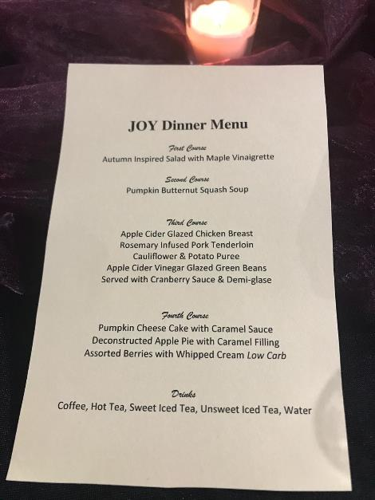
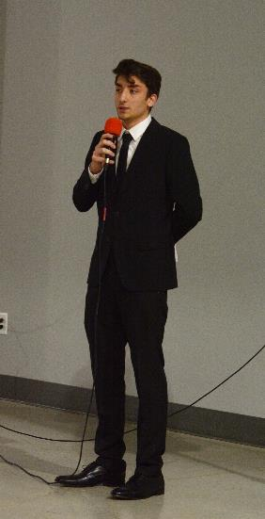
The First Annual
JOY Dinner
At
Julian’s
Cafe

Slide 4
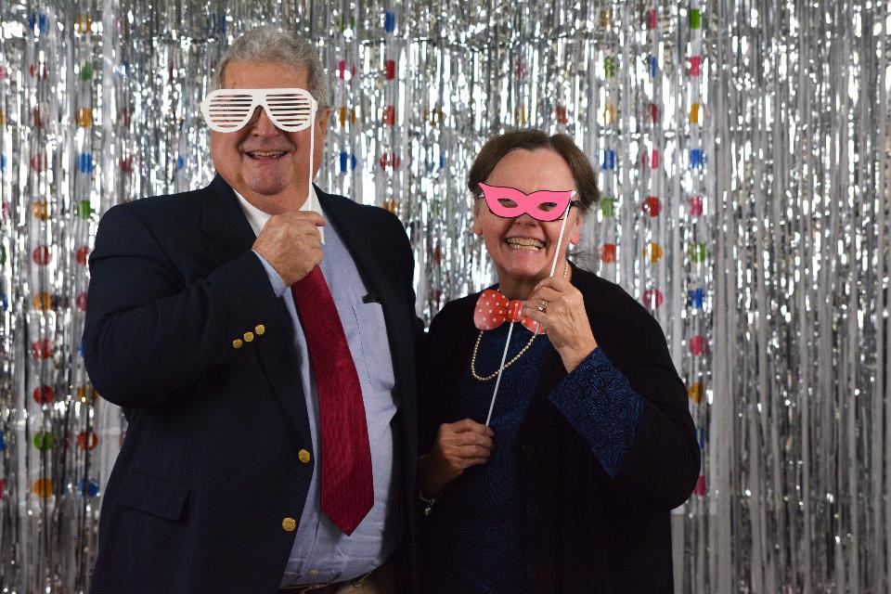

Slide 5
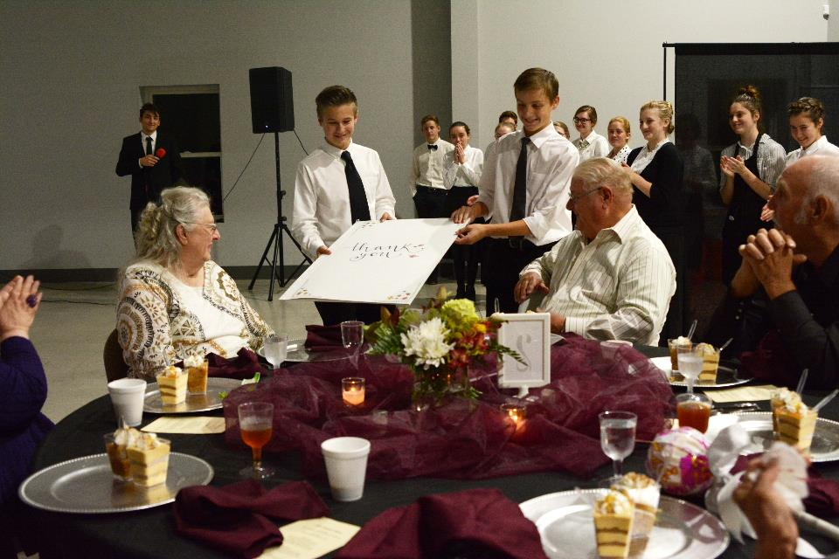

Slide 6
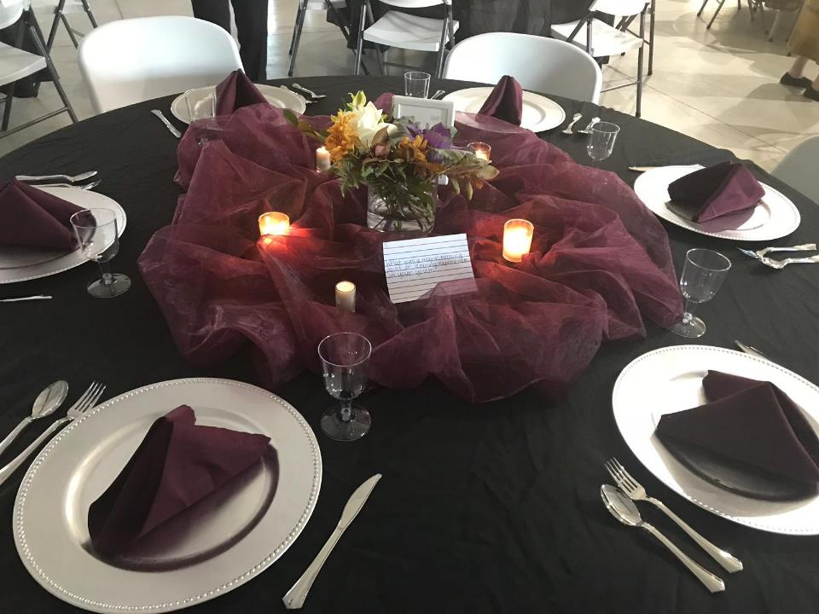

Slide 7
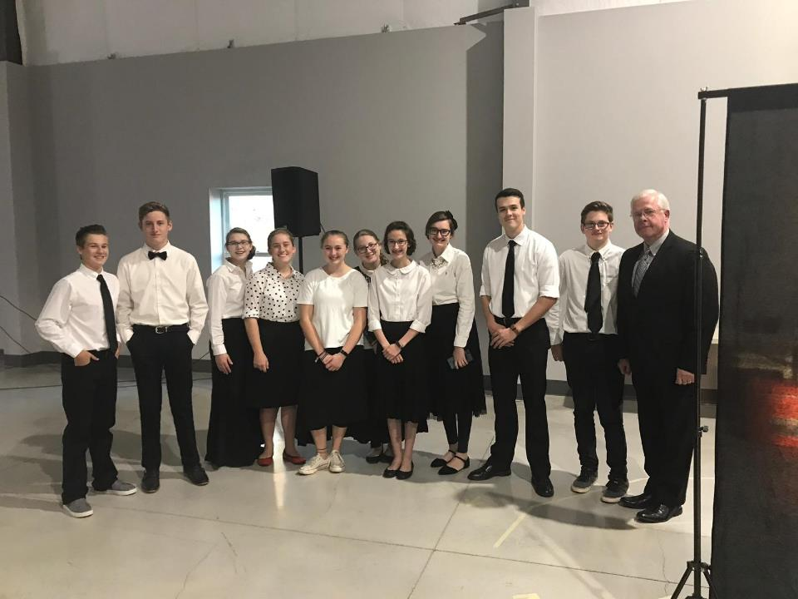

Slide 8
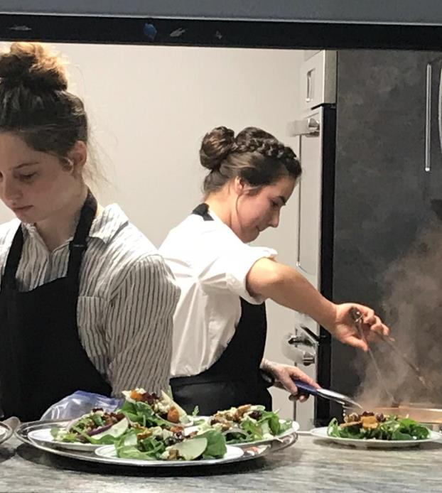
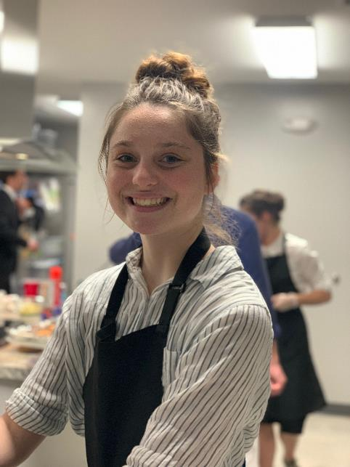

Slide 9
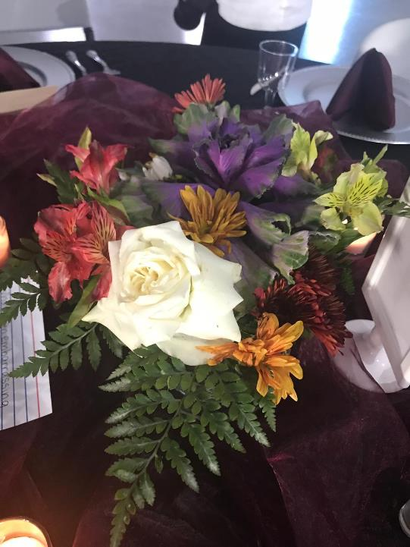

Slide 10
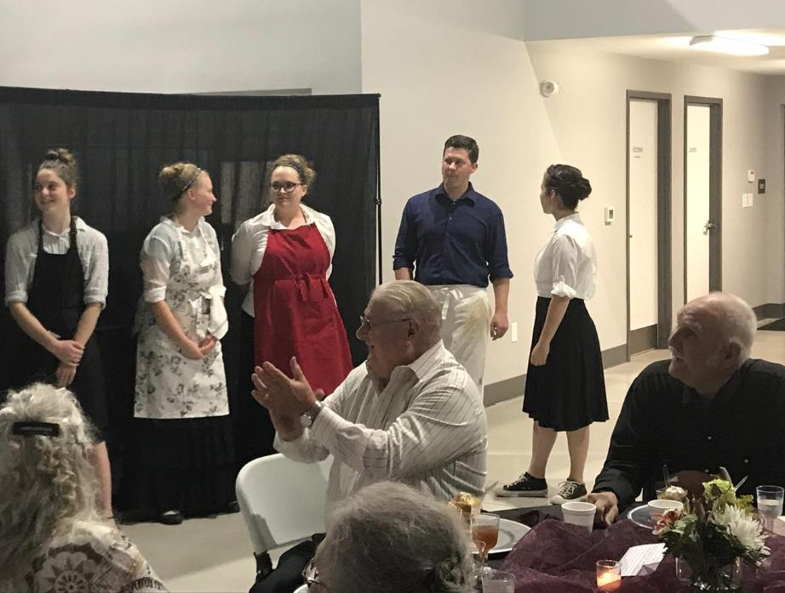

Slide 11
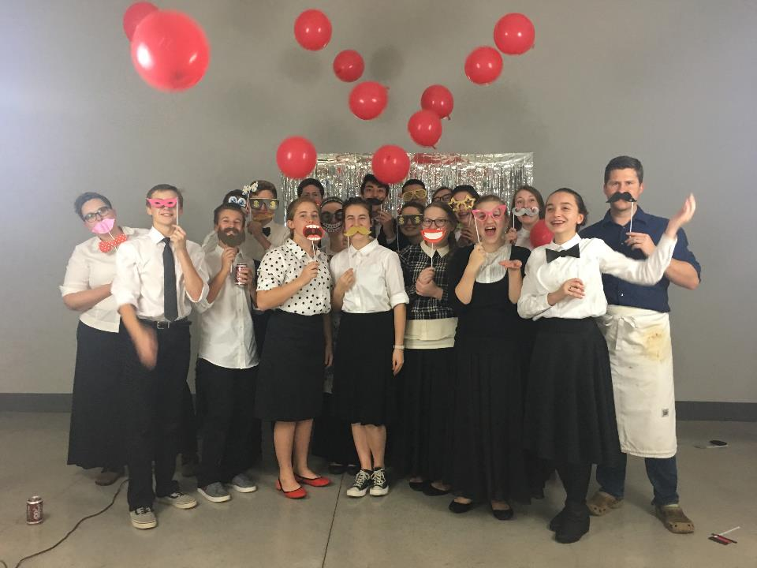

Slide 12
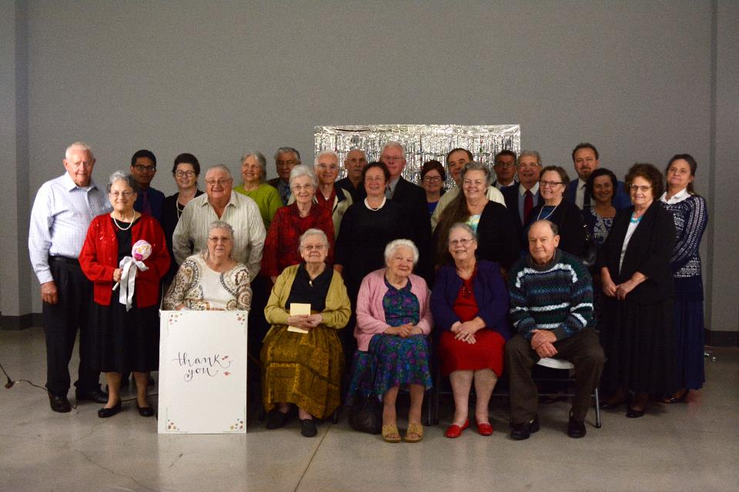

Slide 13
Citizens
of Another Kingdom
EPHESIANS 2:19
Now therefore ye are no more strangers and foreigners, but fellowcitizens with the saints, and of the household of God;

Slide 14
EPHESIANS 2:18-22
For through him we both have access by one Spirit unto the Father. 19 Now therefore ye are no more strangers and foreigners, but fellowcitizens with the saints, and of the household of God; 20 And are built upon the foundation of the apostles and prophets, Jesus Christ himself being the chief corner stone; 21 In whom all the building fitly framed together groweth unto an holy temple in the Lord: 22 In whom ye also are builded together for an habitation of God through the Spirit.

Slide 15
CHRIST.IS.THE.MYSTERY
240 The new Birth is Christ, is a revelation. God has revealed to you this great mystery, and that's a new Birth. Now what are you going to do when you get all that group together, where the revelation is perfectly in harmony, and God expressing it through His Word by the same actions, the same things that He did, making the Word manifest! Oh, if the Church only knew its position! It will, one day. Then, the Rapture will go when it knows what it is.
63-0728

Slide 16
EPHESIANS 2:18-22
18 For through him we both have access by one Spirit unto the Father. 19 Now therefore ye are no more strangers and foreigners, but fellowcitizens with the saints, and of the household of God; 20 And are built upon the foundation of the apostles and prophets, Jesus Christ himself being the chief corner stone; 21 In whom all the building fitly framed together groweth unto an holy temple in the Lord: 22 In whom ye also are builded together for an habitation of God through the Spirit.

Slide 17
Citizenship:
Denotes the link between a person and a state. It is normally synonymous with the term nationality. Possession of citizenship is normally associated with the right to work and live in a country and to participate in political life.
“It can be argued that this growth of slavery was what made Greeks particularly conscious of the value of freedom. After all, any Greek farmer might fall into debt and therefore might become a slave, at almost any time... When the Greeks fought together, they fought in order to avoid being enslaved by warfare, to avoid being defeated by those who might take them into slavery. And they also arranged their political institutions so as to remain free men. Geoffrey Hosking

Slide 18
Fellowcitizen: (Gr.) sumpolites
Possessing the same citizenship with others, a fellow citizen: of Gentiles as received into communion of the saints, i.e. of the people consecrated to God.
ACTS 25:11-12
11 For if I be an offender, or have committed any thing worthy of death, I refuse not to die: but if there be none of these things whereof these accuse me, no man may deliver me unto them. I appeal unto Caesar. 12 Then Festus, when he had conferred with the council, answered, Hast thou appealed unto Caesar? unto Caesar shalt thou go.

Slide 19
JESUS.CHRIST.THE.SAME
39 "Before you was even formed in your mothers belly, I knew you, and called you, and sanctified you, and ordained you a prophet over the nations," before he was ever borned. You believe in predestination, foreordination? It's altogether by grace, not by desire; it's by grace.
God called Abraham out of that whole world of people. Why? 'Cause Abraham was better? No, sir. It's grace. God's chosen, election, and call. You are what you are because the grace of God has made you what you are. 52-0810

Slide 20
The Right of Return
(Hebrew: זכות השיבה‎‎, zkhut hashivah)
JEREMIAH 33:7
And I will cause the captivity of Judah and the captivity of Israel to return, and will build them, as at the first. 8 And I will cleanse them from all their iniquity, whereby they have sinned against me; and I will pardon all their iniquities, whereby they have sinned, and whereby they have transgressed against me.

Slide 21
In 1950, Israel’s Knesset passed a remarkable law, beginning with a few simple words that defined Israel’s central purpose: “Every Jew has the right to immigrate to this country...”
With the inception of the State of Israel, two thousand years of wandering were officially over. Since then, Jews have been entitled to simply show up and request to be Israeli citizens, assuming they posed no imminent danger to public health, state security, or the Jewish people as a whole. Essentially, all Jews everywhere are Israeli citizens by right.
http://www.jewishagency.org/first-steps/program/5131

Slide 22
ZECHARIAH 7:11-14
But they refused to hearken, and pulled away the shoulder, and stopped their ears, that they should not hear. 12 Yea, they made their hearts as an adamant stone, lest they should hear the law, and the words which the LORD of hosts hath sent in his spirit by the former prophets: therefore came a great wrath from the LORD of hosts. 13 Therefore it is come to pass, that as he cried, and they would not hear; so they cried, and I would not hear, saith the LORD of hosts: 14 But I scattered them with a whirlwind among all the nations whom they knew not. Thus the land was desolate after them, that no man passed through nor returned: for they laid the pleasant land desolate.

Slide 23
JEREMIAH 32:37
Behold, I will gather them out of all countries, whither I have driven them in mine anger, and in my fury, and in great wrath; and I will bring them again unto this place, and I will cause them to dwell safely:
ZEPHANIAH 3:20
At that time will I bring you again, even in the time that I gather you: for I will make you a name and a praise among all people of the earth, when I turn back your captivity before your eyes, saith the LORD.

Slide 24
II PETER 1:1-11
But he that lacketh these things is blind, and cannot see afar off, and hath forgotten that he was purged from his old sins. 10 Wherefore the rather, brethren, give diligence to make your calling and election sure: for if ye do these things, ye shall never fall: 11 For so an entrance shall be ministered (supplied and furnished) unto you abundantly into the everlasting kingdom of our Lord and Saviour Jesus Christ.

Slide 25
TOKEN
153 The Holy Spirit, the Word has been quickened to you by the Holy Spirit to vindicate this age, that you have passed from death unto Life, and now you are His. Oh, because He is, we have the right to all that He has purchased for us. Every promise in the Bible is yours.… When God has give you the true baptism of the Holy Spirit, then the Life of Jesus Christ is within you. Now, that's true; every theologian will have to admit that to be the truth; it's the new birth.
63-1128

Slide 26
THE.TOKEN
49 Now we have a Token in this day. We've been given a Token which is an antitype of that type. Of that natural token, we've been given the Supernatural, supreme Token. All that that foreshadowed has been given to this generation, has been given the Token. Now we have the Holy Ghost, is our Token, and It is our identification that we have accepted the death of the Lamb.

Slide 27
Not only was Jesus just a human life to come back on us, but It was God Himself manifested in flesh, that brought back upon us the adoption of sons, that now we are sons and daughters of God. That is the Token. It's our identification of the passover. It's our identification that we have believed God, and God has accepted.
63-1128

Slide 28
ROMANS 8:29-30
For whom he did foreknow, he also did predestinate to be conformed to the image of his Son, that he might be the firstborn among many brethren. 30 Moreover whom he did predestinate, them he also called: and whom he called, them he also justified: and whom he justified, them he also glorified.

Slide 29
LEADERSHIP
119 There's only one form of Eternal Life, and that comes from God. And He foreordained every creature that would ever have It. Just as you were the gene in your father, you was a gene in God; one of His attributes to begin with, or you'll never be There. You come forth in the bedding ground of your mother; your father didn't know you, you were in his loins. And when you come forth in the bedding ground of the mother, then you become a human being and are made in the image of your father, now you can fellowship with him.

Slide 30
And the same thing by God, if you got Eternal Life… And the only way you can come born again, is the only way, is it has to be from your Heavenly Father, His attributes. "All the Father has given Me will come to Me."
121 You are here because your name was placed on the Lamb's Book of Life before there was even a foundation of the world. You're a gene, a spiritual gene out of your Heavenly Father, a part of God's Word.
65-1207

Slide 31
SIRS.WE.WOULD.SEE.JESUS
22 …Jesus was a virgin born in order to tabernacle the Holy Spirit of God… to manifest Himself to the people; and He gave His life, a willing sacrifice that through His righteousness, we unrighteous people might have a right to come into the fellowship like He had with the Father before the foundation of the world.
If that isn't grace and glory, what He did for us. We're living millions of miles below our God given privilege.
57-1211

Slide 32
THE.TOKEN
110 The new Token is the new Life that comes through Jesus Christ, when His Blood was shed, to sanctify a Church and fill It with His Presence, that He might manifest His Word and His promises to the people.
64-0208

Slide 33
THE TOKEN
147 A seal of promise! Ep. 4:30, "Grieve not the Holy Ghost of God, whereby you are sealed until the day of your redemption." Not till the next revival. "Until the day of your redemption!" Being baptized into It, according to I Cor. 12.
And in Him is the fulness, and no sin is recognized in Him. "He that's borned of God, does not commit sin. The seed of God remains in him, and he cannot sin." How can he, when the Token is there? The Token is the sign he has been accepted.

Slide 34
148 Well, you say, "I sin." Well, then you never had the Token. The Token is the barrier, shows that the price is paid. If Satan tries to hand you some sickness you know what to do? Show him your Token. Sure, sickness strikes the Christian. Show him your Token, and prove to him that you're a purchased product of God. "Resist the devil, and he'll flee from you." Hold the Token over your unmovable faith in His promised Word.
64-0308

Slide 35
FORSAKING.ALL
193 If the spirit of a gangster was in me, I'd have guns on me. If the spirit of a painter was in me, I could paint the picture... If the spirit of a mechanic was on me, I could tell you what was wrong with your car.
194 And if the Spirit of Jesus Christ is in me, I'll do the works of Christ, because it's the Life of Christ in you. Forsaken His Sonship, and became sin, took our sins, that He might take sinners and make them sons. He became me, that I might become Him.

Slide 36
Oh, it is striking, what He done. He taken your place, that you might take His place. "You're joint-heirs with Him; in the Kingdom." He become a sinner, like you, your sins placed upon Him; that He might take you and make you a fellow citizen of Heaven, and set you with Him in God's Kingdom. There you are: put His Spirit in you.
And if His Spirit is in you, the works that He did you'll do also.
62-0123

Slide 37
I THESSALONIANS 2:11-12
11 As ye know how we exhorted and comforted and charged every one of you, as a father doth his children, 12 That ye would walk worthy of God, who hath called you unto his kingdom and glory.
HEBREWS 12:28
28 Wherefore we receiving a kingdom which cannot be moved, let us have grace, whereby we may serve God acceptably with reverence and godly fear:

Slide 38
THE.INTER.VEIL
73 Jesus knowed. The Bible said, "Rejoice all you heavens, and you holy prophets, and you earth. For the kingdoms of this world have become the kingdoms of our Lord and His Christ, and He will reign forever," in the Book of Revelation. Jesus knowed He was coming Heir to all of them. But this is the devil's world. That's the reason you got fighting, and war, and troubles, atomic bombs, and murders, and rapes, and everything, because it's a devil's world and controlled by the devil. But you're not of this world. You're in the Kingdom of God.

Slide 39
I don't blame the sinner from sinning. If the sinner goes down and drink beer, smoke cigars, goes to picture shows and acts like the world, I don't blame him. That's the only pleasure he's got now, and the only pleasure he's ever going to have. I don't blame a pig for sticking his nose in the manure pile and eating manure. Certainly not, he's a pig. Let him alone.
But you people who call yourself Christians and then do those things, you're the guy I'm after.
56-0121

Slide 40
CALLING.JESUS.ON.THE.SCENE
72 …Oh, if we tonight could only catch that vision: the very Jehovah that made the heavens and earth is right in this little vessel of ours, while we're sailing life's solemn main. For the Holy Ghost is Jehovah in Spirit form in you.
63-0804

Slide 41
GOD.HAS.A.PROVIDED.WAY
55 God has a provided way. We try to make some other way, but God's got a provided way. It's always best to follow His way. "You shall receive power after you've got your Bachelor of Art… after you become a deacon."
"You shall receive power after this the Holy Ghost is come upon you. Then you shall be witnesses of Me in Jerusalem, Judaea, (and Victoria), and to the uttermost parts of the earth.“ 62-0728

Slide 42
ACTS 1:7-8
And he said unto them, It is not for you to know the times or the seasons, which the Father hath put in his own power. 8 But ye shall receive power, after that the Holy Ghost is come upon you: and ye shall be witnesses unto me both in Jerusalem, and in all Judaea, and in Samaria, and unto the uttermost part of the earth.

Slide 43
CHURCH.AGE.BOOK
Pg. 35-3 "He hath made us!" Oh, there are certain truths we need to emphasize. This is one of them. HE! HE HATH MADE US! Salvation is His doing. Salvation is of the Lord. All of grace.
He redeemed us for a purpose. He bought us for a purpose. We are kings, spiritual kings. Oh, we are going to be kings upon the earth with Him when He sits on His throne. But now we are spiritual kings and we reign over a spiritual kingdom.

Slide 44
Col. 1:13, "Who hath delivered us from the power of darkness, and hath translated us into the kingdom (reign) of His dear Son."
Right now we reign with Christ, having dominion over sin, the world, the flesh, and the devil. Showing forth His praise and glory; showing forth HIMSELF, for it is Christ in us, willing and doing of His good pleasure. Yes, indeed, even now we are seated in heavenly places in Christ Jesus.

Slide 45
THE.TOKEN
152 "You shall know the Truth, and the Truth shall make you free." I claim that Jesus Christ is the same... I believe that God gives the Holy Ghost as a Token, right now, just before the exodus, of the Bride going out of the church.
153 I believe there is so much tommyrot, and people saying they shouted, they spoke in tongues. I believe in those things; but how can you rely on that, and then deny the Word?

Slide 46
154 The Token is the Word identified in you, living Itself out. That's God being His Own interpreter. You don't have to say, "Well, now, you interpret my tongue." That ain't it.
He interprets your life by the Word. When He takes your word, what you are, and identify His Word through there, there don't need any interpretation, it's already there. God does His Own interpretation, and we've had these promises for the day.
64-0308

Slide 48
EPHESIANS 2:19 Now therefore ye are no more strangers and foreigners, but fellowcitizens with the saints, and of the household of God;
Kingdoms of This World
Heavenly Kingdom
Ephesians 2:2-3
Wherein in time past ye walked according to the course of this world, according to the prince of the power of the air, the spirit that now worketh in the children of disobedience: 3 Among whom also we all had our conversation in times past in the lusts of our flesh, fulfilling the desires of the flesh and of the mind; and were by nature the children of wrath, even as others.
Colossians 1:12-14
12 Giving thanks unto the Father, which hath made us meet to be partakers of the inheritance of the saints in light: 13 Who hath delivered us from the power of darkness, and hath translated us into the kingdom of his dear Son: 14 In whom we have redemption through his blood, even the forgiveness of sins:

Slide 49
BALM.IN.GILEAD
52 I said that to a woman one time. She said, "That's the way they make clothes. That's the only way they make."
I said, "They still got goods and sewing machines. You don't have to do that." That's true. You don't have to. It's a spirit that gets on you through television programs, newspapers, advertisements. That's the reason people smoke. They say it makes them slim. They see these movie stars smoking cigarettes. “Well, because she does it...”

Slide 50
If you're borned of the Spirit of God, you don't have that kind of spirit. Your Spirit come from above, where holiness and purity, clean-liness... O God, why can't I make people see that? You have to be borned from above. And when your above comes here on earth, you're a pilgrim. This is not your home. You don't belong here, just sojourning here. But our home is above; we seek a city to come whose builder and maker is God. That's the reason we're peculiar to the world. That's the reason the Spirit of God gets into the meeting and makes peculiar things happen, because it's a peculiar people. 59-1124

Slide 51
Example 1: LUKE 15:13-17
13 And not many days after the younger son gathered all together, and took his journey into a far country, and there wasted his substance with riotous living. 14 And when he had spent all, there arose a mighty famine in that land; and he began to be in want. 15 And he went and joined himself to a citizen of that country; and he sent him into his fields to feed swine. 16 And he would fain have filled his belly with the husks that the swine did eat: and no man gave unto him. 17 And when he came to himself, he said, How many hired servants of my father's have bread enough and to spare, and I perish with hunger!

Slide 52
Example: PRODIGAL
36 And after while his money was gone, and his friends was gone. He was a popular boy. He could've had a date with any of the girls. But when his money was gone, they were gone with the crowd. That's just the way the devil... As long as you've got money, and popular, all right, but when that time wears out, you're finished. That’s the world.
And I can see him. He had to get himself a job. So he went to a citizen of the country, a hog raiser. Look where he dropped from now: a Jew, not even supposed to put their hands on a carcass of a hog. And he was in need; He was starving. And he had to take a job. And they give him the worst thing. That's the way the devil

Slide 53
does. As soon as he can get you started down the hill, he'll fight you with everything he's got.
37 He joined himself with a citizen of the country. And the citizen give him two big slop buckets to go slop the hogs. Think of a boy out there slopping hogs in the pig pen, away from mother, from the religion that he once had, to keep away from hogs, now he was rooting at. That's the way the devil will do. He'll get you smoke your first cigarette, telling you there's no harm in it. And after awhile, you're a cigarette fiend. He'll tell you there's no harm in taking a sociable drink. 50-0827

Slide 54
Example 2: JEHOVAH.JIREH
32 And there was Lot walking right along with Abraham who was a believer too. But he didn't have that constant abiding Presence of God. So when the herdsmen got to arguing, Abraham, said, "We are brethren; let's not have any arguments. You take the east; I'll take the west. Or if you take the west, I'll take the east. Which way you go, I'll go vice versa." That's the way to make a decision.
And Lot, of course, as the worldly minded as he was, he looked down towards the well watered plains of Sodom and Gomorrah, and away he went.

Slide 55
And let's say he become the chief man of the city, set in the gate where the judge always set. He become the judge, or the mayor of the city. His wife belonged, perhaps, to every sewing circle there was done there. And she really got into the class. Certainly. But look what a crowd they mixed up with. God told Abraham to separate himself. That's what God wants Christians to do today, is separate yourself from all the things of the world.
56-0224

Slide 56
THERE.IS.A.MAN.HERE.THAT.CAN.TURNON.THE.LIGHT
144 Look what darkness we're in today! Look what's going on today! Look at murder, rape, strife! Why, it's come to pass. I believe it was Billy Graham said, in his last meeting, "In ten years from now, every citizen of California will have to pack a gun to protect themself. You can't put enough law enforcement." The people has just gone insane; shooting, murder, and rapes, everything, see. It's just gone wild, see, upon the streets. See, it's a day we're living in, a Sodomite day.

Slide 57
But there is a Light shining! If they'd only look, if they'd only see, look into the Word and see what's supposed to be in this hour, they would know what's trying to be done.
145 Now, they claim they're worshiping that Light, so did they claim they was worshiping that Light, but they were worshiping in the glare of another light instead of the real.
63-1229

Slide 58
THE.IDENTIFIED.MASTERPIECE.OF.GOD
148 Now, if I'm going to be a real genuine American, if I'm going to be a true citizen of this nation, I have to be identified with it. I have to be all she ever was, right or wrong. I have to be all she is, right or wrong; all she ever will be, right or wrong. I have to be identified with this nation, if I'm going to be an American. Is that right? In her glory or her shame, freedom or flame, whatever she is. Everything she is, I am. Everything she ever was, I am. All she ever will be, I must be partakers of her.
64-1205

Slide 59
WHY.I'M.AGAINST.ORGANIZED.RELIGION
222 If I stay in the United States, I'm an American. As long as I'm a citizen or a member of this United States, I'm part of it. If I go to Germany and deny my citizenship, I take out citizenship in Germany, I'm no more an American, I'm a German. And if I go to Japan, or wherever, Russia, I become a citizen there.
223 And when you join up with a citizen... a system, and become a citizen of that system, you are showing what you are. And in this last days, God is calling the people out of it. The Bible said so, "Come out of her, that you be not partakers with her, and I will receive you. Touch not her unclean things, see, and I will receive you. And you'll be sons and daughters to Me, and I'll be God to you.” 62-1111

Slide 60
THE.BELIEVER'S.POSITION.IN.CHRIST
31 Oh, you might believe it. You might accept it. You might say, "Yes, I believe the Bible's right. I go to church too." But have you ever died to yourself and be borned again, leaving all the outside off and brought to the Blood into this fellowship and set in heavenly places in Christ Jesus? Paul addressing this letter to them that are in Christ Jesus. And the faithful that's in, see how we come in? No one outside has a right in; no one without coming through the Blood can be in. Oh, he says, "I'm through the Blood," and he's setting right there said, "I don't get these things." Certainly not. He's pretending to come through the Blood.

Slide 61
32 But if he ever becomes a son and a partaker, he's your brother. The same Spirit that was in Christ is in you and in him. And you are fellow citizens. That's the Word I want Fellow citizens of the spiritual Kingdom. Citizenship, aren't you happy you got it tonight? Fellow citizens of the Kingdom of God, looking for the King to come someday...
55-0116

Slide 62
WHO.IS.THIS?
31 Palms in hands, ready to strow the way, "Blessed is he that cometh in the Name of the Lord…” the Holy Spirit comes to do Its work in the Name of the Lord Jesus, all the way from the pulpit to the baptismal pool, to the healing service, to everywhere else in the Name of Jesus Christ. And the world cries out, "Who is this? Where did they come from? What credentials have they? What schools do they come from?" You don't find them on the record." It's in glory where they come from; in heaven's where their records are. For their Kingdom is not of this world, but it's of the world that is to come. Their desire is not of this world, it's of the world that is to come, their fashions, their desires. That's the reason the dressing, and the acting, and the habits of the people of the world is so contrary.

Slide 63
32 You'll usually do like the spirit that's in you. It motivates your life. It makes you what you are, is the life that's in you. And when men and women claim to be Christians and still want to be like the world, there's something wrong somewhere; for we are not of this world, for our spirit...
If we were Germans, we'd like Germany. If we were Finland, we would do as they do in Finland. If they're Americans, they have the American spirit. If we're Christians, we have a heavenly Spirit, and our Spirit come from above that directs our lives and our thoughts. That's godly, brotherly love, clean life, honorable, respected peoples.
59-1004

Slide 64
II PETER 1:10-11
10 Wherefore the rather, brethren, give diligence to make your calling and election sure: for if ye do these things, ye shall never fall: 11 For so an entrance shall be ministered unto you abundantly into the everlasting kingdom of our Lord and Saviour Jesus Christ.

Slide 65
ACTS 14:21
21 And when they had preached the gospel to that city (Derbe), and had taught many, they returned again to Lystra, and to Iconium, and Antioch, 22 Confirming the souls of the disciples, and exhorting them to continue in the faith, and that we must through much tribulation enter into the kingdom of God.
COLOSSIANS 1:12-15
12 Giving thanks unto the Father, which hath made us meet to be partakers of the inheritance of the saints in light: 13 Who hath delivered us from the power of darkness, and hath translated us into the kingdom of his dear Son: 14 In whom we have redemption through his blood, even the forgiveness of sins: 15 Who is the image of the invisible God, the firstborn of every creature:

