Slide 1
No Fear
2 Timothy 1:7, “For God hath not given us the spirit of fear; but of power, and of love, and of a sound mind.”

Slide 2
57-0806 - God Projecting His Love
Love has no fear. Love casts out fear. And I notice in my meetings, so much that when I come into the people… One of the great things I find among them is fear. And what makes fear is lack of confidence. If you lack confidence it’ll make you fear.

Slide 3
Luke 21:26, “Men's hearts failing them for fear, and for looking after those things which are coming on the earth: for the powers of heaven shall be shaken.”
58-0530 - Time-Tested Faith
We’re… That was the last sign of the end of the Jew. I believe we got sputniks in the sky, handwriting on the wall, men’s hearts failing for fear, perplexed of times, distress between nations. One extra drink of Vodka, and we could all go to ashes before morning. You know that. Not a thing to keep them from doing it. 62 New York—just takes one. They got a bomb that’ll blow a hundred and seventy-five feet deep, a hundred and something miles square. Where you going to hide at? You couldn’t dig deep enough: the concussion would get you hundreds and hundreds of feet below the ground. But there’s a hiding place. It’s made out of feathers; under His ar—wings we abide.

Slide 4
61-0429E - The Uncertain Sound
10 Traveling around from nation to nation, I find that everyone seems to be nervous. And the psychic wards are filling up. And the people are… Down the street, there seems to be so much anxiety, and rush just as hard as they can, till they don’t have courtesy even, one for the other. And I’ve noticed it amongst all people.

Slide 5
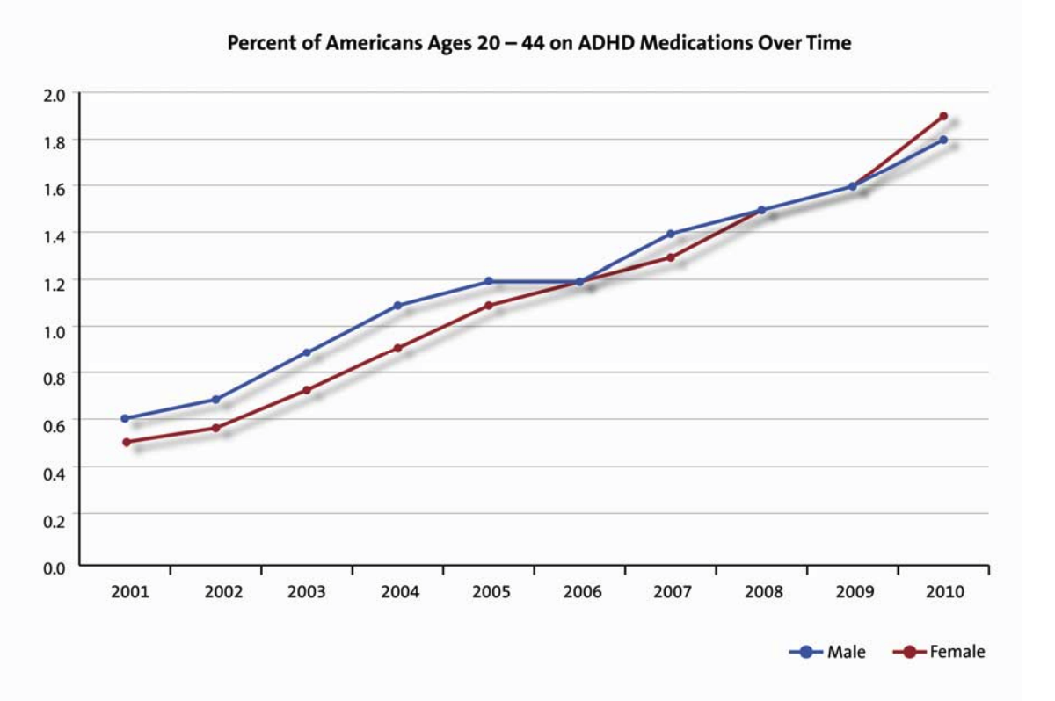

Slide 6
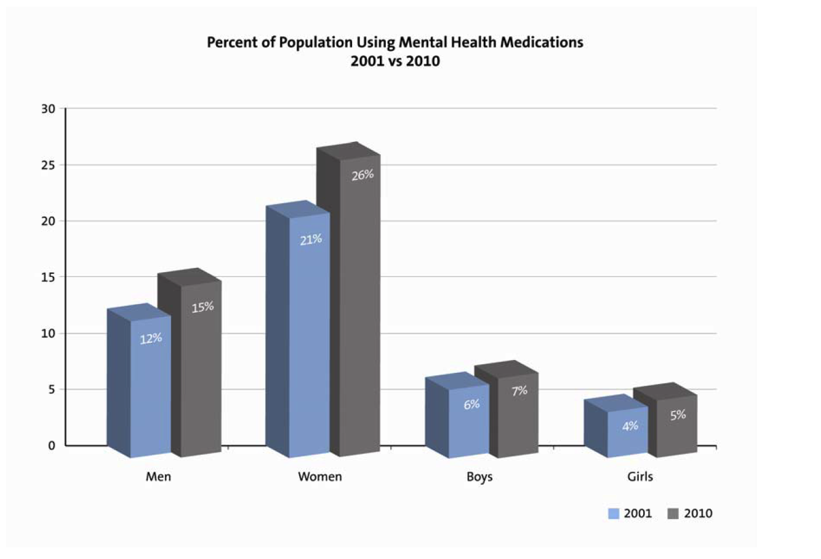

Slide 7
56-0122 - The Junction Time
95 And if they have been through all of these things, when all the world history is climaxing in this great drama… What’s the matter? What makes people so nervous? Why is it even psychiatrist are coming to be prayed for? Why is it the world’s in a nervous age, a neurotic age. When people can’t wait. “Thrrrrp [Brother Branham makes a speeding noise—Ed.],” down the street ninety miles an hour, stop at the beer joint, two hours ’fore they go home, run over people. What’s the matter? What’s everybody in such a hurry, you can’t visit your neighbor? You don’t have no friends. You don’t know who lives next door to you. You ain’t got time to do this. You’re in a hurry. What’s the matter? There’s a great drama being set. That’s right. And the lion-hungered nation are ravishing in. But just before he gets able to take it, God will take His Church.

Slide 8
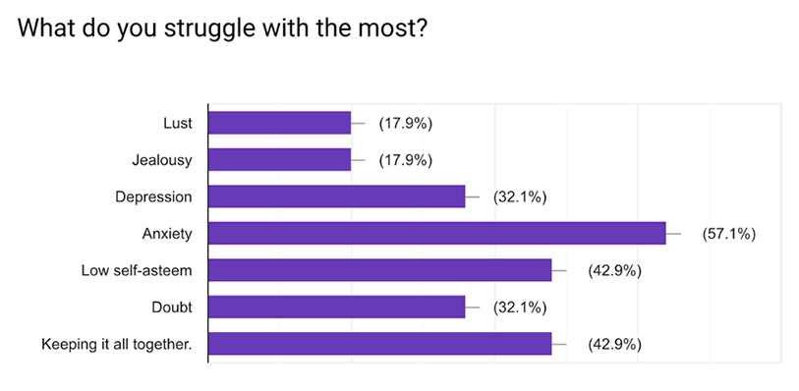

Slide 9
56-0814 - Divine Love And Sovereign Grace
And there’s one of the greatest hindrance that there is in the church today, and right here at Edmonton, and every… or not Edmonton, I didn’t mean to say that. I mean Prince Albert. And—and among other people everywhere is fear, but love, perfect love casteth out fear.

Slide 10
65-0829 - Satan's Eden
10 And—and in this nervous age that we’re living in…And I’m a nervous person, myself. Today I got my mind made up to something, “I’ve just got to do it,” and tomorrow it’s a million miles from me; something has done cut in and done this and that. And you have a time, trying to keep your wits together.

Slide 11
50-0820E - Believe Ye That I Am Able To Do This?
48 Let’s see your hand, sir. I have to see it some other way. You look this a way, sir, and believe with all…?… Now, it’s something different from what… I can’t… You have a few troubles, inward troubles. But not… There’s something, or you wouldn’t be weeping like that, for just merely for that. And it’s… I want you to look this way. And now, I’m not reading your mind, sir. I—I’m—I’m just trying to find out what’s wrong with you. Yes, sir. And I want you to… You believe that God will reveal to me what is wrong with you? You believe with all your heart? Yes, sir. I see what is wrong with you. You’ve tried everything in the world nearly to get well, haven’t you? You’ve been to doctors. Everything has turned you down. And it’s a nerve condition. Isn’t that right? That’s right. Nothing can help you. You’ve been given up. But Jesus will help you now. Do you believe me, brother? You believe it? Will you obey me as His servant now? You want to be healthy and have all that weary and gloomy and crazy feeling, like you’re losing your mind, and things like that? Now, I tell you where that started, on the prostate. See? But what really is doing it, it’s a demon. It haunts you. Isn’t that right? You have no peace at all. Day and night, it’s after you. Seems like you just get gloomy feelings in there. Isn’t that right? Yes, sir. Weary, don’t sleep, nervous, getting up…?… at night. Isn’t that right?

Slide 12
(continued)…….Down through your life, you’ve had a trouble…?… You once was…?… the line, walking…?… Isn’t that right? And you ask forgiveness for that…?… see it one time. Isn’t that right? May God give it to you. Isn’t that the truth? Every word of it. How would I know that except Christ Jesus would reveal that. That’s right. For no one would know that but God Himself alone. Isn’t that true? Now, I’m not reading your mind, but just telling you exactly what’s happened. Is that right? Yes, sir. 50 When you was a—when you was a child, a little boy, with knee pants on, you’ve got problems with something, run… I believe it’s a dog that chased you, or something (Isn’t that right?), a big dog, and you run to a porch. That’s right, I see it as a little boy. Is that the truth, sir? All right. Who would know that but God alone. Isn’t that but right? Oh, my. How marvelous. Now, His… Is that the things, the very truth, my brother? All right. Then I’m going to ask Him to let it leave you. Will you take my word now, and do as I tell you? Will you do it? Now, while I’m praying, you say, “Jesus, I believe with all my heart. And now, I commit myself to You. And I believe that prayer of faith is going to save me now.” You believe that? All right.

Slide 13
51 Let’s bow our heads together. Our heavenly Father, Thou art here to bless my brother. O Thou Son of God, Who’s able to reveal the very thoughts of our hearts, able to do all things, free this poor caged mortal; in a cage that he can’t free himself, like an eagle in a cage beating his wings until his weary eyes fall backwards. O Father, be merciful to him. Thy servant knows what he’s suffering. Thou demon tormenting his life, in the Name of Jesus Christ, the Son of God, come out of the man. Now, look here, sir. It’s gone. Now, you’re free. You go out of here testifying… You feel all right now? Fine. Wonderful. That’s… Go out of here rejoicing, testifying. Now, if I could tell you what happened to you when you was a little boy, down through the age, down to where you are right now, the life that you lived, the things that you’ve done, that was true, wasn’t it, every word, true? Now, I will tell you what will be the results in the coming future. Go out of here happy, singing, testifying, telling people God healed you, forget you ever was nervous. Thirty days from now, you will be a different man altogether. God bless you, my brother.

Slide 14
61-0207 - Expectation
And there’s only two elements in the world that controls the world tonight, that’s fear and faith. Russia’s trying to get everybody to fear them, and we’re trying to get everybody to have faith in God. Now, that’s the difference. That two element controls all nations, controls all people, controls all churches, controls individuals, is fear or faith. 20 Now, fear has no valuation in it, none whatever. It’s perfectly endless, it doesn’t… it hasn’t got one good thing about it. If I was to be shot in the morning, was going to be shot, what good would it do to have fear? What good would it do me? You say, “Well, what good would faith do you?” Faith could deliver me, but fear won’t help me a bit. You just get yourself all worked up and more nervous than ever when it comes time for the gun to fire. So let’s have faith.

Slide 15
55-1009 - The Way To Have Fellowship
26 That’s the trouble with man tonight; that’s what’s the trouble with people tonight; you’re scared. That’s the biggest curse there is on the Full Gospel people, or any other people; is because they are afraid. God has made the provision, but you’re afraid to take His Word for it. If you was—wasn’t afraid tonight, why, you would take your healing by faith, and know that God promised it, and the thing would just go plumb away from you. Afraid, scared… And I’ve noticed it. And that’s the reason I’m such a believer in healing. I know that if you can get away from that scare, and get love in its place, something’s going to happen.

Slide 16
(continued)…There’s only two faculties that govern a human, and one of them is—is faith, which brings results; and the other is fear, which has no value in it at all. Faith is of God. Fear is of the devil. Fear makes you weary; fear makes you wonder. And if I was going to die in the morning, what good would it do me to get all stewed up about it? What if I was going to be electrocuted in the morning, and my life had to end tomorrow morning, what good would that do me to worry about it? 27 “Well,” you say, “what good would it do to have faith?” Faith can sign my pardon, sure; there’s value in faith. Don’t be weary; don’t be scared; don’t be upset; just have faith and believe. And the only way you can have faith, you have to have love first, for love produces faith. For perfect love… Get it. Perfect love casts out all fear.

Slide 17
2 Timothy 1:7, “For God hath not given us the spirit of fear; but of power, and of love, and of a sound mind.”

Slide 18
64-0618 - The Presence Of God Unrecognized
71 Now, when He is not recognized, His power is al-…is always not revealed, when He is not recognized. No matter how much God is standing present, you’ve got to believe it. That’s all. 72 Like the woman with the blood issue. All them people passing by, and all of them standing up, saying, “There goes the Rabbi. That’s the Guy that claims to be a Prophet. This is the fanatic,” and all such as that. 73 But what happened? This little woman had an issue of blood, and she had heard about Him. And when she come down there, regardless of what anybody said, she recognized Who He was. And she said, “If I can only touch His garment!” See? 74 And when that genuine faith, in God, became a positive thing to her, what did it release? It released His power to heal her. It touched Him in such a way, He turned around and told her what was wrong with her, said, “Your faith has saved you.” What did? Faith!

Slide 19
1 John 4:18, “18 There is no fear in love; but perfect love casteth out fear: because fear hath torment. He that feareth is not made perfect in love.”
57-0806 - God Projecting His Love
Love has no fear. Love casts out fear. And I notice in my meetings, so much that when I come into the people… One of the great things I find among them is fear. And what makes fear is lack of confidence. If you lack confidence it’ll make you fear. But if you love, it casts away that fear. And that’s the way God wants His Church, not so many as charter members; He wants members that’s loyal, and loves, and believes, and has confidence in Him.

Slide 20
56-0814 - Divine Love And Sovereign Grace
And there’s one of the greatest hindrance that there is in the church today, and right here at Edmonton, and every… or not Edmonton, I didn’t mean to say that. I mean Prince Albert. And—and among other people everywhere is fear, but love, perfect love casteth out fear. So you… The reason you’re—you’re fearful is because the right temperance of love has never entered yet. When there’s real love, all fear passes away. When you really love the Lord… 16 Now, I’m not condemning you; I’m only trying to bring something to light that you could look at…

Slide 21
HEBREWS.CHAPTER.2.PART.2 57-0825E 58-147
The Bible said, "He ascended on high and give gifts unto men." There was a atmosphere hung over the earth of darkness, of gloom, of death, and weary. The prayers couldn't come up, because the atonement wasn't made, but He broke through that veil. He opened up the way. He broke the veil of sickness. He broke the veil of sin. He broke the veil of worry. He broke the veil of depressed. He broke every veil and made a highway for the wayfaring man walking up the King's highway.

Slide 22
Psalm 46:8-11, “Come, behold the works of the Lord, what desolations he hath made in the earth. He maketh wars to cease unto the end of the earth; he breaketh the bow, and cutteth the spear in sunder; he burneth the chariot in the fire. Be still, and know that I am God: I will be exalted among the heathen, I will be exalted in the earth. The Lord of hosts is with us; the God of Jacob is our refuge. Selah.“

Slide 23
59-0708E - Be Certain Of God
He holds the whole world in His hands. He just, “Phew!” Blows the stars off, made the solar system, spoke His Word, and it was so. The very dirt that you’re setting over is His Word made manifest. If it didn’t, where did it come from? The dirt that you’re walking on is His Word made manifest. He said, “Let there be…” And there was. I believe every Word that He said is the truth. No matter how long it lingers, it’s so anyhow.

Slide 24
John 14:27-28, “27 Peace I leave with you, my peace I give unto you: not as the world giveth, give I unto you. Let not your heart be troubled, neither let it be afraid.28 Ye have heard how I said unto you, I go away, and come again unto you. If ye loved me, ye would rejoice, because I said, I go unto the Father: for my Father is greater than I.”

