Slide 1
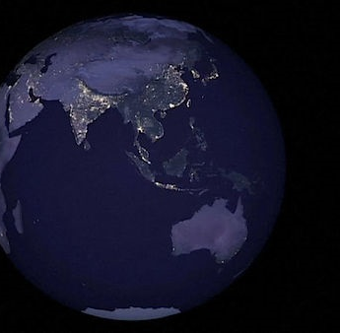
Our Eternal Place
HEBREWS 13:14
For here have we no continuing city, but we seek one to come.

Slide 2
Birthdays
Nov. 11th Ayden Stevens
Nov. 12th Bill Walters
Nov. 13th Julia Clayville
Nov. 14th Peggy Haney
Nov. 20th Jose Cockman
Nov. 22nd Thanksgiving

Slide 3
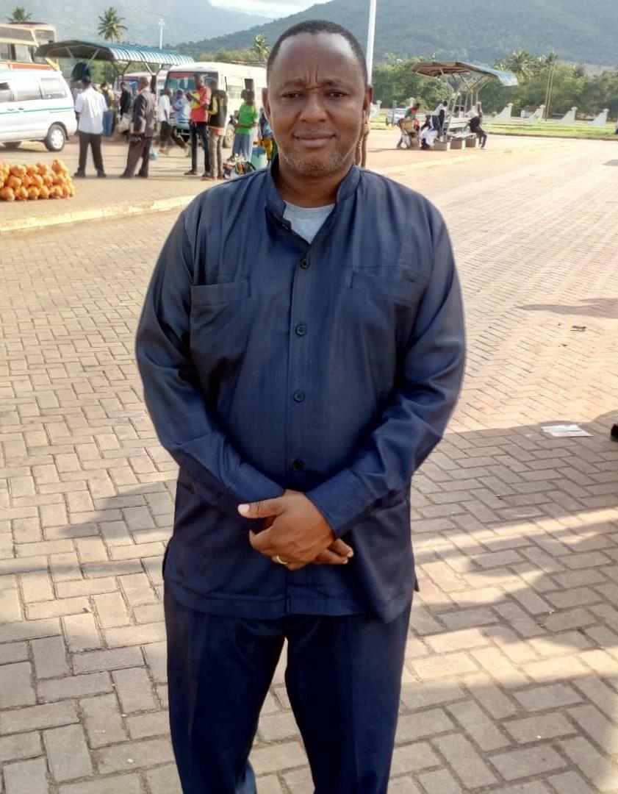
Pastor Moses;
Korogwe Church,
Tanga Region, TZ

Slide 4
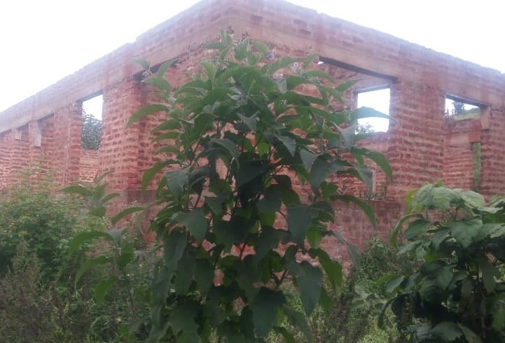

Slide 5
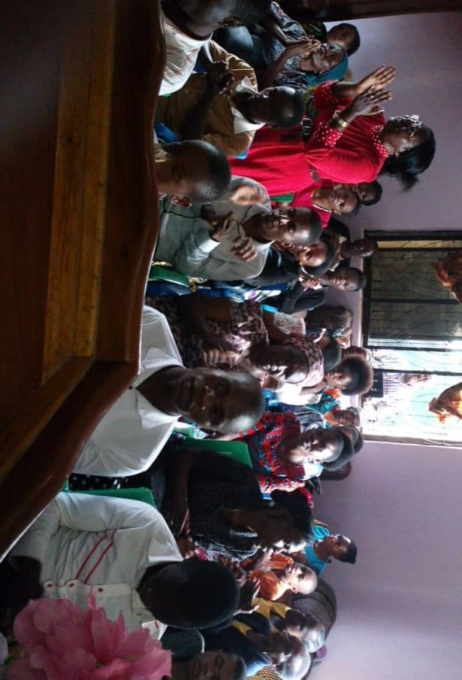

Slide 6
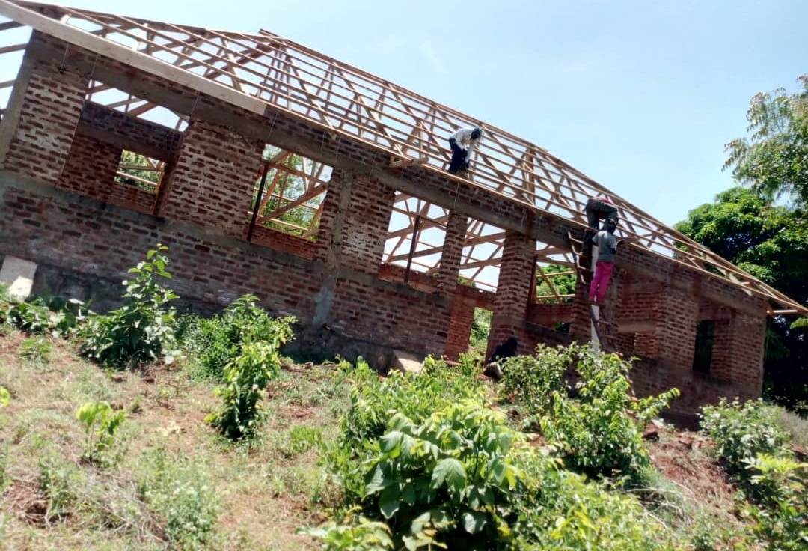

Slide 7
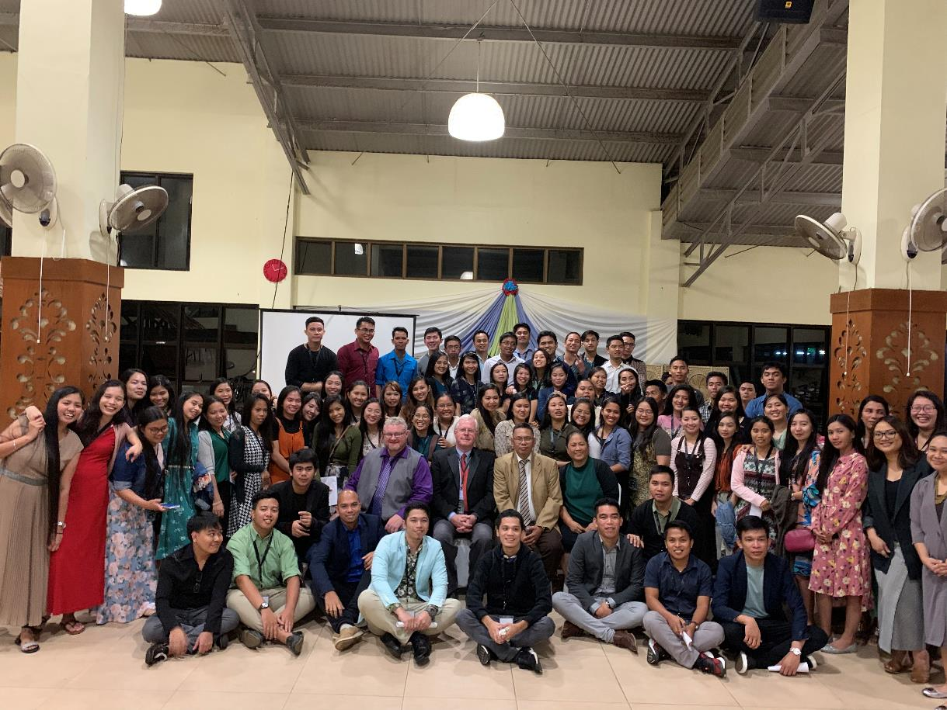
Tagatay, Philippines, November 2018

Slide 8
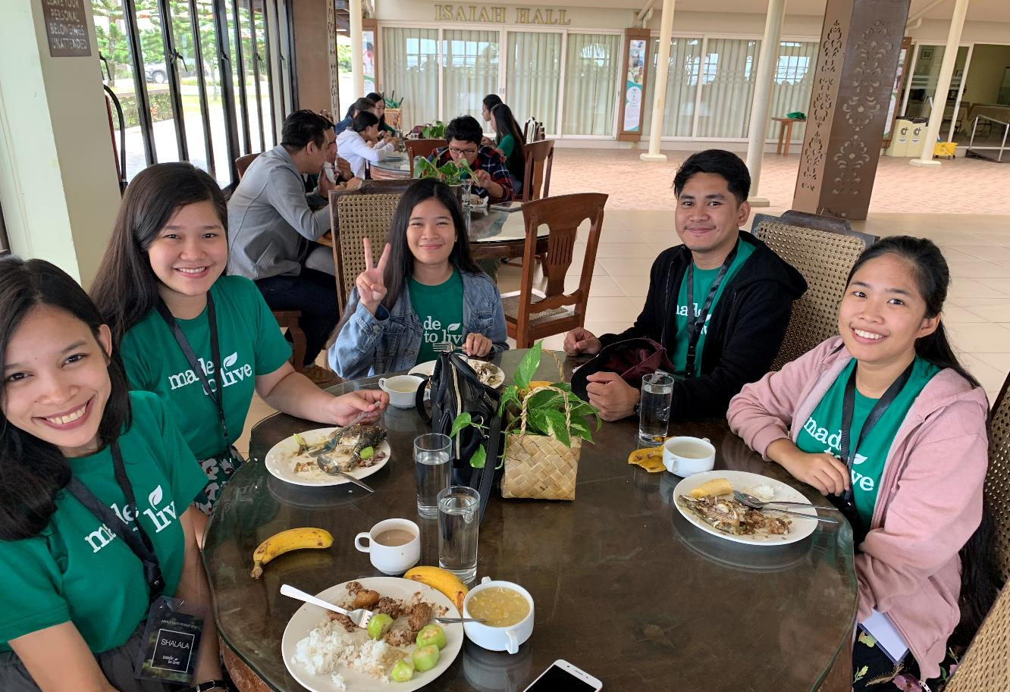

Slide 10
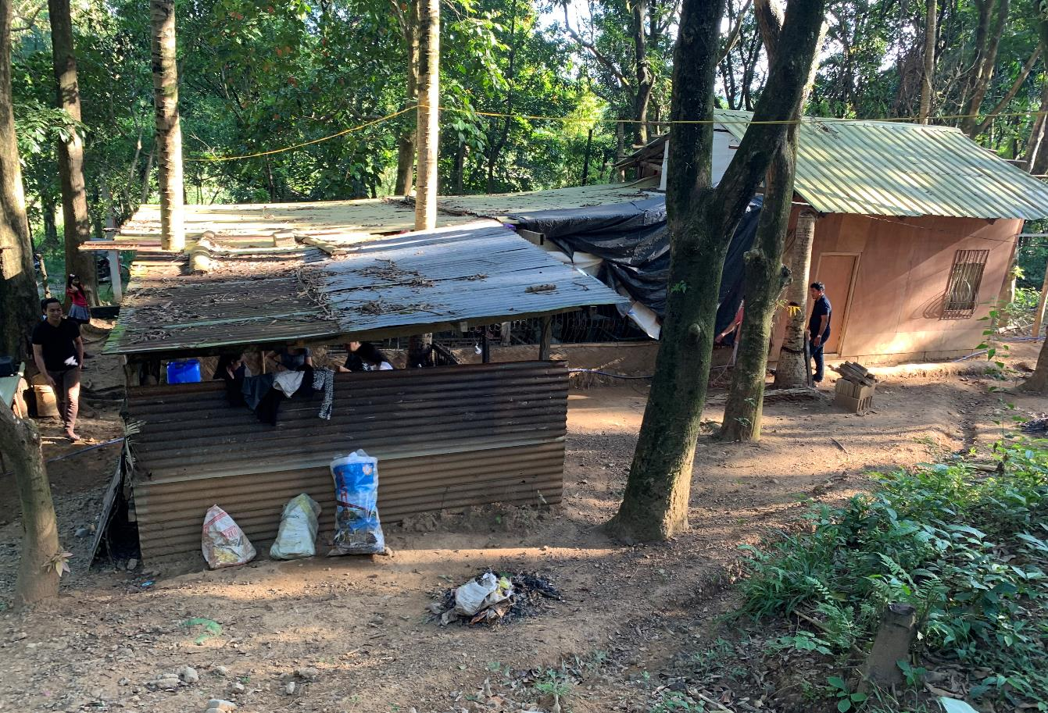

Slide 11
Our Eternal Place
HEBREWS 13:14
For here have we no continuing city, but we seek one to come.

Slide 12
WE.WOULD.SEE.JESUS
6 A man he used to work for us… seen him load a nine hundred pound ash log by himself. And I thought, the arm of that man, I said, "My, he will live a hundred and fifty years." But you know, he died at fifty-two.
It just shows that here we have no continuing city, but we are seeking one to come. We're seeking one which will last forever.
62-0627

Slide 13
QUESTIONS.AND.ANSWERS.3
34 I'm not a politician; I want to be a Christian. And this is not a place for politics. The whole thing's gone anyhow, that way, but this that we're talking about is eternal. Democrat or Republican...
Oh, it's such a mess; it can never be redeemed. It's over, so don't argue about that. The thing to do is live for this Kingdom. "For here we have no continuing city, but we seek one to come." Amen.
64-0830

Slide 14
MATTHEW 6:33
But seek ye first the kingdom of God, and his right-eousness; and all these things shall be added unto you.
Seek: (Gr.) zeteo
Strive after; require, demand: to crave, demand something from someone.
MATTHEW 2:13
“…the angel of the Lord appeareth to Joseph in a dream, saying, Arise, and take the young child and his mother, and flee into Egypt, and be thou there until I bring thee word: for Herod will seek the young child to destroy him.

Slide 15
AT.KADESH.BARNES
3 I drove down past the old Tabernacle and seen the cars out here. Brings back old memories of a long time ago, when used to come in, and have great services and last till two and three o'clock in the morning. The people just sets around together. You know, many of those old timers are up here in the grave today; I mean their bodies, but they're in glory. And generations keep coming on, the younger ones moving up. Won't be long till we'll be gone, another generation, the young ones take our place. So it behooves us to live every day just for the Lord, Him alone.
56-0527

Slide 16
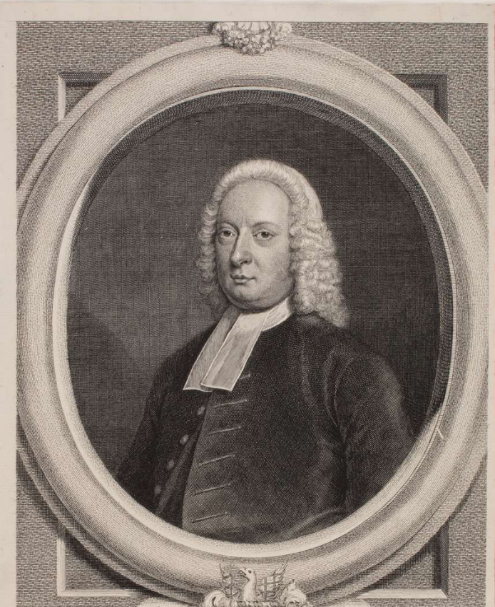
John Gill
Early life & Education
At the age of about 12, Gill heard a sermon from his pastor, William Wallis, on the text, "And the LORD God called unto Adam, and said unto him, Where art thou?" (Gen. 3:9).
The message stayed with Gill and eventually led to his conversion. It was not until six years later that he made a public profession when he was 18.

Slide 17
“…though it was the general case of the saints, in those times, to be obliged to flee from one city to another, having no certain dwelling place: and it may respect the common instability of this world, and of the state of the saints in it: this world, and all things in it, are unstable and transitory, the riches, honours, pleasures, and profits of it, and the persons in it, and even the world itself; the fashion of it passes away: the saints have no settlement and abiding here; they are not of it, though in it; and though they are in it, it is but for a time; and, when they have done the will of God, they are taken out of it; another place is prepared for them: they are but sojourners, and strangers, and pilgrims…”

Slide 18
So where do we go when we die or leave here?
II PETER 1:10
Wherefore the rather, brethren, give diligence to make your calling and election sure: for if ye do these things, ye shall never fall: 11 For so an entrance shall be ministered unto you abundantly into the everlasting kingdom of our Lord and Saviour Jesus Christ.

Slide 19
REVELATION 20:5
But the rest of the dead lived not again until the thousand years were finished. This is the first resurrection.
JOHN 14:1-3
Let not your heart be troubled: ye believe in God, believe also in me. 2 In my Father's house are many mansions: if it were not so, I would have told you. I go to prepare a place for you. 3 And if I go and prepare a place for you, I will come again, and receive you unto myself; that where I am, there ye may be also.

Slide 20
II CORINTHIANS 5:1
For we know that if our earthly house of this tabernacle were dissolved, we have a building of God, an house not made with hands, eternal in the heavens. 2 For in this we groan, earnestly desiring to be clothed upon with our house which is from heaven: 3 If so be that being clothed we shall not be found naked.
4 For we that are in this tabernacle do groan, being burdened: not for that we would be unclothed, but clothed upon, that mortality might be swallowed up of life.

Slide 21
WHO.IS.THIS.MELCHISEDEC
92 After [Samuel] had been dead, buried, rotted in the grave, here he was standing there in that cave, his prophet's robes on; still a prophet, for he said, "Why did you call me out of my rest, seeing you become a enemy to God?" Watch him prophesy. "Tomorrow night, by this time, you will be with me." He was still a prophet, though he was gone from this body.

Slide 22
See, he had become here and was part of that Word, entered from the flesh life back into the body that had been prepared for him before the foundation of the world. He entered into the theophany, which was the Word. You get it? That's where all believers go when we turn from here.
93 Then, in that form, the veil then is lifted. See, you are the Word, also, when you enter into there.
65-0221

Slide 23
GOD’S.PROVIDED.PLACE.OF.WORSHIP
21 You who trust me to tell you the Truth; the dear Lord Jesus, one morning let me see that Land. Now, it wasn't a vision, ever what it was, it was just as real as I'm speaking to you here. I seen the faces of those people, and I couldn't recognize them, they had turned back young again.
22 And it helped me, because I used to have an idea: when a person died, just their soul went off. But when He quoted that to me, "If this earthly tabernacle of our habitation be... we already have one."

Slide 24
And we got to have everything in threes, to make a perfection. And there's one body here, then that body there which is the celestial body, then the glorified body in the resurrection. See, that makes it complete. It's not a myth, idea, not a spirit. It is a man and a woman like you, just exactly.
23 And years ago, I seen the regions of the lost, was there. I tell you, friend, as an old man, let me persuade you, don't never want to view that place… As a minister, I couldn't describe to you. Talk about hell being a burning place, it's a million times worse than that, the horrors that goes with it. 65-1128

Slide 25
PROVING.HIS.WORD
235 …See, it's Son of man, Jesus Christ, will come down in human flesh among us, and will make His Word so real that it'll unite the Church and Him as one, the Bride, and then she'll go Home to the Wedding Supper. Amen. She's already united, we go to the Wed-ding Supper, not to the marriage. "...the marr-iage of the Lamb has come." But, the rapture, is going to the Wedding Supper. When, the Word here unites with the person, and they two become one.
64-0816

Slide 26
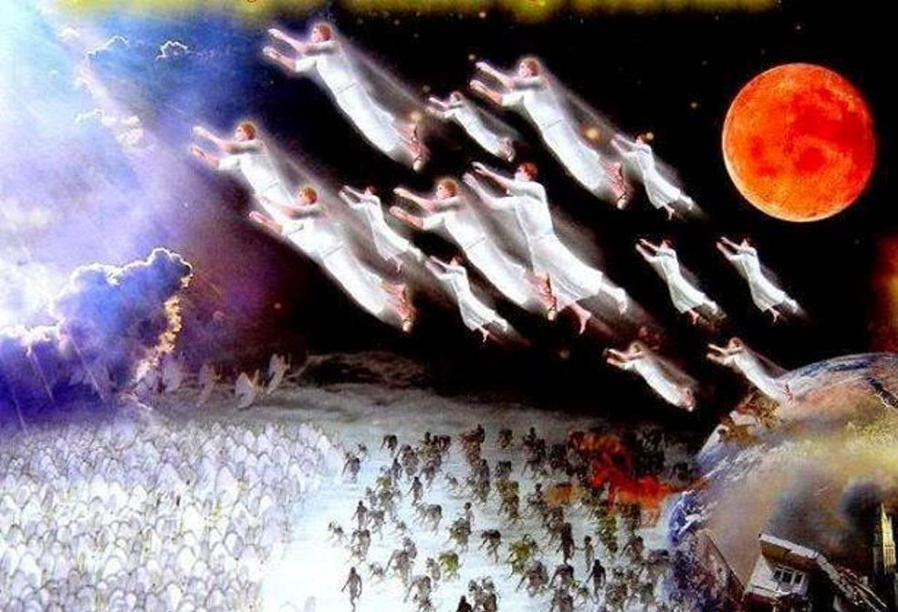

Slide 27
QUESTIONS.AND.ANSWERS.3 (64-0830)
362. Please explain the mystery of the translation of the Bride.
Just a change, our bodies now... Let's say our. You know what I mean when I say that? I don't mean to say ours; I don't mean to say this church; I mean to say every believer.
Abraham, He was looking for a promised son that was promised him. And the Bride is looking for the promised Son. Before the promised son could come to Sarah and Abraham, their bodies had to be changed.

Slide 28
WHO.IS.THIS.MELCHISEDEC
88 Then, after you recognized the very Word of God was Eagle Food, then you left the other thing. You have then been formed into the living image of the living God. You heard from your theophany.
"If this earthly tabernacle be dissolved," if you're an attribute of God expressed here on earth, "you've got a body waiting after you leave this world." There they was, standing on Mount Transfiguration, in their theophany. For, they were prophets to whom the Word came to.
65-0221

Slide 29
QUESTIONS.AND.ANSWERS (54-0515)
40. Will only those who have the baptism of the Holy Ghost be in the rapture of the church, or will all believers be indicated?
We haven't got time to justify that. But, brother, only the Holy Ghost Bride will be in the rapture. The others won't be lost. Who's going to judge the earth? Saints. (Daniel) The rapture, the church had gone on. Then they come down, and the judgment was set, and the Books were opened. Is that right? And another Book was opened which was the Book of Life (the sanctified believer that hadn't received the Holy Ghost).

Slide 30
274 Didn't Jesus teach that ten virgins went out to meet the Bridegroom, all of them were virgins, pure, holy. These went to sleep and didn't get the Holy Ghost; and these got the Holy Ghost, had Oil in their lamp.
276 To you women, when you lay down a pattern. It's a nice piece of goods, the same goods in it, but you take like this and lay your pattern just the way that you're going to cut it… It's just as good a goods as the rest of it, but by election you have chose that.

Slide 31
The rest of it is just as holy and just as good, and just as expensive as the rest of it, but that was your choice.
And God has promised that we are going in the rapture by election.
And the Bible said, "And the rest of the dead lived not for one thousand years." The rest of them will come through judgment; while they didn't.

Slide 32
CHURCH.AGES
364-1 Harvest time. Yes, harvest time. The two vines that grew together and intertwined their branches are now to be separated. The fruits of those vines which were at such variance will be gathered into separate garners. Both spirits go to their separate destinations.
It is time to heed the final call that comes only to the Wheat Bride, 'Come out of her My people that ye be not partakers of her sins, and that ye (wheat) receive not her (tares) plagues (great tribulation of the 6th seal, Matt. 24).

Slide 33
WHO.IS.THIS.MELCHISEDEC
78 When a man is born again, from Heaven, he becomes a spirit babe in Christ. And when this robe of flesh is dropped, there’s a natural body, theophany, a body not made with hands, neither born of a woman, that we go to. Then that body returns back and picks up the glorified body.
That's the reason Jesus went to hell when He died and preached to the souls that were in prison; turned back into that theo-phany. Oh, marvelous! Thank God!

Slide 34
79 2 Cor. 5:1, "If this earthly body be dissolved..." See, we have by-passed that, to come straight from God, the attribute; to be flesh, to be tempted and tested by sin, like Adam did. But when testing of His Word is over, we are taken up to this body that was prepared for us before the foundation of the world. It is the Word there we skipped, to come down here to be tempted, tested. If we'd have come through that, there'd have been no temptation; we'd a-knowed all things. That's the reason Jesus knowed all things, 'cause He was Word before He was flesh. 65-0221

Slide 35
When do we go?
And how do we get there?

Slide 36
TESTIMONY.OF.A.TRUE.WITNESS
263 Father, as life goes back to the root where it come from and waits for another season, we know that we're nearing another season. We can feel the changing of the spiritual atmosphere… that millennium, that next great season that's coming on; that Eternal season.
Change us now Lord, and fashion us, so that we can be citizens of that Kingdom.
61-1105

Slide 37
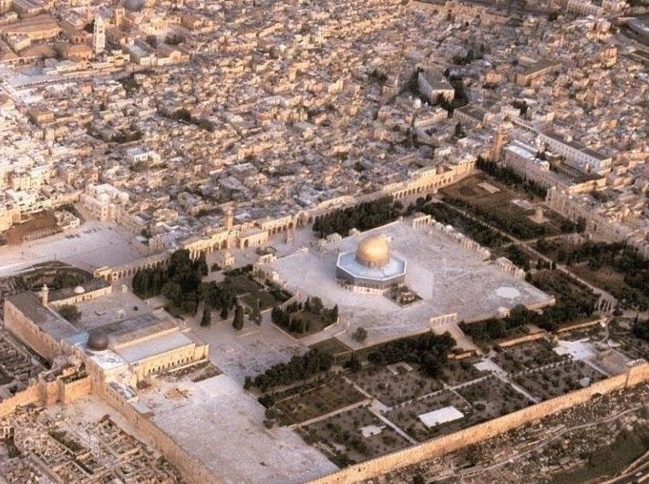
Israel
Amos 9:11-15

Slide 38
QUESTIONS.AND.ANSWERS
312 Will the prophecy of Ezekiel 38 and 39 be fulfilled before the rapture?
I think not. I think the next thing we look for is the rapture of the church.
54-0515

Slide 39
THE MARK OF THE BEAST
If you want to see what day of the month it is, look on the calendar. If you want to see what day in the season it is of the coming of the Lord, watch where Israel's setting. That's God's timepiece…
1961

Slide 40
Matt. 24:32 to Matt. 25:1, 6
Now learn a parable of the fig tree; When his branch is yet tender, and putteth forth leaves, ye know that summer is nigh: 33 So likewise ye, when ye shall see all these things, know that it is near, even at the doors. 34 Verily I say unto you, This generation shall not pass, till all these things be fulfilled.

Slide 41
THE.ONCOMING.STORM
149 Don't worry, the fig tree's putting forth its buds; that's the last sign… She was blinded for a little season, but she's coming together again. God promised it.
The end of the Gentiles will be then. They're looking for a Messiah. Jesus said, "When you see the fig tree putting forth its buds…" Israel begin to be restored. She's a full nation. What are we waiting for? The closing of the Gentiles.
60-0229

Slide 42
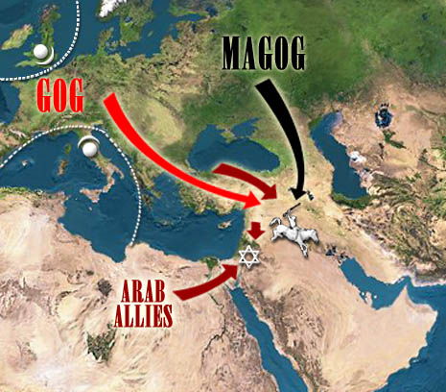
Gog & Magog

Slide 43
THE.CHURCH.OF.THE LIVING.GOD
51-0727
8 (Jn.5) God has seasons, and He had provisions made for that certain generation.
THE.RESURRECTION OF.LAZARUS 50-0813
24 He'll bring His Word to pass regardless. When the season comes, harvesters are ripe, God is going to send His Word and perform His things.

Slide 44
Acts 7:6
⁶ And God spake on this wise, That his seed should sojourn in a strange land; and that they should bring them into bondage, and entreat them evil four hundred years.

Slide 45
CHURCH.AGE.BOOK
298-3 …There is an overlapping, a melting or fading into, rather than an abrupt end and a clear cut start. If you can just think of the seasons, you can get a very good picture of this.
You can't tell exactly when summer became autumn--it just faded into it. That is how the ages are, and especially these last two.

Slide 46
I KINGS 18:29
30 And Elijah said unto all the people, Come near unto me. And all the people came near unto him. And he repaired the altar of the LORD that was broken down.

Slide 47
FROM.THAT.TIME
122 ....And this ministry of discern-ment is now leaving, and I'm stepping into a higher ministry of speaking the Word. And you see what God's done? He's put it right back into the lap of the people.
Let them come with the right approach and watch what happens. But they've got to have the right approach…
60-0716

Slide 48
COD
411-20 (Hattie Wright) And you've heard what's been taken place; that's the ministry that we're entering into. We're way up the road now… And we've got to have rapturing faith in a church that can be changed in a moment in a twinkling of an eye to go out, or we'll not go. But don't worry, it'll be there. And when the power of this church rises, it'll bring its brethren; the power of that church will bring the other brethren; then there'll be a general resurrection.
59-1219

Slide 49
TESTIMONY.OF.A.TRUE.WITNESS
83 …When we are in the season of mortal life, raising our children, marrying and bringing forth families, this is the season of mortal life… and there will come another season.
And that season that will come will be the immortal season. This is the wrong season now; this is mortal season. But immortal season is coming. 61-1105

Slide 50
HEBREWS 11:8-10
8 By faith Abraham, when he was called to go out into a place which he should after receive for an inheritance, obeyed; and he went out, not knowing whither he went. 9 By faith he sojourned in the land of promise, as in a strange country, dwelling in tabernacles with Isaac and Jacob, the heirs with him of the same promise: 10 For he looked for a city which hath foundations, whose builder and maker is God.

Slide 51
Israel
Amos 9:11-15

Slide 52
THE MARK OF THE BEAST
If you want to see what day of the month it is, look on the calendar. If you want to see what day in the season it is of the coming of the Lord, watch where Israel's setting. That's God's timepiece…
1961

Slide 53
Matt. 24:32 to Matt. 25:1, 6
Now learn a parable of the fig tree; When his branch is yet tender, and putteth forth leaves, ye know that summer is nigh: 33 So likewise ye, when ye shall see all these things, know that it is near, even at the doors. 34 Verily I say unto you, This generation shall not pass, till all these things be fulfilled.

Slide 54
AMOS 9:11-15
In that day will I raise up the tabernacle of David that is fallen, and close up the breaches thereof; and I will raise up his ruins, and I will build it as in the days of old: 12 That they may possess the remnant of Edom, and of all the heathen, which are called by my name, saith the LORD that doeth this. 13 Behold, the days come, saith the LORD, that the plowman shall overtake the reaper, and the treader of grapes him that soweth seed; and the mountains shall drop sweet wine, and all the hills shall melt.

Slide 55
14 And I will bring again the captivity of my people of Israel, and they shall build the waste cities, and inhabit them; and they shall plant vineyards, and drink the wine thereof; they shall also make gardens, and eat the fruit of them. 15 And I will plant them upon their land, and they shall no more be pulled up out of their land which I have given them, saith the LORD thy God.

Slide 56
THE.ONCOMING.STORM
149 Don't worry, the fig tree's putting forth its buds; that's the last sign… She was blinded for a little season, but she's coming together again. God promised it.
The end of the Gentiles will be then. They're looking for a Messiah. Jesus said, "When you see the fig tree putting forth its buds…" Israel begin to be restored. She's a full nation. What are we waiting for? The closing of the Gentiles.
60-0229

Slide 57
Gog & Magog

Slide 58
QUESTIONS.AND.ANSWERS
312 Will the prophecy of Ezekiel 38 and 39 be fulfilled before the rapture?
I think not. I think the next thing we look for is the rapture of the church.
54-0515

Slide 60
Four Facts to Remember:
1. God has already defeated Satan and his Program.
2. We have been Translated from the Kingdom of Darkness into the Kingdom of Light.
Giving thanks unto the Father, which hath made us meet to be partakers of the inheritance of the saints in light: 13 Who hath delivered us from the power of darkness, and hath translated us into the kingdom of his dear Son: COL. 1:12-13

Slide 61
3. The Spiritual Battle we fight involves a responsibility to put on the Spiritual protection God has provided for us.
4. The vast majority of Spiritual Warfare never needs to go beyond the regular practice of living out our position in Christ by faith.

Slide 62
THERE.IS.A.MAN.HERE.THAT.CAN
TURN.ON.THE.LIGHT
78 And it takes the Light of God to strike the Word, to make It live. Here is what He spoke [Bible], now let the Light shine! Amen! And the Light will bring every Word to Its right position, in its season… when it comes time!
63-1229

Slide 63
JEREMIAH 29:10
10 For thus saith the LORD, That after seventy years be accomplished at Babylon I will visit you, and perform my good word toward you, in causing you to return to this place.
11 For I know the thoughts that I think toward you, saith the LORD, thoughts of peace, and not of evil, to give you an expected end. 12 Then shall ye call upon me, and ye shall go and pray unto me, and I will hearken unto you.

Slide 64
Perform: (Gr.) pleroo
1) To make full, to complete; so that nothing shall be wanting to full measure.
2) to consummate: to carry through to the end, to accomplish. To carry into realization; of promises or prophecies; to cause God's will to be obeyed as it should be, and God's promises (given through the prophets) to receive fulfilment.
EZEKIEL 12:25
For I am the LORD: I will speak, and the word that I shall speak shall come to pass; it shall be no more prolonged: for in your days, O rebellious house, will I say the word, and will perform it, saith the Lord GOD.

Slide 65
13 And ye shall seek me, and find me, when ye shall search for me with all your heart. 14 And I will be found of you, saith the LORD: and I will turn away your captivity, and I will gather you from all the nations, and from all the places whither I have driven you, saith the LORD; and I will bring you again into the place whence I caused you to be carried away captive.

Slide 66
MATTHEW 1:21
And she shall bring forth a son, and thou shalt call his name JESUS: for he shall save his people from their sins. 22 Now all this was done, that it might be fulfilled which was spoken of the Lord by the prophet, saying, 23 Behold, a virgin shall be with child, and shall bring forth a son, and they shall call his name Emmanuel, which being interpreted is, God with us.

Slide 67
MATTHEW 8:16
When the even was come, they brought unto him many that were possessed with devils: and he cast out the spirits with his word, and healed all that were sick: 17 That it might be fulfilled which was spoken by Esaias the prophet, saying, Himself took our infirmities, and bare our sicknesses.

Slide 68
HEAR.YE.HIM
80 Pentecost has stayed in the wilderness today, wandering around and around the same hill. Married the young, buried the old, kissed the babies, raised crops, and prospered. And that's all right. But, brother, there's a promised land yonder, where all things are possible to him that believes. Every promise in the Book belongs to the church. Christ is the Word to come into the heart of a person and manifest that Word. "Well, I spoke in tongues." That's good. "See, Brother Branham, I got it.” 62-0711

Slide 69
COLOSSIANS 2:10-12
And ye are complete in him, which is the head of all principality and power: 11 In whom also ye are circumcised with the circumcision made without hands, in putting off the body of the sins of the flesh by the circumcision of Christ: 12 Buried with him in baptism, wherein also ye are risen with him through the faith of the operation of God, who hath raised him from the dead.

Slide 70
A.PARADOX
52 God speaks His Word, His children believes it and God. The science cannot prove how it can be done; they know nothing about it. But the children believe it, anyhow, and then God performs a paradox, makes it so. Makes it so, because His Word that spoke the world into existence, can bring, can make every word, that He ever promised, come to pass.
53 That's why Abraham staggered not at the promise of God… Because that he knowed that God could perform and (make) a paradox to happen on something, a miracle to take place, and He did it. 63-0801

Slide 71
DOES.GOD.CHANGE.HIS.MIND
212 I certainly honor the Lutheran for their stand in their day, the Methodist for sanctification in their day, and the Pentecostal for their stand in their day, but we're living in another day...
And now the denomination is pulling away from It, so It can lay in the Presence of the Son… This is the end of it… We're in a Wheat time, a harvest time. I can hear the great combine coming.
65-0427

