Slide 1
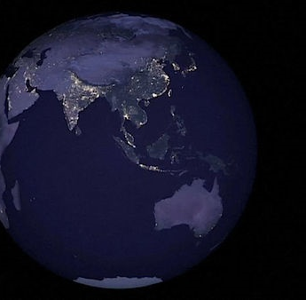
Our Eternal Place II
HEBREWS 13:14
For here have we no continuing city, but we seek one to come.

Slide 2
AN.UNCERTAIN.SOUND
13 Thou hast give us the commission, "Go into the city, heal the sick that's in that city and preach that the Kingdom is at hand."
And God we pray that You'll grant these things to us as Your servants, as Your ambassador, because we do believe that the Kingdom is at hand.
And help us to bring forth that Word in that manner, that people might see and believe on Thee.
61-0315

Slide 3
GOD'S.ONLY.PROVIDED.PLACE
20 And as I see the three of us getting... creeping up towards the aged, the end. Be a very sad thing if we didn't have placed within us that great thing, what we know is Truth. We're just fixing to turn back one of these days, back to our young manhood again... our bodies transformed, made into His likeness to stand. "For when this earthly tabernacle of our habitation be dissolved, there's one already waiting.“
65-1128

Slide 4
MATTHEW 6:33
But seek ye first the kingdom of God, and his right-eousness; and all these things shall be added unto you.
Seek: (Gr.) zeteo
Strive after; require, demand: to crave, demand something from someone.
MATTHEW 2:13
“…the angel of the Lord appeareth to Joseph in a dream, saying, Arise, and take the young child and his mother, and flee into Egypt, and be thou there until I bring thee word: for Herod will seek the young child to destroy him.

Slide 5
AT.KADESH.BARNES
3 I drove down past the old Tabernacle and seen the cars out here. Brings back old memories of a long time ago, used to come in, have great services and last till 2-3:00 o'clock in the morning. The people just sets around together… Many of those old timers are up here in the grave today; I mean their bodies, but they're in glory. And generations keep coming on, the younger ones moving up. Won't be long till we'll be gone, another generation, the young ones take our place. So it behooves us to live every day just for the Lord, Him alone.
56-0527

Slide 6
So where do we go when we die or leave here?

Slide 7
CHRIST.IS.THE.MYSTERY
579 Now, if I never see you again, remember, the Marriage Supper is at hand. And then the Kingdom according to the pro-mise is ready to be issued in, the great Millen-nium, the taking up of the Church, and the destroying of the wicked.
And the world, under the Sixth Seal, to be purified by volcanic, to take all the corruption and sin of the world and to mold her out again, and bring forth a bright new Millennium for the age that is to come.

Slide 8
580 When, we see all these, great threefold revelation: God in Christ; Christ in the Church; the Kingdom coming.
Adam and Eve redeemed back to the Garden of Eden, in the representation of Christ and His Bride, and then the Kingdom is going to be restored according to His promise. Praise be to God!
63-0728

Slide 9
REVELATION 20:5
But the rest of the dead lived not again until the thousand years were finished. This is the first resurrection.
JOHN 14:1-2
Let not your heart be troubled: ye believe in God, believe also in me. 2 In my Father's house are many mansions: if it were not so, I would have told you. I go to prepare a place for you.

Slide 10
II CORINTHIANS 5:1
For we know that if our earthly house of this tabernacle were dissolved, we have a building of God, an house not made with hands, eternal in the heavens. 2 For in this we groan, earnestly desiring to be clothed upon with our house which is from heaven: 3 If so be that being clothed we shall not be found naked.
4 For we that are in this tabernacle do groan, being burdened: not for that we would be unclothed, but clothed upon, that mortality might be swallowed up of life.

Slide 11
WHO.IS.THIS.MELCHISEDEC
92 After [Samuel] had been dead, buried, rotted in the grave, here he was standing there in that cave, his prophet's robes on; still a prophet, for he said, "Why did you call me out of my rest, seeing you become a enemy to God?" Watch him prophesy. "Tomorrow night, by this time, you will be with me." He was still a prophet, though he was gone from this body.

Slide 12
See, he had become here and was part of that Word, entered from the flesh life back into the body that had been prepared for him before the foundation of the world. He entered into the theophany, which was the Word. You get it? That's where all believers go when we turn from here.
93 Then, in that form, the veil then is lifted. See, you are the Word, also, when you enter into there.
65-0221

Slide 13
GOD’S.PROVIDED.PLACE.OF.WORSHIP
21 You who trust me to tell you the Truth; the dear Lord Jesus, one morning let me see that Land. Now, it wasn't a vision, ever what it was, it was just as real as I'm speaking to you here. I seen the faces of those people, and I couldn't recognize them, they had turned back young again.
22 And it helped me, because I used to have an idea: when a person died, just their soul went off. But when He quoted that to me, "If this earthly tabernacle of our habitation be... we already have one."

Slide 14
And we got to have everything in threes, to make a perfection. And there's one body here, then that body there which is the celestial body, then the glorified body in the resurrection. See, that makes it complete. It's not a myth, idea, not a spirit. It is a man and a woman like you, just exactly.
23 And years ago, I seen the regions of the lost, was there. I tell you, friend, as an old man, let me persuade you, don't never want to view that place… As a minister, I couldn't describe to you. Talk about hell being a burning place, it's a million times worse than that, the horrors that goes with it. 65-1128

Slide 15
WHO.IS.THIS.MELCHISEDEC
88 Then, after you recognized the very Word of God was Eagle Food, then you left the other thing. You have then been formed into the living image of the living God. You heard from your theophany.
"If this earthly tabernacle be dissolved," if you're an attribute of God expressed here on earth, "you've got a body waiting after you leave this world." There they was, standing on Mount Transfiguration, in their theophany. For, they were prophets to whom the Word came to.
65-0221

Slide 16
LIFE
23 Then that theophany was made flesh in the Person Christ Jesus. And then all the fullness of the Trinity dwelt in Him, both Father, Son, and Holy Spirit, all in that. And that's the very way we go, plumb back to the original beginning of God… And in that eternal Spirit of love and honesty comes down to make Its place in us.
And then when we die from this life, we go into the body which... If this earthly tabernacle is dissolved, we have a theophany to go into, a body celestial.

Slide 17
Then at the coming of the Lord Jesus, this body is picked from the earth again and made in a glorified state to live in His Presence forever. Then all the perversion, all the things that was in the perversion all goes out of existence. Flesh goes to its punishment. Hell opens up her mouth and swallows in all the evil and the perversion. And God and His beloved Church, His Bride, takes their stand for the eternities to roll on. That's the great hope of the Christian Church.
57-0602

Slide 18
LUKE 24:42-43
And they gave him a piece of a broiled fish, and of an honeycomb. 43 And he took it, and did eat before them.

Slide 19
THE.TRUE.EASTER.SEAL
136 But yet heaven is so many billions of light years beyond that, till it's not even thought of. How would we get there? It's the travel; it'll be with like the mind; it's so fast. It'll be faster... If you could think of heaven, that's how quick you'd be there. Jesus, after He was resurrected, came right through the walls, the doors, stood, and eat boiled fish and honeycomb. Hallelujah.
No sooner than life has gone out of this body we're in the Presence of God yonder. We only know as feet, inches, yards, miles, and so forth; we're in this earthbound system. But when we leave here, brother, oh, my, what a time. 61-0402

Slide 20
WHO.IS.THIS.MELCHISEDEC
78 When a man is born again, from Heaven, he becomes a spirit babe in Christ. And when this robe of flesh is dropped, there’s a natural body, theophany, a body not made with hands, neither born of a woman, that we go to. Then that body returns back and picks up the glorified body.
That's the reason Jesus went to hell when He died and preached to the souls that were in prison; turned back into that theo-phany. Oh, marvelous! Thank God!

Slide 21
79 2 Cor. 5:1, "If this earthly body be dissolved..." See, we have by-passed that, to come straight from God, the attribute; to be flesh, to be tempted and tested by sin, like Adam did. But when testing of His Word is over, we are taken up to this body that was prepared for us before the foundation of the world. It is the Word there we skipped, to come down here to be tempted, tested. If we'd have come through that, there'd have been no temptation; we'd a-knowed all things. That's the reason Jesus knowed all things, 'cause He was Word before He was flesh. 65-0221

Slide 22
When do we go?
And how do we get there?

Slide 23
TESTIMONY.OF.A.TRUE.WITNESS
263 Father, as life goes back to the root where it come from and waits for another season, we know that we're nearing another season. We can feel the changing of the spiritual atmosphere… that millennium, that next great season that's coming on; that Eternal season.
Change us now Lord, and fashion us, so that we can be citizens of that Kingdom.
61-1105

Slide 24
Acts 7:6
⁶ And God spake on this wise, That his seed should sojourn in a strange land; and that they should bring them into bondage, and entreat them evil four hundred years.
Season
of
Restoration

Slide 25
QUESTIONS.AND.ANSWERS
312 Will the prophecy of Ezekiel 38 and 39 be fulfilled before the rapture?
I think not. I think the next thing we look for is the rapture of the church.
54-0515

Slide 26
Season of
Restoration
I KINGS 18:29
30 And Elijah said unto all the people, Come near unto me. And all the people came near unto him. And he repaired the altar of the LORD that was broken down.

Slide 27
THE.CHURCH.OF.THE LIVING.GOD
51-0727
8 (Jn.5) God has seasons, and He had provisions made for that certain generation.
THE.RESURRECTION OF.LAZARUS 50-0813
24 He'll bring His Word to pass regardless. When the season comes, harvesters are ripe, God is going to send His Word and perform His things.

Slide 28
FROM.THAT.TIME
122 ....And this ministry of discern-ment is now leaving, and I'm stepping into a higher ministry of speaking the Word. And you see what God's done? He's put it right back into the lap of the people.
Let them come with the right approach and watch what happens. But they've got to have the right approach…
60-0716

Slide 29
COD
411-20 (Hattie Wright) And you've heard what's been taken place; that's the ministry that we're entering into. We're way up the road now… And we've got to have rapturing faith in a church that can be changed in a moment in a twinkling of an eye to go out, or we'll not go. But don't worry, it'll be there. And when the power of this church rises, it'll bring its brethren; the power of that church will bring the other brethren; then there'll be a general resurrection.
59-1219

Slide 30
TESTIMONY.OF.A.TRUE.WITNESS
83 …When we are in the season of mortal life, raising our children, marrying and bringing forth families, this is the season of mortal life… and there will come another season.
And that season that will come will be the immortal season. This is the wrong season now; this is mortal season. But immortal season is coming. 61-1105

Slide 31
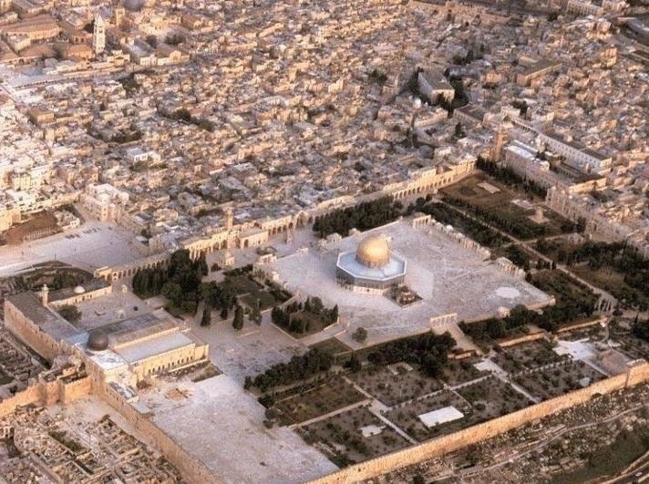
Israel
Season of Restoration

Slide 32
AMOS 9:11-15
In that day will I raise up the tabernacle of David that is fallen, and close up the breaches thereof; and I will raise up his ruins, and I will build it as in the days of old: 12 That they may possess the remnant of Edom, and of all the heathen, which are called by my name, saith the LORD that doeth this. 13 Behold, the days come, saith the LORD, that the plowman shall overtake the reaper, and the treader of grapes him that soweth seed; and the mountains shall drop sweet wine, and all the hills shall melt.

Slide 33
14 And I will bring again the captivity of my people of Israel, and they shall build the waste cities, and inhabit them; and they shall plant vineyards, and drink the wine thereof; they shall also make gardens, and eat the fruit of them. 15 And I will plant them upon their land, and they shall no more be pulled up out of their land which I have given them, saith the LORD thy God.

Slide 34
THE.ONCOMING.STORM
149 Don't worry, the fig tree's putting forth its buds; that's the last sign… She was blinded for a little season, but she's coming together again. God promised it.
The end of the Gentiles will be then. They're looking for a Messiah. Jesus said, "When you see the fig tree putting forth its buds…" Israel begin to be restored. She's a full nation. What are we waiting for? The closing of the Gentiles.
60-0229

Slide 35
Matt. 24:32 to Matt. 25:1, 6
Now learn a parable of the fig tree; When his branch is yet tender, and putteth forth leaves, ye know that summer is nigh: 33 So likewise ye, when ye shall see all these things, know that it is near, even at the doors. 34 Verily I say unto you, This generation shall not pass, till all these things be fulfilled.

Slide 36
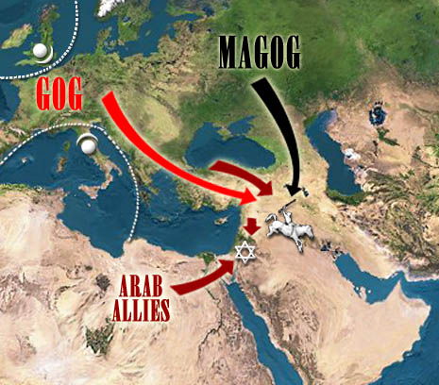
Season
of
Judgement
Gog & Magog

Slide 37
QUESTIONS.AND.ANSWERS
312 Will the prophecy of Ezekiel 38 and 39 be fulfilled before the rapture?
I think not. I think the next thing we look for is the rapture of the church.
54-0515

Slide 39
Four Facts to Remember:
1. God has already defeated Satan and his Program.
2. We have been Translated from the Kingdom of Darkness into the Kingdom of Light.
Giving thanks unto the Father, which hath made us meet to be partakers of the inheritance of the saints in light: 13 Who hath delivered us from the power of darkness, and hath translated us into the kingdom of his dear Son: COL. 1:12-13

Slide 40
3. The Spiritual Battle we fight involves a responsibility to put on the Spiritual protection God has provided for us.
4. The vast majority of Spiritual Warfare never needs to go beyond the regular practice of living out our position in Christ by faith.

Slide 41
THERE.IS.A.MAN.HERE.THAT.CAN
TURN.ON.THE.LIGHT
78 And it takes the Light of God to strike the Word, to make It live. Here is what He spoke [Bible], now let the Light shine! Amen! And the Light will bring every Word to Its right position, in its season… when it comes time!
63-1229

Slide 42
JEREMIAH 29:10
10 For thus saith the LORD, That after seventy years be accomplished at Babylon I will visit you, and perform my good word toward you, in causing you to return to this place.
11 For I know the thoughts that I think toward you, saith the LORD, thoughts of peace, and not of evil, to give you an expected end. 12 Then shall ye call upon me, and ye shall go and pray unto me, and I will hearken unto you.

Slide 43
Perform: (Gr.) pleroo
1) To make full, to complete; so that nothing shall be wanting to full measure.
2) to consummate: to carry through to the end, to accomplish. To carry into realization; of promises or prophecies; to cause God's will to be obeyed as it should be, and God's promises (given through the prophets) to receive fulfilment.
EZEKIEL 12:25
For I am the LORD: I will speak, and the word that I shall speak shall come to pass; it shall be no more prolonged: for in your days, O rebellious house, will I say the word, and will perform it, saith the Lord GOD.

Slide 44
13 And ye shall seek me, and find me, when ye shall search for me with all your heart. 14 And I will be found of you, saith the LORD: and I will turn away your captivity, and I will gather you from all the nations, and from all the places whither I have driven you, saith the LORD; and I will bring you again into the place whence I caused you to be carried away captive.

Slide 45
MATTHEW 1:21
And she shall bring forth a son, and thou shalt call his name JESUS: for he shall save his people from their sins. 22 Now all this was done, that it might be fulfilled which was spoken of the Lord by the prophet, saying, 23 Behold, a virgin shall be with child, and shall bring forth a son, and they shall call his name Emmanuel, which being interpreted is, God with us.

Slide 46
MATTHEW 8:16
When the even was come, they brought unto him many that were possessed with devils: and he cast out the spirits with his word, and healed all that were sick: 17 That it might be fulfilled which was spoken by Esaias the prophet, saying, Himself took our infirmities, and bare our sicknesses.

Slide 47
HEAR.YE.HIM
80 Pentecost has stayed in the wilderness today, wandering around and around the same hill. Married the young, buried the old, kissed the babies, raised crops, and prospered. And that's all right. But, brother, there's a promised land yonder, where all things are possible to him that believes. Every promise in the Book belongs to the church. Christ is the Word to come into the heart of a person and manifest that Word. "Well, I spoke in tongues." That's good. "See, Brother Branham, I got it.” 62-0711

Slide 48
COLOSSIANS 2:10-12
And ye are complete in him, which is the head of all principality and power: 11 In whom also ye are circumcised with the circumcision made without hands, in putting off the body of the sins of the flesh by the circumcision of Christ: 12 Buried with him in baptism, wherein also ye are risen with him through the faith of the operation of God, who hath raised him from the dead.

Slide 49
A.PARADOX
52 God speaks His Word, His children believes it and God. The science cannot prove how it can be done; they know nothing about it. But the children believe it, anyhow, and then God performs a paradox, makes it so. Makes it so, because His Word that spoke the world into existence, can bring, can make every word, that He ever promised, come to pass.
53 That's why Abraham staggered not at the promise of God… Because that he knowed that God could perform and (make) a paradox to happen on something, a miracle to take place, and He did it. 63-0801

Slide 50
DOES.GOD.CHANGE.HIS.MIND
212 I certainly honor the Lutheran for their stand in their day, the Methodist for sanctification in their day, and the Pentecostal for their stand in their day, but we're living in another day...
And now the denomination is pulling away from It, so It can lay in the Presence of the Son… This is the end of it… We're in a Wheat time, a harvest time. I can hear the great combine coming.
65-0427

