Slide 1
Babylon
JEREMIAH 51:6
Flee out of the midst of Babylon, and deliver every man his soul: be not cut off in her iniquity; for this is the time of the LORD'S vengeance; he will render unto her a recompence.

Slide 2
WHY.ARE.WE.NOT.A.DENOMINATION
57 Now, notice the woman, the church; she was Mystery Babylon. We see her appear by Nimrod. What was Nimrod's purpose? Nimrod founded a city and caused all of the other cities to pay tribute to this city. Could we see such a thing today? Is there such a place today?
Is there a church that has domination over every nation in the world? Certainly. Is there a place today that makes every nation pay tribute to it?
58-0927

Slide 3
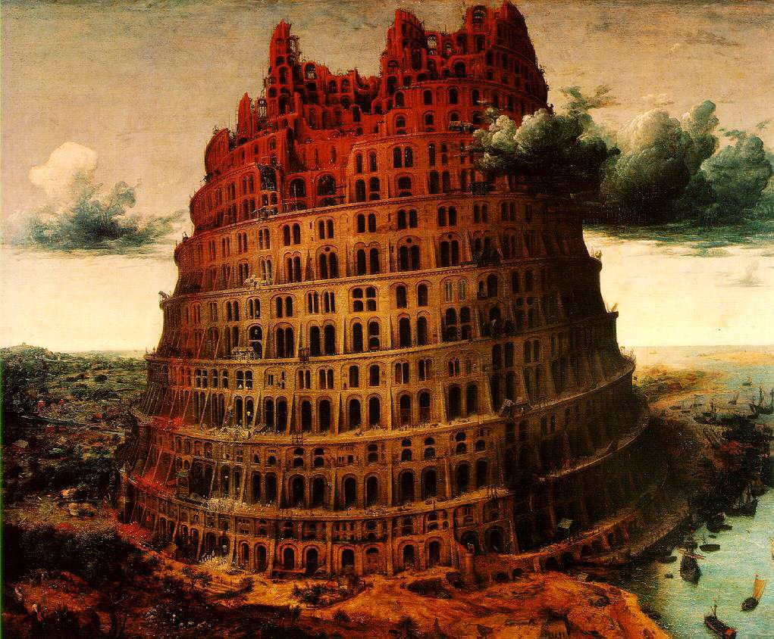
The Little Tower of Babel
Pieter the Elder Bruegel (c. 1563)

Slide 4
Literal Babylon vs. Mystery Babylon
The physical city of Babylon was originally built by Nimrod after the flood. It was located on the Euphrates River, about 55 miles south of where Baghdad, Iraq stands today. The name Babylon came from the Tower of Babel that was constructed there.
Babylon became a large city of global prominence around 1728 BC during the reign of Hammurabi. The glory years of Babylon were achieved under Nebuchadnezzar II (604-562 BC).
The city declined during the reign of Belshazzar, and came to ruin when Xerxes, the Persian king, destroyed it in 478 BC.

Slide 5
The Babylon described in Revelation is called “Mystery Babylon.” The prophecy of Mystery Babylon is found in Rev. 17:3-5.
“So he carried me away in the spirit into the wilderness: and I saw a woman sit upon a scarlet colored beast, full of names of blasphemy, having seven heads and ten horns. And the woman was arrayed in purple and scarlet color, and decked with gold and precious stones and pearls, having a golden cup in her hand full of abominations and filthiness of her fornication: And upon her forehead was a name written, MYSTERY, BABYLON THE GREAT, THE MOTHER OF HARLOTS AND ABOMINATIONS OF THE EARTH.”

Slide 6
WHY.ARE.WE.NOT.A.DENOMINATION
185 And none of these other church ages… never did pick up that Name again, never got that Name, 'cause it went out during this time.
Now, oh, how we could lay that on to them false teachings now, right there, show you it's a mother, the Catholic church the mother of all of it, how she's "Mother, Mystery, Babylon.“
58-0927

Slide 7
WHY.I'M.AGAINST.ORGANIZED.RELIGION
218 Notice, this is the angel of Light, the last angel, it's the angel in the church age to the Laodicea. It's the Laodicea messenger, because the next chapter is the 19th, which is the coming Bride. And this is the last angel that came to bring Light before the coming of the Bride to go meet Christ. It was the Laodicean Church Age, then. What was the Laodicean Church Age messen-ger? Calling them out of Babylon! Churches caught in her cage with her, with her dogmas, denying the Word and accepting dogmas.
62-1111

Slide 8
WHY.I'M.AGAINST.ORGANIZED.RELIGION
205 Now, here comes another messenger coming down, next chapter, her mystery was discovered. Now, this is now the discovery of her mystery and her children's mystery. See, we understand now exactly what made her a harlot: because she committed adultery against God's Word… what made her an organization.
She couldn't stay a Bible church and accept that. And neither can any organization that don't take every Word of It (the way It's wrote) ever be a Bible church…

Slide 9
208 Look, immediately after her mystery was made known, who she was, what she was, who her daughters was, the mystery has been made known, God sent an angel, a messenger to call out. "Come out!" The Message of the hour!
...Come out of her, my people, that you be not partakers of her plagues...He's going to curse her.
208 Come out of her! God sent a messenger. And his Light wasn't in a corner, It scattered over the earth… To lighten the earth and call His people out of her. A messenger was sent from Heaven, to call God's people out of Babylon.

Slide 10
213 You preachers that stand in the pulpit and let them women get by with that, shame on you, to make your denominational more. God will require that of your hand. Come out of it! "My sheep hear My Voice." A cage of hateful, heady, high-minded, lovers of pleasure more than lovers of God, would rather be like the world than to be like Christ. When you see a woman with a lot of makeup on, it goes to show she's empty inside. She's false inside. That's exactly right. I seen one the other day, with a green hair, that's right, of all that green stuff there in their eyes.
62-1111

Slide 11
THE.HANDWRITING.ON.THE.WALL
25 Daniel, an alien away from home, but watch what he did. He purposed in his heart that he wouldn't defile himself with the king's doings down there, all the king's fancy foods and all of his dainties that he was to eat upon and his wines, and liquors. But he purposed in his heart, while he was an alien, he'd keep hisself for God.
Though the world forsake you, everybody laughs and calls you every fanatical name, purpose in your heart to do that which is right, that you'll have nothing to do with the world. 56-0902

Slide 12
SPEAK.TO.THE.ROCK
37 My opinion of culture is a man that hasn't got nerve enough to kill a rabbit but can eat a bellyful of it if somebody else kills it. What we need today's not culture. What we need today is the Holy Ghost to bring faith in us to the Word of the living God.
In this great day of education, of science, what does that mean to God? The science one time built a great big tower, was going to reach all the way into heaven. And God just set and laughed at their ignorance. And the thing He done; He sent a little tongues movement down there and confused the whole thing. 60-0723

Slide 13
LET.YOUR.LIGHT.SO.SHINE.BEFORE.MEN
8 Lady, oneime, told me, "Bro. Branham, do you mean to tell me you hunt rabbits?“ I said, "Yes, ma'am.“ And she said, "Oh, that's ridiculous. You shouldn't shoot those rabbits. Then, season wasn't over till the same lady said, "Would you bring me a couple of those rabbits? They're the finest things I ever eat.“ I said, "Well, I guess that's what I call culture." And someone said, "What do you mean?“

Slide 14
I said, "That lady has culture. Culture is someone who hasn't got nerve enough to kill a rabbit, but they eat after someone else has killed it."
9 I'm a conservationist. I do not believe in killing and wasting. I teach my boys, them who are hunting with me, never take nothing 'less you're fixing to eat it. Leave it alone. Don't shoot a bird just for a target. See, that's not right. Got a target? Set it up out there and shoot at it.
61-0903

Slide 15
TOTAL.SEPARATION
32 It is a total separation. We're not to go back into the world no more, or have anything to do with the world, but cleave only unto God. Jesus is coming after a Bride, a Woman, a Church that's separated from the things of the world, or the cares of the world. She is separated from the fashions of this modern age that we live in.
She is separated from the cares and the traditions of churches. She is separated only to God, and God is the Word. 64-0121

