Slide 1
Life Cultivation 101
Romans 8:14-17, “For as many as are led by the Spirit of God, they are the sons of God.”

Slide 2
Acts 15:37-41

Slide 3
1 Corinthians 15:10
1 Corinthians 15:10, “But by the grace of God I am what I am: and his grace which was bestowed upon me was not in vain; but I laboured more abundantly than they all: yet not I, but the grace of God which was with me.”
2 Timothy 4:11, “Only Luke is with me. Take Mark, and bring him with thee: for he is profitable to me for the ministry.”

Slide 4
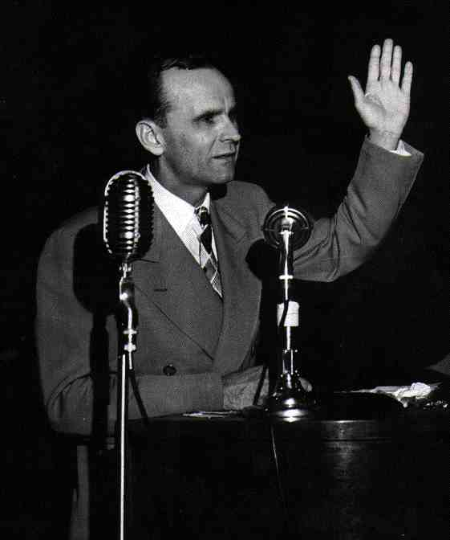
“I listened to what people told me instead of what God told me to do.”

Slide 5
What is the Spirit of The Word?
2 Corinthians 3:6, “6 Who also hath made us able ministers of the new testament; not of the letter, but of the spirit: for the letter killeth, but the spirit giveth life.”
62-0713 - From That Time
I’ll tell you, a genuine Holy Spirit experience will punctuate every sentence of that Bible with a “Amen.” Right. Regardless of what anybody else says, it’ll certainly do it, because It’s the Spirit of God, the Writer of the Bible. And the Spirit—the Spirit of the Word is the Holy Spirit. That’s what quickens It. The letter killeth, the Spirit giveth It Life (See?), gives the letter, just the printed letter, Life, makes It manifest, brings It to pass exactly what God promised.

Slide 6
Thought > Word > Reality
57-0306 - God Keeps His Word #1 “And if there’s one thing, when I stand at the judgment bar, I don’t want to have to give an account for a bunch of illegitimate born children. I’m going to preach to them the Word, the Word of God; and they have the Spirit of the Word, or they don’t have it at all. It’s God’s Spirit comes by the Seed of God, is a Word of God that’s planted in your heart that brings Christ Jesus, not some emotion, not some fantastic. What a time we’re living in.”

Slide 7
The Holy Spirit moves upon His Word.
56-0101 - Why Are People So Tossed About?
A Christian has to have…His faith has to have a solid resting place. You know that. And the only resting place that a Christian, a true, born-again Christian can rest his faith, or hers, is upon the unmovable Word of God. It isn’t built upon the shifting sands of men’s theology and—and doctrines, and upon some church affiliation. But, a true believer, his faith rests solidly, unshifting, as he approaches the Word of God.

Slide 8
Cultivate the Seed.
52-0224 - Believing God
133 Now when God gets rich and deep down here! See, more you get of God in here, more you’ll believe God, because there is more of Him. And the more you cultivate this down here, the more you can believe God. Just like a child, when he’s a little bitty fellow, maybe he doesn’t know very much about It, but, as he grows older, he begins to get knowing more of God. And that’s when this spirit in here takes the nature of our Heavenly Father, Who is God, like I take the nature of my earthly father from my earthly parent.

Slide 9
The Data: Two Questions
Do you read your Bible everyday?
Have you read the church age book from cover to cover?
Do you feel like you have a relationship with Jesus Christ.

Slide 10
Do you read your Bible everyday?

Slide 11
Have you read the Church Age book from cover to cover?

Slide 12
Do you feel like you have a relationship with Jesus Christ?

Slide 13
“Our relationship must be right with God before it can be right with man.” ― Billy Graham
55-0403 - Fellowship By Redemption
Quit your formal worship and get into fellowship with Him once. Stop this going to church on Sunday and saying a little prayer every night before you go to bed, and really get out and come into fellowship. My. You'll hurry up and wash the dishes so you get back to fellowship again, reading the Word, talking with Him. That's what we need. That's what the world needs today, Christian friend. That's what you need. That's what I need. That's what the whole world needs, is back to fellowship, to fellowship with Him, know Him.

Slide 14
How to cultivate a life lived in the Spirit of the Scriptures.

Slide 15
Major Point (maybe 1): Stay in the Word.
54-0513 - The Mark Of The Beast
And if you don’t think no more of God than get down and read your Bible, and pray and ask God, then it goes to show you’re not very interested in your soul.
2 Timothy 3:16-17, “All scripture is given by inspiration of God, and is profitable for doctrine, for reproof, for correction, for instruction in righteousness: 17 That the man of God may be perfect, thoroughly furnished unto all good works.”
Romans 15:4, “For whatsoever things were written aforetime were written for our learning, that we through patience and comfort of the scriptures might have hope.”

Slide 16
Try meditation…
Psalm 1:2, “But his delight is in the law of the Lord; and in his law doth he meditate day and night.”
Joshua 1:8, “This book of the law shall not depart out of thy mouth; but thou shalt meditate therein day and night, that thou mayest observe to do according to all that is written therein: for then thou shalt make thy way prosperous, and then thou shalt have good success.”

Slide 17
Major Point (maybe 2): Get Alone With God
Matthew 6:6, “But thou, when thou prayest, enter into thy closet, and when thou hast shut thy door, pray to thy Father which is in secret; and thy Father which seeth in secret shall reward thee openly.”
55-1009 - The Way To Have Fellowship
Down in there I take my rifle of a morning, sometimes before daylight, and go way alone into the mountain, set my rifle down, set down on top of the mountain, where I could look out; and there I talk to God the rest of the day. Sometimes stay two days, maybe more than that, right there under that tree, or wherever I be, or in a rock. It isn’t so much hunting; it’s getting alone with God.

Slide 18
Contend with “self” when alone.
“I am more afraid of my own heart than of the pope and all his cardinals. I have within me the great pope, Self.”
Martin Luther

Slide 19
Major Point (3): Be Honest
Proverbs 11:3, “The integrity of the upright shall guide them: but the perverseness of transgressors shall destroy them.”
57-0303A - Why Is It That So Many Christians Find It So Hard To Live The Christian Life?
Be in prayer. I just feel… I don’t know. I just feel that someone’s not just exactly honest with yourself. And if you won’t be honest with yourself, how can you ever be honest with God? How could you? God bless you, sir. You… If you, in your own heart know that you’re not living a joyful, peaceful, life of the Spirit, yielded to the Potter, everything just wonderful… God’s on the scene. And you won’t be honest enough with yourself to come receive it, how could you be honest enough with God? See? Come down. 65 There’s numbers of you here ought to be standing here. Don’t tell me I don’t know, for I do. Not me, but the Spirit of God tells me so. See?

Slide 20
Major Point (4): Think of good things.
Philippians 4:8, “Finally, brethren, whatsoever things are true, whatsoever things are honest, whatsoever things are just, whatsoever things are pure, whatsoever things are lovely, whatsoever things are of good report; if there be any virtue, and if there be any praise, think on these things.”

Slide 21
Major Point (5): Be yourself because He lives in you.
56-0101 - Why Are People So Tossed About?
And when Christ, the Holy Spirit, comes into your heart, He is in you with your temperament, and He is living His Own Life through His Own will, through you. Hallelujah! I know that sounds awful, but it’s right. Christ; so yielded you are, that Christ speaks the kind of words He would speak. He thinks the kind of thoughts He would think, through you. He does the kind of works He would do, through you. You are yielded and resting. What a beautiful picture of a consecrated Christian, yielded, God is working through.
Ephesians 2:10, “For we are his workmanship, created in Christ Jesus for good works, which God prepared beforehand, that we should walk in them.”

Slide 22
Be yourself.
62-0711 - Hear Ye Him
Now, just be yourself, simple, humble, waiting for the coming of the Lord. Now, we don’t believe in glamour, something shining.
61-0415B - From That Time
You see, and just—just be yourself. I hate to see anybody try to put on something that they’re really not.

Slide 23
Be yourself, so He can be Himself in you.
63-0803E - Influence
But that’s the reason the Holy Spirit is such a—a—a definite must in this day, because It is the One that lives your life. You don’t live it yourself. It’s Christ in you, then, after you have received the Holy Spirit. And, and if He doesn’t have the preeminences in your life, then you just remember, you haven’t received the Holy Spirit. Cause, if He is in you, He’ll live His Own Life. You’re no more your own. “You are dead, and your life is hid in God, through Christ, and sealed by the Holy Ghost.” So there is no way at all for you to be yourself no more, what you were.

Slide 24
Simeon
61-0308 - Expectations
He sees this little woman everybody’s keeping their distance from. He walks up. The Holy Spirit begins to make his heart beat real fast, you know. Oh, He leads you to the Promise. Yes. If He give you the promise, and you believe in Divine healing, He leads you right into it. If you believe in the baptism of the Holy Ghost, He leads you right into it. See? Where it’s at, He will lead you right to it. Now, He’s got him right here beside. Simeon reaches over, takes that Baby out of its mothers arms, raises up his hands, and said, “God, let Your servant depart in peace, according to Your Word, for my eyes have seen Thy Salvation.”

Slide 25
His light is bringing us into fellowship with Him.
59-0510E - Who Is This?
Seen the news flow back, the next day when she went to the doctor, they taken her from clinic to clinic, and can't find a trace of it. Who is This? Oh, God, be merciful. 98 Who is This that's doing this? Could you dare to say it was your pastor? Never. Could you dare to say man had anything to do into it? Never. It's the Holy Spirit. The Spirit that was on our Lord Jesus, and is coming to unite Himself with His Church is so close that He's spreading forth His great Holy Light to redeem and to bring into fellowship a Church of the living God for the rapture that's near at hand. Amen.

