Slide 1
The Seven Breaths of God

Slide 2
John 1:1-5
In the beginning was the Word, and the Word was with God, and the Word was God. The same was in the beginning with God. All things were made by him; and without him was not any thing made that was made. In him was life; and the life was the light of men. And the light shineth in darkness; and the darkness comprehended it not.

Slide 3
Psalms 33:6
By the word of the Lord the heavens were made, their starry host by the breath of his mouth.
Colossians 1:16
For in him all things were created: things in heaven and on earth, visible and invisible, whether thrones or powers or rulers or authorities; all things have been created through him and for him.

Slide 4
Proverbs 8 The Lord brought me (Spirit of Wisdom) forth as the first of his works, before his deeds of old... I was formed long ages ago, at the very beginning, when the world came to be. When there were no watery depths, I was given birth, when there were no springs overflowing with water;

Slide 5
…before the mountains were settled in place, before the hills, I was given birth, before he made the world or its fields or any of the dust of the earth. I was there when he set the heavens in place, when he marked out the horizon on the face of the deep

Slide 6
Gen 1:2
Now the earth was formless and empty, darkness was over the surface of the deep, and the Spirit of God (Ruach) hovering over the waters.
Gen 8:1
But God remembered Noah and all the wild animals and the livestock that were with him in the ark, and he sent a wind (Ruach) over the earth, and the waters receded.

Slide 7
Ruach (ר֫וּחַ) [Hebrew]: Wind; by resemblance breath, i.e. A sensible (or even violent) exhalation; figuratively, life, anger.
Pneuma (πνεῦμα) [Greek]: A current of air, i.e. breath (blast) or a breeze; by analogy or figuratively, a spirit.
Spiritus [Latin]: Breath, breathing; breeze, air; inspiration; character.

Slide 8
Gen 2:7
Then the Lord God formed a man from the dust of the ground and breathed into his nostrils the breath of life, and the man became a living being.
Job 32:8
But it is the spirit in a person, the breath of the Almighty, that gives them understanding.
Job 33:4
The Spirit of God has made me; the breath of the Almighty gives me life.
John 20:22
And with that he breathed on them and said, “Receive the Holy Spirit.

Slide 9
2 Timothy 3:16
All Scripture is God-breathed
Acts 4:31
And they were all filled with the Holy Spirit and spoke the word of God boldly.
2 Peter 1:21
For prophecy never had its origin in the human will, but prophets, though human, spoke from God as they were carried along by the Holy Spirit.

Slide 10
Revelation 3:1
"To the angel of the church in Sardis write: These are the words of him who holds the seven spirits of God and the seven stars.
Revelation 4:5
From the throne came flashes of lightning, rumblings and peals of thunder. In front of the throne, seven lamps were blazing. These are the seven spirits of God.
Revelation 5:6
Then I saw a Lamb, looking as if it had been slain, standing at the center of the throne, encircled by the four living creatures and the elders. The Lamb had seven horns and seven eyes, which are the seven spirits of God sent out into all the earth.

Slide 11
So we see that the Seven Spirits actually refer to the One Spirit of God working out the will and Word of God in different generations.
An Exposition Of The Seven Church Ages -
7 - The Sardisean Church Age
Rev. William Marrion Branham

Slide 12
Putting our Scriptural discoveries together it is evident that the seven Spirits of God refer to the continuous ministry of the same Holy Spirit in the lives of seven men with whom God identifies Himself very closely. They are His eyes, and they are His lamps.
An Exposition Of The Seven Church Ages - 7 -
The Sardisean Church Age
Rev. William Marrion Branham

Slide 13
Thus we know that the seven Spirits of God mean it is the one and same Spirit coming forth in a sevenfold way… Putting our Scriptural discoveries together it is evident that the seven Spirits of God refer to the continuous ministry of the same Holy Spirit in the lives of seven men with whom God identifies Himself very closely. An Exposition Of The Seven Church Ages – 7 - The Sardisean Church Age Rev. William Marrion Branham

Slide 14
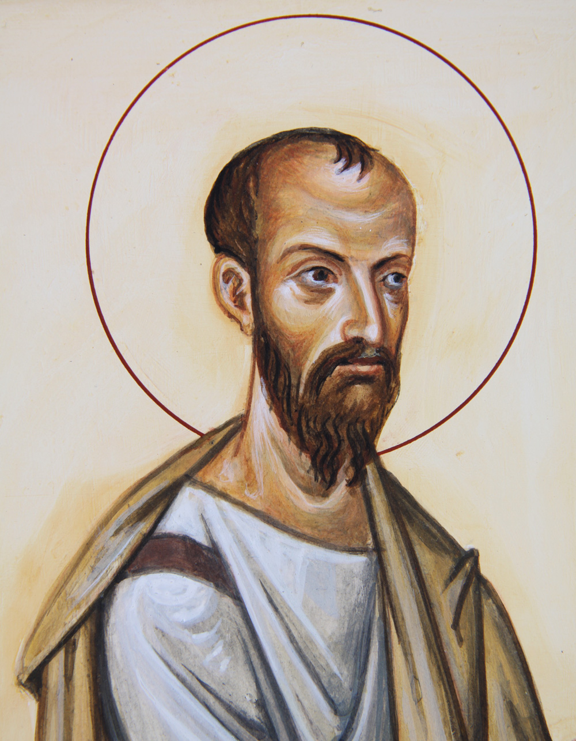
Paul Ephesus Age
Beyond the four gospels, Paul’s inspired teaching formed the basis of the New Testament.
After Paul, the church fell into apostasy and Gnosticism

Slide 15
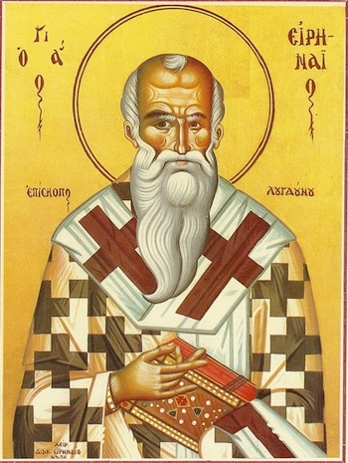
Irenaeus Smyrna Age
Defended the Word against Gnosticism (Marcion, Valentinus). Rejected the power of the Bishop of Rome
After Irenaeus, Constantine came to power and the Church itself began wars and persecutions.

Slide 16
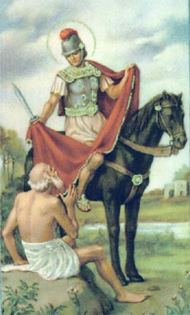
Martin Purgamum Age
Rejected the trappings of Christendom, and the power of the church to wage war and persecute. Set the stage for the Protestant Reformation.
After Martin, Europe fell under control of the Roman Church.

Slide 17
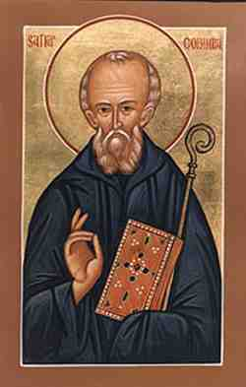
Columba Thyatira Age
Brought Monasticism to what is now the UK. Set the stage for the future Great Awakening.
After Columba, the 1000-year reign of the Roman Church begins.

Slide 18
Luther ended “The Thousand Year Reign”
Wednesday, March 23, 2016 ·
Posted In: Daily Column, History, Saving Our Soul
Catholic Church Online Journal of Catholic Fundamentalism
Revelation 20 tells us that The Thousand Year Reign ended when “the dragon was released from the abyss”. Luther ended “The Thousand Year Reign” of The Church Jesus Founded. The Roman Catholic Church had ruled Christendom for the preceding thousand years.

Slide 19
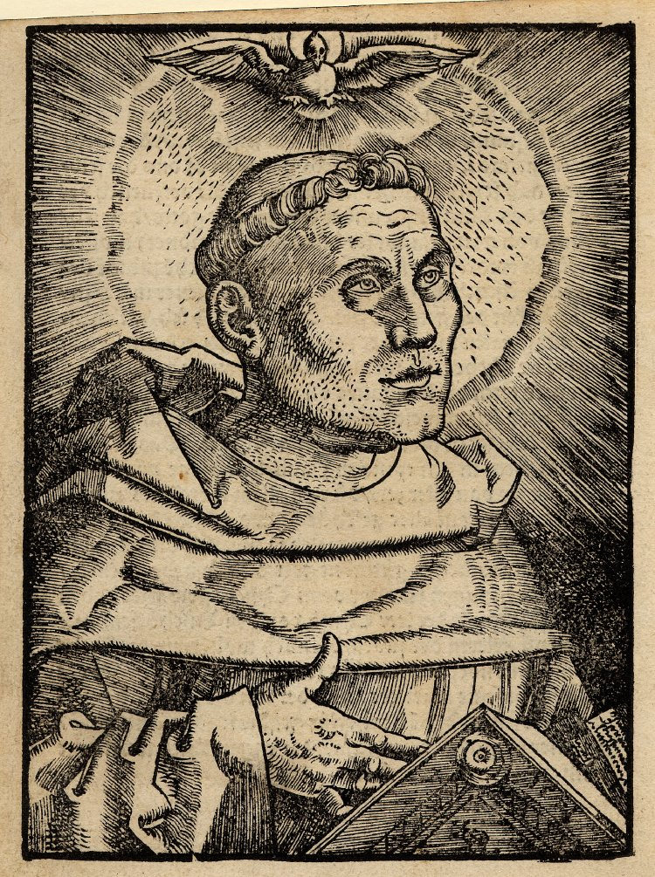
Luther Sardis Age
Strove to reform the Roman Church. Worked to make the Word accessible to the public. Justification.
After Luther, denominations formed and began wars and persecutions.

Slide 20
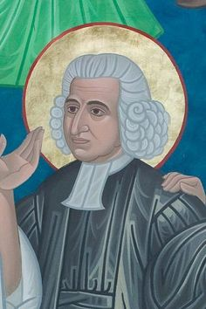
Wesley Philadelphia Age
Leader of the Second Great Awakening. Sanctification.
After Luther, denominations formed, Christendom warred with modernism.

Slide 21
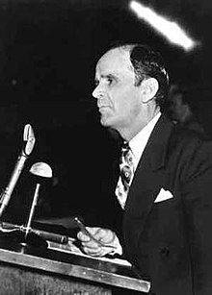
Branham Laodicia
Focal point of the Pentecostal revival and the healing campaigns of the early 20th century. Pushed to return to the faith of the early church.
After Branham, the 1000-year reign of Christ begins.

Slide 22
78 What is it now? We’ve passed around sixty years, the Pentecostals has organized, “We are this, we are that,” and God has walked right away from it; out in yonder, and bringing forth a Bride, an Elect, out of that group. Which, there’ll never be another church age.
64-0125 - Turn On The Light
Rev. William Marrion Branham

Slide 23
391. Brother Branham, have you made statements recently concerning that church age has ended, Laodicea?
No, I never said it’s ended. If I did, you misunderstood, or I said it wrong. It is…This is the last church age; it’s the end of church ages, the Laodicea. It hasn’t ended; when it ends, the Church is gone. So as long as the Church is here, it hasn’t ended. See? …The Bride, when She’s taken from the church, then the church age will cease.
64-0830E - Questions And Answers #4
Rev. William Marrion Branham

Slide 24
And the first time there will come forth, for the Bride age, for a resurrection out of dark denominationalism, will be a Message, that the full maturity of the Word has turned back again in Its full Power, and being waved over the people, by the same signs and wonders that He did back there.
65-0418M - It Is The Rising Of The Sun
Rev. William Marrion Branham

Slide 25
At the end time, both trees are coming to the seed and proving themselves. Here we are, right today, Laodicea and the Bride, just as clear and pretty as it can be in the Scripture, and right before your faces.
65-1125 - The Invisible Union Of The Bride Of Christ
Rev. William Marrion Branham

Slide 26
This is for the Bride, going Home of the Bride. We got something different... We’re in the Bride age... Don’t go with that crowd that’s moving on yonder, friend, that Laodicea Church Age.
65-1125 - The Invisible Union Of The Bride Of Christ
Rev. William Marrion Branham

Slide 27
Now it’s begin to pull away, the wheat’s begin to be seen. This is not a Pentecostal age. This is the latter-day age. This is the Bride age. This is the evening Light. This is when Malachi 4 must be fulfilled, to follow God’s pattern. This is Luke 17:30, to be fulfilled.
65-1127E - I Have Heard But Now I See
Rev. William Marrion Branham

Slide 28
Exodus 15:8
By the blast of your nostrils (Ruach) the waters (of the Red Sea) piled up.
Isaiah 4:4 The Lord will wash away the filth of the women of Zion; he will cleanse the bloodstains from Jerusalem by a spirit of judgment and a spirit (Ruach) of fire (literally: a hot breath of fiery judgement).
Isaiah 11:4 He will strike the earth with the rod of his mouth; with the breath of his lips he will slay the wicked.

